Slide 1
Historical changes in food technology

Slide 2
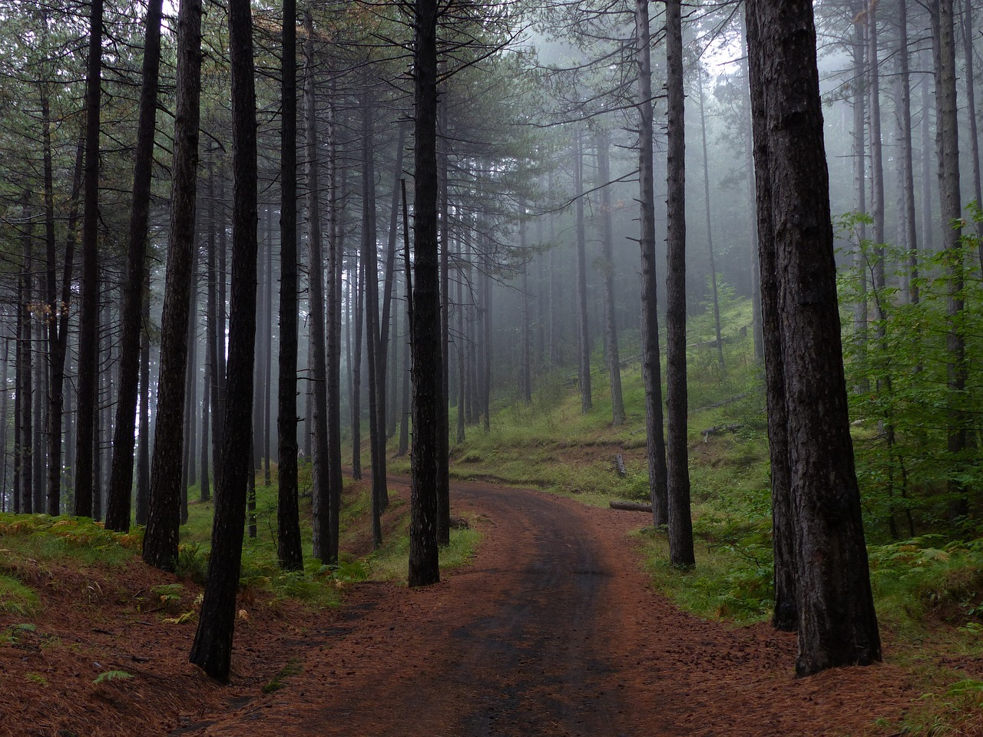
Hunter-gatherers
Throughout the ages, people have hunted animals and gathered plants for food.
In pre-historic times people would have eaten a wide variety of fruit, nuts, meat and roots, which they would have obtained from local surroundings.

Slide 3
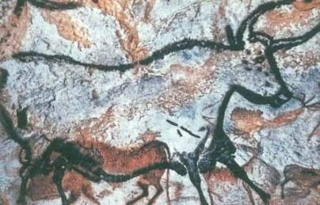
Hunter-gatherers
All the animals and plants would have been wild.
The diet consisted of what was growing locally and animals which were easy to catch.
The discovery of fire led to the realisation that it could be used to cook animals and plants to make them easier to eat, and tastier.

Slide 4
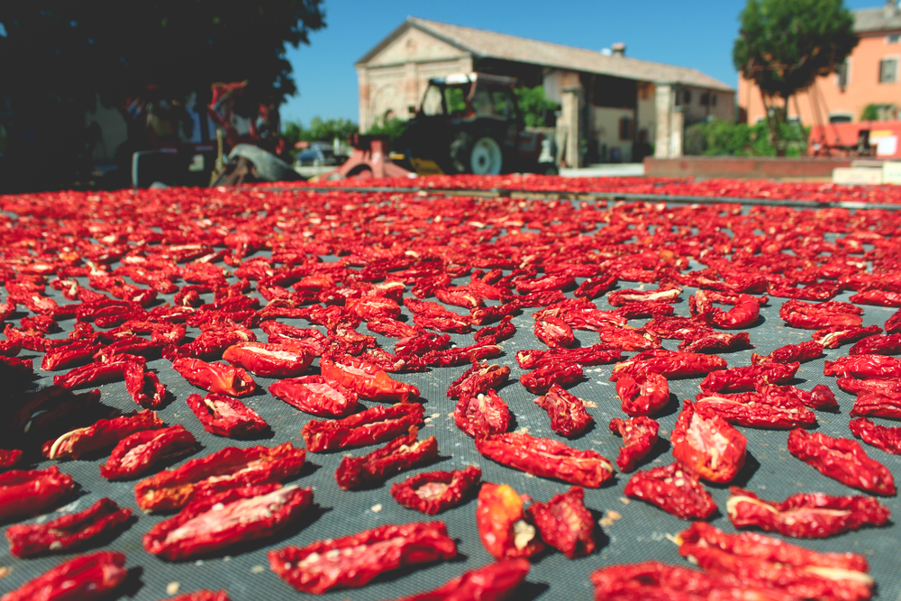
Hunter-gatherers
The weather and the seasons would have affected the food supply available. In spring and summer, there would have been a glut of food. However, in the winter months, food would have been scarce.
Methods of preserving foods, such as sun drying, salting, fermenting and smoking were used to help keep the food fit to eat longer. Modern preservation methods today still follow similar principles.
Sun-drying tomatoes today

Slide 5
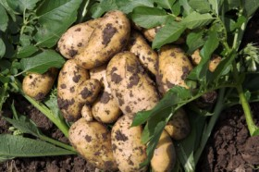
Farmers
The progress from hunting to farming took place gradually. Keeping animals and plants for food probably started around 12,000 BC. However, not all animals and plants that had been eaten previously could be produced on farms.
By observing the usefulness and yield of different varieties, a small proportion of plants were selected for cultivation.

Slide 6
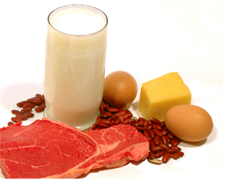
Cultivation
The first plants to be cultivated were the wild grasses which were developed into wheat, barley, oats, rye and millet.
A few species of animals, such as goat, pig, sheep, were kept to produce food, i.e. meat and milk.

Slide 7
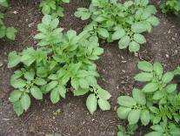
Cultivation
Early farming began to reduce the time needed for hunting, and people began to move into settlements. Farming and trapping became full time activities.
The settlements were very basic, yet housed many people and their animals.
The cultivated fields, which were worked by the people who lived nearby. This gradually led to the development of villages.

Slide 8
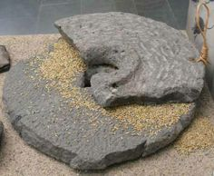
Domestication
During this period of early farming, domestication began to rise and spread. Domestication refers to the selection process of plants and animals to better suit the needs of human beings. There were also many technological developments in agriculture and animal husbandry.
Stone polishing led to the making of new tools and utensils, such as hoes and ploughs. Querns of polished stone made it possible to grind grains into flour. Clay pots were made on potter’s wheels and were eventually fired and glazed.

Slide 9
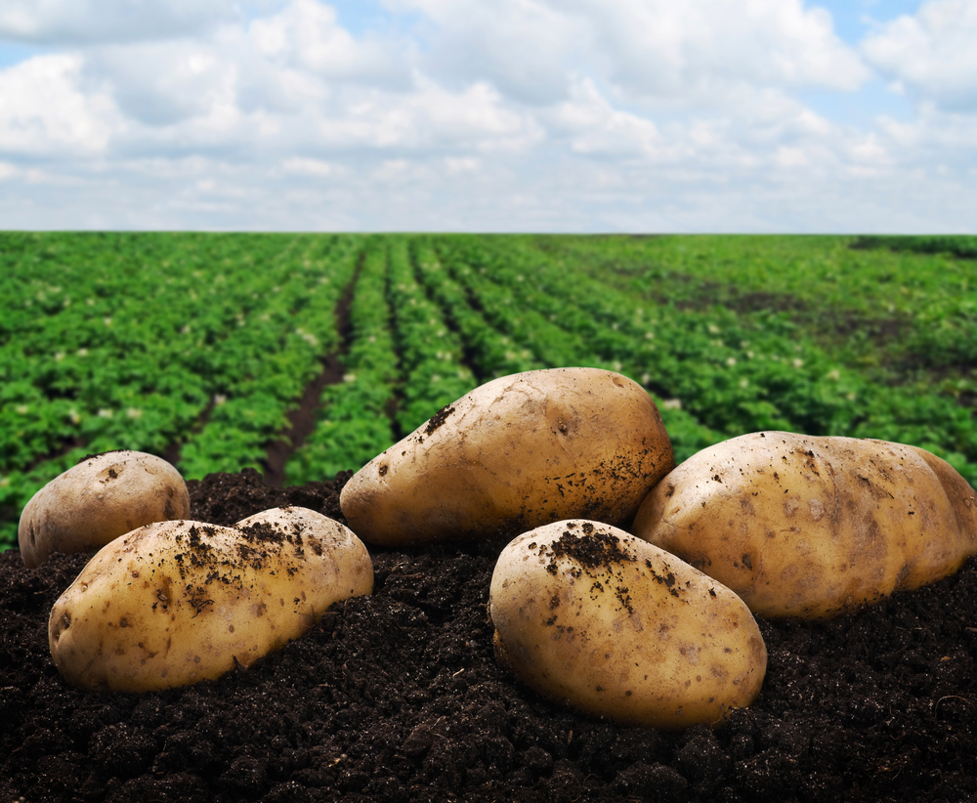
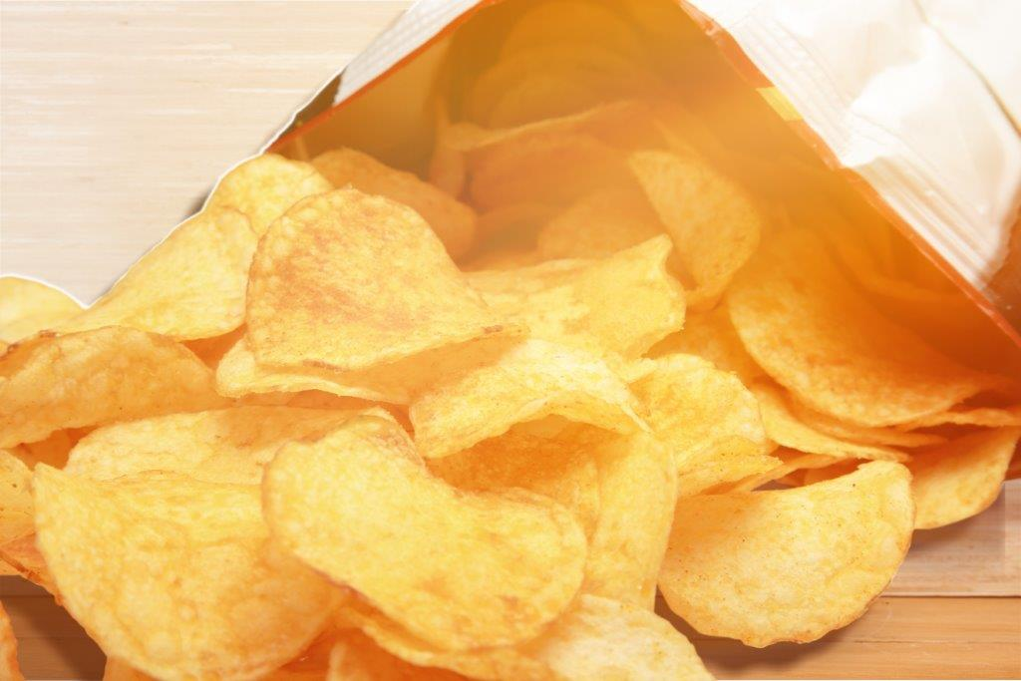
Varieties of food sources
Through the centuries the process of producing new or improved strains of plants and animals has continued. From the vast array of crops used as food by the hunter-gatherers, people now use only 14 major cereal crops to provide food for the world.
Rather than eating many different crops, a range of different food products is now made from a small number of staple foods, for example potatoes may still be manufactured into – crisps, extruded snacks, gnocchi, soup, chips, waffles, potato starch (used in instant desserts) and instant mash.

Slide 10
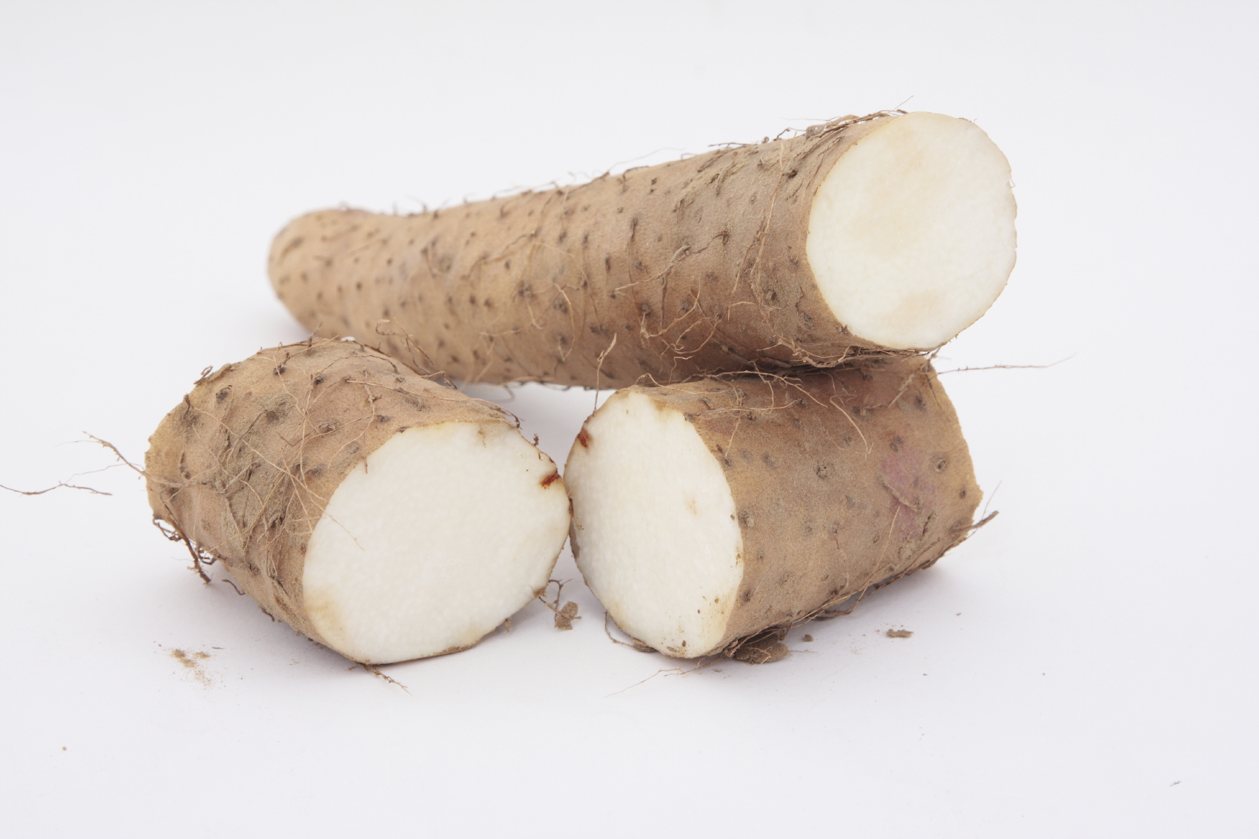
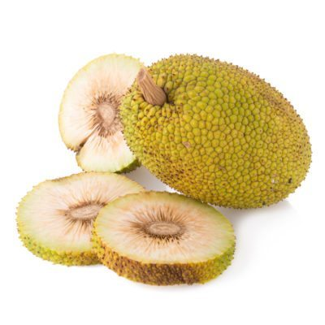
Crops
The most important staples in the world today are: wheat, maize, rice, potatoes, rye, oats, cassava, sweet potatoes, miolet, yam, plantain, teff, breadfruit and taro.
However, in isolated parts of the world some groups of people, such as the Wopkamin in Papua New Guinea, still use over 420 different varieties of seeds, leaves, grain, bark, roots and animals for their food supply.
Yam
Breadfruit

Slide 11
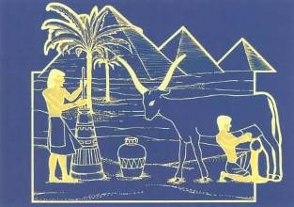
Influential civilisations
Throughout history civilisations around the world have introduced specific cooking, preserving and farming methods.
Ancient Egypt showed aspects of:
• butchery;
• bakery, e.g. bread, rough cakes and porridge;
• fermentation, e.g. beer, yogurt and cheese;
• drying, e.g. fruit and vegetables.

Slide 12
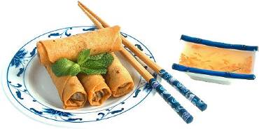
Influential civilisations
China and Japan showed aspects of:
• fermentation, e.g. soy sauce and tofu;
• rice production around 5000BC;
• freezing around 1800 BC.
The Roman empire showed aspects of:
• transport, e.g. road system;
• farming on large scale;
• preservation, e.g. bottling.

Slide 13
Historical changes in food technology
For further information, go to:
www.foodafactoflife.org.uk
This resource meets the Guidelines for producers and users of school education resources about food.

