Slide 1
Milk processing

Slide 2
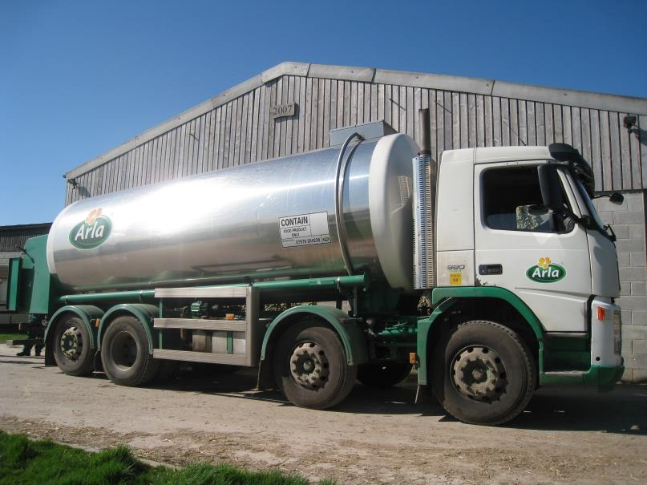
Primary milk processing
After the milk has been delivered from the dairy, it is pasteurised.
Pasteurisation is a process used to kill harmful microorganisms, such as certain pathogenic bacteria, yeasts and moulds, which may be present in the milk after initial collection.
Killing any harmful bacteria will make the fresh milk safe to drink/consume.
This process also extends the shelf life of milk.

Slide 3
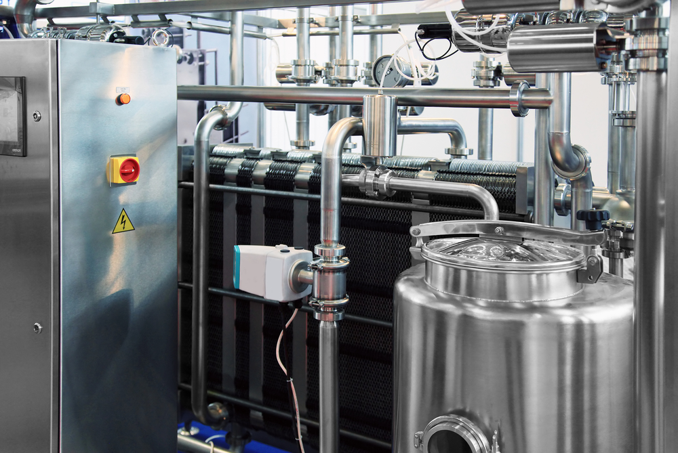
Pasteurisation
The basic process for whole milk involves heating the milk to a temperature of no less than 71.7ºC for 25 seconds.
This process is known as High Temperature Short Time (HTST).
The milk is then cooled for packing, storage and transportation.

Slide 4
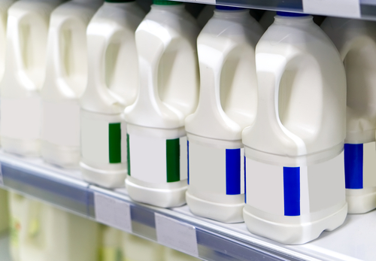
Homogenisation
Homogenisation of milk involves the milk being pumped at very high pressures through narrow tubes, breaking up the fat globules in order for these to disperse through the liquid.
This process produces milk of a uniform composition and palatability, without removing or adding any constituents.
Most milk available for purchase is homogenised.

Slide 5
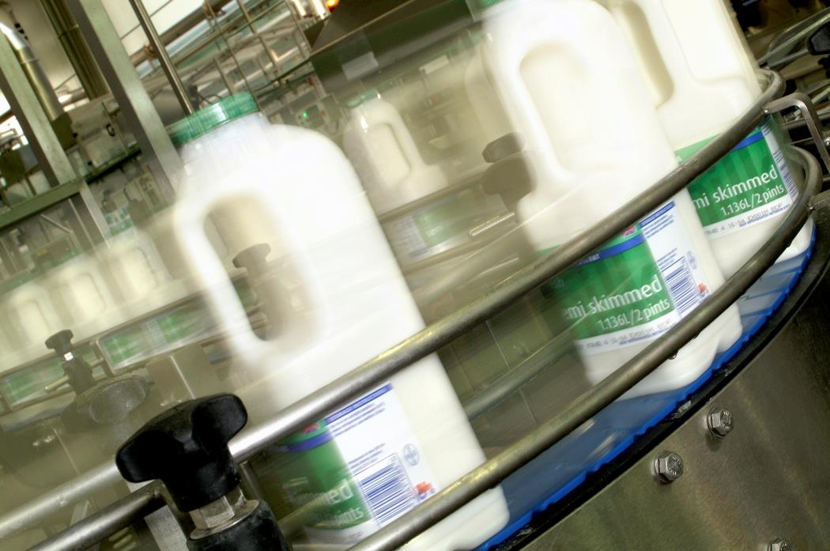
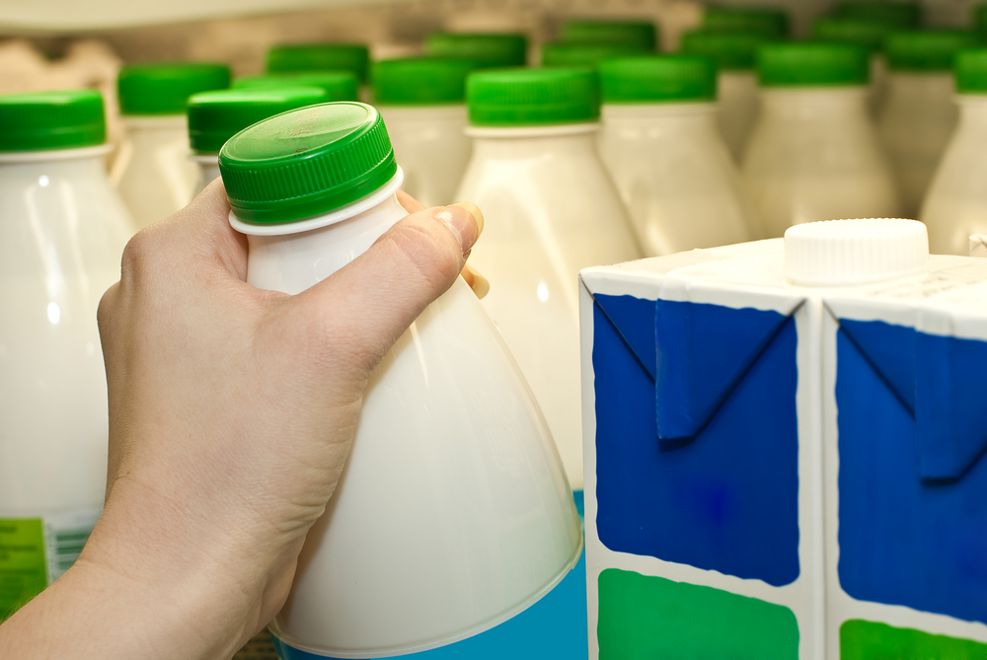
Packing
The milk is then packaged into bottles and labelled.
The packaging helps to increase the shelf-life of the milk.
The milk is then distributed to supermarkets and shops for sale.
Many plastic bottles now have up to 30+% recycled plastic.

Slide 6
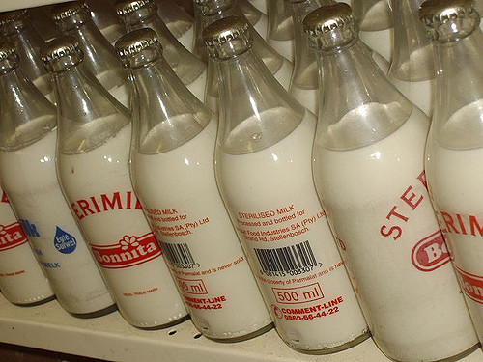
Sterilisation
This process uses a temperature in excess of 100ºC in order to destroy nearly all micro-organisms present in a food. This is important as some micro-organisms can form spores which have the ability to survive at high temperatures.
The product is packed in air-tight containers either before or after heat treatment.
Sterilising enables milk to be kept for months unopened and unrefrigerated but may result in a burnt, caramelised flavour and browning.
Once opened, the milk should be refrigerated and consumed within three days.

Slide 7
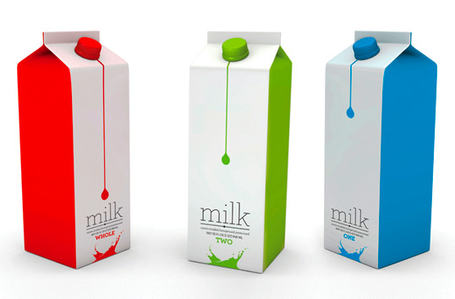
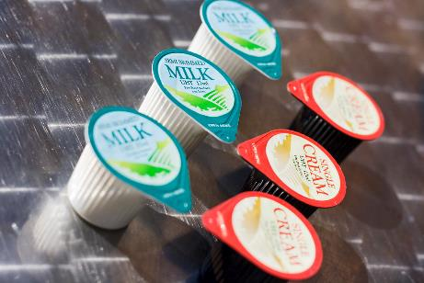
Ultra heat treated (UHT)
UHT is a continuous process and the product is packaged after treatment into sterile containers. Typical temperatures and times specified for UHT treatment of milk are 130º C-150º C for 1-3 seconds.
As the product is moving continuously, rather than being stationary, high temperatures can be reached resulting in fewer chemical changes, but having the same sterilising effect.
UHT treatment was developed to destroy all micro-organisms without causing as much damage to the product as sterilisation. Milk may taste cooked and will be slightly brown in colour.

Slide 8
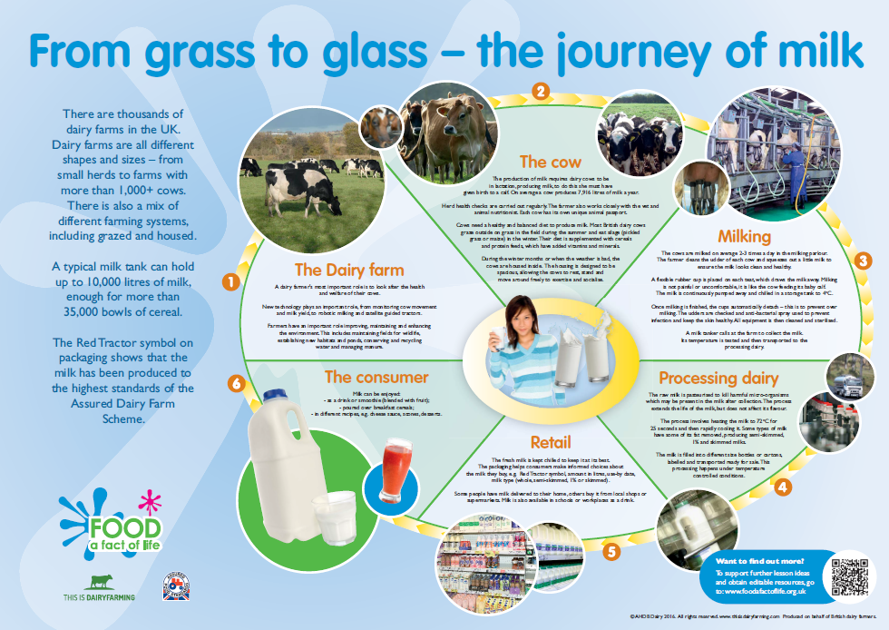
Find out more about milk
To find out more about milk, access the From grass to glass – the journey of milk poster.

Slide 9
For further information, go to:
www.foodafactoflife.org.uk
This resource meets the Guidelines for producers and users of school education resources about food.

