Slide 1
Growing strawberries

Slide 2
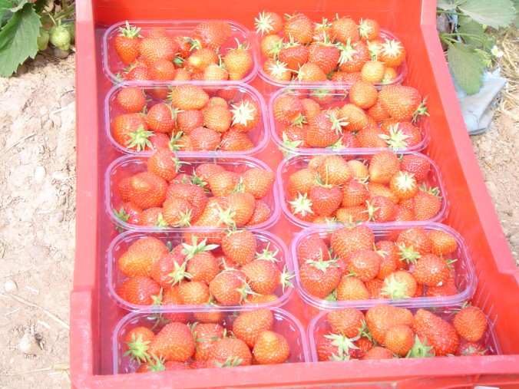
Do you know what these are?
They are strawberries.
How are they grown?

Slide 3
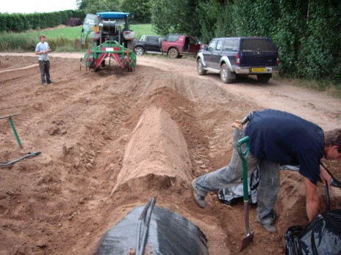
First, the farmer makes soil mounds.
The mounds are called beds.

Slide 4
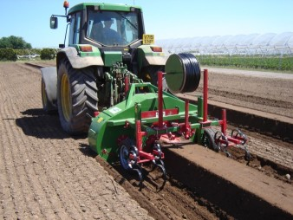
Some farmers use a machine to do this.
The machine is called a bedformer.

Slide 5
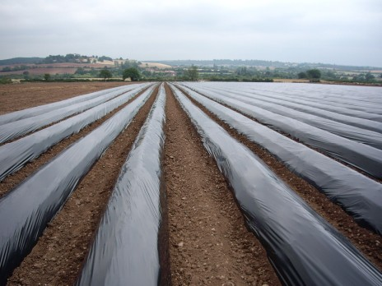
Next, the beds are covered with plastic.

Slide 6
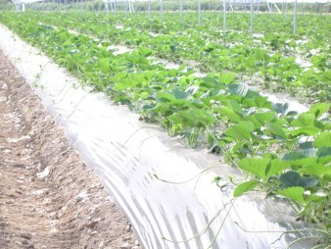
The farmer makes holes in the plastic and plants the strawberry plants.
The plastic keeps the strawberries warm and helps them grow.

Slide 7
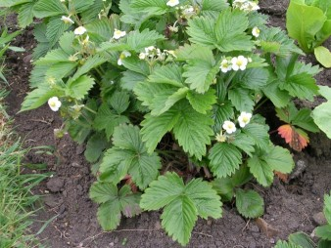
The strawberry plants grow small white flowers.

Slide 8
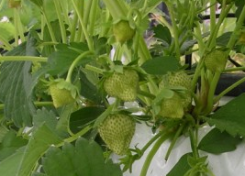
The flowers die and fruit grows in their place.
Can you see the strawberries?
What colour are they?

Slide 9
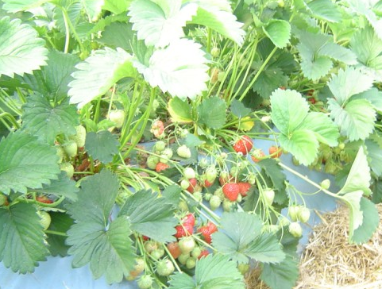
When the strawberries turn red, they are ready to be picked.

Slide 10
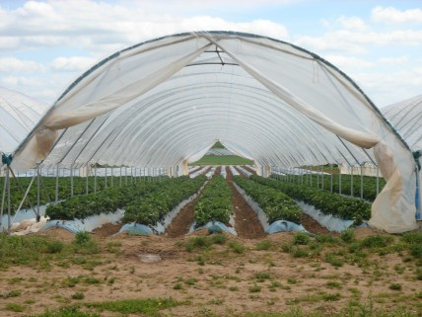
Some farmers grow strawberries in large plastic tunnels.
The tunnels protect the strawberries from bad weather.

Slide 11
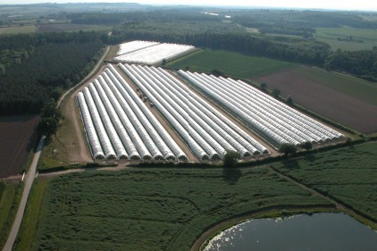
Look at all these tunnels!
How many tunnels can you see?

Slide 12
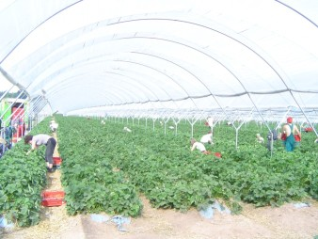
When the strawberries are ready, they are picked by hand.
They have to be picked by hand because they are too soft to be picked by machine.
Can you see the pickers?

Slide 13
When they have been picked, the strawberries are put into punnets.
How many punnets can you see?

Slide 14
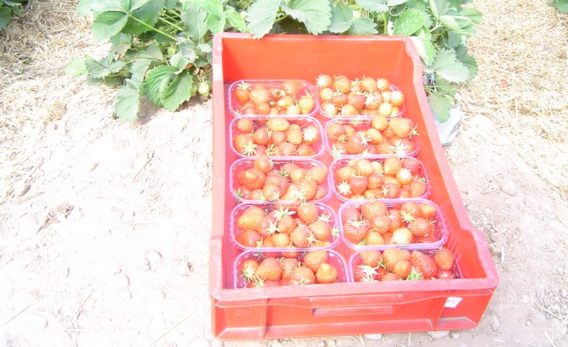
The punnets are put into crates so they can be moved around easily.

Slide 15
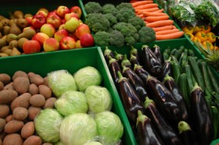
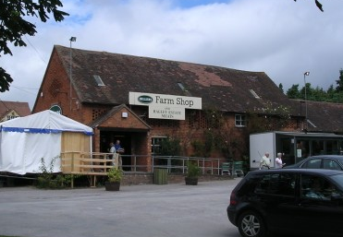
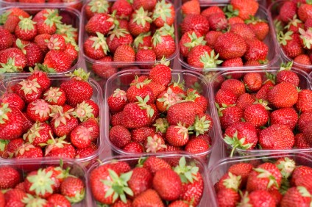
Sometimes the strawberries are sold in a farm shop or on a market.

Slide 16
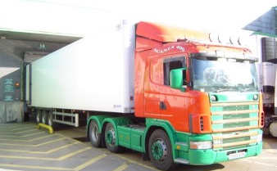
Sometimes strawberries are loaded into a lorry and taken to a supermarket.

Slide 17
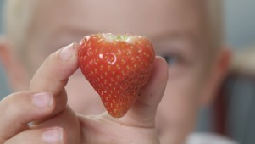
Do you like strawberries?

Slide 18
Growing strawberries
For further information, go to:
www.foodafactoflife.org.uk
This resource meets the Guidelines for producers and users of school education resources about food.

