Slide 1

Food skills, recipes and diversity Eastern European cuisines 15 June 2022
@foodafactoflife

Slide 2
Housekeeping and overview
Good food hygiene and safety practices - are you ready to cook?
Long hair tied up.
Jumpers removed/long sleeves rolled up.
Nail varnish and jewellery/watches removed.
Thoroughly washed and dried hands.
Clean apron on.
Turn off mobile phone (pop on vibrate)
You should have all your equipment and ingredients ready/handy
Get ready to cook!
Chat box – feel free to use to ask questions and share info/links and ideas
Camera on – we want to see your food skills
Help and direction (please don’t take as criticism!)
Feel free to ask questions and engage!
Feedback – it’s good to get your views!
Tweet or post on Facebook!
Enjoy!
@foodafactoflife

Slide 3
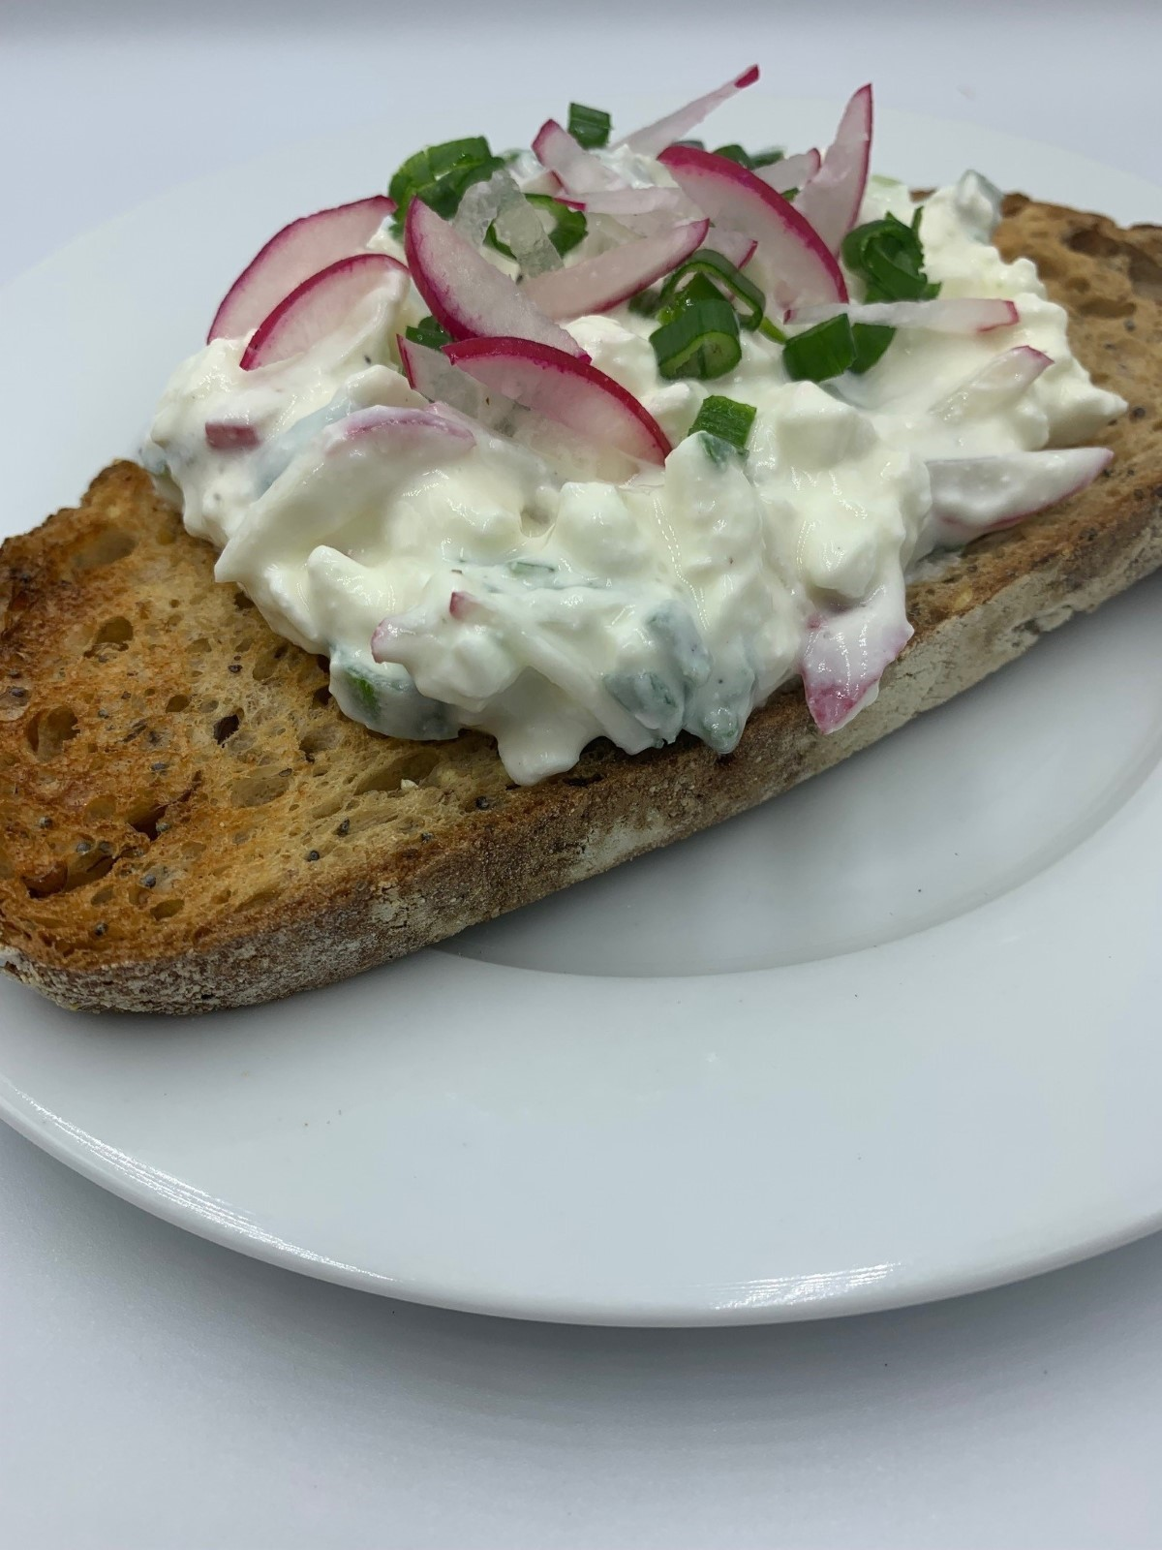
Welcome
As part of the British Nutrition Foundation’s work around a ‘modern, diverse food and nutrition education’ we asked students what was important to them about the recipes they cooked at school.
Students responded that they want dishes that are:
tasty, healthy, family/everyday recipes;
most significantly they want them to be dishes from around the world that are - modern, diverse and reflect different cultures.
Please say hello in the chat box!
The British Nutrition Foundation is grateful for the support from the All Saints Educational Trust for this work.

Slide 4
Session aims
During the session we will:
make two recipes from around the world that are new to Food – a fact of life;
use traditional ingredients and consider alternatives;
develop, acquire and secure practical food skills using recipes that are suitable and practical for schools and their budgets, promote healthier eating, reflect more global cuisine, and encourage dialogue around culture and inclusivity;
consider planning and implementing practical activities in the secondary classroom;
demonstrate good food hygiene and safety practices;
provide links to Food – a fact of life.

Slide 5
Programme
16.45 Registration
17.00 Welcome
Practical food skills, recipes and diversity – Eastern European cuisines
17.15 Twarog (homemade cottage cheese) – activity
17.35 Speedy Hungarian goulash – activity and review
18.05 Gzik – activity and review (Twarog and Gzik)
18.25 Review and next steps
18.30 Finish – evaluation, certificate and voucher

Slide 6
Diversity and inclusion in Schemes of Work
Know your pupils!
Know and understand the local community, e.g. what are the challenges that young people are facing?
Understand what young people (and their families) want to make in food lessons. Not just cakes though!
Ensure recipes and practical activities build on knowledge and skill.
Incorporate different flavours, ingredients and culinary techniques and experiences to widen young people’s understanding of food and cultures around the world.
Encourage pupils to share their personal experiences around food culture, ingredients and recipes with the class or school community.
Consider healthy, sustainable diets – nutrition.org.uk
Did you know?
Some food and drink-related traditions are currently recognised by UNESCO and its Representative List of the Intangible Cultural Heritage of Humanity

Slide 7
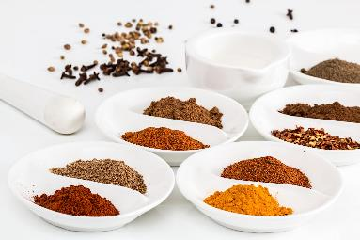
In the classroom
Consider the following:
time and budget available;
pupils - practical skills;
equipment available;
provision/availability of ingredients e.g. spices or herbs that may not be used often, vegetables that might not be readily available in your area;
involving the school/local community – there may be an ‘expert’ in a particular cuisine that could offer guidance and/or input to the lesson;
sharing the success of your pupils work through school social media, newsletters and special events such as open evening and options.

Slide 8
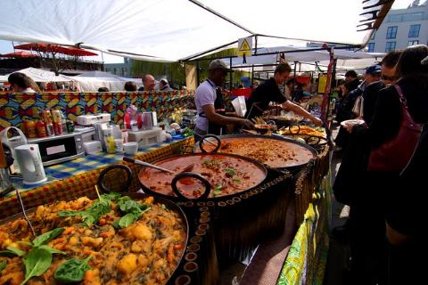
Generation Z and food culture
Globalisation has been changing the food we eat and the ways we eat those foods. But it is not new!
Food cultures are moving, and globalisation has made a wide range of cuisines more accessible.
Food culture is no longer tied down to where it originated from and can spread far and wide.
Trends:
Street food
Fusion food
Travel – trying a wider variety of cuisines
Notes:
Gen Z = born in 1997 or later - makes up a quarter of all the people going out to eat – high spending power. Organics/sustainability/plant based all feature.
A strong theme in Gen Z eating habits is authenticity and exploring exciting flavours from all over the world. Some of this may come from growing up in the same households as Gen X and Millennial foodies.
Gen Z brought up as 'digital natives' - they see and experience food around the globe – heritage and authenticity are key words.
Food trade has played a significant role in the history of globalisation, as it has allowed for cultural exchange for thousands of years. From the transporting of spices along the Silk Road, to the potatoes being imported from the Andes to Ireland in 1589 by Sir Walter Raleigh.
e.g. Italian coffee culture – worldwide verses local culture e.g. snakes, spiders
The economic and cultural boundaries between countries are becoming less rigid and the gradual diffusion of different elements of national culture such as food and cuisine are some examples of this trend.

Slide 9
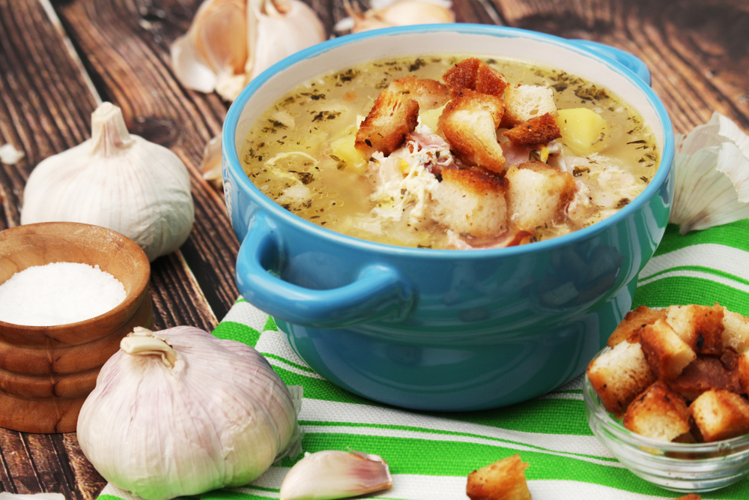
History
Due to its geographical location, the cuisine of Eastern Europe was influenced by traditions from Northern and Eastern Europe, Central Asia, Siberia, the Caucuses, and East Asia.
Marriages between the nobility centuries ago brought the cuisine and flavours of Italian, French, Turkish, Russian, Jewish and German foods to mix with those of Eastern Europe.
There was a significant influence by almost all other areas of Europe to create the diverse and cross-cultural cuisine of Eastern Europe.
Traditional Czech garlic soup - Cesnecka

Slide 10
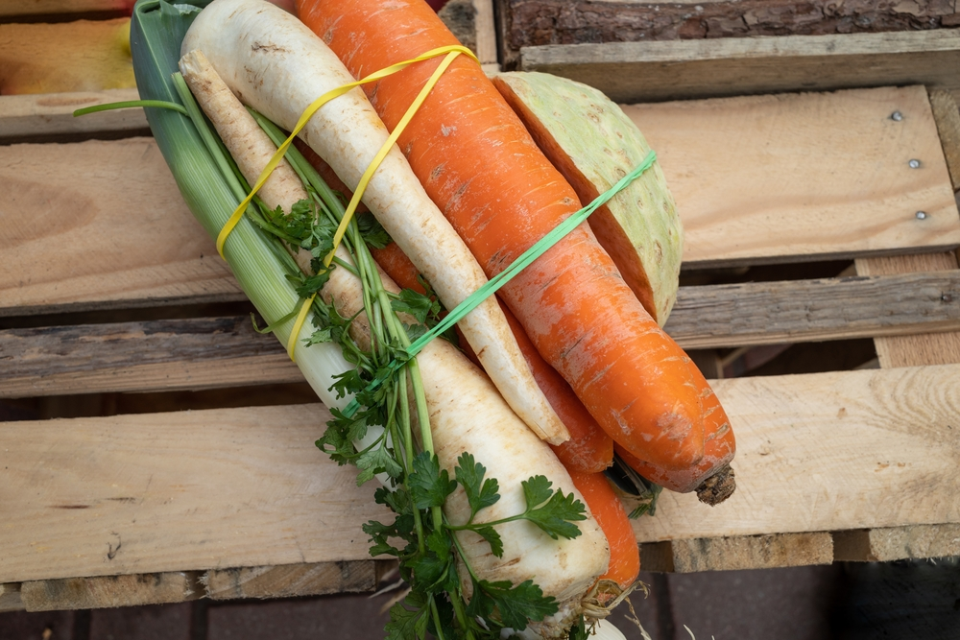
History
Vegetables other than cabbage and root vegetables were virtually unknown in Poland until 1518.
Queen Bona Sforza, an Italian princess married the Polish King Sigismund I (Zygmunt), introduced them to her new homeland.
Many Polish words for vegetables are taken directly from Italian such as:
kalafiory (cauliflower)
pomidory (tomatoes)
sałata (lettuce), for example.
Soup vegetables are known as włoszczyzna or "Italian stuff," włoski being the Polish word for Italian.

Slide 11
Modern cuisine
Chefs throughout the major cities of Eastern Europe are transforming traditionally heavy dishes including meat and potatoes into lighter dishes, adding a contemporary spin and emphasising local ingredients and heritage-breed meats.
Example:
Warsaw restaurant Qchnia, offers a tasting menu described as "modern, light, healthy food, both Polish and inspired by tastes of the world."
For example, a small portion of spinach lasagna with sheep's milk cheese might be followed by blood sausage, pickled cucumber and beets served with horseradish and mustard.
Burghul
Freekeh

Slide 12
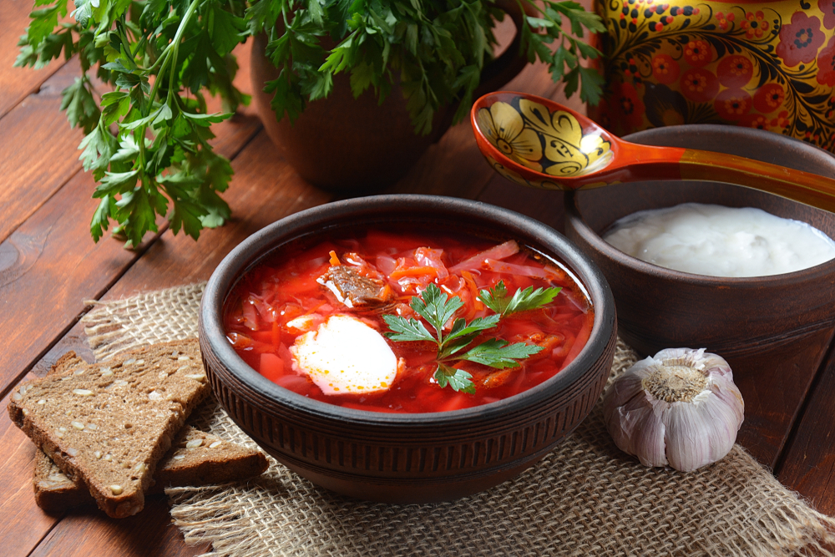
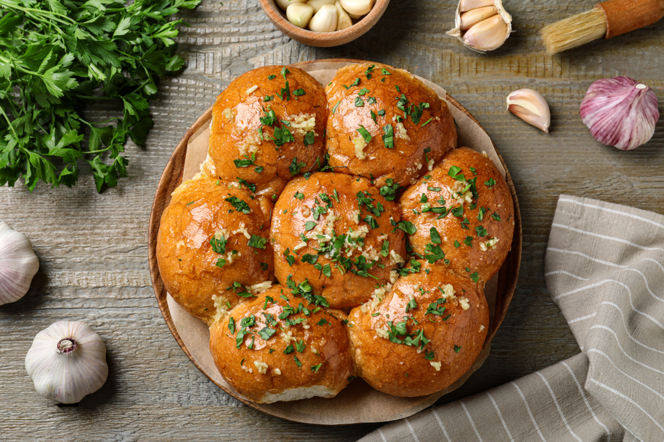
Popular dishes
Borscht is a famous soup that is eaten all over Ukraine, Russia and many other countries of Eastern Europe. Served hot in the winter and cold in summer it is a versatile soup with variations depending on the region.
It is made with beets, potatoes, cabbage, carrots, spring onions, garlic and tomatoes, and is often garnished with dill leaves. Traditionally it is made with meat but now it's often made as a vegetarian dish.
It is typically served with a spoonful of sour cream on top and brown or garlic bread called Pampushky on the side.
Beets are an important part of Eastern European cuisine. They are enjoyed in everything from salads to soups to side dishes.
Notes:
Bread - Once the bread is finished baking, a garlic and parsley infused sunflower oil is brushed over the hot bread (sunflowers are the national Ukrainian flower and symbol of peace )

Slide 13
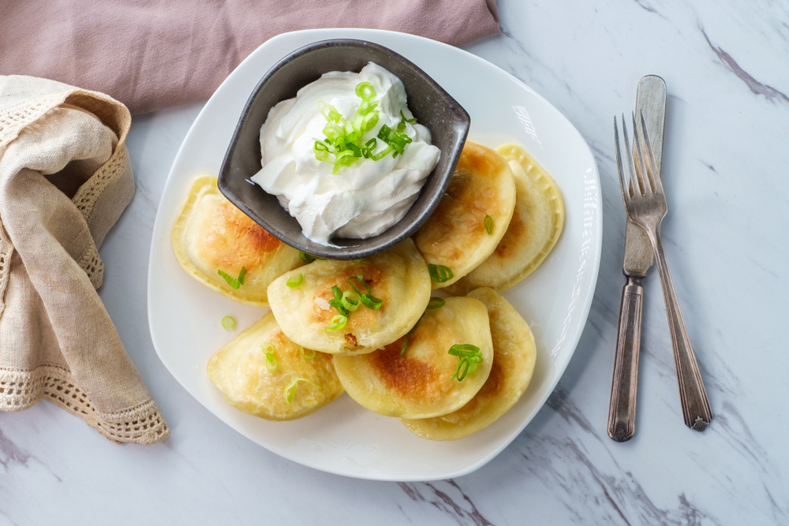
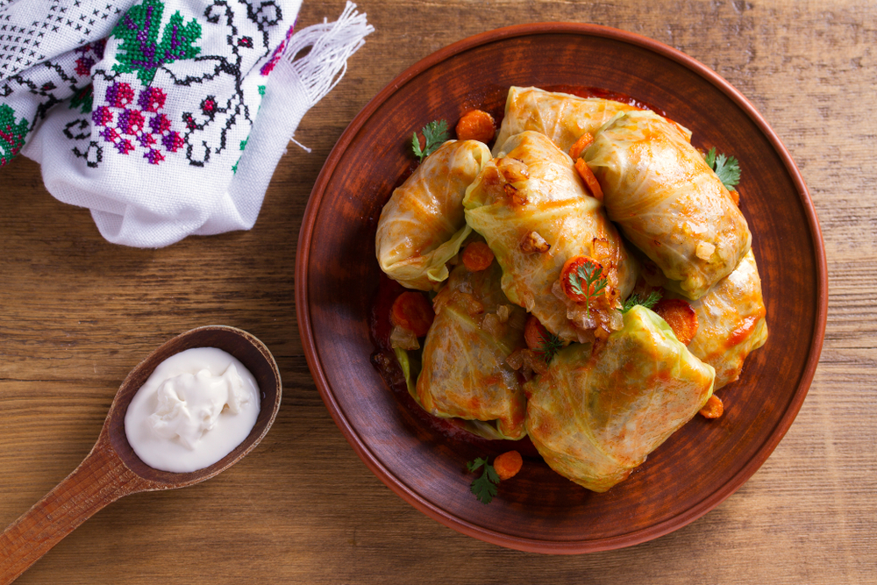
Popular dishes
Pirog (pirogi is the plural form) are boiled and then pan fried half-moon dumplings usually filled with some kind of meat, cheese, potato or sweet filling.
The name comes from the word pir, meaning "banquet" or "festivity" in an ancient form of the Russian language.
Sarmi (Bulgarian stuffed cabbage) - the cabbage rolls, or sarmi, are made with veal, pork, carrots, tomato juice, and served with a yogurt-paprika sauce.
Beet or other vegetable leaves or grape leaves are used in some counties instead of cabbage. They are popular throughout Eastern Europe.

Slide 14
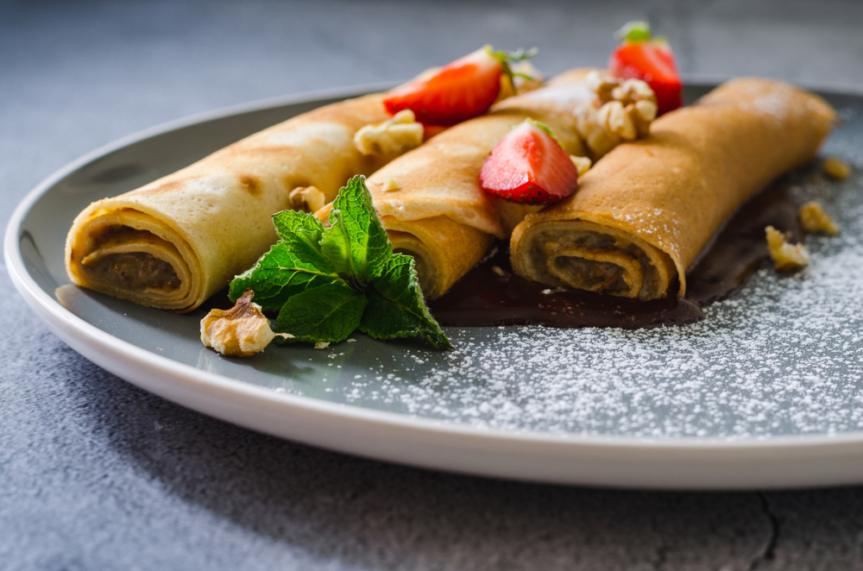
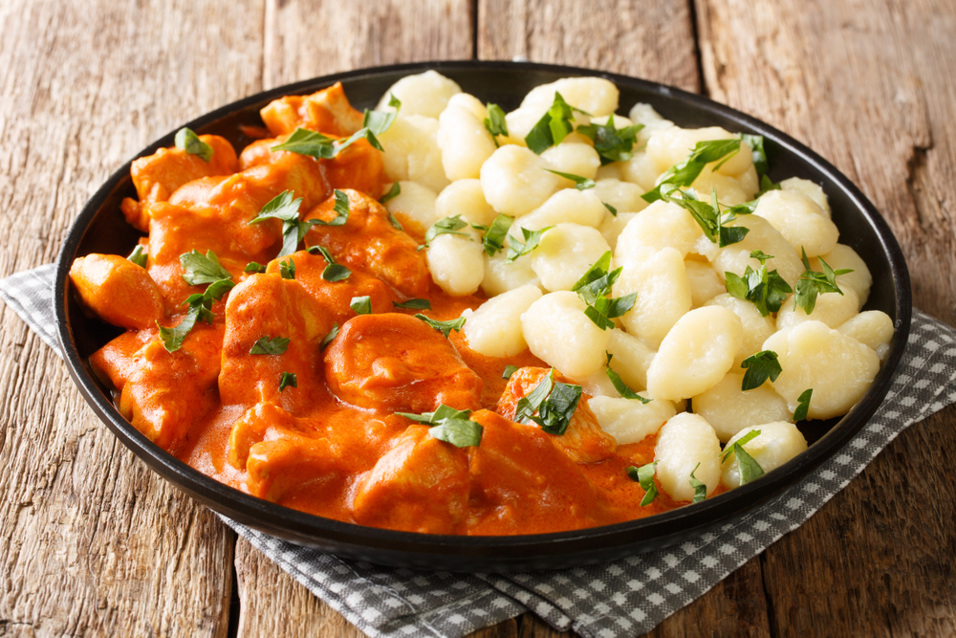
Popular dishes
Polish naleśniki are crepe-like pancakes with either sweet or savoury fillings. Every Eastern European country has its own version of pancakes or crepes.
Once filled and rolled, they can be baked or pan-fried. Another variation is to dip them in beaten egg and breadcrumbs before frying or baking.
Chicken Paprikash comes from the Hungarian word for paprika and describes a range of stew-like dishes made with meat, onions, paprika, and sour cream.
Tomatoes are not used in the authentic Hungarian dish. Though chicken seems to have been the original meat used in paprikash, lamb, pork and especially veal are also used. Traditionally, Chicken Paprikash is served with dumplings.
Hungarian palacsinta

Slide 15
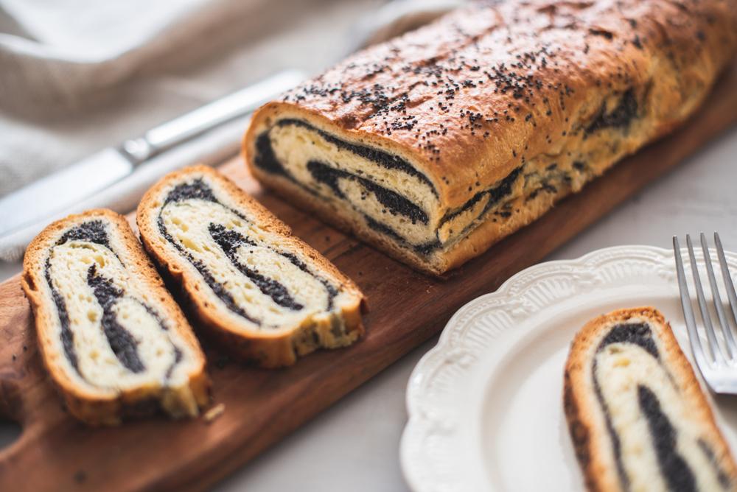
Popular dishes
Poppy Seed Cake (Makowiec) - is a traditional poppy seed roll cake made with a sweet, yeast cake base.
Poppies feature heavily in Polish desserts as historically this was one of the most easily accessible sweet ingredients in the area.
The poppy seed paste often has raisins and finely chopped nuts added. Sometimes the paste is made of chestnuts or walnuts instead of poppy seeds.
Makowiec is often topped with a royal icing topping and candied nuts or raisins.
This dessert is popular and has variations across Central and Eastern Europe and is one of the most popular sweet treats in Poland.

Slide 16
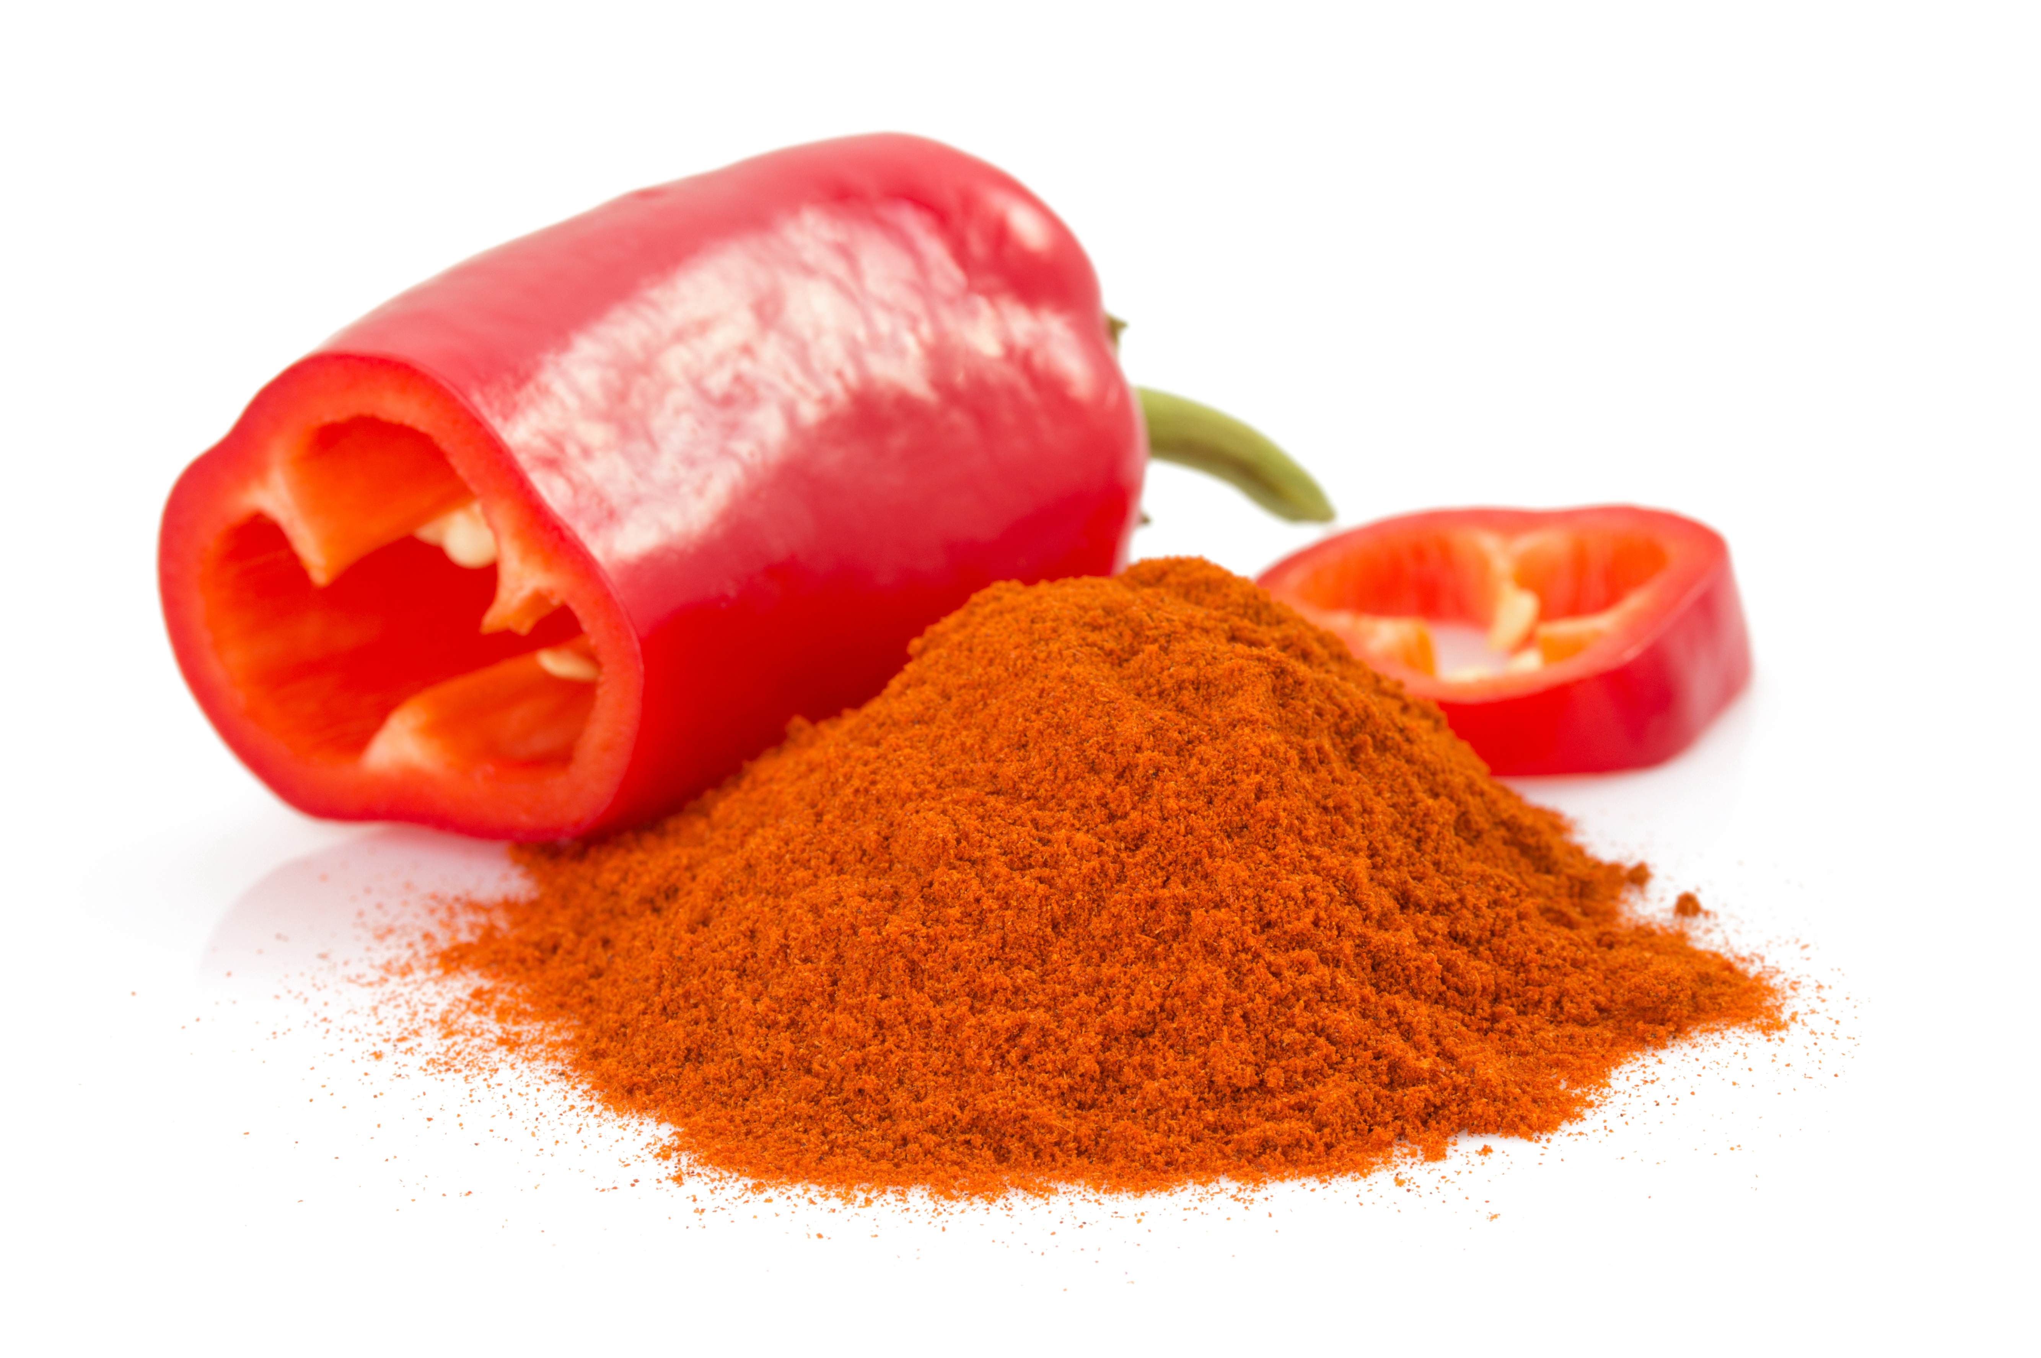
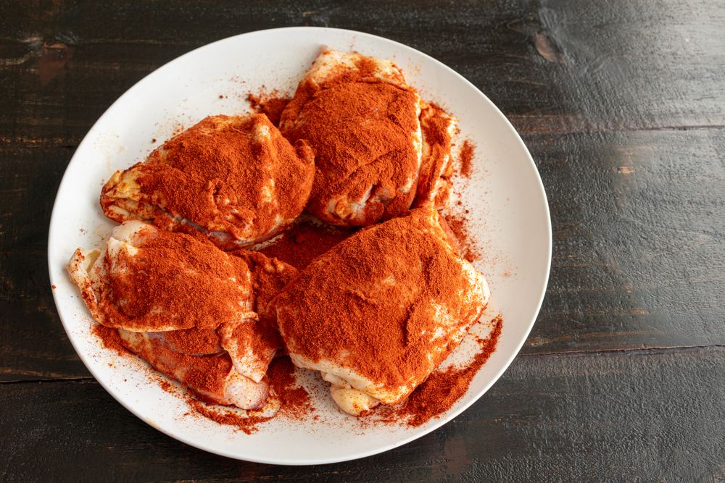
Ingredients
Paprika is made from the dried, ground, ripened fruit pods of Capsicum annum - peppers. It is mildly flavoured and has a brilliant red colour. The name Capsicum is derived from the Latin/Greek word for “capsule” which refers to the shape of the fruits.
The variety and flavour of paprika can vary greatly depending on the country in which it was made. The most well-known paprika producing countries are Spain and Hungary.
Hungarian paprika has eight different grades and can range from mild and sweet to spicy and smoked. Sweet or mild paprika does not contain any capsaicin as the seeds and membranes are removed, which is what gives chilies their heat.
Notes:
Early Spanish explorers took red pepper seeds back to Europe, where the plant gradually lost its pungent taste and became "sweet " paprika. Paprika is considered as the national spice of Hungary, where it was introduced by the Turks in 1569. Hungarian paprika is available in eight different varieties ranging in colour and pungency. In 1937, the Hungarian chemist Albert Szent-György won the Nobel Prize for research on the vitamin content of paprika. Pound for pound, paprika has a higher content of Vitamin C than citrus fruit.
Grades:
Special or különleges is very bright red and has no heat at all.
Félédes is a half sweet and half spicy.
Csípősmentes csemege is delicate and mild.
Csemege paprika is similar to csípősmentes csemege but more pungent.
Csípős csemege is delicate yet hotter than csemege.
Rózsa or rose paprika has a mild taste and can sometimes have more of an orange-red hue.
Edesnemes has a slight heat and is the most commonly exported Hungarian paprika.
Erős is the most pungent or hottest of the Hungarian paprikas. This paprika has more of a brownish tone compared to the natural redness of the other grades.
The 14 allergens are: celery, cereals containing gluten (such as barley and oats), crustaceans (such as prawns, crabs and lobsters), eggs, fish, lupin, milk, molluscs (such as mussels and oysters), mustard, peanuts, sesame, soybeans, sulphur dioxide and sulphites (at a concentration of more than ten parts per million) and tree nuts (such as almonds, hazelnuts, walnuts, brazil nuts, cashews, pecans, pistachios and macadamia nuts).

Slide 17
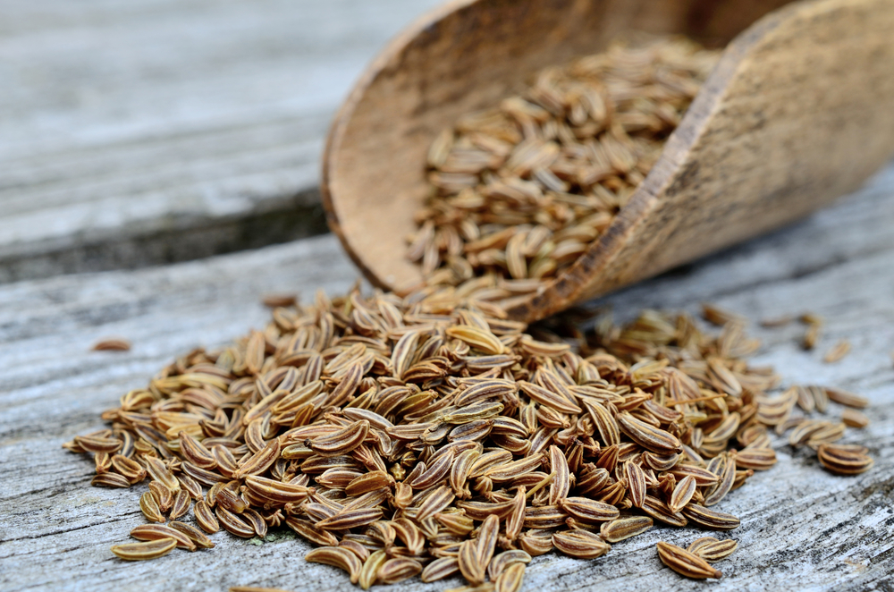
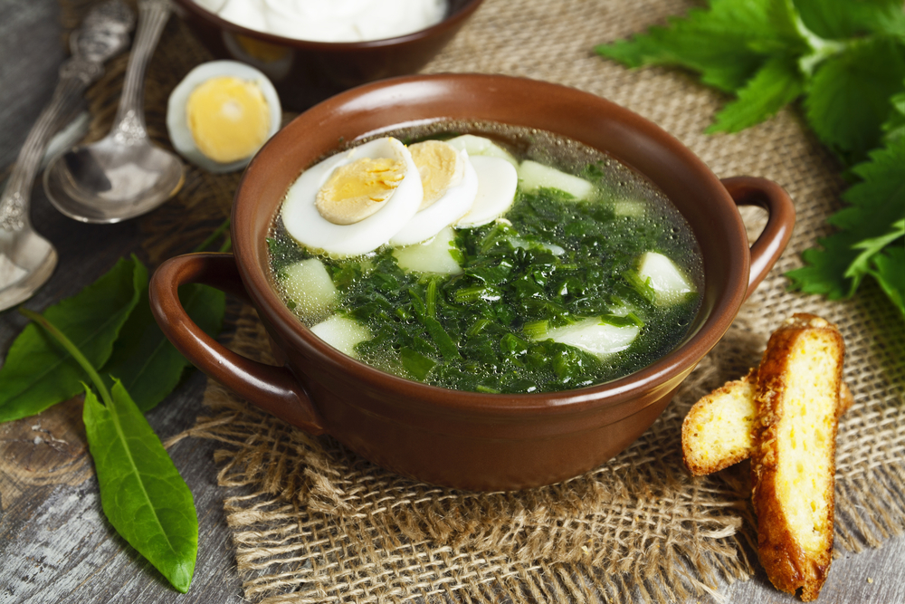
Ingredients
Caraway seeds - have a bittersweet, sharp and peppery anise flavor that is important in traditional dishes like stewed cabbage, solyanka, fresh cabbage salad similar to coleslaw, or sauerkraut – pickled cabbage.
Sorrel – is used to make a hot or cold soup. It has a bright, sour flavour that is also sometimes used in egg omelets and salads but the most traditional Russian and Eastern European way of serving it is in soup served with smetana, a type of sour cream.
Sorrel soup

Slide 18
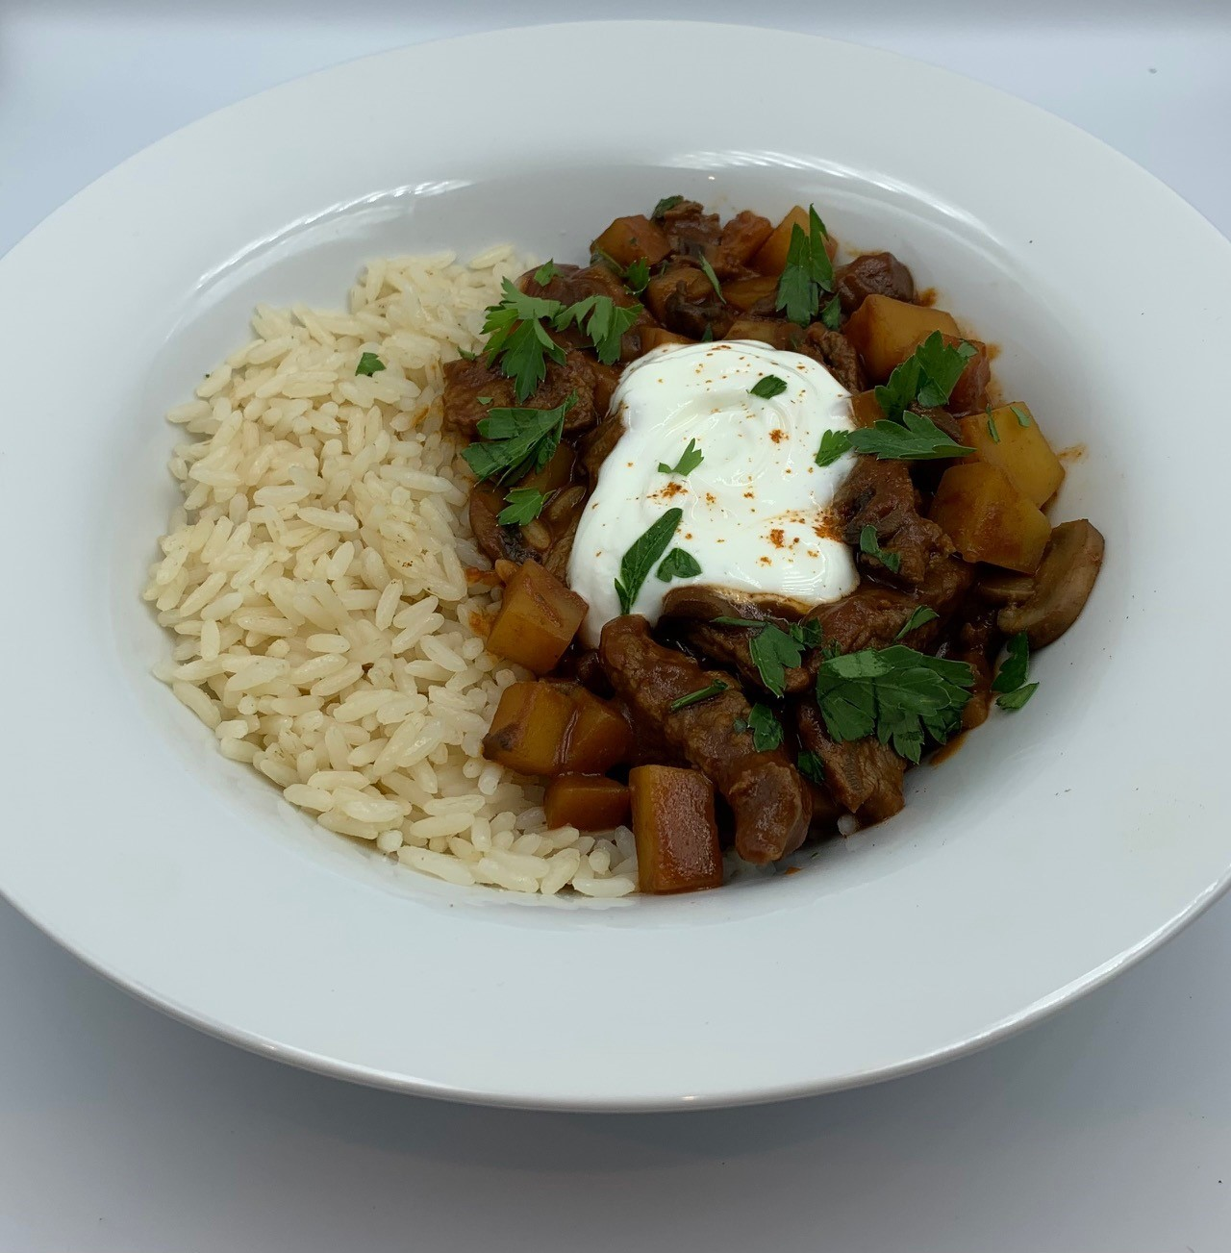
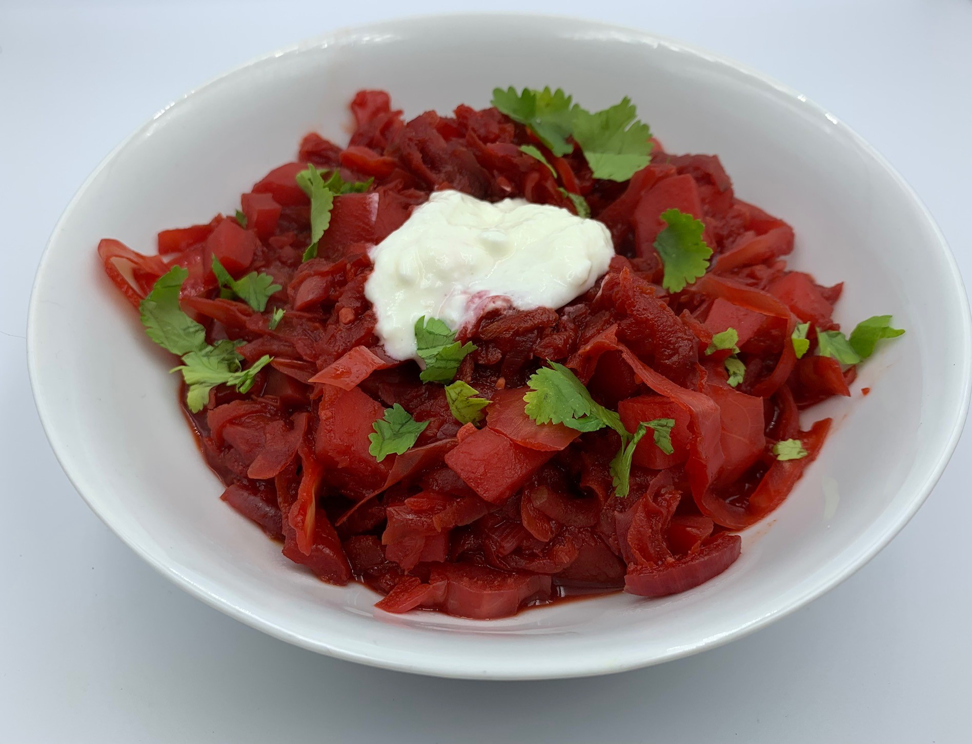
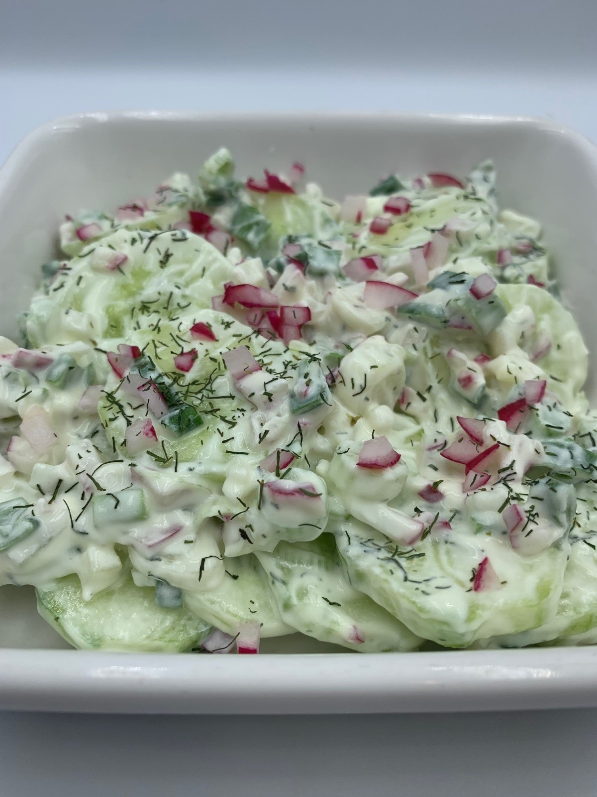
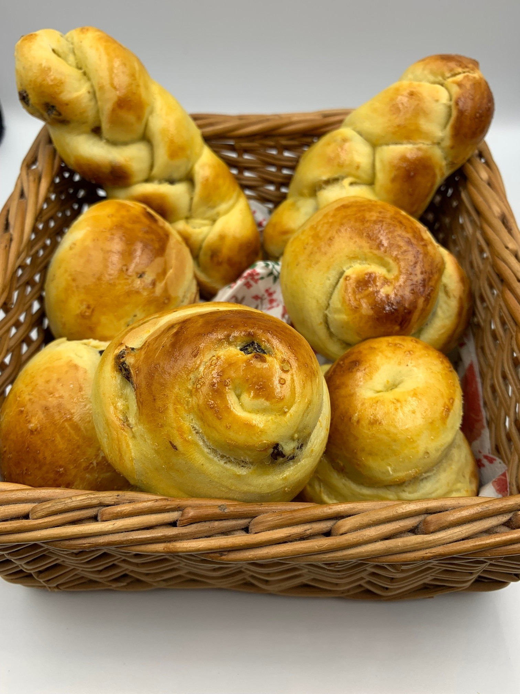
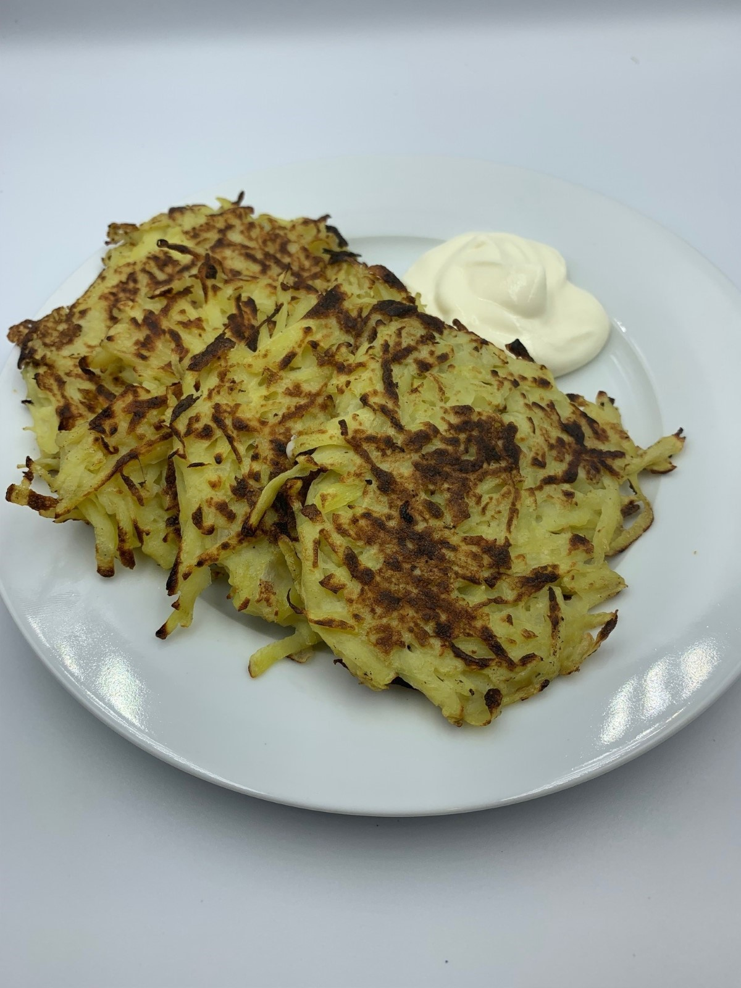
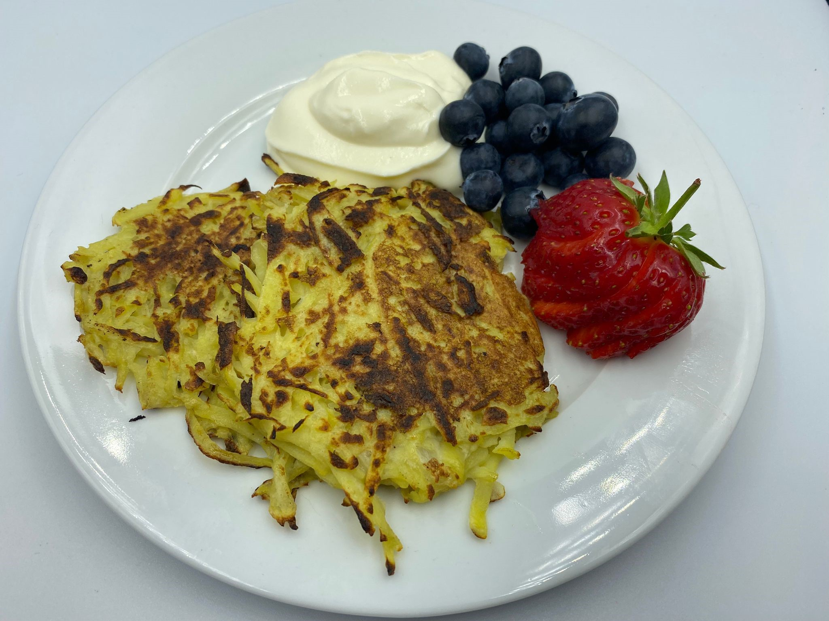
The recipes
Recipes that will be available on the Food – a fact of life website:
Gzik
Twarog
Paska
Polish potato cakes
Quick Hungarian goulash
Ukrainian perogi
Pol mizeria

Slide 19
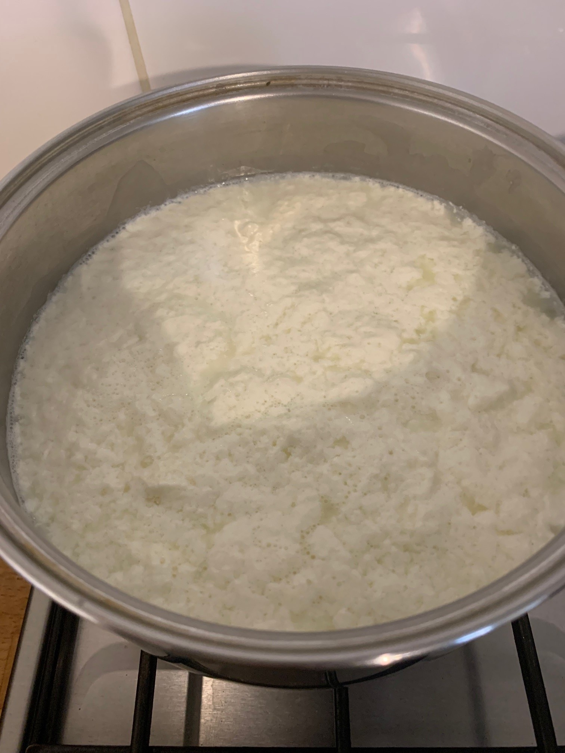
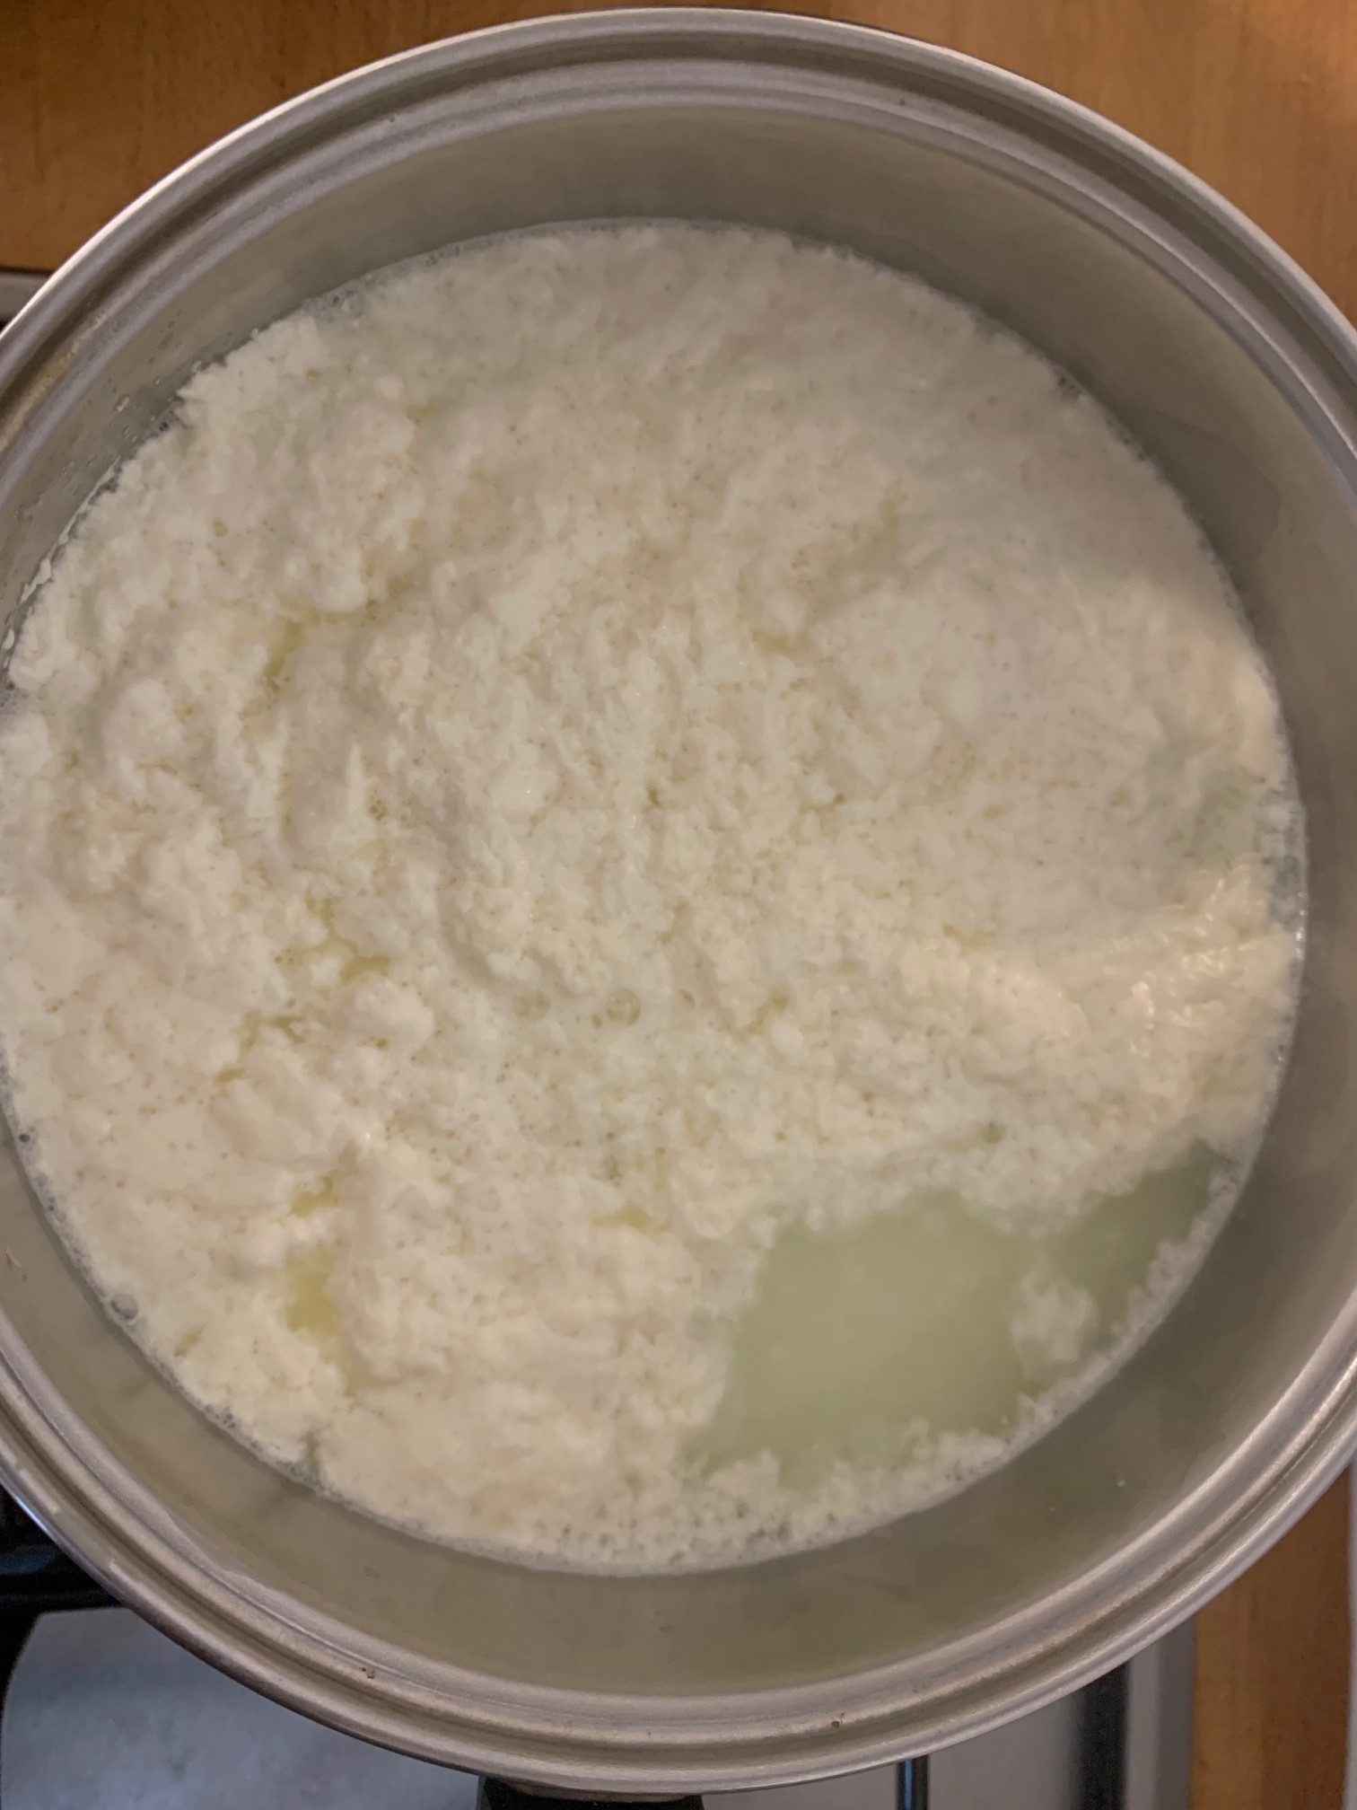
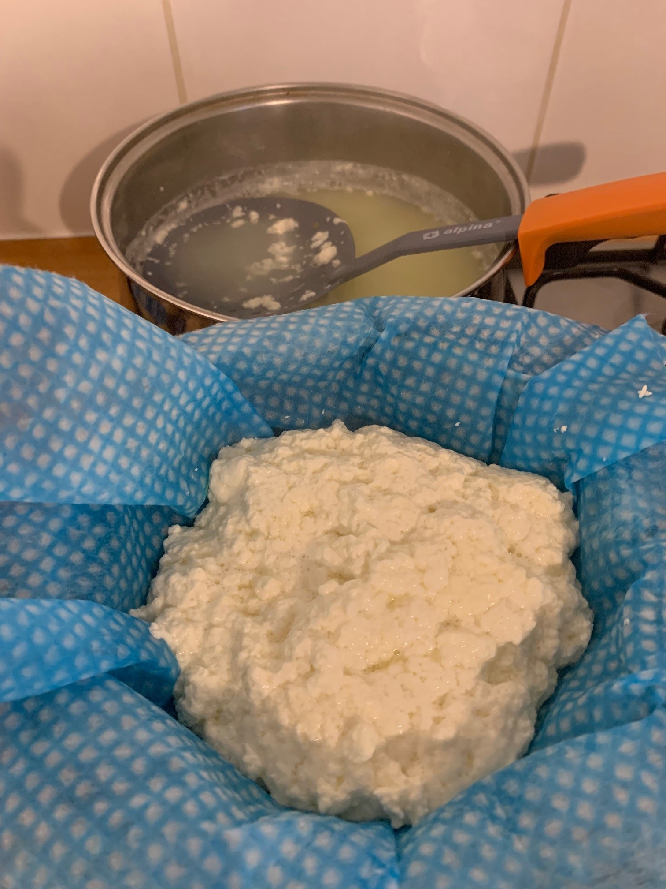
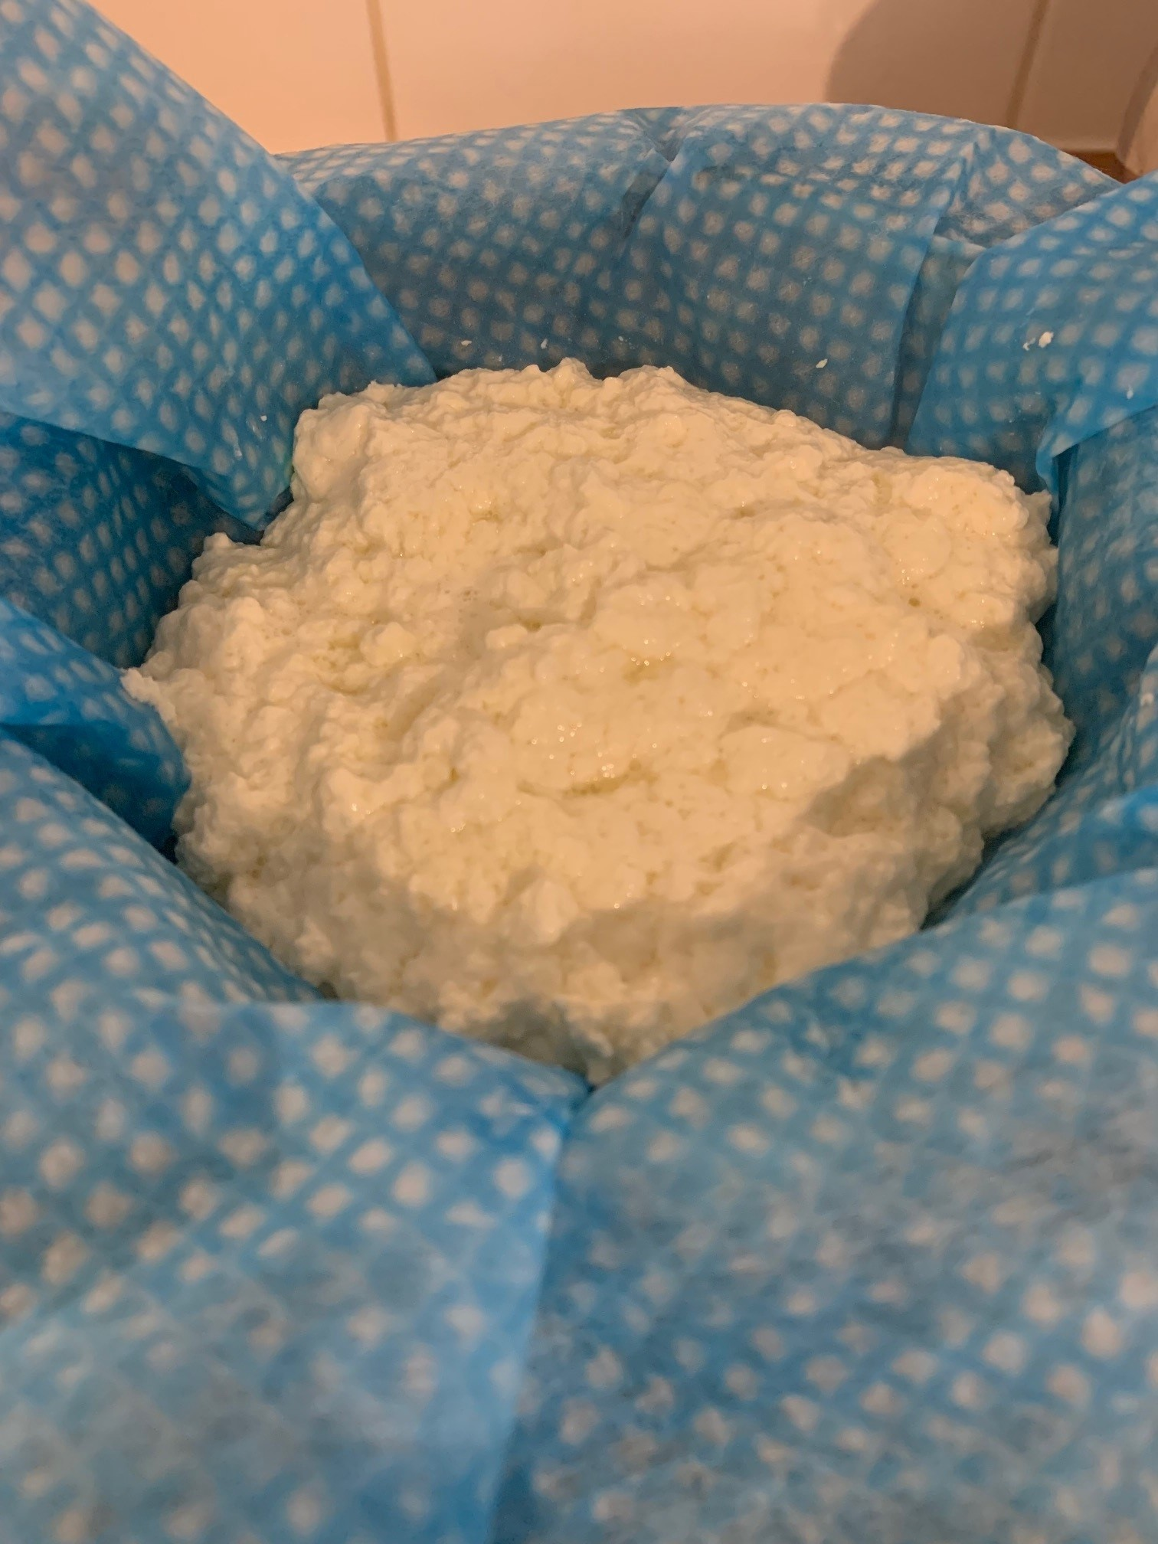
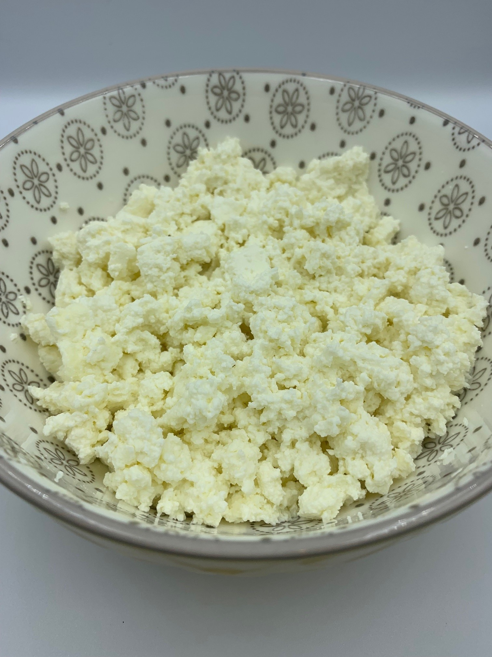
Making homemade cottage cheese

Slide 20

Twarog (homemade cottage cheese)
Why are we doing this?
Learning in lesson: focus on skill/knowledge, not recipe.
A quick to prepare, low complexity recipe.
Demonstrates basic food skills but provides an opportunity for discussion around food science, use of less-common ingredients and simple recipes from different cultures.
Uses ingredients that are easy to source.
Nutrition science: dairy in the diet.
Food science: heat transfer, the effect of cooking, use of lactic acid in cheese making.
Sensory science: Testing, tasting and evaluation.
Maths: Weighing, measuring, time, temperature.
English: Reading and following a recipe, following written and verbal instructions.
Notes:
Kefir is a cultured, fermented milk drink, originally from the Caucasus Mountain region that divides Asia and Europe. It is similar to yogurt but thinner in consistency. It has a tart, sour taste and a slight ‘fizz’, due to carbon dioxide – the end product of the fermentation process. The length of the fermentation time determines the flavour. It can be used in the same way as milk/yogurt, as the base for dips/marinades and in baking. Due to its acidity, it can be used instead of buttermilk to make soda bread.

Slide 21
Twarog (homemade cottage cheese)
Ingredients
1.136 litres (2 pints) fresh, full fat milk
225g kefir, buttermilk or natural yogurt
Method
Pour the milk into a large saucepan and heat for a few minutes over a medium heat.
When it is warm, reduce the heat to low.
Add the kefir, buttermilk or yogurt and mix gently.
Heat until you notice the separating whey.
Remove the curds with a slotted spoon and place in a sieve lined with muslin, cheesecloth or a clean dish cloth.
Leave to drain any remaining whey.
Store in the refrigerator.
Notes:
Twaróg (also known as Polish-style Farmer’s Cheese) is a type of white fresh cheese. It’s a firmer and drier variety of Quark – although the flavour is quite unique and it’s hard to compare it to any other cheese.
This cheese is essential to Polish cuisine, it’s a key ingredient of many classic dishes including (but not limited to):
Breakfast bread spreads/pastes
‘Gzik’ – a creamy dip, mixed with cumin, spring onion and dill.
Various fillings, e.g. for Sweet Cheese Pierogi, for Potato and Cheese Pierogi, or for ‘Naleśniki’ (Polish-style crêpes)
Desserts: Cheese Yeast buns (‘Drożdżówki’), Cheese Babka, Cheesecakes, Easter Pascha
Dough for dumplings (e.g. ‘Leniwe’ dumplings)
Milk + cultures = lacto-fermentation creates curds and whey - save the whey for smoothies, soups, or bread making. Acid (lemon juice/vinegar) curdles the milk creating a different texture
Lactobacillus bacteria convert sugars naturally present in food (including fruit or vegetables) into lactic acid.
Farmer’s Cheese loses freshness very rapidly, Twaróg absorbs other smells easily. To prevent that from happening, store the cheese in a container, tightly covered with a lid. Refrigerate for a maximum of 4-5 days.

Slide 22
Quick Hungarian goulash
Why are we doing this?
Learning in lesson: focus on skill/knowledge, not recipe.
A quick to prepare, medium-high complexity recipe.
Demonstrates a range of basic food skills but can be extended to allow for differentiation and inclusion.
Uses ingredients that are easy to source, offers alternatives for different dietary needs. An opportunity to discuss similar versions of recipes around the world.
Nutrition science: Role of meat and vegetables in the diet.
Food science: Heat transfer, Maillard reaction.
Sensory science: Testing, tasting and evaluation.
Maths: Weighing, measuring, time, temperature.
English: Reading and following a recipe, following written and verbal instructions.
Notes:
Beef Stroganoff is a popular Russian dish of small pieces of beef fillet sautéed in sour cream sauce together with onions and mushrooms.
The dish was named after Count Alexander Grigorievich Stroganoff, who lived in the late 19th century in Odessa. There're two versions of the dish's origin.
According to one of them, Beef Stroganoff was invented by the French chef Andre Dupont for the elderly Count, whose teeth were no longer strong enough for chewing large pieces of meat.
According to another, more popular version, this dish was prepared specially for the guests of Count Stroganoff. Being a wealthy and childless person, Stroganoff often invited people for so-called "open tables". Everyone could join these dinners, the only condition was to be properly dressed and fairly educated. Beef Stroganoff was a tasty meal that could be easily divided into portions. Therefore it was ideal for such "open tables" provided by Stroganoff.
Traditional goulash is a stew/soup, usually using a cheaper cut of meat suited to slow cooking. It usually contains potatoes and other vegetables.
A true stroganoff consists of paprika-dusted fillet steak quickly pan fried with mushrooms and onions in a sour cream and brandy sauce. It is usually served with rice.

Slide 23
Quick Hungarian goulash
Ingredients
1 small onion
2 potatoes (approx. 250g)
50g chestnut mushrooms
Spray oil
200g stir-fry beef strips
1½ x 5ml spoon paprika
150g passata
1 reduced salt beef stock cube
Optional
A handful of fresh parsley
Reduced fat natural yogurt
Method
Prepare the ingredients:
peel and chop the onion.
peel and dice the potatoes;
slice the mushrooms.
chop the parsley if using.
Spray a saucepan with oil and fry the beef for 2 minutes, stirring occasionally. If necessary, do this in batches.
Tip the meat onto a plate.
Off the heat, spray with a little more oil if needed.
Add the onion and mushrooms to the pan and fry for 2-3 minutes, until they start to colour.
Remove from the heat and sprinkle the paprika over the mushrooms and onion and cook for 1 minute.
Add the potatoes and passata. Crumble over the stock cube.
Add 300ml boiling water and stir.
Bring to the boil and then reduce to a simmer.
Cover and cook for 20 minutes, until the potatoes are cooked.
Add the beef and warm through, about 3-4 minutes.
Stir in the parsley and a swirl of yogurt if using, and serve.
Notes:
Chestnut - these brown mushrooms are interchangeable with closed cup, but have a slightly deeper flavour. A chestnut mushroom is a strain that grows just a bit browner instead of white, giving it a tan-coloured top. They are very much like cremini mushrooms and about the same size. They have better flavour and texture than the plain white mushrooms.
Paprika powder is made from very specific peppers found in paprika-producing countries such as Spain and Hungary. Ground chili powder, on the other hand, is a mixture of spices that includes ground chili pepper as well as cumin, garlic powder, salt, and, in fact, paprika. The second most obvious difference between paprika and chili powder is taste. A typical paprika will taste sweet, while chili powder has a more earthy flavour with a bit of spice.
Sweet or mild paprika does not contain any capsaicin since the seeds and membranes are removed, which is what gives chilies their heat. For the spicy paprikas, some of the seeds and the placenta and the capsaicin glands (or veins) are left on the pepper when they are dried and ground into the powder. Smoked paprika obtains its flavour from being smoked over an oak fire.
Hungarian paprika has a sweet or mild-tasting spice – there are eight different grades:
Special or különleges is very bright red and has no heat at all.
Félédes is a half sweet and half spicy.
Csípősmentes csemege is delicate and mild.
Csemege paprika is similar to csípősmentes csemege but more pungent.
Csípős csemege is delicate yet hotter than csemege.
Rózsa or rose paprika has a mild taste and can sometimes have more of an orange-red hue (high quality)
Edesnemes has a slight heat and is the most commonly exported Hungarian paprika.
Erős is the most pungent or hottest of the Hungarian paprikas. This paprika has more of a brownish tone compared to the natural redness of the other grades.
Hungarian Sweet Paprika is the classic choice for several dishes in Hungary, including gulyás (Goulash), pörkölt (stew), lecsó (thick vegetable stew), chicken paprikás (Chicken Paprikash), and halászlé (fisherman’s soup)

Slide 24
Quick Hungarian goulash - review
Skills and knowledge developed and demonstrated | Practicalities in the secondary classroom | Alternatives – ingredients, cooking methods …
 | Storage pre+post preparation and cooking. Hygiene and safety using raw meat. Vegetarian option – add drained chickpeas at step 11 White closed cup mushrooms can be used but have less flavour than chestnut. Consider providing the paprika if needed | For a vegetarian version swap the beef for a 400g can of chickpeas (drained and rinsed) or use a plant-based meat alternative and increase the mushrooms to 100g. If time allows, use or demonstrate making in a slow cooker or cooking in the oven. Provides an opportunity to discuss different cooking methods and use of cheaper cuts of meat that require a longer cooking time.
Practical food skills: Measure, peel, cut, slice, dice, fry, stir, boil, simmer
Nutrition science: Role of meat and vegetables in the diet
Food science: Effect of cooking on protein. Heat transfer, Maillard reaction
Sensory science: Testing, tasting and evaluation.
Maths: Weighing, measuring, time, temperature.
English: Reading and following a recipe, following written and verbal instructions.

Slide 25
Gzik
Ingredients
250g reduced fat natural cottage cheese
2-3 radishes
1 small bunch of chives or 2-3 spring onions
1 x 15ml reduced fat sour cream, crème fraiche or Greek yogurt
Black pepper
Method
Prepare the ingredients:
finely chop the radishes;
finely chop the chives or the spring onions (green tops only).
Place the cottage cheese in a mixing bowl.
Add the chopped radishes and spring onion green and mix well with a fork.
Add the sour cream, crème fraiche or Greek yogurt and mix well.
Add black pepper for seasoning.
Serve with bread, toast or boiled/baked potatoes (known as Pyry-z-gzikiem).
Notes:
This is mostly served on Fridays as a simple, tasty meatless dish. It was originally intended for the have-nots of Wielkopolska (Greater Poland).

Slide 26
Twarog/Gzik- review
Skills and knowledge developed and demonstrated | Practicalities in the secondary classroom | Alternatives – ingredients, cooking methods …
 | Storage pre+post preparation and cooking. Costs – consideration of kefir, buttermilk or natural yogurt for Twarog. Making soft cheese with lemon juice information. | To reduce food waste, chop the whites of the spring onions and add them to the cottage cheese mix. Other ingredients can also be added e.g. boiled egg, garlic, smoked mackerel, chopped vegetables, e.g. peppers, carrots. Herbs such as dill can also be added.
Practical food skills:
Measure, simmer, mix, drain
measure, cut, chop, mix.
Nutrition science: Dairy and vegetables in the diet.
Food science: Heat transfer, the effect of cooking, use of lactic acid in cheese making.
Sensory science: Testing, tasting and evaualtion.
Maths: Weighing, measuring, time, temperature.
English: Reading and following a recipe, following written and verbal instructions.

Slide 27

Food – a fact of life: How can we help?
Food – fact of life website.
Tried and tested recipes.
Good practice guidance for primary and secondary schools, as well as supporting pupils with additional needs.
Resources to support pupils with additional needs
Whole school support
Guidelines for school education resources around food
My dashboard – store collections of recipes and resources in your own online area.
Personal and professional development (PPD) for teachers. PPD newsletter – sign up!
www.foodafactoflife.org.uk

Slide 28
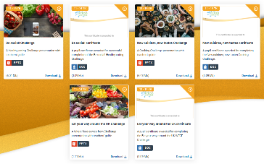

Challenge activities
The Challenges cover Healthy eating, Cooking and Where food comes from and provide a wide range of activities that teachers can select depending on their pupils’ needs, age and abilities, and the time available.
there are 12 Challenges developed to be used with nursery, primary or secondary pupils;
each Challenge presentation comprises:
slides to present the Challenge to the class, including images, information and questions/tasks to stimulate pupil discussion and planning;
a teachers' guide with opportunities for learning and a variety of pupil activities that can be completed individually or in groups.
11-14 years and 14-16 years

Slide 29
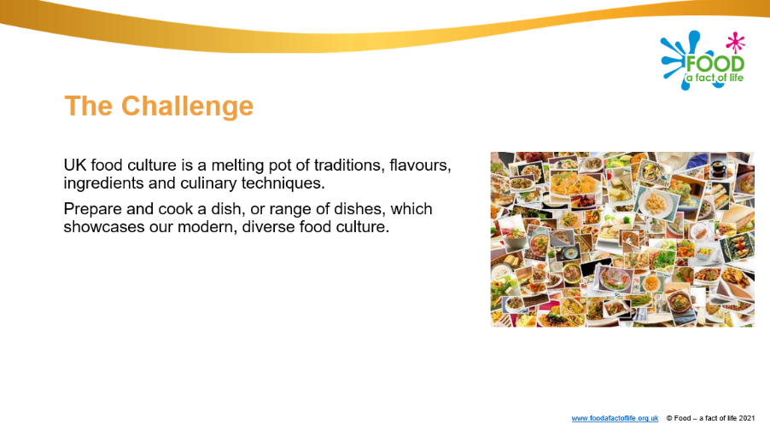
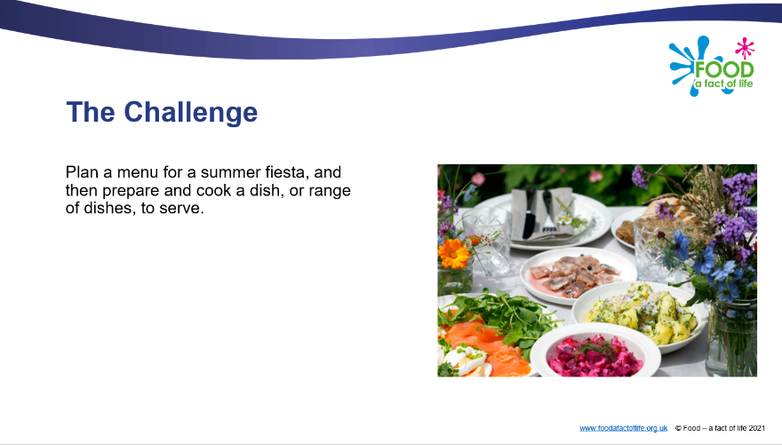
Diverse food culture Challenges
11-14 years and 14-16 years

Slide 30
Other FFL resources
Classroom resources and activities | Teaching and learning | Personal and professional development (PPD)
Bread activity pack Fibre activity pack Harvest activity pack Knowledge organisers 11-14 and 14-16 Nutritional analysis Quizzes 11-14 Quizzes 14-16 Remote learning resources Videos – cooking Videos – where food comes from | Good food hygiene and safety practices Planning sheets Resources and presentations Resources to support UK examination specifications Schemes of Work Teaching and learning videos Practical food skill progression and complexity rating | FFL training PPD toolkit Schemes of Work and lesson planning – advice and support Teacher knowledge and skills
Links to resources that focus on topics covered in today’s workshop can be found in your joining instructions.

Slide 31
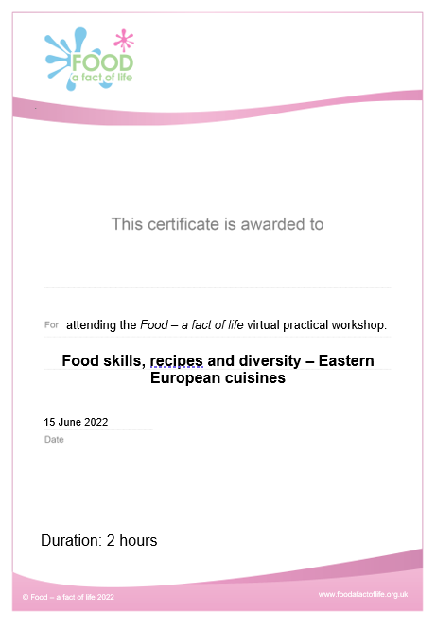
Last words ...
Review of training – ‘bright spots’?
Evaluation – a link will be sent to you. When completed …
Personalised certificate – will be emailed to you
Voucher – will be sent to you

Slide 32
Thank you for joining!
For further information, go to:
www.foodafactoflife.org.uk

