Slide 1
Filling, forming and enrobing

Slide 2
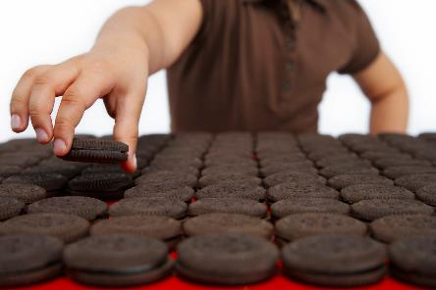
Forming
Many manufactured food products are formed into shapes.
The main aim of forming is to ensure that the products are of a uniform shape and size.
Forming can also be used to add decoration to a product, through embossing.

Slide 3
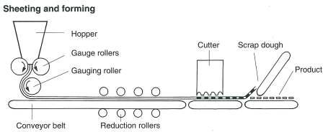
Sheeting and forming
This method rolls the mixture, usually a dough, into a continuous strip. The thickness of the dough is regulated by ‘gauge rollers’. The dough passes along a conveyor belt to a ‘cutter’.

Slide 4
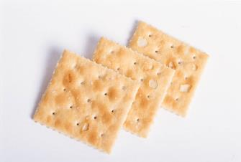
Sheeting and forming
This stamps out the product shape and may also be used to emboss the product with a design.
The scrap dough is removed (to be recycled) and the formed product continues its journey through a specific manufacturing process.
This method is used to make crackers or semi-sweet biscuits.

Slide 5
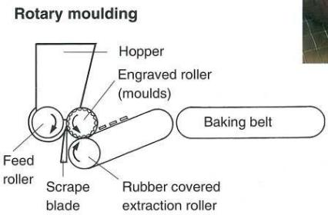
Rotary moulding
Pre-mixed ingredients, such as biscuit dough or vegetarian burger mix, are fed into a hopper.
The mixture is then forced down on to an engraved roller.
The mixture is forced into the ‘moulds’ and rotated around to a rubber-covered conveyor belt which helps remove the moulded product.
There is no scrap to recycle.

Slide 6

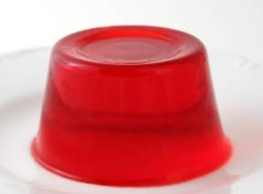
Using a mould
Solid products, such as chocolate bars are produced by either filling or forcing the product into a mould. A domestic example would be the use of a mould to produce a jelly.

Slide 7

Using a mould
Hollow-moulded products, such as chocolate eggs, use two separate moulds.
These have chocolate injected into the moulds.
They are turned upside down to remove the excess.
The length of time between injecting and turning is regulated by the thickness of the chocolate.
The moulds then travel through a cooling tunnel to set.
The egg halves are removed from the moulds and, finally, using melted chocolate, two halves are sandwiched together.

Slide 8
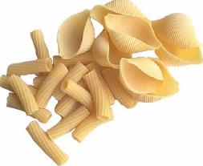
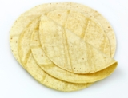
Extrusion
Pre-mixed ingredients are held in a hopper and pumped through a barrel-shaped chamber. The mixture is usually heated and forced under pressure through a die. This shapes the product into a continuous filament.
A wire cutter or blade operates below and cuts the product into a uniform size. The pieces then drop onto a conveyor belt.
Extrusion is used to produce products such as pasta, flatbreads, textured vegetable protein, confectionery and snacks.

Slide 9
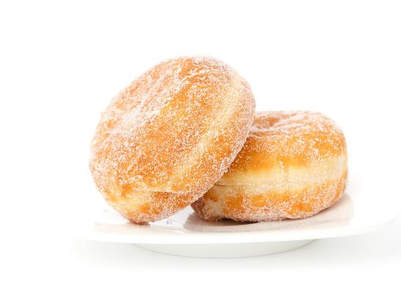
Filling
The process of filling can be separated into two techniques:
• a measured quantity of product is put into a container, either before or after cooking;
• a food mixture, such as jam or butter, is injected or sandwiched into the centre of a food (e.g. doughnut or chicken Kiev).

Slide 10
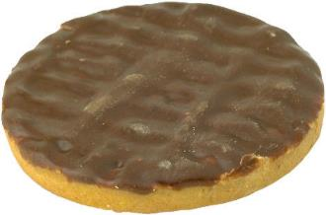
Enrobing
Food that has been enrobed has been coated with an outer layer. Examples of these are chocolate-coated wafers and fish fingers with breadcrumbs. Sometimes only one side is coated (e.g. chocolate digestive biscuits).
The type of food being enrobed or coated will determine the process it goes through. However, the basic principles are the same.

Slide 11
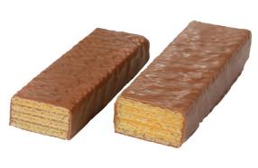
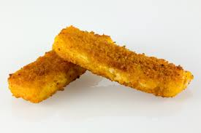
Principles of enrobing
The main principles of enrobing are:
• the food moves along a conveyer (mesh);
• it passes through a curtain coating, e.g. chocolate;
• the food emerges coated;
• excess coating is removed by vibration or air drying.

Slide 12
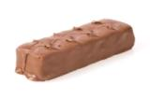
Enrobing - coating
It is important that the coating sticks to the food. Liquid chocolate will stay easily.
However, to apply a dry coating, another step is needed in the process. Before the food reaches the coating stage it is sprayed or dipped into a liquid to which dry coating can stick.
The thickness of the coating can be regulated. A common process is to pass products under a current of air. This removes excess coating (which can be recycled) and may also leave a pattern.

Slide 13

Enrobing
Coating one side of a food is a similar process. For example, if you wish to sprinkle coconut on top of a biscuit, the biscuit (which has a suitably sticky top) passes through a curtain of coconut.
The excess coconut falls through the mesh conveyor and the biscuit emerges coated.

Slide 14
Filling, forming and enrobing
For further information, go to:
www.foodafactoflife.org.uk
This resource meets the Guidelines for producers and users of school education resources about food.

