Slide 1
Washing and drying hands

Slide 2
Washing and drying hands
Wet your hands
Use soap
Rub soap all over your hands
Use a nail brush
Rinse your hands
Dry your hands well

Slide 3
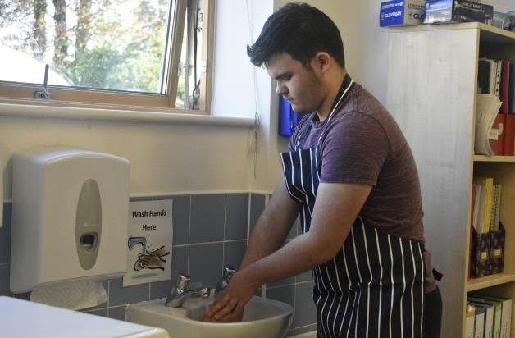
1. Wet your hands
Use warm water

Slide 4
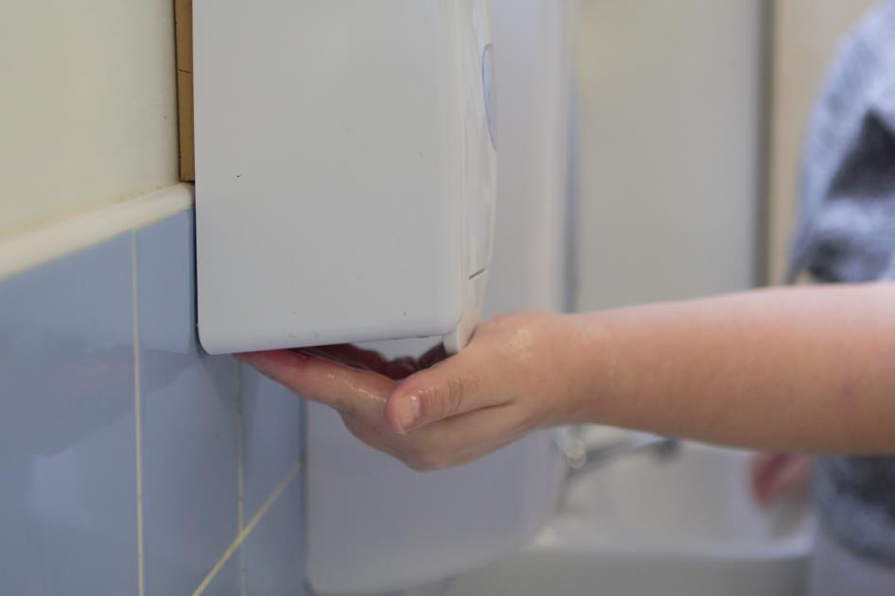
2. Use soap

Slide 5
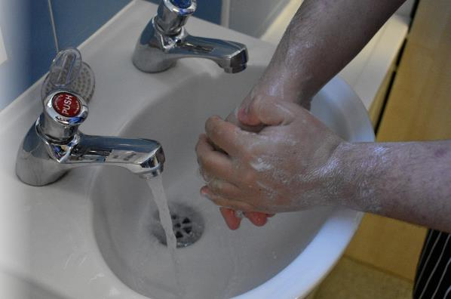
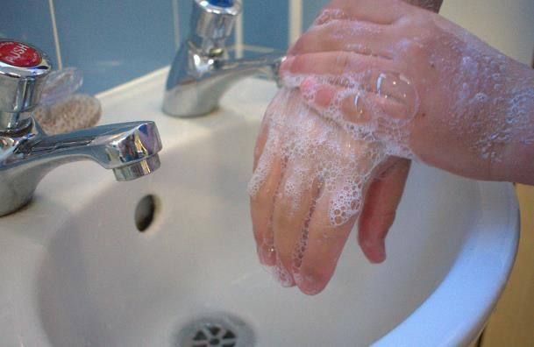
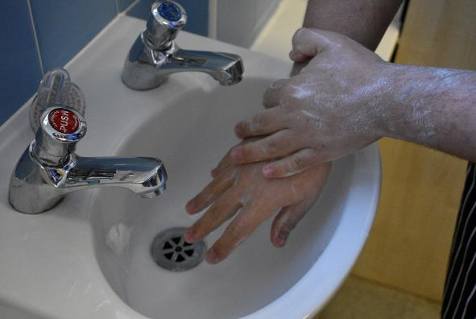
3. Rub soap all over your hands

Slide 6
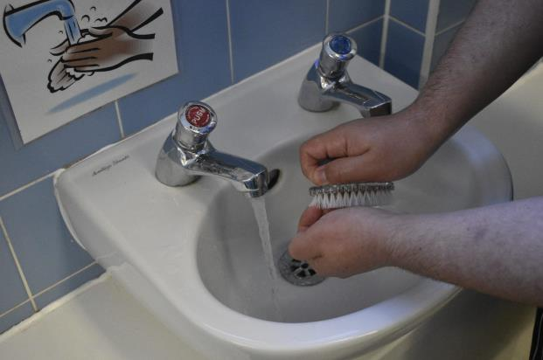
4. Use a nail brush

Slide 7
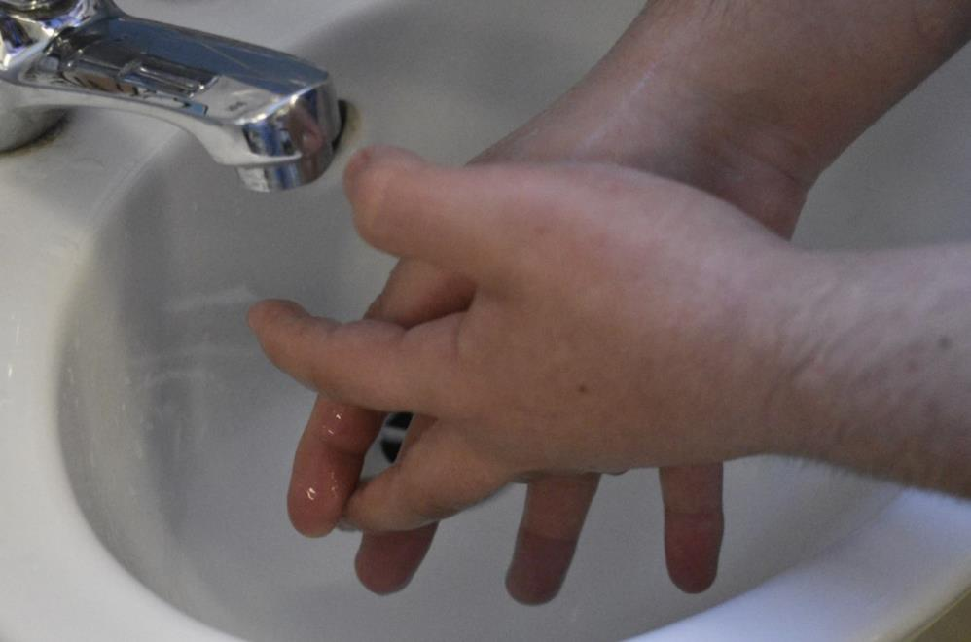
5. Rinse your hands
Use warm water

Slide 8
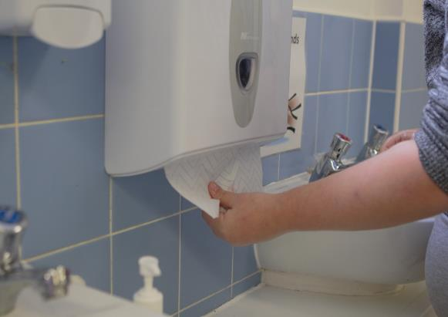
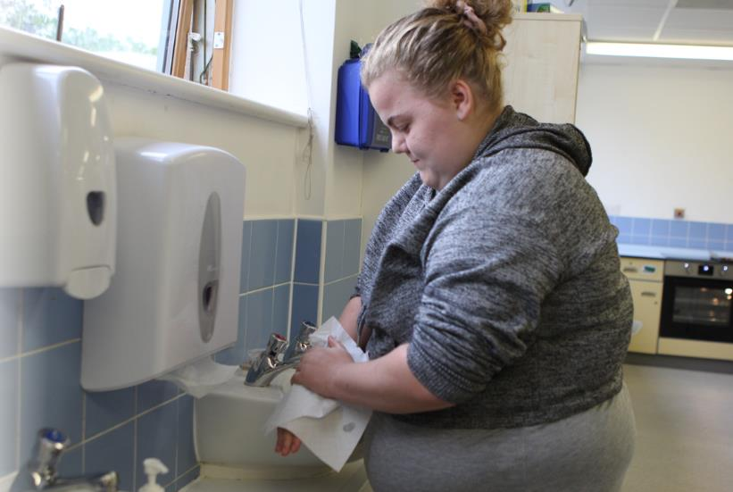
6. Dry your hands well

Slide 9
Washing and drying hands
Wet your hands
Use soap
Rub soap all over your hands
Use a nail brush
Rinse your hands
Dry your hands well

Slide 10
Washing and drying hands
For further information, go to:
www.foodafactoflife.org.uk
This resource meets the Guidelines for producers and users of school education resources about food.

