Slide 1
What is a recipe?

Slide 2
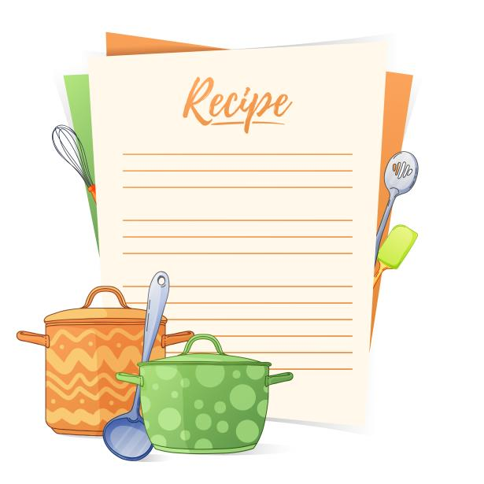
A recipe is made up of 3 parts:
a list of all the ingredients needed (metric);
a list of all the equipment;
the method, i.e. how to make the dish.

Slide 3
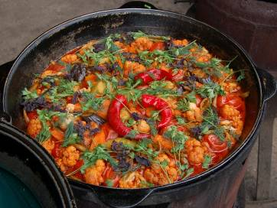
A recipe may also include:
a picture of the final product;
serving suggestions, e.g. how to present the dish or ideas for accompaniments;
number of portions it serves.

Slide 4
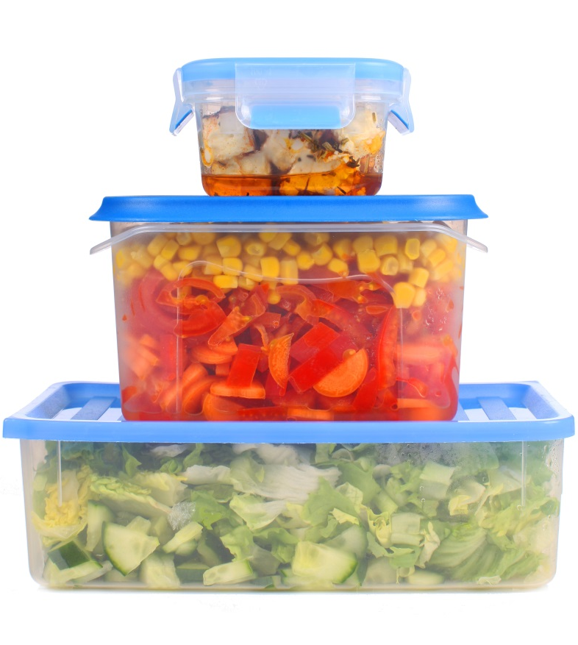
Ingredients
The ingredient list may also give details for the size of a food item needed, for example:
a large egg;
1 small can of tomatoes.
Sometimes the list will explain how the ingredient should be prepared, for example:
1 onion, chopped;
50g cheese, grated;
100g canned sweetcorn, drained.

Slide 5
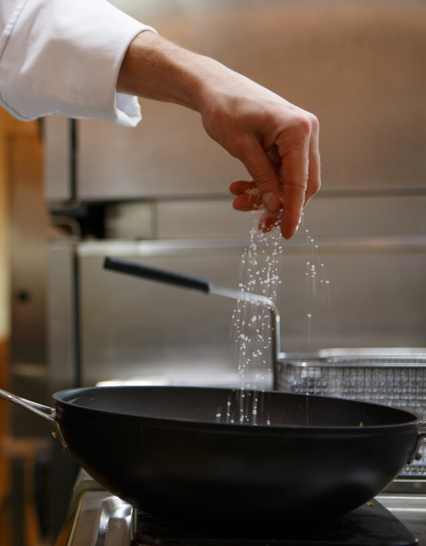
Ingredients
All measurements should be given in metric units, for example:
50g flour;
100ml milk;
5ml spoon mustard powder.
Do not use imperial and metric measurements in the same recipe.

Slide 6
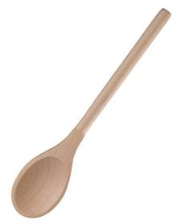
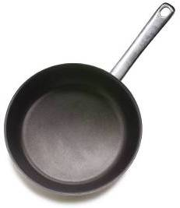
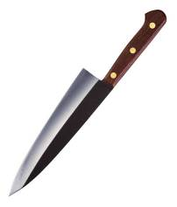
Equipment
List all the equipment needed to make the dish.
If you need the oven, ensure that the shelves are set to the correct height, and it is preheated to the precise temperature.
You may need to prepare cake tins or other equipment in advance.

Slide 7
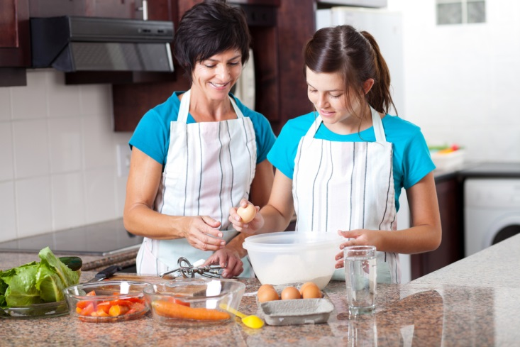
Method
The method is a logical step-by-step set of instructions.

Slide 8
Method
In addition, a ‘method’ may:
give instructions to preheat the oven first, if required;
state the cooking time and temperature;
sequence the task to ensure effective use of time;
give other steps that need to be undertaken while food is cooking;
highlight specific skills, such as sift, whisk, mix, fold, beat, line or cream.

Slide 9
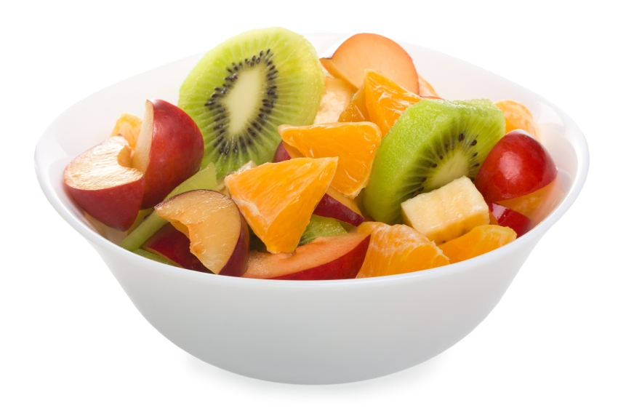
A Recipe
Title, e.g. Fruit salad sunshine.
Ingredients, e.g. 1 banana.
Equipment, e.g. a chopping board.
Method, e.g. 2. Slice the banana.

Slide 10
What is a recipe?
For further information, go to:
www.foodafactoflife.org.uk
This resource meets the Guidelines for producers and users of school education resources about food.

