Slide 1
Food in Victorian times

Slide 2
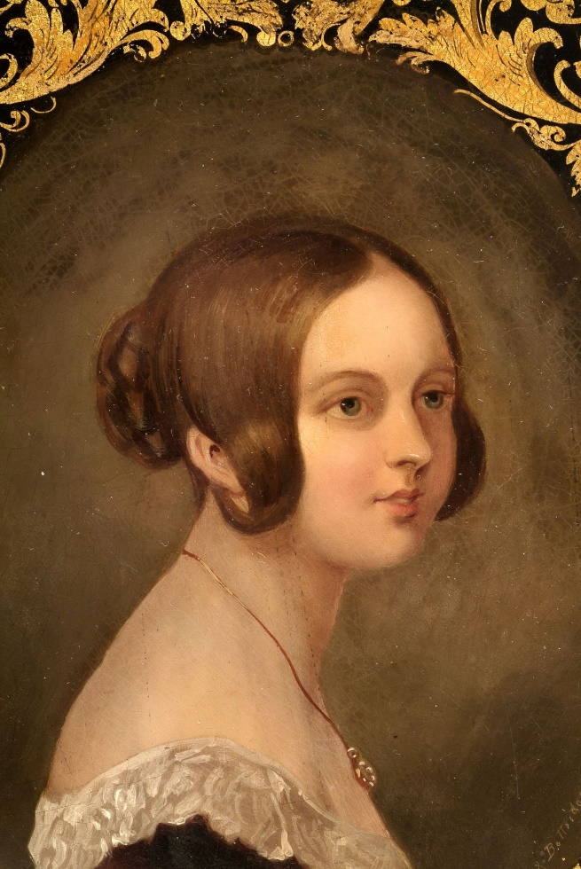
Victorian times
The Victorian times were between 1837 and 1901 when Queen Victoria was on the throne. She reigned for 64 years.
The time around the middle of Queen Victoria’s reign, 1855 – 1880, is called the ‘mid-Victorian’ times.

Slide 3
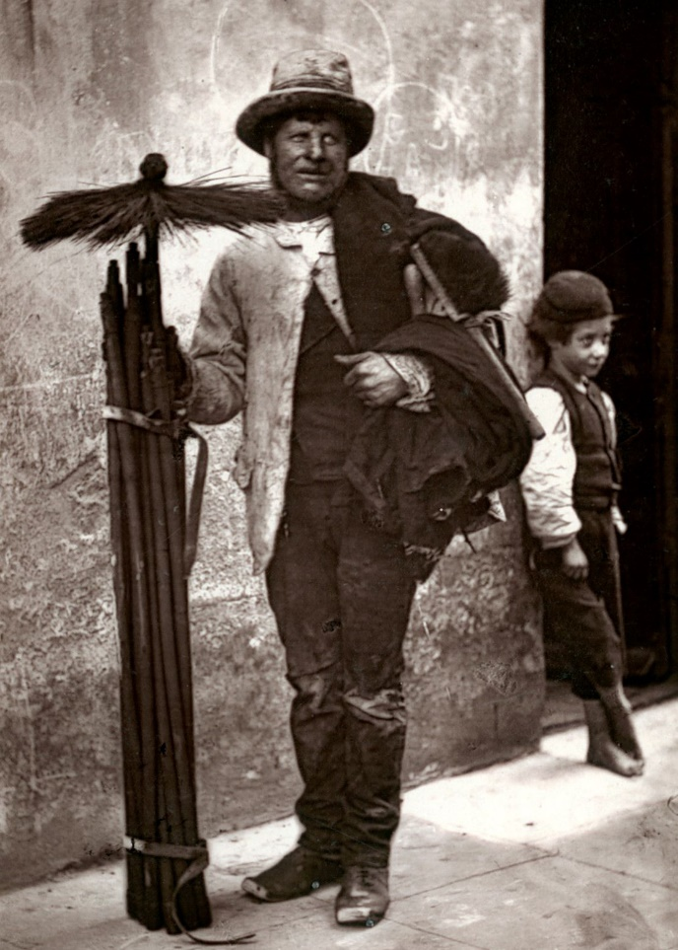
Victorian times
We are going to look at what eating was like for the working classes during the mid-Victorian times.
The working classes made up around three-quarters of the Victorian population. Some of the working classes had a bit more money than others, but for most life was still hard and uncomfortable.

Slide 4
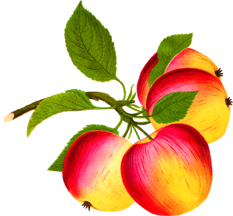
Fruit and vegetables
In the mid-Victorian times, most of the fruit and vegetables eaten were grown in the UK.
People had to eat the fruit and vegetables that were in season.
Why do you think that was?

Slide 5
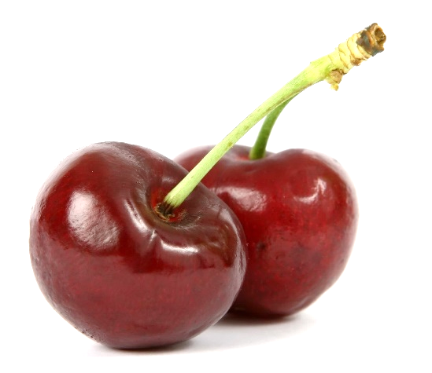
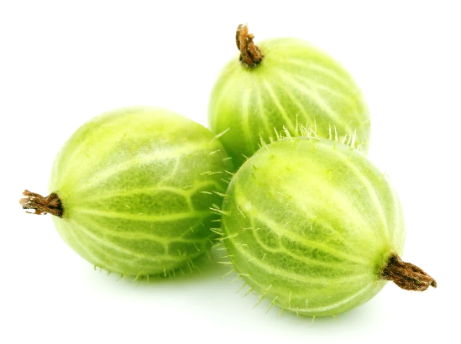
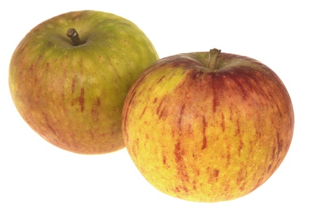
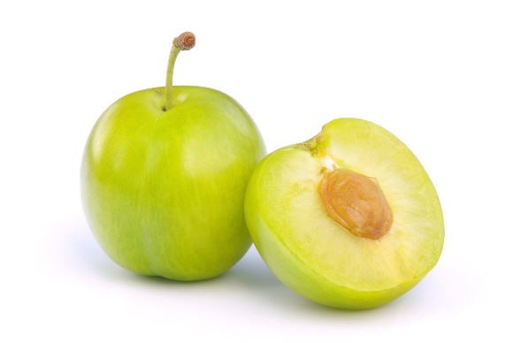
Fruit and vegetables
This fruit was cheap and widely available in Victorian times.
Name each fruit.
Have you tried all of these?
Cherries
Gooseberries
Apples
Greengages

Slide 6
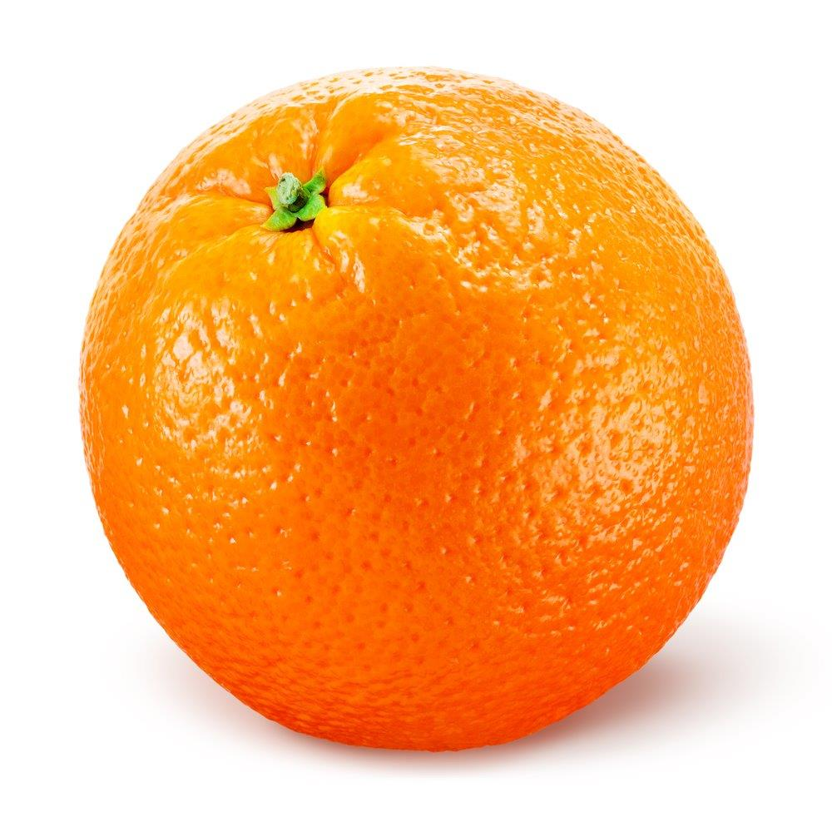
Fruit and vegetables
For a special treat at Christmas, some people might have had an orange in their Christmas stocking.
Why do you think an orange would be a treat for Victorians?
If you were given an orange as a present, how would you react?

Slide 7
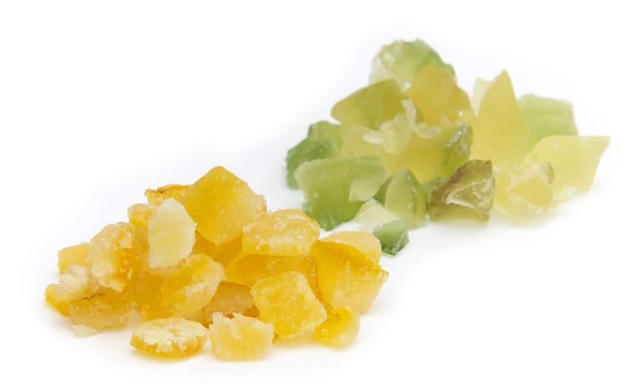
Fruit and vegetables
Candied peel and dried fruit were popular in Victorian times. They were always cheap and available and used to flavour desserts, such as bread and butter pudding.
Candied peel is the peel from citrus fruit, such as oranges, that is cooked in sugar syrup. This preserves it (makes it last longer).
Have you had any dried fruit or candied peel before? What was it like?

Slide 8
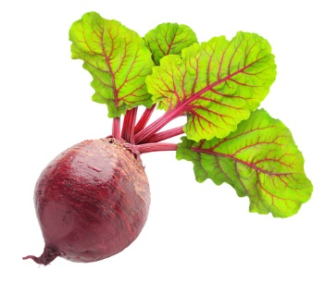
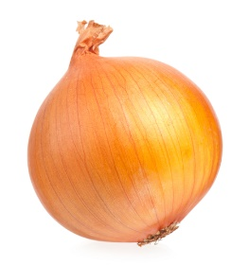
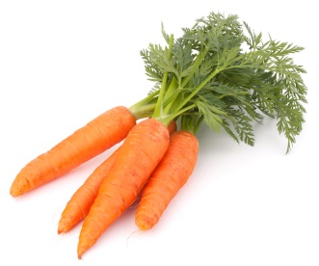
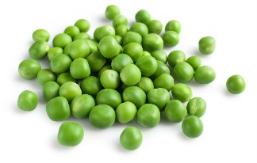
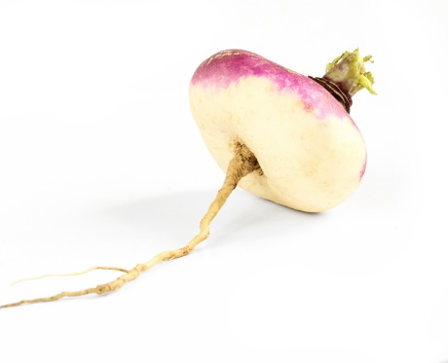
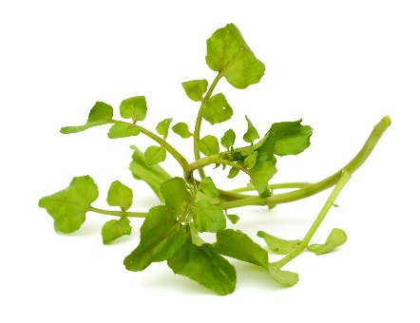
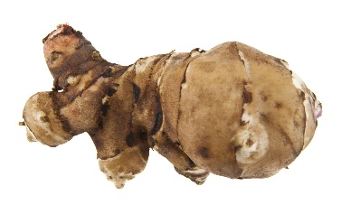
Fruit and vegetables
Onion
These vegetables were cheap and widely available in Victorian times. This meant Victorians often used a lot of vegetables in their cooking.
Name each vegetable.
Do we still eat these today?
Beetroot
Peas
Carrots
Turnip
Jerusalem artichoke
Watercress

Slide 9
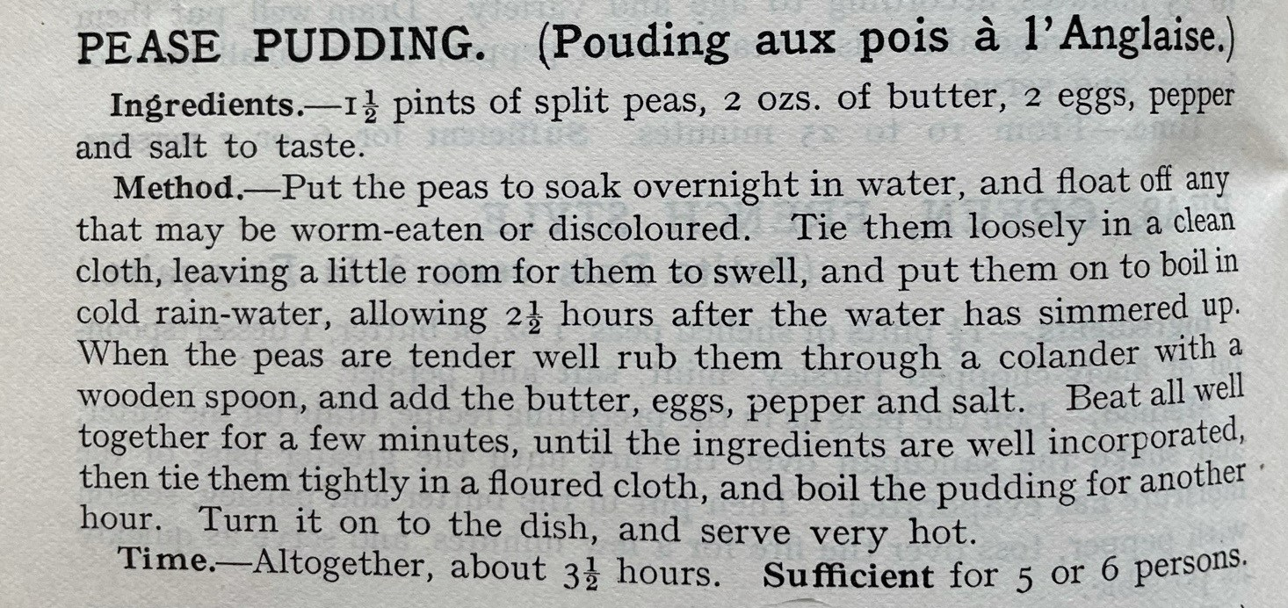
Legumes
The Victorians also ate legumes, such as yellow split peas (dried peas).
They made a dish called pease pudding using yellow split peas and served it with cold meat and bread.
It was called ‘pease’ pudding because it was made from dried peas.
Pease pudding is still eaten by some people today.
Recipe © Mrs Beeton’s Book of Household Management, published 1861
Read the recipe. Describe how you think it would taste.

Slide 10
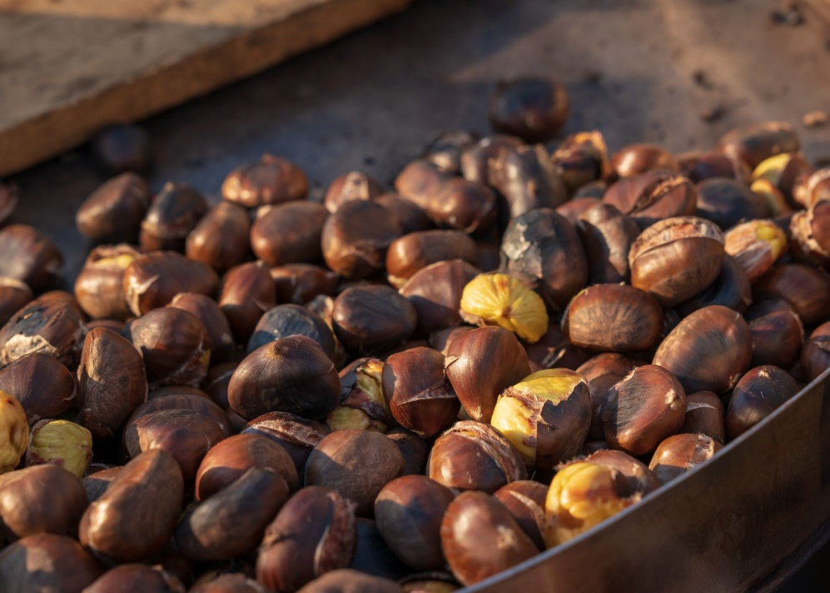
Nuts
Chestnuts were commonly eaten, often as a street snack. Even poor Victorians bought cheap street food, such as roasted chestnuts.
Hazelnuts and walnuts were popular too.
Have you tried chestnuts, hazelnuts or walnuts?

Slide 11
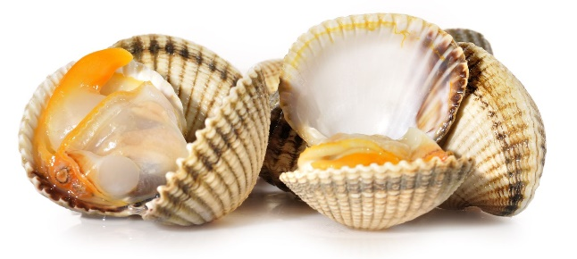
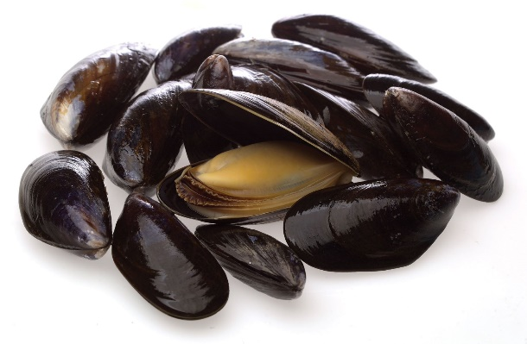
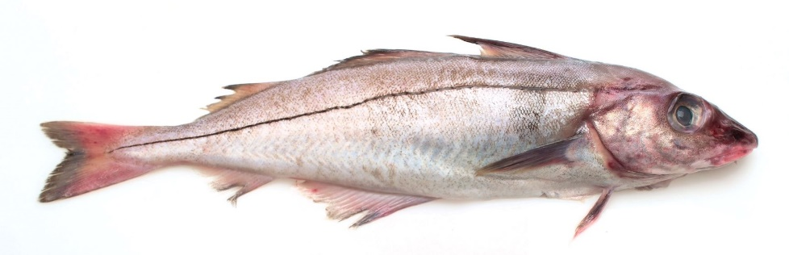
Fish
The Victorians ate plenty of fish. There were lots of cheap varieties available.
They ate herrings, sometimes fresh and sometimes pickled, eels and shellfish, such as oysters, cockles, mussels and whelks. Cod and haddock were also available and the whole fish, including the head, would usually be eaten!
Fish and chips was not available, but fried whitebait (a small fish) was a favourite street food.

Slide 12
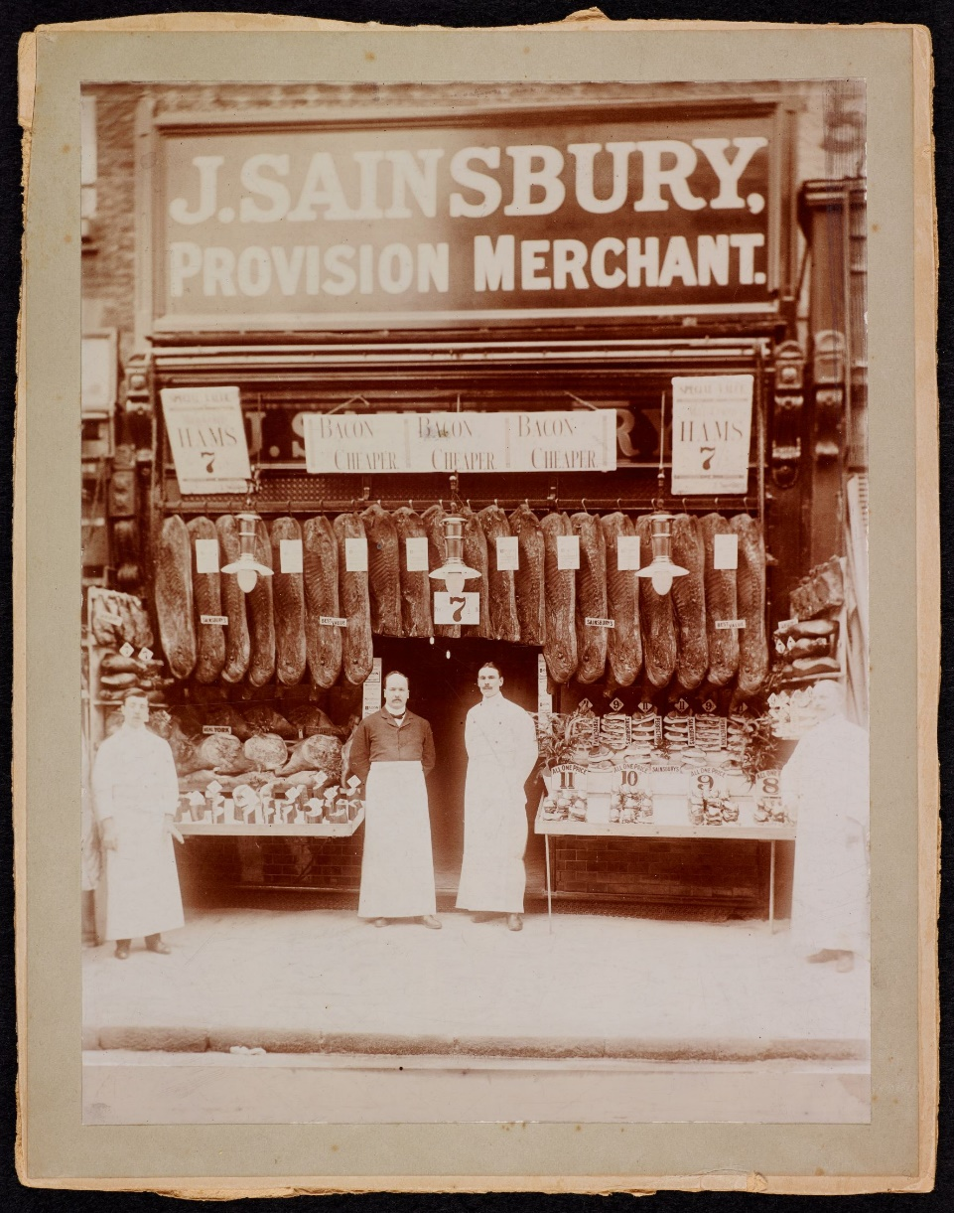
Meat
Meat was expensive so most Victorians would only have a small amount. This photo shows a shop selling bacon and ham.
A joint of meat would be an occasional treat. Cheaper parts of an animal, such as kidneys, heart, brains and liver, could be eaten more often. Sheep’s heads could also be bought cheaply.
Image © The Sainsbury Archive, Museum of London Docklands.

Slide 13
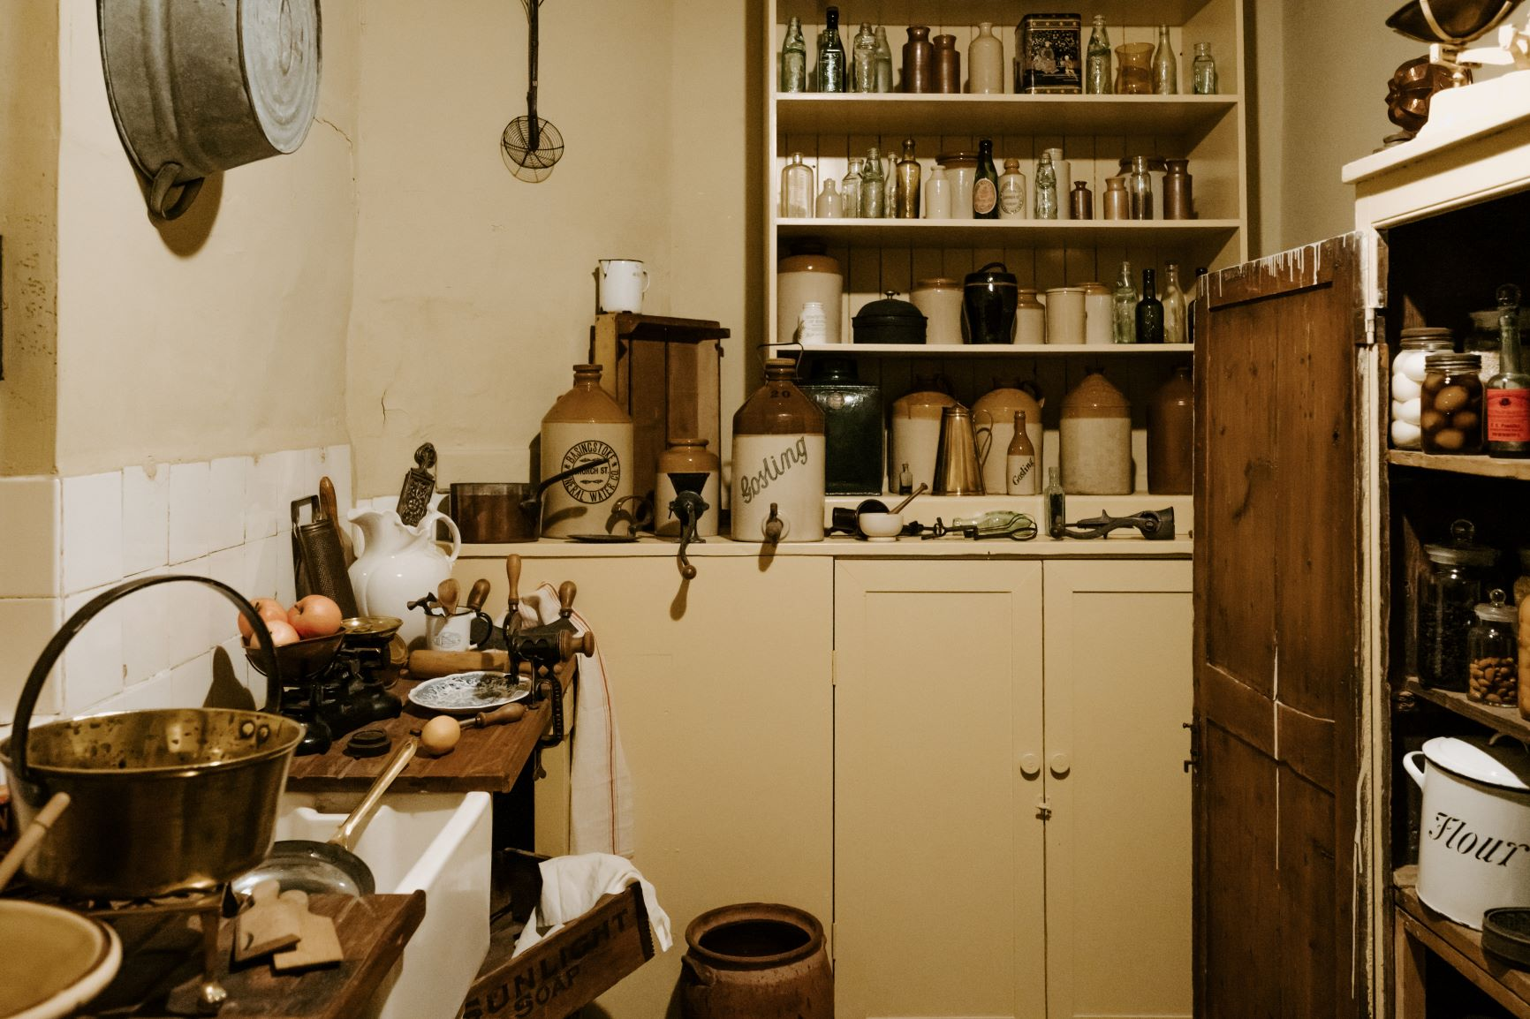
Other food
Eggs were available in Victorian times. Some people kept their own hens and ate or sold the eggs.
Victorians ate some milk and butter, but not too much because of the cost. They ate some cheese too.
Lard and dripping (the fat and juices from cooked meat) were often eaten with bread.

Slide 14
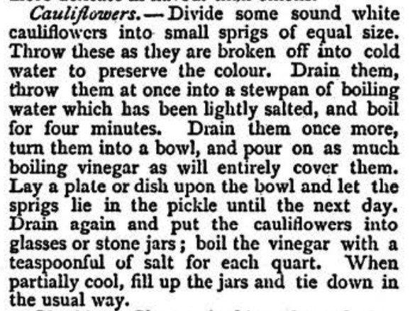
Preserved food
Some food was preserved in Victorian times to help it last long. Pickled was one way of preserving.
The Victorians ate pickled food such as herrings (when they were not in season), pickled cabbage, pickled gherkins and other pickled vegetables.
What pickled food can you name?
Home Made Pickles, by Phillis Browne
(Girl's Own Paper, 1883) https://www.victorianvoices.net/ARTICLES/VT/2015/1509-pickles.pdf

Slide 15
A poor Victorian’s menu
Breakfast:
Porridge made with water
Lunch:
Bread and watercress
Evening meal:
Fish head soup and bread follow by stewed apple with breadcrumbs
Snack:
Roast chestnuts (from a street seller)
Here is an example of what a poorer working class Victorian might have eaten during a day.
What would you think if this was a day of food for you?

Slide 16
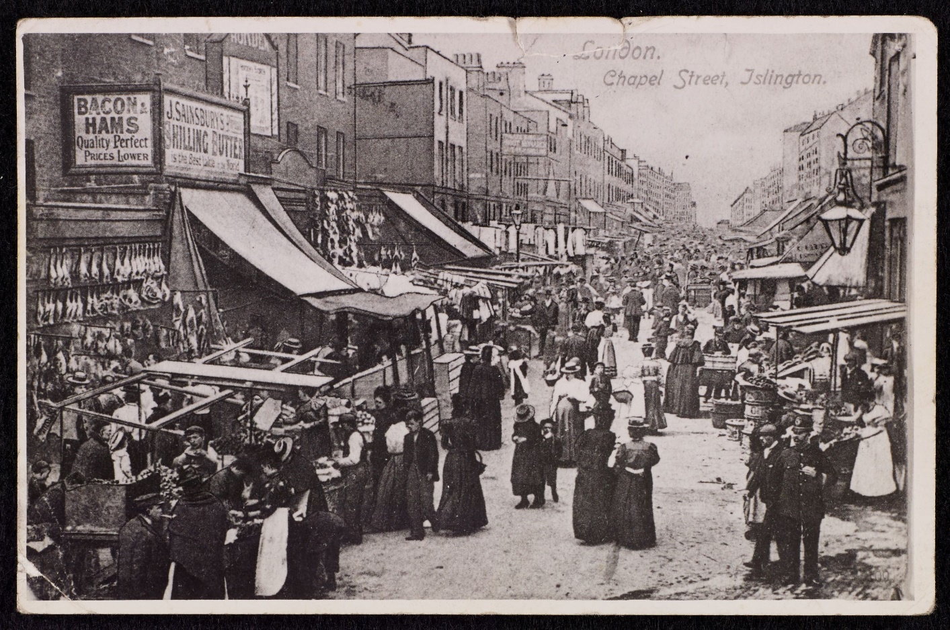
Food shopping
Wages were usually paid on a Saturday, so the best food of the week would be eaten at the weekends. As the week went on and the money ran out, the meals would deteriorate.
There were no fridges to keep food fresh, so the Victorians would often have to go shopping and just buy a small amount at a time.
Image © The Sainsbury Archive, Museum of London Docklands.

Slide 17
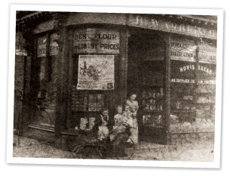
Food shopping
There were no supermarkets, so the Victorians would have to visit lots of different, small shops, such as a butchers or grocers, to get different food.
Here is a photo of a grocery shop in around 1870.
What can you see here?
Image © Warburtons

Slide 18
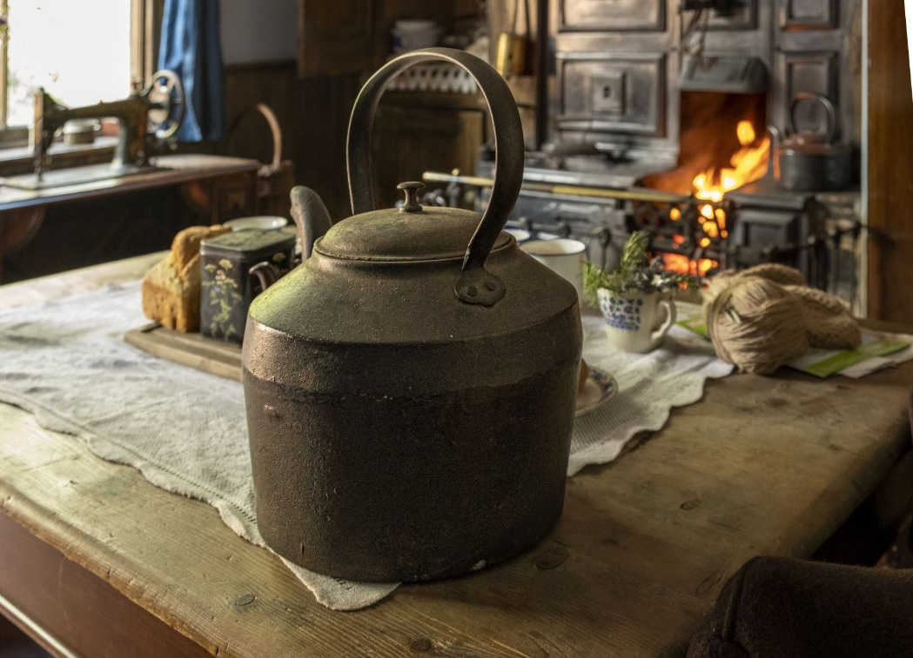
Kitchen equipment
Victorian kitchens did not have all the equipment we have in our kitchens today. Most families would only have a few pieces of cooking equipment.
The poorest Victorians might only have a kettle, a saucepan and a frying pan.
What cooking equipment do you have at home?

Slide 19
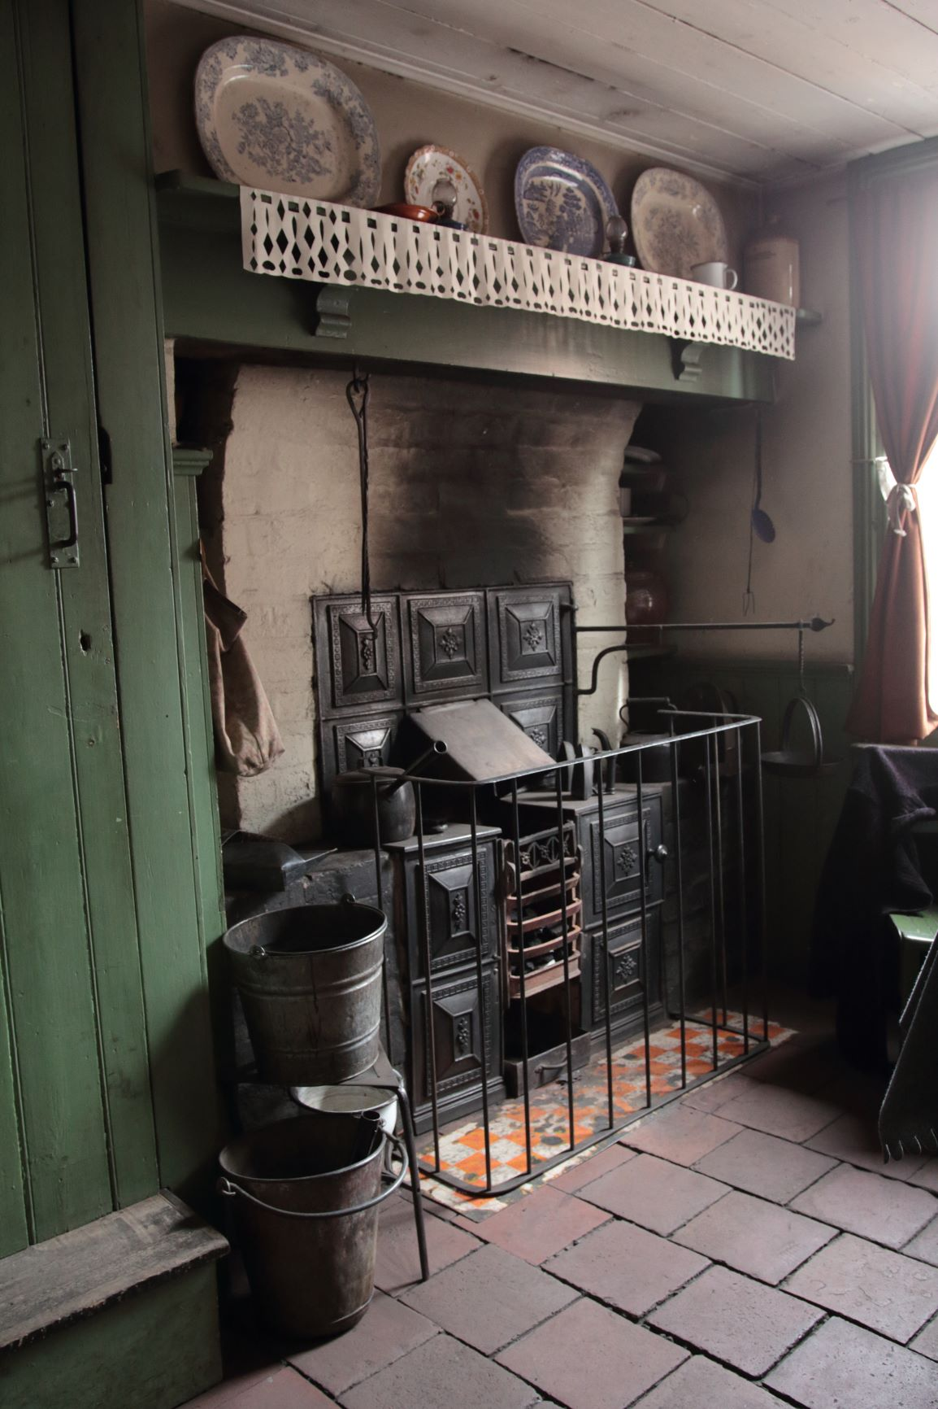
Cooking
Mid-Victorian working classes, with more income, might have a ‘range’ (a bit like a modern day aga cooker) or built-in oven to the side of the fire.
Those with less income may just have had an open fire, over which to hang saucepans and kettles for cooking. This, and their lack of money, limited the types of meals they could cook.

Slide 20
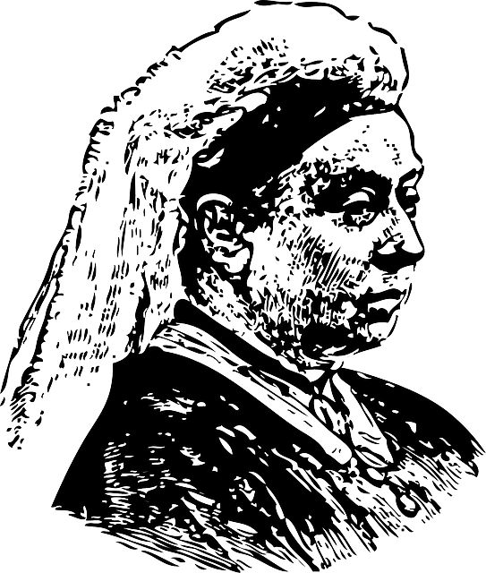
What Queen Victoria ate
Queen Victoria enjoyed eating and because she was Queen, and had plenty of money, she could eat whatever she wanted.
This was quite the opposite to most of the Victorian population, who had very little money.

Slide 21
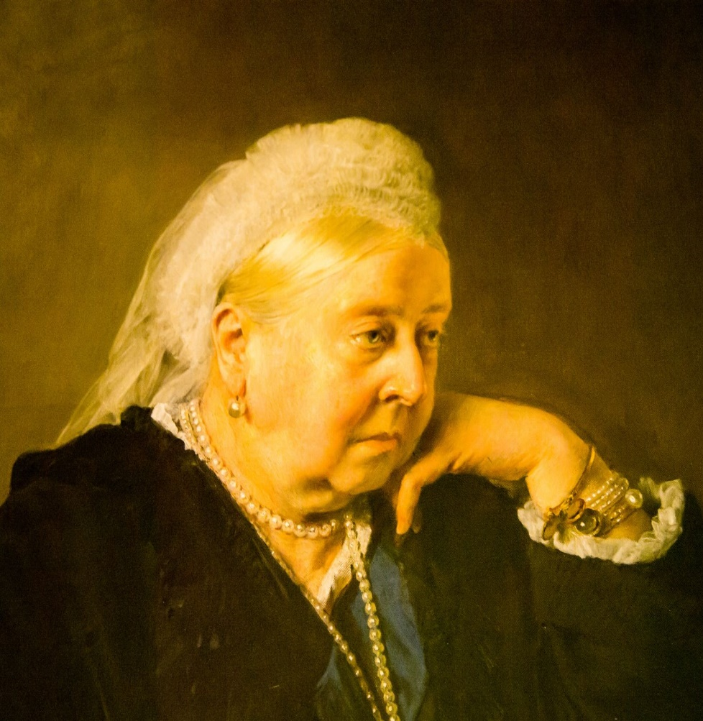
What Queen Victoria ate
Queen Victoria had many banquets while she was entertaining guests at Buckingham Palace. However, even when she was just at home with her family, mealtimes were a feast!
Queen Victoria often wrote about food in her letters and journals, usually complaining that she had been somewhere and there was not enough food! She would often take a hamper of food with her to an event even if she had eaten a big meal before she went.

Slide 22

What Queen Victoria ate
Here is an example of a typical day of food Queen Victoria would have eaten.
What do you find interesting or surprising about this menu?
Breakfast: Mutton chops and potatoes. Bread, toast biscuits and spreads
Lunch: Lamb cutlets, asparagus and cold fowl. Cinnamon rice pudding. Fruit compote.
Dinner: Poached eggs and clear chicken soup. Sole gratin and fried whiting. Roast beef and capon with asparagus. Vol-au-vents with. bechamel sauce and grilled eggs. Apricot flan. Waffles with cream.
Evening snack: Cold meats and pies. Fresh fruit.

Slide 23
Food in Victorian times
For further information, go to:
www.foodafactoflife.org.uk

