Slide 1
Gelation and gelatinisation

Slide 2
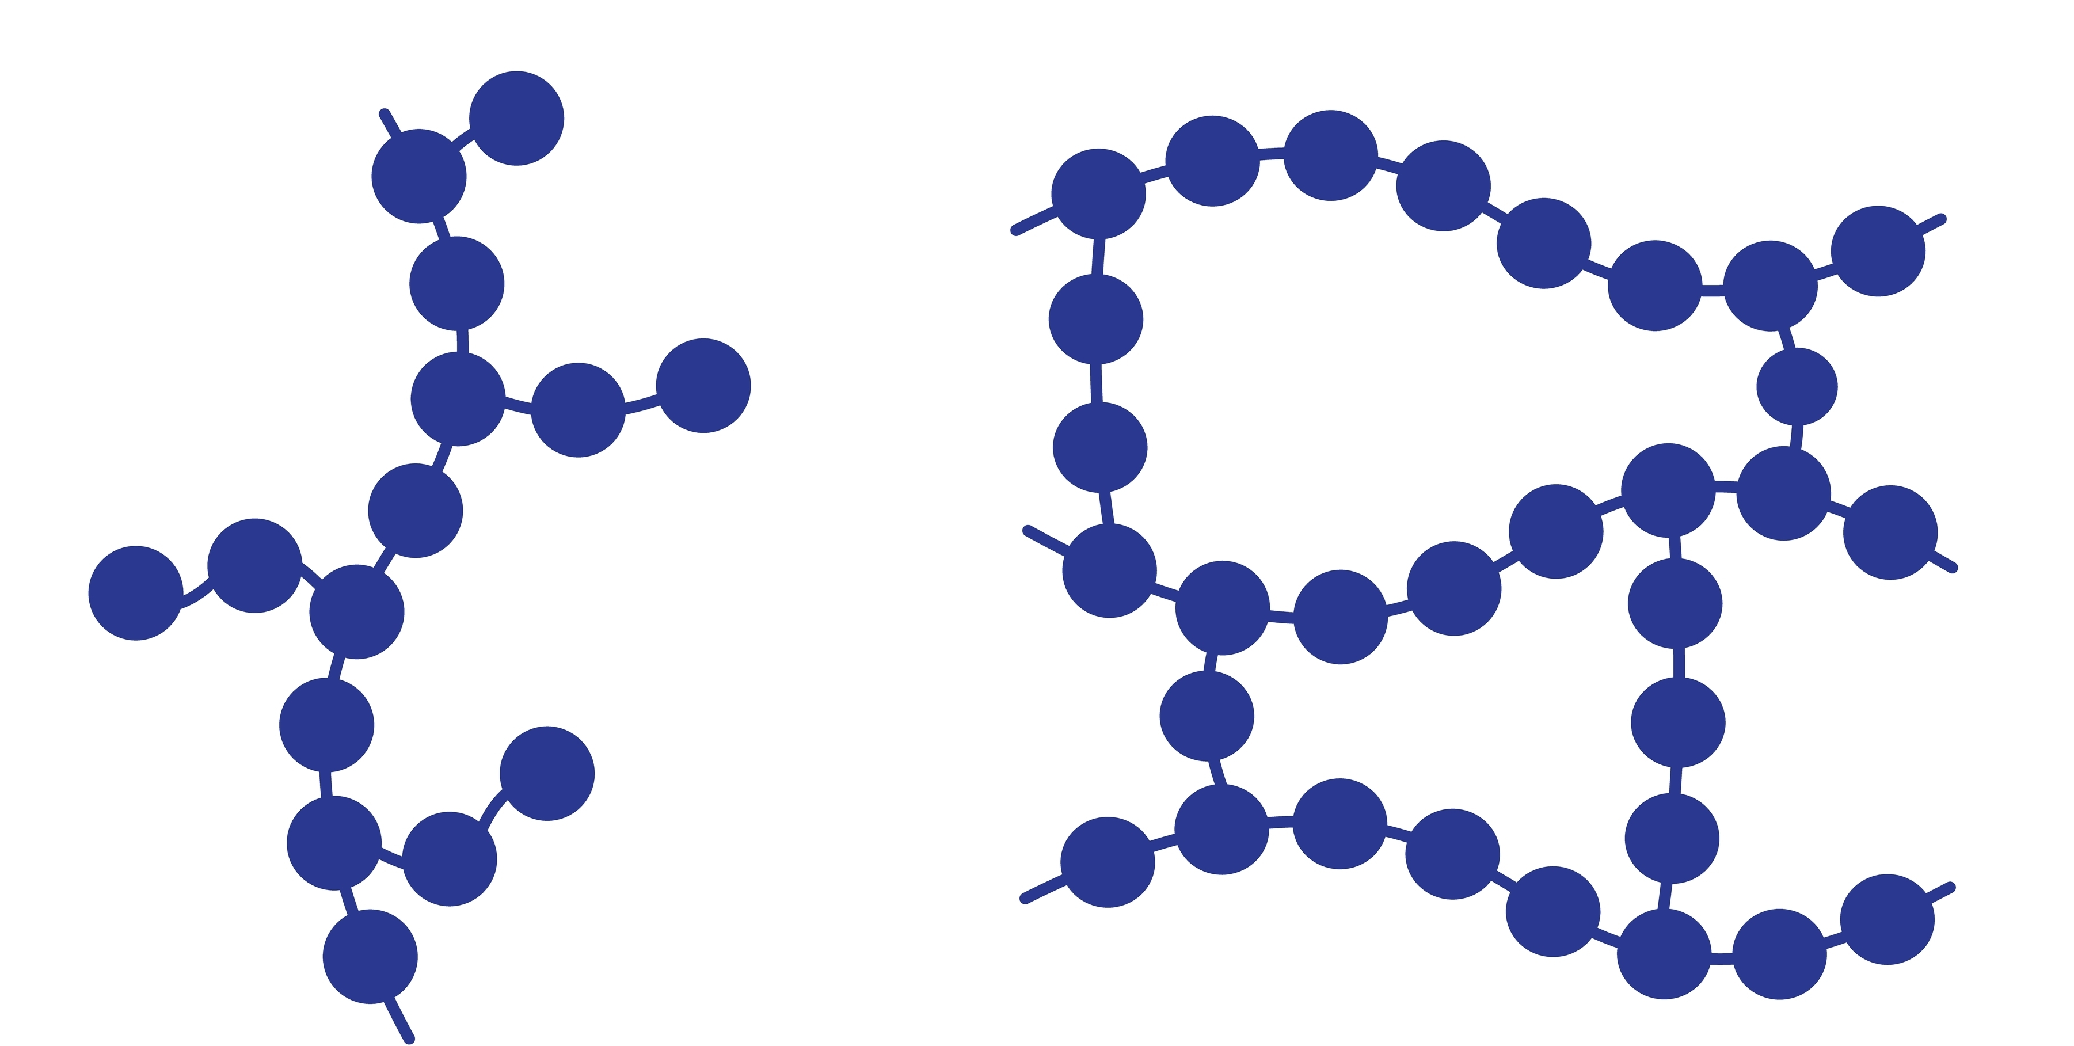
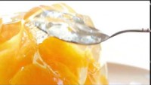
Introduction – what is a gel?
Liquid trapped here, forming a gel
A gel is a semi-solid mixture of a solid and a liquid.
The liquid in a gel is contained by a solid that forms a network and traps the liquid, preventing it from flowing freely.
This means that although a gel is mostly liquid, it behaves more like a solid.
Proteins are important components of many gels. A commonly used protein used to form gels is gelatine.
When a gel is formed, large molecules bond together and hold liquid in the pockets that form.

Slide 3
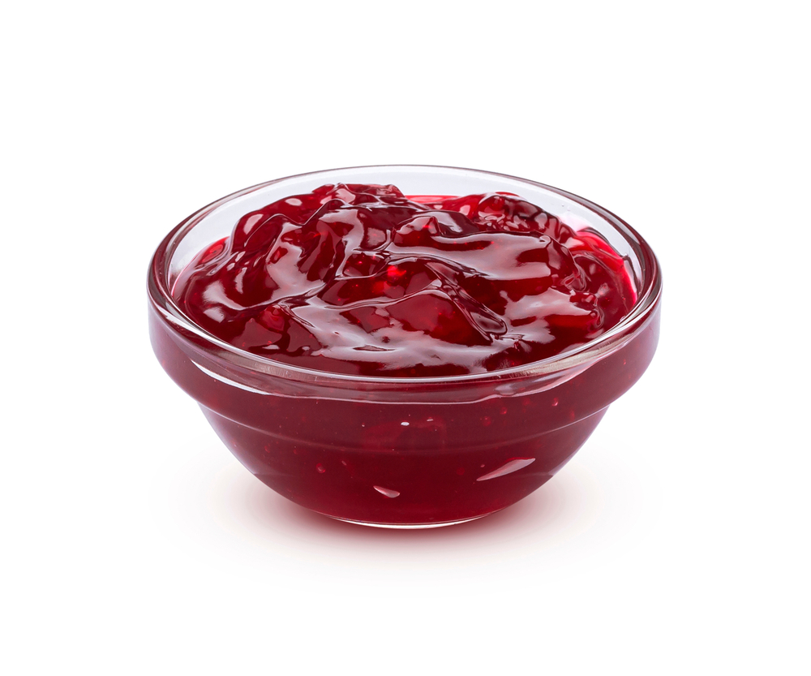
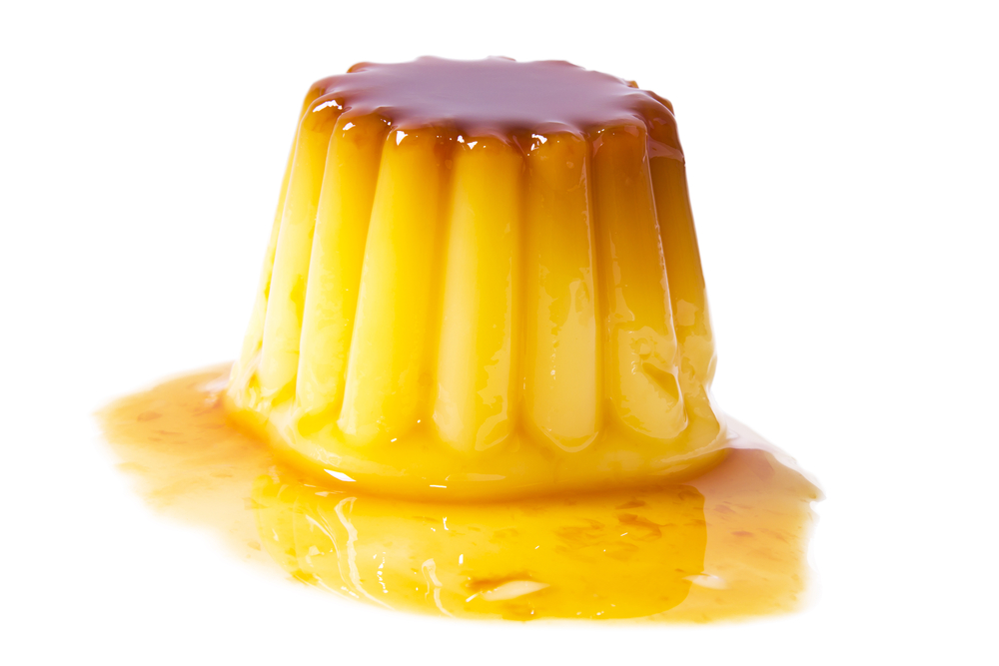
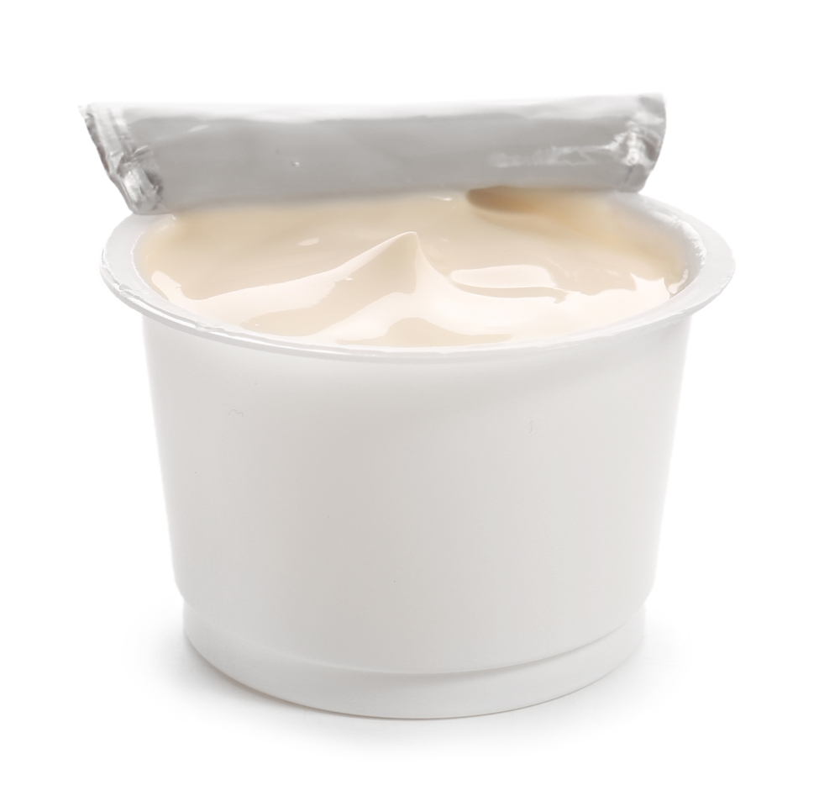
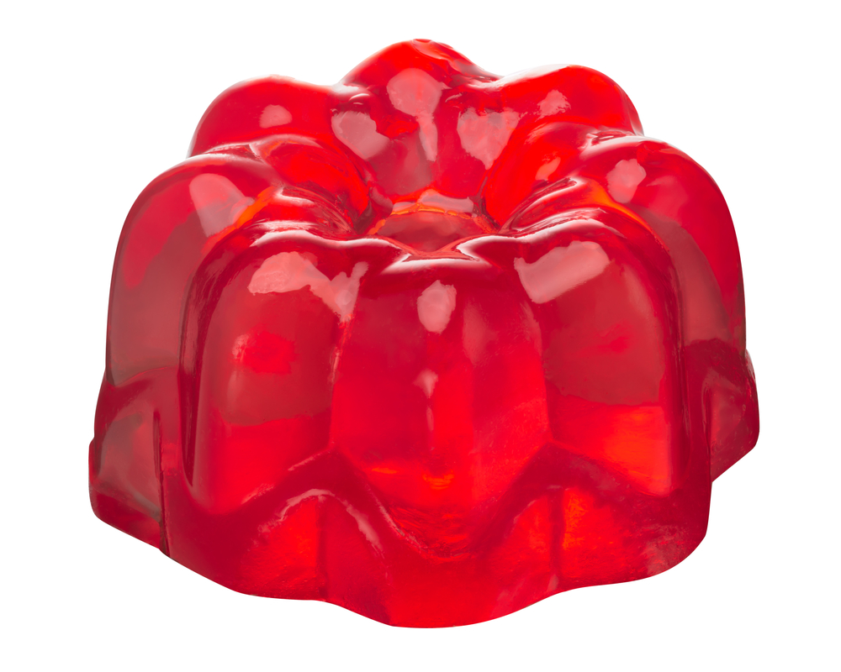
Foods that are gels
Set custards
Jams
Yogurts
Jellies

Slide 4
Gelation in food
Baked custards are gels that are formed by a network of egg proteins.
Yogurt is a gel that is formed when bacteria digest the lactose in milk to lactic acid. This makes the yogurt more acidic. The acidity causes the protein in yogurt to form a gel and trap the liquid.
Jams contain pectin, which is found in some fruits and can also be added to foods. Pectins form the network that traps the liquid in a jam.
Jellies rely on gelatine, or a vegan alternative (e.g. agar, carrageenan). Gelatine is made from collagen, a protein found in connective tissues in animals. This means it is not vegan suitable.

Slide 5
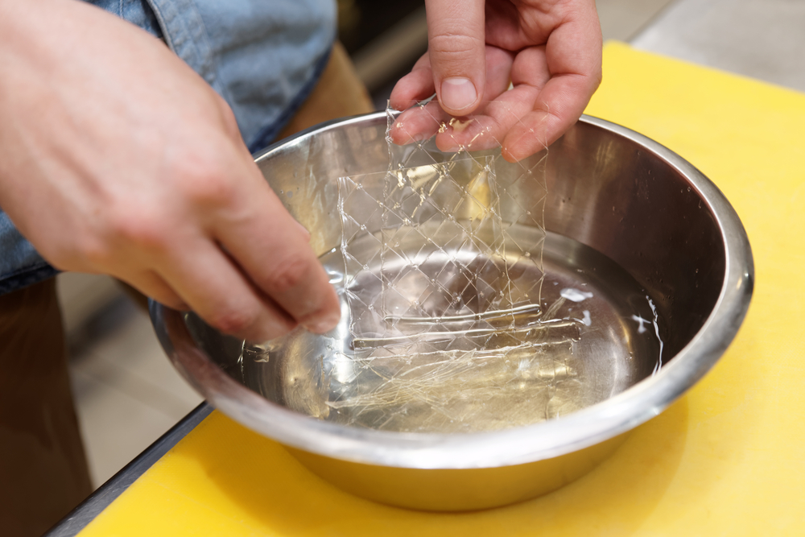
The science of gelation - gelatine
To form a gel, a gelling agent must be added to food.
One of the most common gelling agents used in food is gelatine.
Gelatine is usually bought as a dry powder, or sold in sheets. When added to liquid, the gelatine ‘blooms’, meaning it expands.
Once warmed, the gelatine can dissolve into the liquid. Upon cooling, a gel is formed.
Not only is gelatine used to form gels, in smaller amounts it can also stabilise and thicken foods, such as cream cheeses and dairy spread alternatives.

Slide 6
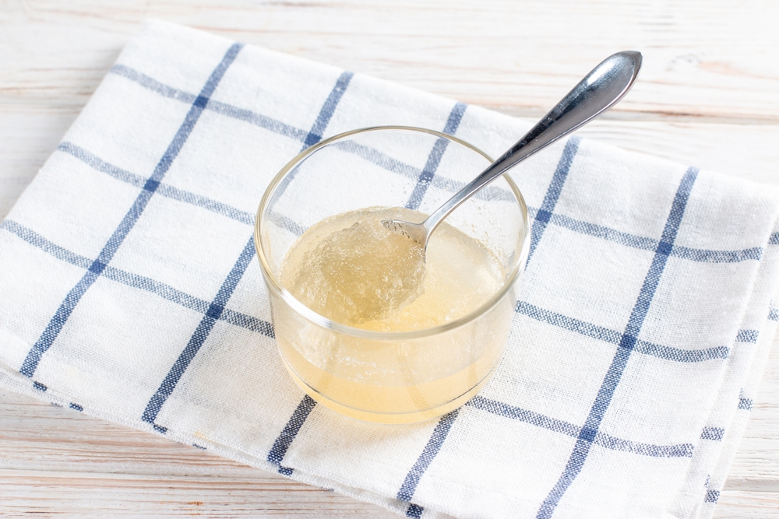
Gelatine
When gelatine is mixed with water and warmed, the proteins become denatured and unwind.
As the mixture is cooled, these proteins bind together and form a network around the liquid, resulting in a gel that is technically a liquid, but that has many properties of a solid.

Slide 7
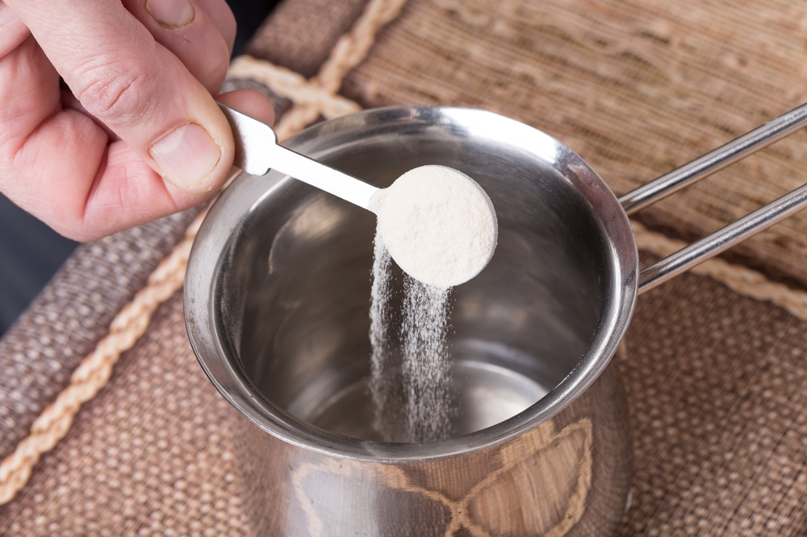
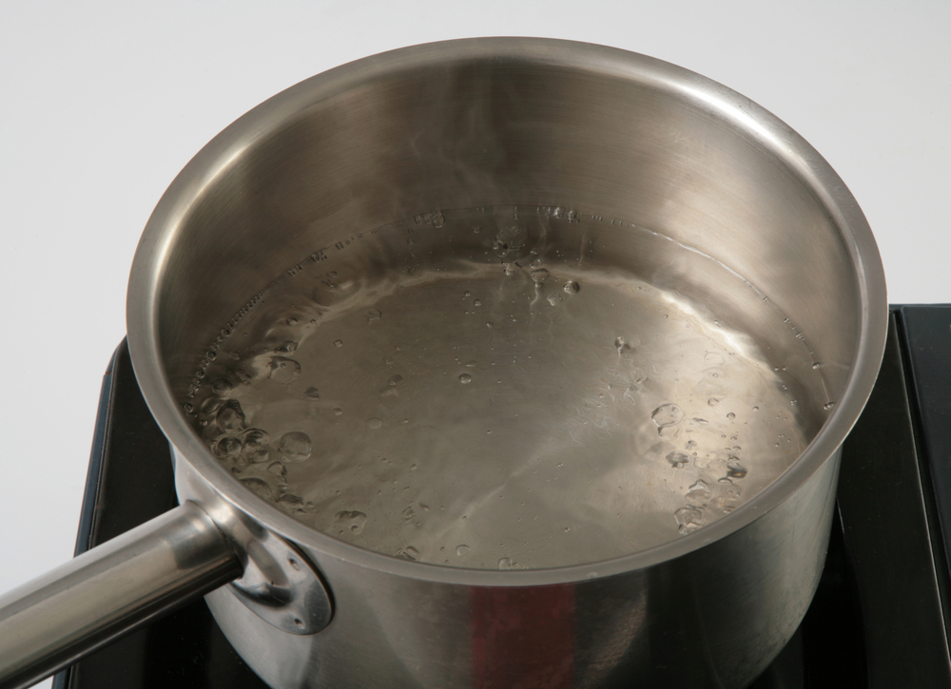
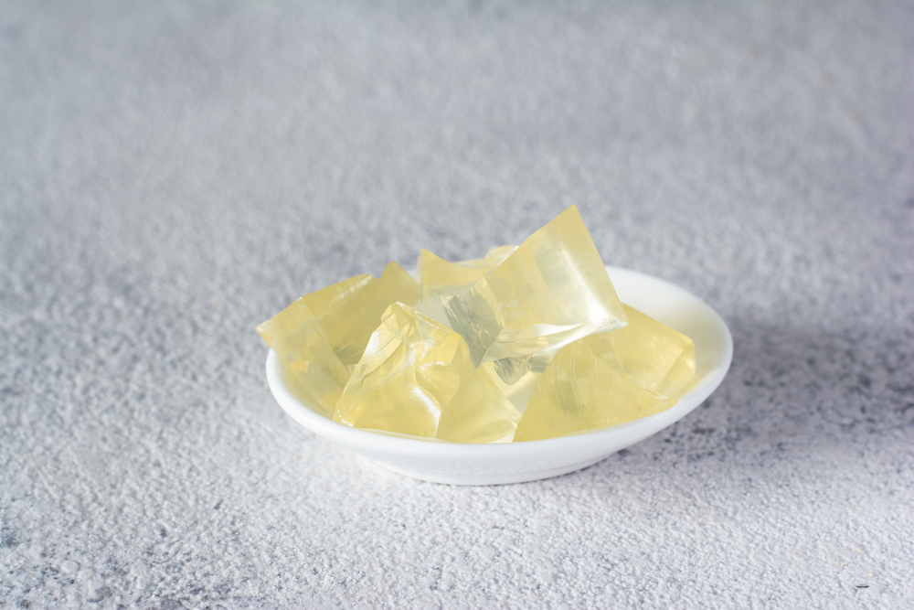
Applying the science - gelatine
When bloomed, the gelatine granules will expand as they absorb liquid
Add gelatine (powder or sheets) to water and allow to bloom
Add gelatine to hot water to fully dissolve
Cool to form a gel

Slide 8
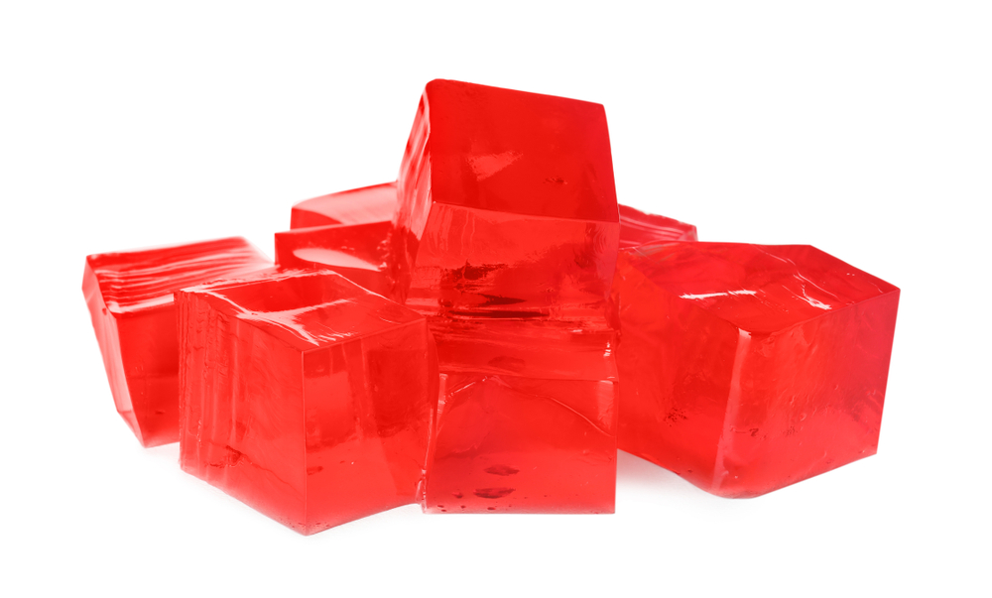
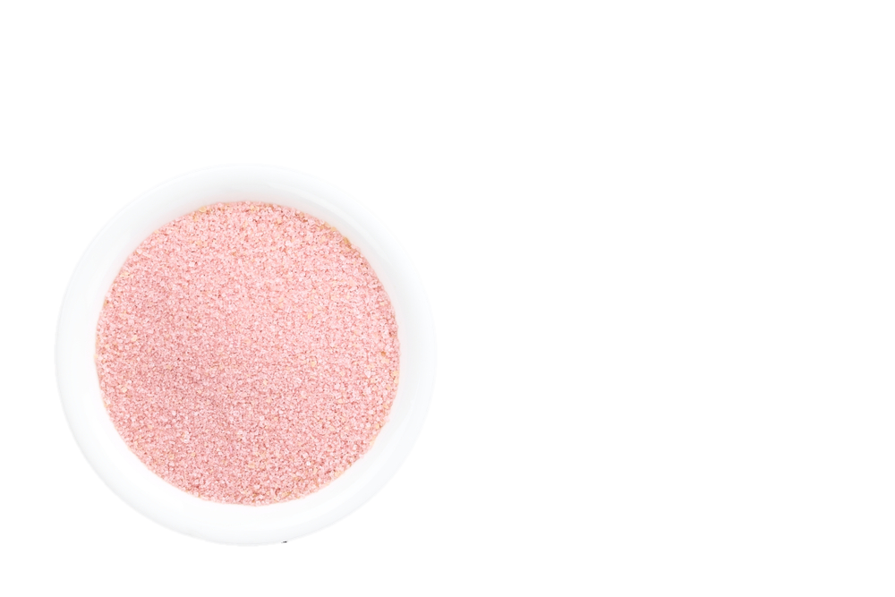
The science of gelation – making jelly
Jelly cubes usually contain gelatine, which helps the jelly to set. They also contain sugar, sweeteners, colours and flavouring.
When heated in water, the colours, flavourings and sugar or sweeteners dissolve into the liquid and are also trapped.
Heating the cubes with water also releases the gelatine, which forms a network as it cools.
The result is a colourful, flavourful gel, that wobbles but stays solid – a jelly!

Slide 9
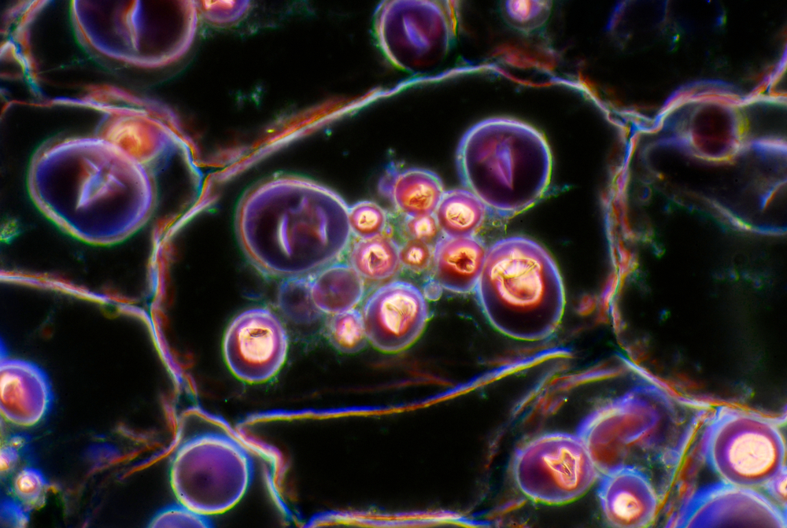
Gelatinisation
Gelatinisation is different to gelation. It involves the swelling of starch granules when exposed to liquid and heat.
Flours and other carbohydrates (e.g. potatoes) contain starch granules, that swell as they are heated with liquid. Eventually, the granules swell to the point that they burst and release starch.
This thickens the liquid.
A key difference between gelation and gelatinisation is that gelation involves solidifying on cooling, whereas gelatinisation involves thickening on heating.
This image shows starch granules in a potato under a microscope

Slide 10
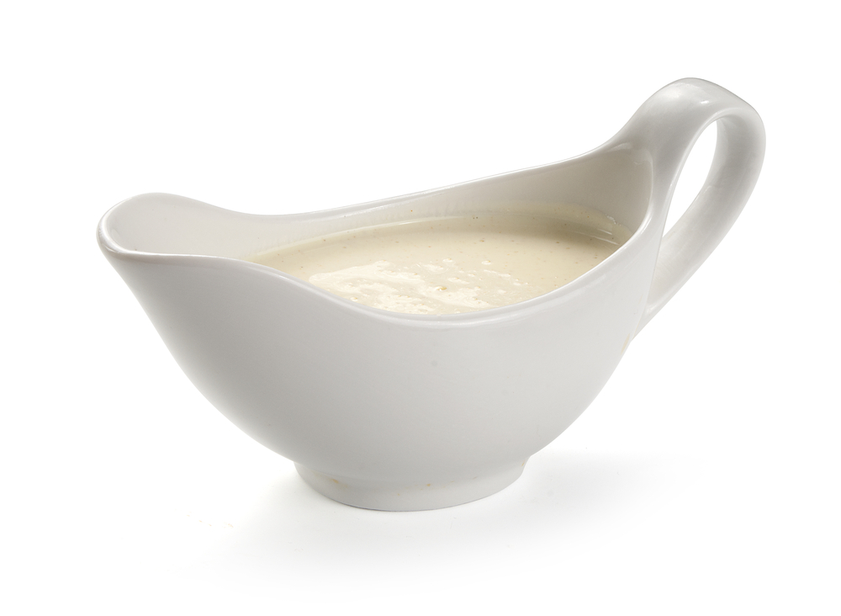
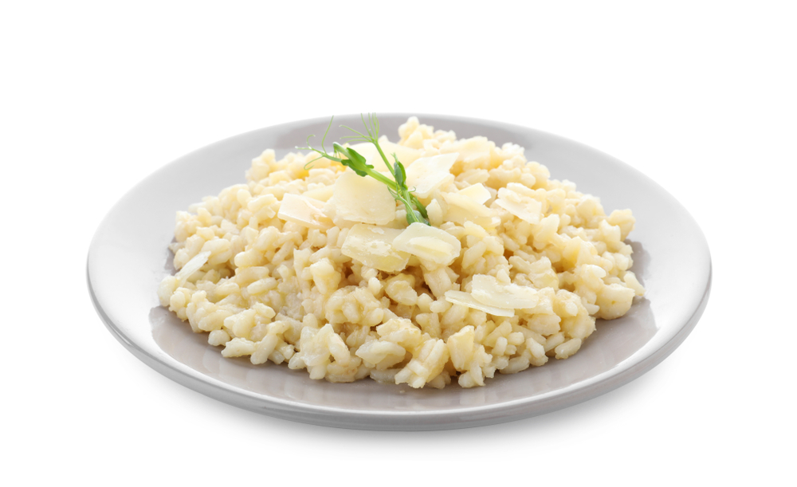
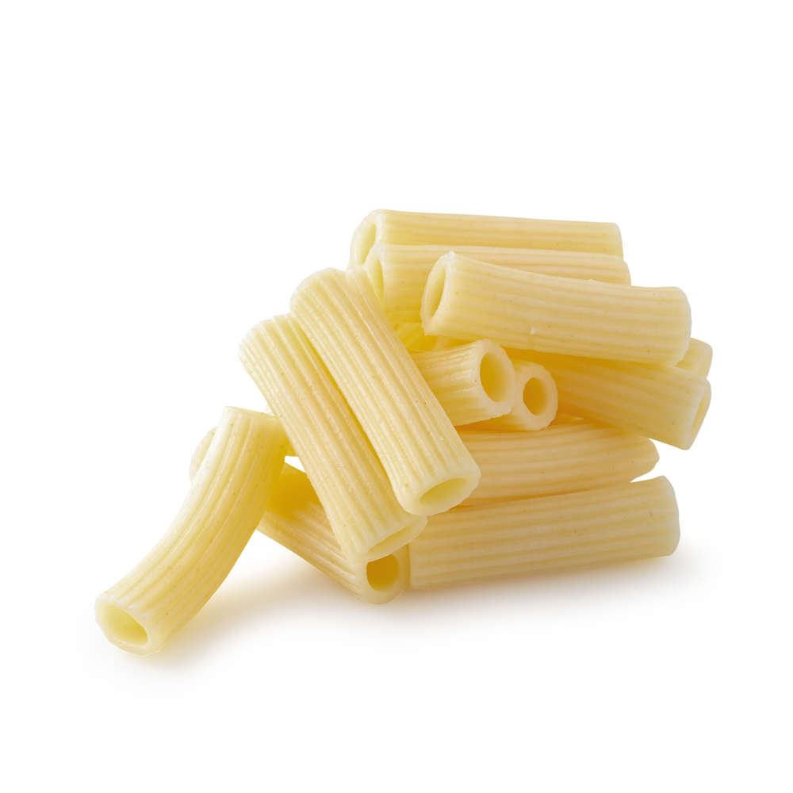
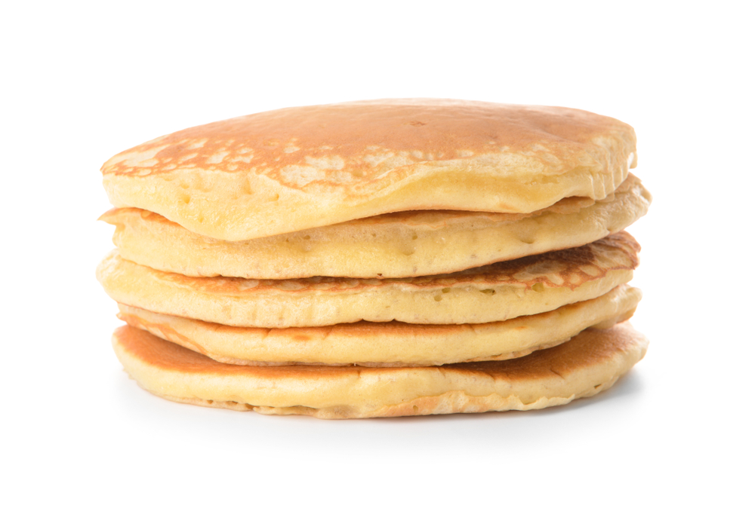
Foods made by gelatinisation
White sauce and other roux-based sauces
Risotto
Cooked pasta
Pancakes

Slide 11
Gelatinisation in food
White sauce is a roux-based sauce. A mixture of flour and butter helps to thicken the sauce as milk is added.
Pasta softens when heated in water, as the starch absorbs water and expands.
Risotto gets it’s thick and smooth texture from gelatinisation, as starch seeps out from the rice, into the liquid that is added during cooking.
When heated in a frying pan, the starch granules in pancake mixture (from flour) absorb moisture and swell up.

Slide 12
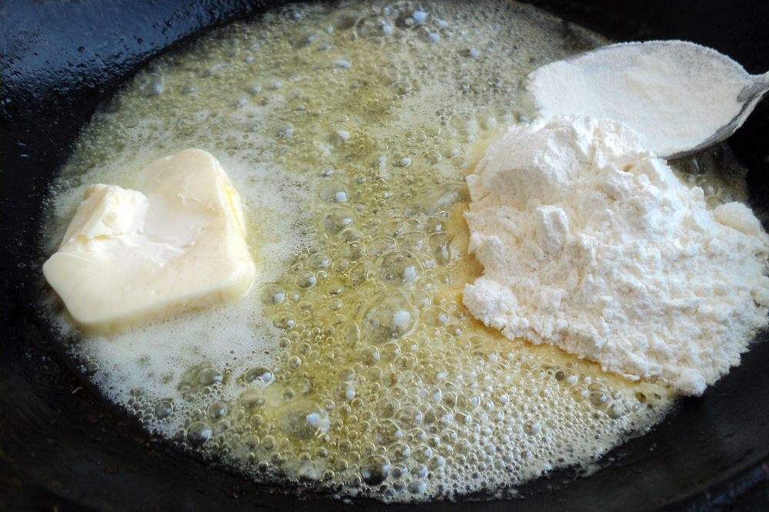
The science of gelatinisation - roux
Many sauces use a roux as the base. A roux is a paste made from butter and flour. This helps the sauce to thicken.
For example, when making white sauce, a roux is formed first before milk (infused with other flavours) is slowly added.
This not only thickens the sauce, but gives is a smooth mouthfeel when it is eaten.

Slide 13
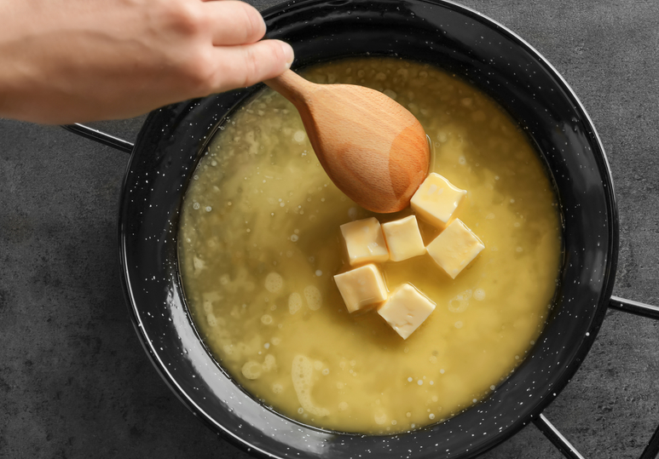
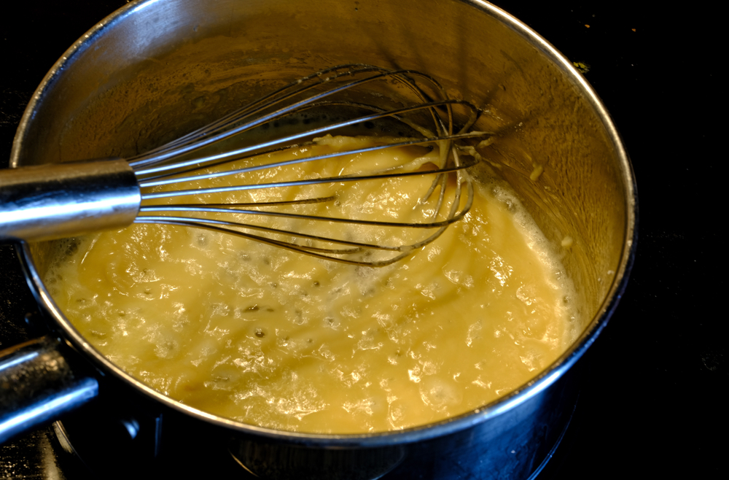
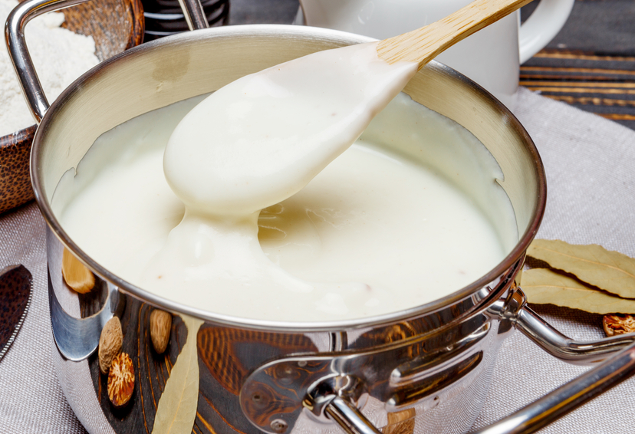
Applying the science – white sauce
Mix or whisk together and allow to cook for at least 3 to 5 minutes to allow the starch to absorb the liquid
Add equal amounts flour to the pan and stir to combine
Slowly add milk a little at a time, until a smooth sauce is formed
Melt butter in a pan

Slide 14
Key words
Key word | Meaning
Blooming (gelatine) | Soaking gelatine in water in order to allow the gelatine granules to absorb water and expand, helping them to dissolve and form a smooth gel.
Gel | A colloid which has a liquid dispersed in a solid, e.g., jelly.
Gelatine | A protein formed form the hydrolysis of collagen*. It has the capacity to hold water molecules in a gel matrix. Used to set sweet and savoury jellies.
Gelatinisation | The process of thickening which takes place when a mixture of starch in liquid is heated, e.g., when making a roux sauce.
Gelation | A semi-solid mixture of a solid and a liquid, where the liquid is trapped by a solid network (e.g. jelly).
Roux | A mixture of flour and fat mixed together, used to thicken sauces (e.g. white sauce).
*Hydrolysis is a chemical reaction in which water breaks chemical bonds

Slide 15
Teachers’ guide

Slide 16
Teaching about gelation and gelatinisation:
Pupils need to understand the mechanisms behind gelation and gelatinisation.
They should be aware of the different mechanisms and definitions. Gelation is the trapping of liquid between cross-linked polymers. Gelatinisation is the expansion of starch granules, causing softening and the thickening of sauces.
Pupils should understand how gelation and gelatinisation relate to different foods. Jellies are a good example of gelation, whilst roux-based sauces are good examples of gelatinisation.

Slide 17
Introduction - gelation
A gel is formed when a liquid is trapped in a solid matrix. Jelly is a classic example. It is made up of mostly liquid, but because the liquid is trapped it cannot flow freely.
Proteins are important components of many gels. A commonly used protein used to form gels is gelatine.
Liquid trapped here, forming a gel

Slide 18
Gelatine
When gelatine is mixed with water and warmed, the proteins become denatured and unwind.
As the mixture is cooled, these proteins bind together and form a network around the liquid, resulting in a gel that is technically a liquid, but that has many properties of a solid.

Slide 19
Applying the science - gelatine
When bloomed, the gelatine granules will expand as they absorb liquid
Add gelatine (powder or sheets) to water and allow to bloom
Add gelatine to hot water to fully dissolve
Cool to form a gel

Slide 20
The science of gelation
Foods such as jams, puddings and some bakery products may all utilise carbohydrates for their gel-like properties. For example, jams contain pectins (naturally occurring within the fruit), which give the final product its jelly-like consistency, preventing it from collapsing.
Foods such as salad dressings and cake batters may contain forms of modified cellulose, also used for their gelling properties.

Slide 21
Gelatinisation
Gelatinisation is the result of starch granules (found in foods such as grains and starchy tubers such as potatoes) absorbing water in the presence of heat and expanding.
This can cause foods containing starch to soften (e.g. cooking pasta) or can cause the thickenings of sauces (e.g. white sauce and other roux-based sauces).

Slide 22
Applying the science – white sauce
Mix or whisk together and allow to cook for at least 3 to 5 minutes to allow the starch to absorb the liquid
Add equal amounts flour to the pan and stir to combine
Slowly add milk a little at a time, until a smooth sauce is formed
Melt butter in a pan

Slide 23
Activities
Pupils, individually or in groups, could:
Use the Sauces fact sheet and the What is a roux sauce? presentation and What is a roux sauce? information sheet to understand how sauces are made and their different properties. As a teacher, you can use the Understanding sauces teacher’s guide to help.
Pupils can also use the Viscosity chart to investigate the viscosity of different sauces, including those made in the Sauce making experiment.
Use the Gelatinisation lesson plan to teach your pupils more about gelatinisation. Pupils can then fill out the Investigating gelatinisation worksheet.
Additional learning – enzymes can affect the structure and integrity of gels. Use the Enzymes and gels worksheet to learn more.

Slide 24
Further supporting resources
IFST – Carbohydrates: Gelatinisation
RSC – Kitchen Chemistry: Enzymes and jellies

Slide 25
Recipes
Gelation
Raised pork pie
Fruit jelly
Gelatinisation
White sauce
Savoury choux buns with a roux sauce filling
Moussaka stuffed aubergine, topped with cheesy souffle sauce
Chicken pie
Fish pie
Fruit pancakes
Pasta Fiorentina
Pork and leek risotto
Muesli pancakes with summer berry compote

Slide 26
Gelation and gelatinisation
For further information, go to:
www.foodafactoflife.org.uk
This food science pack is one of a series of resources produced for the pHood Futures project, supported by the Royal Society of Chemistry.
This resource meets the Guidelines for producers and users of school education resources about food.

