Slide 1
Sizzling stir fry
Complexity: medium - high

Slide 2
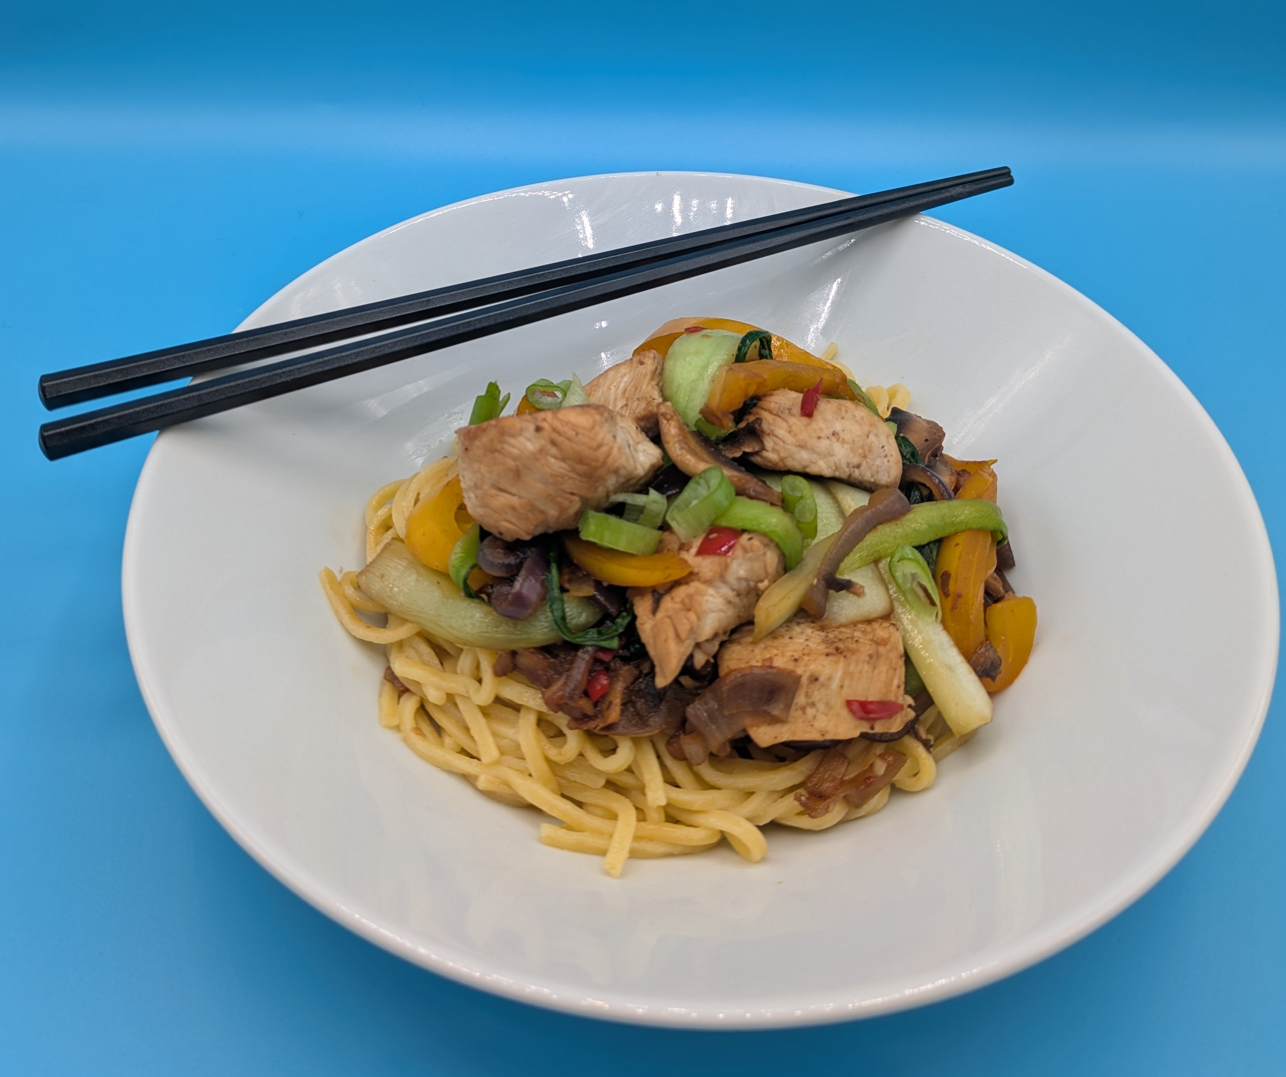
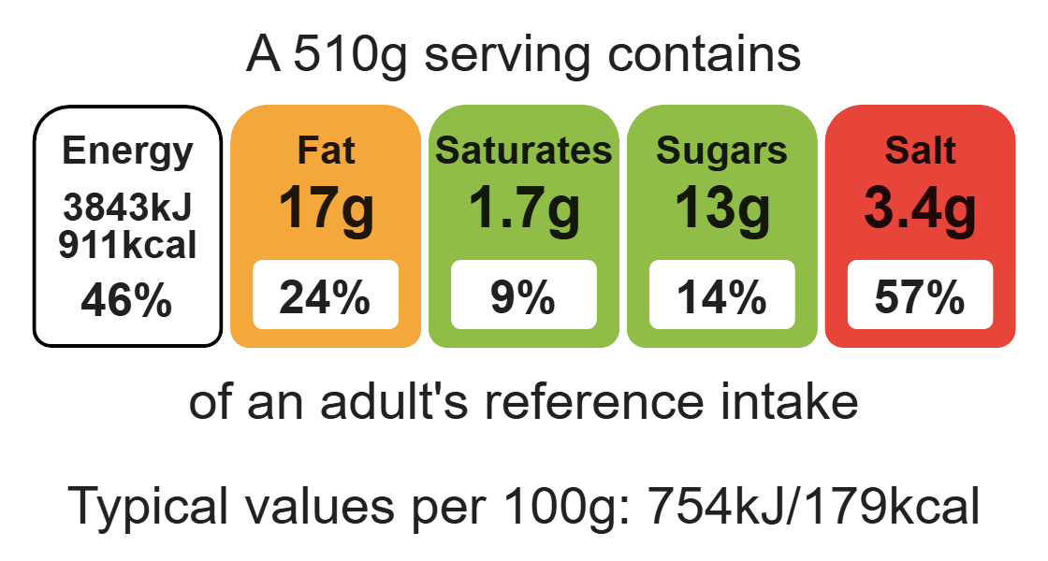
Nutritional analysis
Serves 1-2

Slide 3
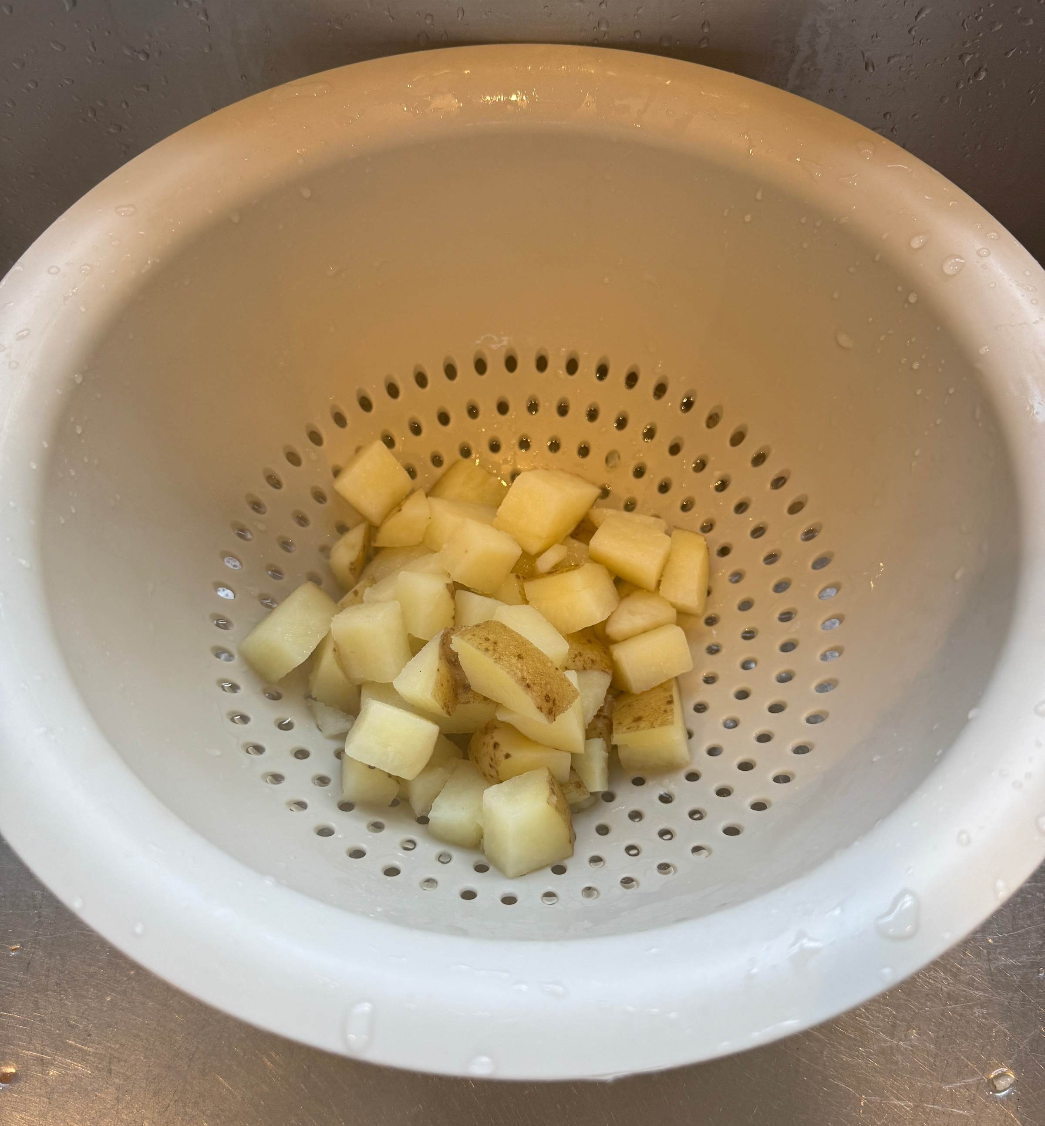
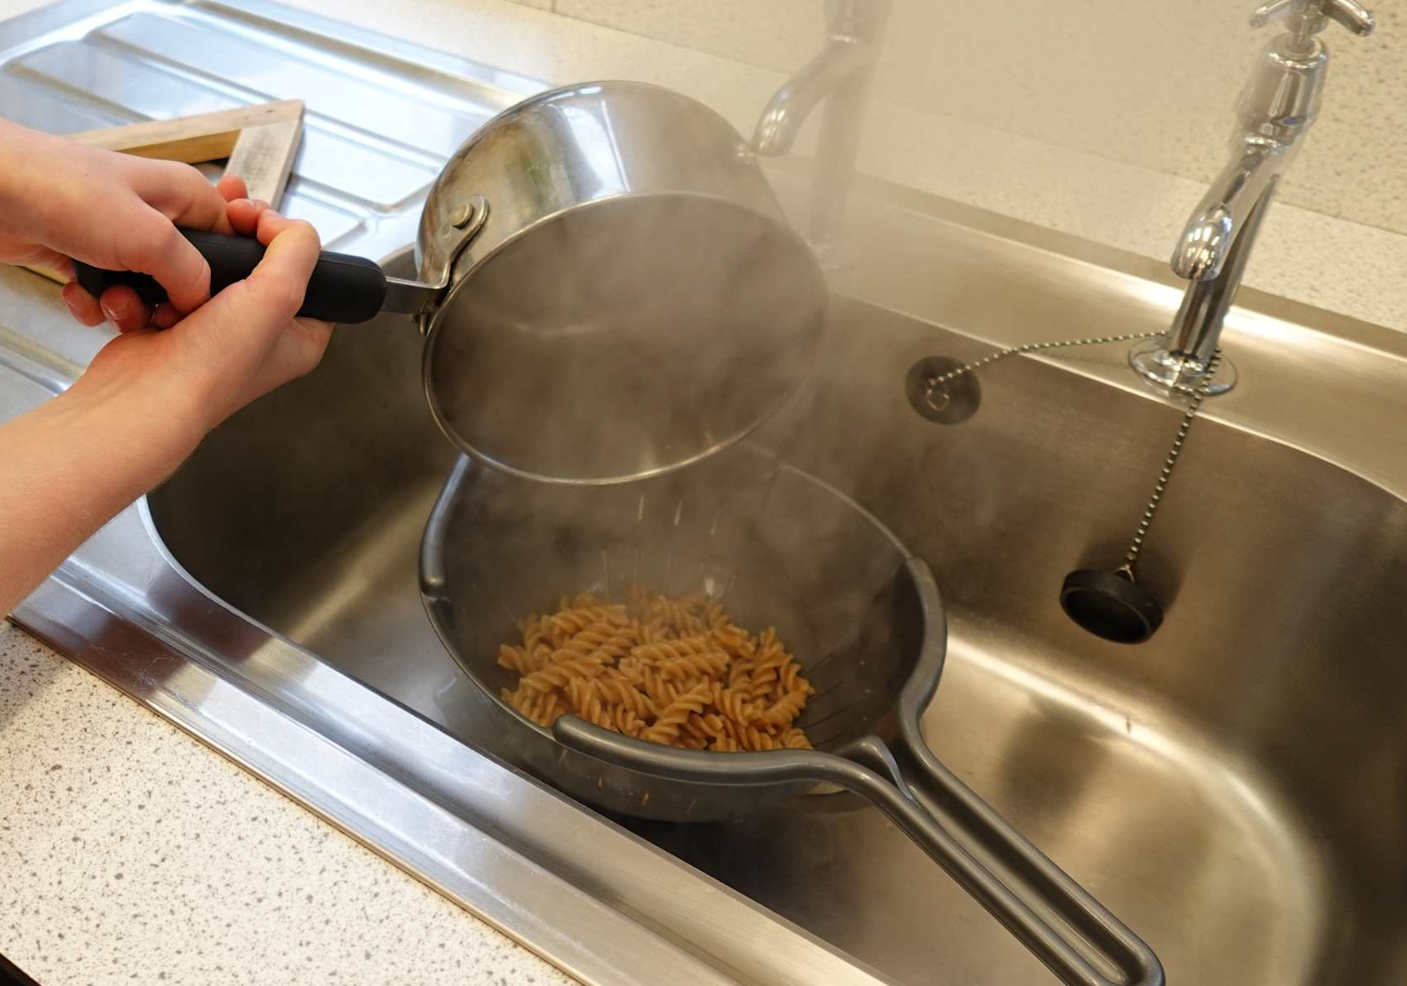
Starter activity
Name the piece of equipment.
Explain how to use it safely.

Slide 4
Example responses
Name the piece of equipment?
Explain how to use it safely.
Colander
The colander should be placed into the sink, the contents poured into it, allowing the liquid to drain away. Hands should be well away when pouring hot liquids, to prevent burning.

Slide 5
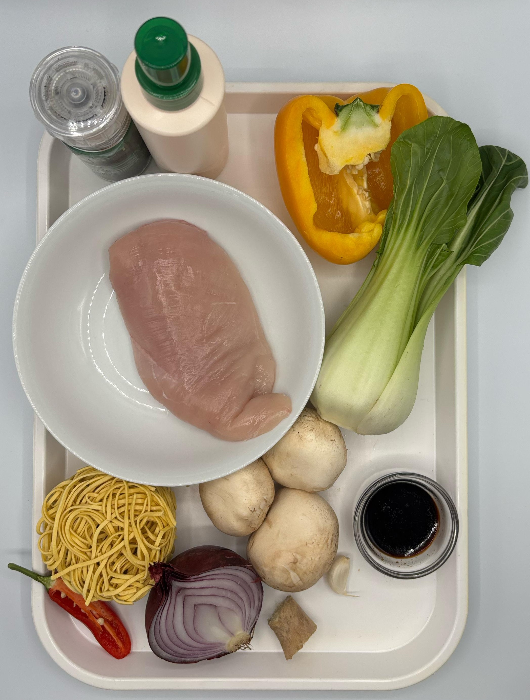

Ingredients (serves 1-2)
80g noodles
1 x chicken breast (or 3-4 thighs)
1 clove garlic
½ chilli
1cm fresh ginger
½ red onion
½ pepper
3 mushrooms
1 pak choi
1 x 15ml spoon oil or spray oil
1 x 10ml spoon reduced-salt soy sauce
Check for any food allergy, intolerance, special dietary requirement or religious/cultural reasons for not handling or eating the ingredients in this recipe.

Slide 6
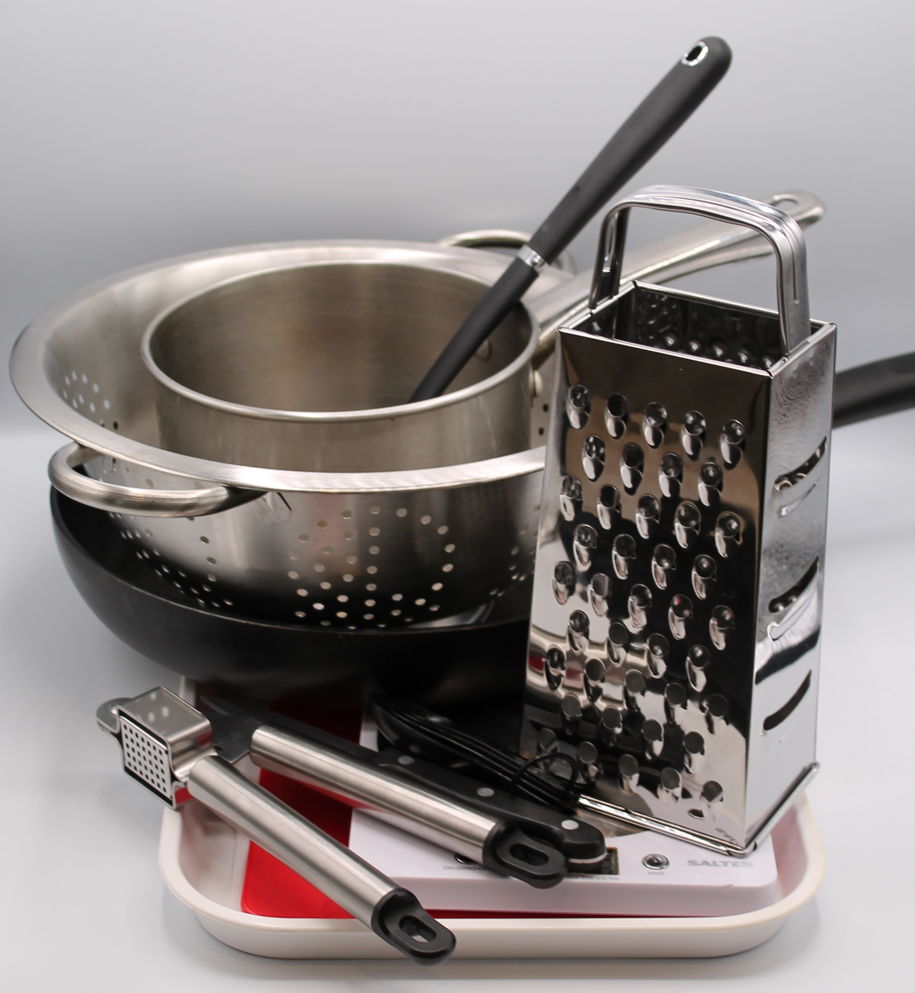
Equipment
Weighing scales
Saucepan
2 Chopping boards
Sharp knife
Garlic press
Wok or frying-pan
Heat resistant spoon
Colander
Measuring spoons
Grater

Slide 7
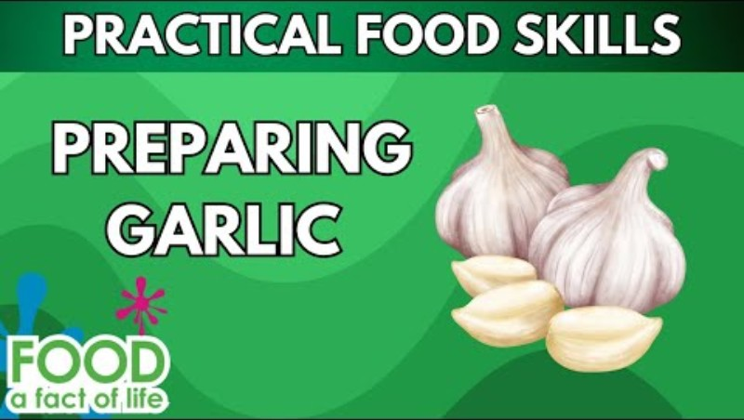
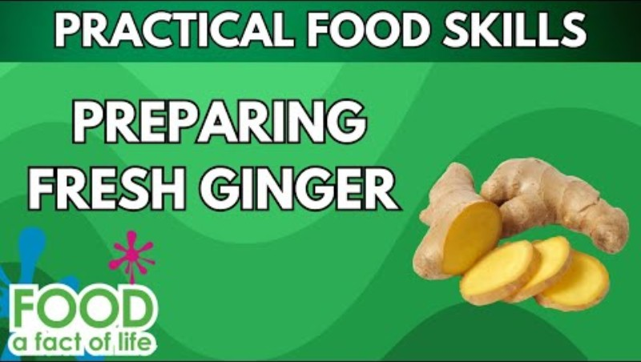
Food skills
Click below to watch how to prepare garlic
Weigh
Measure
Crush
Chop
Slice
Dice
Trim
Drain
Peel
Stir-fry
Boil
Mix
Stir and combine
Click below to watch how to prepare ginger

Slide 8
Method
Cook the noodles in boiling water. Check the packet for details.
On a red chopping board, remove any gristle from the chicken and cut into strips. Thoroughly wash and dry hands after touching the raw chicken.
Prepare the vegetables with a fresh knife on a clean chopping board:
peel and crush the garlic;
deseed and slice the chilli;
peel and slice the ginger;
peel and slice the onion;
deseed and slice the pepper;
slice the mushrooms;
shred the pak choi.

Slide 9
Method
Heat the oil in the wok or frying pan.
Add the onion, garlic, chilli and ginger. Cook for 1 minute.
Add the chicken and stir-fry for 3-4 minutes. Check that the chicken is cooked and no pink remains.
Add the pepper, mushrooms, pak choi and soy sauce and continue to cook for a further 2 minutes.
Drain the noodles into a colander in the sink.
Stir in the cooked noodles and cook for 2 minutes until hot.

Slide 10
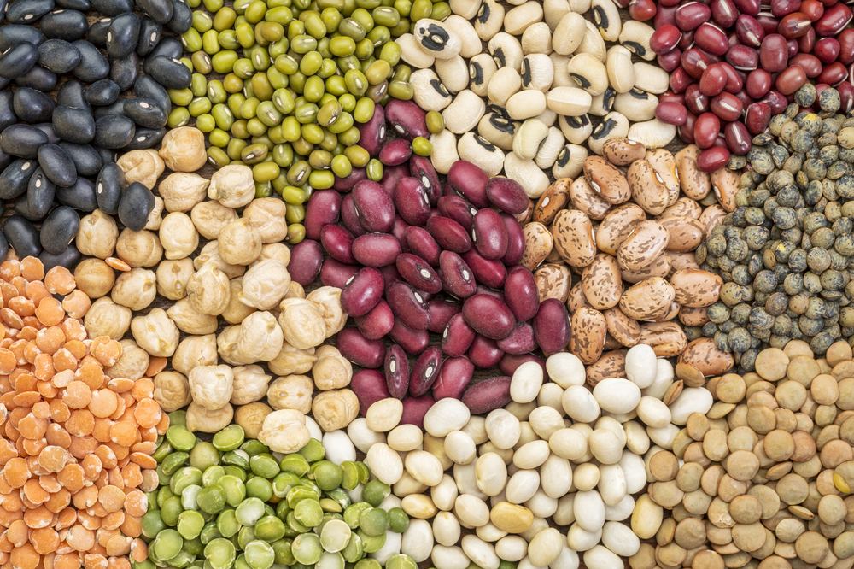
Top tips
Reduce food waste: Add any leftover vegetables, such as, courgette, carrots or leeks to your stir-fry.
Vegetarian alternative: Replace the chicken with tofu, beans or pulses for a vegetarian alternative.
Vary your protein: Try this recipe with prawns or thin strips of beef or pork.
Mix in ready cooked noodles or rice for a quick main meal.

Slide 11
Food science
Denaturing of proteins
Denaturation is the change in structure of protein molecules. The process results in the unfolding of the protein’s structure. Factors which contribute to denaturation are heat, salts, pH and mechanical action.
When stir-frying, the chicken denatures due to the heat, resulting in a tender texture.

Slide 12



Plenary
Evaluate how well you worked today.
 |  |  |  | Comments
Safe preparation of chicken
Peeling, slicing
Deseeding
Stir-frying

Slide 13

Example responses
 |  |  |  | Comments
Safe preparation of chicken |  |  |  | I used a red chopping board and when finished I washed and dried my hands and cleaned the bench.
Peeling, slicing |  |  |  | Peeling was easy but my slicing was not very even. I need to practise using my claw grip.
Deseeding |  |  |  | I removed all the seeds carefully.
Stir-frying |  |  |  | My temperature was very hot and I did not move the food around enough, which made the veg dark brown. Next time I will make sure to stir it more often.

Slide 14
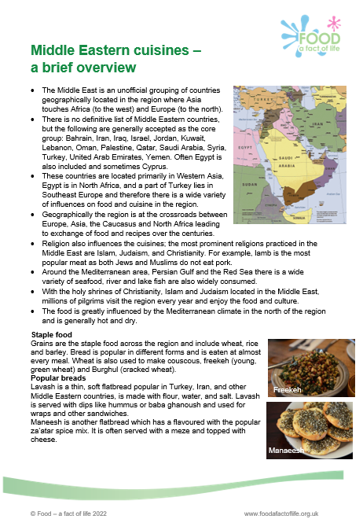
Looking for more…
If you are looking to extend pupils’ learning around food from different cultures, there are Food – a fact of life resources and recipes to support teaching and learning around the following cuisines:
Middle Eastern
African
Eastern Asian
Caribbean Islands
South American
Eastern European
There is an information pack for each cuisine and region of the world which includes history, ingredients and traditional dishes.

Slide 15
Sizzling stir fry
For further information, go to:
www.foodafactoflife.org.uk
This resource meets the Guidelines for producers and users of school education resources about food.

