Slide 1
Building cultural awareness in delivering healthy eating messages in the primary classroom

Slide 2
Building cultural awareness when delivering healthy eating messages in the primary classroom
Georgine Leung
Nutritionist and Food Consultant
PhD Researcher, Institute of Education, University College London

Slide 3
Outline
Diets of ‘minority ethnic groups’ in the UK, what should we take note of?
What is a traditional diet, and what are traditional foods? How do they fit into our everyday food culture?
Examples of how The Eatwell Guide can be adapted to different food cultures.
How can we engage with pupils from different cultural backgrounds during food lessons?

Slide 4
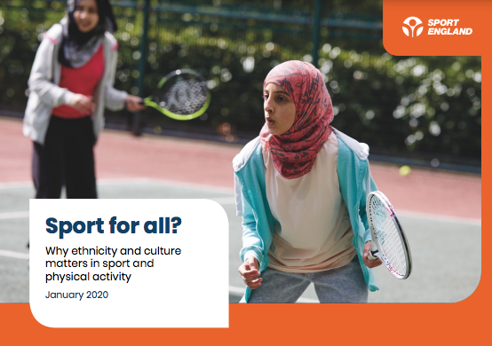
Ethnicity, health and diet
‘Ethnicity’ is self-reported
Health disparities across ethnic groups, driven by many factors, especially socioeconomic and deprivation backgrounds
Associations with traditional diets or dietary assimilations?
Drivers of food choice important
Terminology matters
Community and social eating
Physical activity recommendations
Notes:
Ethnicity is a very complex, multidimensional concept, defined by a multitude of factors such as shared history, family origins, language, cultural traditions and so on. In our increasingly globalised world, it is also worth noting that families may share different cultures, such as from a mix-raced background. According to the 2021 Census (latest which shows data on minority ethnic data), 15% of the people in England identified themselves as belonging to an ‘ethnic minority group’ such as Asian, Black and ‘Others’, but it can be argued that these categories of race do not encompass all the cultural backgrounds people may identify themselves with.
Health data is difficult to capture as race may be only one factor in determining health, what are important drivers to health disparities include socioeconomic and deprivation backgrounds which are better indicators of any health outcomes of individuals. One particular health outcome is obesity, research has found that South Asians tend to have higher amount of body fat at a lower BMI that calls for earlier health interventions with accurate weight ranges, to control their risks for Type 2 diabetes and cardiovascular disease, using culturally appropriate approaches. It is also important to note that whilst traditional diets are gateways to understand how people eat, dietary assimilations mean that many third, second or even first generation-migrant families will incorporate an extent of ‘local foods’ to their daily repertoire.
For example, the Born in Bradford one of the country’s largest birth cohort study which studies over 13,500 children in Bradford on the determinants of childhood and childhood disease, observed that compared to white British homes, Pakistani homes were more likely to have and serve fruit and sugar-sweetened beverages compared to water, as a sign of hospitality, however the cheapness and desirability of these drinks have also influenced personal consumption too. But no story is one-size-fits-all. It is very important to understand these ideas and exploring them across different generations of migrants too. Importantly, we also know that people from lower socioeconomic backgrounds are more likely to experience poor health outcomes, some ethnic groups such as Bangladeshi (40%) and Pakistani (39%) adults are more likely to have a lower socioeconomic classification.
There are many drivers to food choice, apart from cultural background, household and disposable income, access to (traditional) foods, preparation time and so on.
However, it is very important when talking about health differences, it is easy to risk stigmatisation and messages should come across as inclusive, rather than patronising. This is why terminology and representation matters. It is important to understand people’s lived experiences, and this is why qualitative research has been very useful in identifying people’s reasons behind food choices.
It is also important to address that social and community eating plays a huge role in some minority ethnic groups, this is why this context is key in understanding what works for nutrition interventions.
Further according to this report by Sport England, we know that children from minority ethnic groups are less likely to be as active as their white counterparts. The issue of representation has been raised for some sports such as swimming, basketball and cricket where some group are under- or over-represented. The inequalities across physical activity levels are further exacerbated by their socioeconomic backgrounds. This is why factors such as access to facilities, confidence to take part especially group activities, learning the benefits of exercise, and the enjoyment, are important to improve the widening participation of children from different backgrounds.

Slide 5
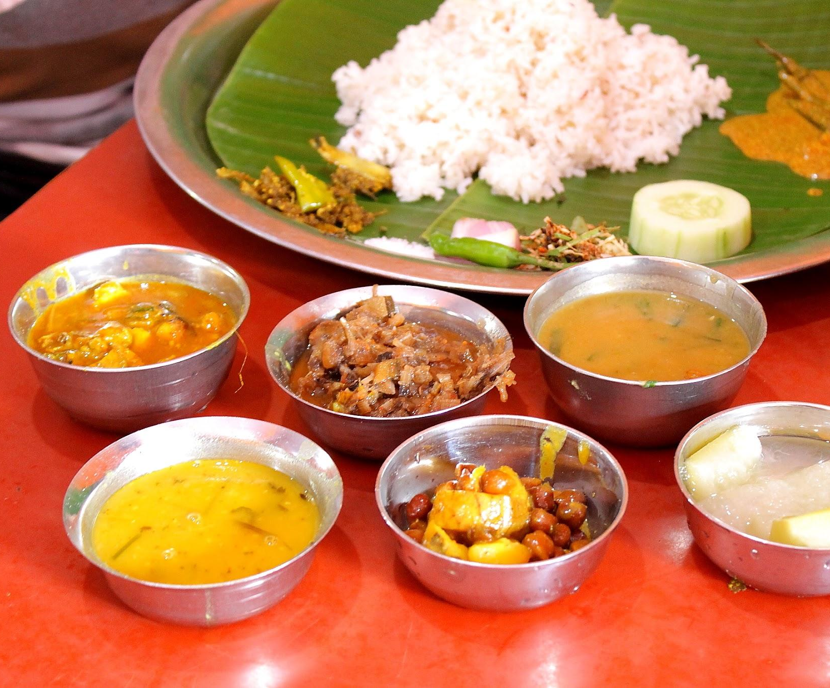
Traditional foods and diets
Food offers a tangible way for families and young people to connect with their culture, and to mark their social identity
There are a range of traditional foods, flavours and cooking techniques available
Important to note extent of assimilation and generational change

Slide 6
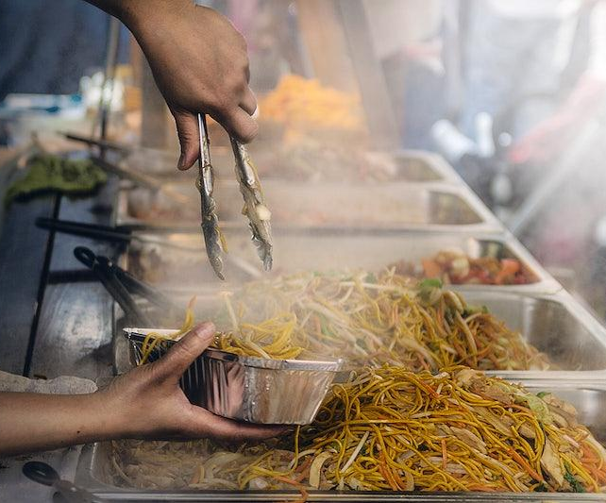
What are world foods?
World cuisines, foods and flavours imported from the rest of the world
Mutual influences through historical trade routes, migration, international travels and social media
The squeeze in household incomes may prompt more home cooking to experience a more affordable way to recreate international restaurant flavours at home (Mintel, 2023)
Notes:
World foods encompass a massive retail sector, and are really quite fluid in terms of how they are defined. If you go to the World Foods aisle at supermarkets, you might be able to find products which are also offered in the mainstream aisles, perhaps just branded differently. These include starchy staples such as rice, noodles, breads, to cooking companiments such as coconut milk. Historically, we might associate world foods with the styles of Indian and Chinese cuisines - these are still the two most popular, but increasingly we find cuisine types such as African Caribbean, American, pan-Asian, Eastern European, Irish as well as foods that are associated to faiths such as Halal and Kosher, available in mainstream supermarkets.

Slide 7
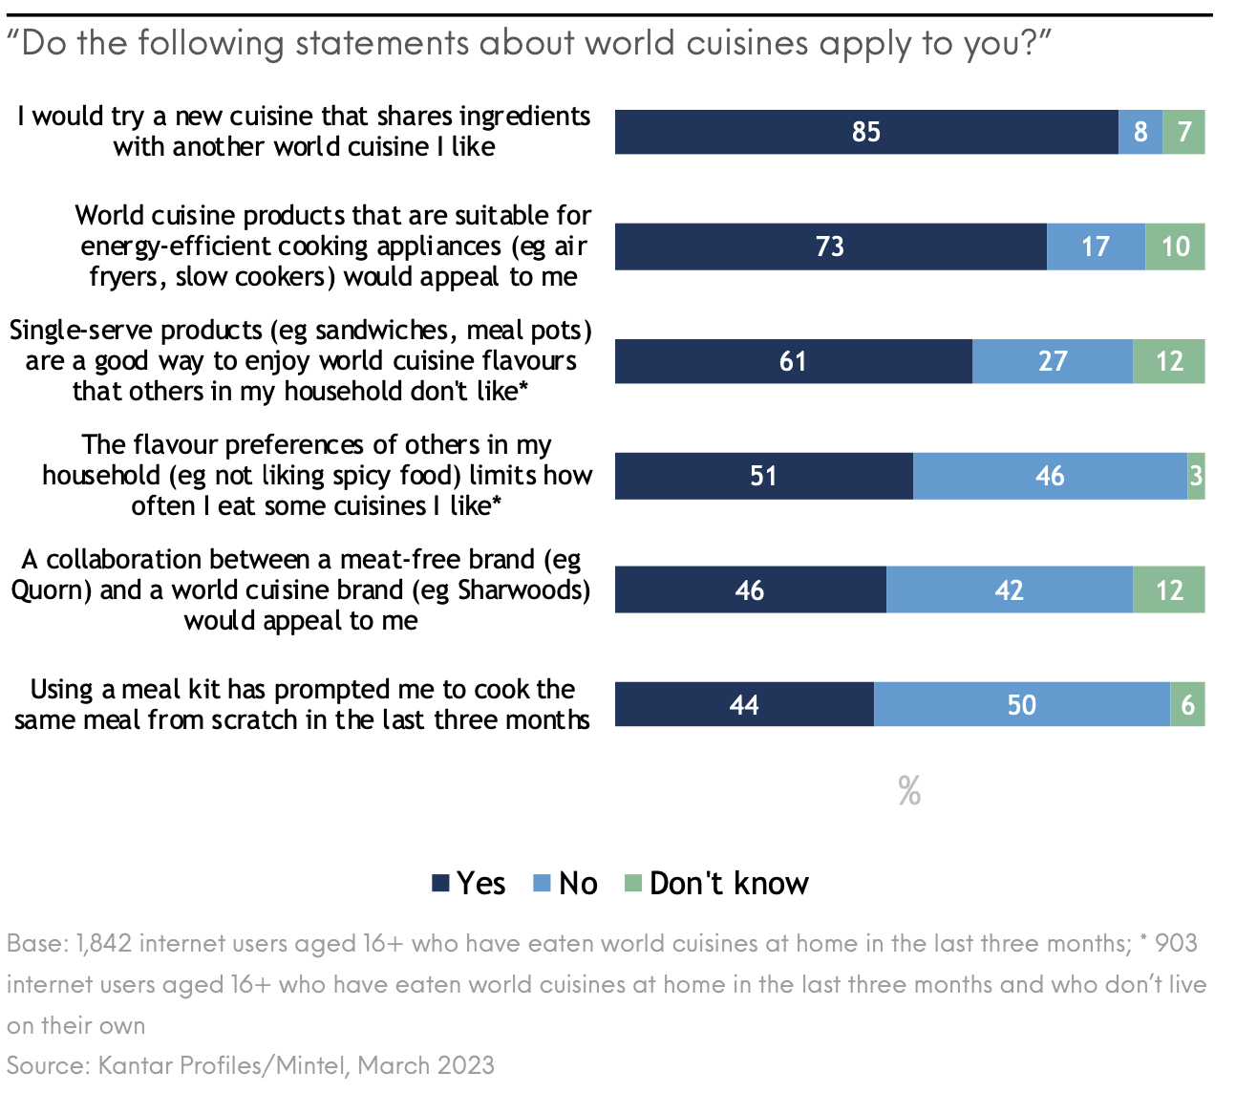
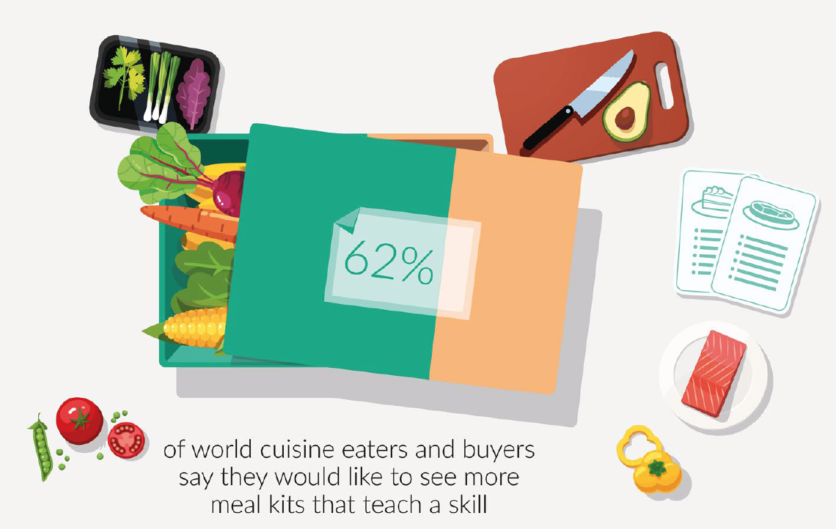
Market trends
44%
Behaviours relating to World Cuisines, March 2021
Notes:
More interest in cooking from scratch, rather than ready meals and using meal kits

Slide 8
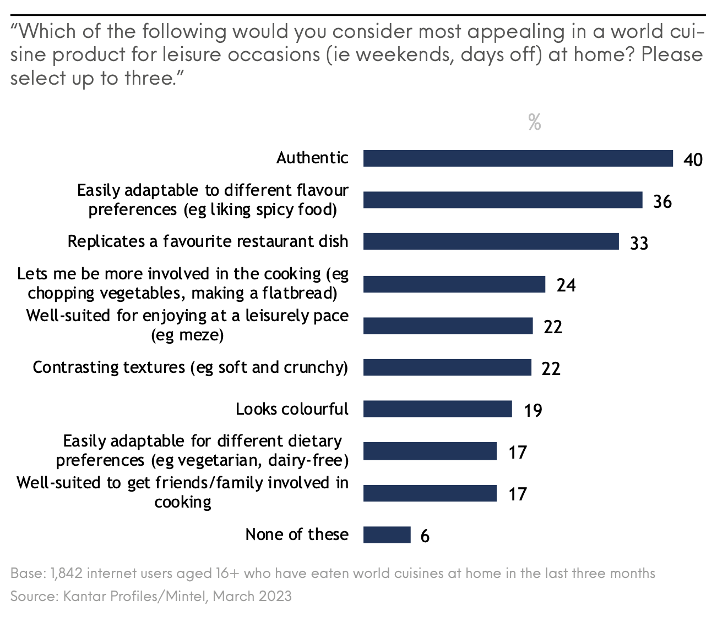
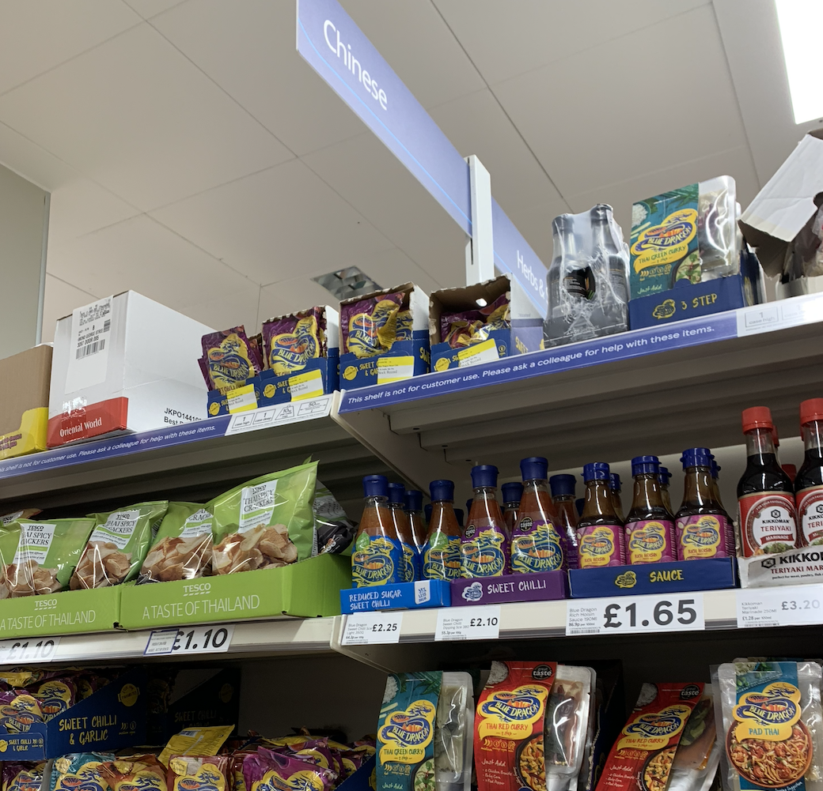

Slide 9
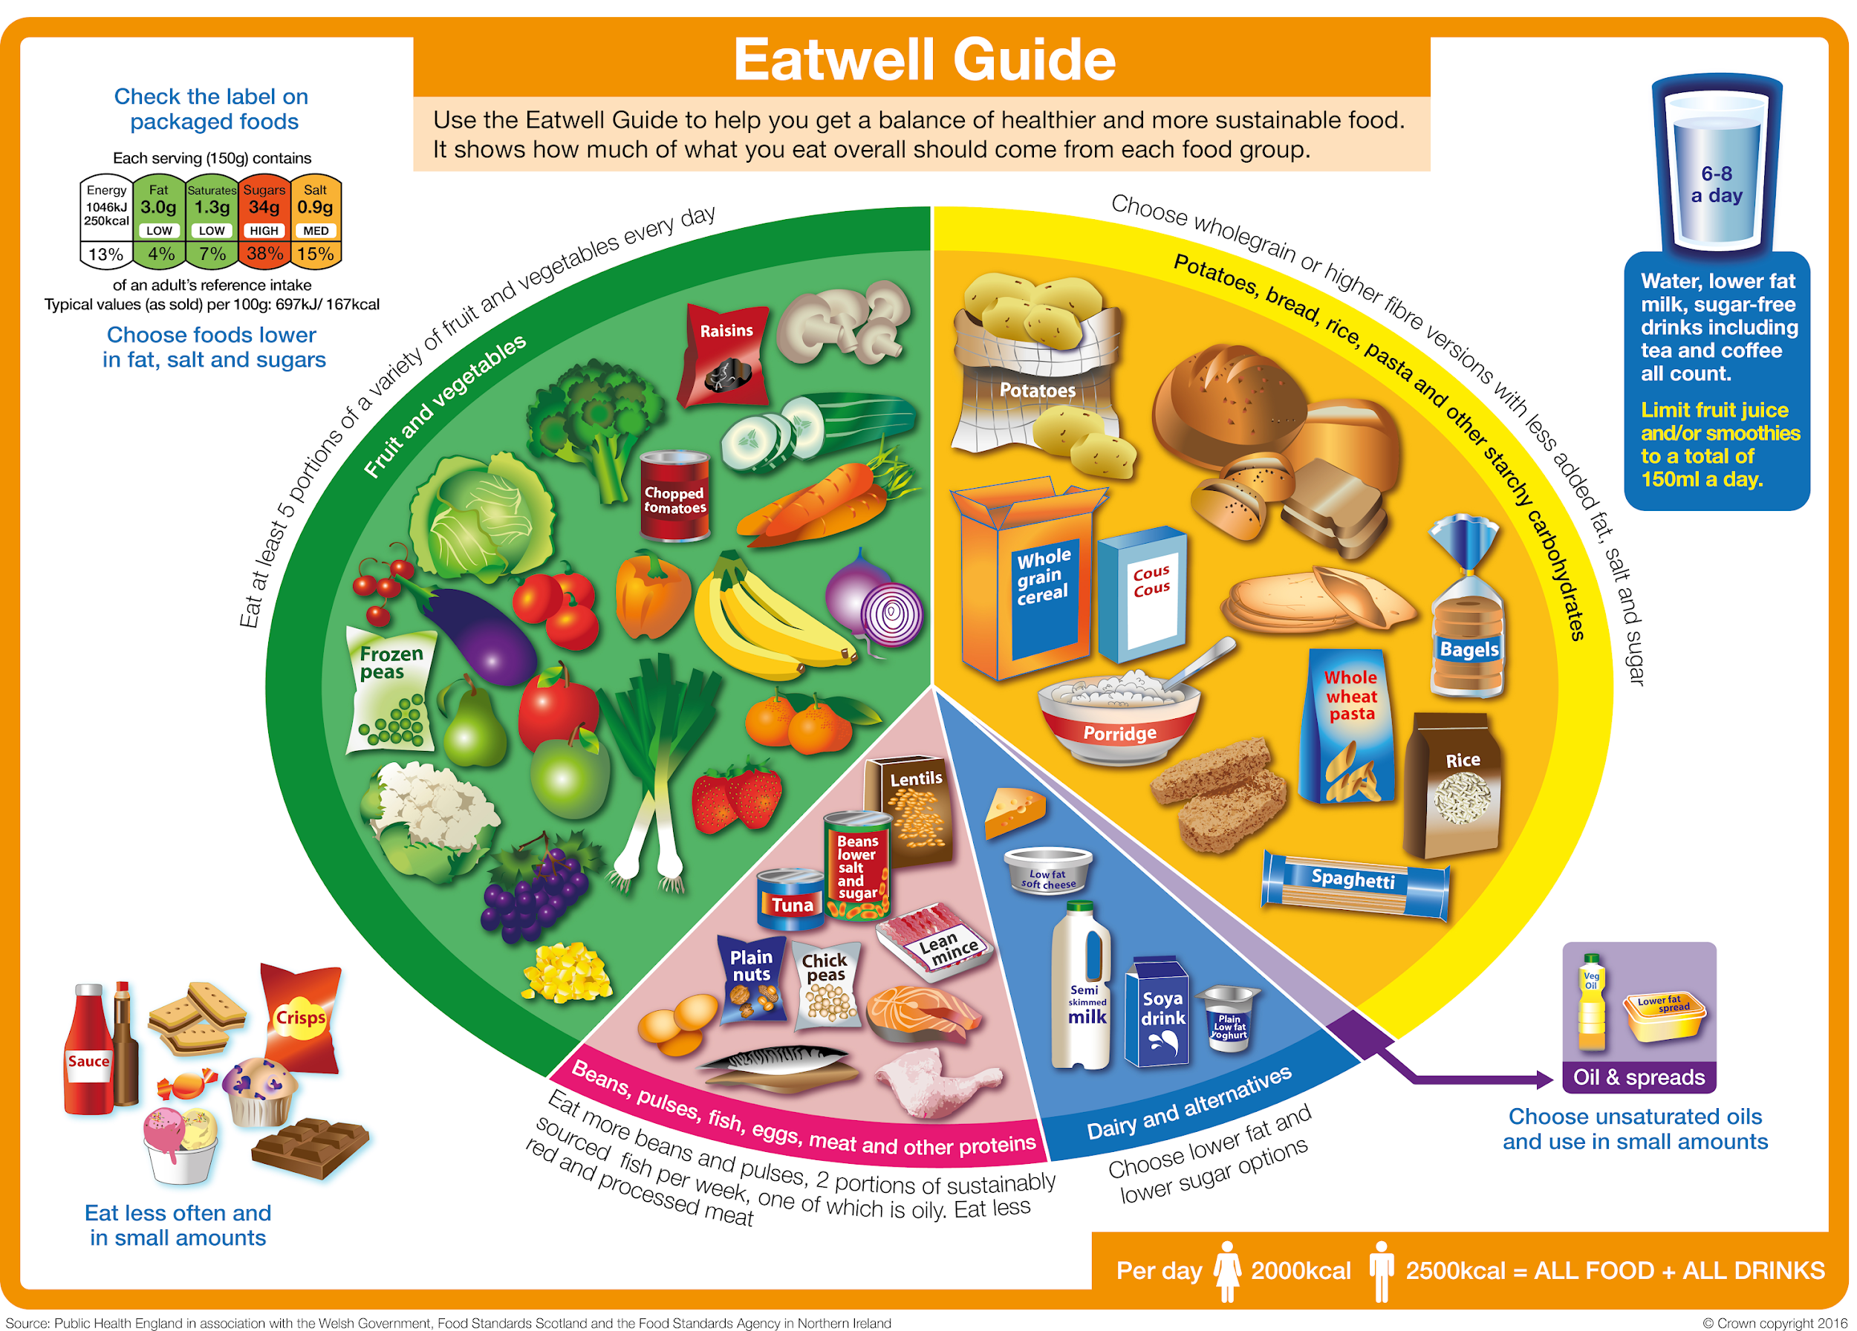

Slide 10
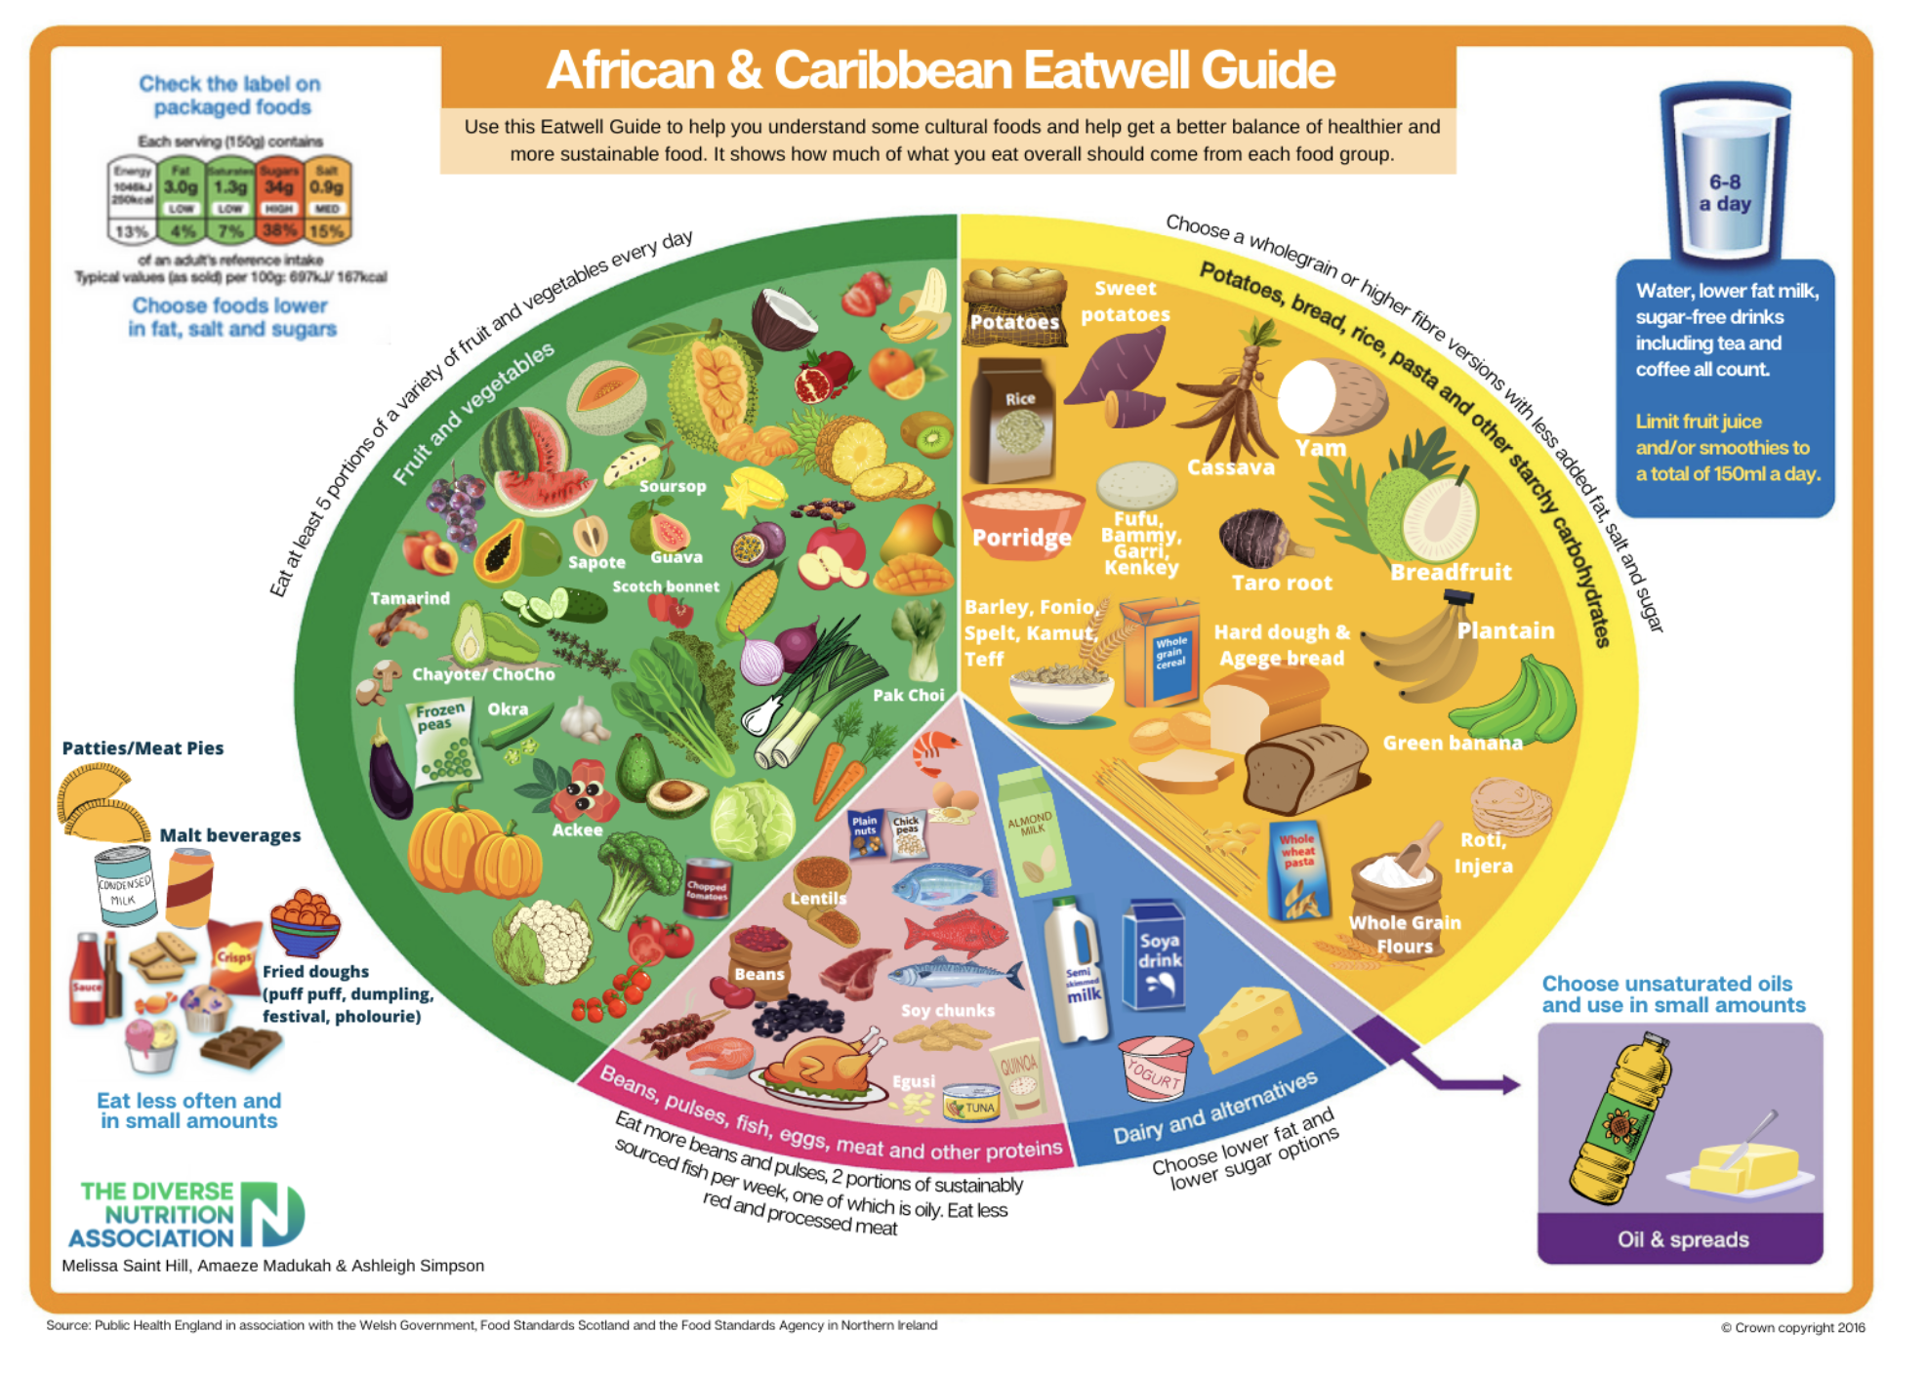
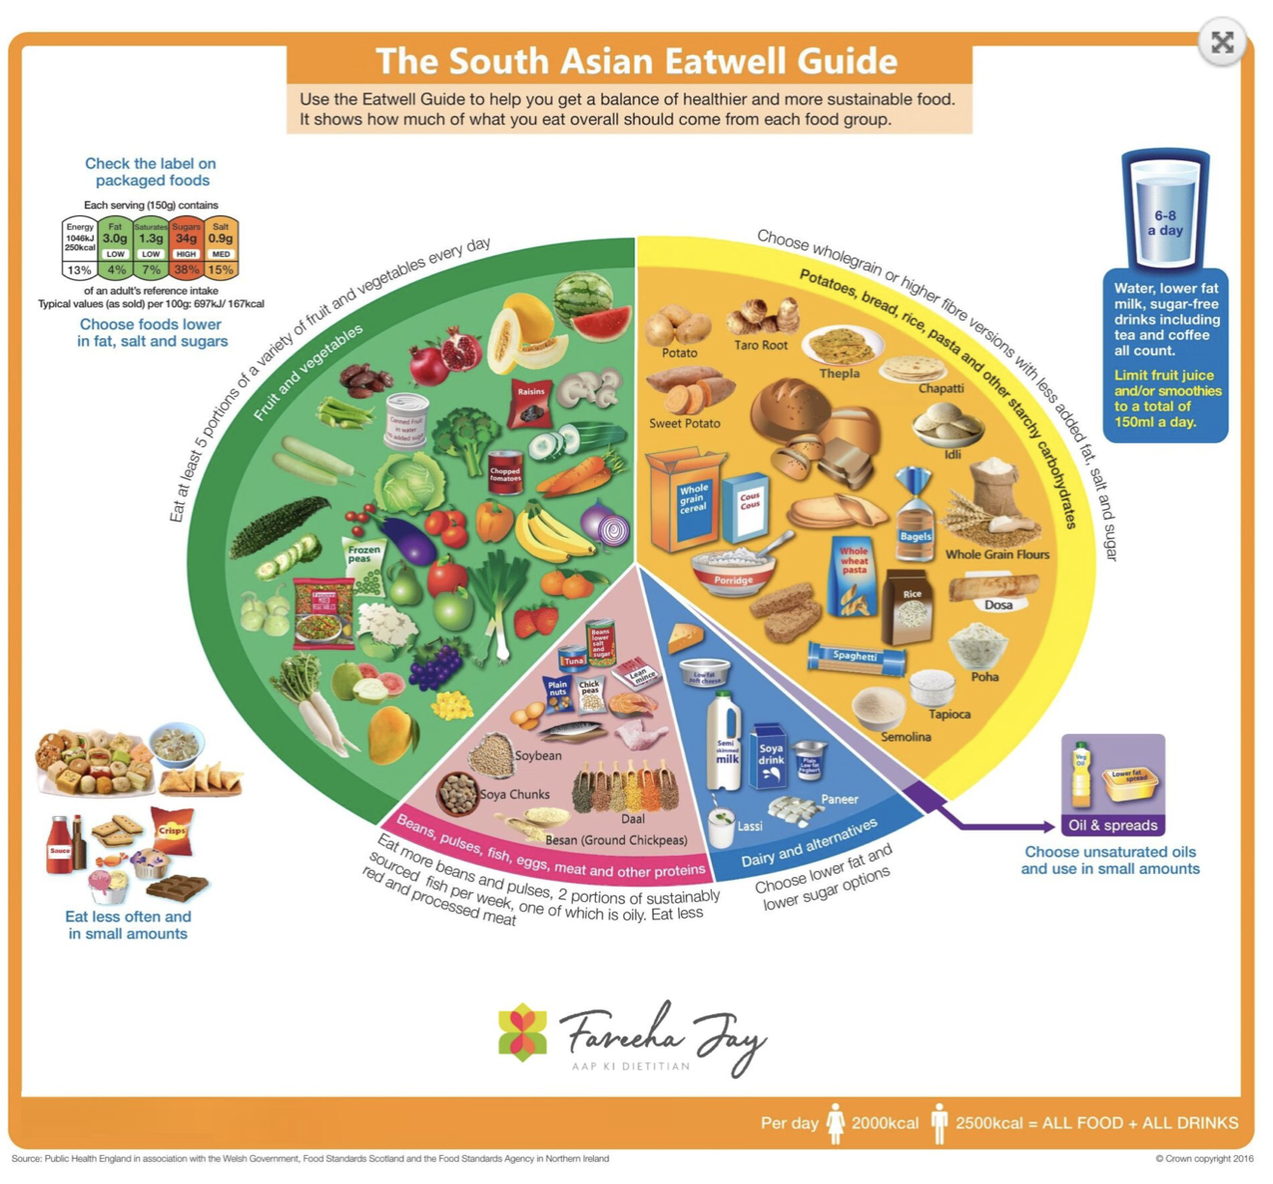
Notes:
These are some of the Eatwell Guides available which are put together by private and other charity bodies as an example on how to embed traditional foods into teaching about healthy eating. One features African-Caribbean foods, the other South Asian diets. There will be students who relate to other food cultures, and a multitude of food cultures at the same time, and it would be really interesting to explore these.

Slide 11
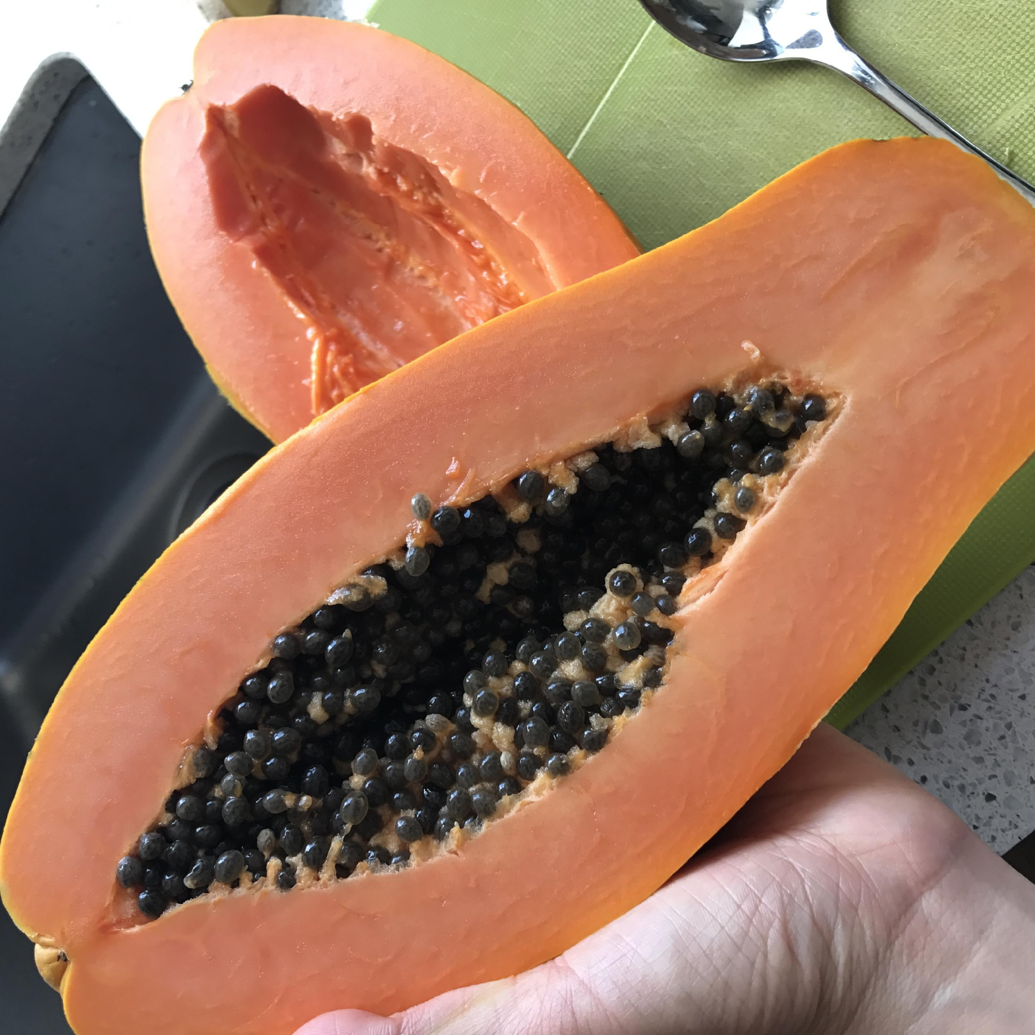
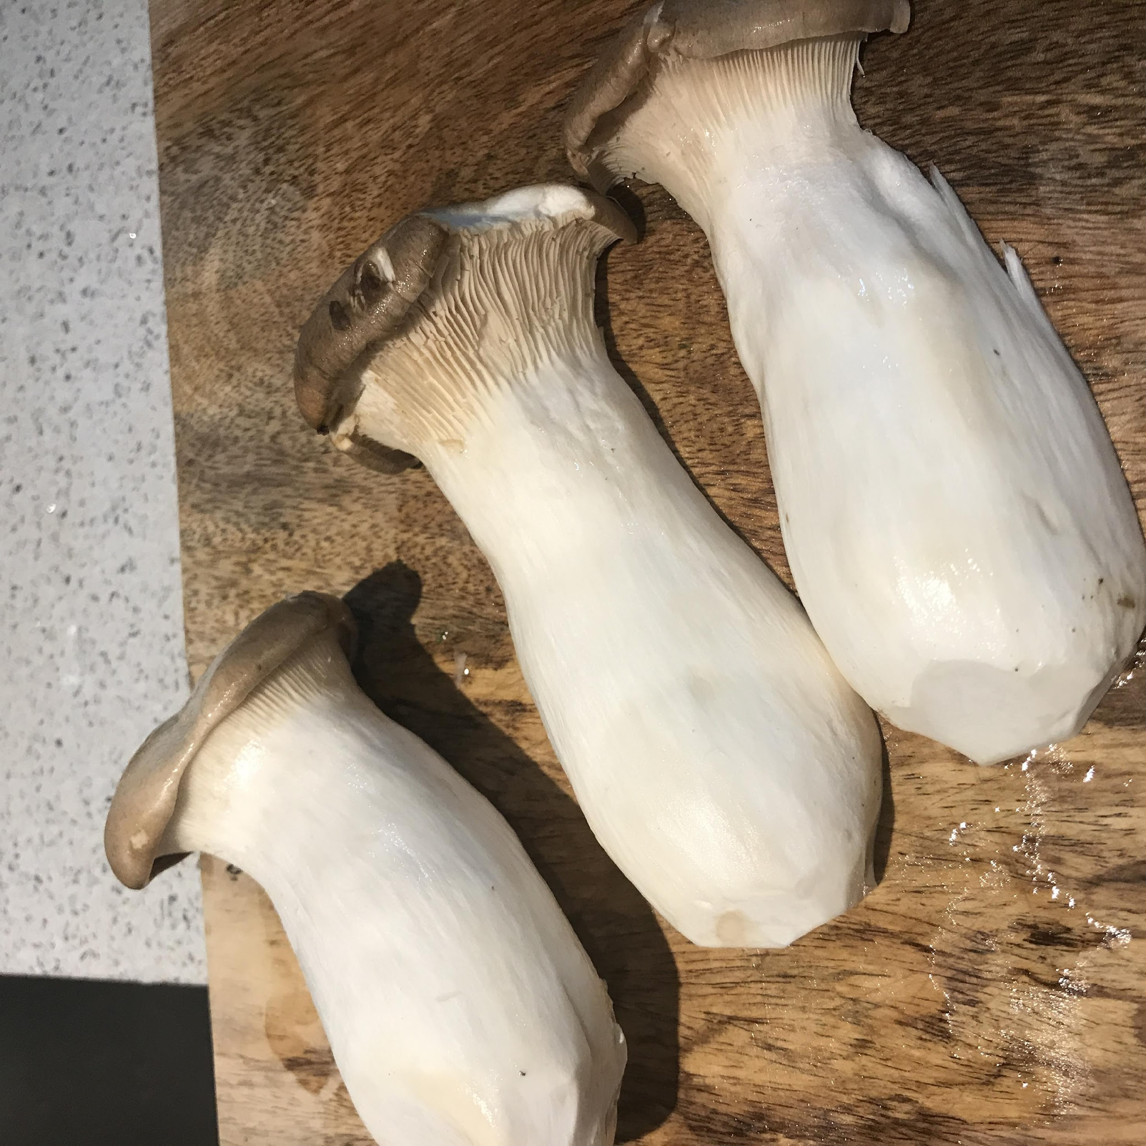
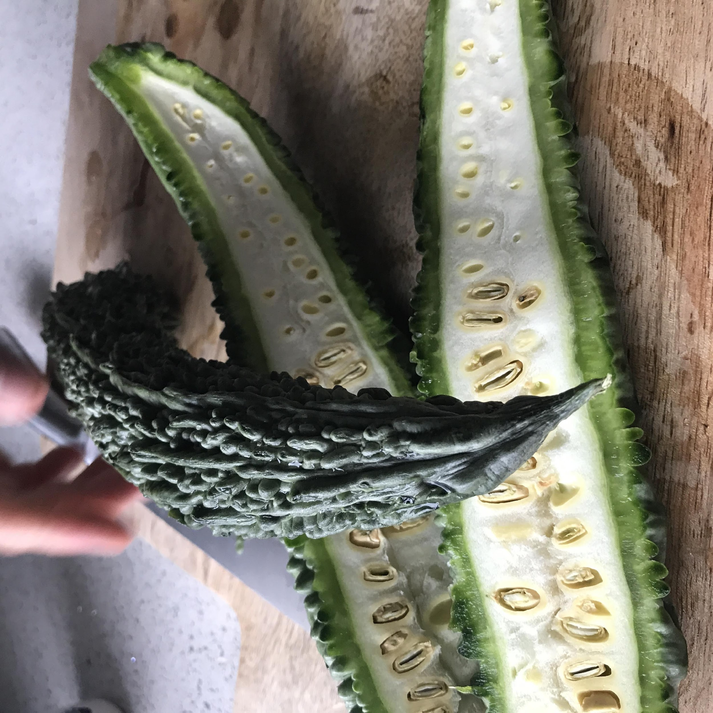
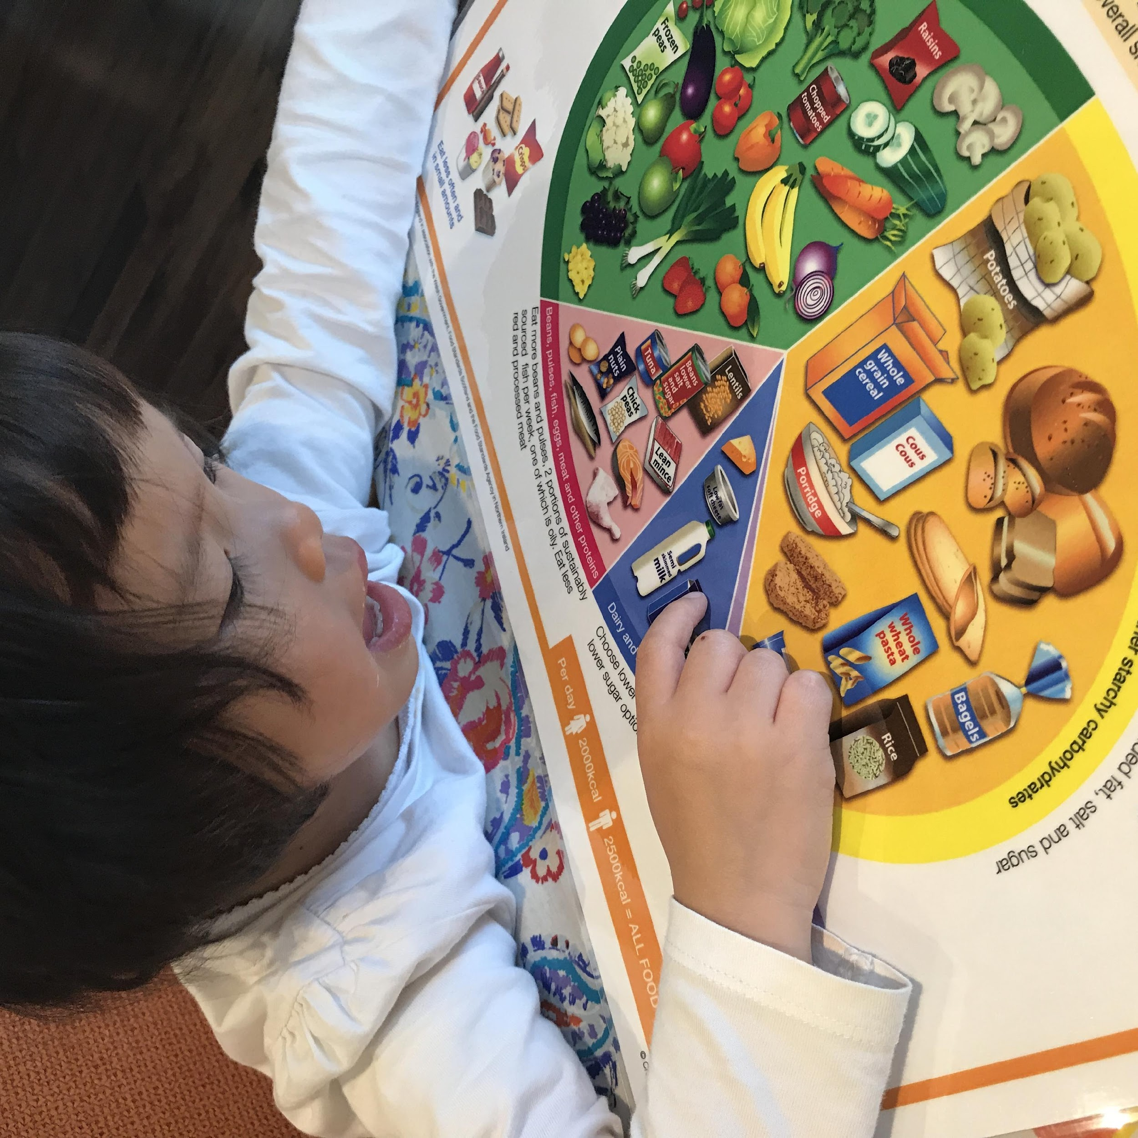
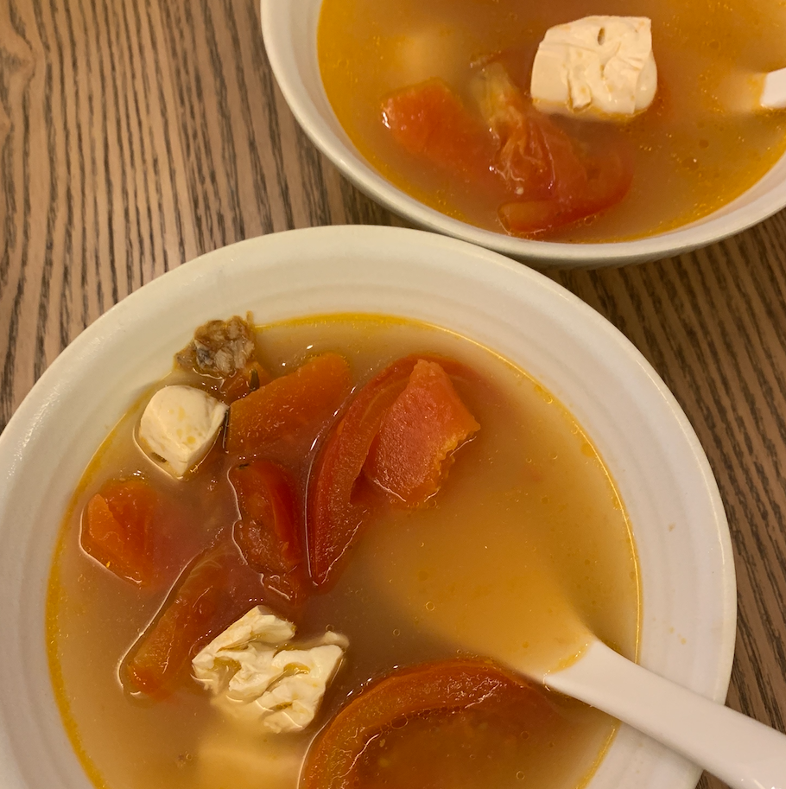
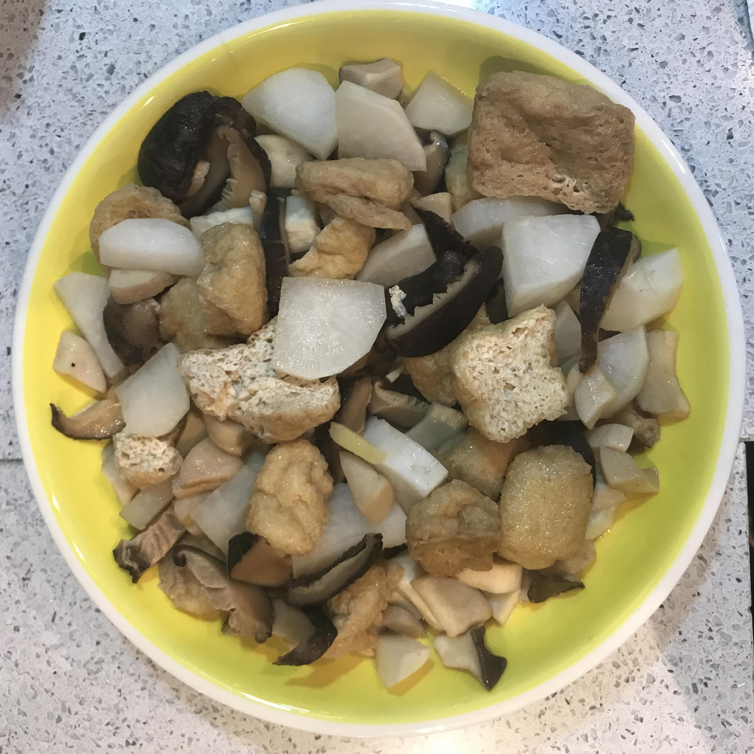
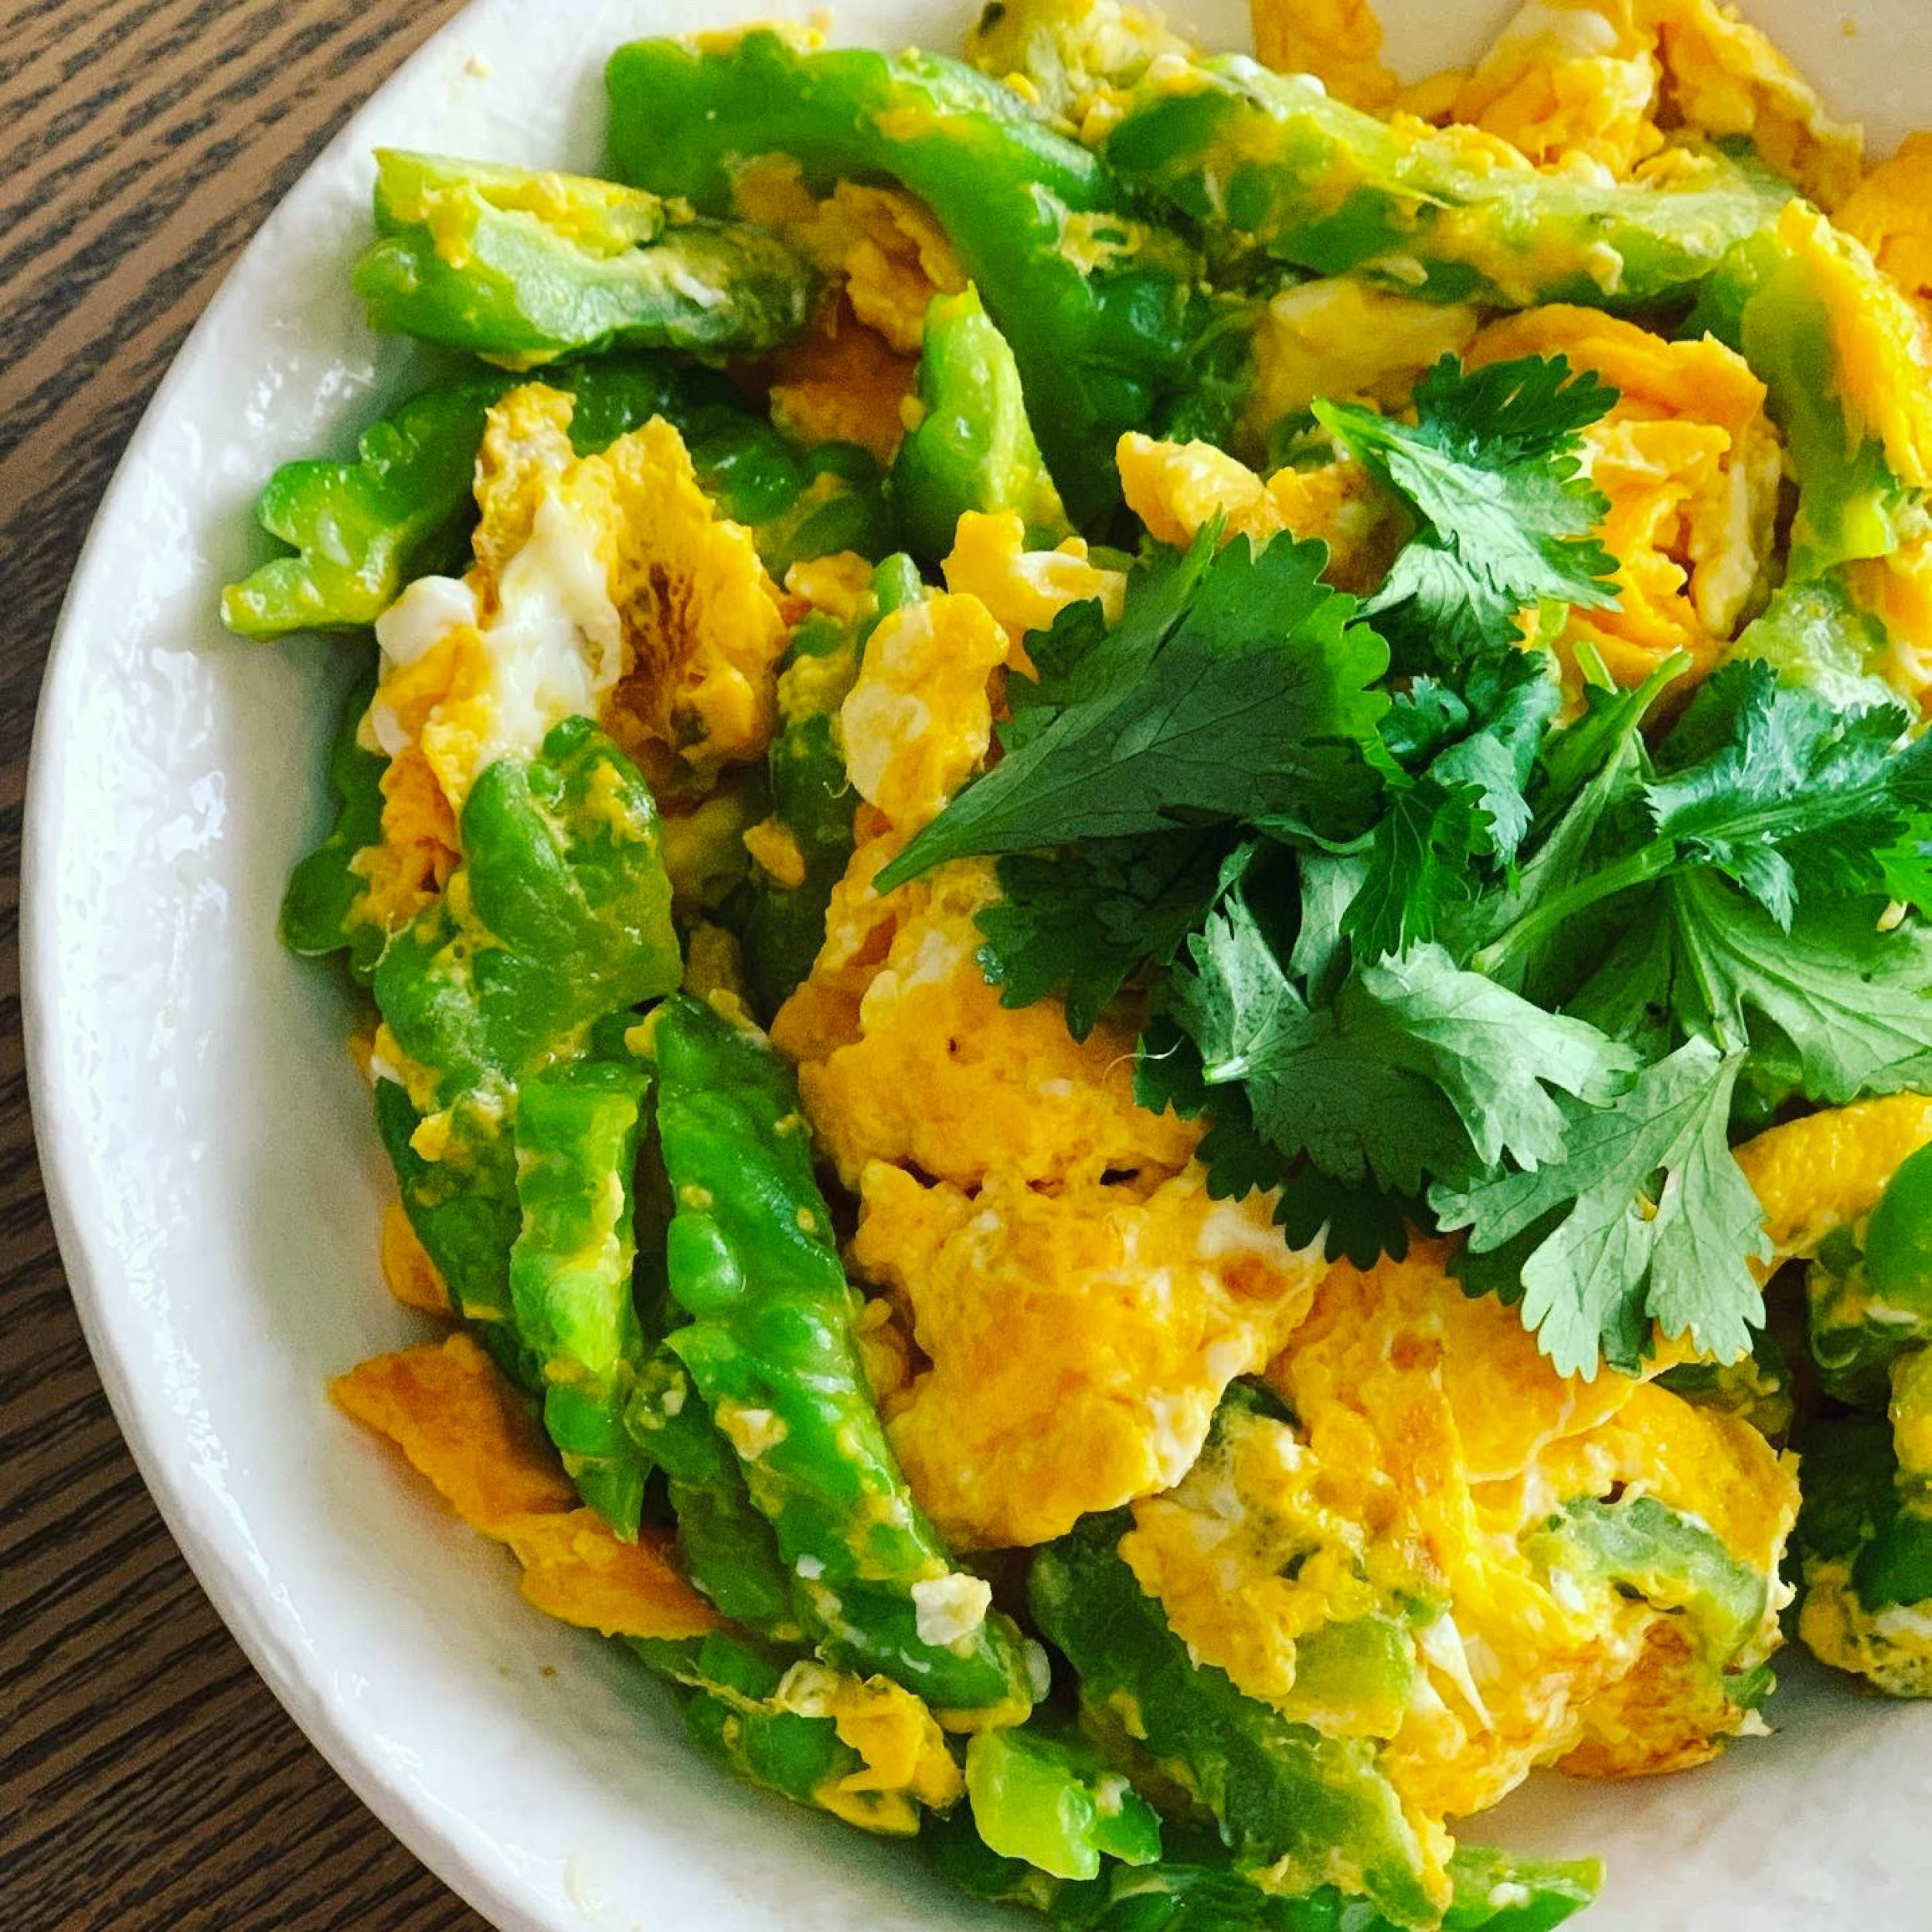
Learning about ingredients and dishes

Slide 12
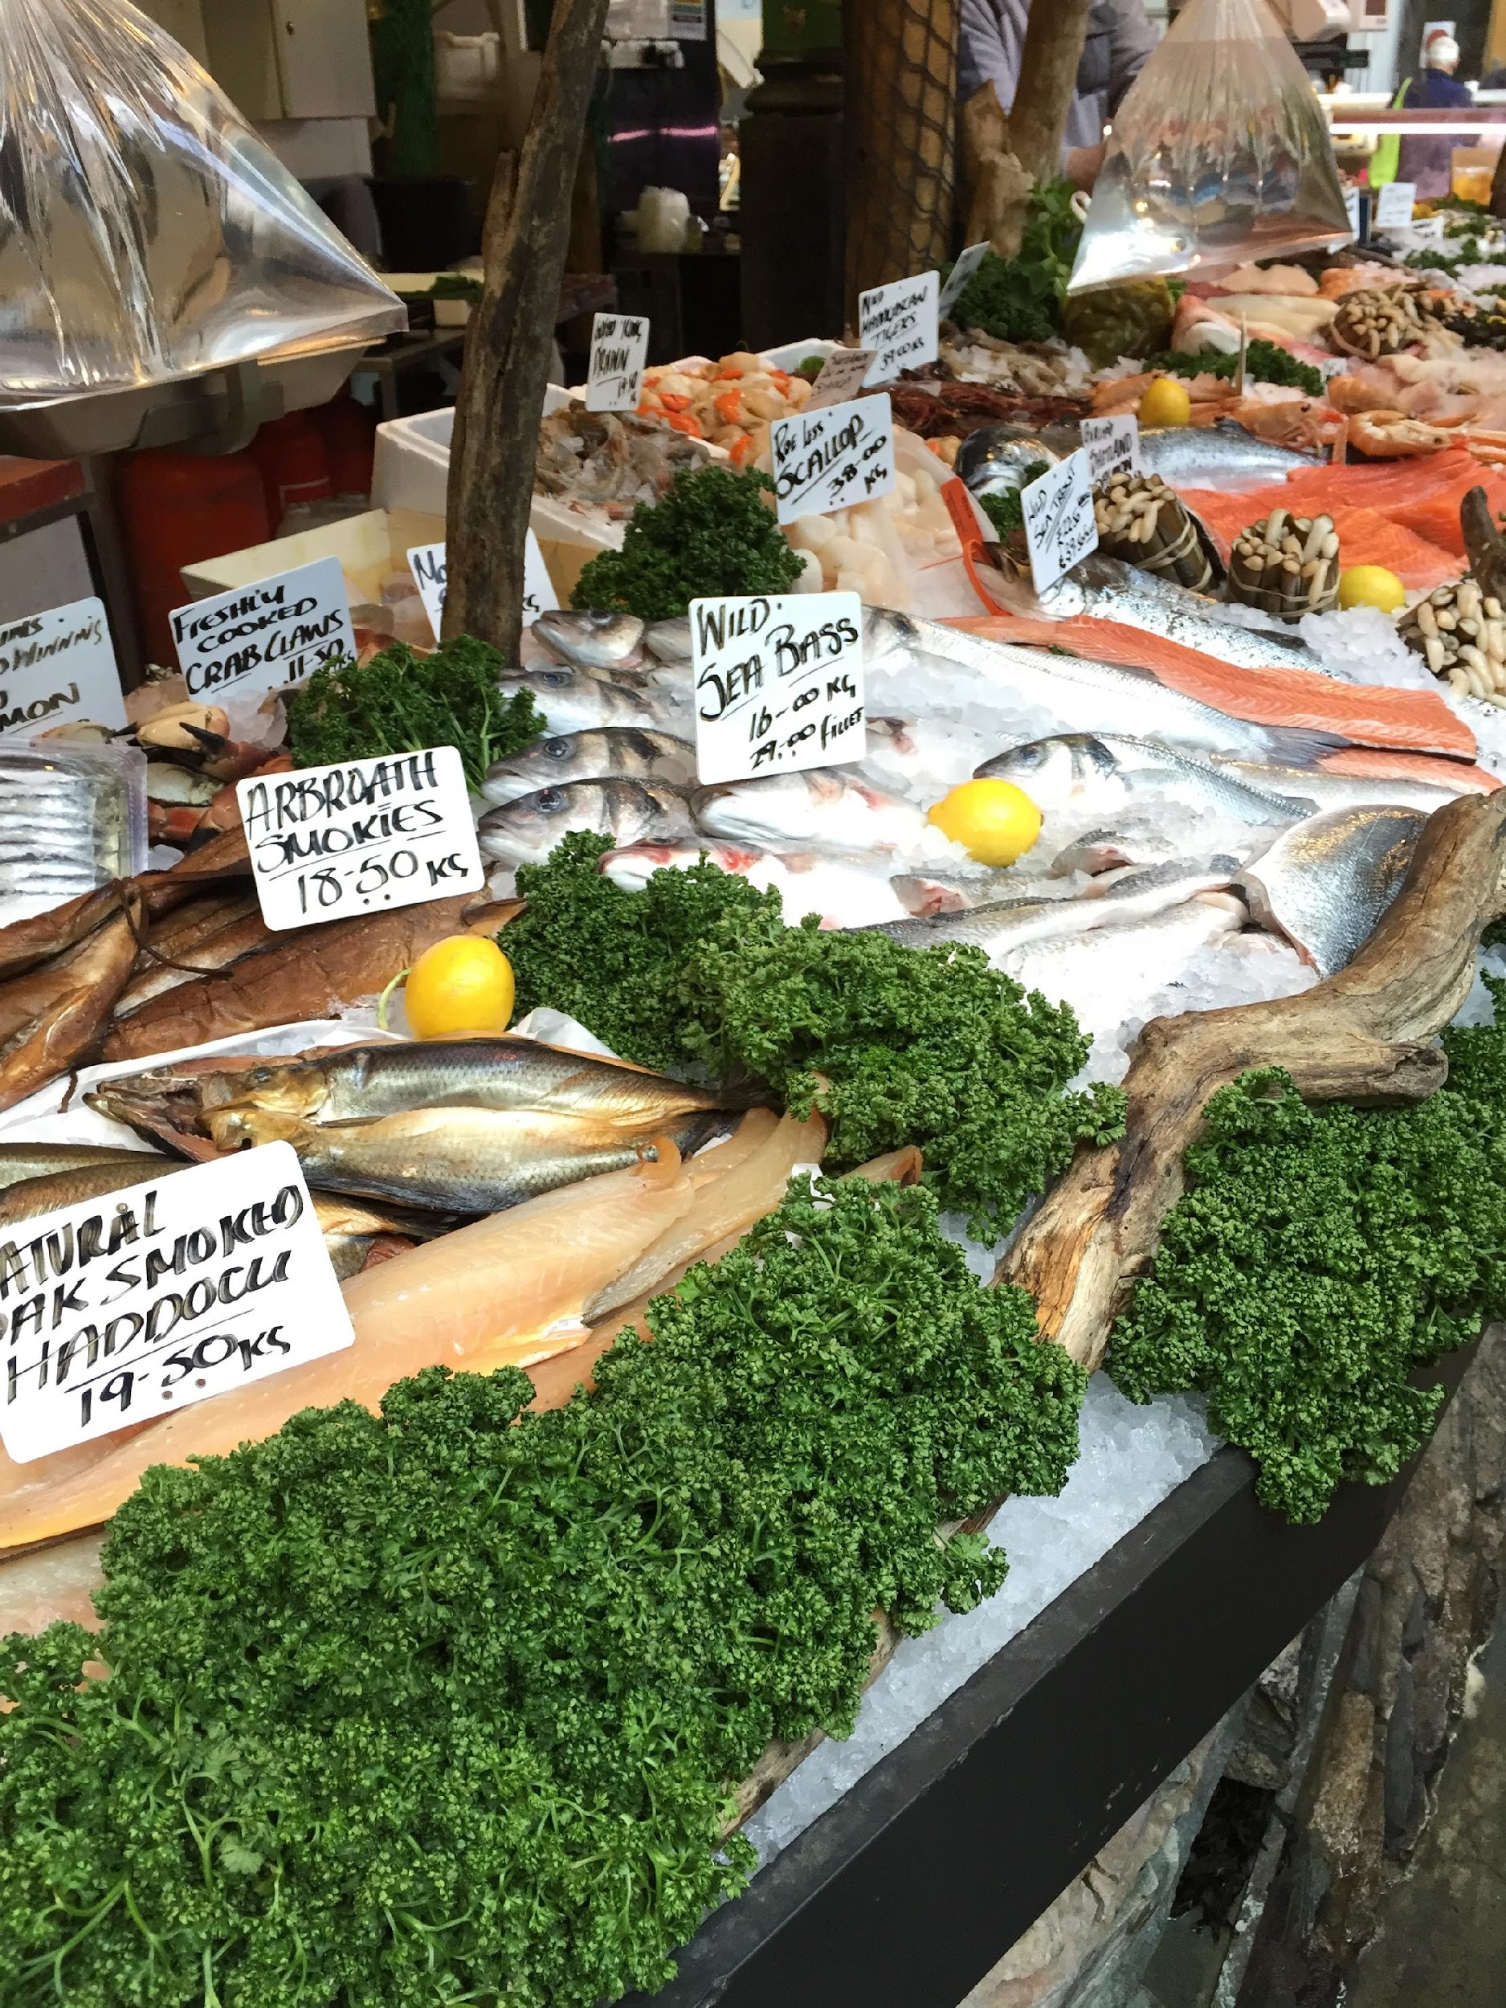
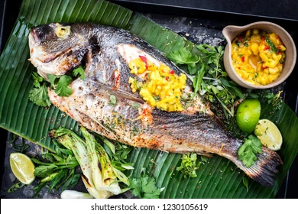
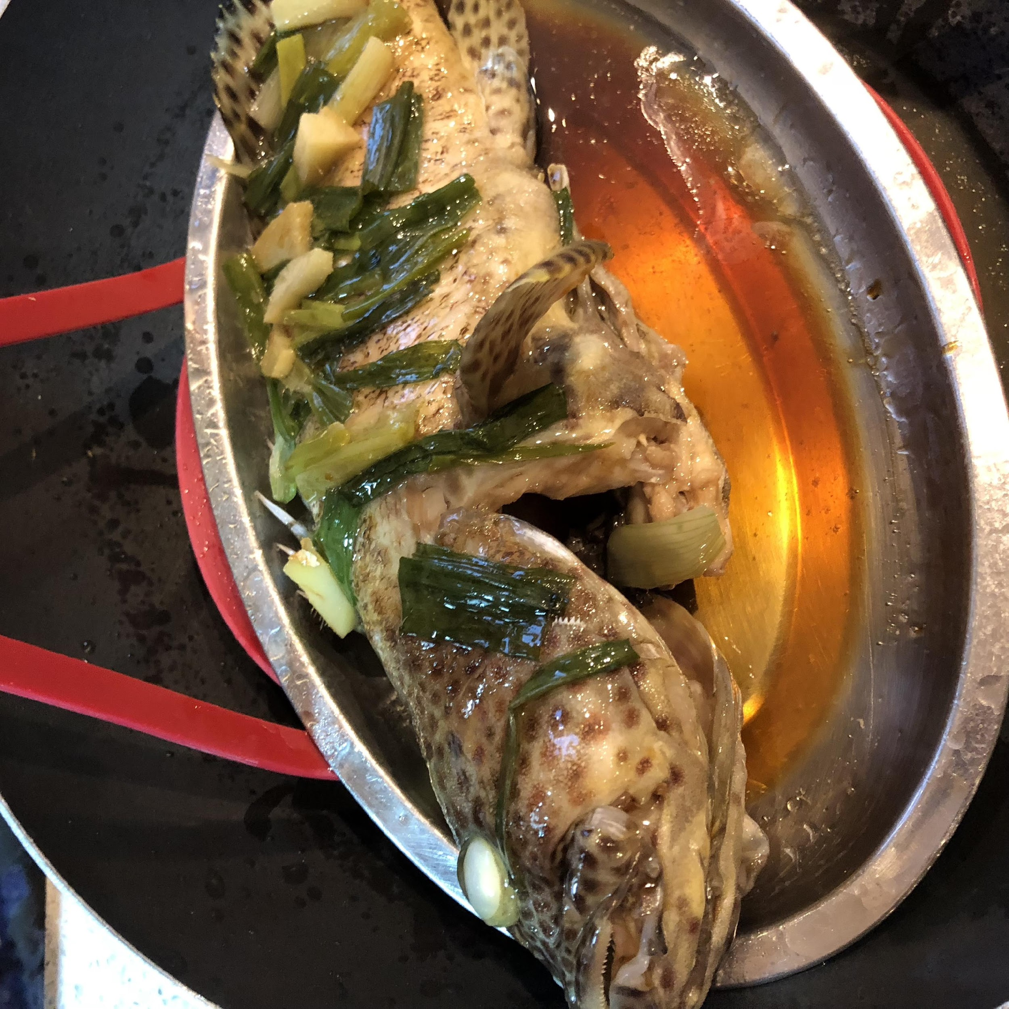
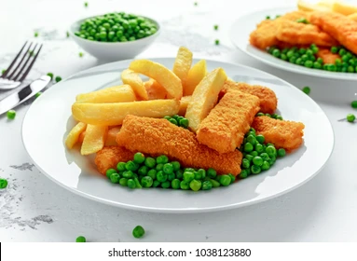
Learning about different cooking techniques

Slide 13

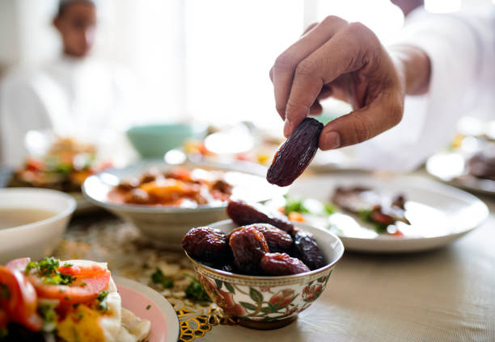
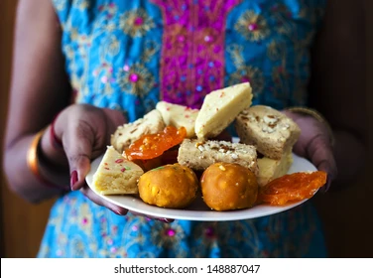
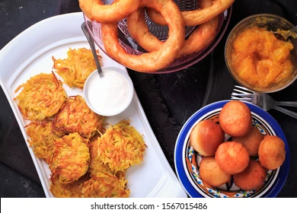
Learning about traditions and festive foods
Notes:
Traditional festivals and festive foods offer a way to further the understanding of students of different cultures. Often these enable to learn more about world history too. There are many examples of these, some of the more notable festivals include the Lunar New Year, marked by many events in China Town, the Iftar meal that is eaten at sunset, during the month of Ramadan celebrated by the Muslim community, the Hindu festivals of Holi (Festival of Colours), Diwali (Festival of lights) where food is a major focus where families share sweet foods, and Hannukah, also the Festival of Lights marked by the Jewish community. This is particularly important to students whose families practise this, and a way to learn about the importance of festivals through stories, as well as the foods which mark these occasions.

Slide 14
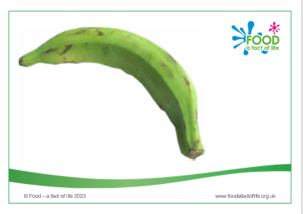
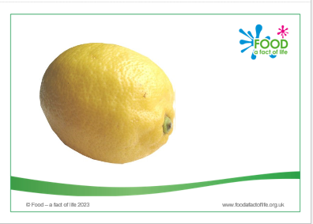
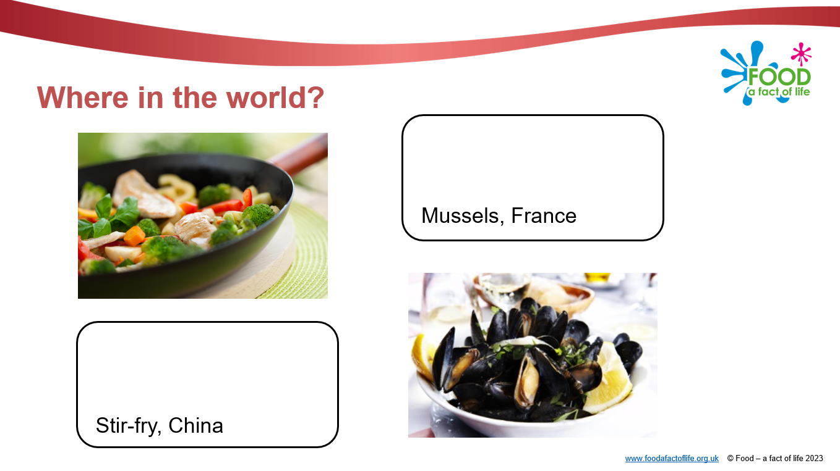
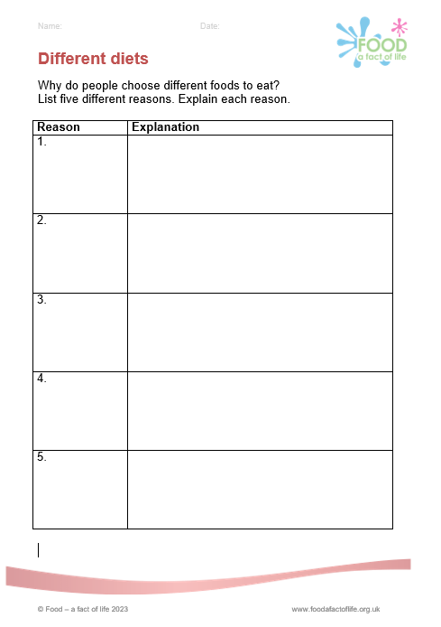
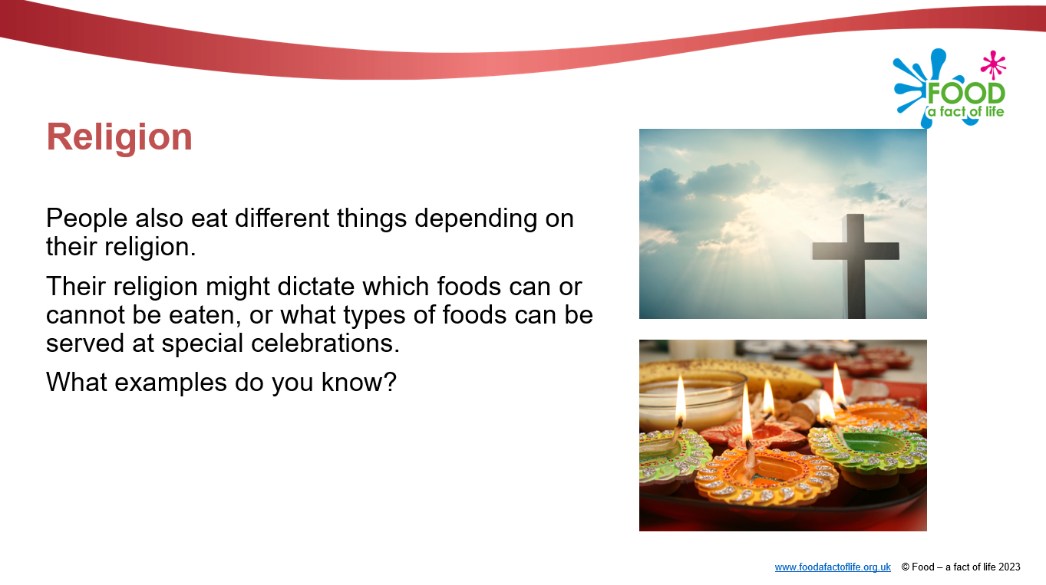
World foods
Food - a fact of life: 7-11 Years - Healthy eating
Activity 1: A range of factors determine what people eat (e.g. religion, climate, culture)
Activity 2: Dishes and meals eaten around the world often comprise similar food (or ingredients) combined in different ways. Activity 3: People all around the world need a variety of food from different food groups to have a healthy diet.
To find out more, go to: https://www.foodafactoflife.org.uk/7-11-years/healthy-eating-7-11-years/the-diet-7-11-years/

Slide 15
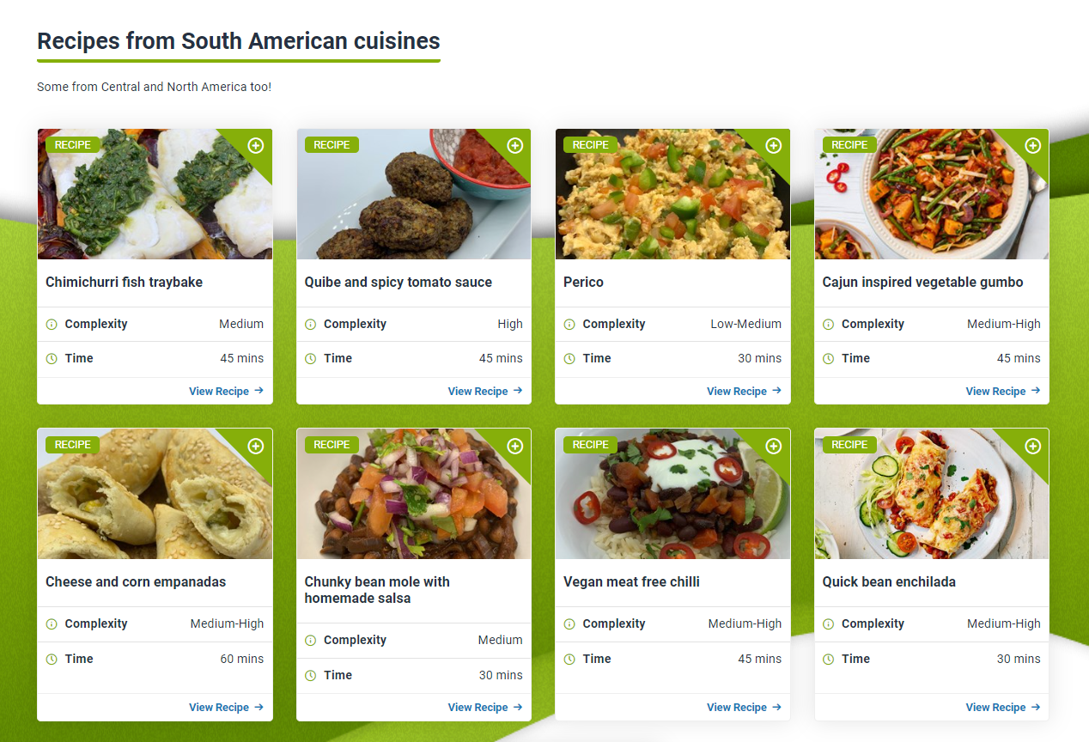
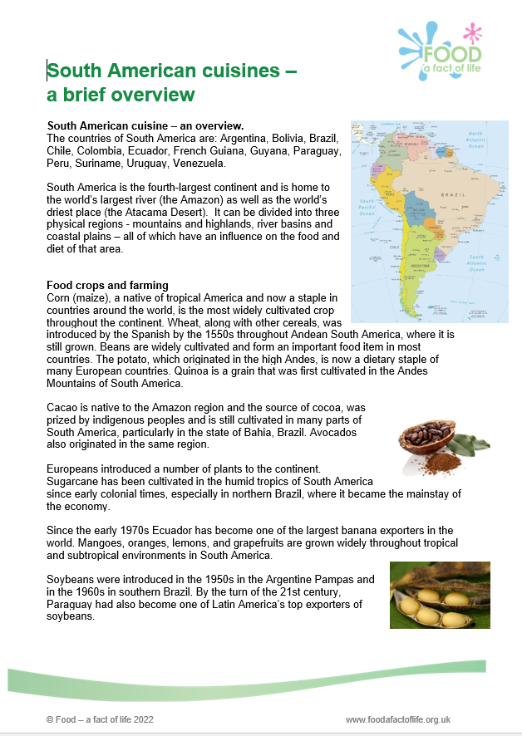
Global cuisine recipes and supporting resources
Introductory presentation, fact sheet (history, traditions, ingredients) and recipes, available for:
African;
Middle Eastern;
Eastern Asian;
Caribbean Islands;
South American;
and Eastern European cuisines.
To find out more, go to: https://www.foodafactoflife.org.uk/professional-development/teaching-and-learning/planning-and-teaching/the-future-of-food-education/future-of-food-education-teacher-training-resources/

Slide 16

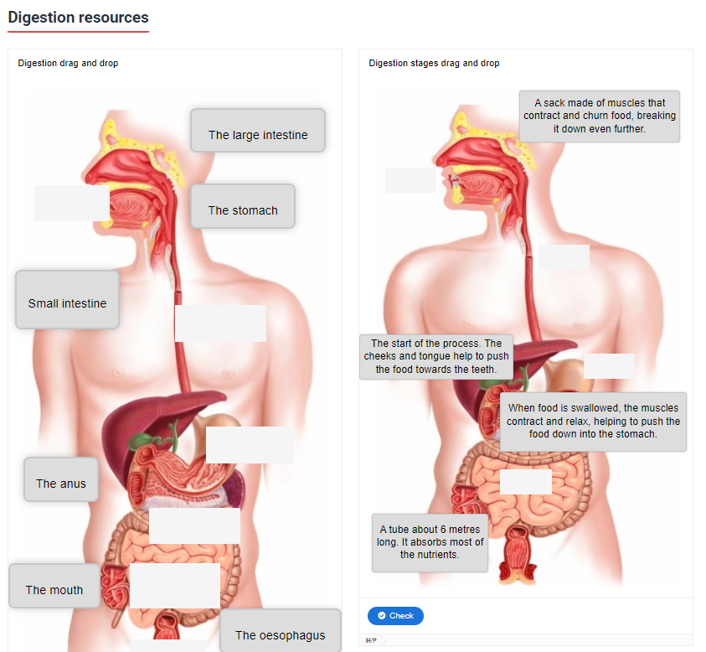
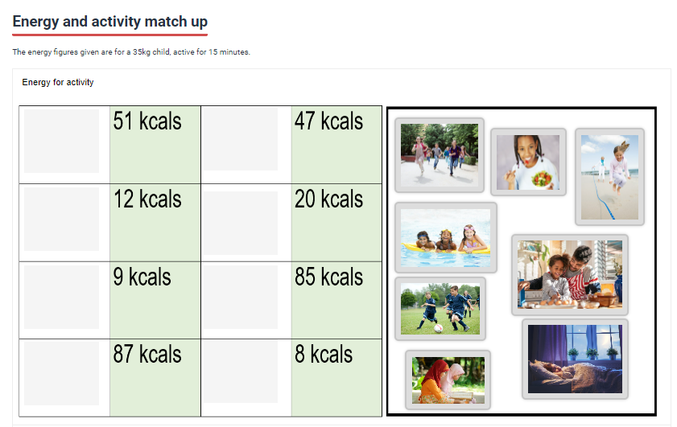
Interactive healthy eating resources
Drag and drop games!
The Eatwell Challenge
Digestion
Energy and activity match up
To find out more, go to: https://www.foodafactoflife.org.uk/7-11-years/healthy-eating-7-11-years/healthy-eating-interactive-resources-7-11-years/

Slide 17
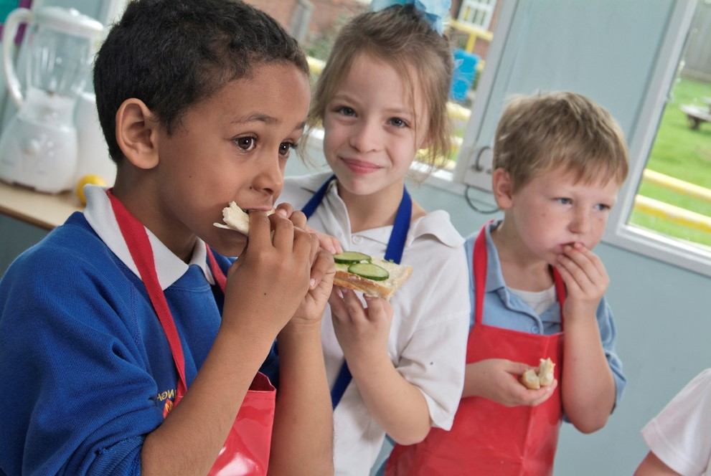
Future training events
Coming next…diary dates
Tue 5 Dec 2023 – 4pm Supporting pupils with additional needs
Tue 16 Jan 2024 – 4pm Bringing seasonality to life, using blueberries!
Tue 27 Feb 2024 – 4pm Ask an expert
Tue 12 March 2024 – 4pm Engaging parents/carers & extra-curricular cooking
Tue 23 April 2024 – 4pm Cooking with heat in primary 2
Tue 14 May 2024 – 4pm Outside cooking!
Tue 4 June 2024 – 4pm Cook-a-long - global recipes
Remember that all webinars are recorded and the 22/23 recordings can be found here.
Also don’t forget our INSET package – seven topical videos ideal for you and your colleagues.

Slide 18
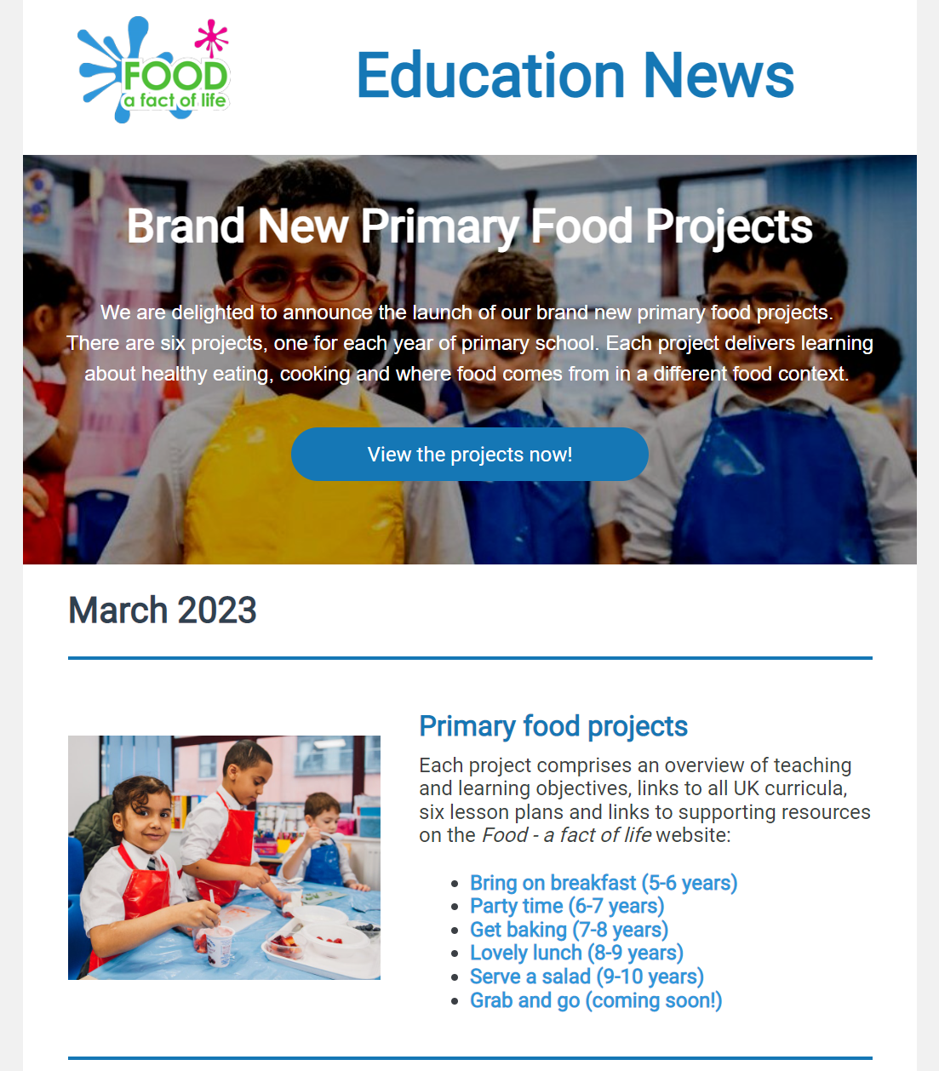
Keep up to date with our free resources and training
Education News (monthly email update)
Sign up on the homepage: www.foodafactoflife.org.uk
Follow us on Twitter @Foodafactoflife
https://twitter.com/foodafactoflife
Keep in touch: education@nutrition.org.uk
Do you know anyone who would find the TPFN programme useful?
They can view this introductory presentation and then register for free!

Slide 19
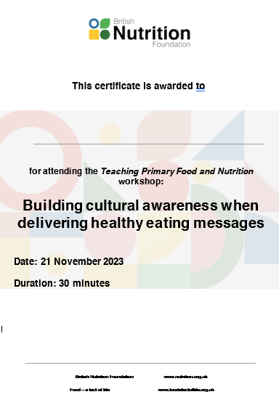
Thank you
Please complete the webinar evaluation. If you are watching a recording of this webinar, you will find a link to the evaluation at the end of the PPT presentation in the Healthy eating and nutrition area of the TPFN training page.
Webinar evaluation link: Building cultural awareness when delivering healthy eating messages
You will receive a link to the certificate once you have completed the evaluation. Please download the certificate, add your name and print it out for your records.

Slide 20
Thank you
For further information about TPFN training or to find recordings of previous webinars and workshops, click here.

