Slide 1
Development of food technology

Slide 2
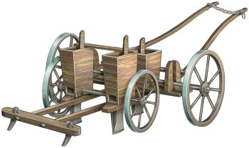
From farm to factory
Between the 16th Century and the early 18th Century, farming technology developed very little.
During the 16th Century there were new farming tools, such as the first horse drawn hoe and field drill devised by Jethro Tull.
Breeding of animals continued, with the introduction of new breeds of cattle which gave higher milk yields.

Slide 3
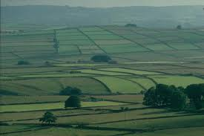
Enclosure Acts
In the reign of George III three million acres of common land were removed from common ownership by the ‘Enclosure Acts’. This meant that people lost arable land, grazing areas for their animals, scrub to collect fuel and sometimes even their small garden plots.
The acts were devised to make better profits from more efficient agriculture.

Slide 4
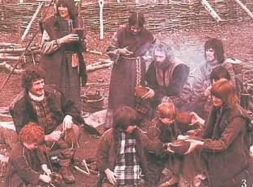
Effect of ‘Enclosure Acts’
The effect for many people was poverty, poor diet, and loss of traditional cooking and preserving skills.
Many villages were deserted and industrial centres grew as people were no longer able to make a living from the land and moved to towns.

Slide 5
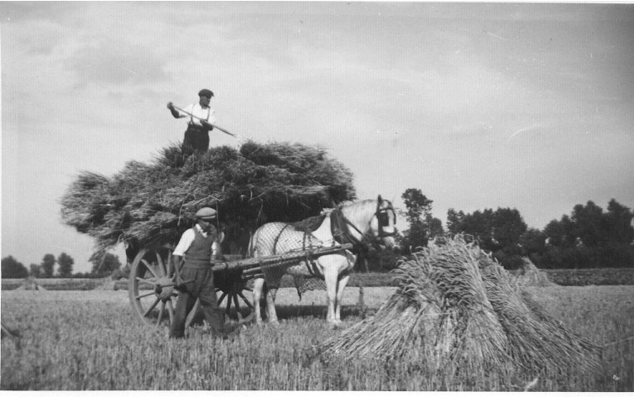
Before the Industrial Revolution
In the 19th Century, food was largely harvested by hand and cooked, as it had been for many centuries, in the home.
However, a few basic food items such as bread, were available from bakeries. In fact, the price and weight of bread was regulated as far back as 1267AD, by royal order. The production levels of bread were domestic, being based in simple kitchens with open fires and ovens.

Slide 6
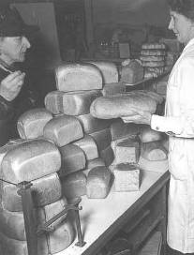
The Industrial Revolution
The Industrial Revolution brought many technologies together and provided new possibilities for investigation.
Mechanisation took place, increasing the volume of production of goods, including food products.
As more and more factories were built for mass production of goods, so towns and cities grew, and populations expanded. This also meant that there were more people to feed.

Slide 7

Housing
The development of housing, which grew into towns around factories, allowed people to live closer to their work.
However, it also prevented people from growing crops and rearing animals. In order to support this growing population food had to be processed and manufactured in factories. This in turn provided employment and a constant supply of food.

Slide 8
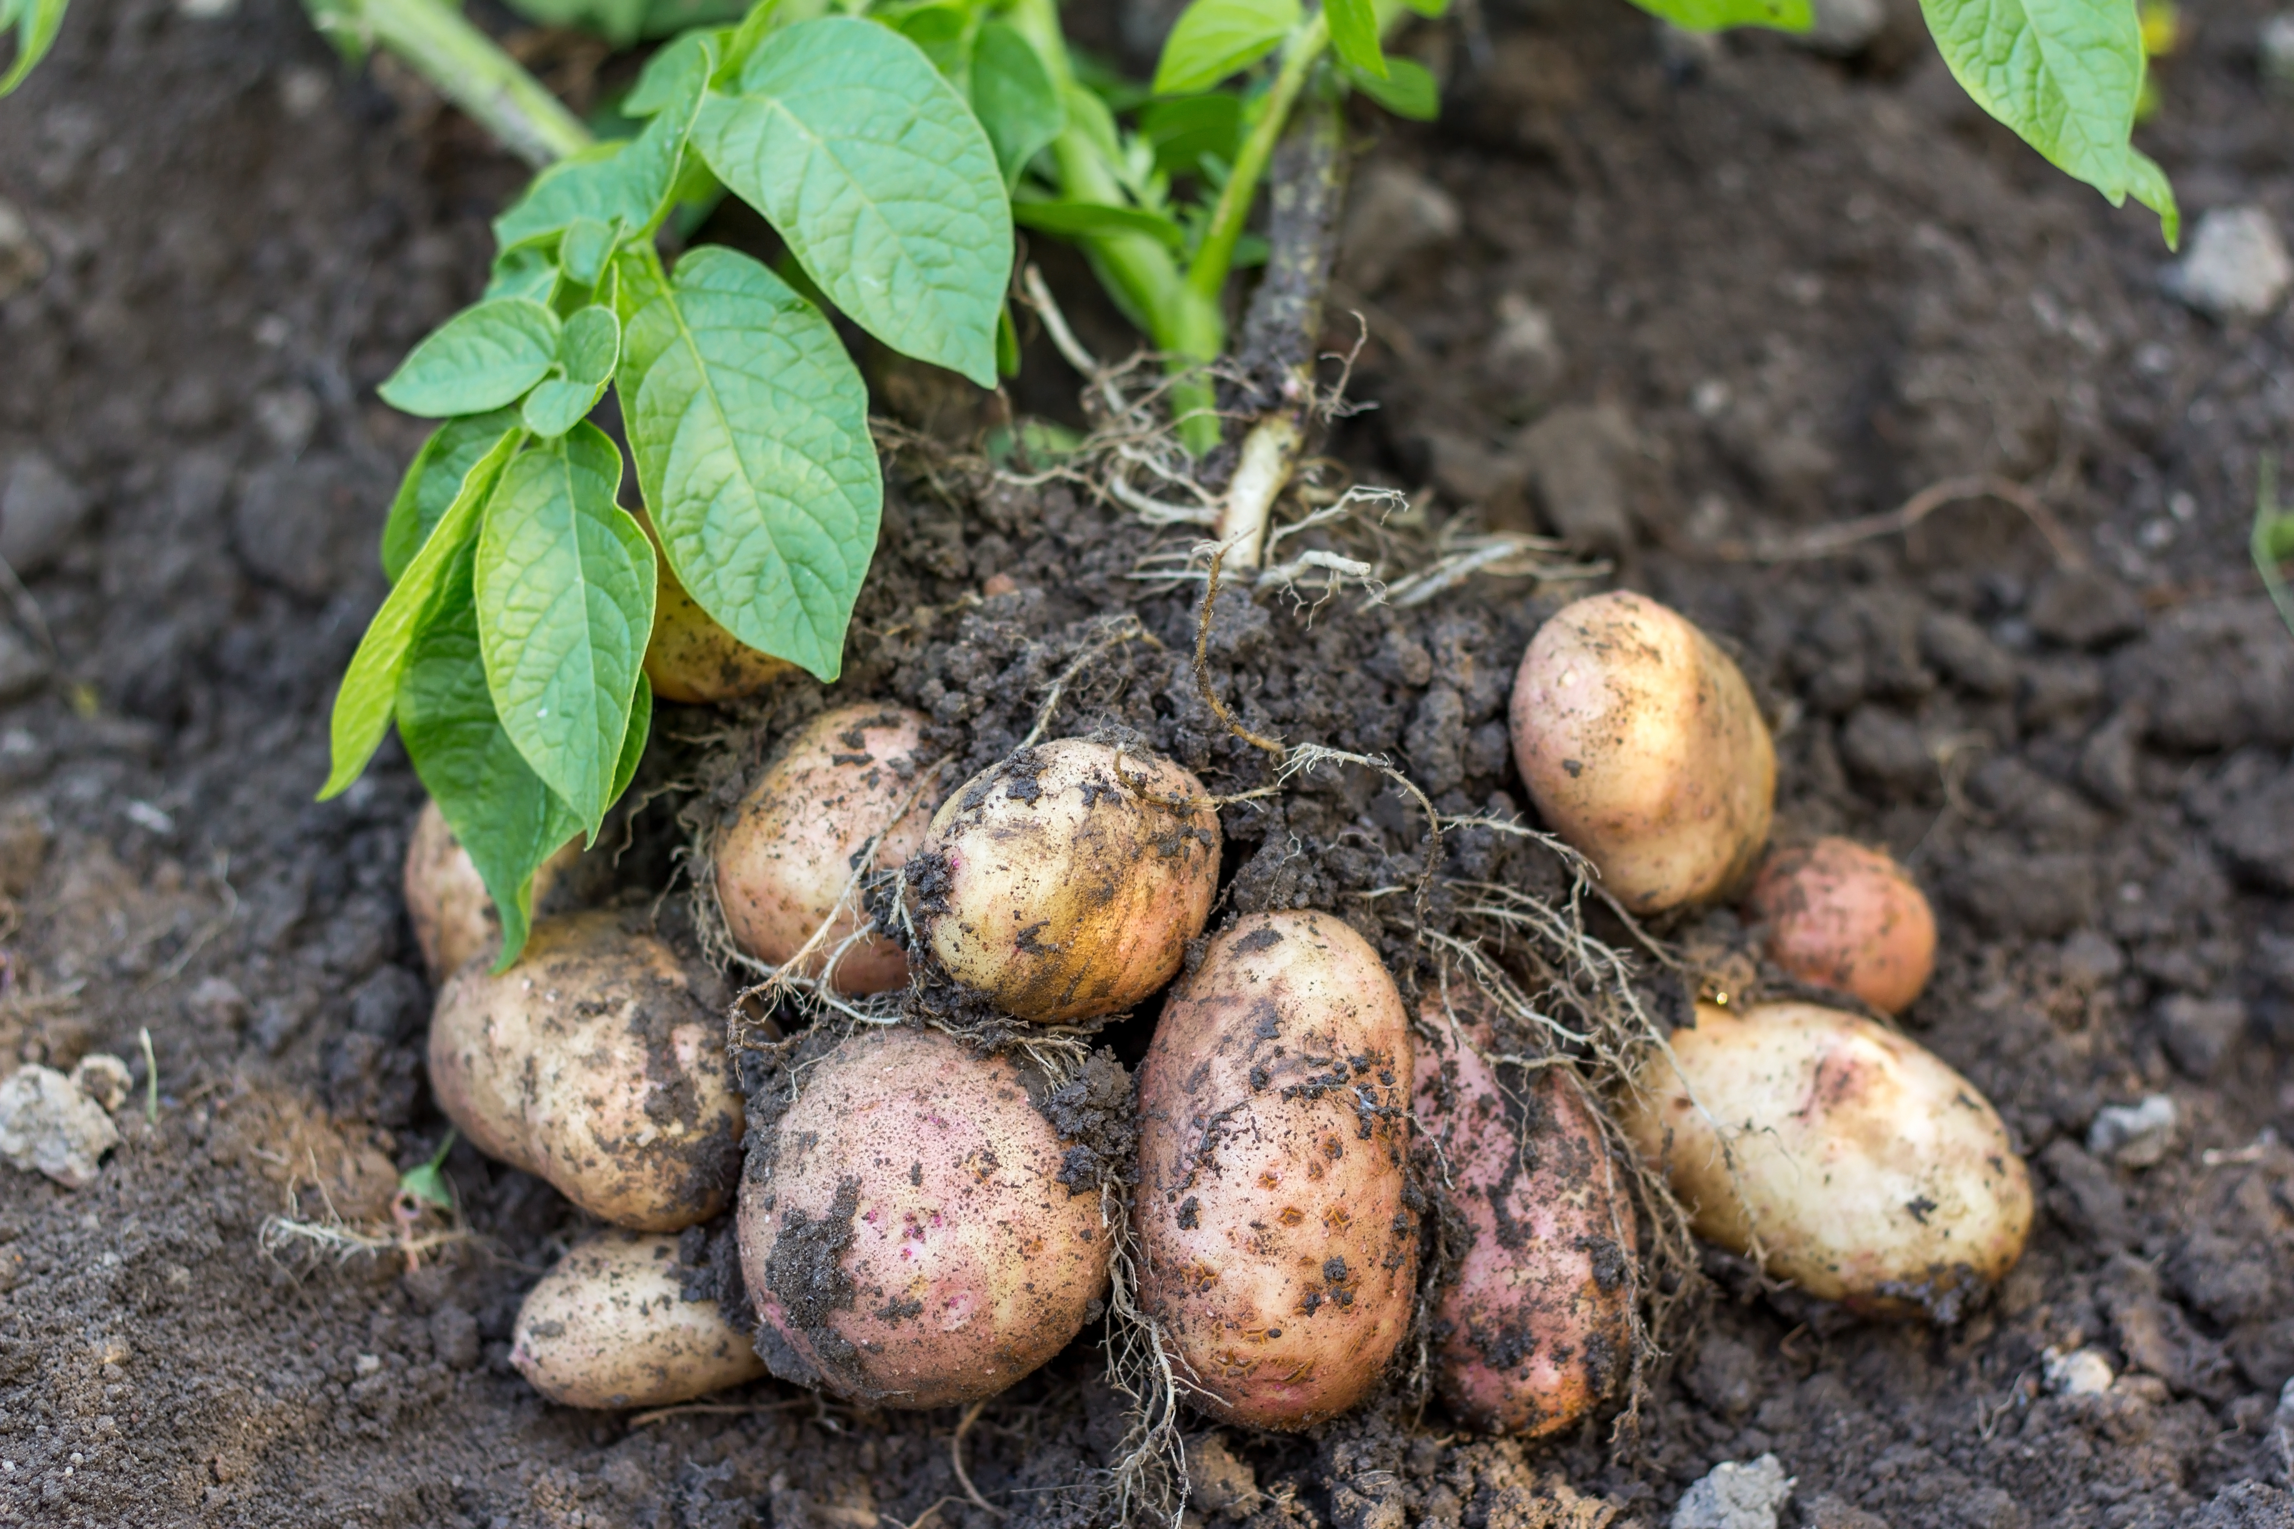
Malnutrition
However, chronic hunger and malnutrition were a problem for the majority of the population of the world including England, until the 19th century. Due to malnutrition, life expectancy in places like England was about 35 years.
The diet of poor people working in the towns consisted of potatoes, bread and tea, with milk and sugar once a week and an occasional piece of bacon.

Slide 9

Food adulteration
Adulteration is the process by which the quality or nature of a food is reduced by the addition of a foreign substance and the removal of a vital element.
As there was a need for cheap food, nearly all food at this time was adulterated to make it go further. For example, oak leaves were added to tea and roasted corn was added to coffee.
Eventually legislation was introduced to prohibit adulteration and set standards for food products.

Slide 10
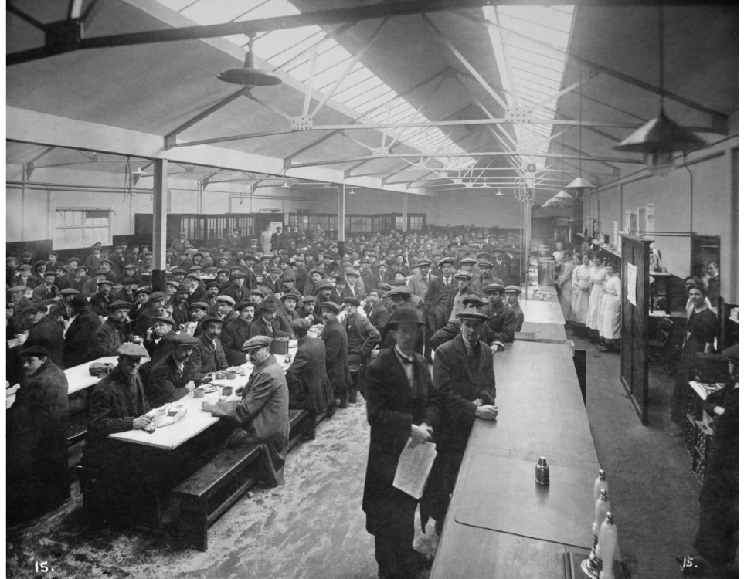
The war years
The diet of most people hardly changed until the outbreak of war in 1914. At this time workers in the munitions factories were very important, and the need for adequate nutrition was recognised.
By the end of the war there were a thousand industrial canteens supplying a million meals a day.
For the first time workers in industry were provided with hot, well cooked meals at reasonable prices.

Slide 11
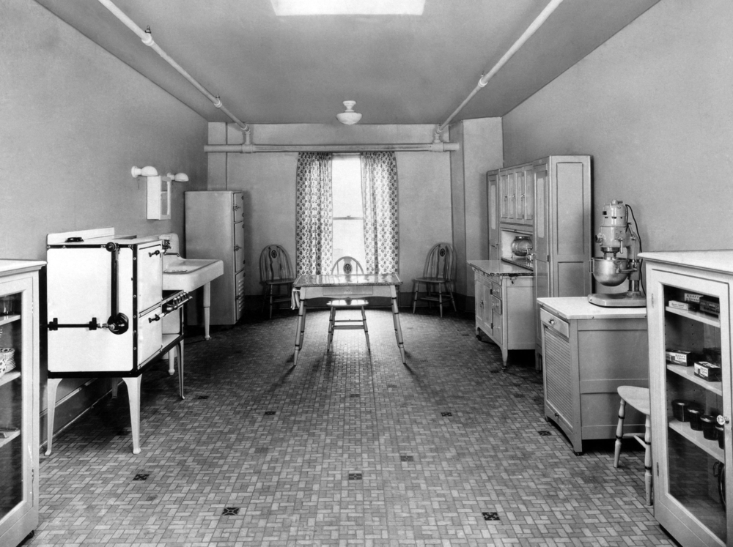
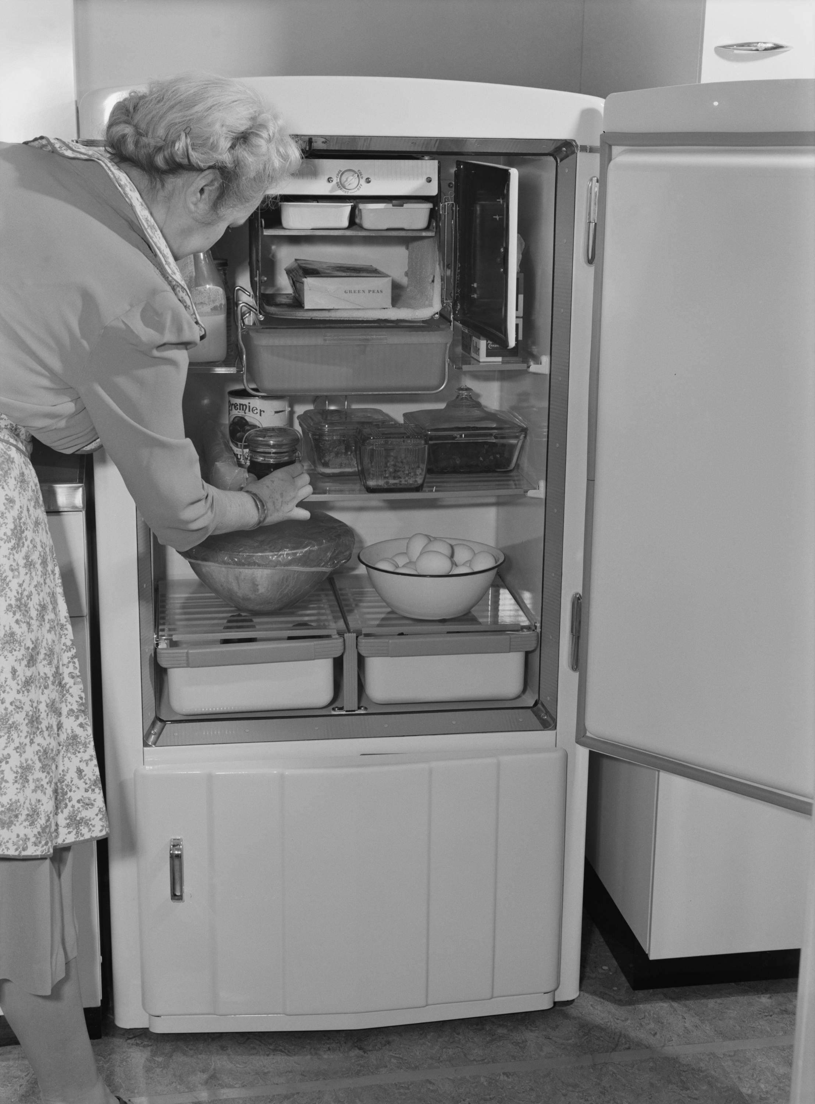
After the war
There was a period of intense trading in food-stuffs. For the first time people could eat fresh fruit in winter and much food started to come packaged under brand names that soon became familiar.
The need for cooking in the home was reduced by the availability of processed foods, which as well as improving convenience, also provided consumers with far greater choice.
1920s kitchen
1940s fridge

Slide 12
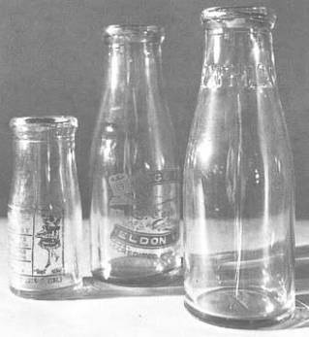
Food science
Many of the developments that followed relied on the food science and technology expertise that had been generated by the war.
Much more was learnt about food manufacture and preservation, and industrial food manufacture became established.

Slide 13
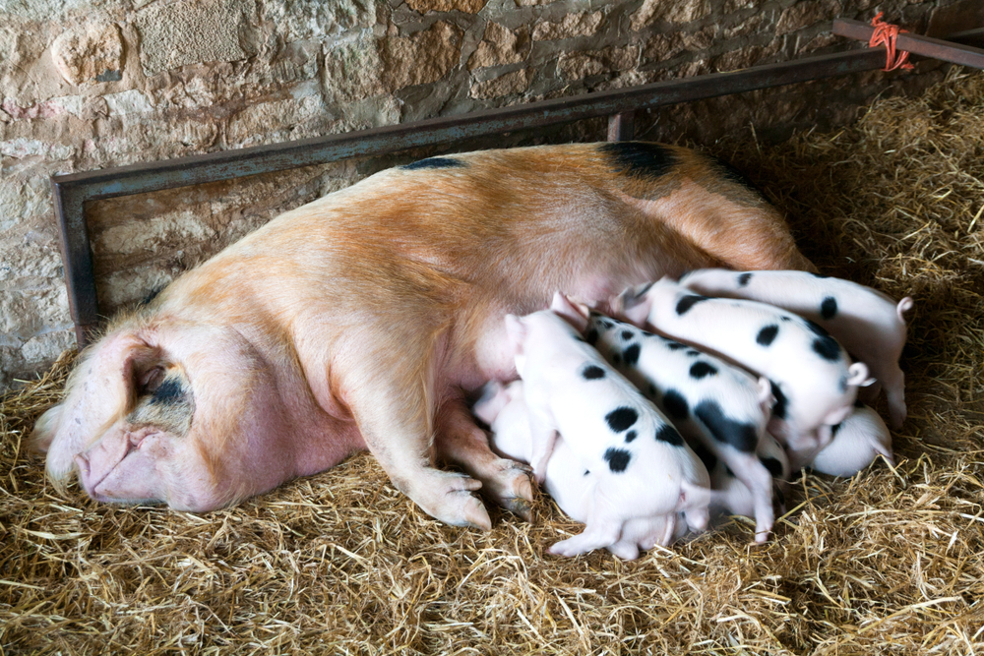
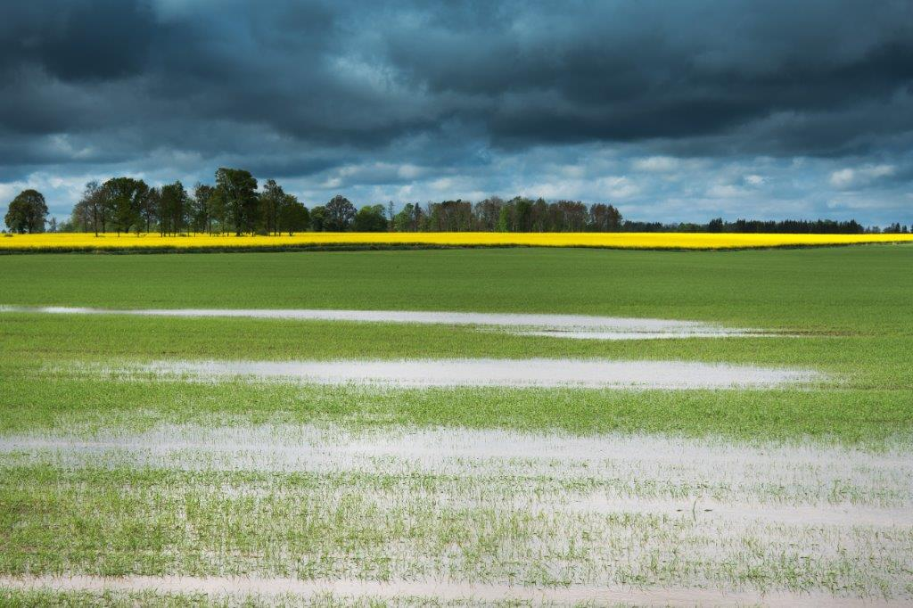
Factors affecting food technology
Today, factors affecting food technology include:
domestication of animals and crops;
preservation methods;
development of villages and towns;
changes of land ownership;
transport and travel (national, European, worldwide & space)
war;
religion and culture;
famine;
drought, flood, disease.

Slide 14
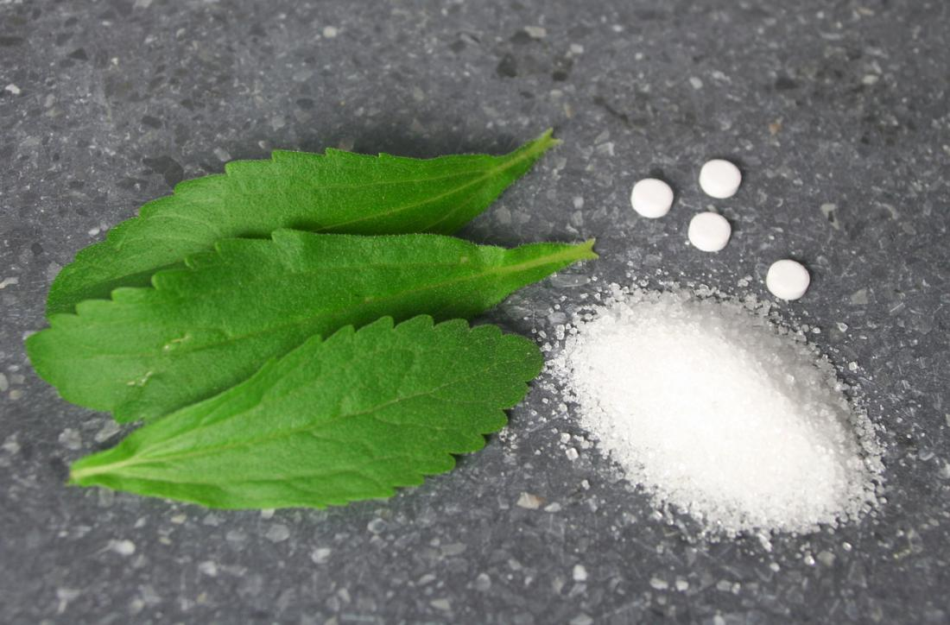
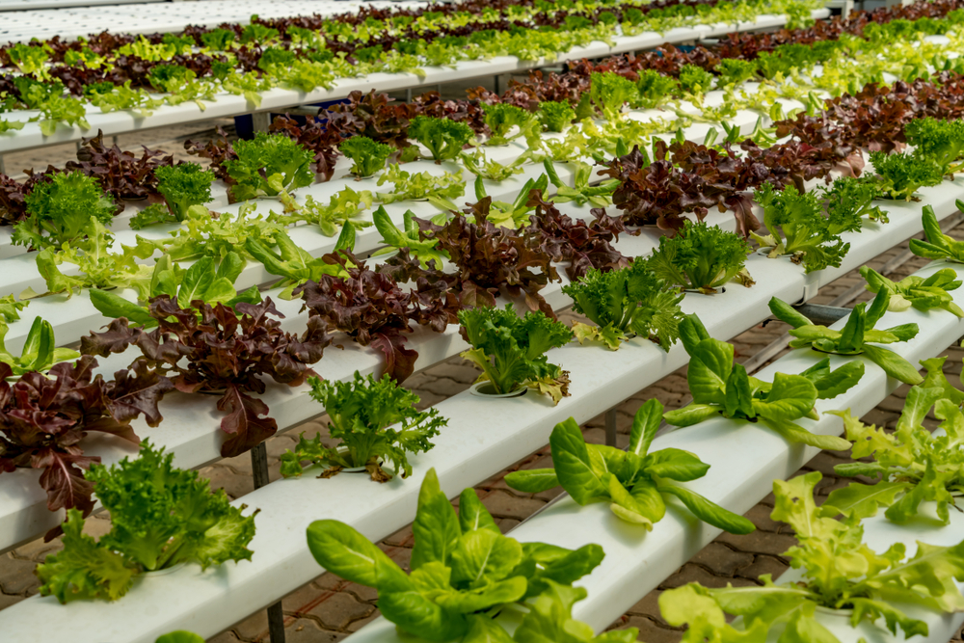
Factors affecting food technology
Today, factors affecting food technology also include:
mechanisation;
electricity;
discovery and use of raw materials;
understanding of scientific principles;
research and development of food ingredients;
increasing technological capabilities;
economic understanding and trade;
changes in society, e.g. the changing role of women;
changes in retailing.
Stevia – used to sweeten food
Hydroponics – growing lettuces

Slide 15
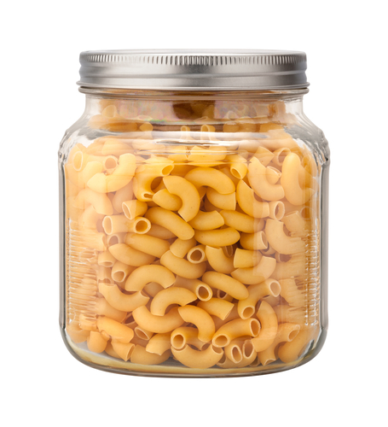
The last 50 years
A number of major developments since World War II have changed the way in which food is produced and manufactured today.
These include:
developments in technology, which has allowed advances in food processing, such as freeze drying and extrusion, and introduced ‘new’ food ingredients, such as textured vegetables protein (TVP) and myco-protein;
the increase in the use of biotechnology and nanotechnology.
Macaroni is produced by extrusion

Slide 16
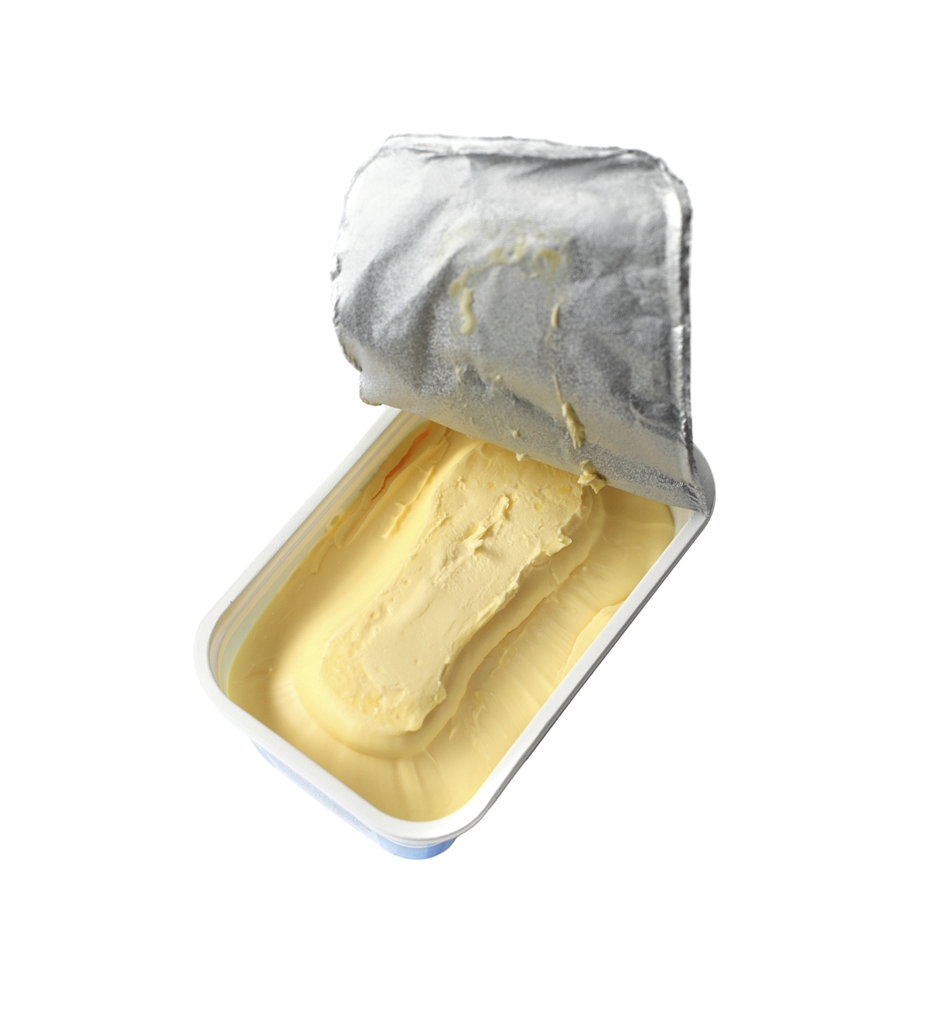
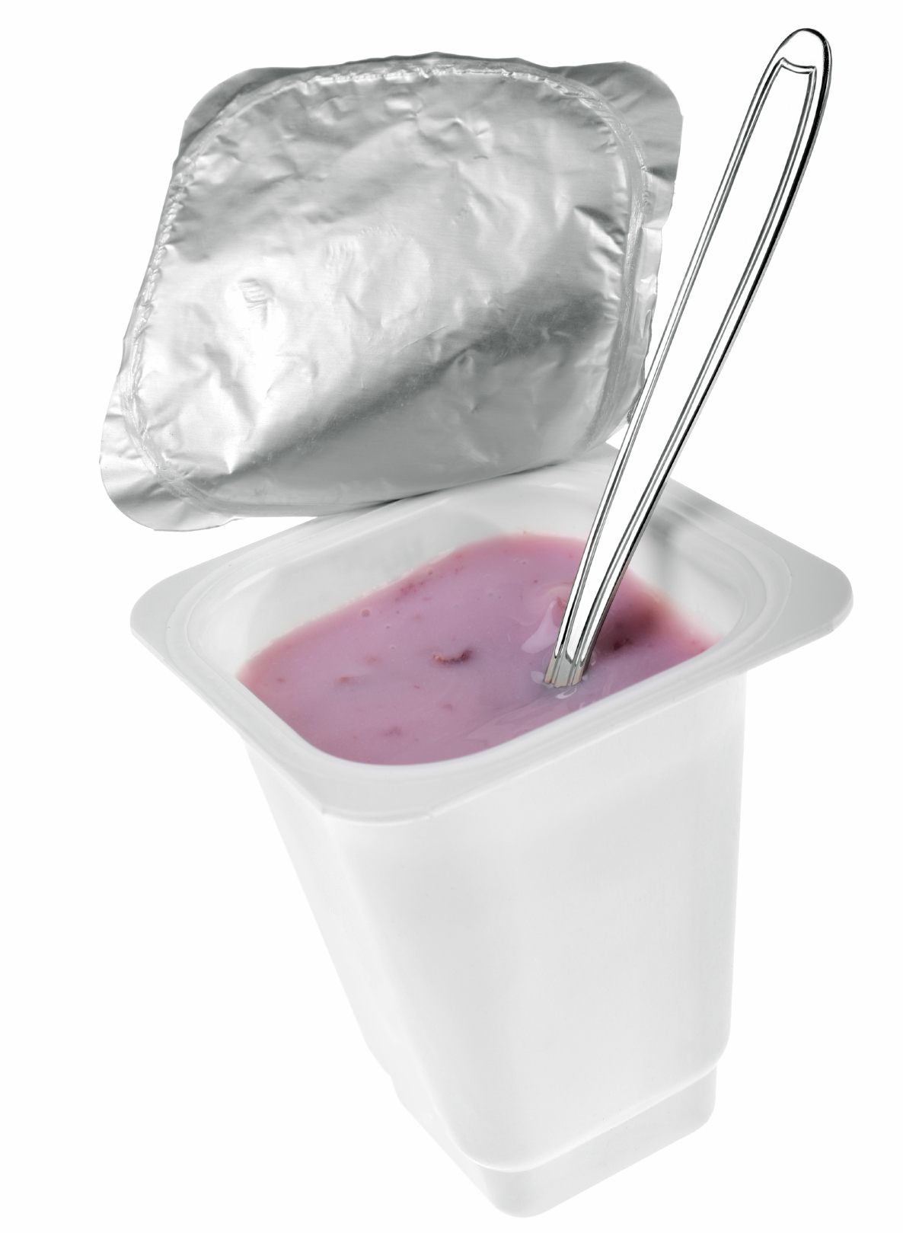
The last 50 years
Developments also include:
greater consumer awareness of nutrition, diet and health which has led to new areas of food manufacture, and the formulation of food products with modified nutritional composition, for example, reduced fat spreads, reduced fat dairy products and low-calorie drinks;
the modification of ingredients;
concern for the welfare of animals and humans in food production, which has also influenced the types of foods available and how they are produced.

Slide 17
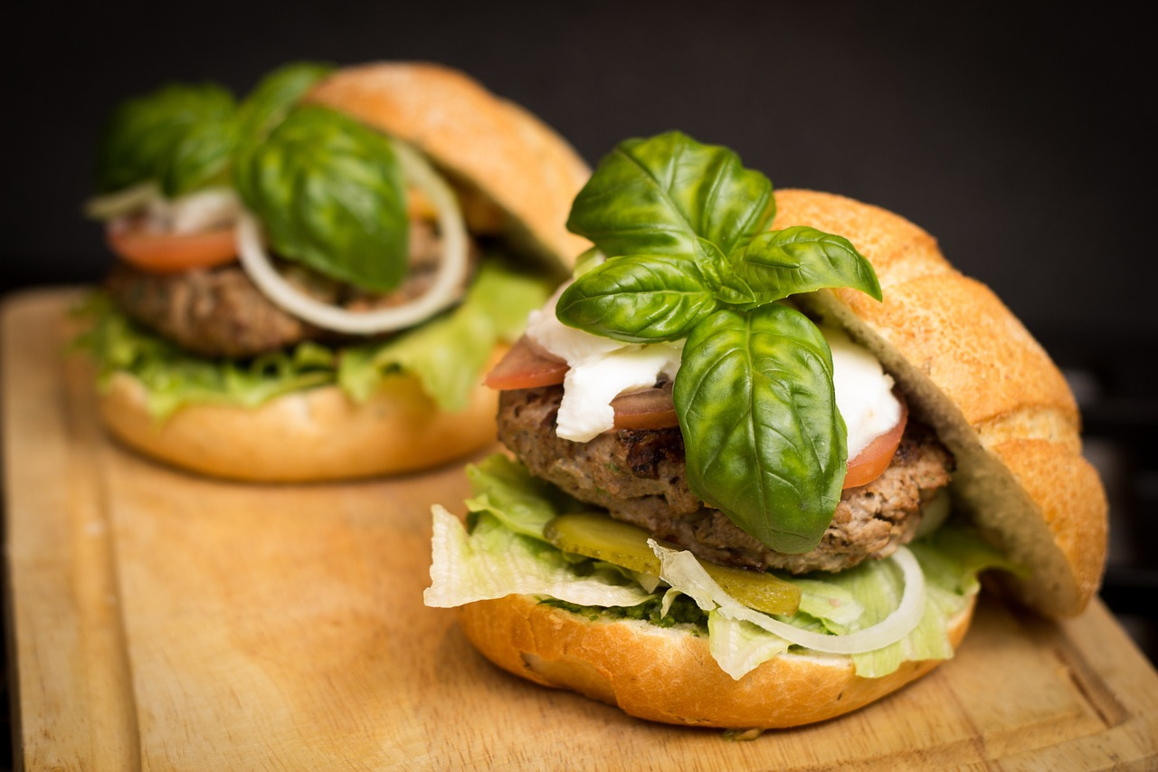
The future
Six key technology areas have been identified by the Food Standards Agency as the most likely to have an impact on the UK food system and food safety over the coming decade. These include new ways to produce and process food, like indoor farming and 3D printing, and finding creative uses for leftover parts.
There's also interest in alternative protein sources, like insects, and lab-grown meat. Advancements in Synthetic Biology are changing how we make food, especially with lab-grown meat. Both will help support the growing trend of reducing meat in the diet.
Food Standards Agency 2021

Slide 18

The future
Meanwhile, using genetics helps ensure food safety and can even tailor diets to individuals. On the packaging front, new ideas like smart, biodegradable, and reusable materials are being explored to keep food fresh and reduce waste.
Lastly, digital tools are becoming essential in the food industry for analysing data, making decisions, and tracking products throughout their journey from farm to table.
Food Standards Agency 2021

Slide 19
Development of food technology
For further information, go to:
www.foodafactoflife.org.uk
This resource meets the Guidelines for producers and users of school education resources about food.

