Slide 1
Processing food to make it edible and safe

Slide 2
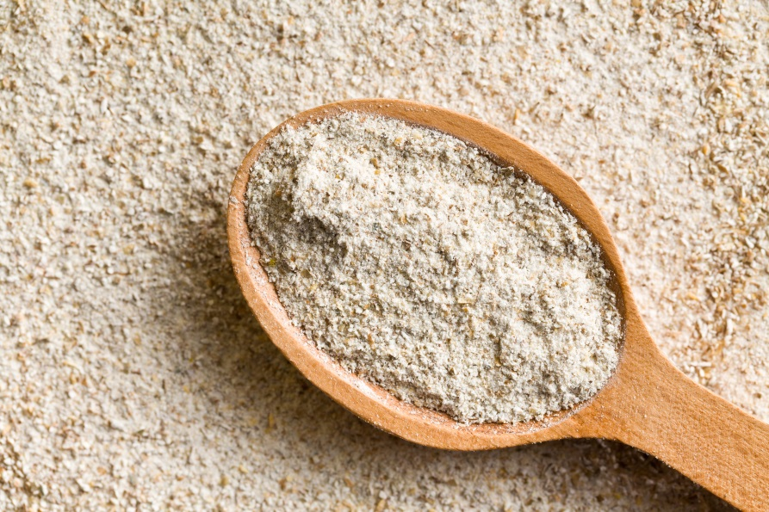
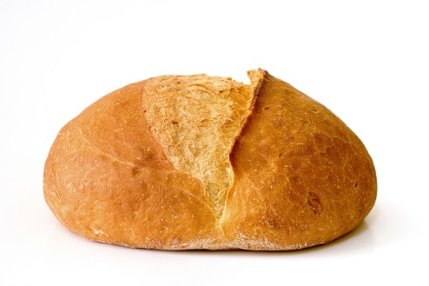
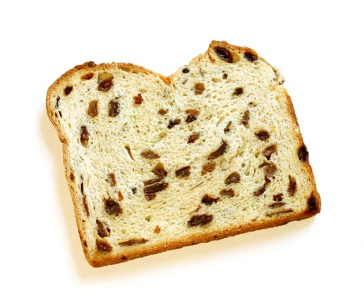
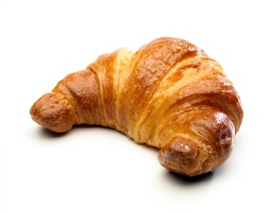
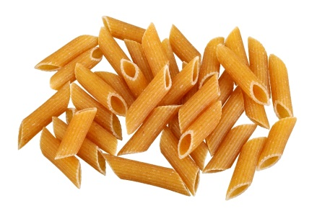
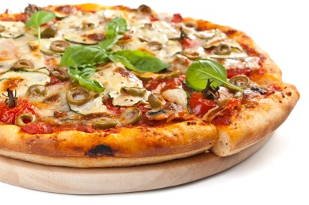
Flour
Can we eat this?
What do we have to do before we can eat it?
Name five dishes which can be made with flour.
Combine with other ingredients
Cook (bake, boil or steam)

Slide 3
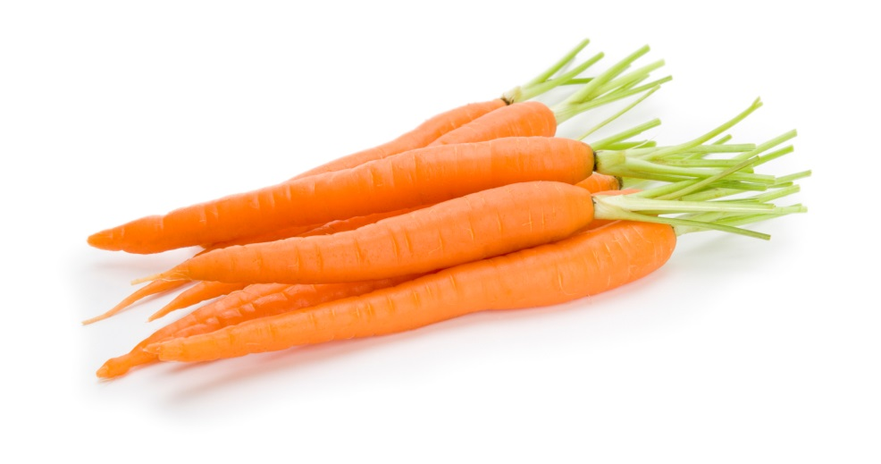
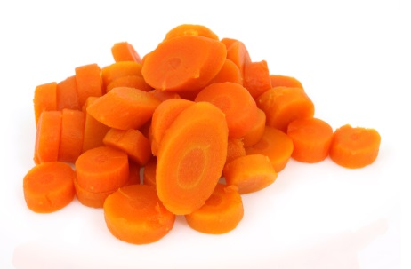
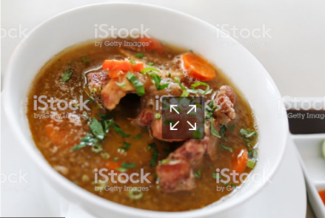
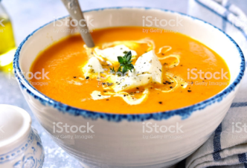
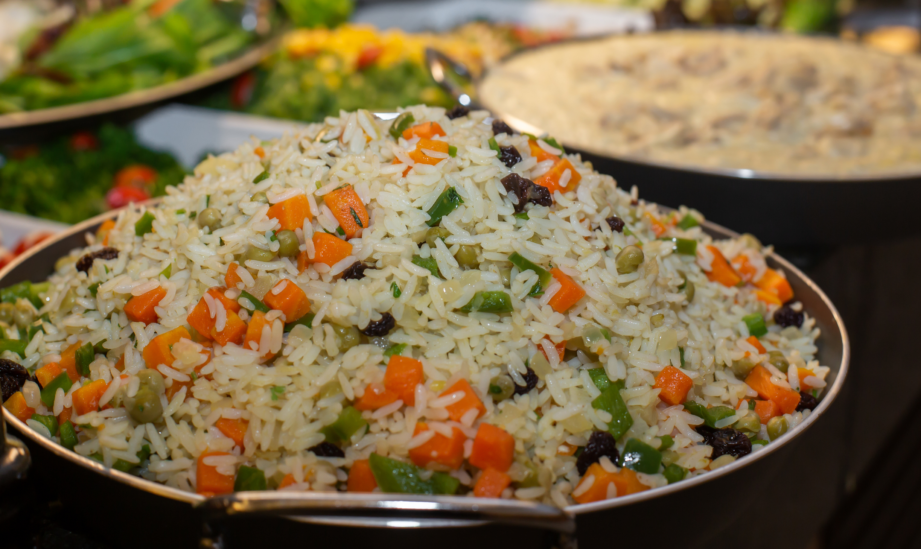
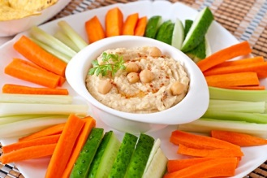
Carrots
Can we eat these?
What do we have to do before we can eat it?
Name five dishes which can be made with carrots.
Wash
Peel
Remove the ‘top’ and ‘tail’
Eat raw or cook (boil, steam, roast)

Slide 4
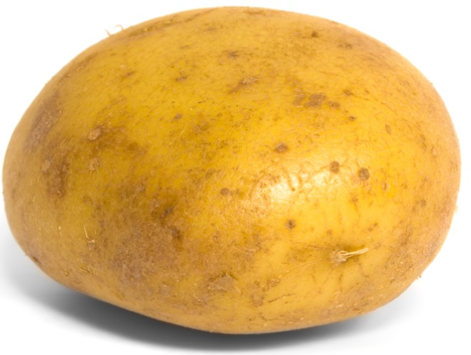
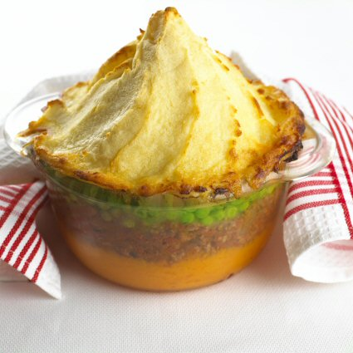
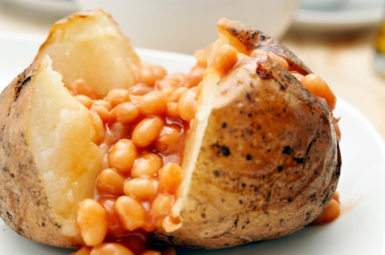
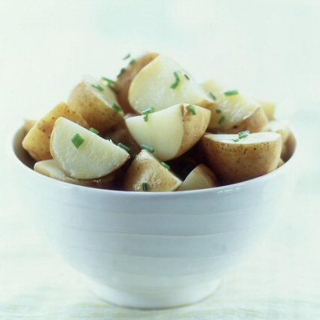
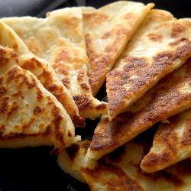
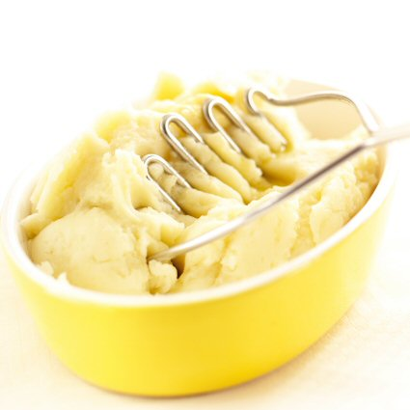
Potato
Can we eat this?
What do we have to do before we can eat it?
Name five dishes which can be made with potatoes.
Wash
They can be peeled
They can be cut into smaller pieces
Cook (boil, steam, roast, fry)

Slide 5
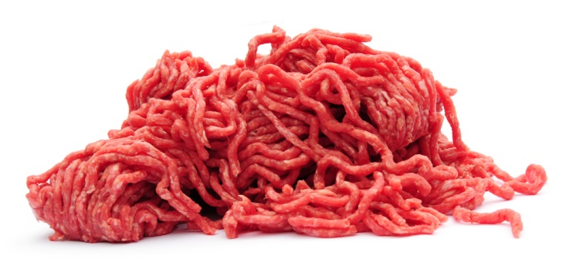
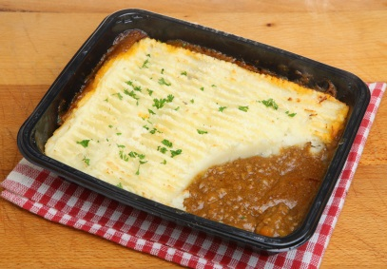
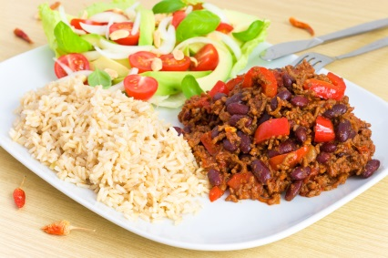
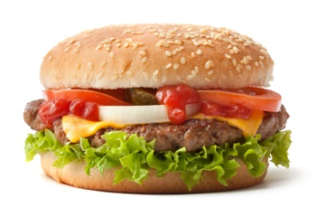
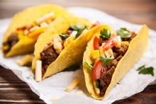
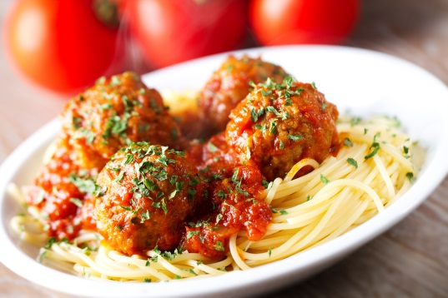
Beef
Can we eat this?
What do we have to do before we can eat it?
Name five dishes which can be made with beef.
Combine with other ingredients
Cook
Make sure there is no ‘pink’

Slide 6
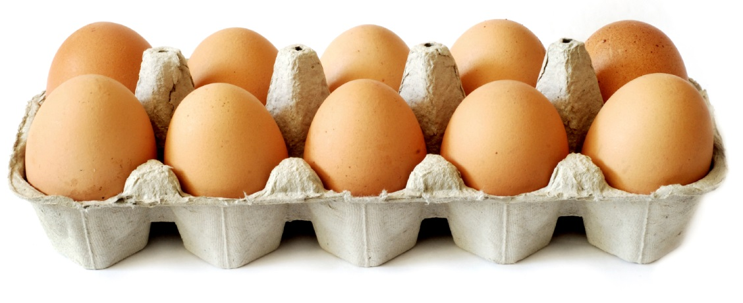
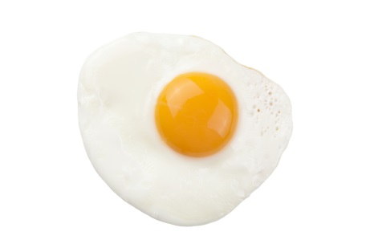
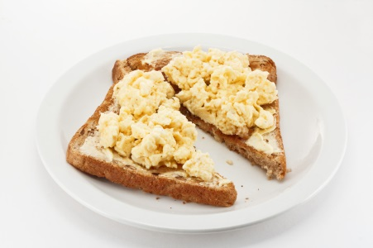
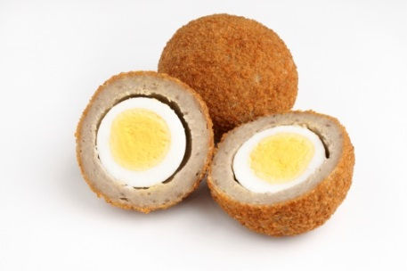
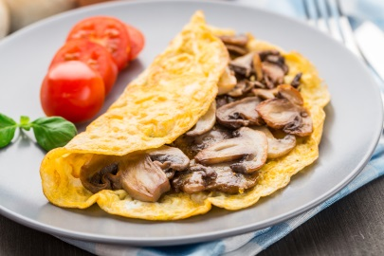
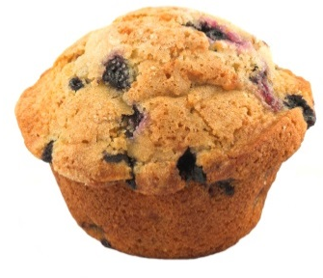
Eggs
Can we eat these?
What do we have to do before we can eat them?
Name five dishes which can be made with flour.
Crack the egg
Cook
Some people prefer the ‘yolk’ to be runny, others hard

Slide 7
Processing food to make it edible and safe
For further information, go to:
www.foodafactoflife.org.uk
This resource meets the Guidelines for producers and users of school education resources about food.

