Slide 1
Eat well

Slide 2
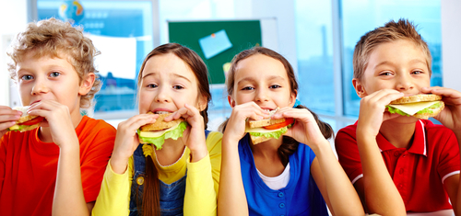
Healthy eating
We all need a healthy, balance and varied diet.
We need a range of different foods and drinks.
We all need to eat well.

Slide 3
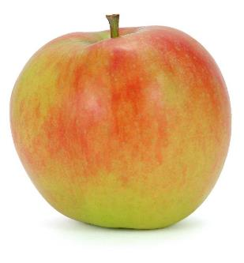
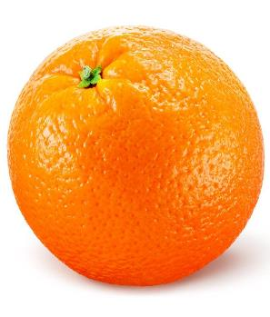
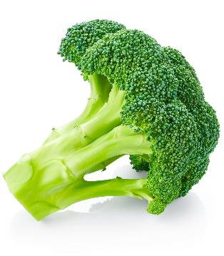
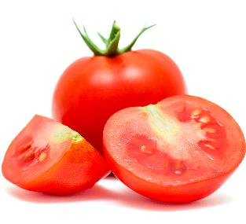
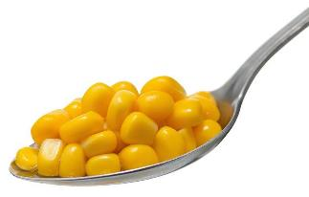
5 A DAY
Have at least 5 fruit and vegetables each day.
1
2
3
4
5
apple
orange
broccoli
sweetcorn
tomatoes

Slide 4
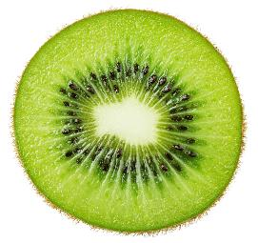
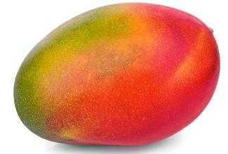
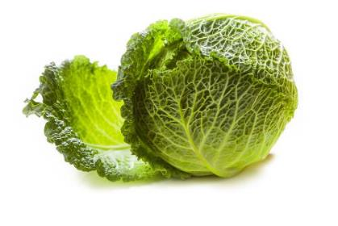
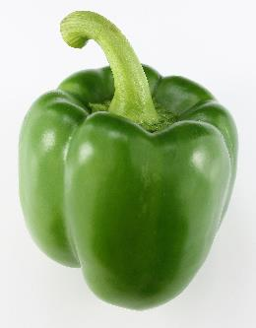
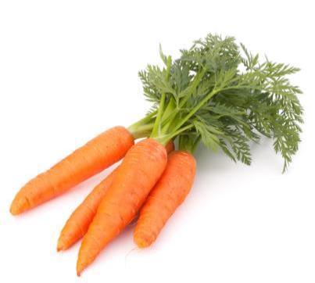
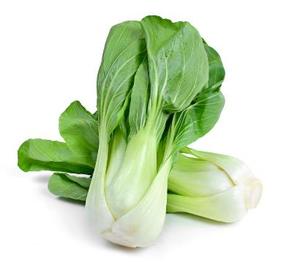
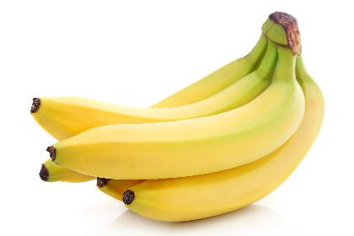
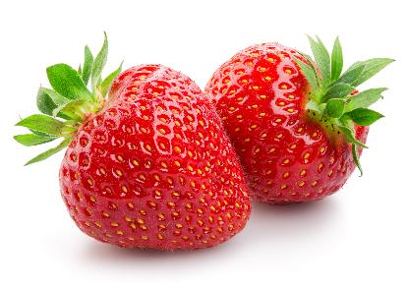
5 A DAY - fresh
Fresh fruit and vegetables include:

Slide 5
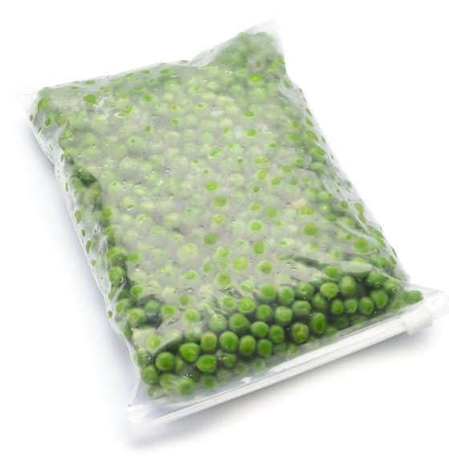
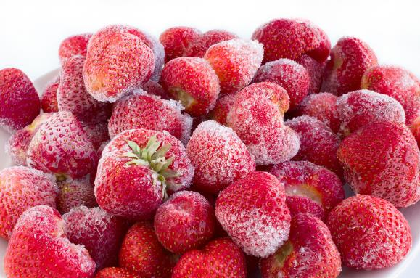
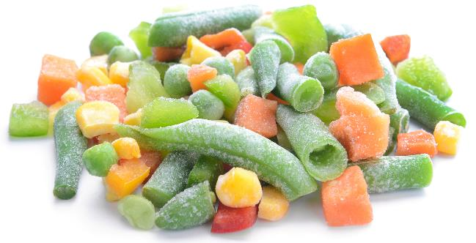
5 A DAY - frozen
Frozen fruit and vegetables include:

Slide 6
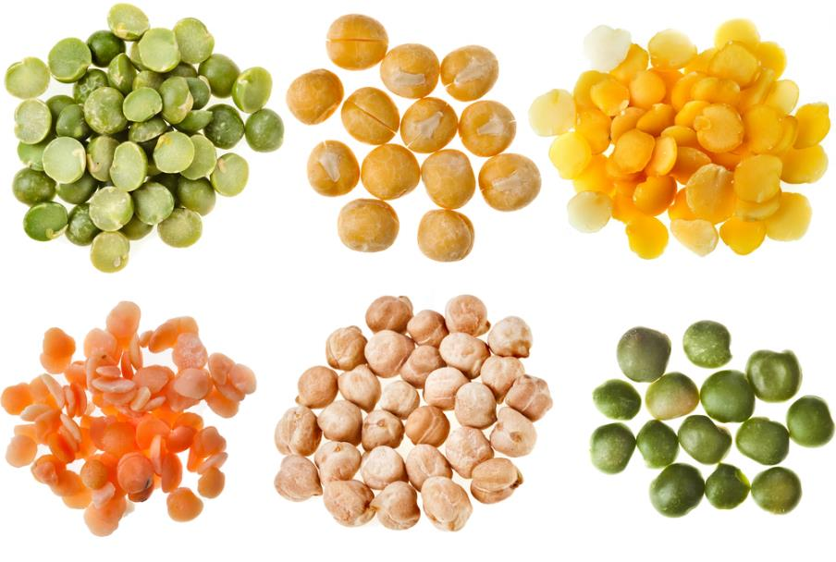
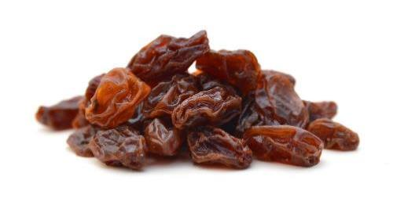
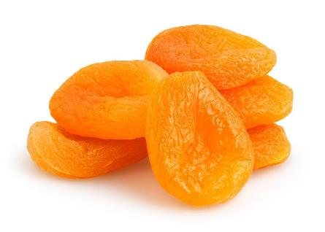
5 A DAY - dried
Dried fruit and vegetables include:

Slide 7
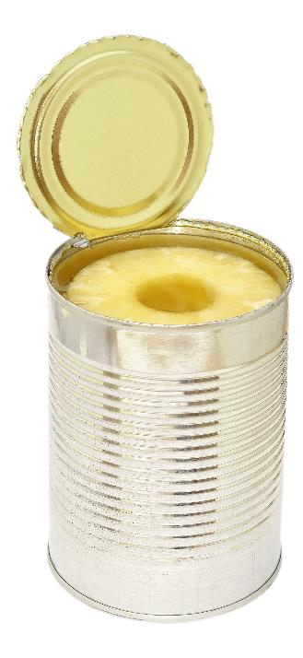
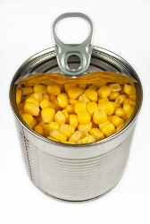
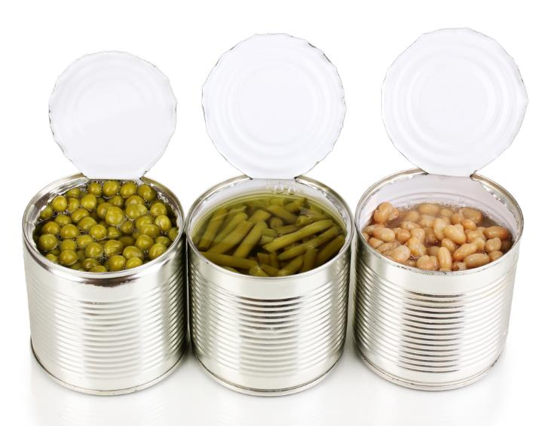
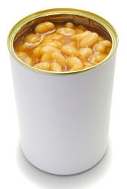
5 A DAY - canned
Canned fruit and vegetables include:

Slide 8
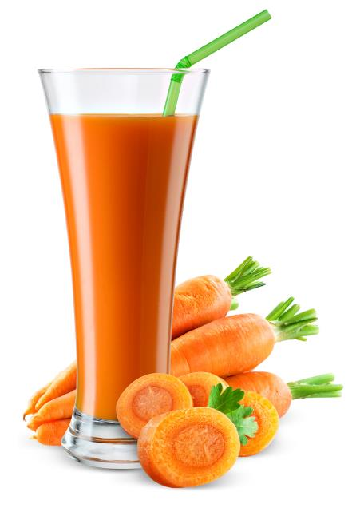
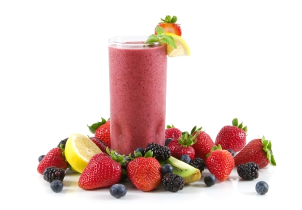

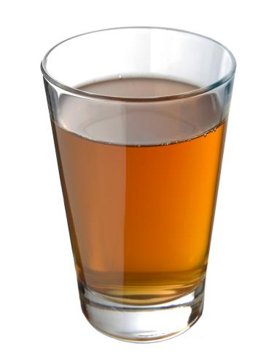
5 A DAY - juiced
Juiced fruit and vegetables include:

Slide 9
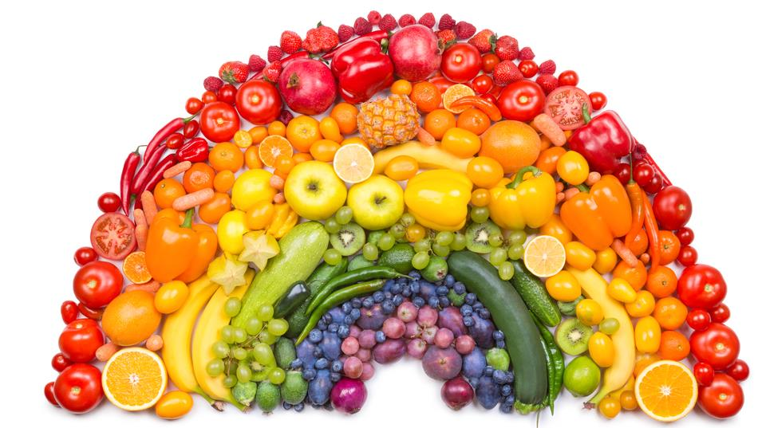
Eat a rainbow
Eat a variety of fruit and vegetables – eat a rainbow!

Slide 10
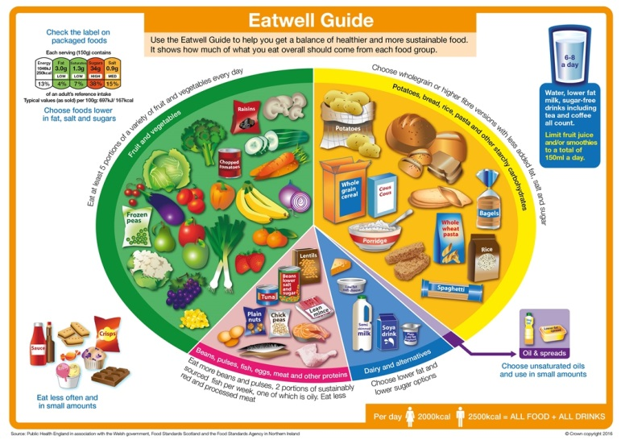
The Eatwell Guide
We need a balance and variety of food and drink.
The Eatwell Guide shows how much of what you eat should come from each food group.

Slide 11
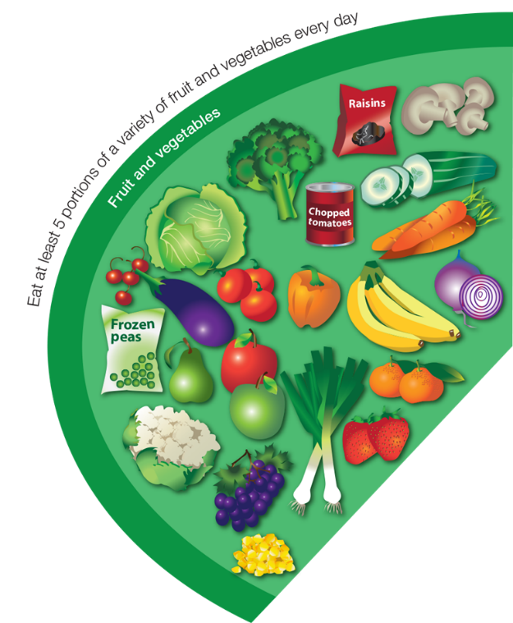




















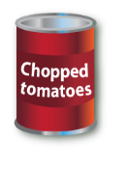
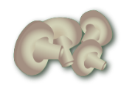
Fruit and vegetables
Eat at least 5 portions of a variety of fruit and vegetables every day.

Slide 12
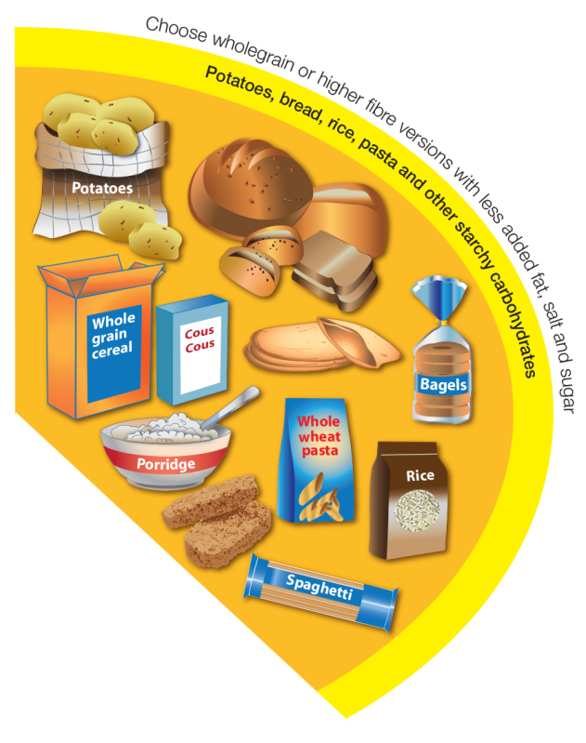
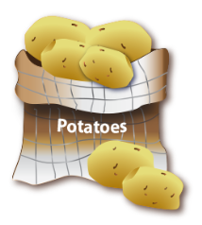
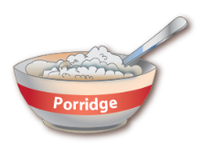



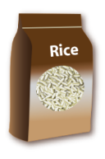




Potatoes, bread, rice and pasta
Base meals on potatoes, bread, rice, pasta or other starchy carbohydrates; choosing wholegrain versions where possible.

Slide 13
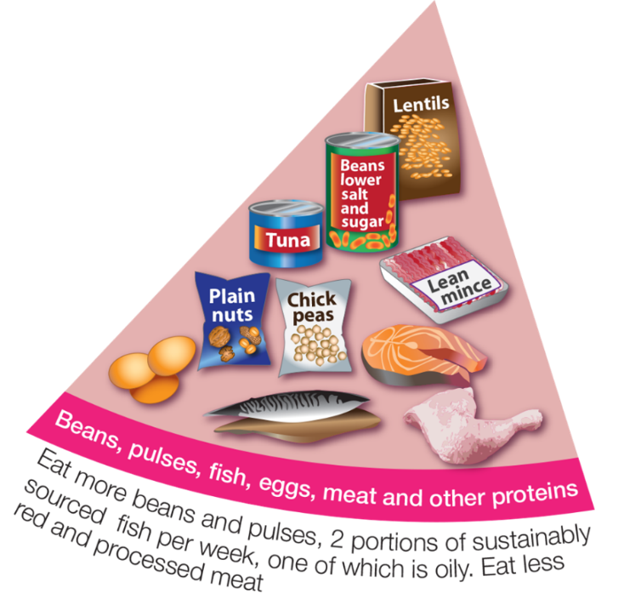









Beans, pulses, fish, eggs and meat
Eat some beans, pulses, fish, eggs, meat and other proteins (including 2 portions of fish every week, one of which should be oily).

Slide 14
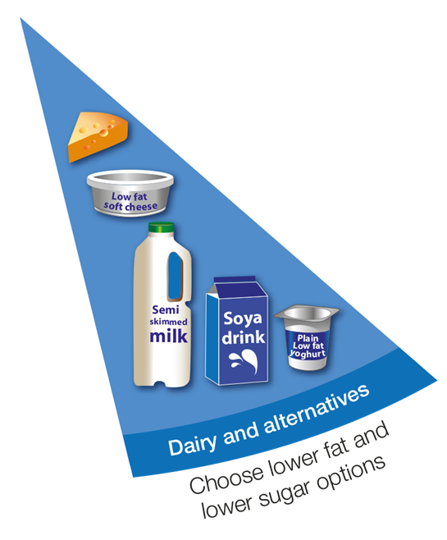





Dairy and alternatives
Have some dairy or dairy alternatives (such as soya drinks); choosing lower fat and lower sugar options.

Slide 15
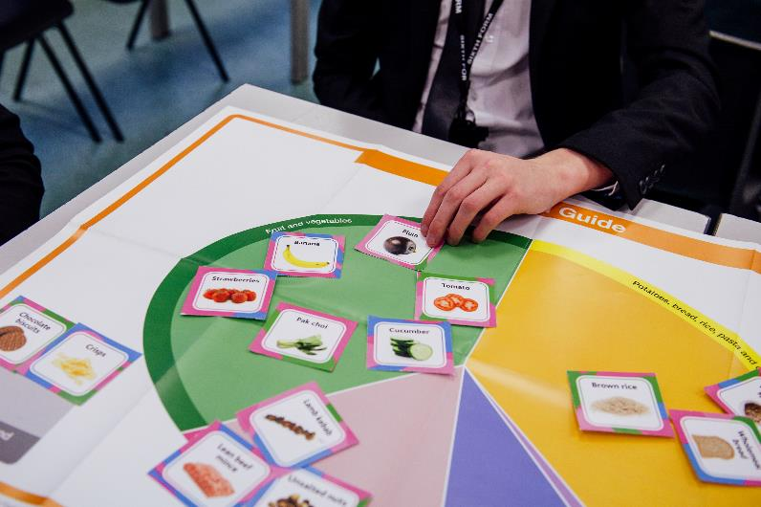
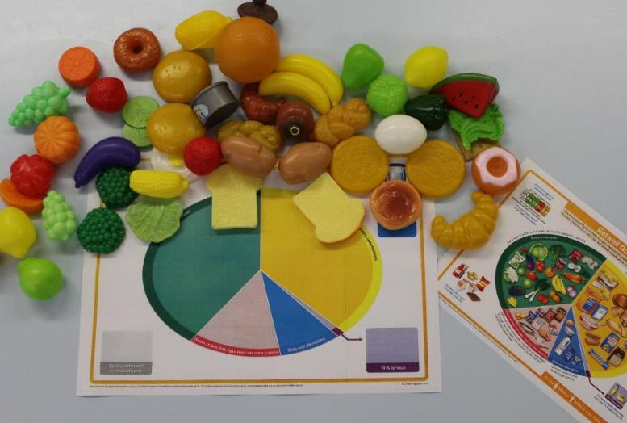
The Eatwell Guide
Place the foods in to the correct food groups.

Slide 16
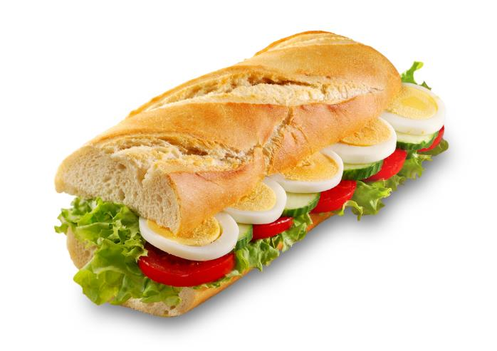
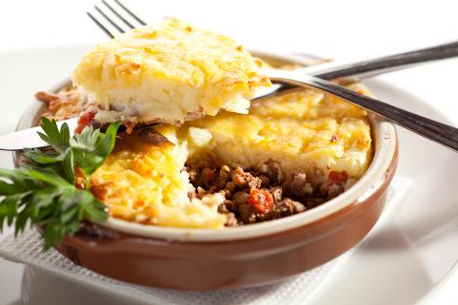
Meals and snacks
We do not eat separate foods at every meal, as shown on the Eatwell Guide.
Foods are prepared and cooked (with other foods) to make meals and snacks.

Slide 17


Meals and snacks – egg and salad roll
bread
egg
tomato
lettuce

Slide 18

Meals and snacks – cottage pie
potato
beef
carrot
onion

Slide 19




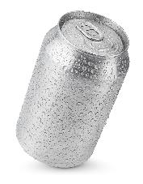
Drink plenty
Have 6-8 drinks every day.
1
2
3
4
water
tea
juice
water
5
6
7
8
milk
diet lemonade
water
water

Slide 20
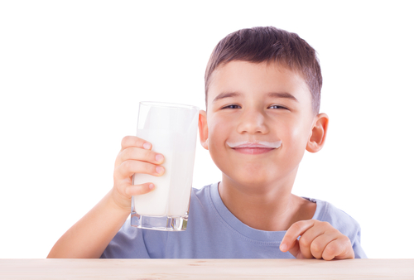
Drink plenty
Water, lower fat milk and sugar-free drinks including tea and coffee all count.
Fruit juice and smoothies also count – a max of 150ml in a day.
Swap sugary soft drinks for diet, sugar-free or no added sugar varieties.

Slide 21
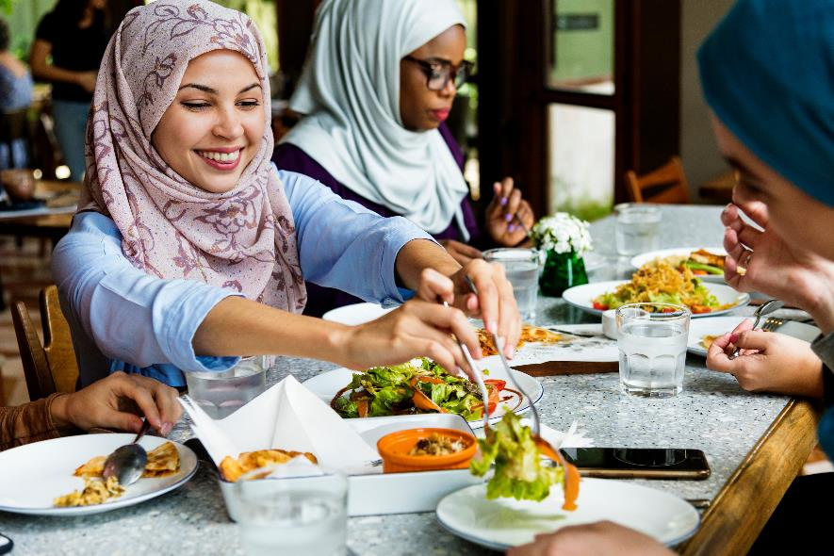
Is it balanced?
We need to have a healthy, balanced and varied diet.
Make sure your meals are balanced and have a variety of different foods.
Make sure you have a drink.

Slide 22
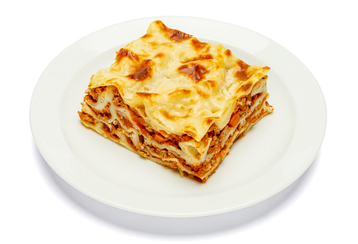
Is it balanced?
You could add …
vegetables or a salad
a drink

Slide 23
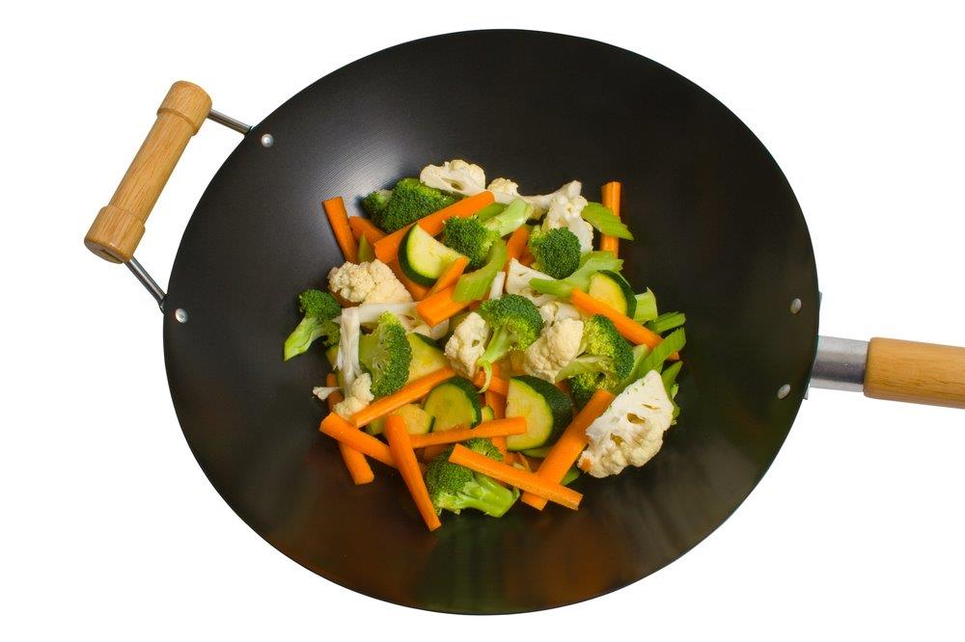
Is it balanced?
You could add …
rice or noodles
chicken, beef, tofu or Quorn
a drink

Slide 24
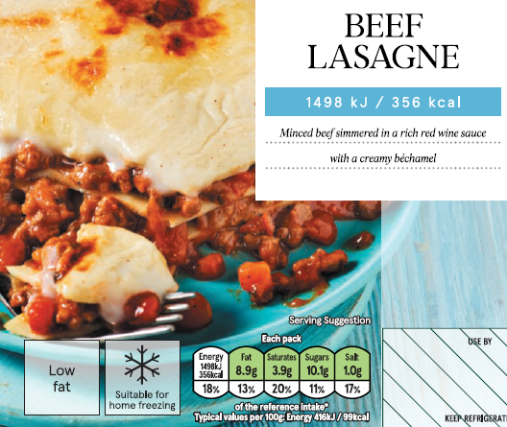
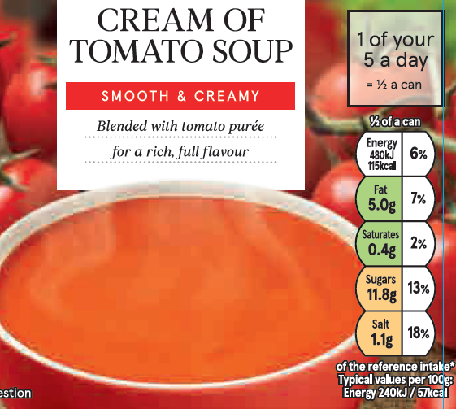
Read the label
Labels can help us make a healthier choice.

Slide 25
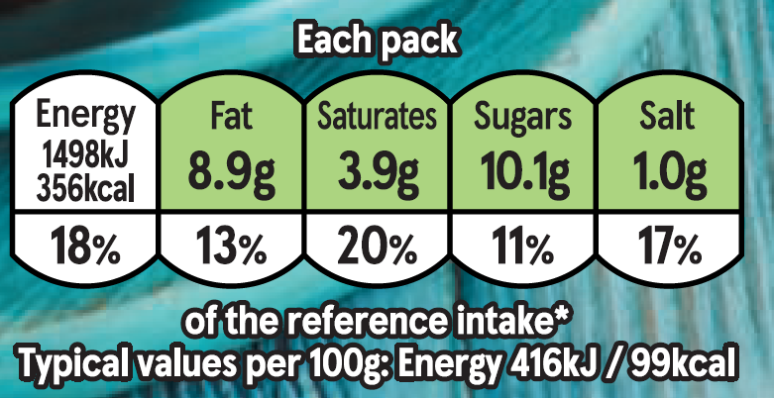

Read the label
Two lasagne dishes. Which is healthier?
Less energy
More ‘greens’

Slide 26

Read the label
Two soups. Which is healthier?
Less energy
More ‘greens’

Slide 27
Eat well
For further information, go to:
www.foodafactoflife.org.uk
This resource meets the Guidelines for producers and users of school education resources about food.

