Slide 1
Food spoilage

Slide 2
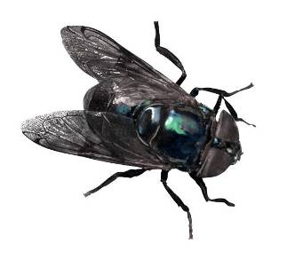
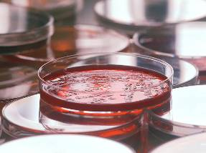
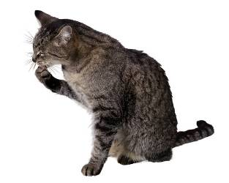
Food spoilage
Food can spoil and decay due to the action of:
microorganisms
insects
pests or pets

Slide 3
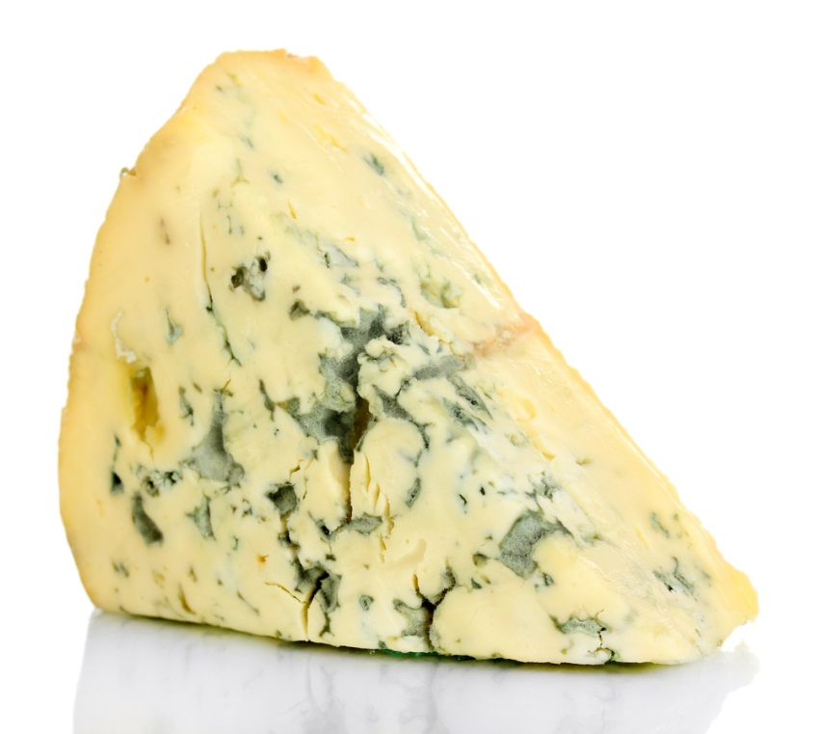
Food spoilage
Sometimes, food may spoil because of the changes in the food itself.

Slide 4
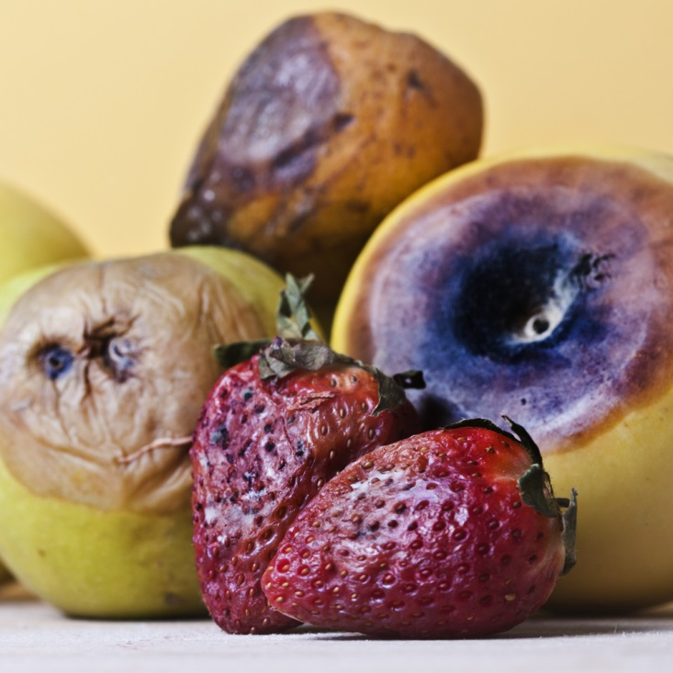
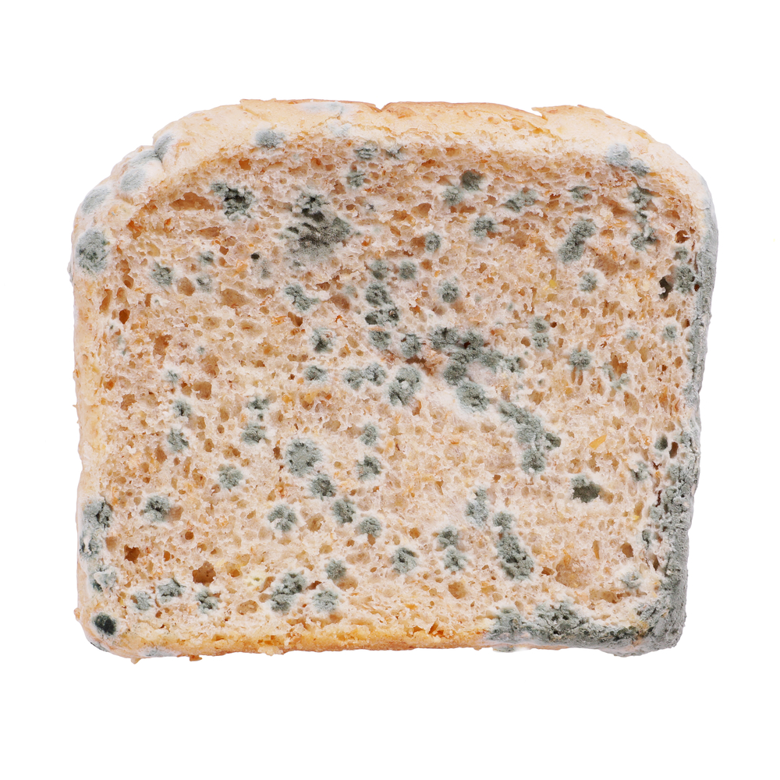
Food spoilage
When food spoils, the following may change:
appearance;
taste;
texture;
odour.
Food may become unsafe to eat.

Slide 5
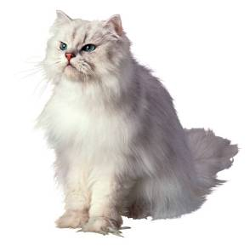
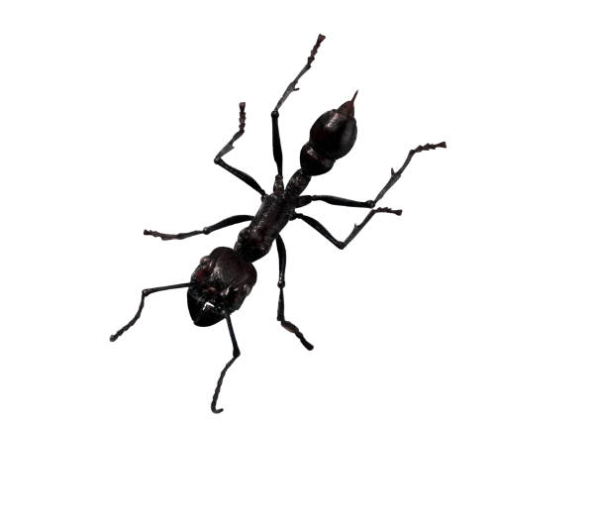
microorganisms
microorganisms are everywhere.
microorganisms can be carried by food, people, dirty equipment, animals and pests.
Most are harmless.

Slide 6
What are microorganisms?
microorganisms
Very small
Living things

Slide 7

Food poisoning
Food poisoning is caused by some of these microorganisms.
These are called food poisoning bacteria.

Slide 8
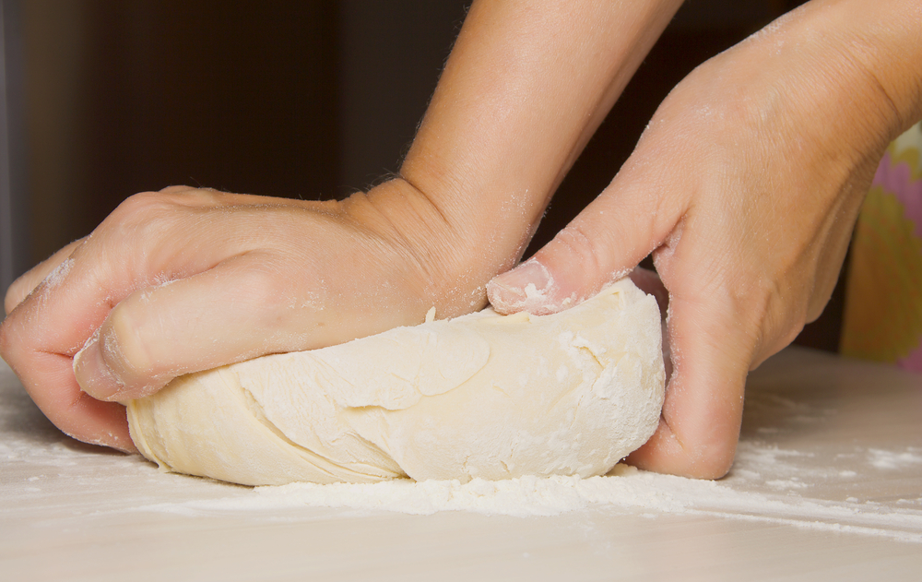
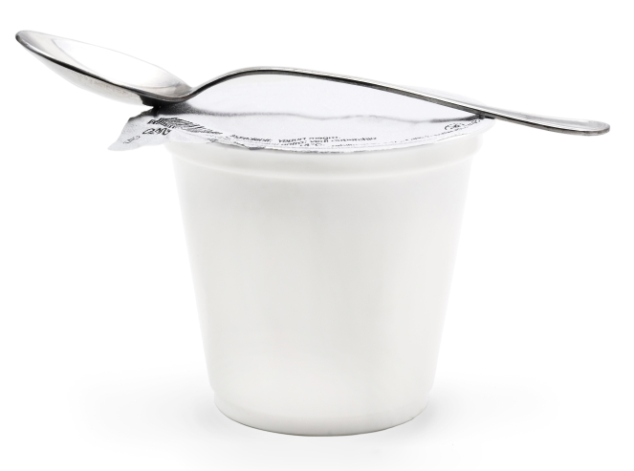
microorganisms
There are beneficial uses of some microorganisms.
Bread dough – raising agent.
Yogurt making – fermentation.

Slide 9
microorganisms
microorganisms need certain conditions to grow – this is why food needs to be stored properly.
microorganisms need:
warmth
food
time

Slide 10
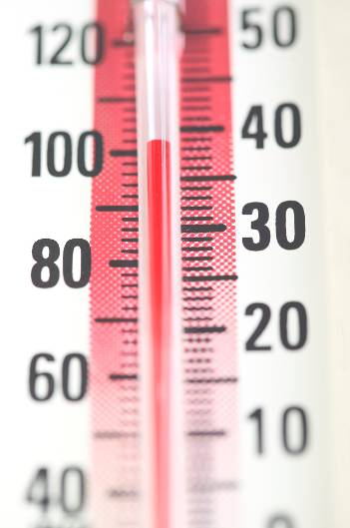
microorganisms
The ideal temperature for microorganisms is 5ºC to 63ºC.

Slide 11
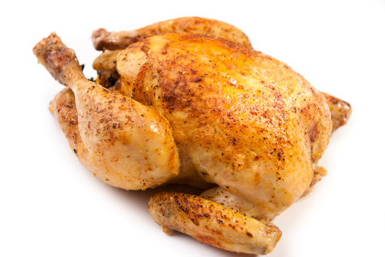
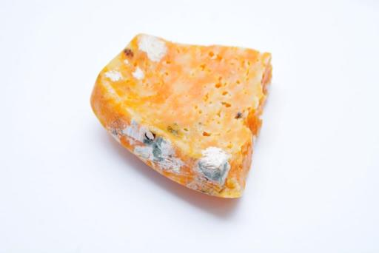
Food (and water)
The type of food is important.
Ready to eat foods, such as cooked meat and chicken or dairy foods, can support the growth of microbes.
They need to be stored properly, e.g. chilled.

Slide 12
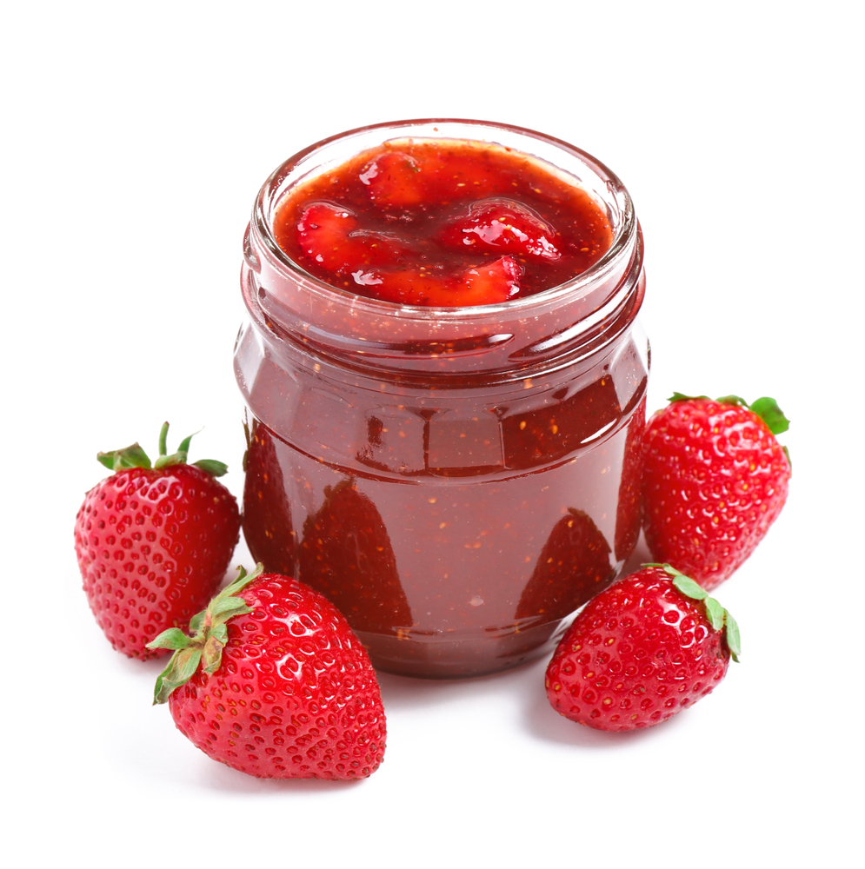
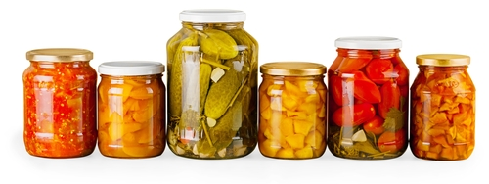
Food (and water)
Dried foods – these do not have water, so the microorganisms cannot grow, e.g. dried milk, instant soup mix.
Pickles and jams – these contain vinegar or sugar which stop the microorganisms from growing.

Slide 13

microorganisms
In the right conditions, food poisoning bacteria (microorganisms) can double every 2 minutes.

Slide 14
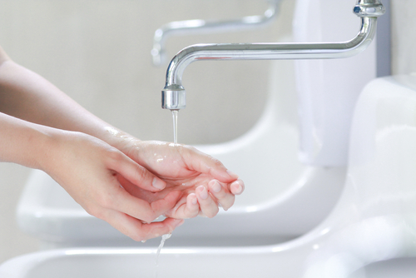
The risk of food poisoning
The risk of food poisoning can be minimised through:
good food safety;
good hygiene procedures.

Slide 15
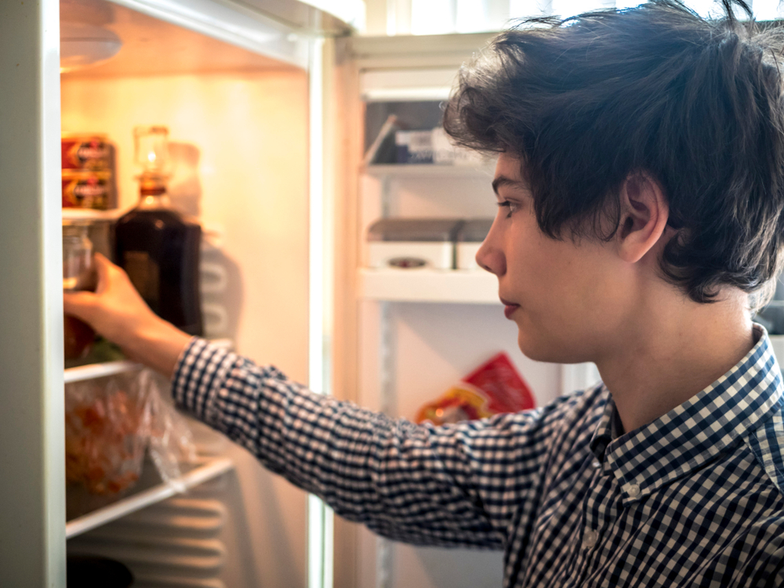
Store food in the right place
Check labels for where they should be stored.
Check date marks on food labels.
Do not leave foods out – they could get warm or be contaminated with microbes from an insect or pest.

Slide 16
Prepare and cook food hygienically
Get ready to cook – wash your hands, tie up your hair, wear an apron.
Prepare raw foods away from cooked foods – do not mix up.
Cook foods thoroughly, e.g. no raw areas in roast chicken.
Clean up and be tidy all the time.

Slide 17
Food spoilage
For further information, go to:
www.foodafactoflife.org.uk
This resource meets the Guidelines for producers and users of school education resources about food.

