Slide 1
The digestion process

Slide 2
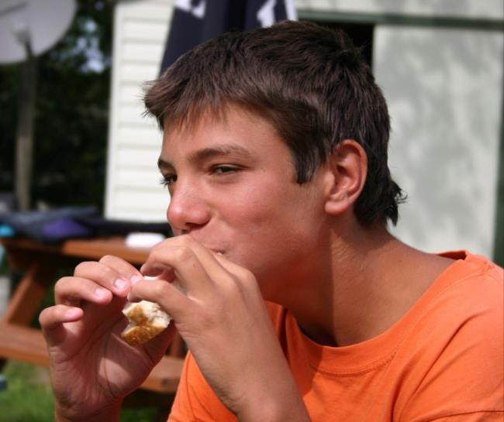
Food as a fuel
The body requires energy from food.
Our bodies release the energy and nutrients from food.
Sometimes food can take 2 or 3 days to be fully digested and absorbed by the body.

Slide 3
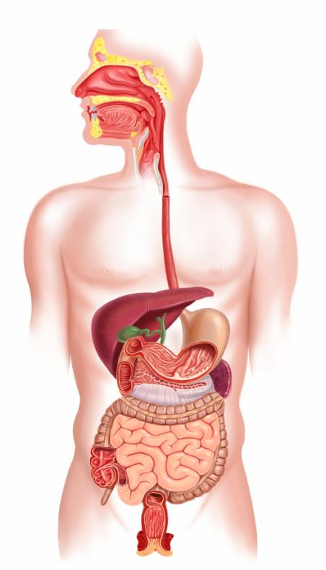
The digestion process
The parts of the body involved in the digestion process are:
the mouth;
the oesophagus (gullet);
the stomach;
the intestines.

Slide 4

The body parts used in the digestion process
Mouth
Oesophagus (gullet)
Stomach
Intestines

Slide 5

The mouth
When we eat, the teeth break down food into smaller pieces.
Teeth of different shape tear, chop and grind the food.
In the mouth there is also saliva which helps to break down the food and makes it easier to chew and swallow.

Slide 6
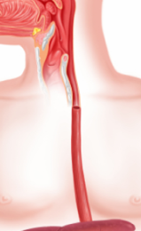
Oesophagus (gullet)
The oesophagus (gullet) moves the food we eat from our mouth to our stomach.
Did you know?
Each mouthful of food takes about six seconds to reach the stomach once it is swallowed.

Slide 7
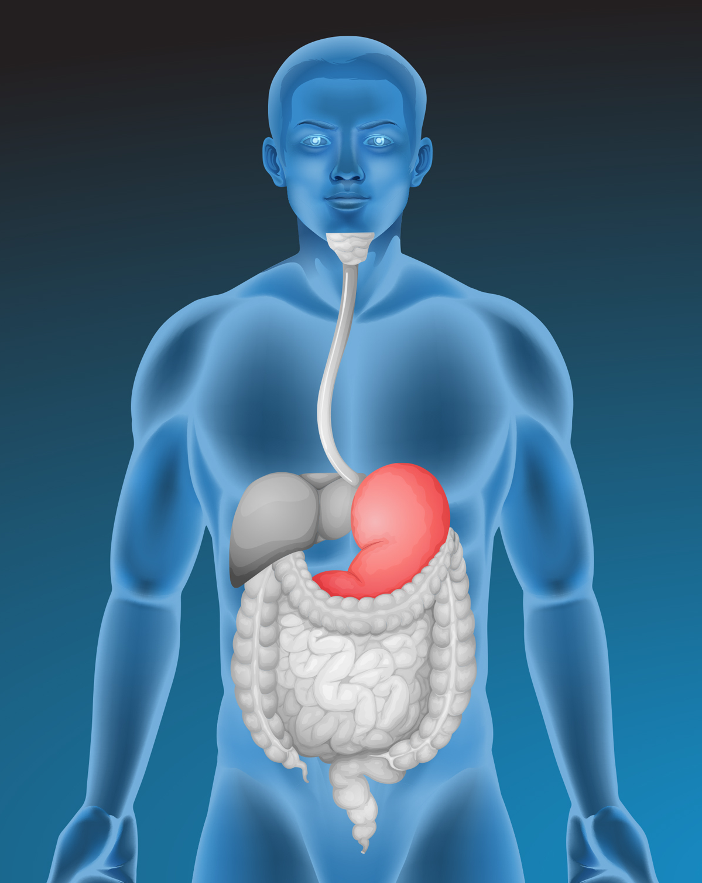
The stomach
The stomach helps to break down food even further.
The stomach is acidic which kills bacteria and it has special chemicals which break down the food. These are called enzymes.
Did you know?
Food can spend up to 2 to 3 hours in the stomach.

Slide 8
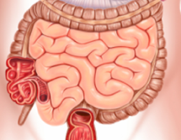
The intestines
There are two parts to the intestines in the body: the small intestine and the large intestine.
The small intestine absorbs digested food and the large intestine helps to pass all the waste materials out of the body.

Slide 9
The intestines
The small intestine absorbs the useful substances from the food into the bloodstream so it can be used by the body.
Once the food reaches the large intestine it is mostly waste the body does not need.
The waste passes through the large intestine and is removed by the body when we go to the toilet.

Slide 10
The digestion process
For further information, go to:
www.foodafactoflife.org.uk
This resource meets the Guidelines for producers and users of school education resources about food.

