Slide 1
Meat alternatives

Slide 2
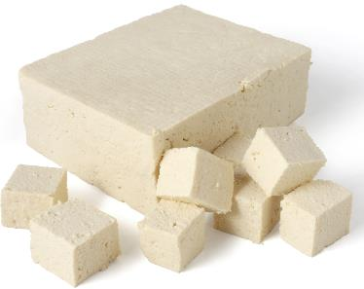
Meat alternatives
Meat alternatives (sometimes called meat substitutes or meat analogues) are plant-based products designed to replace meat.
Examples of meat alternatives include:
mycoprotein – protein sourced from fungi;
tofu (bean curd) – made from coagulated soy milk;
tempeh – fermented soybeans pressed into blocks;
seitan – gluten protein extracted from flour;
textured vegetable protein (TVP) – from soy beans.
Tofu is often used for
stir-fries, because it absorbs flavours very efficiently

Slide 3
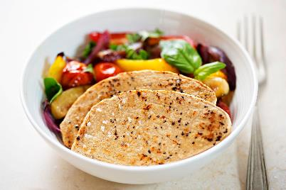
Mycoprotein
Mycoprotein is a meat substitute made from a fungus called Fusarium venenatum.
This species of fungus is high in protein, is able to be grown in large quantities and to be formed into a solid end-product.
In order to fully mimic meat, different ingredients, flavourings and colourings are added so that the differences in taste and appearances are less obvious.
This allows mycoprotein to be formed into many different product substitutes (e.g. burgers, sausages, steaks, chicken pieces).

Slide 4
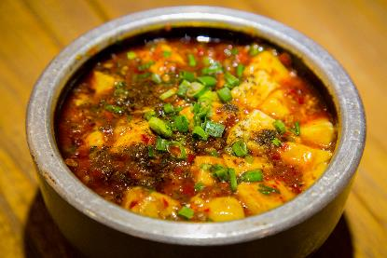
Tofu
Tofu was first produced in China, but has since spread to many other East Asian countries.
It is produced in a similar way to cheese, with the most important step being the coagulation of proteins from soybeans.
These coagulated proteins can then be pressed into blocks.
Tofu comes in many different styles, often depending on how much moisture it contains.
It is typically fairly bland, but absorbs flavours well, allowing it to be incorporated into many dishes.

Slide 5
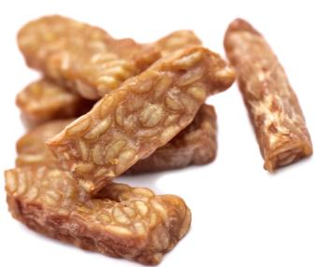
Tempeh
Tempeh is another meat substitute made from soybeans. It was first made in Indonesia.
To make tempeh, whole soybeans are fermented (broken down) by a fungus called Rhizopus oligosporus.
Unlike tofu, tempeh has a stronger flavour and typically a firmer consistency. It can be aged to develop this flavour further.
Tempeh can be cooked in the same way as meat.

Slide 6
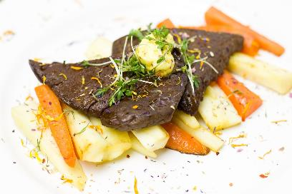
Seitan
Seitan is a meat substitute made from wheat gluten. Gluten is a protein complex that is found in wheat (and some other grains).
When the gluten is extracted, it forms a dense, sticky dough. This is typically steamed or boiled to solidify the dough and enable it to be sliced.
Seitan has little flavour on its own, so it is often boiled in flavourful broths, or has additional ingredients incorporated into the dough.
Seitan can be moulded to mimic meat products such as steaks

Slide 7
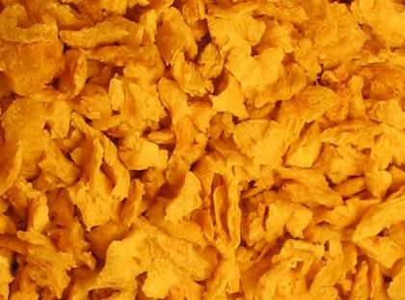
Textured vegetable protein (TVP)
Textured vegetable protein (TVP) is made from a by-product of soybean oil production. The protein is separated from the fat and formed into various shapes.
The size and shape of the final TVP product determines how it can be used in cooking.
TVP is sometimes included alongside meat in dishes (e.g. pies), because it adds bulk, is often less costly than meat and allows the food to be sold for a lower price.
Chunks of TVP before being processed and added to dishes

Slide 8
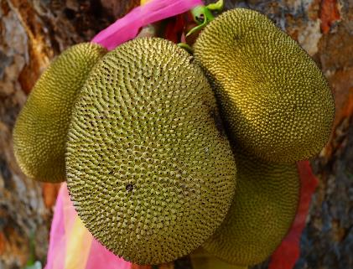
Other meat alternatives
Other meat alternatives include:
falafel - made from chickpeas and/or broad beans;
jackfruit and breadfruit – dense fruits that can be seasoned with herbs and spices to taste and appear more like meat;
nut roasts – made from blended nuts, grains and seasonings;
mushrooms – some species of mushrooms have textures and flavours similar to meat products and are occasionally used as substitutes.
Jackfruit segments can be used as meat alternatives, with the addition of herbs and spices

Slide 9
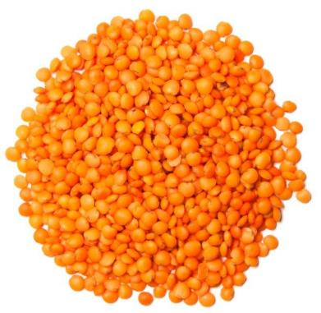
Lentils, grains, nuts and seeds
Some plant foods are included in dishes to provide protein, bulk and body to the dish, without being formed into ‘meat-like’ shapes. Plant sources of protein include:
pulses (e.g. lentils, chickpeas, peas, most beans);
soya;
quinoa;
nuts and seeds (e.g. almonds, walnuts, sunflower seeds).

Slide 10
Meat alternatives
For further information, go to:
www.foodafactoflife.org.uk
This resource meets the Guidelines for producers and users of school education resources about food.

