Slide 1
Engaging parents/carers in their child’s school food journey
Claire Theobald, Education Services Manager

Slide 2

This session will cover:
What will be covered?
The value of engaging with parents/carers
Ideas for running health promoting workshops with parents/carers
What parents/carers can do with their children at home to support their learning around food
Food – a fact of life resources to support

Slide 3

What does parental engagement mean?
Parental engagement refers to teachers and schools involving parents in supporting their children’s academic learning. It includes:
approaches and programmes which aim to develop parental skills such as literacy or IT skills
general approaches which encourage parents to support their children with, for example reading or homework
the involvement of parents in their children’s learning activities
more intensive programmes for families in crisis.
Ref: Education Endowment Foundation (what is it)

Slide 4

What is the value of engaging with parents/carers?
Benefits can include:
Consistent approach and expectations for children
Better behaviour
More confidence and greater self-esteem
Higher attendance rates
A lower risk of exclusion
More enthusiasm about learning
Better results
Many parents/carers have fantastic experience, skills and knowledge that can be utilised to support your school and children’s learning

Slide 5
What is the value of engaging with parents/carers?
Parents play a crucial role in supporting their children’s learning, and levels of parental engagement are consistently associated with better academic outcomes.
The average impact of the Parental engagement approaches is about an additional four months’ progress over the course of a year.
Ref: Education Endowment Foundation (key research findings)

Slide 6
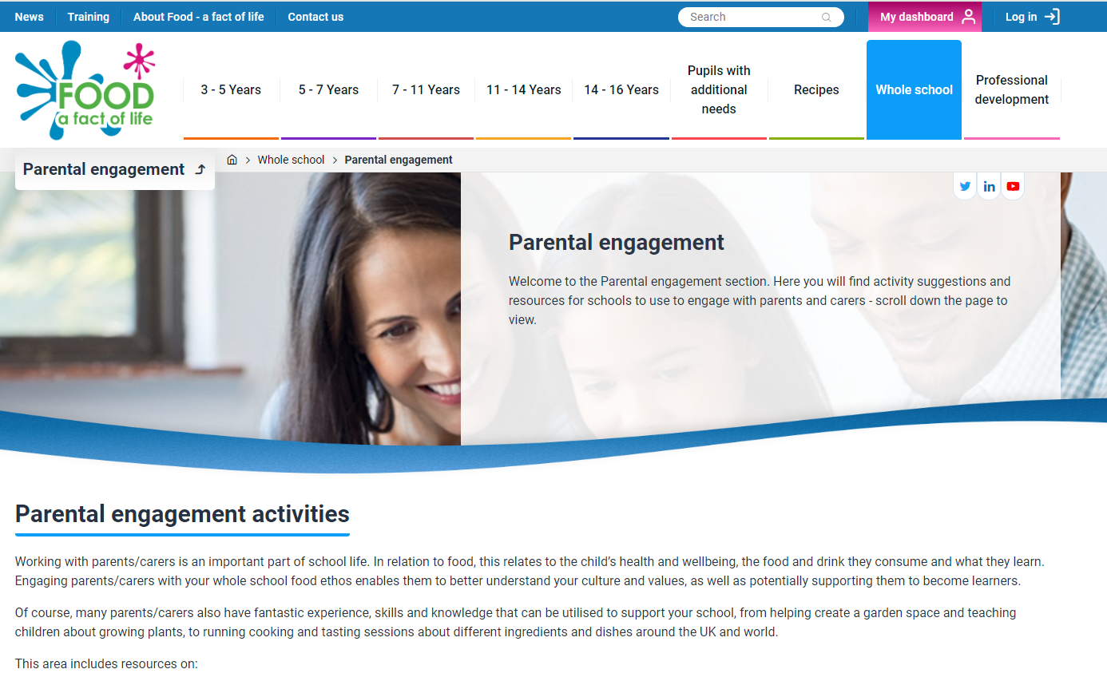
Ideas for running health promoting workshops with parents/carers
Food – a fact of life > Parental engagement area
https://www.foodafactoflife.org.uk/whole-school/parental-engagement/
This area includes resources on the
topics of:
Eating more vegetables
Breakfast
Eat well
Healthy lunchboxes
Healthy hydration
Physical activity
Sleep

Slide 7
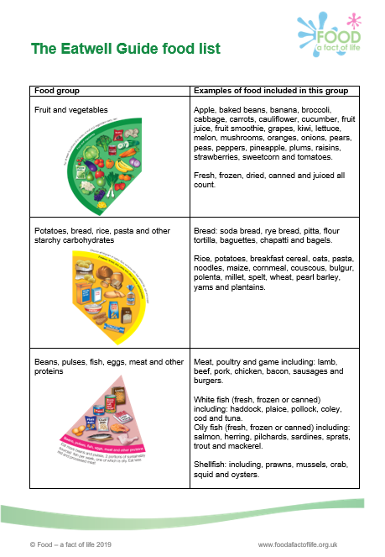
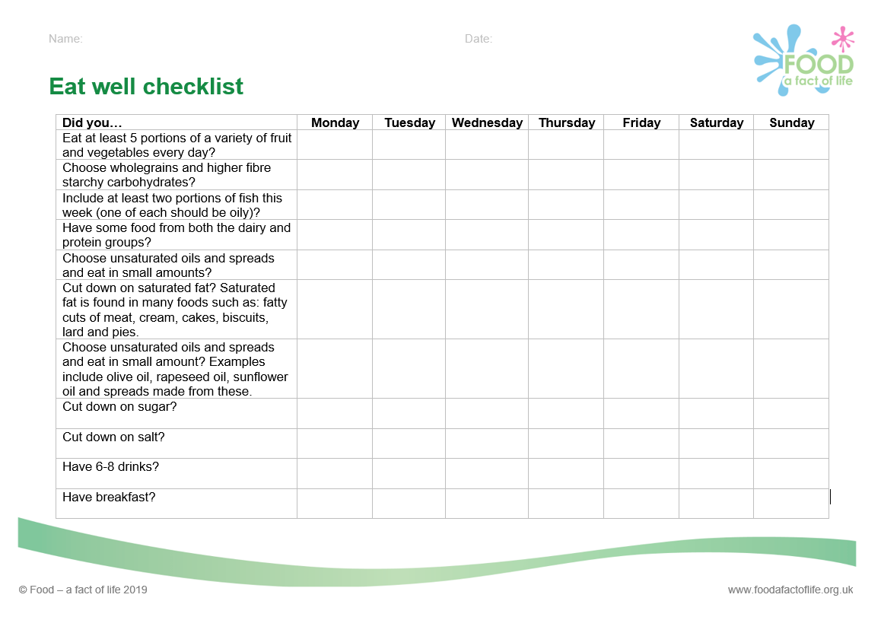
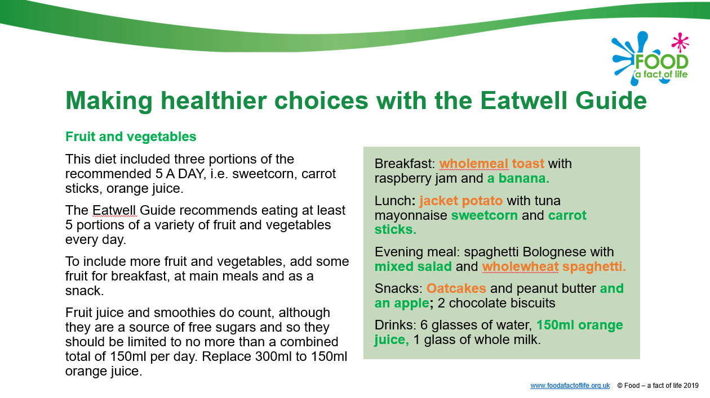
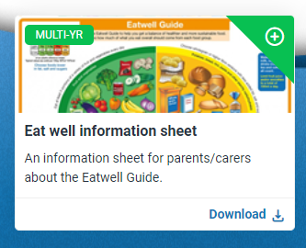
Health promoting workshops with parents/carers
Food – a fact of life > Parental engagement area
https://www.foodafactoflife.org.uk/whole-school/parental-engagement/
Eat well workshop resources
Eat well information – The Eatwell Guide
Eatwell Guide presentation - with practical examples of applying the healthy eating advice
Eat well workshop – plan for running a practical workshop (making simple recipes)
Eat well checklist
Eatwell Guide food list
Eat well diary
Eatwell Guide video

Slide 8
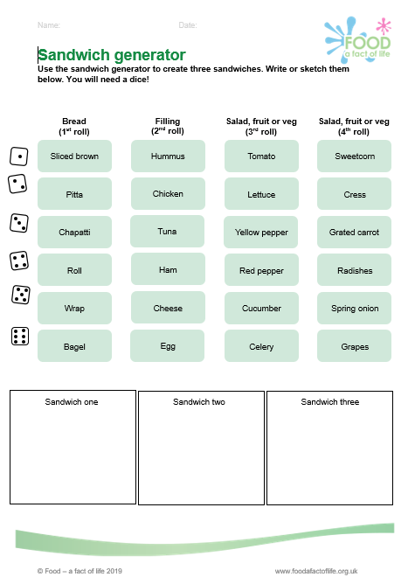
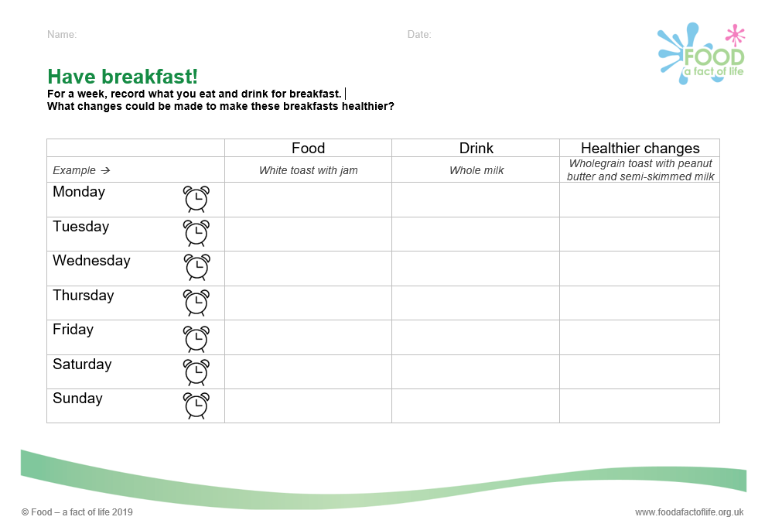
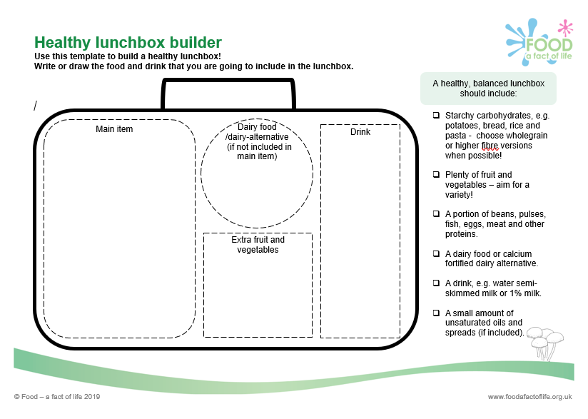
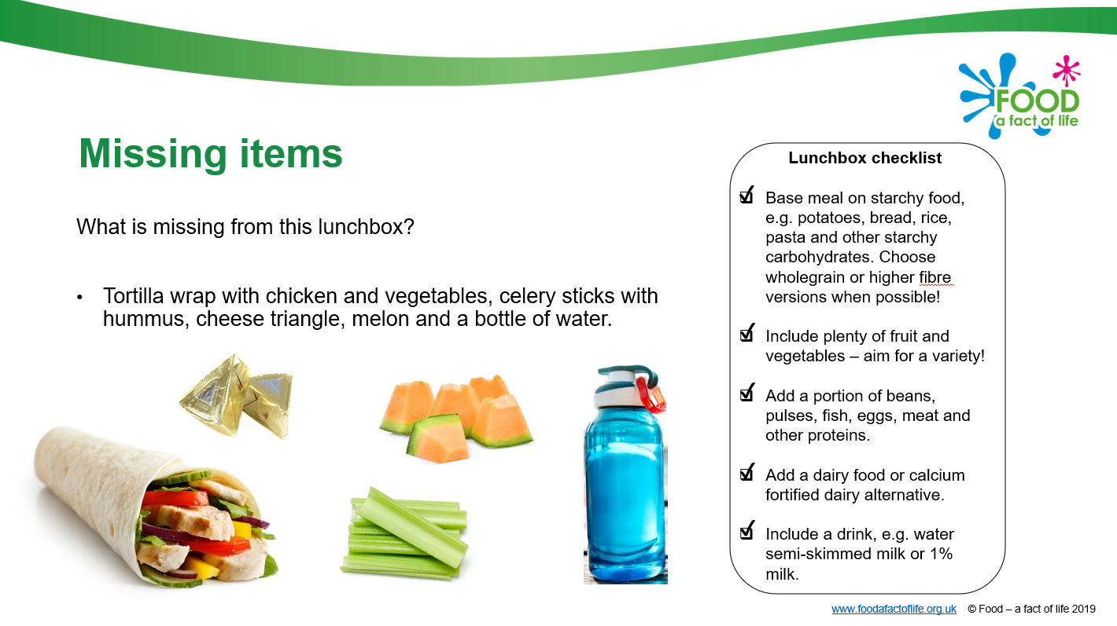
Health promoting workshops with parents/carers
Food – a fact of life > Parental engagement area
https://www.foodafactoflife.org.uk/whole-school/parental-engagement/
Breakfast
Lunchboxes
Breakfast paper from the British Nutrition Foundation (for interest)

Slide 9

What parents/carers can do with their children at home to support their learning around food
Cook together – prepare simple recipes
Taste together – use the senses to describe a food
Shop together – look a varieties of ‘X’ (pasta, bread, apples), prices, food labels, storage instructions
Weighing family food waste, to reduce waste!

Slide 10
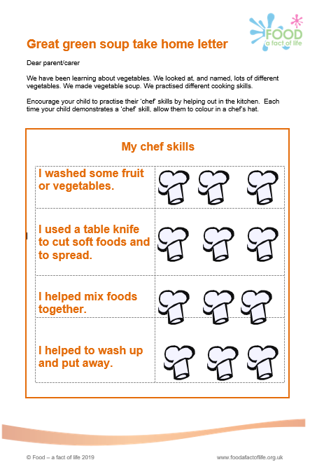
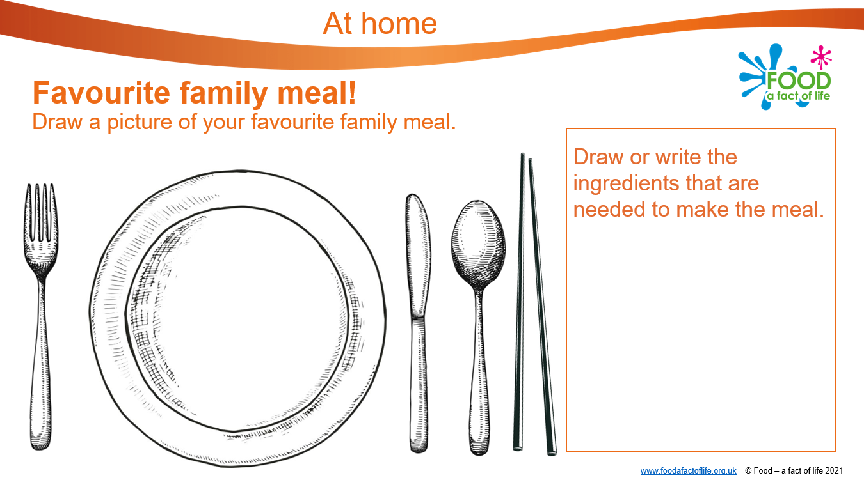
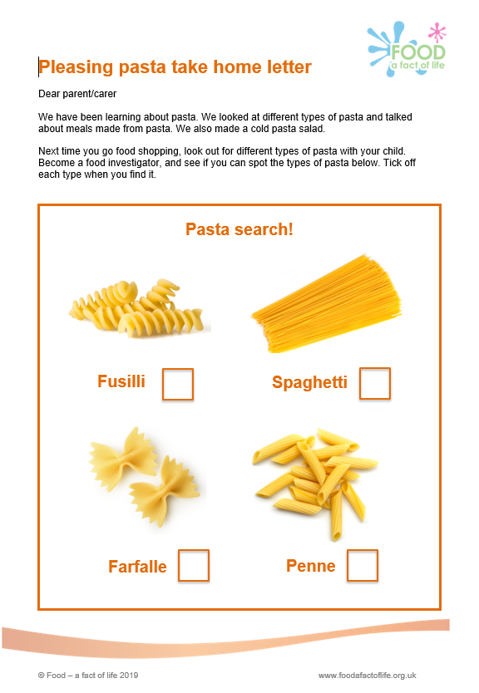
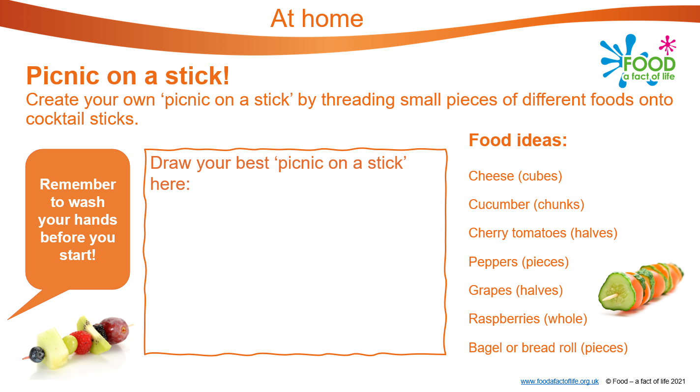
Resources to support food themed home learning
Food based sessions (3-5 years) – take home letters that summarise lesson learning and set a task
Six early years packs (3-5 years) – simple food related activities to complete with parents/carers

Slide 11
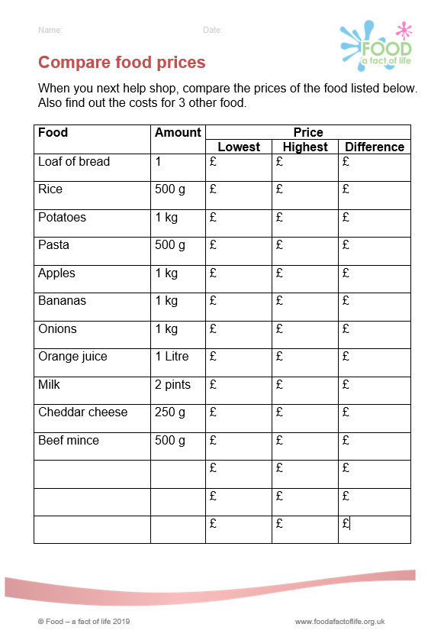
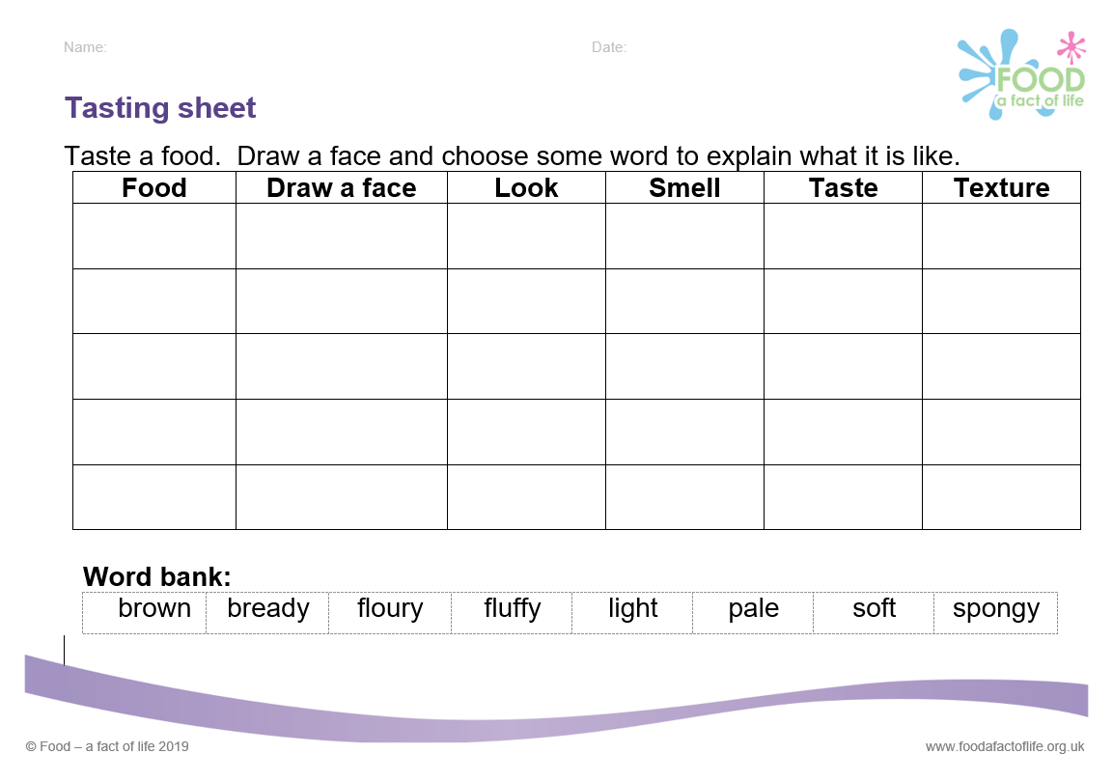
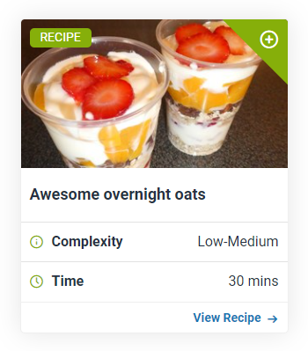
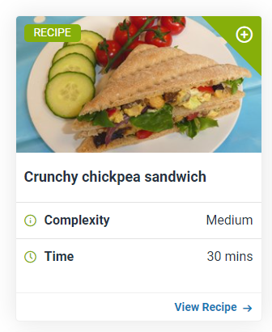
Resources to support home learning
Food – a fact of life recipes – simple recipes to support healthy eating messages. Share links or print outs!
Activity sheets to support tasting activities and supermarket trips
Tasting sheet
Compare food prices sheet (7-11 years, Food route resources)

Slide 12
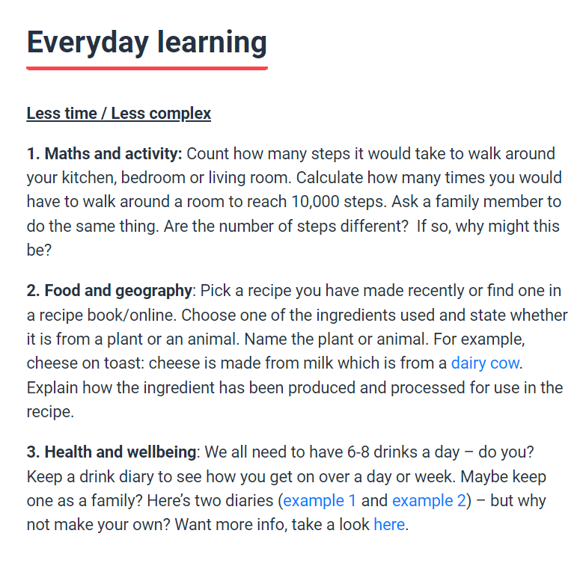
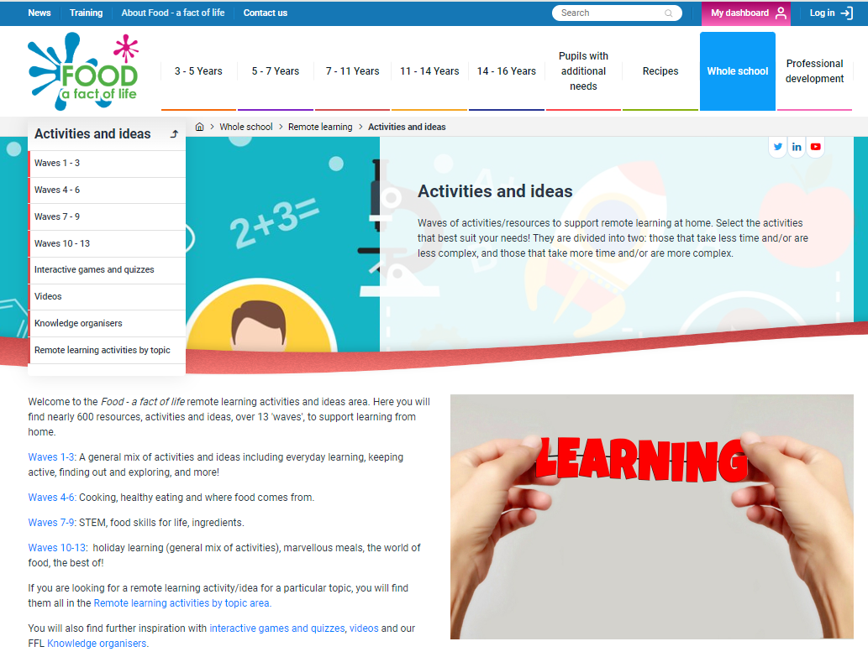
Resources to support home learning
Food – a fact of life - Remote learning area
A wide variety of simple food-themed activities that can be completed at home, with minimal resources

Slide 13

Whole school approach to food – information and resources
Food – a fact of life > Whole school approach (area) includes information around:
Whole school food policy
Food provision
Breakfast clubs
Growing clubs
Healthy lunchboxes

Slide 14

Engagement tips
Building relationships
Be available at the school gate/home time to chat and find out about parents/carers
Communicate – share updates about what children are learning, and how parents/carers can get involved, e.g. weekly text messages, social media updates, short termly letters/emails
Share practical information/tips to help parents/carers, e.g. leaflets, simple fact sheets
Find out how parents/carers would like to be communicated with

Slide 15

Engagement tips
For parent/carer workshops
Be flexible with timings – send a survey/poll to ask about the best time
Consider choosing a venue outside of school, e.g. a local community centre
Be clear on what will happen and the benefits
Keep it informal and welcoming
Allow children to come along too!

Slide 16

Engagement tips
Utilising knowledge and expertise
Invite parents/carers in to do a talk about food (perhaps in pairs) – cooking, growing, traditional dishes, favourite foods
Home learning activities around food
Keep activities simple and enjoyable to help make them manageable and engaging
Be clear on the ways you’d like parent/carers to support with home learning – what would you like them to do, and how (tips, strategies, questions)

Slide 17
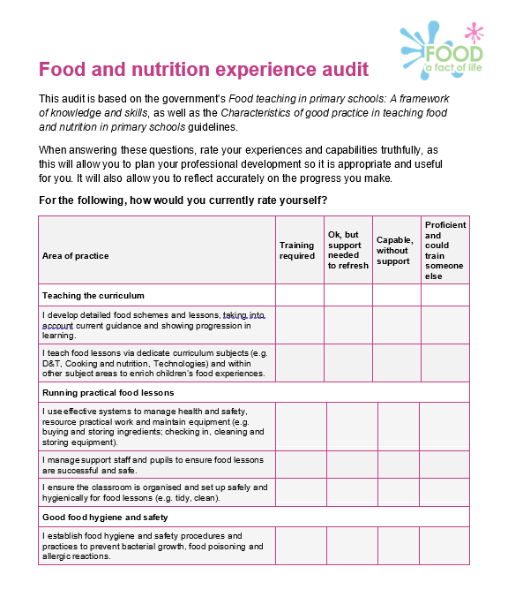
Where does this fit in the TPFN programme?
Food and nutrition experience audit 5
Whole school approach
I contribute to a whole school approach to food education, e.g. support the whole school food policy, help ensure consistency of healthy eating messages across subjects and age groups, work with colleagues to enhance learning opportunities.

Slide 18
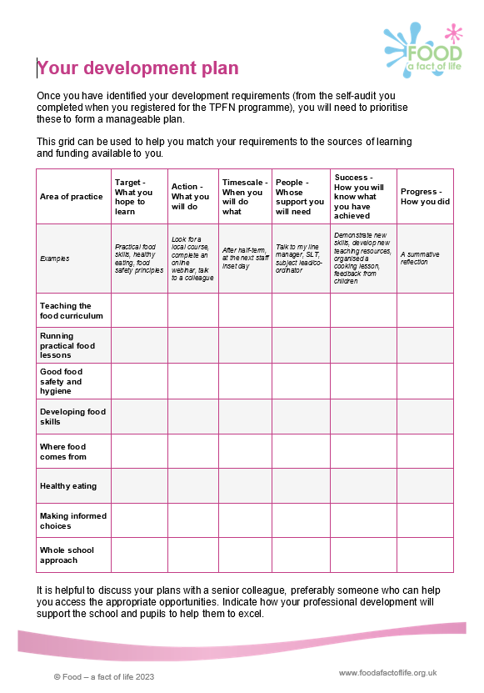
What could you do?
Your development plan 5
Review how your school (placement school) currently works with parents/carers – is it successful?
Research what works well
– speak to other teachers, your headteacher, colleagues in other schools – what works well?
- read around the subject for ideas (see slide 20)
Set simple food-based home learning activities (to engage parents/carers) and share what works well with other staff
Plan and deliver a parent/carer food-themed workshop with a colleague – perhaps to address a specific school issue, e.g. lunchboxes

Slide 19

Further reading
Education Endowment Foundation
Parental engagement | EEF (educationendowmentfoundation.org.uk)
National College for School Leadership
How to involve hard-to-reach parents: encouraging meaningful parental involvement with schools
@TeacherToolkit
10 Tips For Engaging Parents - TeacherToolkit

Slide 20

Future training events
Coming next…diary dates
Tue 23 April 2024 – 4pm
Cooking with heat in primary 2
Tue 14 May 2024 – 4pm
Outside cooking! TBC
Tue 4 June 2024 – 4pm
Cook-a-long - global recipes
Remember that all webinars are recorded and can be found here.
Also don’t forget our INSET package – seven topical videos ideal for you and your colleagues.

Slide 21

Thank you
Please complete the webinar evaluation. If you are watching a recording of this webinar, you will find a link to the evaluation at the end of the PPT presentation in the curriculum and whole school learning area of the TPFN training page.
Engaging parents/carers in their child’s school food journey
You will receive a link to the certificate once you have completed the evaluation. Please download the certificate, add your name and print it out for your records.

Slide 22
Thank you
For further information about TPFN training or to find recordings of previous webinars and workshops,
click here.

