Slide 1
Moral and ethical reasons for food choice

Slide 2
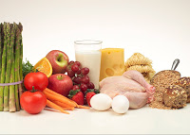
Why we choose food
We make decisions everyday about food. For example:
what we eat;
when we eat;
where we eat.
There are many factors that we take into account when choosing what we eat.
One of these may be ethical considerations.

Slide 3

Why we choose food
When people make decisions about the food, they choose they may consider some ethical factors.
What does this mean?
Ethical factors are aspects seen as morally right - in that person’s opinion.
These factors can cover a wide range of topics.

Slide 4
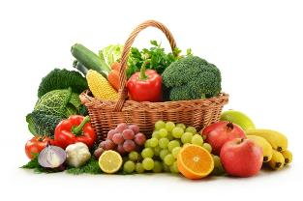
Food ethics – animal welfare
Some people choose to follow a vegetarian diet. They may make that choice for a variety of reasons:
they do not like the taste of meat;
they do not believe that animals should be reared for food;
they follow a religious faith that forbids the eating of meat;
they have a medical condition.
Which of these reasons would be an ethical choice?

Slide 5



Food ethics – animal welfare
Modern factory farming may raise ethical concerns for some people.
Consumers may choose to buy food that is based on high animal welfare standards.
Foods assured means that the farms and food companies meet high standards of food safety and hygiene, animal welfare and environmental protection.

Slide 6
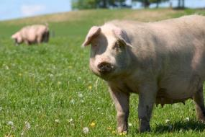
Food ethics – animal welfare
Consumers may choose to buy food that has been reared or grown in a way that they feel is better for the animal or the environment. Such as:
organic food – food sold as ‘organic’ must come from growers, processors and importers who are registered and approved by organic certification bodies, which are shown on the food label;
free range – animals are allowed to roam freely outside. This food may be more expensive;
local food – some believe that food produced locally is more sustainable and supports local farmers and producers.

Slide 7
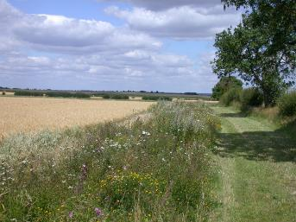
Food ethics – the environment
Some consumers are concerned about industrialised farming methods.
For example, widespread use of chemical pesticides and artificial fertilisers could be harmful to birds, insects and wild flowers.
Farms assured by Red Tractor and other schemes have a responsibility to protect the countryside by preventing pollution of watercourses, soil, air and wildlife habitats.
Protection of the natural environment would be an ethical choice.

Slide 8
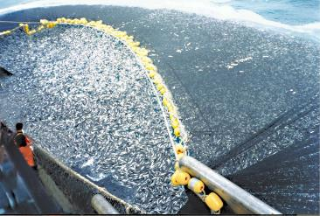
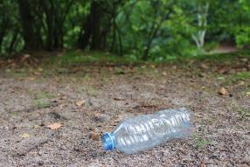
Food ethics – the environment
Ethical issues about food and the environment include:
sustainable farming methods;
sustainable fishing practices;
climate change;
how far food travels and food with low carbon footprint;
genetically modified food;
the overuse of non-recyclable packaging materials.
Find out more – why do these issues cause concern to some people?

Slide 9
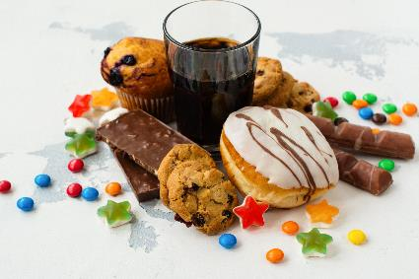
Food ethics – healthy eating
There is worldwide concern about the rise in obesity and other diet related disease.
Some people think that the availability and consumption of highly processed food and additives is a concern.
This is an ethical concern.

Slide 10
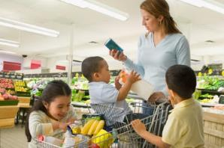
Food ethics – healthy eating
Ethical concerns about healthy eating are often about the general population, especially children and young people. These may include:
how personal choice is influenced;
how food is marketed;
food labelling and regulation;
the availability of certain food and drinks to children and young people.
Suggest some examples of issues that have been in the news recently.

Slide 11
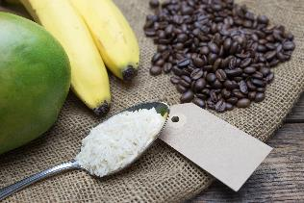
Food ethics – fair trading
A high percentage of our food is produced in lower economically developed countries.
Some people think that it is unfair that only a small percentage of money is paid back to the producers.
They support certification schemes that help to ensure the producers receive a fair prices for their products.
This is an ethical decision or choice.

Slide 12
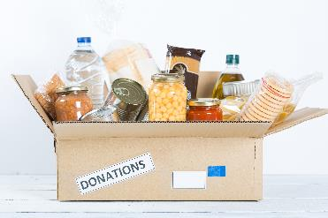
Food poverty
Food poverty means that an individual or household cannot obtain healthy, nutritious food, or can’t access the food they would like to eat.
This often results in people eating poor diets, which can lead to diet related diseases.
It is about the quality of food as well as quantity.
To find out more about food poverty, go to www.trusselltrust.org

Slide 13
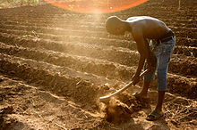
Food security
Food security exists, “when all people, at all times, have physical, social, and economic access to sufficient, safe, and nutritious food that meets their dietary needs and food preferences for an active and healthy life”. (United Nations’ Committee on World Food Security)
Food security refers to the availability and accessibility of food and is an issue that affects everyone.

Slide 14

Food ethics - choice
Many people will not take these ethical positions – they may have a variety of reasons for doing so.
Can you identify what reasons there might be?

Slide 15
Moral and ethical reasons for food choice
For further information, go to:
www.foodafactoflife.org.uk
This resource meets the Guidelines for producers and users of school education resources about food.

