Slide 1
Needs of different people

Slide 2
Around the world, people have different food needs.
What food needs do you have?

Slide 3


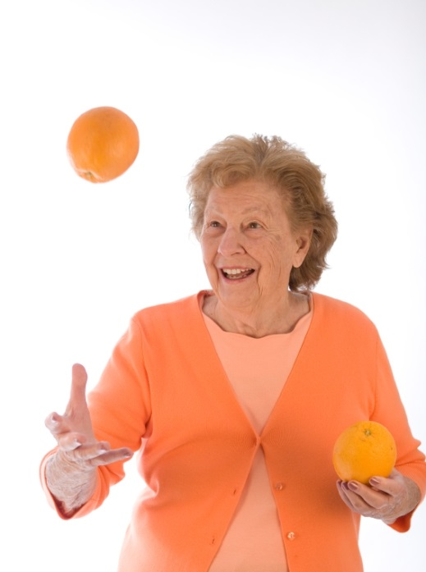
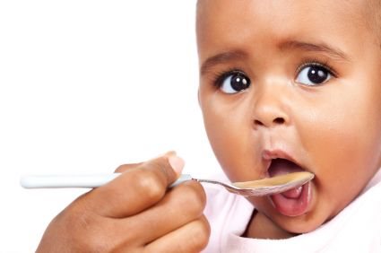
Age
The type of food we eat depends on our age.

Slide 4
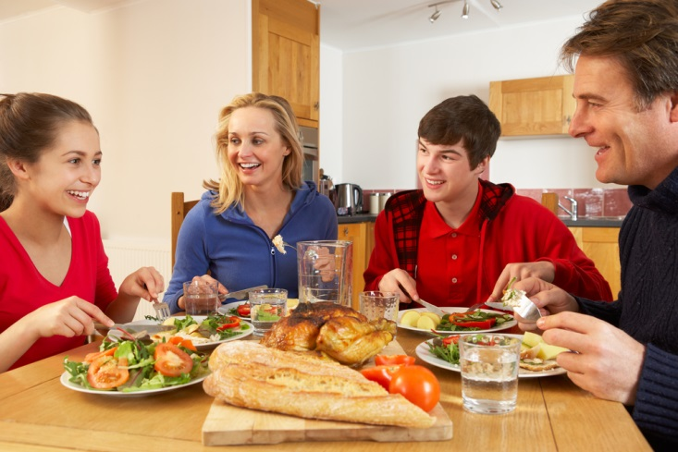
Energy and nutrients
Throughout life, we all need different amounts of energy and nutrients.

Slide 5
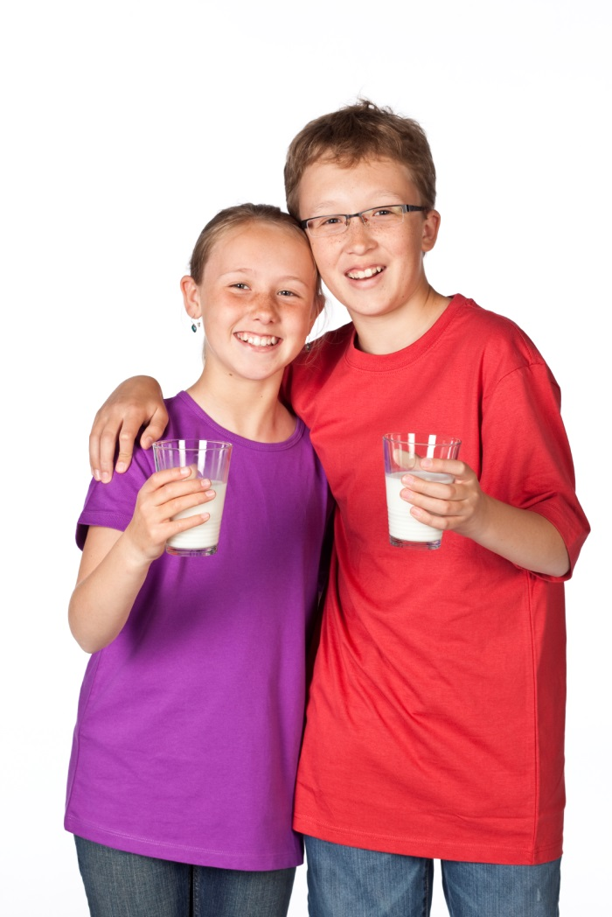
Likes and dislikes
Everybody has personal preferences about the food they like and dislike.
What is your favourite food or drink?
What is your friend’s favourite food or drink?
Are they the same?

Slide 6
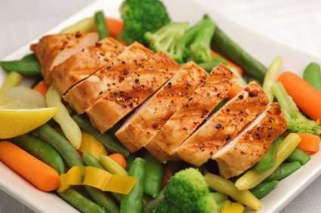
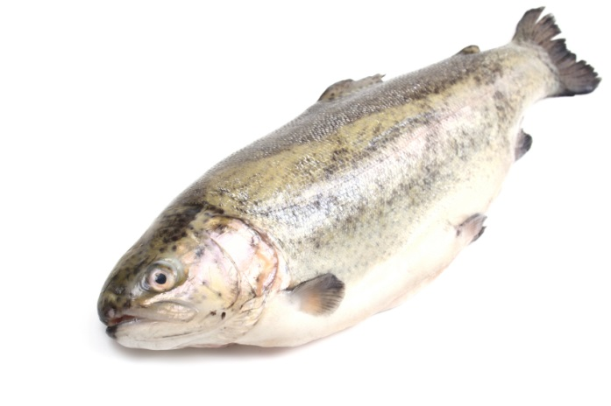
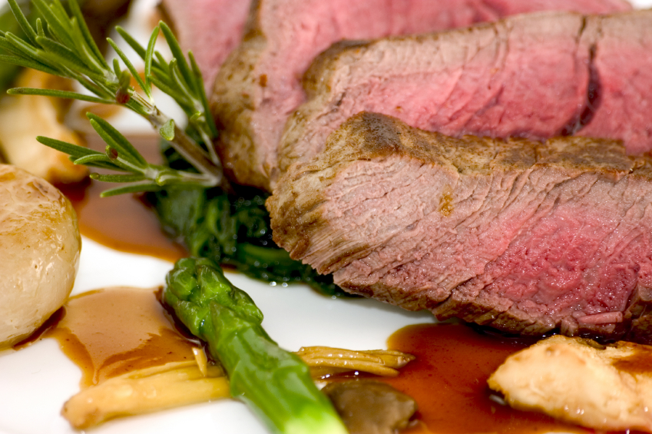
Vegetarian
Some people choose not to eat certain foods.
A vegetarian does not eat meat or fish.
Why might someone become vegetarian?

Slide 7

Where you live
Depending where you live in the world, you might eat different foods. Some people also like to eat local foods, produced by farmers near where they live.
What might you eat if you lived in:
Spain?
Japan?
India?

Slide 8
Religion
Religion can affect food choices, for example:
Judaism – no pork or shellfish
Hinduism – must not eat beef
Islam – must not eat pork

Slide 9
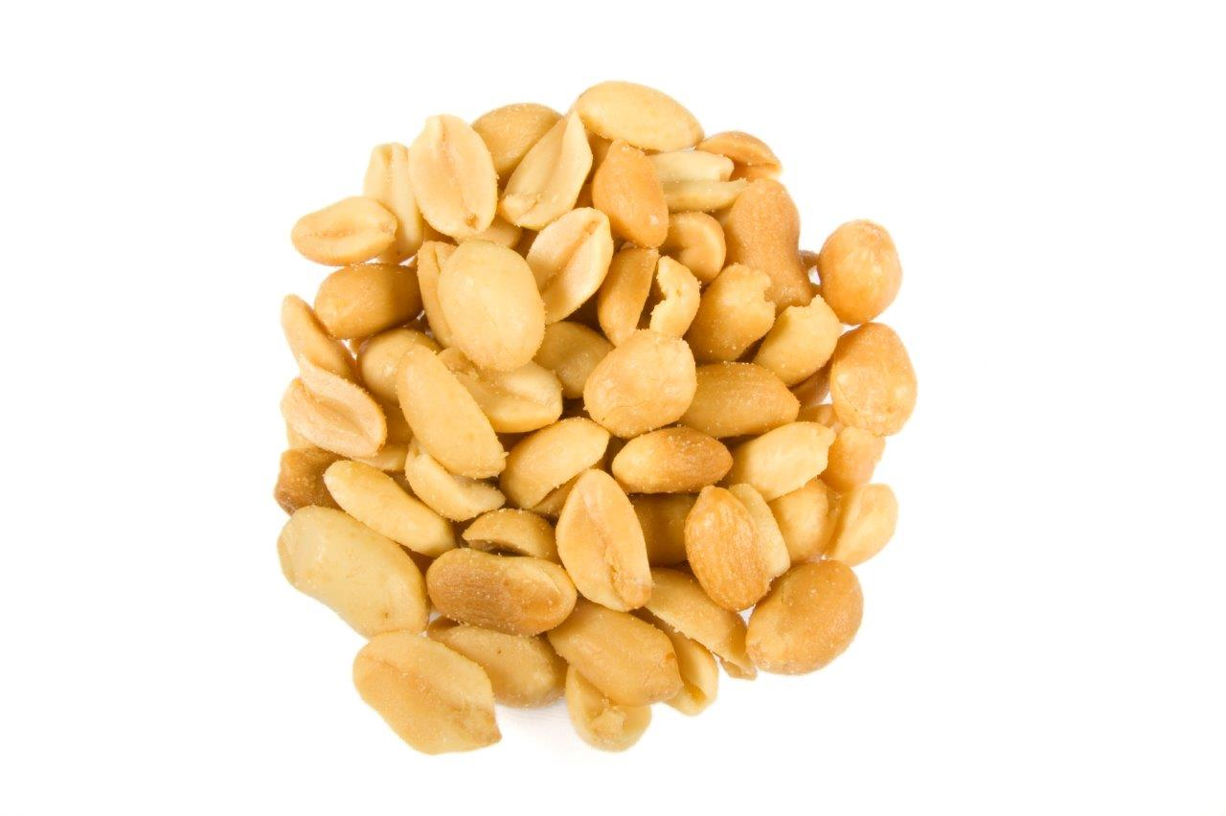
Allergy
A small number of people have an allergy to a food, such as peanuts.

Slide 10
Balance
Although we might have different needs, one factor remains the same:
We all need a balanced and varied diet to stay healthy.

Slide 11
Needs of different people
For further information, go to:
www.foodafactoflife.org.uk
This resource meets the Guidelines for producers and users of school education resources about food.

