Slide 1
Stages of product development

Slide 2

Stages of product development
Product development is the process of creating new or modified food products.
The aim of product development is to increase sales and maintain a company’s competitiveness. The process of product development involves a complex series of stages, requiring the combined talents of many specialists to make it successful.
Manufacture of products is controlled throughout to ensure that the original specification is met. The products should fill a gap in the market. In addition, consumers must be tempted to buy the new products in preference to similar products.

Slide 3

Initial ideas
There must be a concept for the product. This is attained in a variety of ways such as conducting market research, analysing consumer trends or modifying existing products.
Usually, the marketing department will provide the product development team with a brief for the type of product they want.

Slide 4
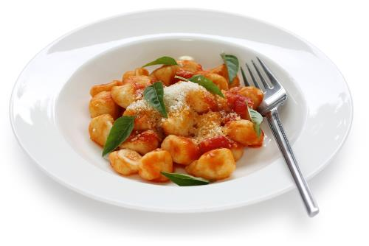
Test kitchen
Research is carried out, to formulate a number of recipes and specify the ingredients to be used. Several versions of the product are usually made, using slightly different ingredients or processes, i.e. the products are prototyped in the company’s test kitchen, often by a professional chef or food consultant.
A small number of staff, experienced in sensory evaluation, test the products and evaluate them informally. On some occasions, if a company does not have a test kitchen, an initial concept for a product is sent to an independent developer.

Slide 5

Sensory evaluation
It is usual for sensory evaluation to be carried out at many stages of the development process.
Trained assessors comment on the appearance, odour, taste and texture of the products to make sure that the product being developed displays the desired characteristics.
The assessors are able to do this with great accuracy.

Slide 6
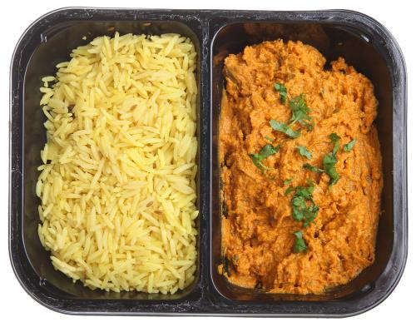
Pilot plant
When an acceptable product has been made in the kitchen it is then produced using pilot scale equipment. A pilot plant is a small version of the equipment used in manufacture. Many manufacturers have these facilities.
They produce the product on a small scale, but in the same way as it would happen during large scale manufacture. This allows them to judge whether the product can be successfully produced on a large scale, and whether it meets the original specification.
Enough product must be made for market research and sensory evaluation to be undertaken.

Slide 7
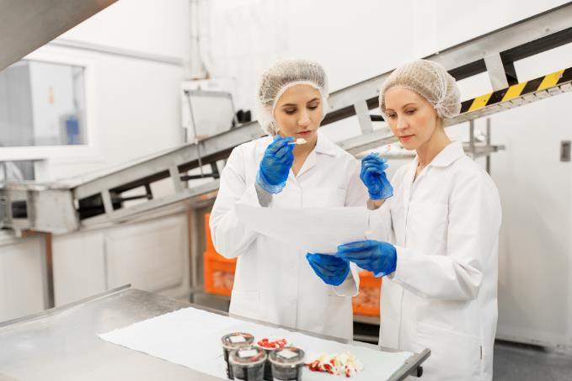
Sensory evaluation
Additional sensory evaluation and recipe modification can be undertaken to deal with any problems which are identified at the pilot plant stage.

Slide 8
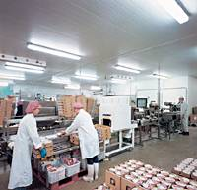
Product specification
After testing and modifying the product on the pilot plant, a final product is created. This details exact ingredients and precise methods of production.
The specification is very important as it will be used for the production of each batch of the product to ensure consistency.

Slide 9

Consumer testing
Many manufacturers test new products on potential consumers before moving on to large scale production.
If the new product is targeted at a particular group of the population, the consumers will be selected from that group, e.g. vegetarians. Otherwise, the company will try to ensure that different sub-groups are represented, e.g. males and females from a variety of backgrounds across a range of ages.

Slide 10

Consumer testing
Three main methods are used:
group discussions – usually up to 8 people are involved in a discussion run by a trained person. The aim is to hear a detailed view of a new product.
street interviews – people are asked to taste samples of the product and say what they like or dislike ; this produces a 'snapshot’ of opinions about the test product.
home trials - consumers are provided with a product and asked to try it at home. This gives the opportunity to sample the product in a ‘real life’ situation and to have a response from the whole family. The trial may result in minor changes to the product specification and the manufacturing process.

Slide 11
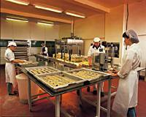
Scale up
Once the company is confident that the product is likely to succeed, it is ready for large scale manufacture to begin.
The manufacturing process is sometimes organised in unit operations, such as size reduction, mixing and cooking. These are controlled to maintain consistent product quality, safeguard, staff health, food safety standards and to avoid problems that may stop the production line running, which would result in ‘down-time’.

Slide 12

Launch
Some new products are shown at a trade launch. This is intended to allow large supermarkets and distributors to look at and sample the products. Often deals are made at this stage for sales.
Sometimes products are launched in different regions of the country to measure their performance. This may indicate whether the product could be launched at a national level or should be dropped from production.
Advertising then takes place to let the consumer know that the product is available. Finally, the new product is launched. After a fixed period, products are always reviewed to see how well they are performing.

Slide 13
Stages of product development
For further information, go to:
www.foodafactoflife.org.uk
This resource meets the Guidelines for producers and users of school education resources about food.

