Slide 1
Cheese production

Slide 2
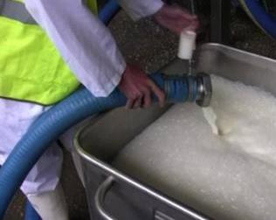
Cheese production
In this cheese factory, up to 25,000 litres of milk can be delivered from dairy farms at any one time.
The milk is unloaded and literage is checked before the milk is transferred into silos.

Slide 3
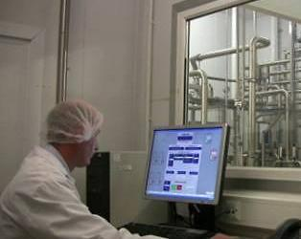
Pasteurisation
The first process the milk goes through is pasteurisation.
Pasteurisation reduces the number of spoilage microorganisms and provides a good environment for the starter cultures to grow.
The basic process involves heating the milk to a temperature of no less than 71.7ºC for 25 seconds.
This process is known as High Temperature Short Time (HTST).
Milk is cooled in a vat after pasteurisation to 32 °C.

Slide 4
Ensuring a consistent product
In order to achieve a consistent dairy product, producers need to overcome two issues:
different cows have different fat levels;
as the cows move from grass to grain fat levels change (even wet grass will dilute the fats and proteins in milk).
The way producers overcome this is in two steps:
They will have at least two vats, one whole milk and one skimmed milk, and will balance the two to get the correct fats;
They will homogenise, i.e. disperse the fat evenly through the liquid.

Slide 5
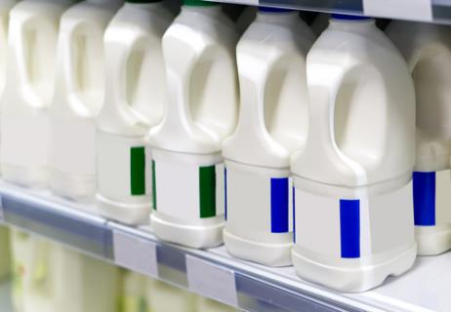
Homogenisation
Homogenisation of milk involves the milk being pumped at very high pressures through narrow tubes, breaking up the fat globules in order for these to disperse through the liquid.
This process produces milk of a uniform composition and palatability, without removing or adding any constituents.
Most milk available for purchase is homogenised.

Slide 6
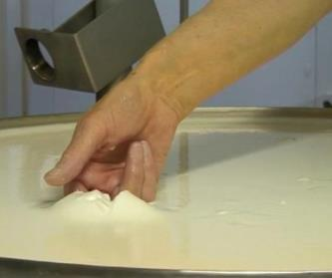
Curdling
A starter culture, is then added to the pasteurised milk. This begins to acidify the milk.
The curlding step allows the bacteria to grow and begin fermentation.
Rennet, an enzyme that acts on the milk protein caesin, is added and the milk coagulates, forming lumps.
The milk is mixed and then left to settle, while the junket forms, where the milk curdles and separates into curds and whey.

Slide 7
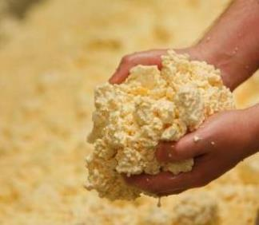
Draining belt and draining whey
The curds and whey run from the cheese vat onto the draining belt.
The draining belt is used to:
1) cool the curds and whey;
2) separate the curds from the whey.
The whey is drained off for further processing where cream is removed from the whey by centrifuge and made into butter. The cream removed from the whey is called ‘whey cream’.
Protein is also extracted from the whey for different ingredients. In addition, lactose (a sugar in the milk) is removed from the water and then used in the food industry and for animal feed.

Slide 8
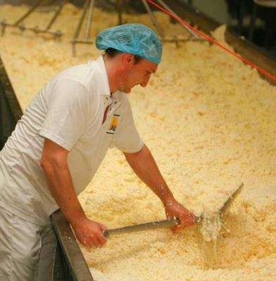
Cheddaring
The mixture is moved around on the cooling tables allowing the whey to drain out through a central perforated channel.
As the liquid is drained off a solid mass is created, called curd mats.

Slide 9
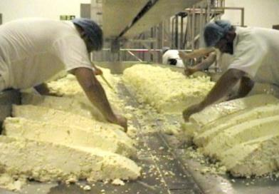
Cheddaring
The curd mats are cut into sections and piled on top of each other and turned periodically.
This step is called ‘cheddaring’.

Slide 10
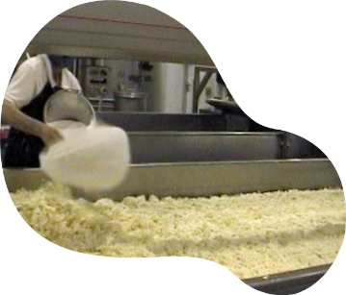
Salting
Around 1,900 kg of cheese can be made on the cooling table within an hour.
The curd pieces are fed into a mill and sliced into pieces about half the size of a thumb. This ensures the salt can be uniformly mixed throughout the curd.
Salt is added to act as a preservative and prevent the cheese from going rancid during the maturing process. It also adds flavour to the cheese.

Slide 11
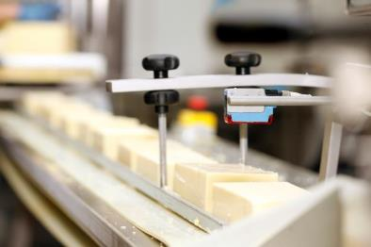
Cheese blocks
The mixture is then taken into a six metres high tower to form rectangular shaped cheese blocks, weighing 20 kilograms each. After confirming the weight, these blocks are individually identified, ensuring traceability.
Following this, the blocks are vacuum packaged and encased in six or seven wooden boards.
They are then taken to the cool room and are chilled to a temperature of 10-12°C.

Slide 12
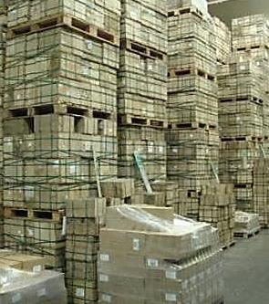
Cheese ripening
In the cool room, acidification of cheese continues at a much slower rate; this period is known as ripening.
When it is time to select the cheese, the grader decides which cheeses are the best eaten young and which should be left to ripen (for up to 18 months) developing the special features and flavours associated with West Country Farmhouse Cheese.

Slide 13
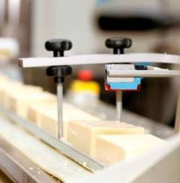
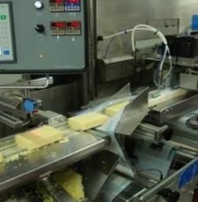
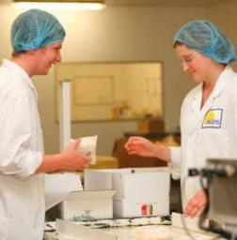
Cheese packaging
The final stage in cheese production is slicing and packaging.
The cheese blocks are then cut into specific sizes, packaged and labelled. These products are sold via retailers large and small throughout the UK, as well as in the farm shop.

Slide 14

Protected names
Three European Union schemes of geographical indications and traditional specialties promote and protect names of quality agricultural products and foodstuffs.
They are known as:
Protected designation of origin (PDO);
Protected geographical indication (PGI);
and Traditional specialities guaranteed (TSG)

Slide 15
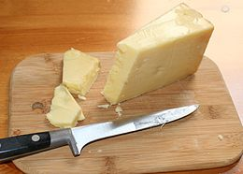
Protected names
The protected name of the cheese being made is West Country Farmhouse Cheddar.
The conditions are:
The cheddar is made using milk from local herds reared and milked in the four Counties (Cornwall, Devon, Somerset, Dorset);
The cheddar contains no colouring, flavouring or preservatives;
The cheddar is made in these four counties to traditional methods, e.g. cheddaring;
The cheddar is made and matured on the farm and aged for at least 9 months.

Slide 16
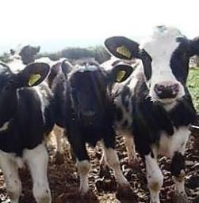
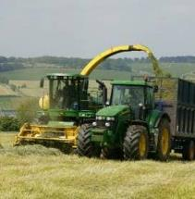
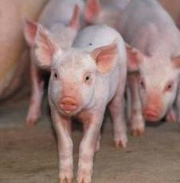
By-products from the farm
In addition to the cheese, there are other products produced on the farm. The male calves are kept to form a herd of beef animals supplying quality meat to the farm shop.
Arable crops, including wheat, barley, oats, oilseed rape and maize is grown. Some of the grain is used to feed the stock, such as dairy cows and pigs, while the rest is sold.
Pigs are fed on whey from the cheese production and cereals grown on the farm.

Slide 17
For further information, go to:
www.foodafactoflife.org.uk
This resource meets the Guidelines for producers and users of school education resources about food.

