Slide 1
Raising Agents

Slide 2
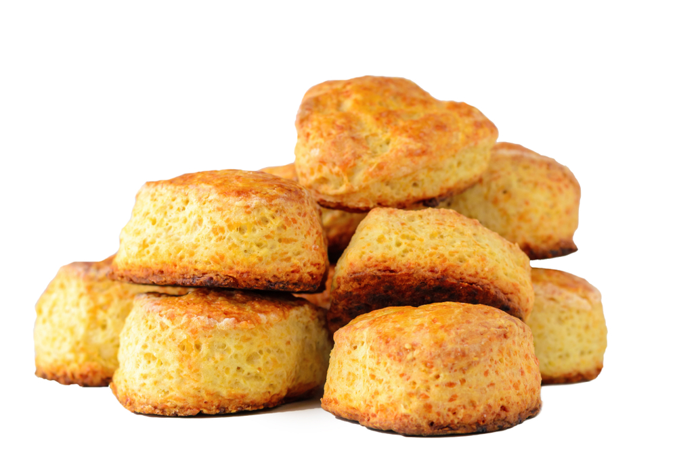
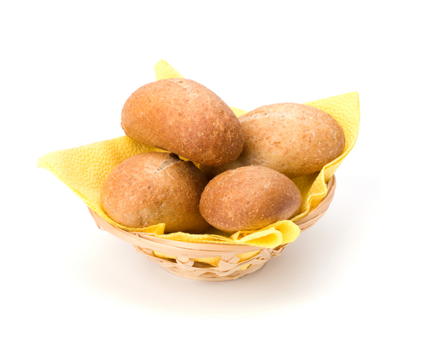
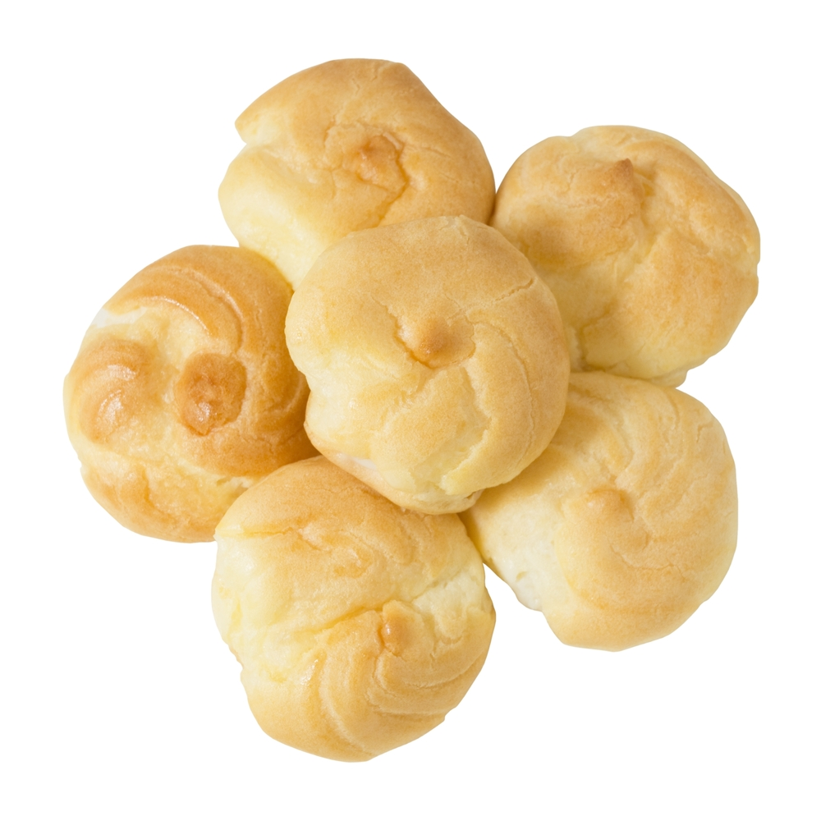
Foods made with raising agents
Scones:
Made with baking powder that reacts with water to form carbon dioxide
Bread:
Dough contains yeast, which ferment sugars to carbon dioxide. Further expands on baking.
Choux buns:
A moist dough, raised by steam created through the heat of the oven.

Slide 3
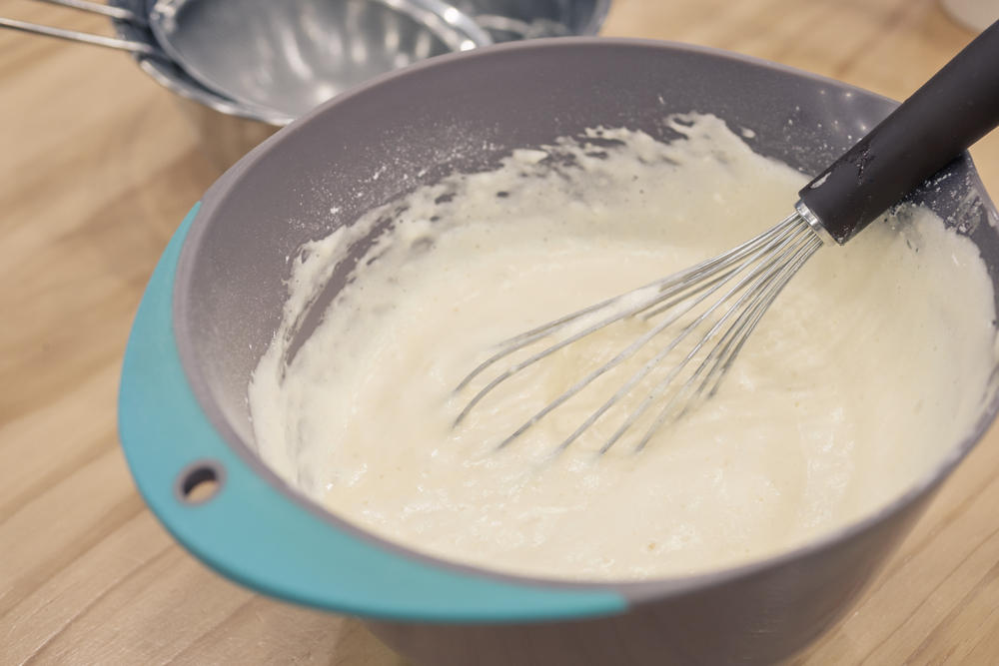
Introduction
Raising agents are used in baked products like scones, cakes and bread. They are used to aerate the mixture to give a light, airy, spongy texture.
Raising agents include anything that causes rising within foods, and are usually used in baked goods.
Raising agents are added to baked products during the preparation stage. They create gas, air or steam which expands when heated and causes the food to rise.

Slide 4
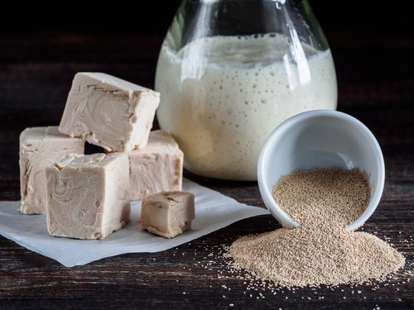
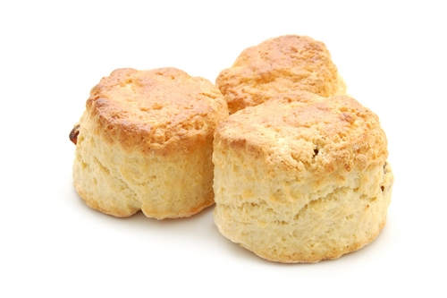
The science of raising agents
The gases are introduced to the mixture in different ways.
Carbon dioxide is produced by:
Yeast cells as they reproduce – this is called a biological raising agent. Yeast is used to make bread and other baked products.
Baking powder or bicarbonate of soda – this is called a chemical raising agent.
These raising agents are used to make scones and cakes.

Slide 5
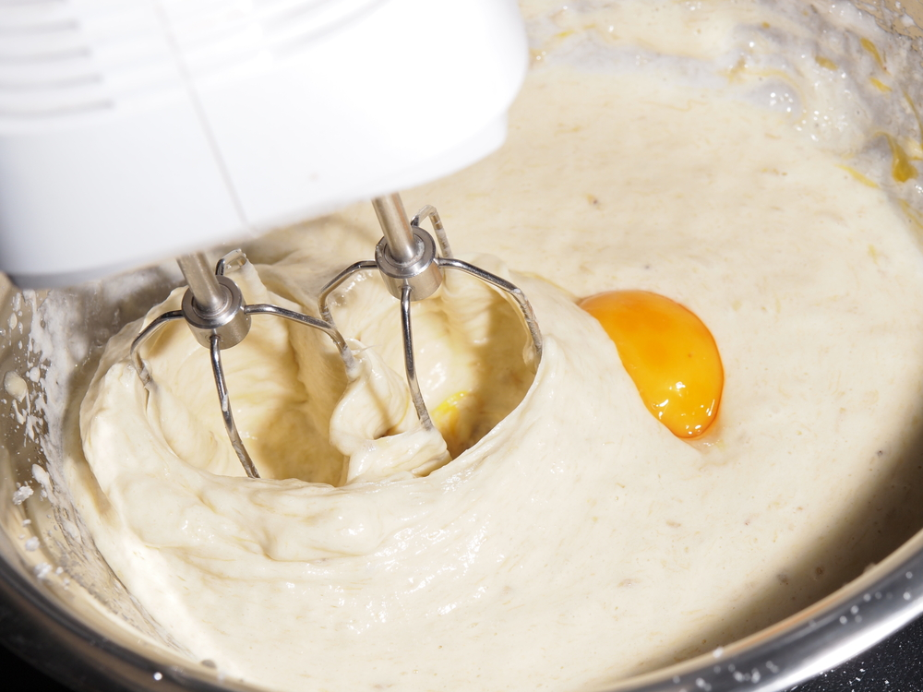
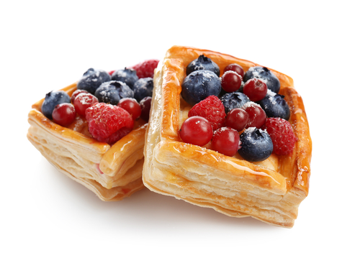
The science of raising agents
Air is introduced into mixtures in different ways. This is called a mechanical raising agent.
The air is trapped in mixtures by:
sieving flour;
rubbing in fat to flour e.g. shortcrust pastry;
creaming fat and sugar e.g. sponge cake;
whisking e.g. Swiss roll;
beating e.g. batter;
folding and rolling e.g. flaky pastry.

Slide 6
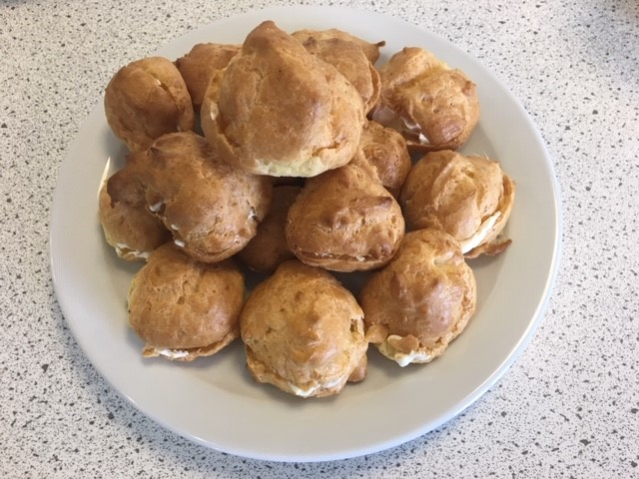
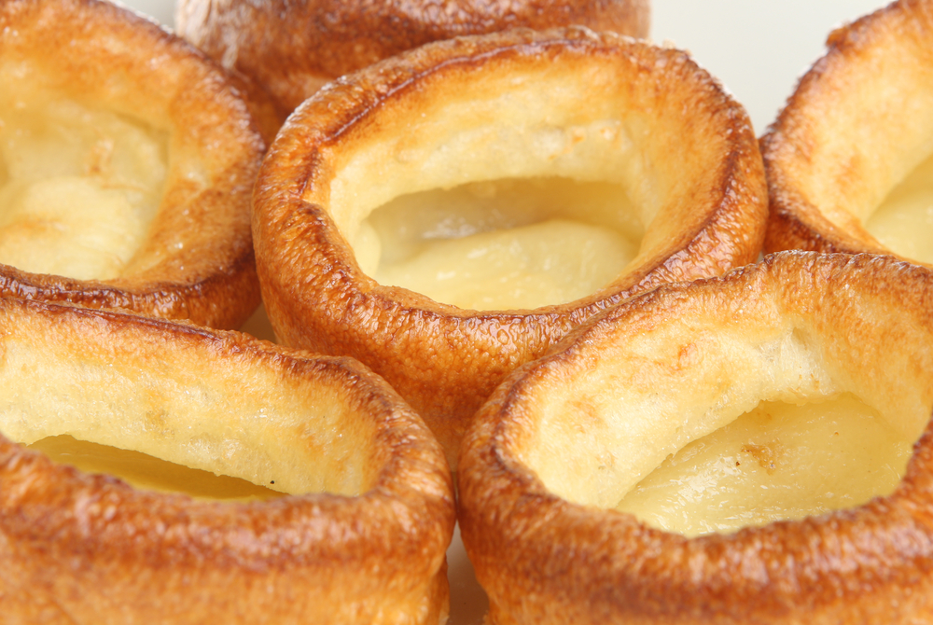
The science of raising agents
Steam is produced from liquid added to mixtures. It works as a raising agent for mixtures that contain a lot of water such as:
choux pastry;
batters;
flaky pastry.
It also helps other mixtures rise, for example:
along with air and carbon dioxide in cakes and bread;
along with air in pastry.
Savoury choux buns

Slide 7
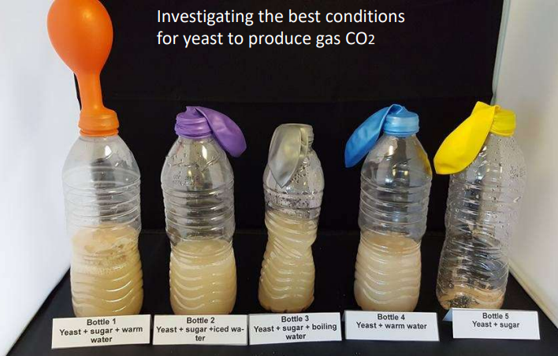
Carbon dioxide - how does it work?
Yeast – biological (in bread making)
Yeast needs the correct conditions to reproduce. These are: warmth, moisture, food and time.
In the right conditions the fermentation process takes place. The yeast uses the food (starch and sugar) to produce carbon dioxide gas.
The dough is left to prove in a warm place, the gas expands and rises the dough.
The high temperature of the oven kills the yeast, but the gas also expands more as it is heated, causing further rising.
Photograph courtesy of Barbara Monks @ https://thecookeryteacher.com/

Slide 8
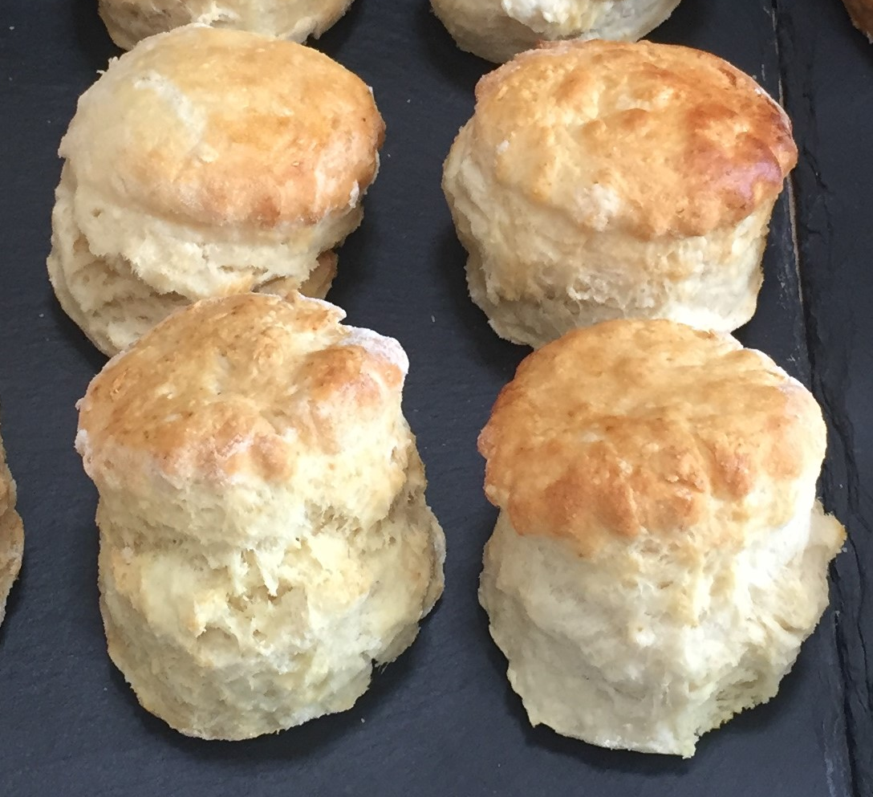
Carbon dioxide – how does it work?
Baking powder and bicarbonate of soda – chemical
Bicarbonate of soda creates carbon dioxide when mixed with an acid and heated.
The carbon dioxide bubbles that are produced allow the dough to rise.
Baking powder is a pre-made mixture of bicarbonate of soda (alkali) and cream of tartar (acid). The alkali and acid react with each other (in the presence of water) to produce carbon dioxide.
Baking powder is added to plain flour to make self-raising flour.
Mixtures that use baking powder and bicarbonate of soda should be used straight away as the gas dissipates quickly and the product won't rise as well.

Slide 9
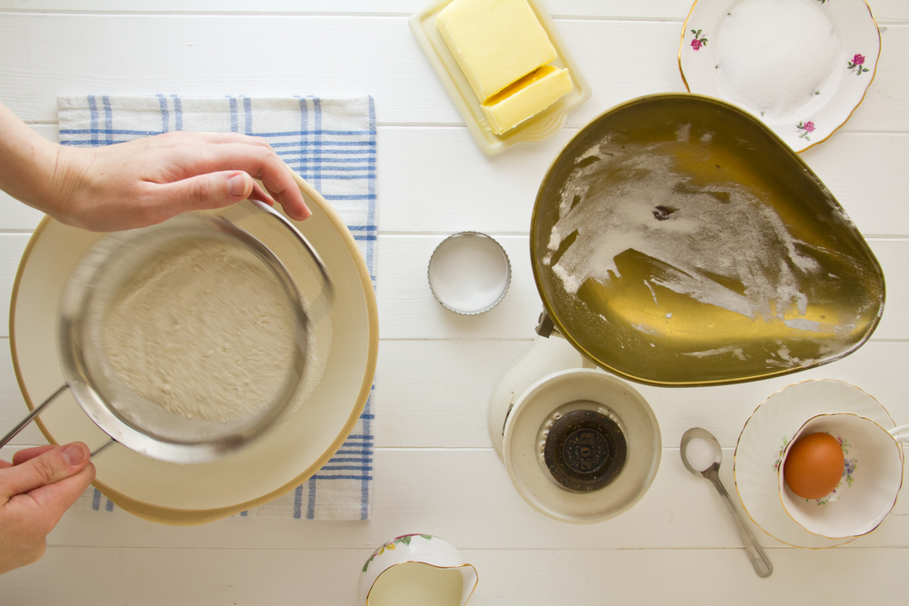
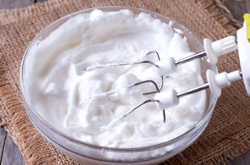
Air - how does it work?
Air is introduced into the mixture to help the mixture rise. When heated in the oven, trapped air can expand further.
Sieving and rubbing in traps air between the flour particles to help pastry, scones and cakes rise.
Creaming fat and sugar traps tiny air bubbles in the mixture. The mixture changes colour and becomes paler and looks creamy. The air bubbles expand in the heat of the oven and raise the mixture.
Whisking whole eggs and sugar traps air bubbles to create a foam. The flour is folded in gently and the mixture is cooked quickly to stabilise the foam.
Egg whites are whisked to trap air bubbles and make a foam for dishes such as mousses and meringues.

Slide 10
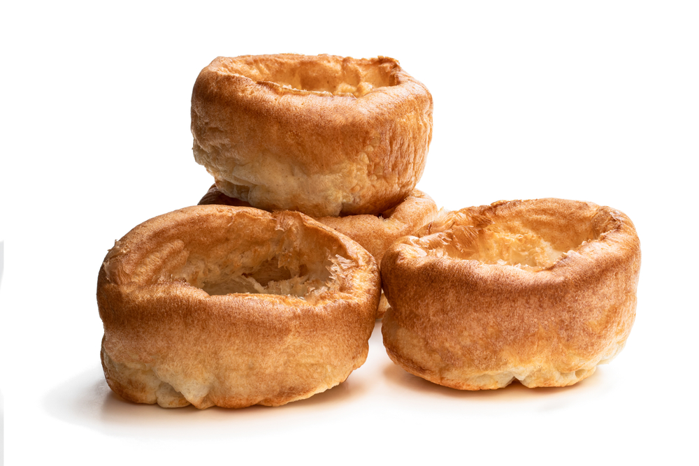
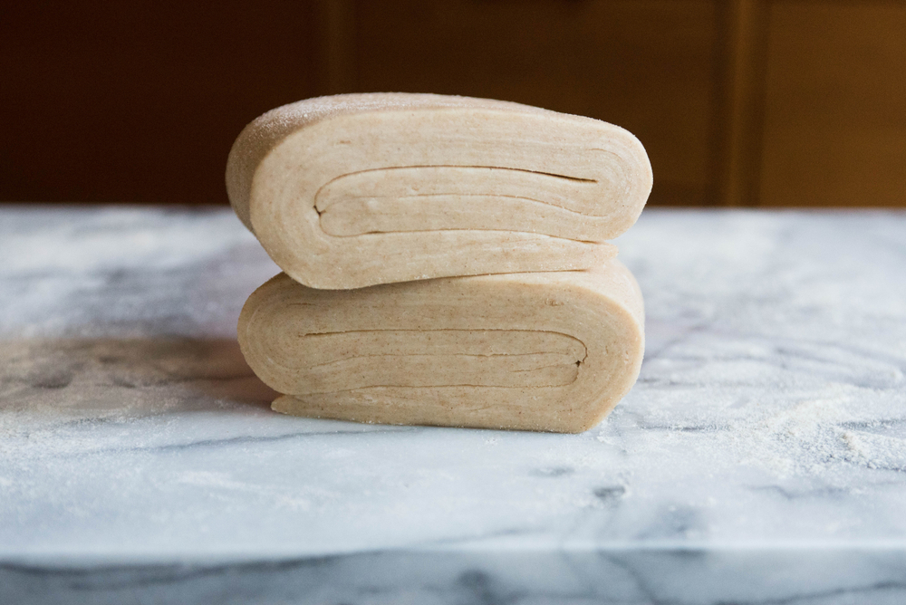
Air – how does it work?
Beating is used when making batters for recipes such as Yorkshire pudding or choux pastry. This adds a little air but in most batters steam is the main raising agent.
Folding and rolling is used to make flaky and puff pastry. Layers of air are trapped when the pastry is folded. During cooking the air expands in between the layers and rises the dough. This is also called lamination.

Slide 11
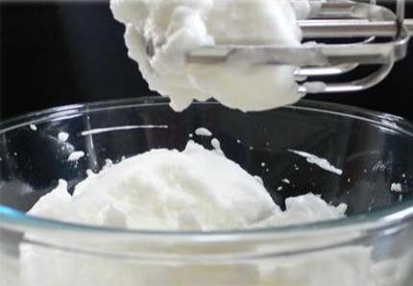

What is a foam?
Photograph courtesy of Barbara Monks @ https://thecookeryteacher.com/
A foam is made when a food is aerated.
This means a gas has been added to a liquid – an example would be air whisked into egg white.
It is called an air-in-liquid foam.
Creating a foam denatures the egg white protein. The strands of protein unravel and change shape and allow the egg white to trap the air bubbles and become light and airy.
Liquid egg white (blue for illustrative purposes)
Air starts to be incorporated
More air incorporated, proteins start to denature
Proteins denature, egg white traps air bubbles to form a foam

Slide 12
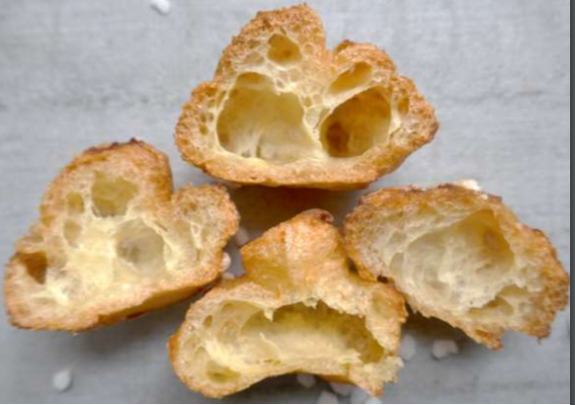
Steam - how does it work?
Steam is used in recipes such as batter, choux pastry and flaky pastry.
Steam is produced when the liquid in the recipe such as eggs, milk or water is heated in a high temperature oven. This is to raise the liquid quickly to boiling point to create the steam.
The steam is forced through the mixture making it rise and it is then set by the egg and flour making an open texture with pockets of air.
Photograph courtesy of Barbara Monks @ https://thecookeryteacher.com/

Slide 13
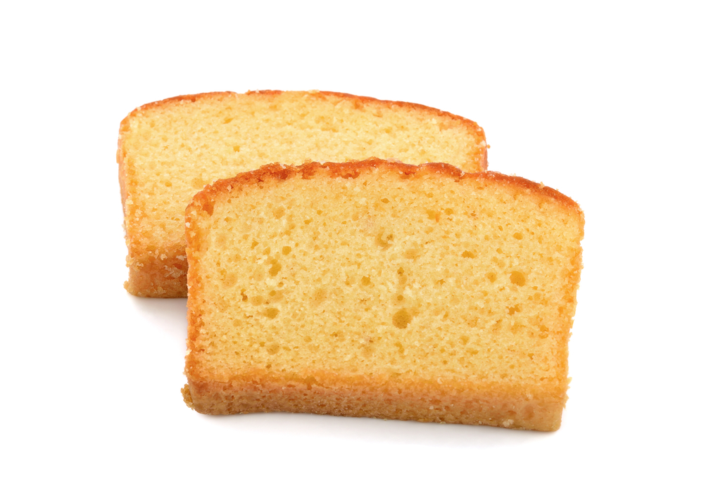
Raising agents working together
When making a creamed cake mixture, air, steam and carbon dioxide work together make the cake rise and produce a light, airy texture.
Air is added by:
creaming the fat and sugar together;
beating in the egg;
sieving the flour.
Steam is formed from the liquids in the mixture during cooking.
Carbon dioxide is given off by the baking powder when it is mixed with the liquid in the recipe and during cooking.

Slide 14

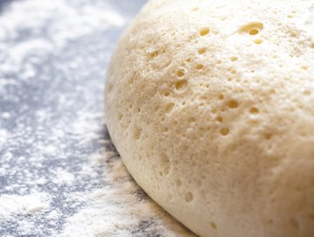
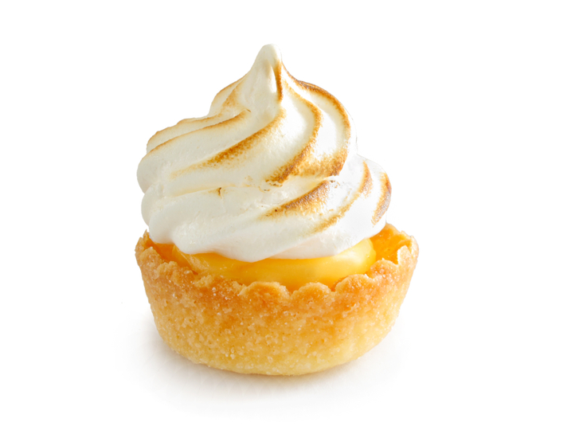
Applying the science
A whisk is used to aerate egg white to create a foam. This is used to make meringue.
Yeast is a biological raising agent. Given warmth, moisture, food and time it produces carbon dioxide.
The process is called fermentation.
Scones are raised by carbon dioxide, air and steam. The carbon dioxide is produced using a chemical raising agent.
This may be baking powder or self-raising flour.

Slide 15
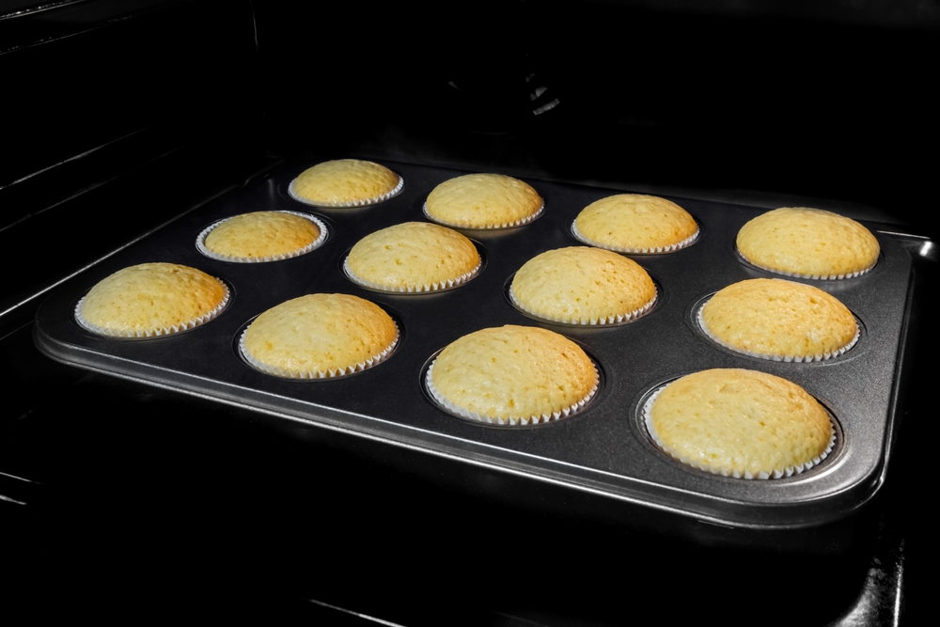
What happens in the oven?
After making a dish the raising agent should be distributed through the mixture. Air that has been added is in tiny bubbles.
When heated the raising agents work like this:
the air expands;
steam is produced from liquid which make the air cells bigger;
carbon dioxide is produced by yeast or the action of heat and moisture on the baking powder;
the carbon dioxide aerates the mixture. The gases expand when heated;
the gluten in the flour stretches as the mixture rises. The proteins in the egg and flour are coagulated by the heat and the mixture sets in its risen position.

Slide 16
Key words
Key word | Meaning
acid | Any substance that increases the concentration of hydrogen (H+) ions when added to a water solution (pH 1-6).
aerate | Incorporate air into a mixture.
alkali | Any substance that decreases the concentration of hydrogen (H+) ions when added to a water solution (pH 7-14).
beating | Mixing of ingredients using a wooden spoon, electric whisk, food mixer or food processor to thoroughly combine the ingredients.
carbon dioxide | A colourless gas composed of one carbon and two oxygen atoms.
coagulation | The irreversible denaturation of protein molecules, e.g., when liquid egg turns to solid during cooking.
creaming | Beating sugar and softened butter together to form a lighter-coloured mixture that is aerated.

Slide 17
Key words
Key word | Meaning
denaturation | A change in the structure of protein molecules, resulting in their unfolding, e.g., whisking egg white to make meringues.
fermentation | The process by which alcohol and carbon dioxide are produced from sugars by yeasts, e.g., during breadmaking.
foam | A colloid which has a gas dispersed in either a liquid, e.g., beaten egg white, or a solid, e.g., cake.
proving | When dough is allowed to rest before baking. During this time, fermentation takes place causing the dough to rise.
sifting | The method of passing flour, cocoa or icing sugar through a sieve to remove lumps and aerate it.
whisking | Rapidly beat or stir a substance to incorporate air.

Slide 18
Teachers’ guide

Slide 19
Teaching about raising agents
Explain why raising agents are used
Explain the different types of raising agents
Explain how the different types of raising agents work
Use examples to illustrate the above. For example, whisking egg white* to create a foam, the use of yeast
Give examples of recipes that demonstrate the use of different raising agents
Carry out investigations/experiments that demonstrate the scientific principle for the use of chemical, mechanical and biological raising agents.
*Teacher’s note: refer to the foams pack for more information

Slide 20
Introduction
Raising agents are used in baked products like scones, cakes and bread. They are used to aerate the mixture to give a light, airy, spongy texture.
Raising agents include anything that causes rising within foods, and are usually used in baked goods.
Raising agents are added to baked products during the preparation stage. They create gas, air or steam which expands when heated and causes the food to rise.

Slide 21
The science of raising agents
The gases are introduced to the mixture in different ways.
Carbon dioxide is produced by:
Yeast cells as they reproduce – this is called a biological raising agent.
Baking powder or bicarbonate of soda – this is called a chemical raising agent.
Air is introduced into mixtures in different ways. This is called a mechanical raising agent.
The air is trapped in mixtures by: sieving flour, rubbing in fat to flour (e.g. shortcrust pastry) creaming fat and sugar (sponge cake), whisking (Swiss roll), beating (batters) folding and rolling (flaky pastry).

Slide 22
The science of raising agents
Steam is produced from liquid added to mixtures. It works as a raising agent for mixtures that contain a lot of water such as choux pastry, batters, flaky pastry.
It also helps other mixture rise, for example: with air and carbon dioxide in cakes and bread and with air in pastry.
Yeast - biological
Yeast needs the correct conditions to reproduce. These are: moisture, warmth, food and time. In the right conditions – warmth (37°C), moisture, food and time – fermentation takes place. The yeast uses the food (starch and sugar) to produce carbon dioxide gas.

Slide 23
Chemical raising agents – how do they work?
Chemical raising agents are widely used in baked products like scones and cakes. They aerate the mixture evenly and can be measured easily to give accurate amounts.
There are 3 types that are used:
Bicarbonate of soda
Bicarbonate of soda + an acid
Commerical baking powder – prepared bicarbonate of soda + acid (usually acid calcium phosphate) plus a filler to absorb moisture during storage.
Self raising flour – plain flour and raising agent are blended. To every 400g of flour 4 x 5ml spoons baking powder are added.

Slide 24
Bicarbonate of soda
If used without an acid bicarbonate of soda reacts with heat and moisture to release carbon dioxide. It also forms sodium carbonate (washing soda) an alkaline which has a 'soapy' or bitter taste and a yellowish colour. It is therefore only used in strongly flavoured cakes such as gingerbread.
2 NaHCO3 CO2 + H2O + Na2CO3
Adding an acid such as cream of tartar (or lactic acid in buttermilk) stops this reaction and prevents the unwanted colour and flavour.
2 NaHCO3 + Acid HX CO2 + H20 + NaX
Sodium hydrogen carbonate
Carbon
dioxide
Water
Sodium carbonate
Sodium hydrogen carbonate
Carbon
dioxide
Water
Sodium salt - tasteless

Slide 25
Foams
A foam is made when a food is aerated.
This means a gas has been added to a liquid – an example would be air whisked into egg white. It is called an air-in-liquid foam.
Stages:
Early in the process the egg white is clear, there are bubbles that coalesce (join together into larger bubbles).
As whisking continues the proteins in the egg white stretch, bubbles become smaller and are surrounded by a thin film of egg white.
The bubbles become smaller and are trapped in the mixture to form a foam.
If whisking continues the foam becomes thicker, whiter and glossy.
Whisking creates enough heat to slightly coagulate the protein which stabilises the foam.

Slide 26
Foams – top tips
Eggs should be fresh – if the white has become alkaline the foam will be less stable.
Use eggs at room temperature – cold egg whites do not whisk as easily because they are more viscous.
Avoid any traces of fat in the egg white (including utensils and egg yolk) as it affects the formation of the foam and will have less volume.
If using a stabiliser such as lemon juice or salt, add after the initial 'foamy stage' this enhances the foam stability – the acid weakens the elasticity of the protein structure allowing the foam to stretch more.
Sugar delays form formation therefore takes longer create a foam.
Over whisked egg white protein causes the loss of volume and a dry foam which is difficult to add to other mixtures.

Slide 27
Raising agents working together
Raising agents are often used in combination with each other as in the example below.
Air is added by:
creaming the fat and sugar together;
beating in the egg;
sieving the flour.
Steam is formed from the liquids in the mixture during cooking.
Carbon dioxide is given off by the baking powder when it is mixed with the liquid in the recipe and during cooking.

Slide 28
Raising agents - activities
Pupils, individually or in groups, could:
Use the Raising Agents presentation to review and discuss their use and complete the Raising Agents worksheet
Learn more about aeration using the Aerate factsheet
Use the Meringues information sheet and recipe factsheet to investigate foams and their stability
Find out more about the function of colloidal systems in food products (14-16yrs) - presentation and worksheet
Investigate the effect of different conditions on yeast development – bread making yeast experiment and complete the gluten content investigation
Functions of ingredients (cakes) an information sheet
Teachers will need to decide on the level of complexity of the tasks chosen, depending on age, stage and need, and considering progression.

Slide 29
Further supporting resources
Functional properties of ingredients presentation and worksheet
Fats and their functional properties in food products presentation and worksheet
Food functions poster
Ingredients – functional characteristics knowledge organiser
Use The science of bread baking information sheet and Bread making – the theory to support a practical demonstration of bread making
The science of bread making presentation
Baking bread record sheet - a worksheet to record the functions of ingredients used in bread making
Bread activity pack - supporting teaching and learning around bread, its history, production and uses
Teachers will need to decide on the level of complexity of the tasks chosen, depending on age, stage and need, and considering progression.

Slide 30
Further supporting resources
Peer-to-peer practical food skills videos – using an electric hand whisk, folding in
Licence to cook recipe videos – dinner rolls, Finnish fruit plait, courgette and cheese muffins, mini fruit cakes, marble pear traybake
Scheme of work:
Year 7 - lesson plan 11 and lesson plan 12 (muffins)
Year 8 – lesson plan 4 (mini carrot cakes recipe)
Year 8 – lesson plan 13 and lesson plan 14 (bread making – pizza wheels)
Year 9 – lesson plan 9 (function of ingredients)
Resources around food science can be found here: 11-14 years, 14-16 years
Further information, support and resources around functional characteristics of ingredients can be found here 11-14 and 14-16.
Ingredients - functional characteristics Knowledge Organiser 11-14

Slide 31
Further support resources
External resources
IFST - Fats and oils – aeration
IFST - Food investigation - conducting experiments videos
IFST - Protein – foam formation
IFST - Stability of egg white foams experiment
IFST - Raising agents – biological (fermentation)
IFST - Raising agents - chemical
IFST - Raising agents – physical

Slide 32

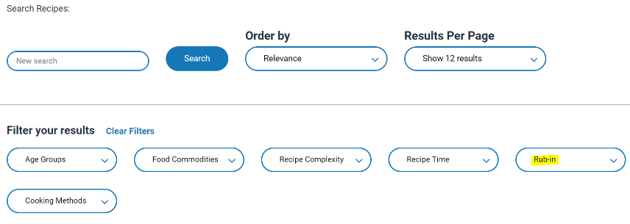
Raising agents - recipes
Yeast
Quick bread buns
Oatmeal loaf
Wholemeal cottage loaf
Naan bread
Simmit bread
Breakfast muesli loaf
Rosca de reyes (Mexican Christmas bread)
Potato and rosemary bread rolls
Go to the recipes section and filter Food Skills for more recipes.

Slide 33
Raising agents - recipes
Yeast
Pizza wheels
Pizza
Pesto pizza
Chelsea buns
Finnish fruit plait
Hot cross buns
Quick Jamaican coco bread
Paska
Go to the recipes section and filter Food Skills for more recipes.

Slide 34
Raising agents - recipes
Steam
Savoury filled choux buns
Air
Swiss roll
Chemical raising agents: Baking powder
Mini carrot cakes
Blueberry and oat muffins
Cheese and bacon muffins
Carrot and cranberry muffins
Chemical raising agents: Baking powder
Breakfast muffins
Fruity muffins
Chemical raising agents: Bicarbonate of soda
Gingerbread people
Soda bread
Anzac biscuits
Honey cake
Charlston sausage brunch (pancakes)

Slide 35
Raising agents
For further information, go to:
www.foodafactoflife.org.uk
This food science pack is one of a series of resources produced for the pHood Futures project, supported by the Royal Society of Chemistry.
This resource meets the Guidelines for producers and users of school education resources about food.

