Slide 1
Cost of living, diet inequalities and impact on learning
Ewen Trafford
Nutrition Education Officer, British Nutrition Foundation

Slide 2

Introduction
Childhood and adolescence is a challenging time due to high nutrient requirements and often less than adequate nutrient intakes.
However, COVID-19 and the cost of living crisis risk exacerbating the problem further.
We will review the health status in children and young people in England and the UK, and try to understand the implications of the cost of living crisis on schools and pupils.

Slide 3



Health status in children and young people
Intake of key foods (11-18 year-olds in the UK)
12%
4%
2g
getting 5-A-Day
getting enough fibre
avg. oily fish eaten per day
Overall dietary quality in UK children and adolescents is poor
This suggests that childhood and adolescence is a key time to make targeted changes
NDNS: results from years 9 to 11 (2016 to 2017 and 2018 to 2019)
Notes:
Only 12% getting 5-A-DAY and 4% getting enough fibre.
Both of these are an issue in the adult population too, but worse in teenagers.
Two portions of fish a week, one of which is oily is the general recommendation for oily fish
Children under the age of 16 should avoid eating any shark, swordfish or marlin. This is because the levels of mercury in these fish can affect a child's nervous system.
You can give boys up to 4 portions of oily fish a week, but it is best to give girls no more than 2 portions a week. This is because the low levels of pollutants that oily fish contain can build up in the body and may harm an unborn baby during a future pregnancy.
Research suggests that the overall dietary quality in UK adolescents is poor and not diverse. This is a period of change and therefore it is challenging to intervene but this is an important period for development.

Slide 4
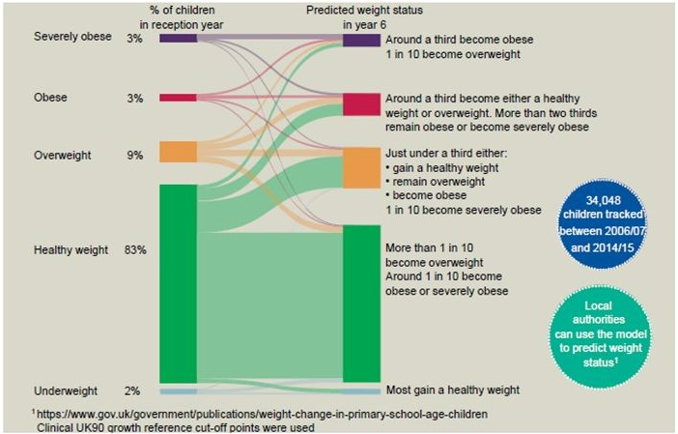
National Child Measurement Programme 2022
The NCMP was established in 2006. ~17,000 schools submit data to the Programme.
Current data show 1 in 5 children in England are obese by the end of primary school.
National Child Measurement Programme 2022: information for schools - GOV.UK (www.gov.uk)

Slide 5
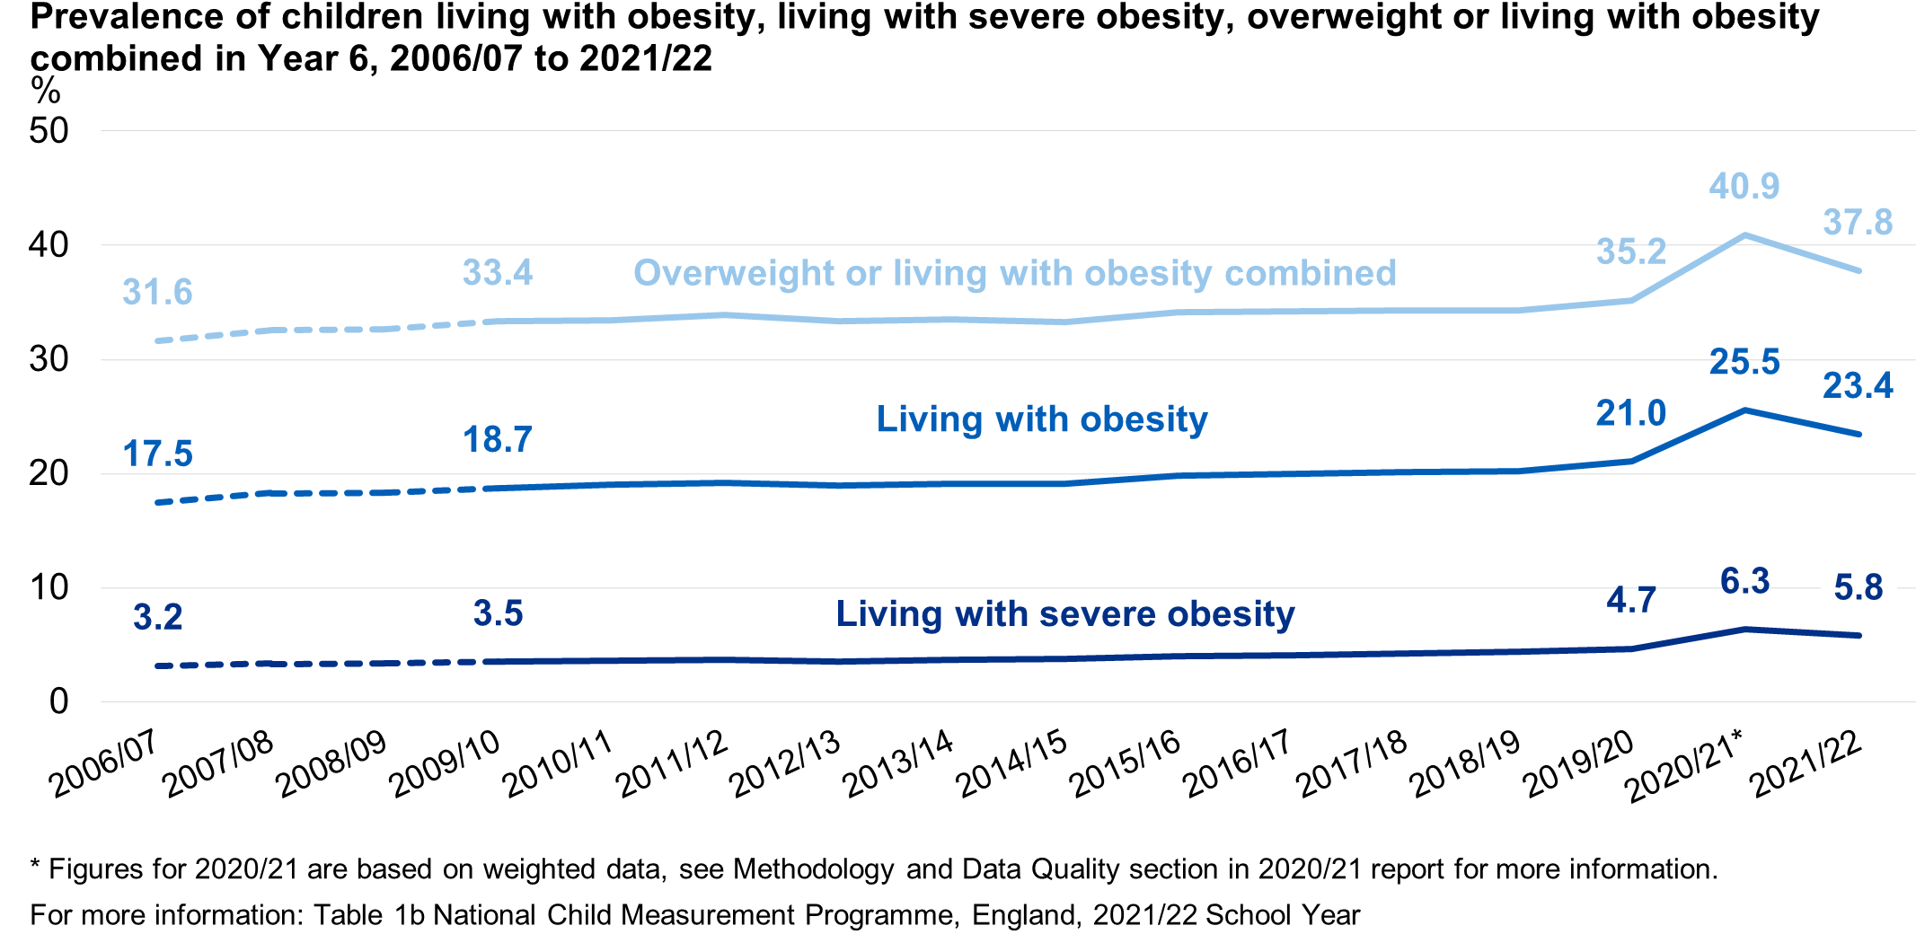
Health status in children and young people
Overweight, Obesity and Physical Activity (England)
1 in 5
obese by year 6
Fewer than 50%
meeting recommended activity guidelines
Statistics on Obesity, Physical Activity and Diet, England, 2020
National Child Measurement Programme England, 2021/22 school year, 2022
Notes:
1 in 5 by year 6 and this percentage continues to rise as children get older. Between the ages of 13 and 15, 36% of all children in England are overweight or obese. We can also see from this graph that the total overweight, obese and severely obese by age 11 has continued to steadily rise with time.
Guidelines – children and young people (5 to 18) should aim to be physically active for at least 60 minutes per day across the week.
Fewer than 50% of children and young people meet the recommended activity guidelines, compared to 67% of adults. We do know that boys are, on average, a little bit more physically active than girls as well.
When we factor in for deprivation, more deprived children have a much higher rate of obesity and as they get older this gap increases (Children in England by year 6 27.5% obese in most deprived areas vs 11.9% in least deprived) – NCMP 2019/20
Obesity in childhood tracks into adulthood
Part 1: Age, time series and sex - NDRS (digital.nhs.uk)

Slide 6
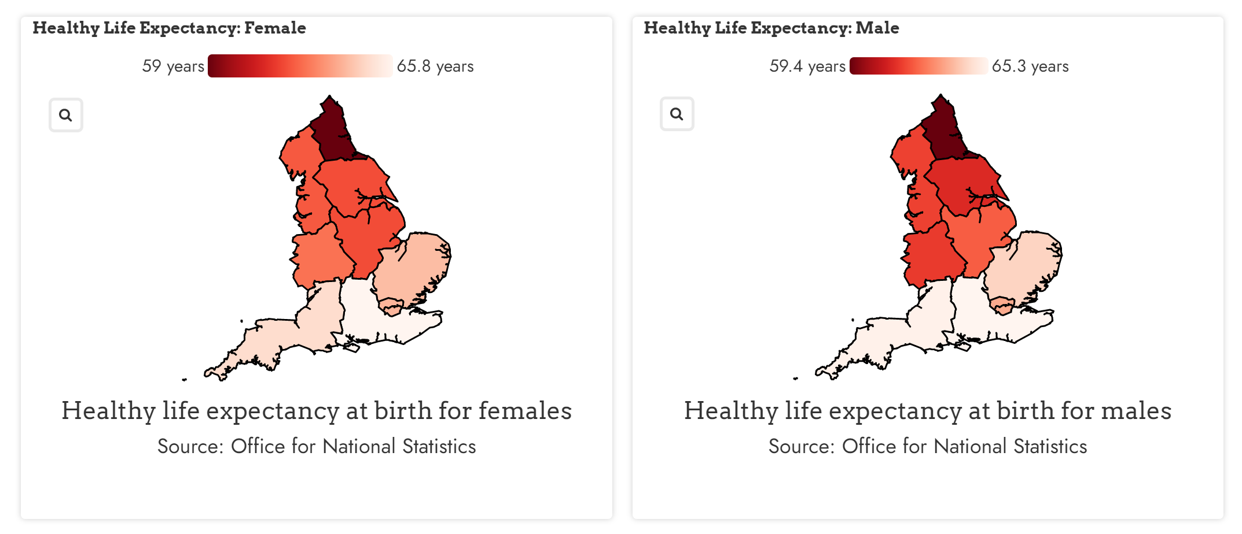
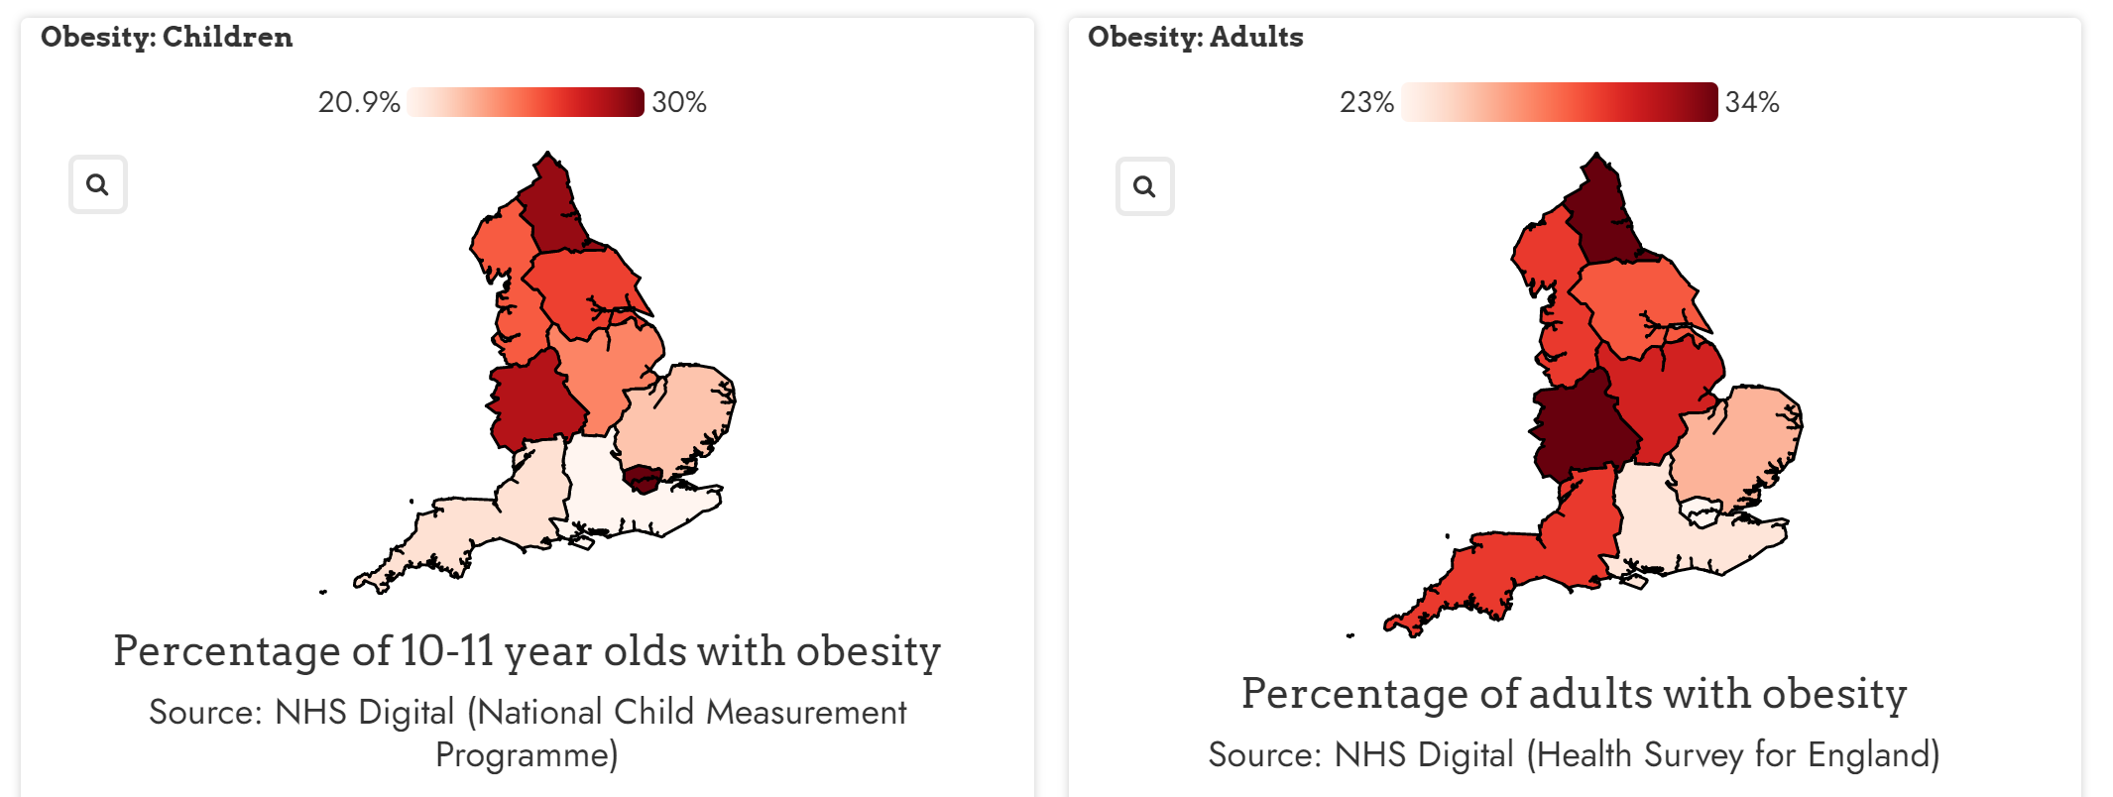
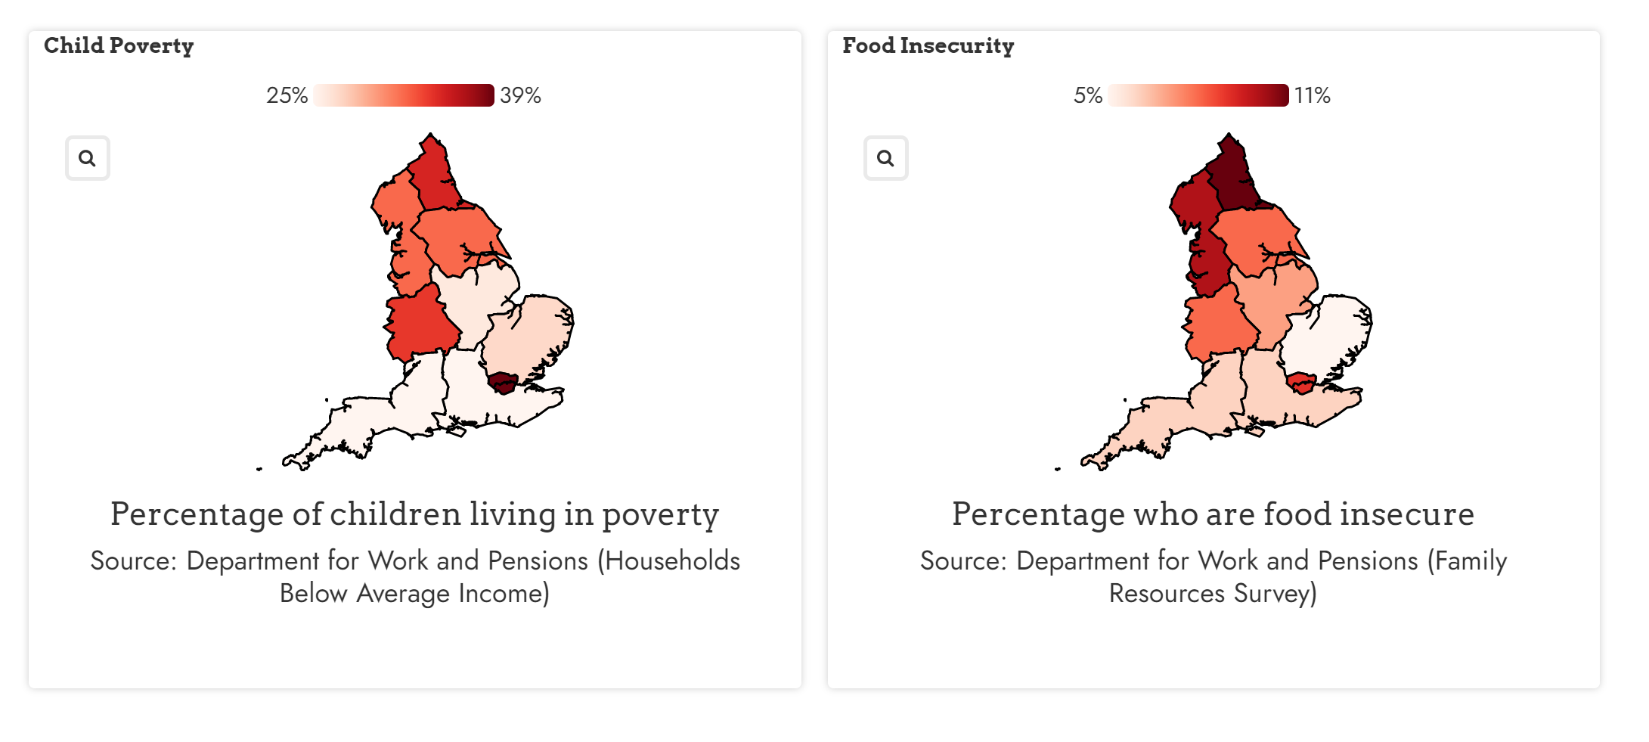
Health disparities (UK and England)
Disparities are evident for areas of England and the UK, particularly the Northeast and London (for some measures).
Levelling Up on Regional Dietary Inequalities: A Data Story | Food Foundation

Slide 7

Cost of living – children and families
8 in every 30 children are in poverty.¹
An estimated 500,000 more children will be pushed into poverty if wages don’t increase with inflation.²
1 in 5 parents in Great Britain have said they struggled to provide food during the cost of living crisis.³
Over a quarter said their child’s mental health had worsened due to the situation.³
Courtney Sutton (Action for Children)⁴ describes one family’s situation:
“We’re working with a family who are on a low income. They aren’t entitled to public funding and they’re in a rented one-bedroom flat costing £1000 a month. The family rely on dad's income, but mum has now returned to work to support the family – just three months after having a baby.
Without charitable support, the family would have struggled for basic food and essentials.”
Child poverty facts and figures | CPAG
Cost-of-living report: impacts on children and young people | Barnardo's (barnardos.org.uk)
Lack of support for low-income families will see 1.3 million people pushed into absolute poverty next year • Resolution Foundation
How is the cost of living crisis impacting children? | Action For Children

Slide 8

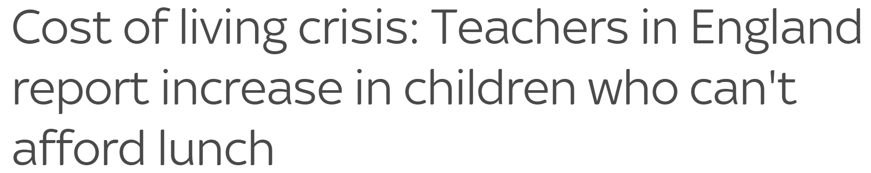

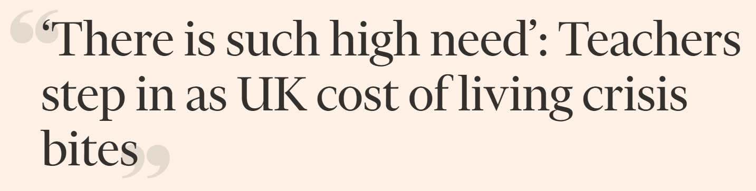
Cost of living affecting schools
1
Costs of energy bills and resources for schools rising dramatically due to inflation.
Anecdotal evidence of:
  Reduced uptake of after-school clubs
  Increase in pupils skipping meals
  Increased absences due to fuel prices
  Printing bans
  Reductions in clothing donations
Energy bills have as much as trebled in some schools.
The National Association of Head Teachers says 9 in 10 schools will fall into a deficit by the next academic year.
2
3
4
Schools face bankruptcy as energy bills jump 300% during cost of living crisis (inews.co.uk)
Cost of living crisis: Teachers in England report increase in children who can't afford lunch | UK News | Sky News
Cost of living: Schools now 'part of the welfare state' (schoolsweek.co.uk)
‘There is such high need’: Teachers step in as UK cost of living crisis bites | Financial Times (ft.com)
Notes:
2. 15 points higher for deprived schools

Slide 9
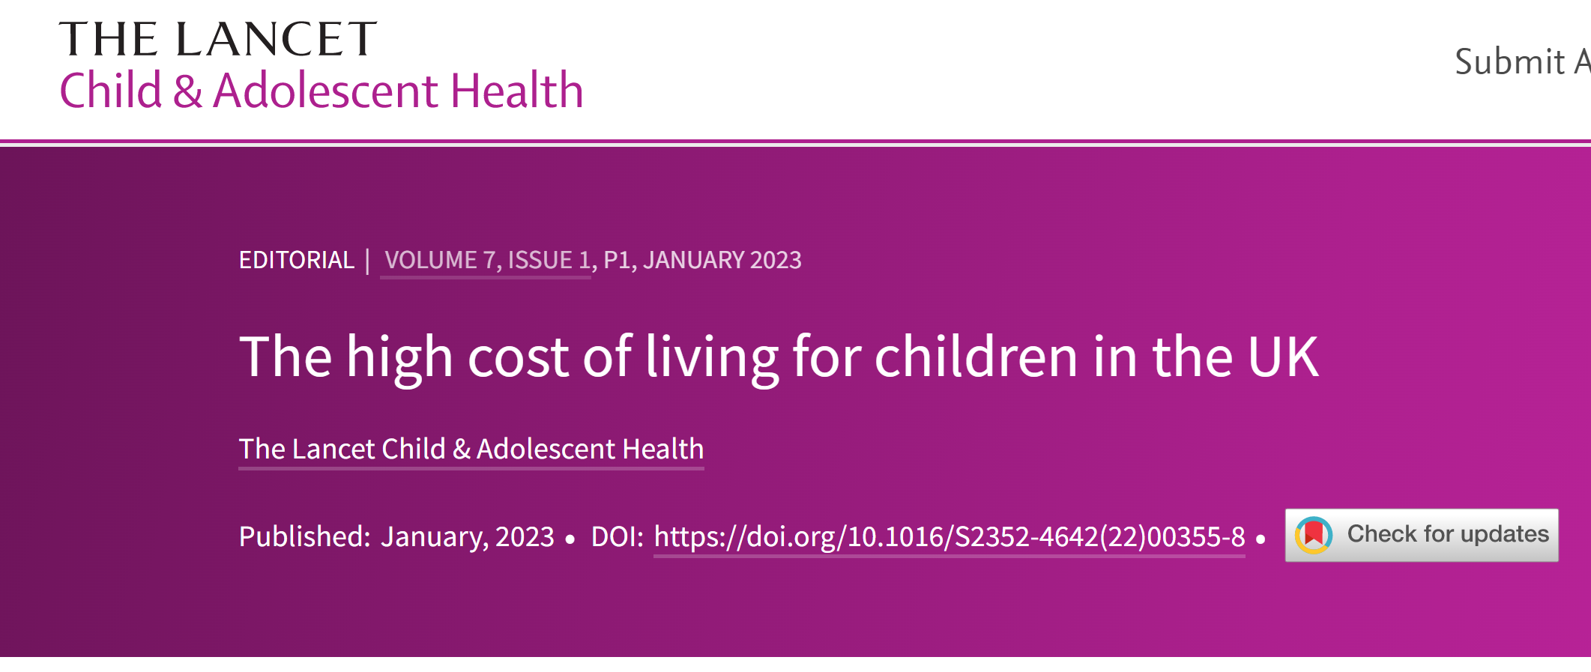
Additional research and professional opinion
Mounting evidence of increased poverty in UK children is becoming more apparent in hospitals.¹
The Lancet recently published an editorial² on the cost of living for UK young people:
  Children and young people living in poverty 72% more likely to be diagnosed with long-term illness.
  90% of the UK has seen a rise in living costs.
The All-Party Parliamentary Group³ (Jan ’23) found that:
  23% of children in England who are food insecure miss out on free school meals.
  34% of children in the North were living in poverty during COVID-19. 28% in the rest of England
How the cost of living crisis is damaging children’s health | The BMJ
The high cost of living for children in the UK - The Lancet Child & Adolescent Health
Cost of living: One in three children in North living in poverty - BBC News

Slide 10
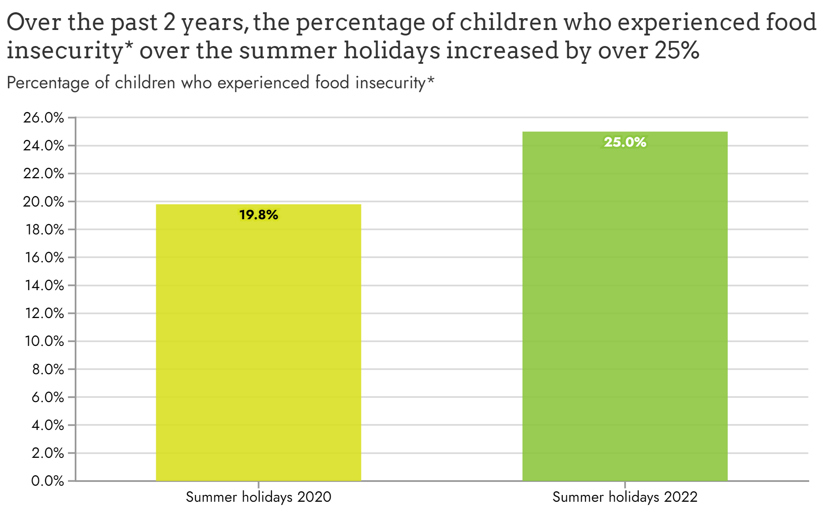
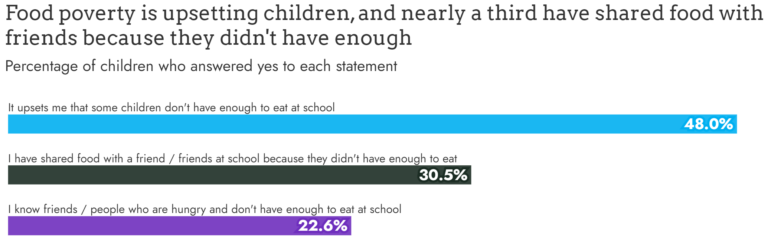
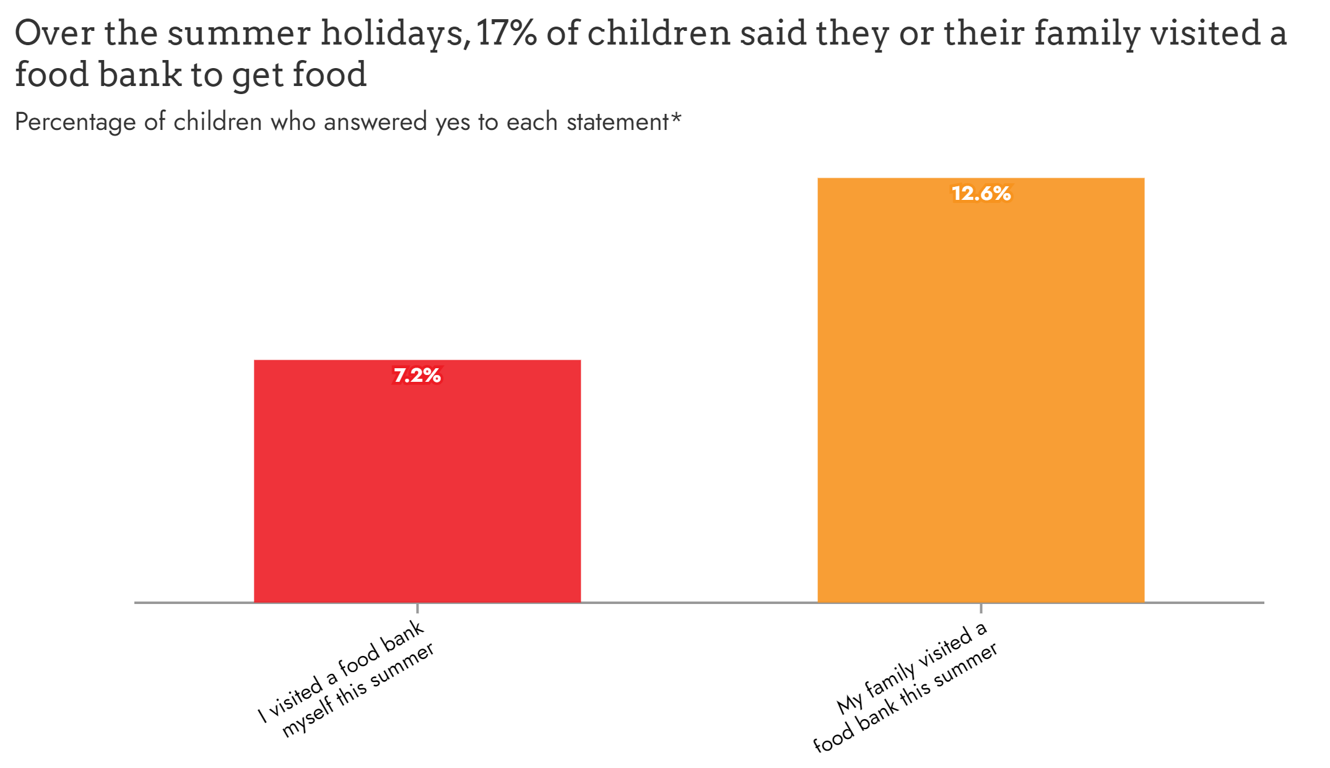
Food insecurity in English children
The Food Foundation publishes surveys, including ‘Children’s experiences of food poverty in England’:
These results were from a ‘Childwise’ survey, conducted with 1,000 children.
Food Insecurity Tracking | Food Foundation
Notes:
Food Insecurity Tracking | Food Foundation

Slide 11

Free School Meals
Several organisations recommend the extension of free school meals to all primary school pupils in England.^{1,2}
The UK Government has extended eligibility to children in households with no recourse to public funds (e.g., those without immigration status, on work visas, some asylum seekers etc.).²
According to a 2022 survey, more than half of school leaders in England are seeing more pupils who cannot afford meals, who are not eligible for free school meals.³
The Government rejected expanding FSM eligibility in 2022 and the threshold remains the same, despite inflation.
National Food Strategy: The Plan – Independent Review
At what cost? The impact of the cost-of-living on children and young people (Barnardo’s)
Providing free school meals to families with no recourse to public funds (NRPF) - GOV.UK (www.gov.uk)
School leaders report rise in pupils not on free meals going hungry | Schools | The Guardian (ampproject.org)
Notes:
3. (6,200 teachers in England) Almost 2/3 in the most deprived schools. Survey also showed almost ¾ of teachers said financial pressures

Slide 12
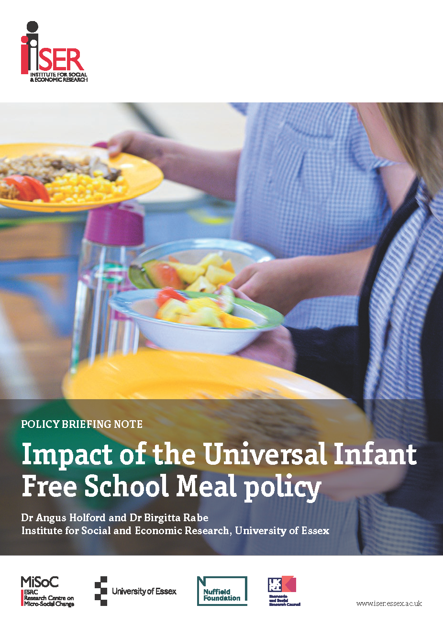
Healthy eating and food in schools (England)
The University of Essex report on impact of Universal Infant Free School Meals policy¹ found:
  Take-up of school meals by non-FSM pupils rose from 30-35% to 85%.
  Families saved ~£20 per month.
  Children in healthy weight range improved by 1.1 percentage points
  Absence rates reduced
Final report published on the impact of Universal Infant Free School Meals policy - Institute for Social and Economic Research (ISER) (essex.ac.uk)
Notes:
Final report published on the impact of Universal Infant Free School Meals policy - Institute for Social and Economic Research (ISER) (essex.ac.uk)

Slide 13
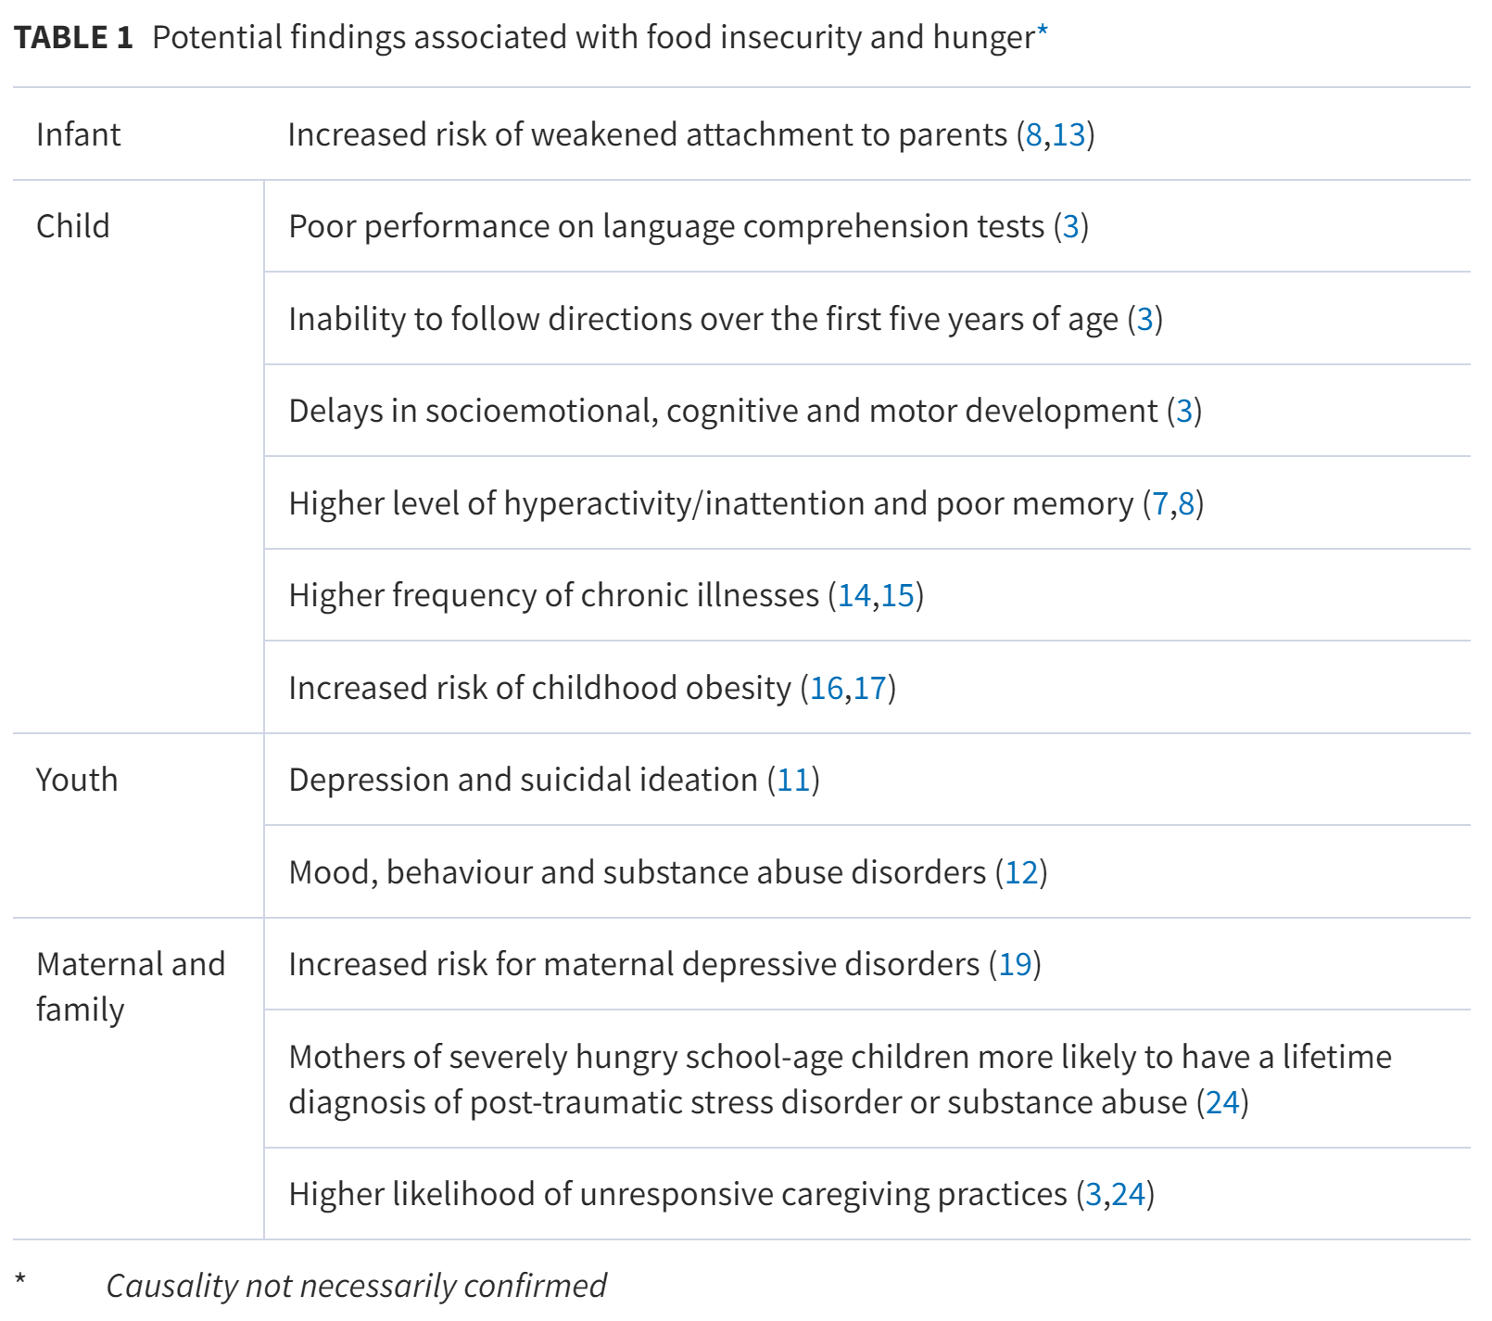
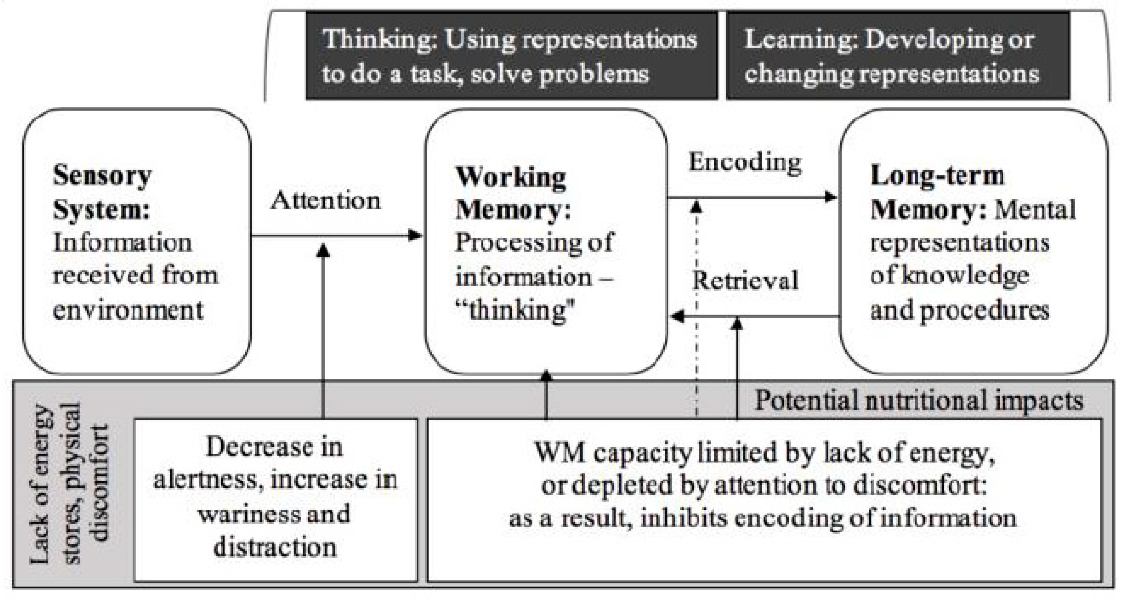
Hunger and learning – acute and chronic effects
Hunger is associated with:
  Poorer cognition and learning
  Mental health concerns
  Behavioural issues
  Higher risk of chronic disease
  Higher risk of overweight and obesity
2
1
Nutrients | Free Full-Text | How Lifestyle Factors Affect Cognitive and Executive Function and the Ability to Learn in Children (mdpi.com)
Food insecurity and hunger: A review of the effects on children's health and behaviour | Paediatrics & Child Health | Oxford Academic (oup.com)

Slide 14
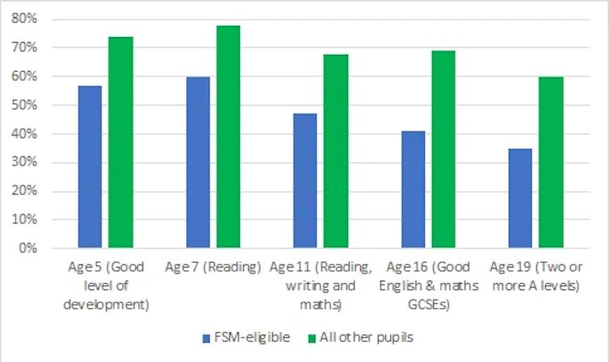
Financial inequality and attainment
Research consistently demonstrates lower attainment for children from disadvantaged households, gaps widening with age.¹
Over three quarters of educators responding to a survey stated that their students had demonstrated fatigue or poor concentration as a result of poverty.²
More than half said their students had experienced hunger or ill health. ²
Over a third said their pupils experienced bullying due to their financial circumstances. ²
A
B
Notes:
The UK education system preserves inequality – new report | Institute for Fiscal Studies (ifs.org.uk)
Child poverty - the facts | NEU
Child poverty and education outcomes by ethnicity - Office for National Statistics (ons.gov.uk)

Slide 15
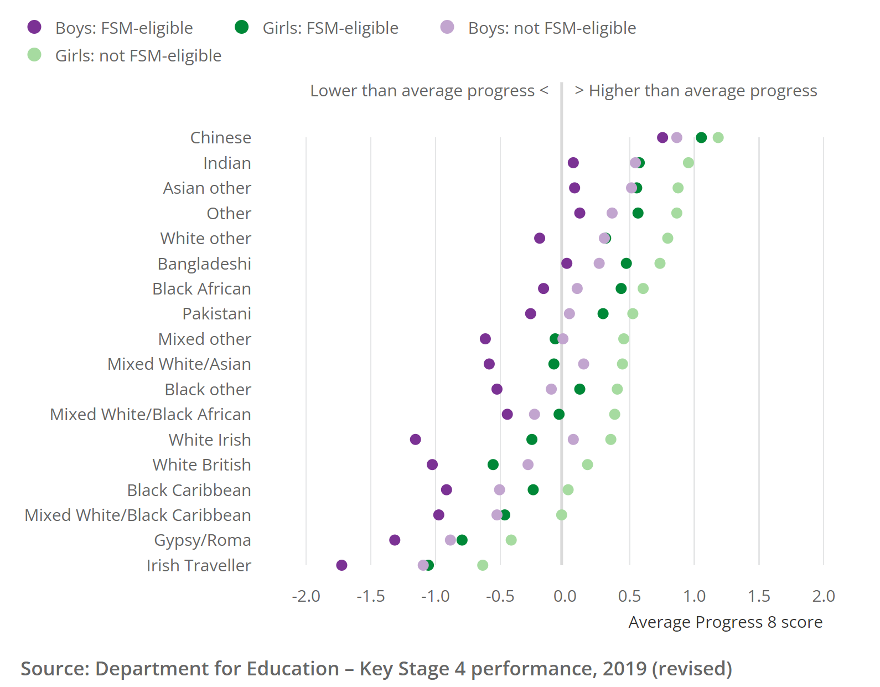
Financial and ethnic inequalities
DfE data shows lower attainment for certain ethnicities, as well as lower on average for those who are FSM-eligible.
Boys are also shown to be performing worse, on average, than girls.
Child poverty and education outcomes by ethnicity - Office for National Statistics (ons.gov.uk)
Key stage 4 performance 2019 (revised) - GOV.UK (www.gov.uk)
Notes:
Disparaties on a local level as well, particularly in cities, where averages across large populations don’t tell full story

Slide 16
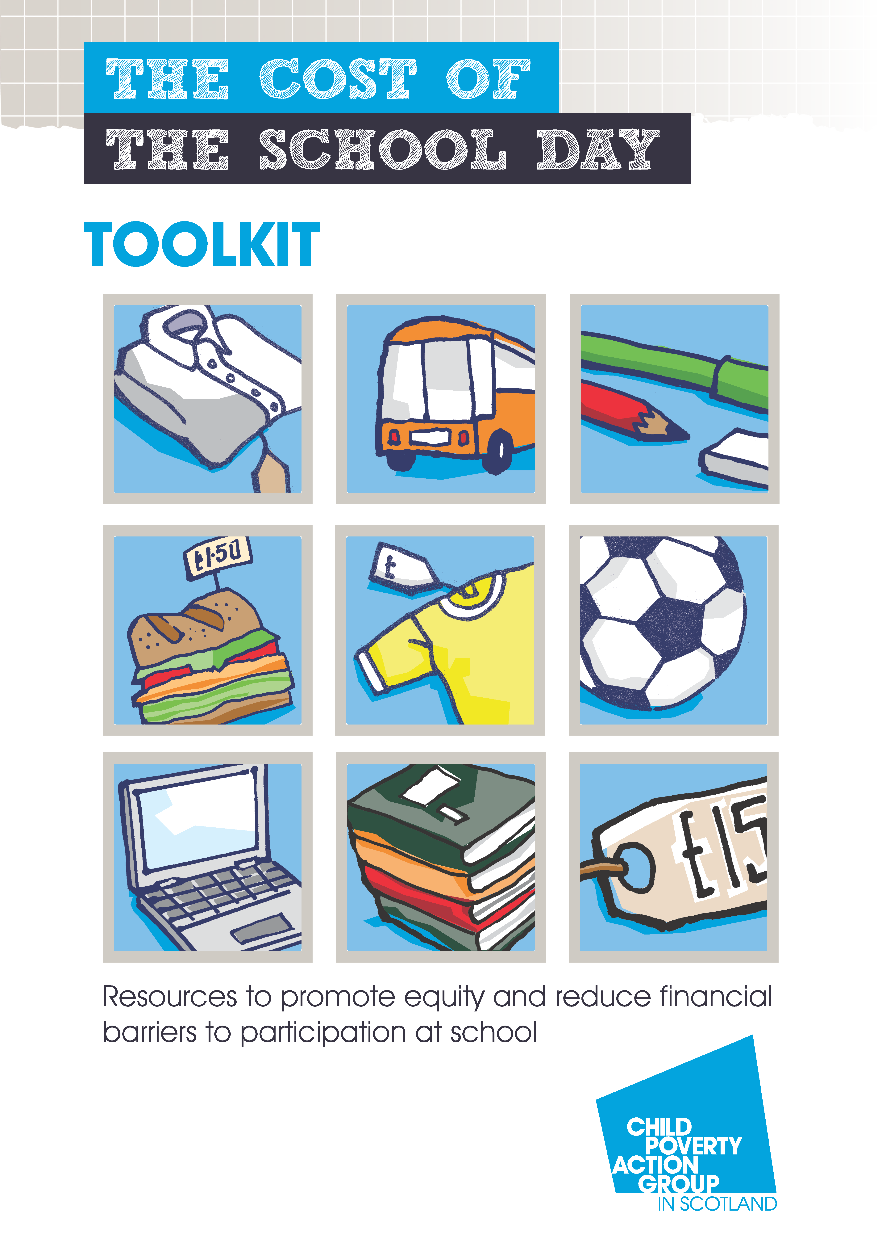
The Cost of the School Day
Growing concerns about levels of child poverty in Scotland, exacerbated by COVID-19.
The Cost of the School Day Toolkit was commissioned by Public Health Scotland, to help schools ‘investigate cost barriers and poverty related challenges.’
The Toolkit contains a 5-step programme to walk through the procedure from start to finish:
  Do the Groundwork
  Involve Your School Community
  What Did You Find Out? Identify Actions
  Put Cost of the School Day Actions in Place
  Regularly Revisit Your Action Plan
The Cost of the School Day, Child Poverty Action Group, 2021
Notes:
after break Louise Davies with be talking about the impact of the cost of ingredients on food lessons across the UK. Also we have two case studies from teachers how they support families and pupils.
Attendance can be lower where transport, fundraising or other self-funded activities are used

Slide 17

Conclusion
As a nation, we face stark challenges related to obesity outcomes and other facets of health.
1 in 5 children leave primary school obese, and nutritional status in adolescents is poor.
Continuing cost of living crises are likely to exacerbate these issues.
Schools continue to try to cut costs to curb increased prices.
Much of the quantitative data on disparities and health status is from 2021 or earlier and so the full extent of the cost of living crisis is yet to be fully realised.
Notes:
Key takeaway: The combination of COVID-19 and the ongoing cost of living crisis has further increased the burden upon pupils, their families and their schools. Understanding the implications of the crisis and how it relates to your school, your classes and most importantly your pupils will go some way towards alleviating the negative effects, but ultimately, the burden lies with policymakers to support schools in this difficult time.

Slide 18
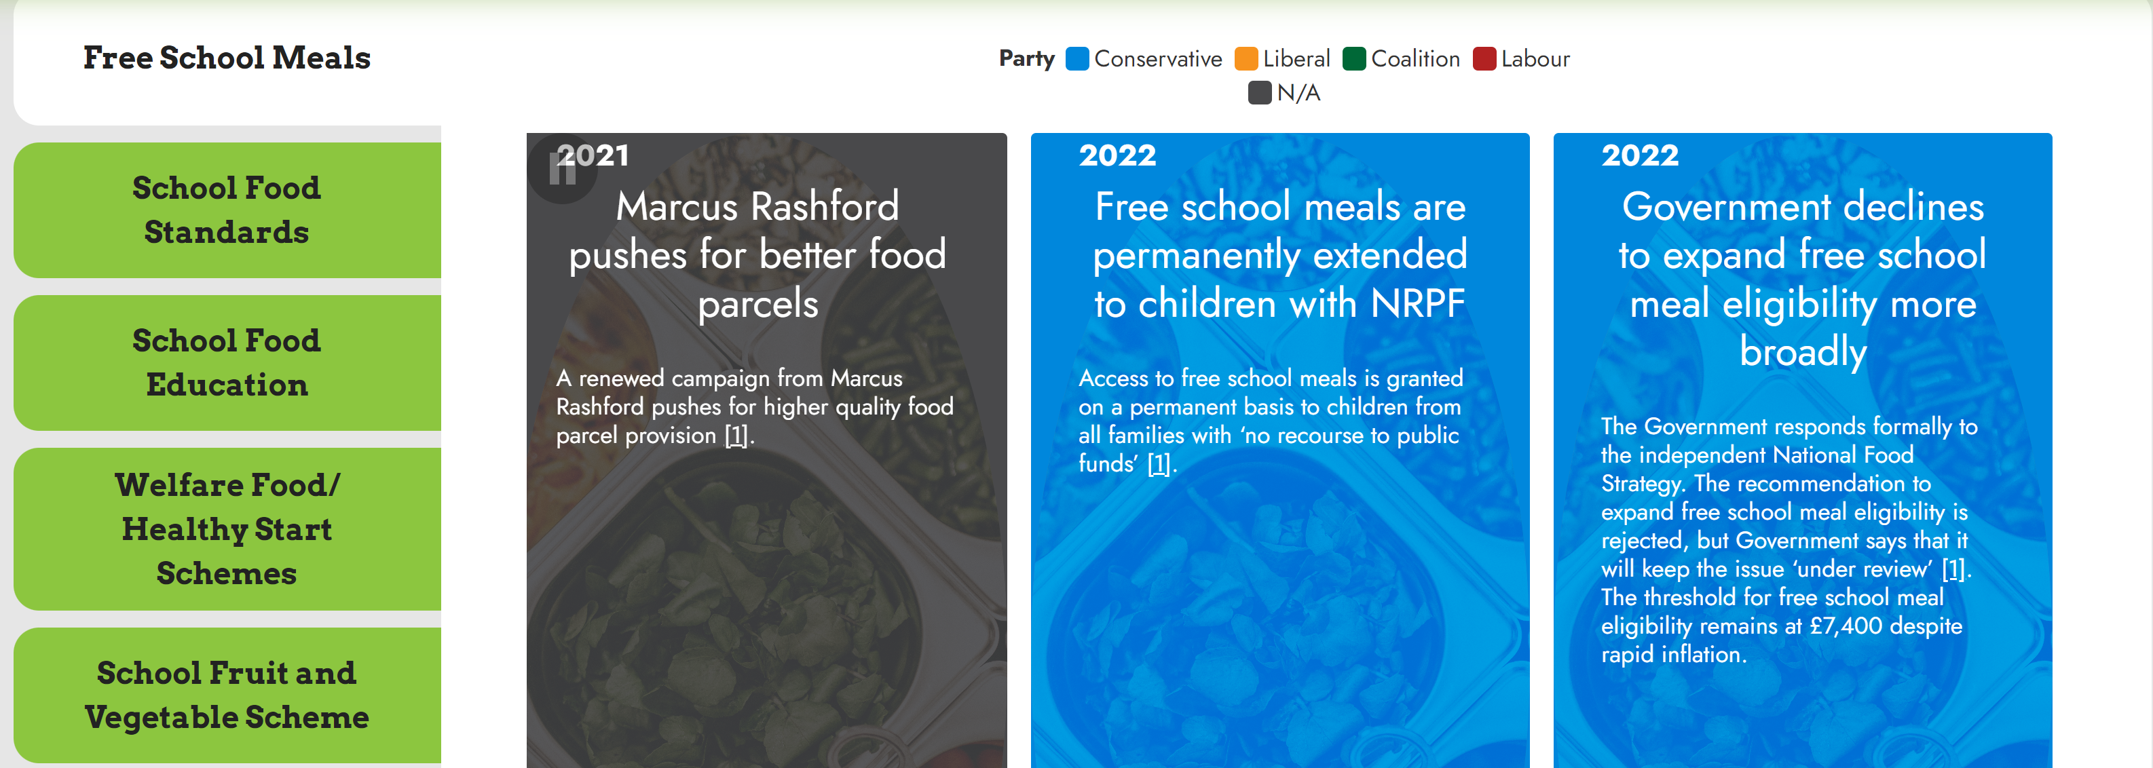
Additional resources
The Children’s Food Policy Library is hosted by the Food Foundation.¹
The Library serves as a guide to campaigns and legislation over time that affects policy.
This is a useful resource for keeping up to date with relevant legislation surrounding schools
Ofsted’s ‘Common Inspection Framework’ includes inspections of whether pupils gain knowledge of how to eat and live healthily and make informed choices about food and activity.²
DfE have published a ‘practical guide’ for school food standards, including advice and checklists for school meals.³
Children's Food Policy Library | Food Foundation
Creating a culture and ethos of healthy eating - GOV.UK (www.gov.uk)
School food standards practical guide - GOV.UK (www.gov.uk)

Slide 19
Thank you

