Slide 1
Supporting teaching knife skills in primary school
Claire Theobald, Education Services Manager (primary)
Frances Meek, Education Services Manager (secondary)

Slide 2
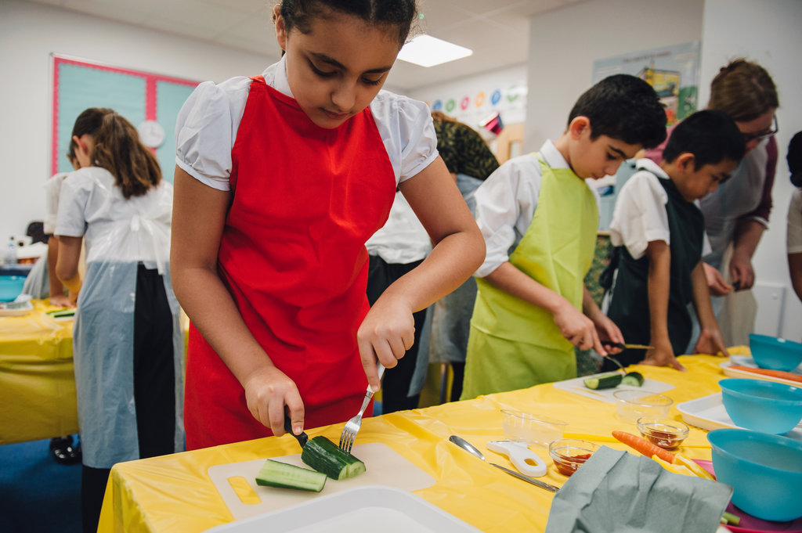
This session will cover:
Setting up practical food lessons (a reminder)
Teaching practical food skills (e.g. using a knife)
Making Stripy salad pots
Demonstration and guidance on delivering good food hygiene and safety practices
Links to Food – a fact of life resources

Slide 3
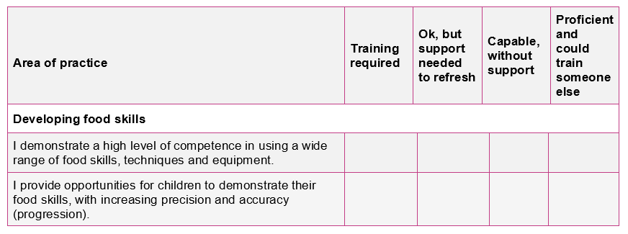

Your audit (completed with registration)
Developing food skills
Audit document is also available online (see Supporting documents)

Slide 4

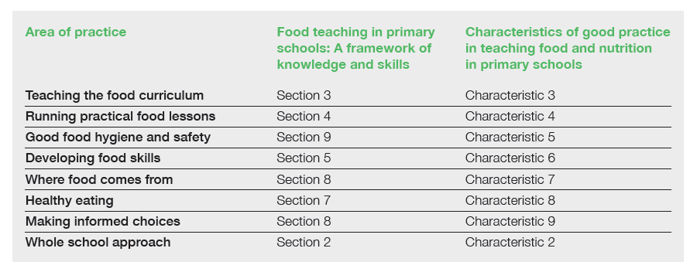


Developing food skills
Supporting documents
TPFN booklet, page 5

Slide 5
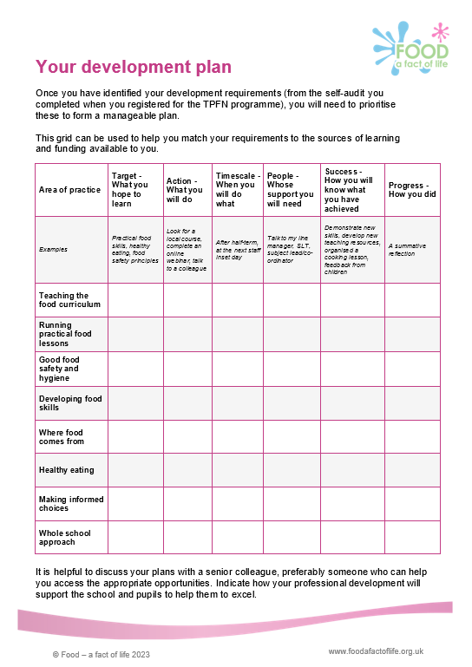
Your development plan
Developing food skills
Area of practice | Target - What you hope to learn | Action - What you will do | Timescale - When you will do what | People - Whose support you will need | Success - How you will know what you have achieved | Progress - How you did
Developing food skills | Cutting techniques | Look at food skills videos and guide on FFL (links in TPFN email update, Feb ‘2023). Visit local secondary to observe a food lesson. Attend FFL training event 29 March 2023 - Supporting teaching knife skills. | After Easter - teach Hedgehog class bridge hold and fork secure to make a fruit salad. | Check with Head teacher if can use planning (PPA) time to visit secondary school to do an observation. | Hedgehog class use food skills safely to prepare fruit – photos! Share feedback at staff meeting. | Food skills videos useful. Re-watch and share with pupils. Helpful visiting Fizal - seeing food skills and being able to discuss techniques.
The development plan is available online (see Supporting documents)

Slide 6
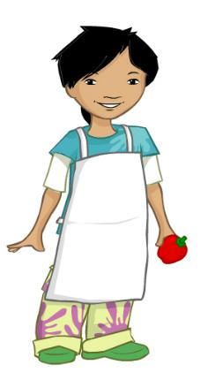
Getting ready to cook
All adults must be a role model!
Tie long hair at the back of your head.
Roll up long sleeves.
Remove nail varnish.
Remove jewellery.
Put on an apron.
Wash and dry hands.

Slide 7
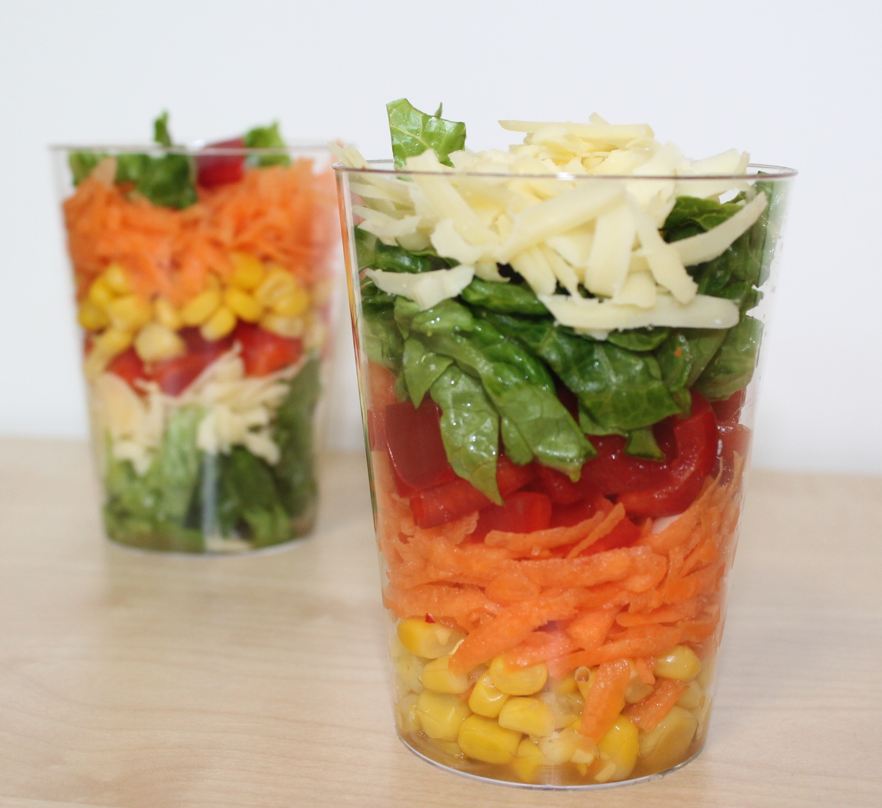
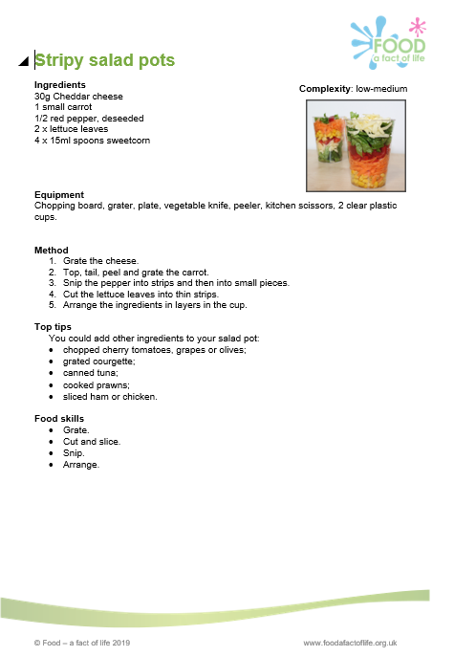
Stripy salad pot
Ingredients
30g Cheddar cheese
1 small carrot
1/2 red pepper, deseeded
2 x lettuce leaves
4 x 15ml spoons sweetcorn
Equipment
Chopping board, grater, plate, vegetable knife, peeler, kitchen scissors, 2 clear plastic cups.
Method
Grate the cheese.
Top, tail, peel and grate the carrot.
Snip the pepper into strips and then into small pieces.
Cut the lettuce leaves into thin strips.
Arrange the ingredients in layers in the cup.
Recipe

Slide 8
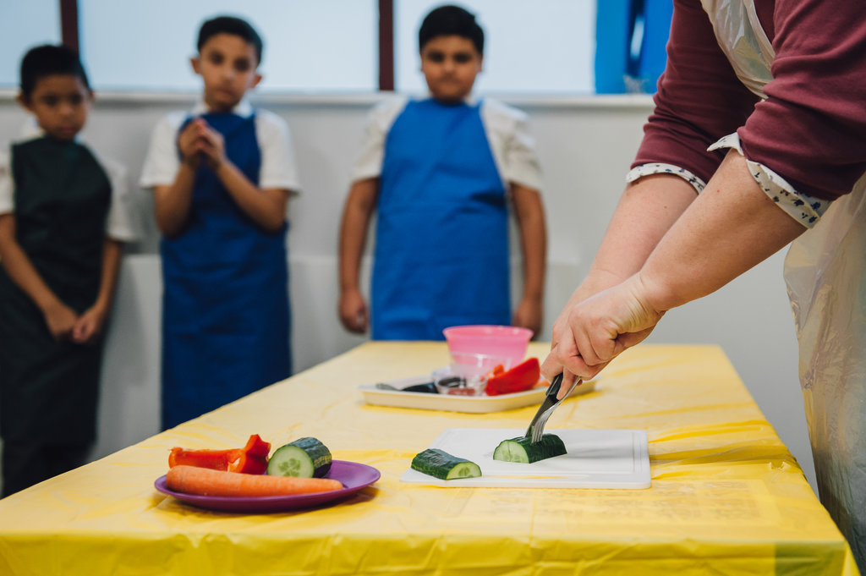
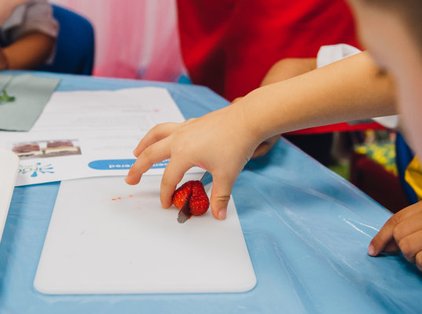
Developing food skills
Thinking about you
Make sure you feel confident about teaching the food skills safely
Plan a manageable lesson that you feel comfortable with - start small, e.g. soft fruit and table knives!
Be organised and think everything through carefully – risk assessment
Organise extra support in the classroom
Put procedures in place in case of an injury – make sure pupils know about these too
Make sure you are confident and comfortable with your plan for the lesson.

Slide 9
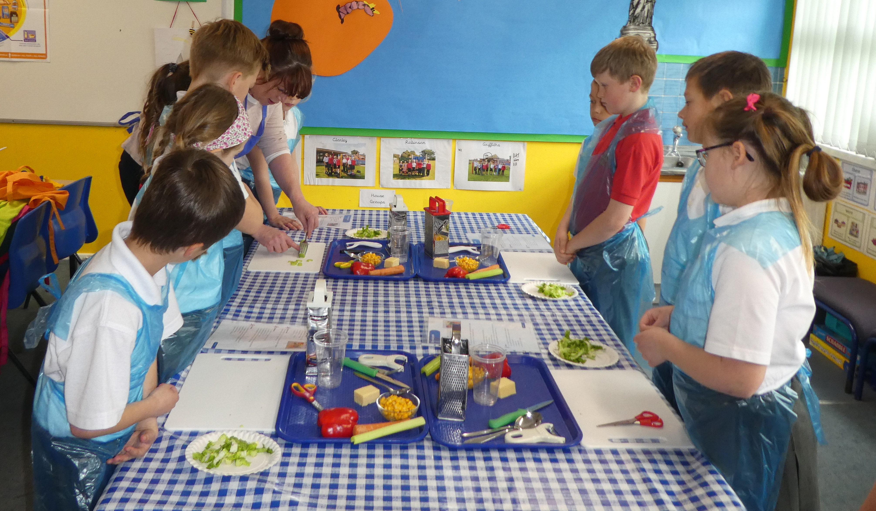
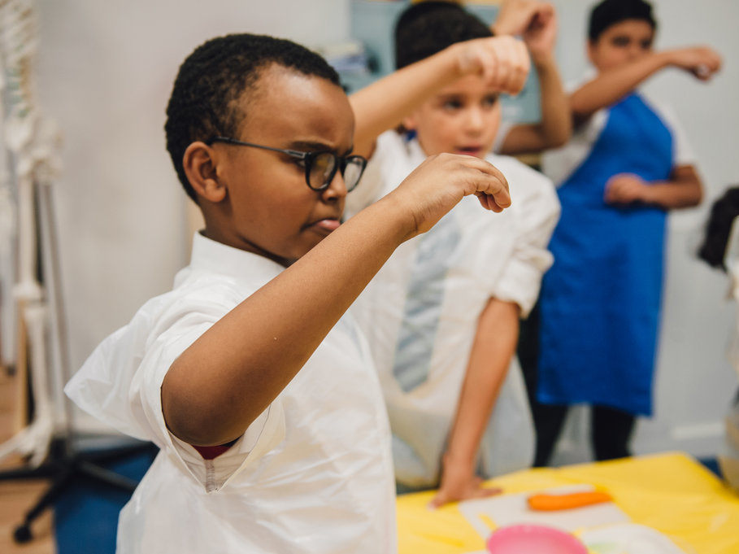
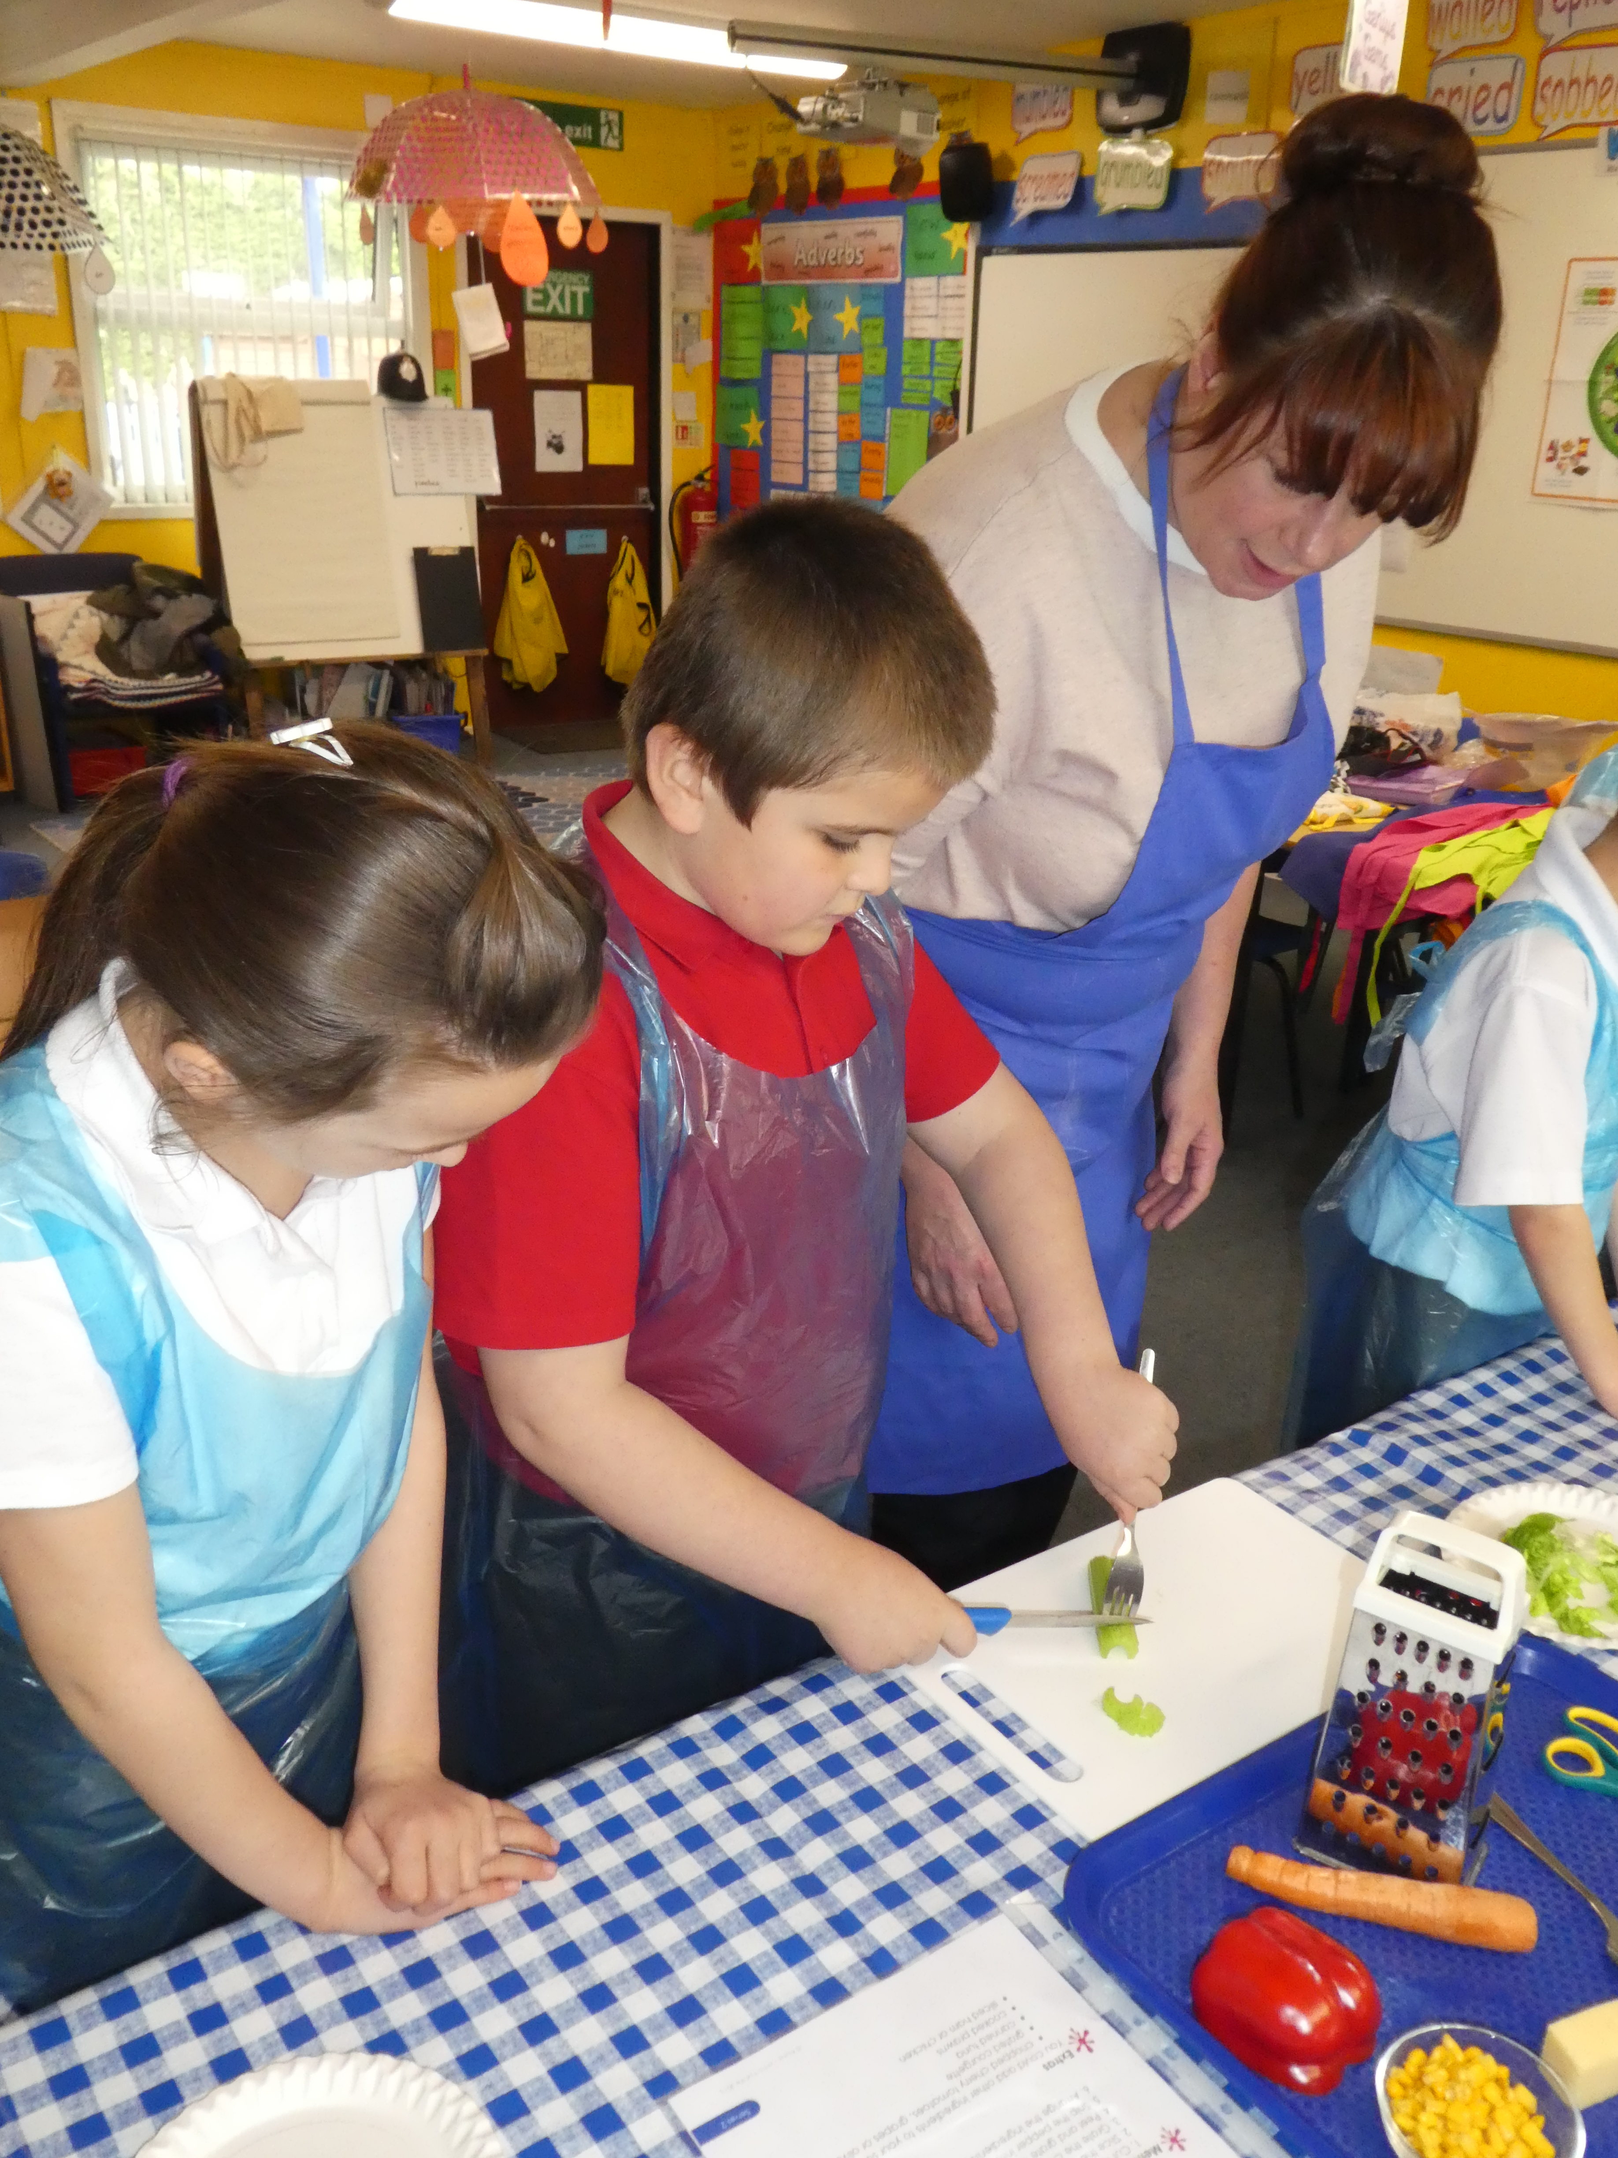
Developing food skills
Thinking about the pupils
Are they used to the routines of food lessons? E.g. getting ready to cook, rules for using equipment
What are their food skill capabilities?
Have you got equipment that is an appropriate size for their hands?
Will the ingredients be appropriate in terms of size, firmness (not too hard to cut)?
Will they be able to see your food skill demonstration properly?
How long will they need to avoid having to rush?
Think it through from a pupil perspective.

Slide 10
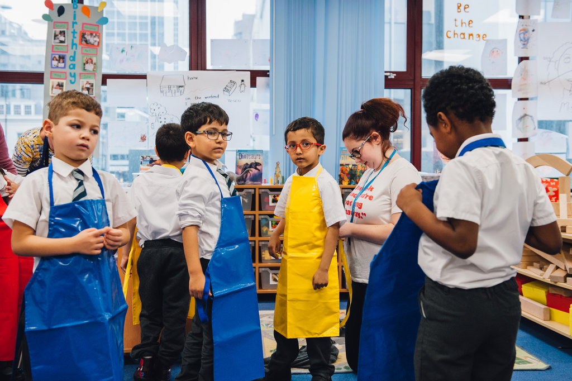
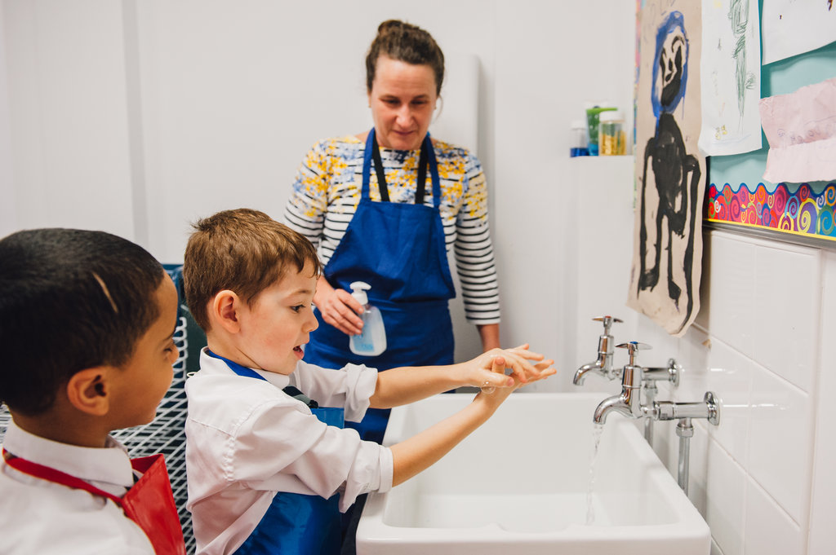
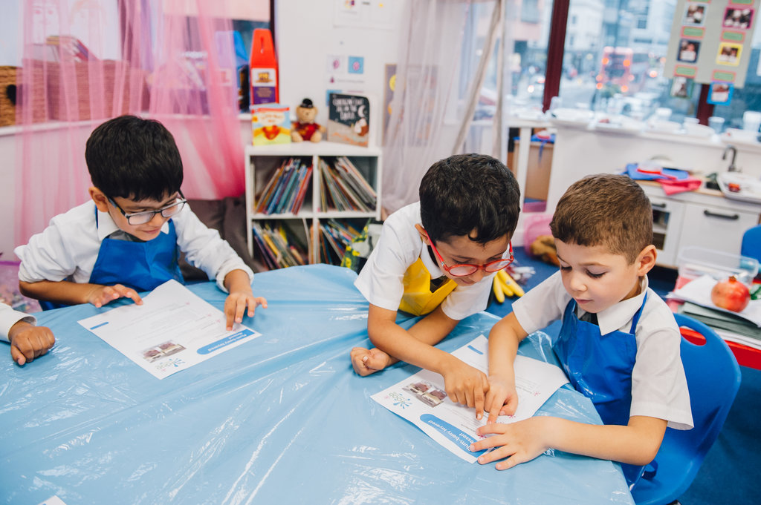
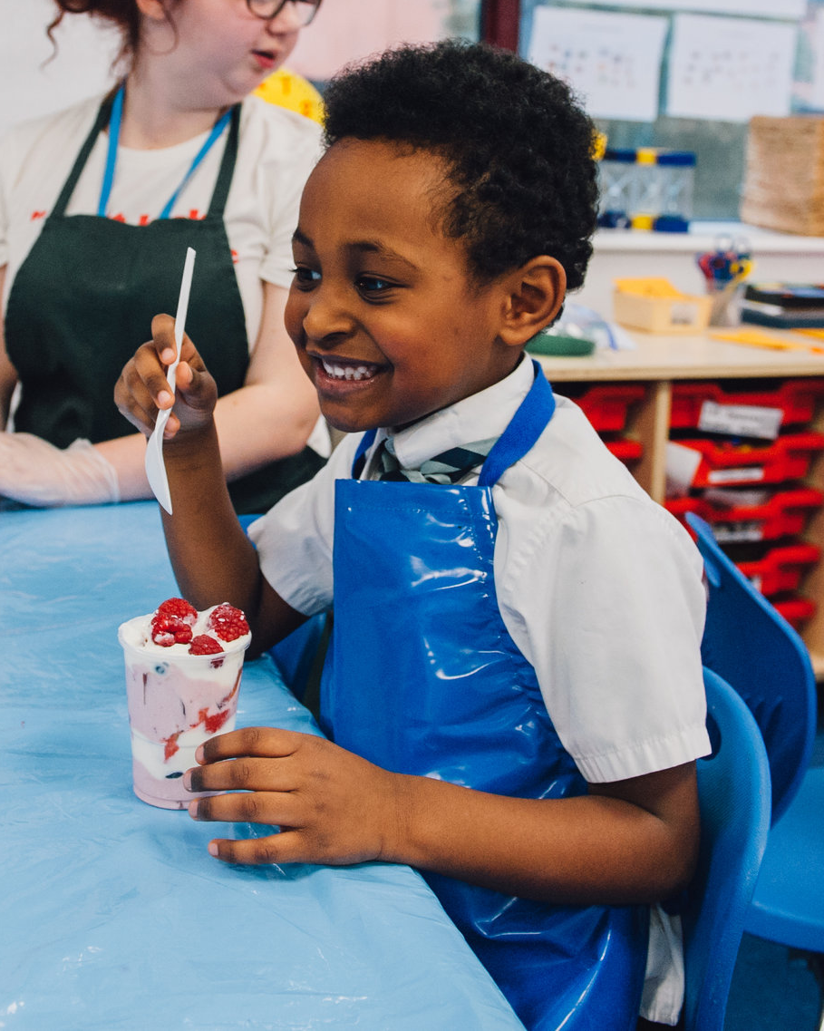
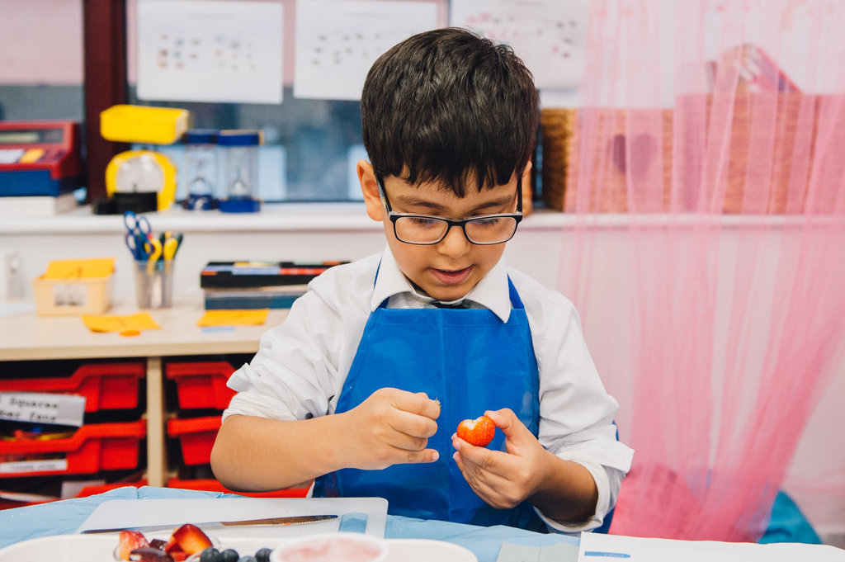
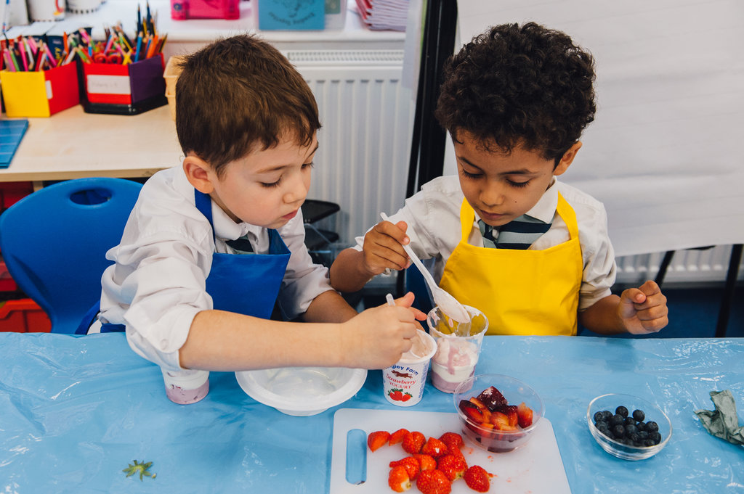
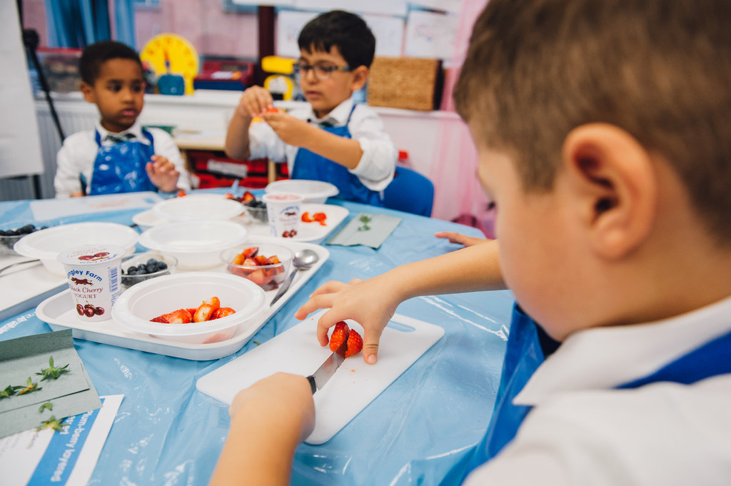
Developing food skills
Example lesson with pupils age 5-6 years

Slide 11
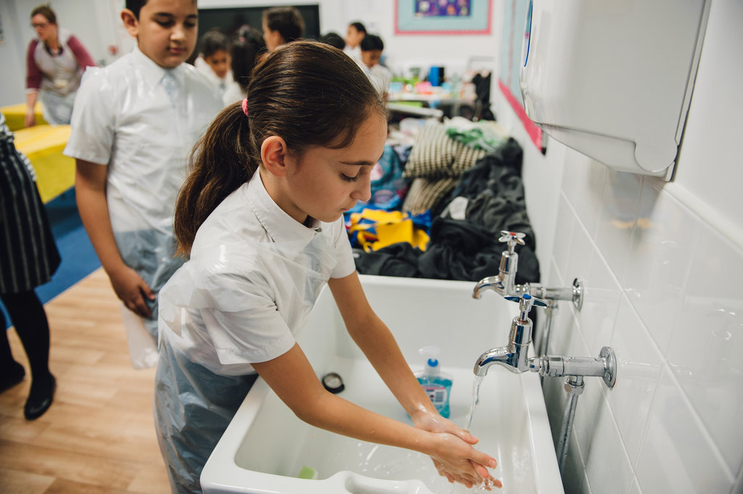
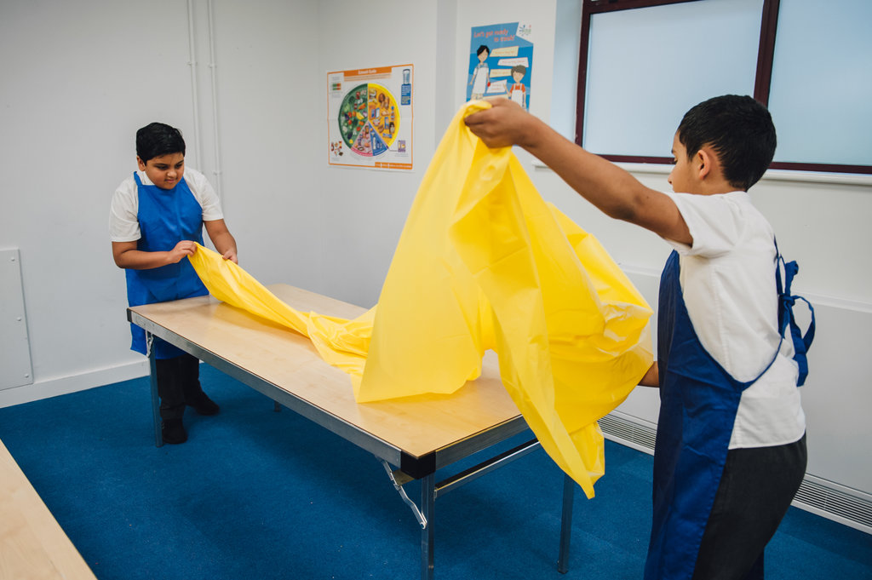
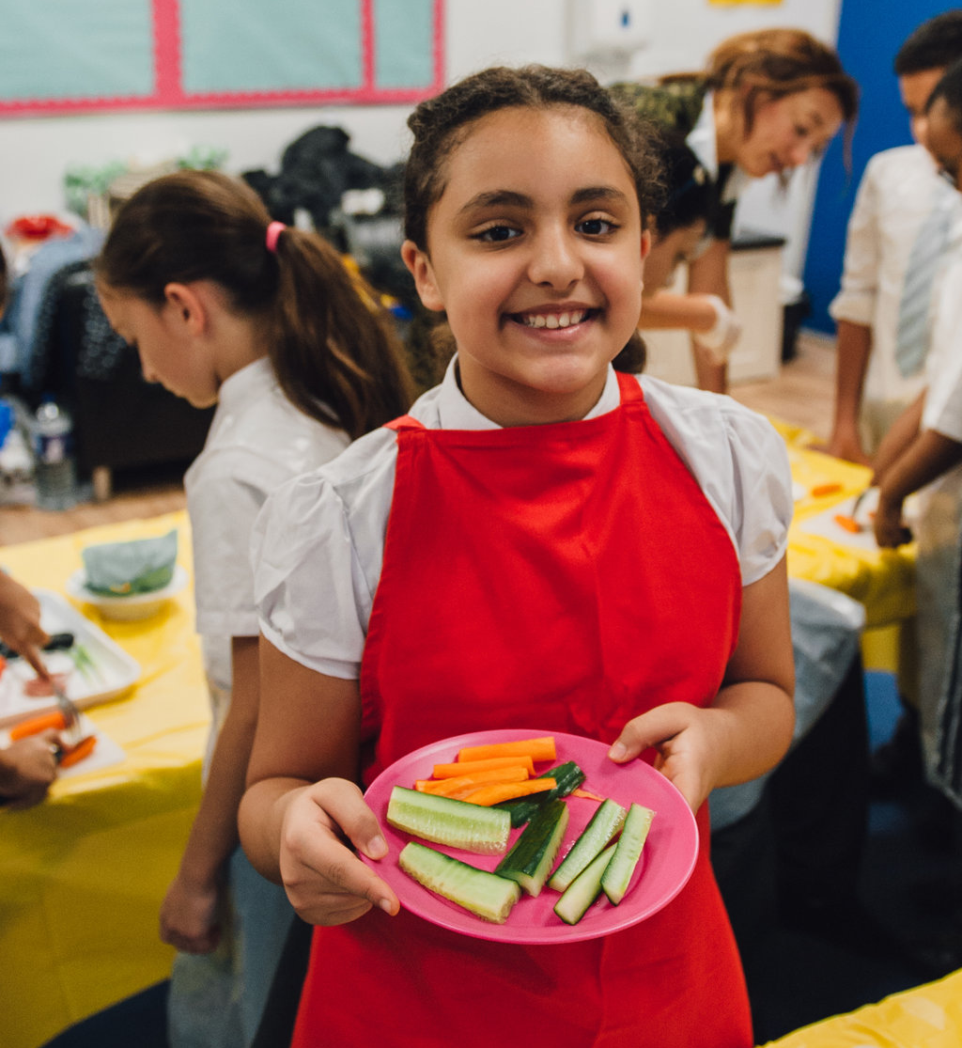
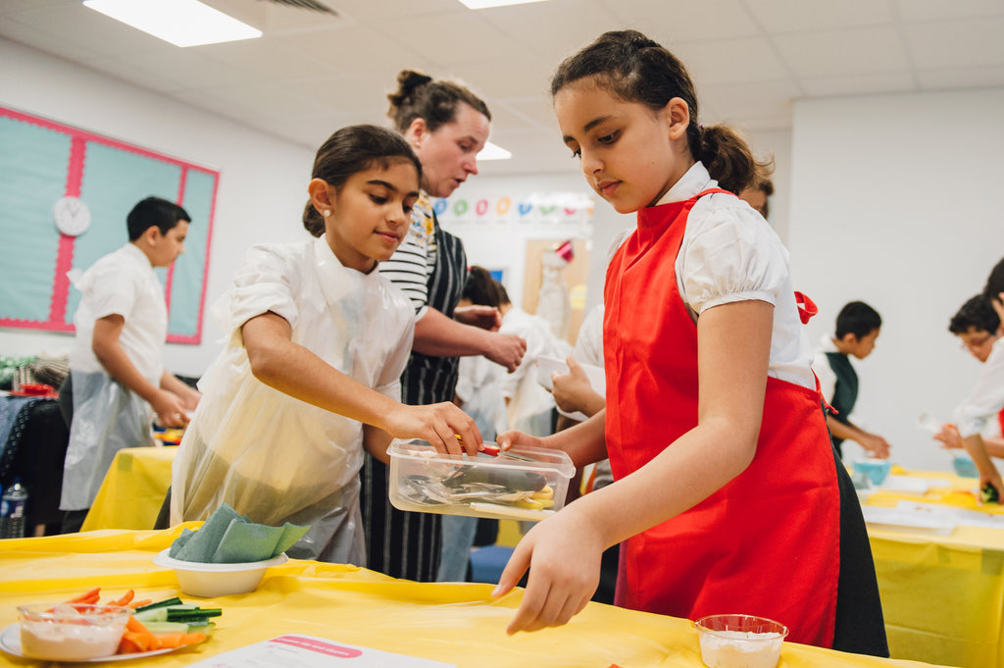
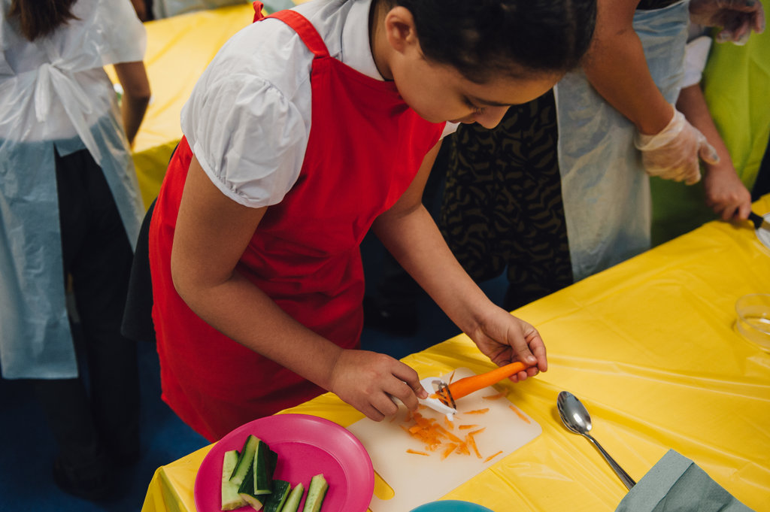
Developing food skills
Example lesson with pupils age 9-10 years

Slide 12
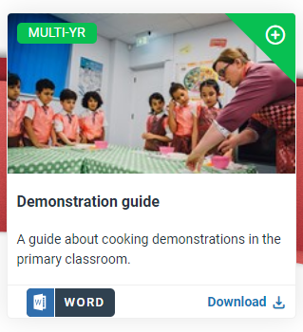
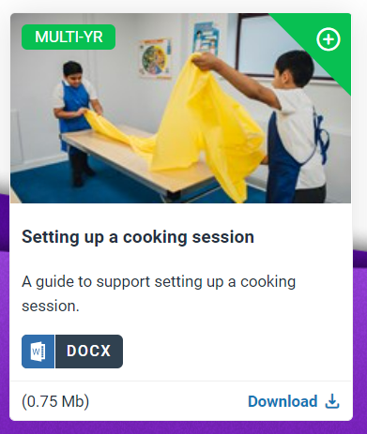
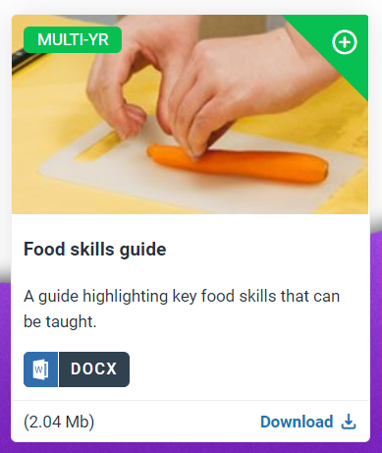
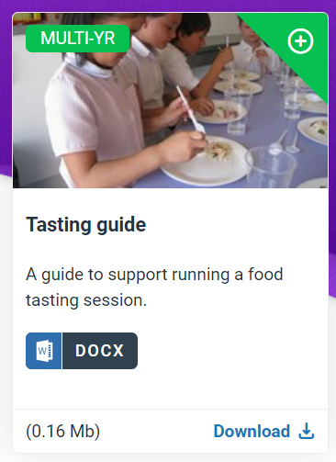
Resources
Guides
Demonstration guide
Setting up a cooking session guide
Food skills guide
Tasting guide

Slide 13
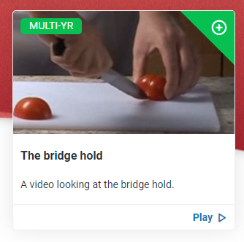
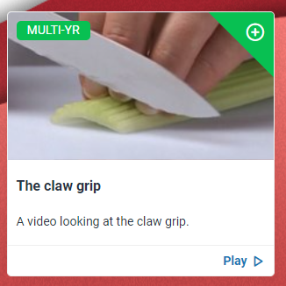
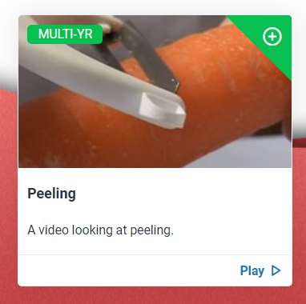
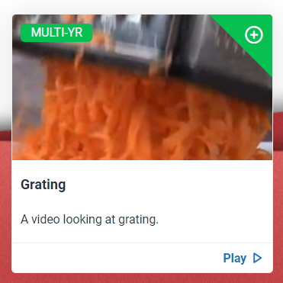
Resources
Skills videos

Slide 14
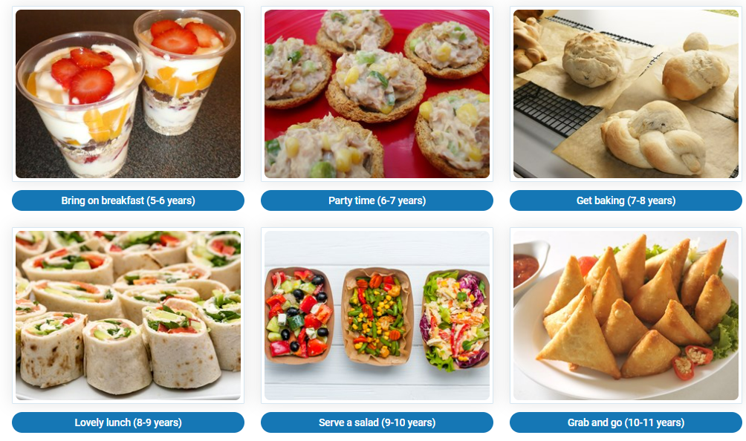
Resources
Primary projects

Slide 15
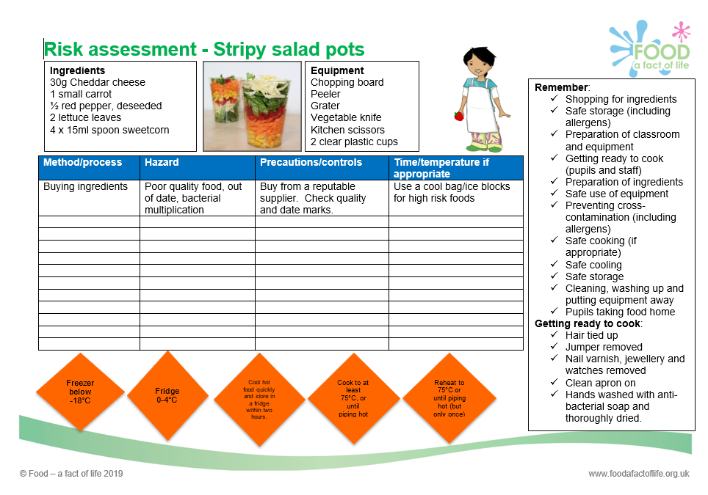
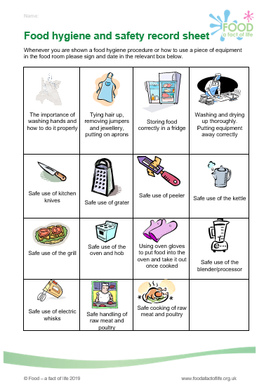
Record sheet
Risk assessment

Slide 16
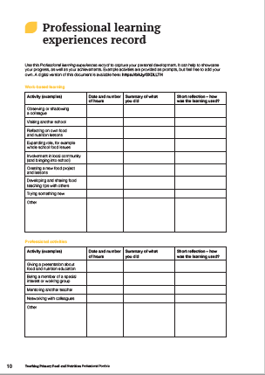
Your Professional learning experience record
Reminder! There are useful ideas for CPD activities on this record!
Activity (examples) | Date and number of hours | Summary of what you did | Short reflection - how was the learning used?
Attending training, workshops and/or webinars | 29 March 2023 - 1 hour 30 minutes hour. | Attended a TPFN workshop (online): Supporting teaching knife skills in primary school Practised different knife and food skills to make a Stripy salad. Considered hygiene and safety and progression.
The record is available in the TPFN booklet and online (see Supporting documents)

Slide 17
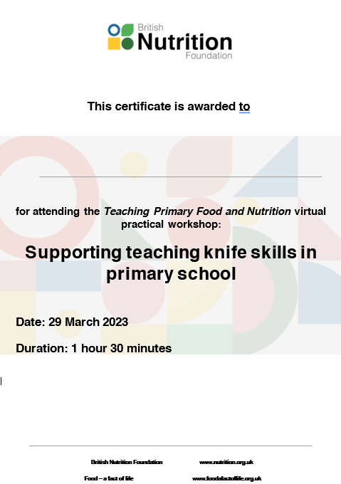
Thank you
Please complete the webinar evaluation. If you are watching a recording of this webinar, you will find a link to the evaluation at the end of the PPT presentation here.
Supporting teaching knife skills in primary school
You will receive a link to the certificate once you have completed the evaluation. Please download the certificate, add your name and print it out for your records.

