Slide 1
Coronary heart disease

Slide 2
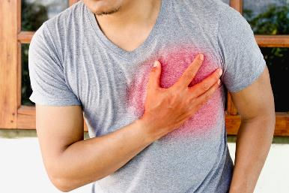
Coronary heart disease
Coronary heart disease (CHD) is caused by a narrowing of the blood vessels to the heart. This reduces the flow of blood to the heart.
If one of the blood vessels becomes completely blocked, the blood supply to part of the heart stops and is damaged. This is called a heart attack.
If the blood supply to a large part of the heart is stopped it may cause death.

Slide 3
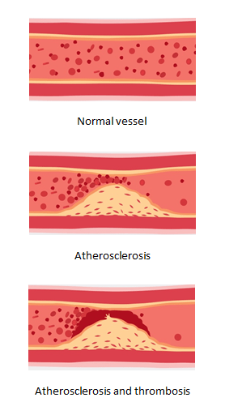
Atherosclerosis
Atherosclerosis is the narrowing of the space inside the artery, due to a build-up of plaque that consists of substances, including cholesterol.
The narrowing of this space restricts blood flow and if this occurs in the coronary arteries (arteries supplying blood to the heart) the supply of oxygen to the heart is reduced.
If a plaque ruptures or breaks down, a blood clot can form in the vessel (thrombosis) blocking the flow of blood.
If this occurs in the coronary arteries it can lead to a heart attack and if the blockage occurs in a blood vessel that supplies the brain it can result in a stroke.

Slide 4
Rates of CHD
Approximately 26% of all deaths in the UK are due to CVD and 42,000 people die prematurely (under the age of 75) each year as a result of the disease.
It is estimated 7 million people in the UK are living with CVD, which costs the NHS £6.8 billion a year.
Coronary heart disease (CHD) is the leading cause of death in the UK, with around 1 person dying from CHD every 8 minutes.
However, it is believed 80% of CHD and stroke could be prevented by changes to lifestyle factors, such as diet, physical activity and smoking.

Slide 5
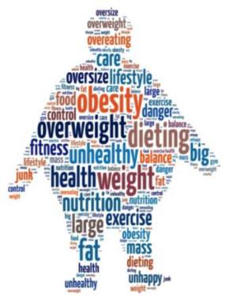
Risk of CHD
The chance of suffering from CHD is affected by many factors. These are called risk factors.
Factors that increase the risk of CHD include:
gender;
age;
smoking;
diet;
weight;
stress;
inactivity.

Slide 6
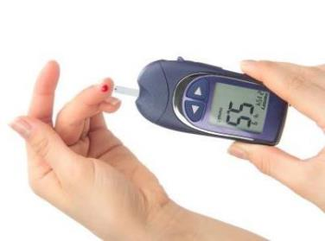

Risk of CHD
Other risk factors for CHD include having:
a family history of CHD;
high blood cholesterol level;
high blood pressure;
high intake of saturated fats;
diabetes.
Some factors cannot be changed, such as family history. Other factors can be changed, for example diet or other aspect of lifestyle which are called modifiable risk factors.

Slide 7
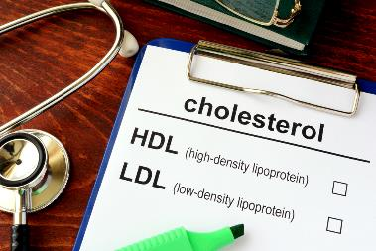
Blood cholesterol levels
Cholesterol is a type of fat that is essential for the body (not in the diet) in small amounts. It is produced in the liver and some is also obtained from the diet.
There are two main types of cholesterol, HDL (high density lipoprotein) known as ‘good cholesterol’ and LDL (low density lipoprotein) known as ‘bad cholesterol’.
Cholesterol is carried around the body in the blood. High levels of LDL cholesterol in blood increase the risk of CHD. The level of cholesterol in the blood depends partly on genetic factors, but diet is also important.

Slide 8
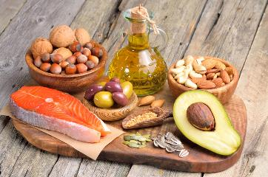
Cholesterol and the diet
The level of blood cholesterol is affected by the amount and type of fat in the diet.
High intakes of saturated fatty acids, and of total fat, can increase the amount of cholesterol in the blood, and increase the risk of CHD.
Most people are consuming too much saturated fat and need to switch to foods containing unsaturated fat. There's good evidence that replacing saturated fats with unsaturated fats can help lower cholesterol.

Slide 9
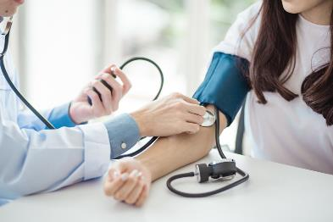
Blood pressure
High blood pressure increases the risk of CHD. Blood pressure tends to be raised in people who:
are very overweight;
drink a lot of alcohol;
take little exercise;
smoke cigarettes;
eat a lot of salt.
Considering which of these factors are relevant, and altering them is necessary, can help to reduce blood pressure.
A normal blood pressure in adults is considered to be around 120/80 (known as 120 over 80).

Slide 10
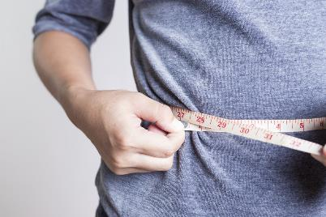
Maintaining a healthy weight
Being very overweight (obese) increases the risk of CHD.
Eating a balanced diet and being physically activity is important in maintaining a healthy body weight.
This will also reduce the risk of high blood pressure, which is a risk factor for CHD.

Slide 11

Distribution of fat
The distribution of fat in the body also affects risk. People who have a high proportion of fat around the central part of the body (‘apple shaped’) have a greater risk of CHD than those who have most of their fat around the hips and thighs (‘pear shaped’).
The fat around the central part of the body is known as visceral fat and is more dangerous as it surrounds major organs including the liver, pancreas and kidneys. Men tend to be more ‘apple shaped’ whereas women tend to be more ‘pear shaped’.

Slide 12


Fatty acids
There are many different fatty acids. Different types of fatty acids behave differently in the body.
Fatty acids can be divided into two groups:
1) Saturated – these have all of the hydrogen atoms they can hold and all are single chemical bonds, e.g. stearic acid.
Single bond

Slide 13



Fatty acids
2) Unsaturated – these have some hydrogen atoms missing and contain double bonds.
Monounsaturated – this is where there is one double bond, e.g. oleic acid.
Polyunsaturated – this is where there are more than one double bond in the compound, e.g. linoleic acid.
Double bond

Slide 14

Fatty acids
Most people in the United Kingdom are eating too much saturated fat.
Unsaturated fats are normally liquid at room temperature, are usually of a vegetable origin, and are commonly known as oils.
Olive oil is an example of an oil predominately containing monounsaturated fat.
Sunflower oil is an example of a polyunsaturated fat.

Slide 15
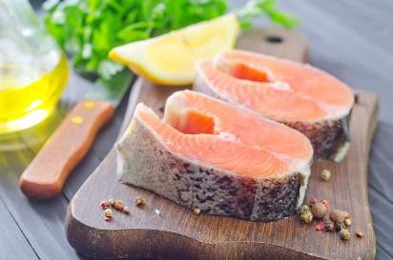
Diet and CHD
Long chain omega 3 fatty acids, such as EPA and DHA, are found in oily fish such as salmon, sardines and mackerel contribute to the normal function of the heart.
Consumption of fish, fruit and vegetables, nuts, fibre and replacing saturated fats with polyunsaturated fatty acids are associated with a reduced CVD risk, while consumption of saturated fatty acids, trans fatty acids and salt are associated with a negative effect on CVD risk (i.e. increased risk).

Slide 16
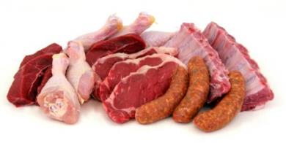
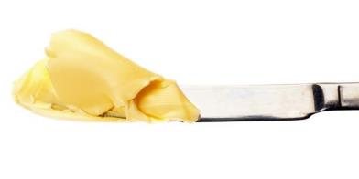
Cutting back fat tips
Helpful guidelines on how to reduce fat (in particular saturated fat) in the diet include:
• cut down – try to limit the amount of high fat foods consumed;
• look for low fat – read food labels and make the choice to purchase food lower in fat;
• change your cooking – trimming fat from meat before cooking it is an easy way to create a dish lower in fat;
• swaps – switching high fat food with a lower fat alternative foods, e.g. ice cream with low fat Greek yogurt.

Slide 17
Quiz- Kahoot
Open the link below on the main screen and get students to log onto kahoot.it on their tablets or smartphones. They can then enter the code (that will come up on the main screen when you start the game) and their own nickname. They can then play along with the quiz choosing the multiple choice answers that correspond with the questions on the main screen. There will then be a leaderboard of the scores after each question and at the end.
https://play.kahoot.it/#/?quizId=c1965223-509e-4535-9da4-c25e21bf42a1

Slide 18
Coronary heart disease
For further information, go to:
www.foodafactoflife.org.uk
This resource meets the Guidelines for producers and users of school education resources about food.

