Slide 1
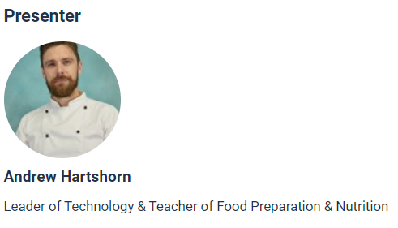
Recipes and food skills for a modern, diverse food and nutrition education
Welcome!
The webinar will start at 4.30pm
Let us know who you are – type your name and organisation in the chat box.
Set your chat box to everyone.

Slide 2
Housekeeping
Please let us know who you are in the chat box – full name and organisation.
The webinar is being recorded and will be available on www.foodafactoflife.org.uk.
If you have any questions, please type them in the chat box and they will be answered at the end.
At the end of the webinar, you will be redirected to a short online evaluation (1 min) and downloadable certificate. Please download the certificate, add your name and print it for your records.

Slide 3
Food skills and recipes for a modern, diverse food and nutrition education
08/06/2022

Slide 4

The Future of food education
The British Nutrition Foundation is undertaking work to explore what a future, modern food education, that is relevant to young people and society, might look like and contain.
The project has the following elements:
1. A teacher and pupil survey, exploring current and future practice – results are here.
2. A half-day consensus-building event – recordings, presentations and recommendations are here.
3. The development of new recipes that are more inclusive of our diverse culture and society – recipes so far are here.
4. The provision of teacher training, based on the outcomes of the work above.
The British Nutrition Foundation would like to gratefully acknowledge the financial support provided by the All Saints Educational Trust for this work.

Slide 5
Covered in today’s webinar
What do young people want?
What is the ideal curriculum aka the death of the fruit salad …
Obstacles and solutions.
Recipes and practical activities to excite young people.
Health and sustainability, underpinning what you do.
Resources and support available from Food – a fact of life.
This webinar forms part of the British Nutrition Foundation’s work around the ‘Future of food education’.

Slide 6
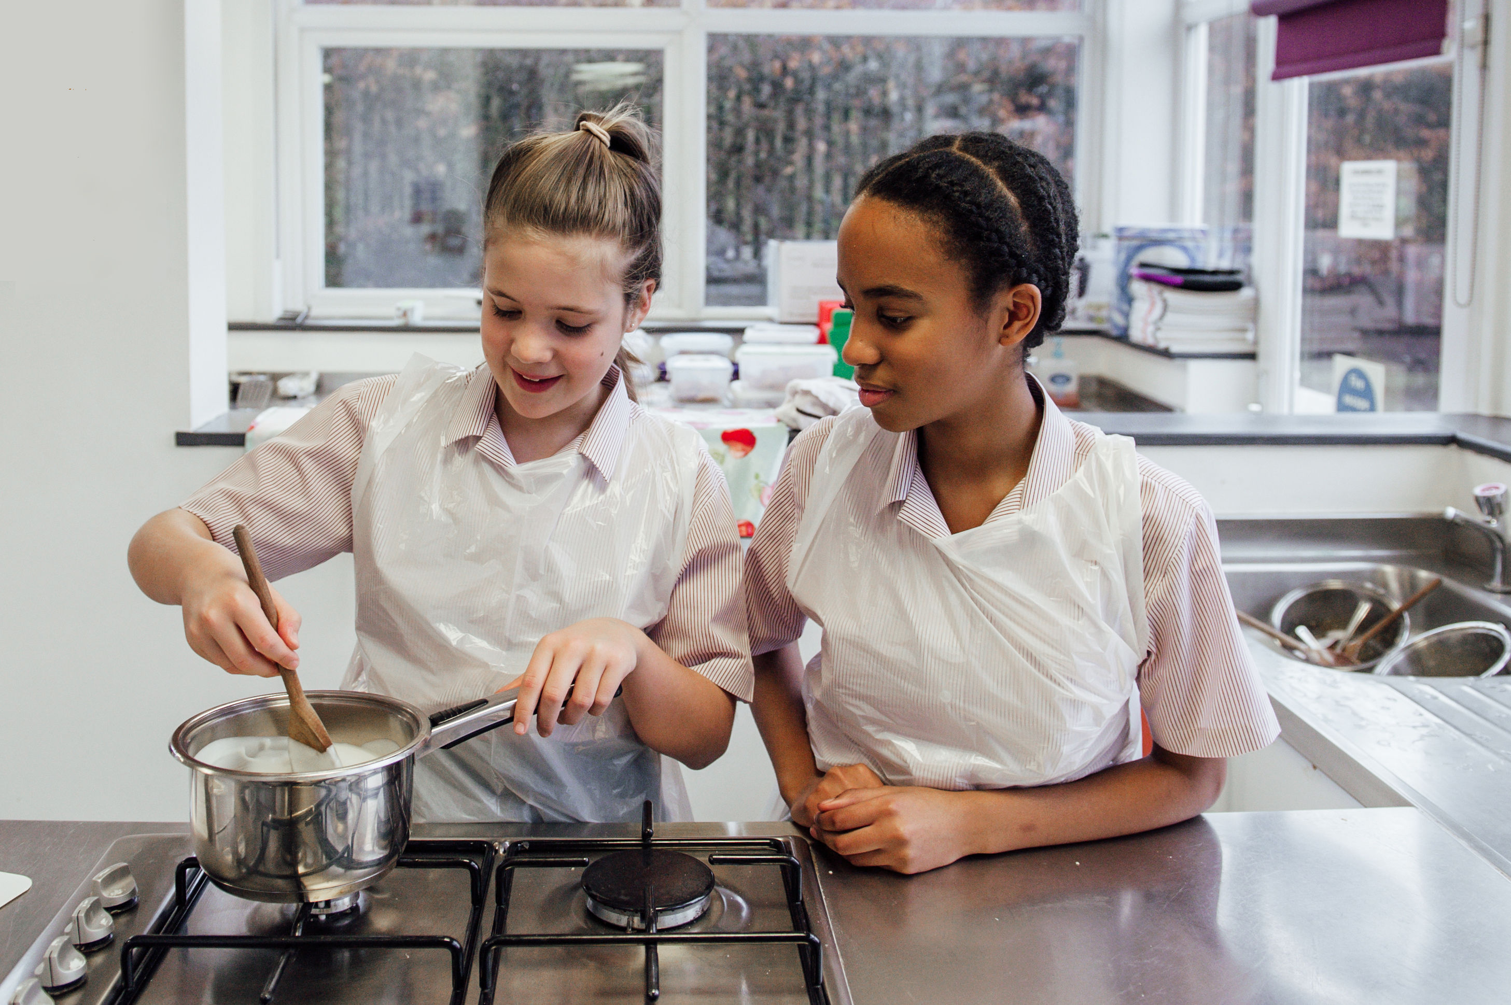
What do pupils want?
As part of the British Nutrition Foundation’s work around a ‘modern, diverse food and nutrition education’ we asked pupils (aged 13-18 years) what was important to them about the recipes they cooked at school.
Pupils responded that they want dishes that are:
tasty, healthy, family/everyday recipes;
most significantly, they want them to be dishes from around the world that are modern, diverse and reflect different cultures.

Slide 7
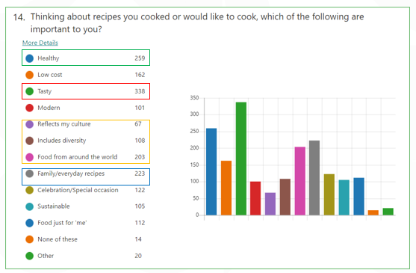
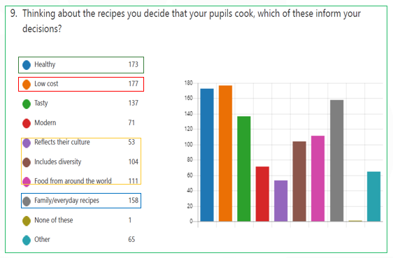
Recipes – what is important?
Pupils
Teachers

Slide 8
What have pupils cooked in school and what would they like to cook?
The graph below plots some of the most commonly mentioned types of food. Green indicates where pupils state they have made this type of food and red indicates where they said they would like to make this type of food.

Slide 9
Is there anything that pupils would have liked to be taught?
  More practicals and food skills/techniques e.g. knife skills, flavour combination, using kitchen appliances, catering for dietary needs, quick meals, food presentation, meals from scratch.
  Wider variety of recipes, e.g. dishes from different cultures/around the world such as Japanese, Nigerian, curry, pizza, healthy meals.

Slide 10
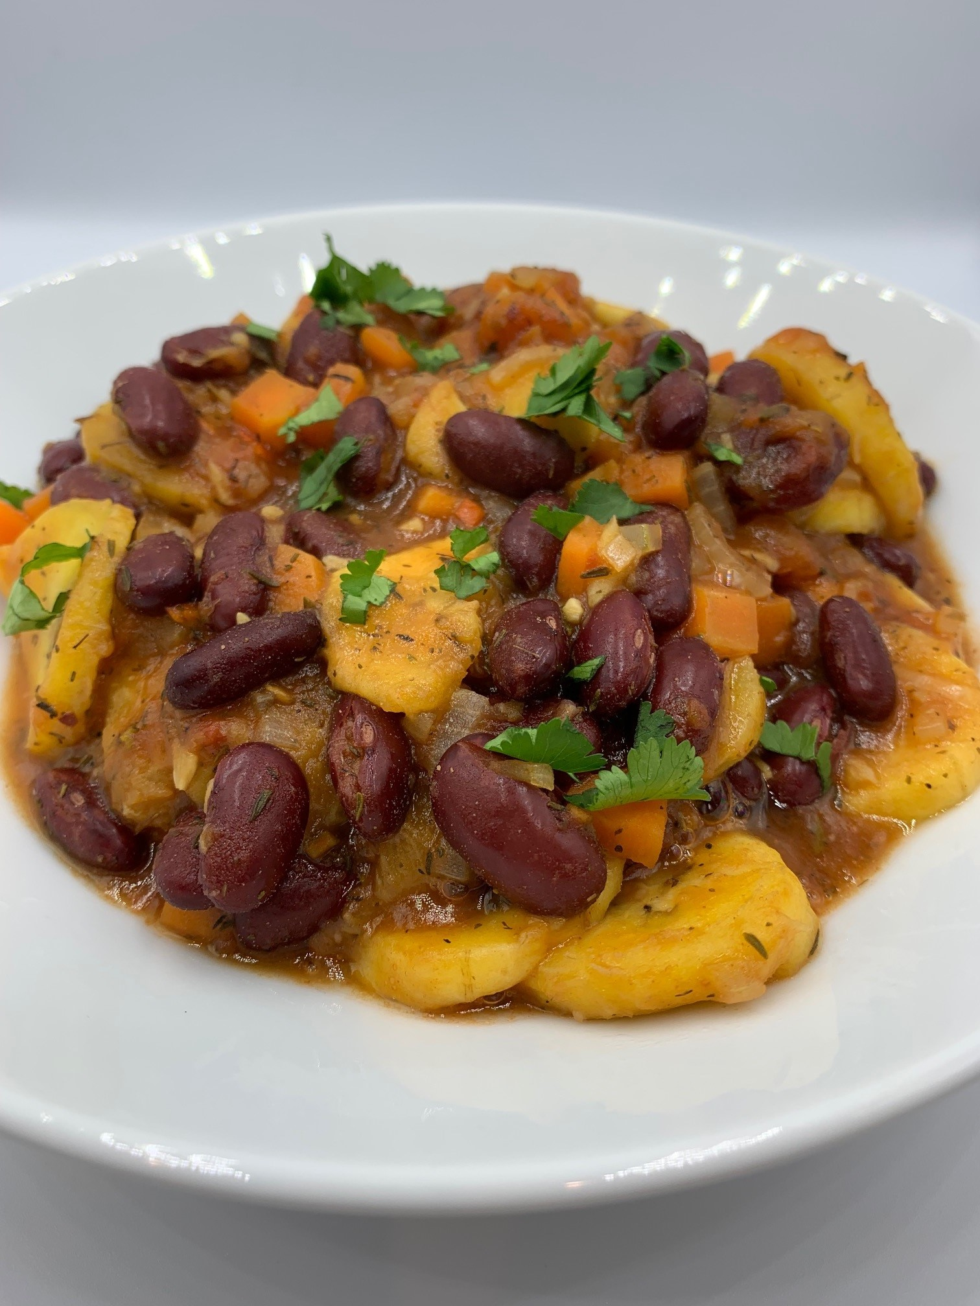
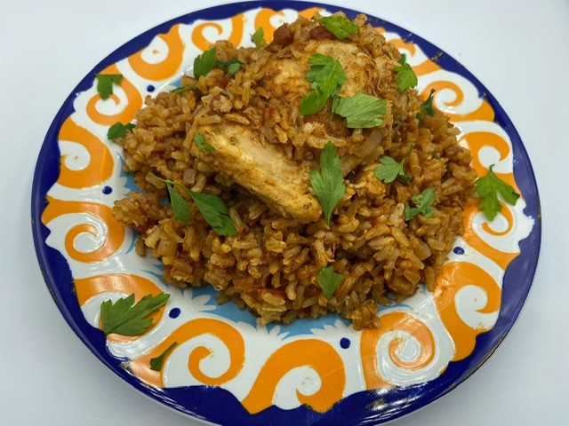
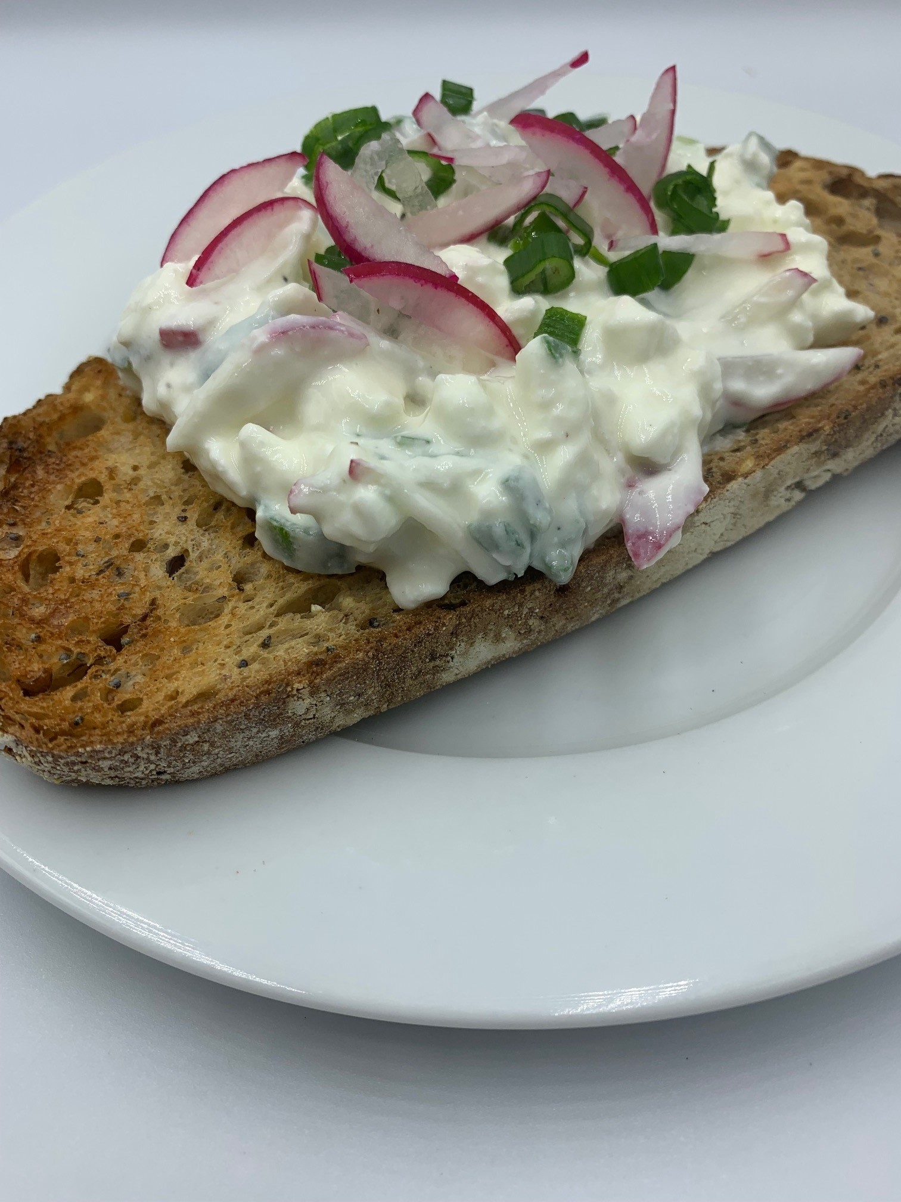
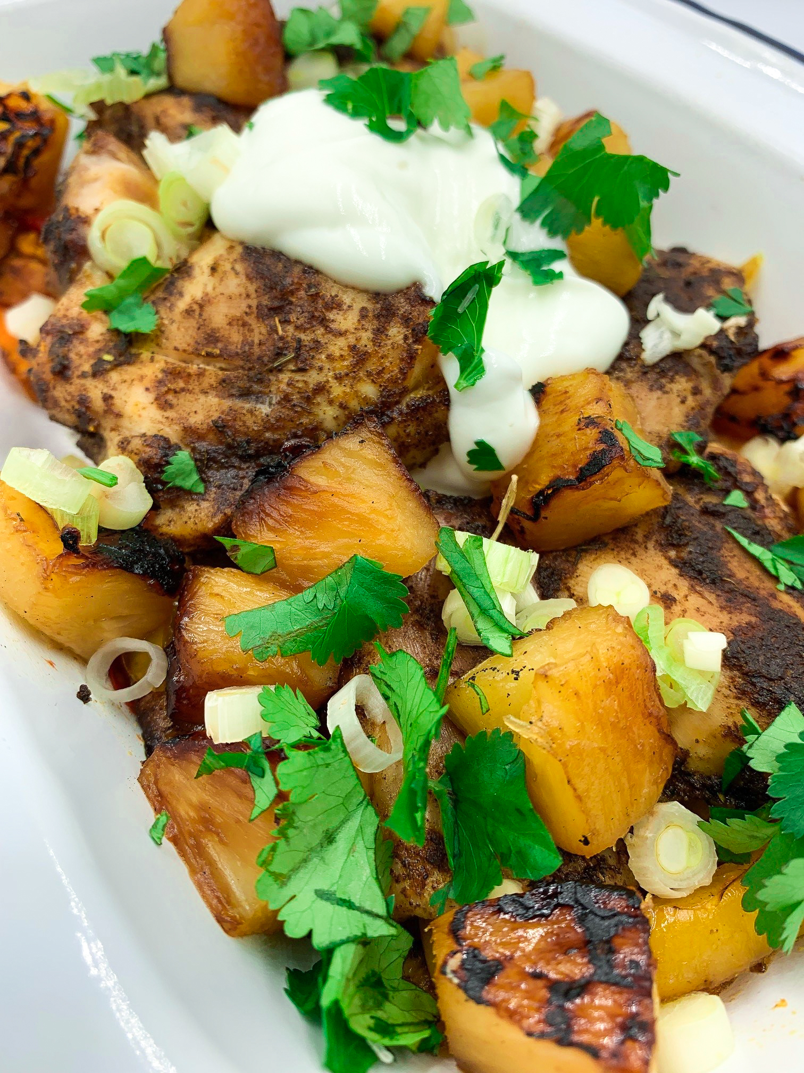
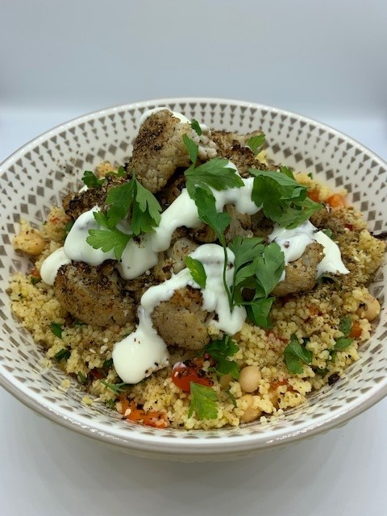
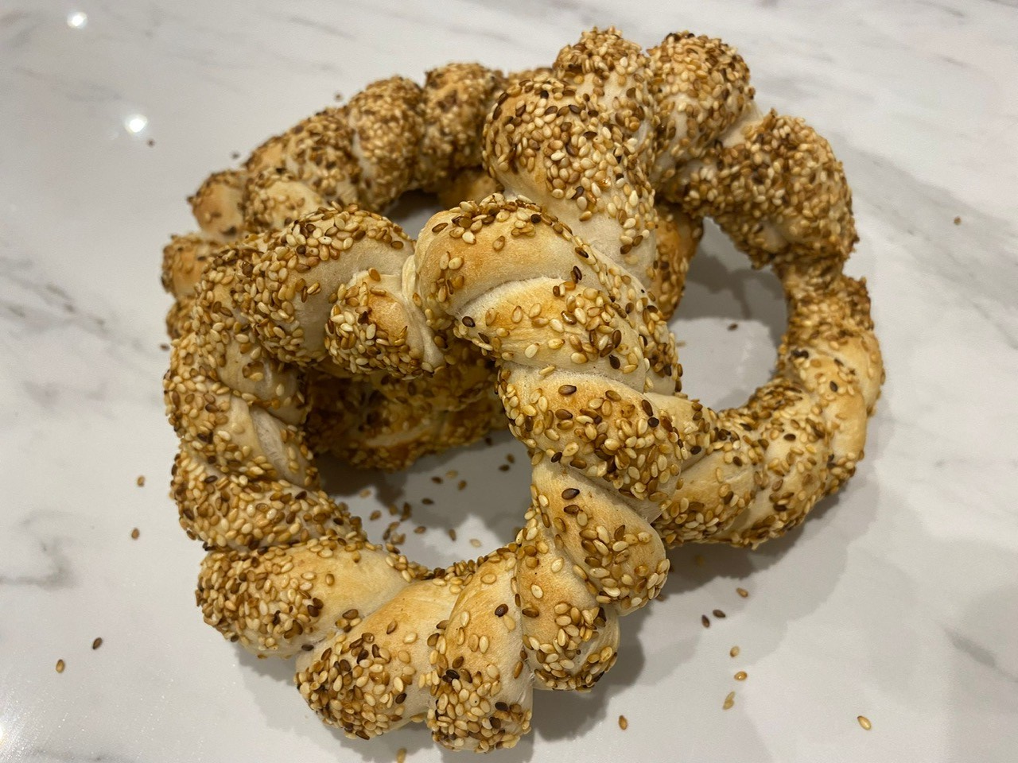
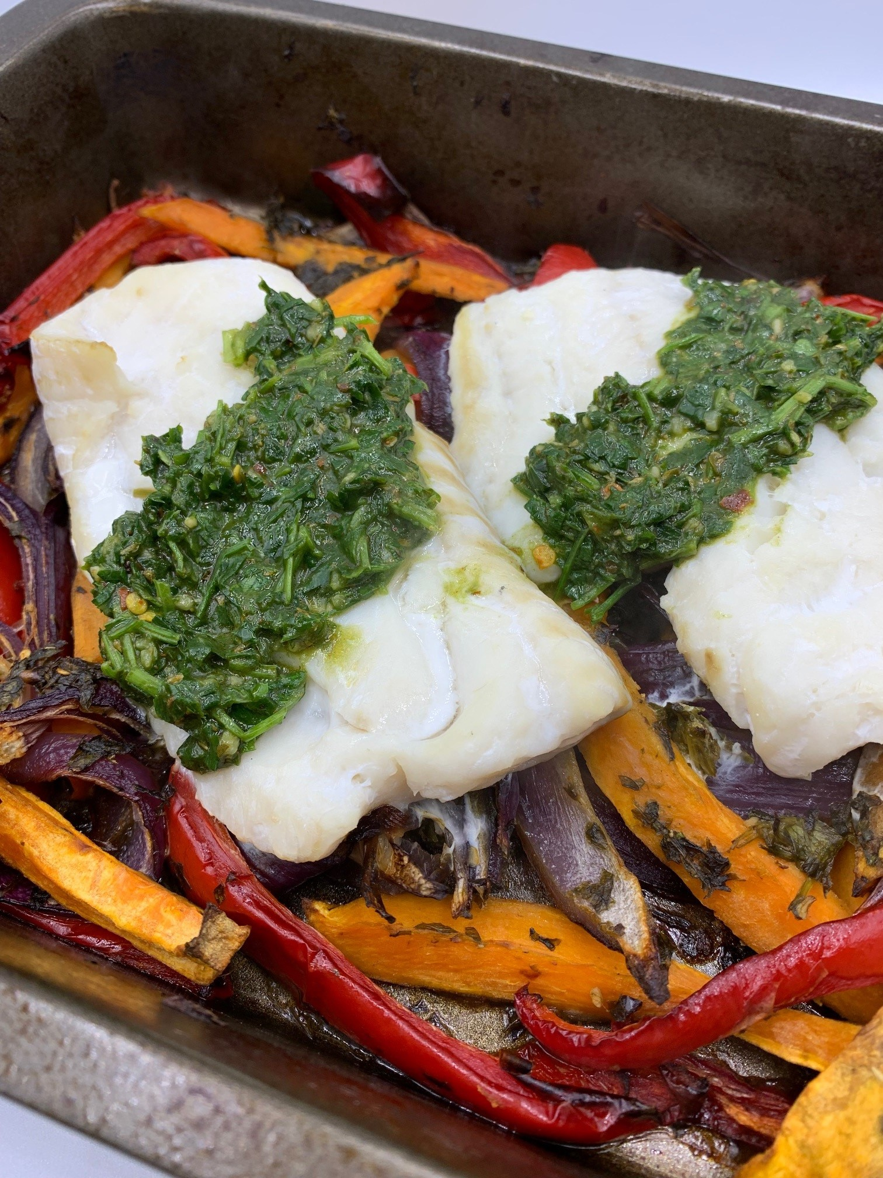
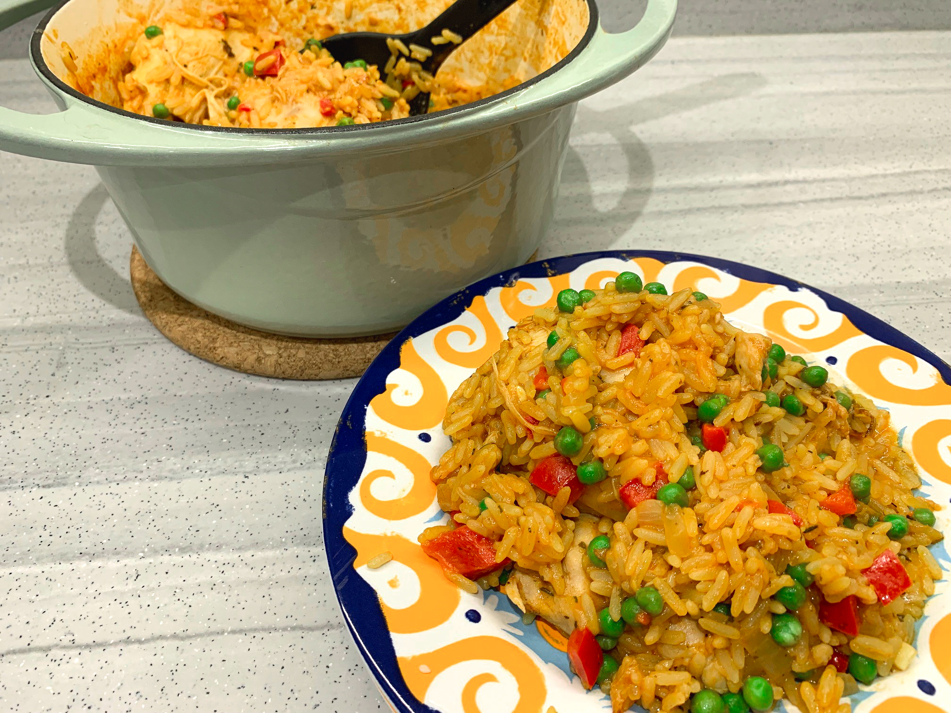
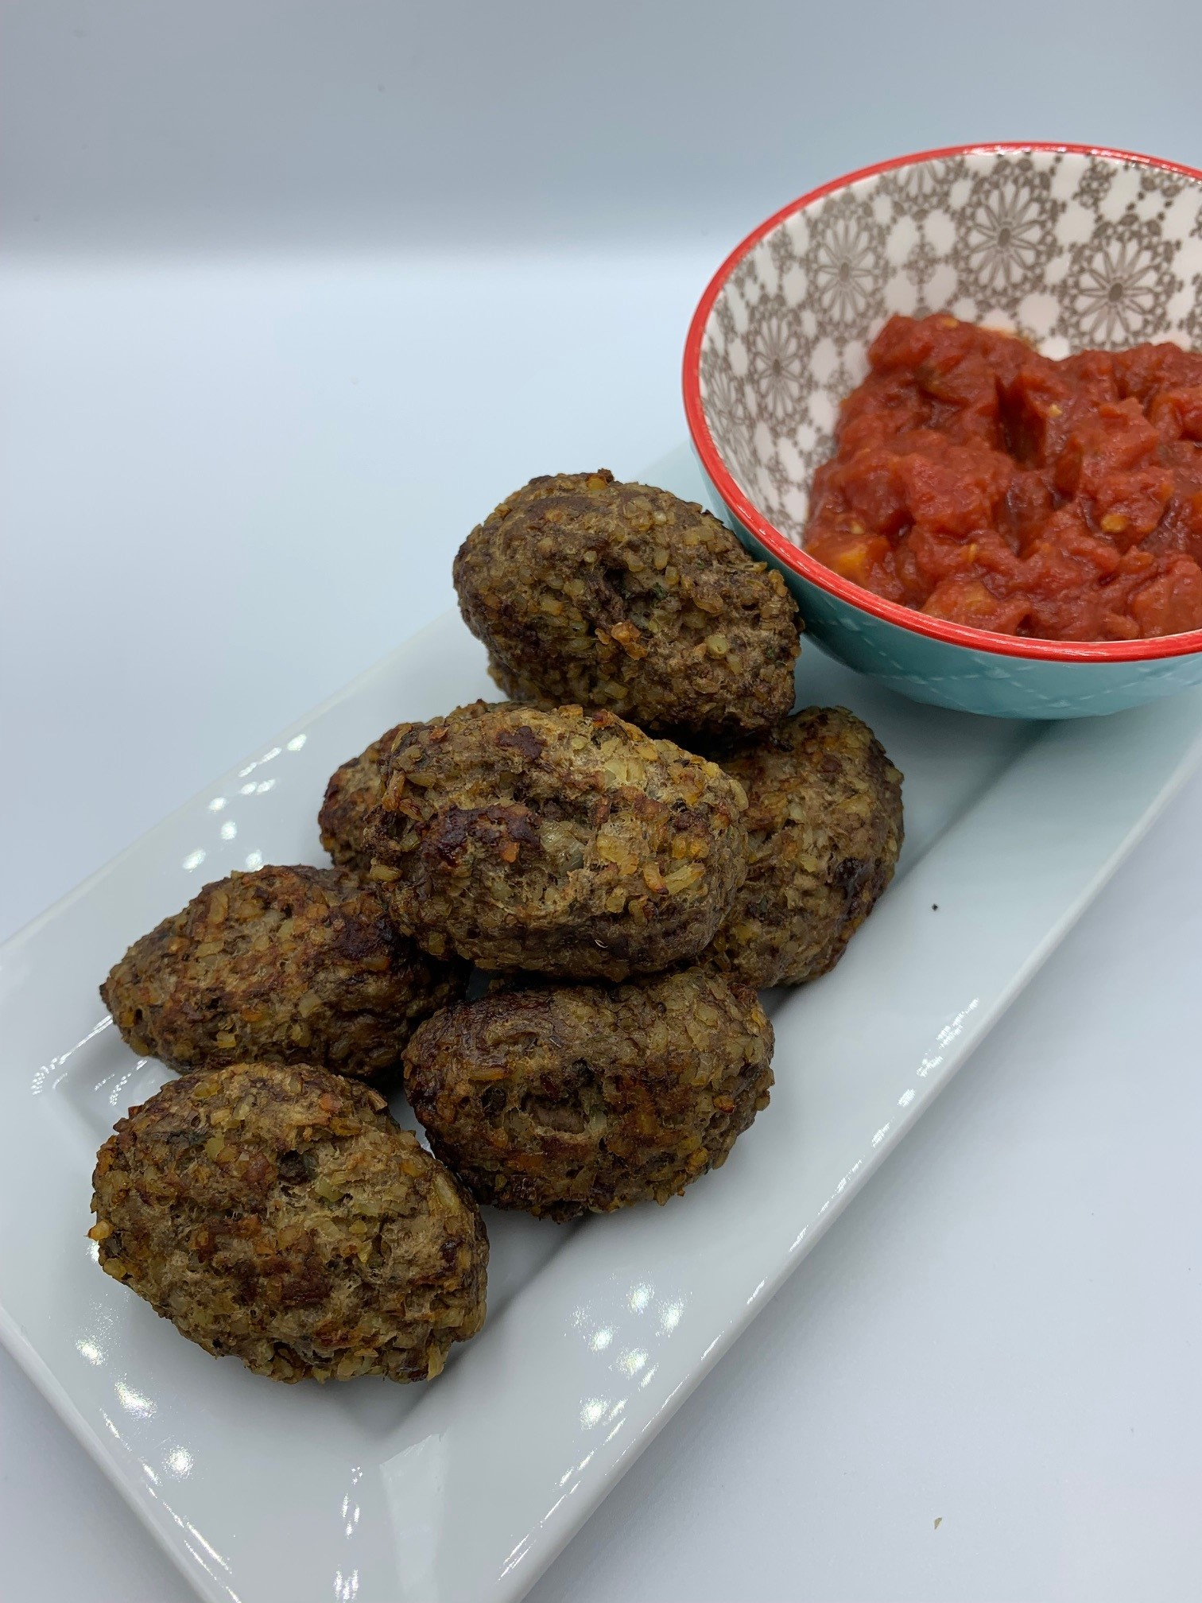
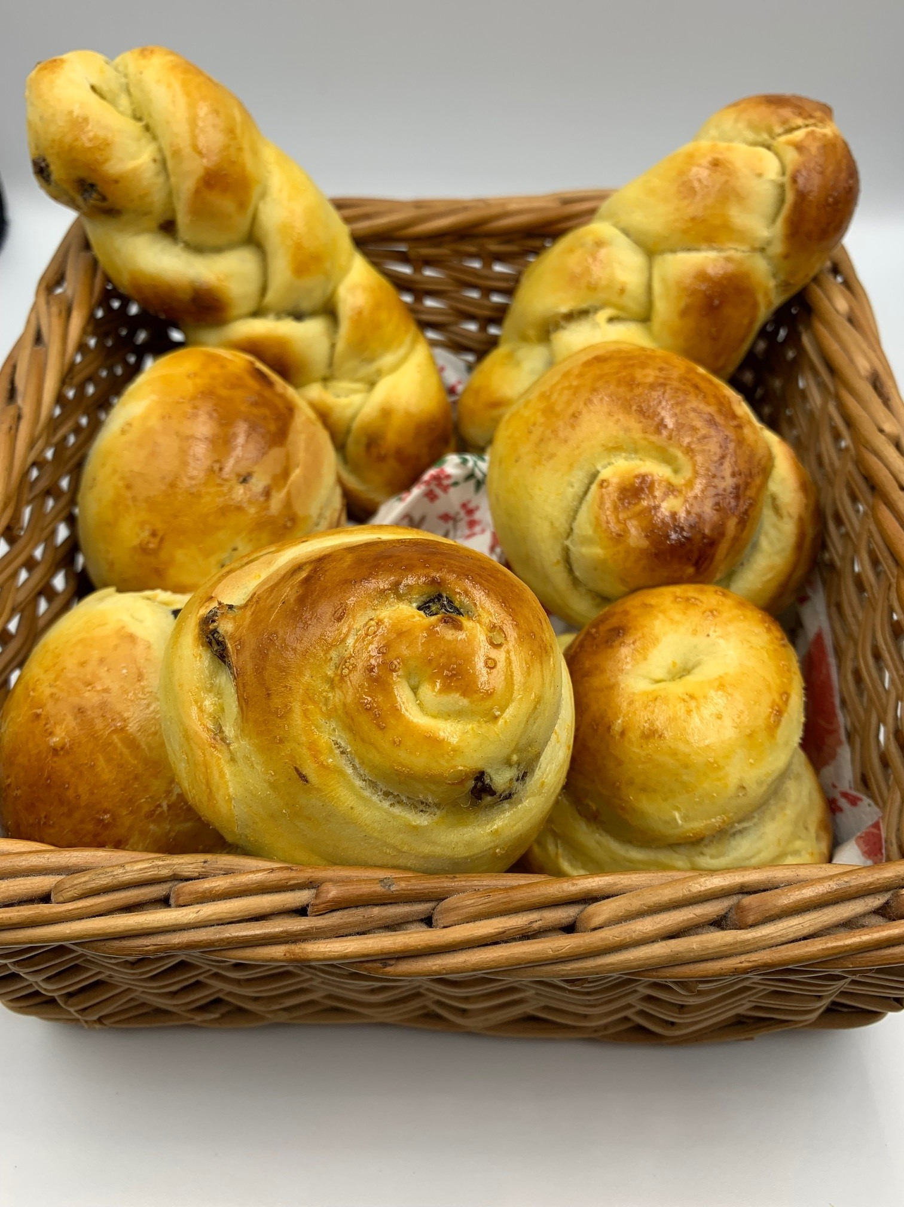
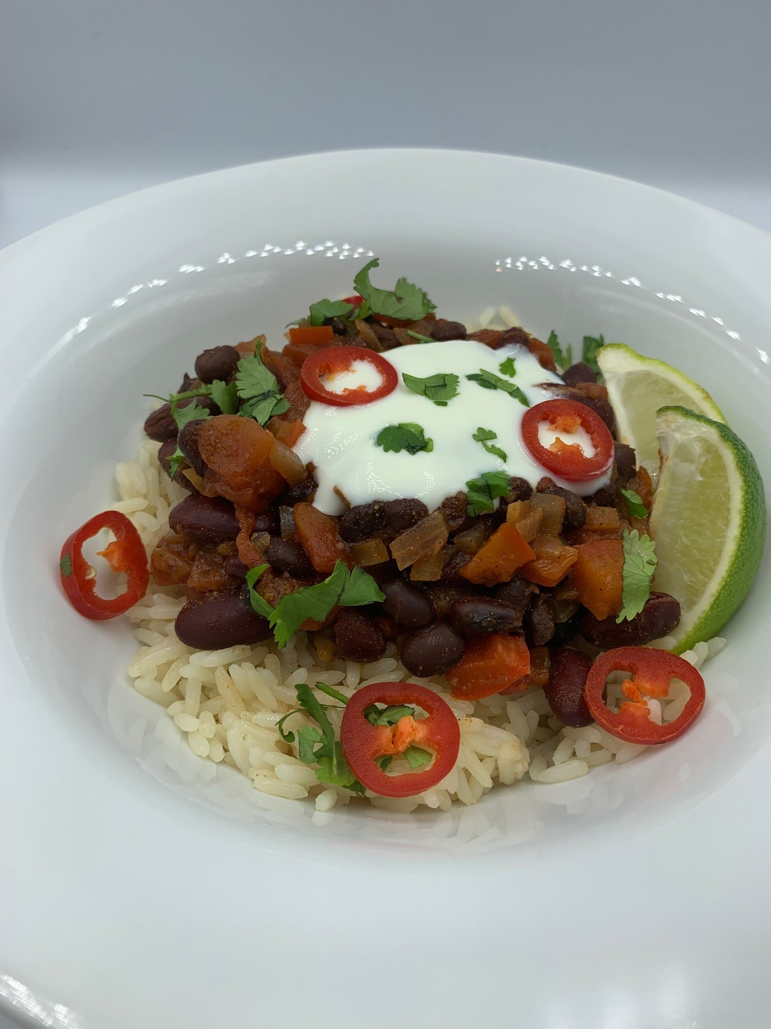
Food skills, recipes and diversity
New resources to support teaching different global cuisines.
New recipes to enable students to develop, acquire and secure practical food skills through using recipes that are suitable and practical for schools and their budgets, promote healthier eating, reflect more global cuisine, and encourage dialogue around culture and inclusivity.
Resources and recipes

Slide 11
Recipes are a vehicle for learning
Pupils should be taught to:
use the basic principles of a healthy and varied diet to prepare dishes;
prepare and cook a variety of predominantly savoury dishes using a range of cooking techniques;
cook a repertoire of predominantly savoury dishes so that they are able to feed themselves and others a healthy and varied diet; become competent in a range of cooking techniques.
Practical food skills - different actions (basic …. extend … practice … become proficient)
Recipe choice to support learning objectives/ intent
Equipment (basic … extend … cooker … electrical tools … practice … become proficient)
Accuracy and precision … Safety & hygiene > Complexity > Combination of skills …
Eatwell Guide … Savoury … Variety and cuisines … Creativity … People and diversity

Slide 12
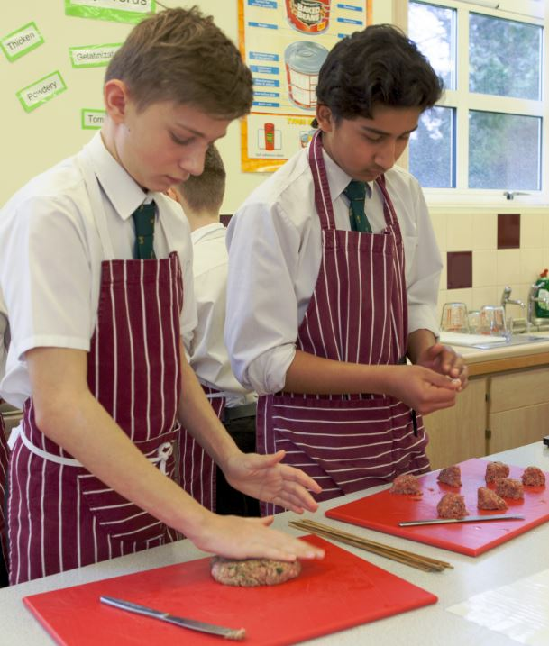
In conclusion - its all about context
Teaching should reflect ‘the now’ (and continue to evolve with change), taking into account cultural aspects, family life, socio-economics, health and sustainability. Food and nutrition education is for all pupils, diverse and inclusive.
Schemes of Work/Learning should include dishes that pupils want to make, and that reflect their families/lifestyles, in the context of healthy and sustainable diets.
Pupils should be given opportunities to use ingredients that they are initially familiar with, but then extended over time to broaden their learning experiences, handling, cooking and tasting a variety of ingredients.
Three recommendations from a consensus building event in October 2021

Slide 13
Further training
Webinars
Developing skills for independent living: Food and drink Thursday 9/06/22
Plant-based diets – expanding pupil learning experiences Thursday 16/06/22
Healthy and sustainable diets – what needs to be considered? Wednesday 22/06/22
Tackling food waste in schools Wednesday 29/06/22
Virtual practical workshop
Food skills, recipes and diversity (Eastern European cuisines) Wednesday 15 June 2022
Webinar recordings
Online modular courses
To find out more and to book, go to: https://www.foodafactoflife.org.uk/training/
More PPD information, support and newsletter sign-up: https://www.foodafactoflife.org.uk/professional-development/

Slide 14
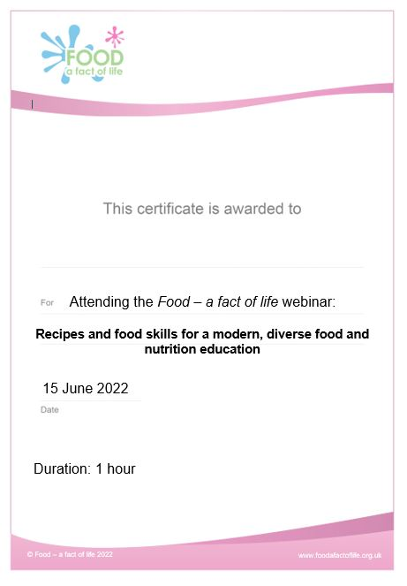
Thank you
Please complete the webinar evaluation. You should be automatically redirected to the evaluation when the webinar finishes. If you are using a tablet or mobile phone, this may not be automatic – we will email a link to the evaluation. Please make sure you have told us your name and organisation in the chat box!
Recipes and food skills for a modern, diverse food and nutrition education
You will receive a link to the certificate once you have completed the evaluation. Please download the certificate, add your name and print it out for your records.

Slide 15
Food skills and recipes for a modern, diverse food and nutrition education
For further information, go to:
www.foodafactoflife.org.uk
This webinar forms part of the British Nutrition Foundation’s work around the ‘Future of food education’, supported by the All Saints Educational Trust.

