Slide 1
Digestive system

Slide 2
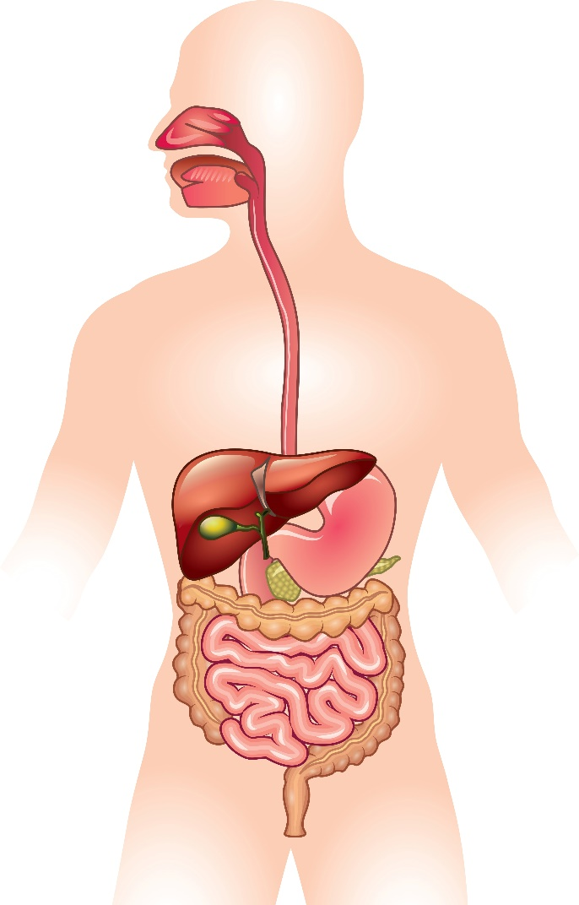
Starter
Label the digestive system’s organs from memory on the worksheet provided.

Slide 3
Mouth
Oesophagus
Liver
Gall bladder
Stomach
Small intestine
Large intestine (colon)
Rectum
Anus

Slide 4
Mix and match
Stomach
The start of the process. The cheeks and tongue help to push the food towards the teeth.
Teeth
A small sac below the liver. It stores and releases bile into the small intestine.
When food is swallowed, the muscles contract and relax, helping to push the food down into the stomach.
Mouth
Gall bladder
A sack made of muscles that contract and churn food, breaking it down even further.
A tube about 6 metres long. It absorbs most of the nutrients.
Different shapes tear, chop and grind the food into smaller pieces for digestion.
Oesophagus
Intestines

Slide 5
Mix and match
Oesophagus
Stomach
Teeth
When food is swallowed, the muscles contract and relax, helping to push the food down into the stomach.
A sack made of muscles that contract and churn food, breaking it down even further.
Different shapes tear, chop and grind the food into smaller pieces for digestion.
Mouth
Intestines
Gall bladder
The start of the process. The cheeks and tongue help to push the food towards the teeth.
A tube about 6 metres long. It absorbs most of the nutrients.
A small sac below the liver. It stores and releases bile into the small intestine.

Slide 6
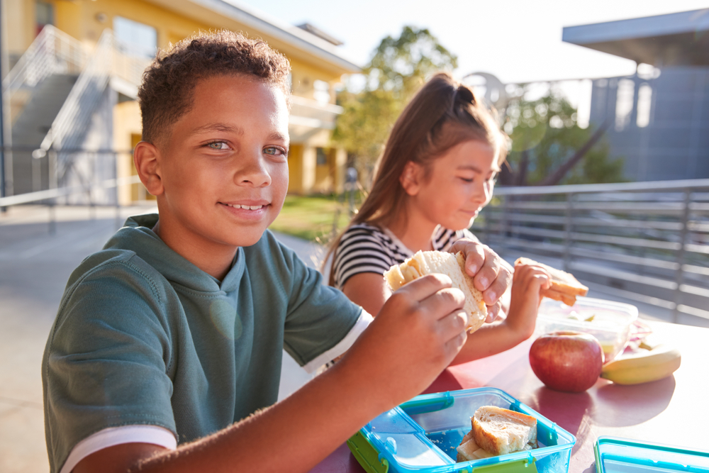
Food as a fuel
The body requires energy from food and drink.
Our bodies release the energy and nutrients from food.
Sometimes food can take 2 or 3 days to be fully digested and absorbed by the body.

Slide 7
The digestion process
The gastrointestinal (GI) tract comprises:
mouth;
oesophagus;
stomach;
small intestine – duodenum, jejunum and ileum;
liver and gall bladder;
pancreas;
colon
anus.

Slide 8
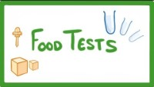
Fill in the gaps
Watch the video and complete the fill in the gaps on the worksheet provided.
The three main food groups that we need food from are ________, ________ and ________. Digestion breaks down food via two processes: ________ breakdown and ________ breakdown. The process of digestion starts in the mouth. Food then moves down the ________ (gullet) and into the ________. The stomach produces hydrochloric acid that kills ________.
Food passes from the stomach into the ________ ________where nutrients are absorbed into the bloodstream. The surface area of the small intestine is increased by the ________. Most of the digestive enzymes are made in the ________. The gall bladder releases ________ to help with the breakdown of fats.
Video used with the kind permission of Cognito

Slide 9
Fill in the gaps
The three main food groups that we need food from are carbohydrate, fats and protein. Digestion breaks down food via two processes: physical breakdown and chemical breakdown.
The process of digestion starts in the mouth. Food then moves down the oesophagus (gullet) and into the stomach. The stomach produces hydrochloric acid that kills bacteria.
Food passes from the stomach into the small intestine where nutrients are absorbed into the bloodstream. The surface area of the small intestine is increased by the villi.
Most of the digestive enzymes are made in the pancreas. The gall bladder releases bile to help with the breakdown of fats.
Video used with the kind permission of Cognito

Slide 10
Round the room
Different organs have a different role in digestion.
Research each organ and its role, using the sheets around the room.
Fill in your table as you go around the room.

Slide 11
Quiz- Kahoot
Open the link below on the main screen and get students to log onto kahoot.it on their tablets or smartphones. They can then enter the code (that will come up on the main screen when you start the game) and their own nickname. They can then play along with the quiz choosing the multiple-choice answers that correspond with the questions on the main screen. There will then be a leaderboard of the scores after each question and at the end.
https://play.kahoot.it/#/?quizId=0f07089f-a94b-4760-bc22-a4789e656799

Slide 12
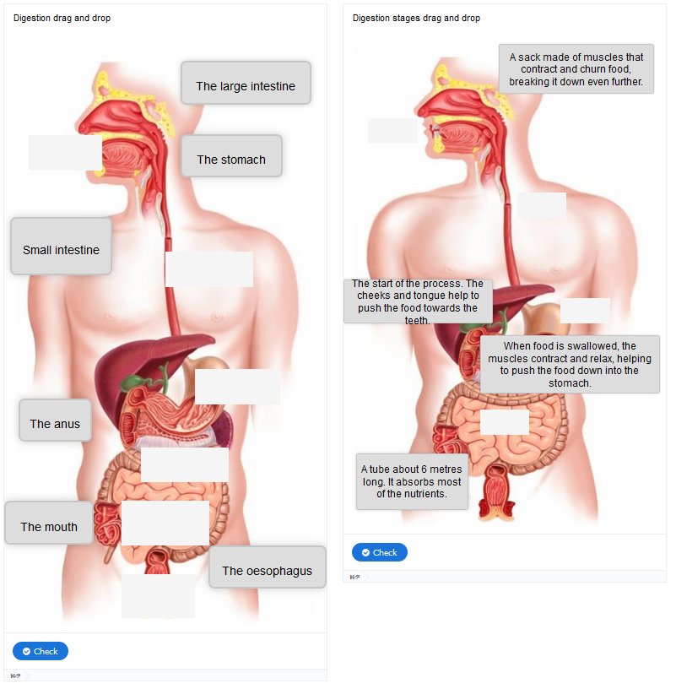
Interactive resources
Let’s see how well we’ve remembered today’s information by completing this Digestion interactive activity.

Slide 13
Enzymes in digestion
Enzyme | Where it is made | Where it works | What it does
Protease
Lipase
Amylase
Use your text book, or the internet, to research the enzymes and complete the table.

Slide 14
Enzyme | Where it is made | Where it works | What it does
Protease | Stomach, pancreas, small intestine | Stomach, small intestine | breaks protein molecules in to amino acids
Lipase | Pancreas, small intestine | Intestine | breaks fat molecules into fatty acids and glycerol
Amylase | Salivary glands, pancreas | Mouth, small intestine | Breaks down starch into sugars

Slide 15
Key words
Key word​ | Meaning​
Oesophagus | The tube connecting the mouth to the stomach.
Gall bladder | The organ that acts as a reservoir for the bile produced by the liver.
Pancreas | A gland connected to the duodenum that secretes digestive juices. It also produces insulin.
Stomach | Organ that is part of the digestive system situated just below the diaphragm. The stomach helps digest food by mixing it with digestive juices and churning it into a thin liquid.
Small intestine | The long, thin winding tube that food goes through after it leaves the stomach.
Liver | A large organ which makes bile, which neutralises stomach acid.

Slide 16
Teachers’ guide

Slide 17
Lesson structure
Starter: Label digestive system worksheet. (10 minutes)
Think, Pair, Share: Match the nutrient with their definition (5 minutes). Discuss with the class.
Fill in gaps: Video and go over (10 mins)
Put the treasure hunt slides around the room and ask pupils to complete the table from the information they find (15 minutes)
Kahoot quiz (10 minutes)
Plenary: Interactive digestion resources. Can use as cold calling* with the class (5 minutes).
Homework: Digestive enzymes table.
*When the teacher chooses who to respond and it could be anyone.

Slide 18
Teaching about digestion
Name and locate the major organs in the human digestive system.
Describe the importance of digestion.
Describe where digestive enzymes are made and the sites of digestion.

Slide 19
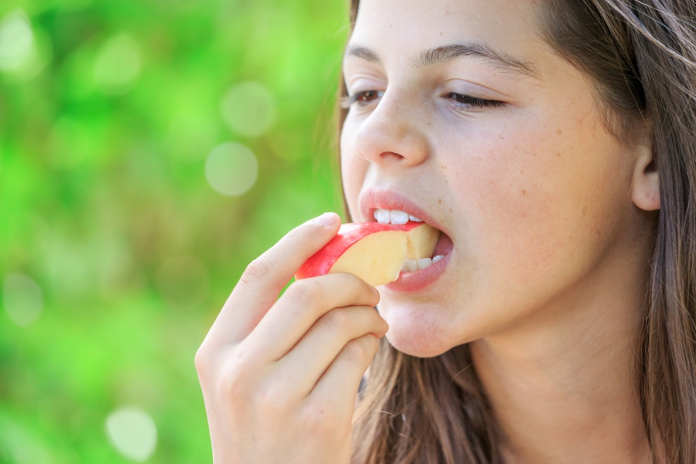
The mouth
Mastication is the action of the teeth and the jaws working together to break food down.
Food needs to be chewed and broken down into pieces small enough to swallow.
Breaking the food down also gives it a larger surface area for the digestive enzymes to work on.
Did you know?
There are two main types of teeth in the mouth:
incisors to tear food, e.g. meat;
molars to grind the food.

Slide 20
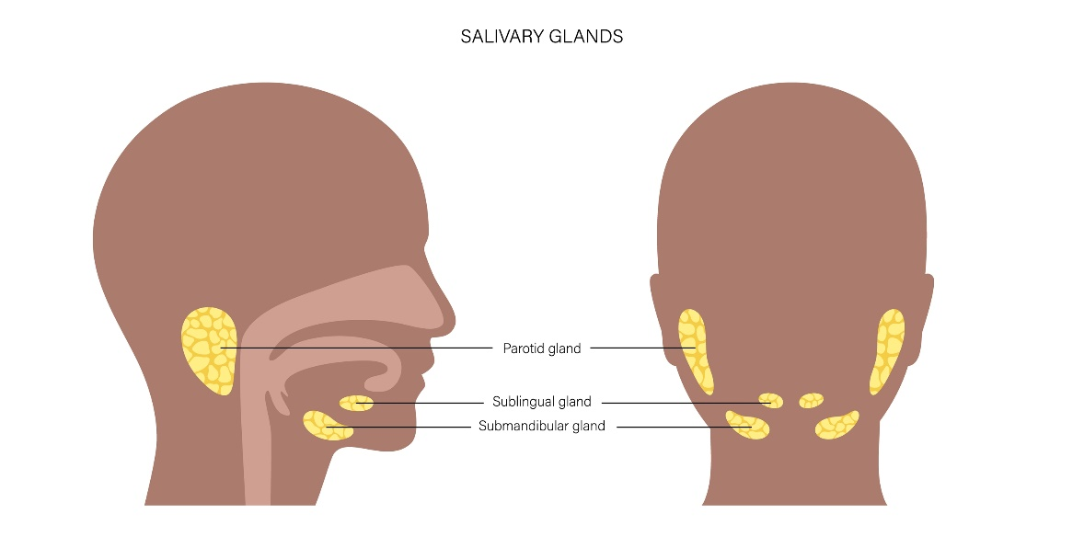
Saliva
Saliva contains the enzyme amylase which breaks down starch into simple sugars.
It also moistens the food to allow easier passage through the gastrointestinal tract.
Saliva is secreted from salivary glands around the mouth.
Did you know?
The sight, smell, taste or even the thought of food will start to increase the amount of saliva secreted.

Slide 21
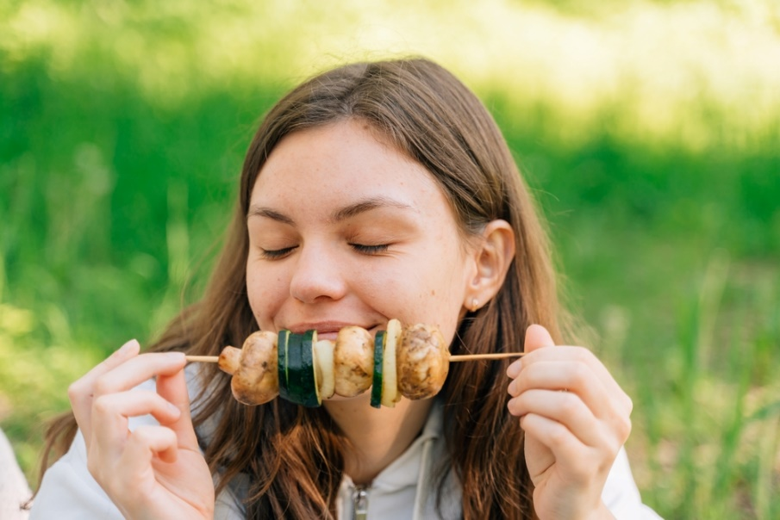
Moving on from the mouth
Food is masticated and mixed with saliva in the mouth.
The tongue and cheeks help to push the food into the teeth and shape the food into a ball or bolus before being swallowed.
The bolus is passed through to the oesophagus.

Slide 22
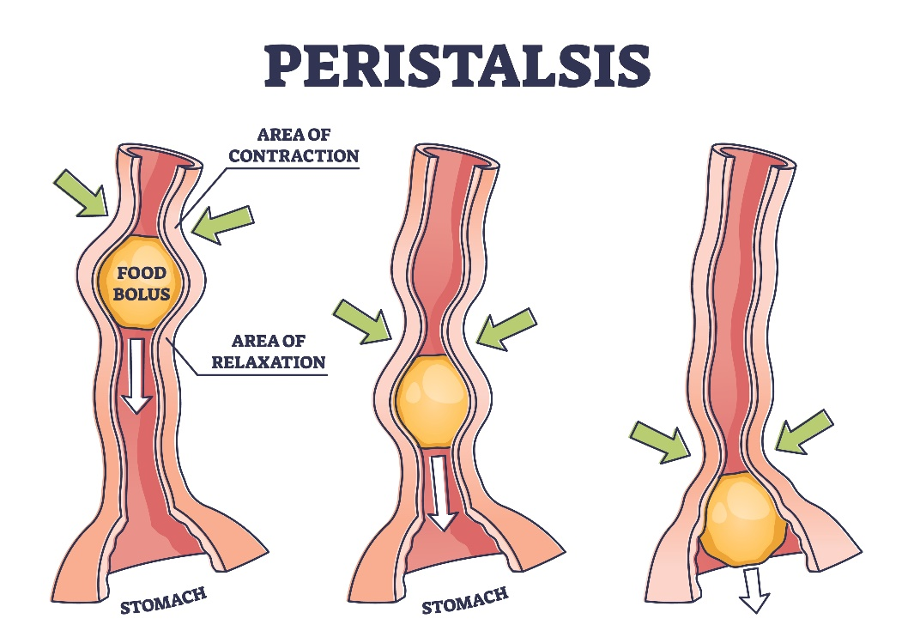
The oesophagus
The oesophagus is similar to a conveyor belt, as it transfers the food bolus from the mouth to the stomach in a few seconds.
Circular muscles in the wall of the oesophagus relax in front of the bolus while circular muscles behind the food contract, pushing the food bolus onward. This is called peristalsis.
Did you know?
People do not have conscious control over the muscles in the oesophagus. Even if someone is upside down, the food will be passed on to the stomach.

Slide 23
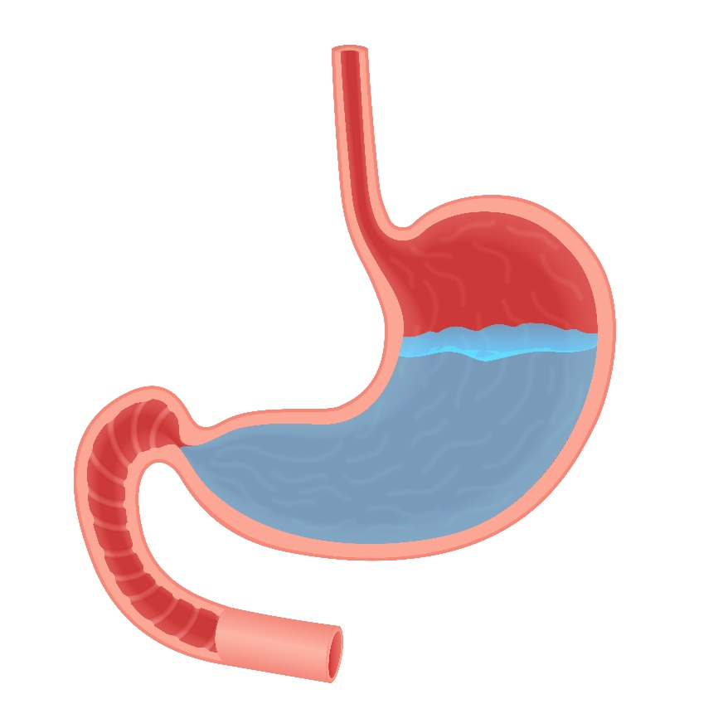
The stomach
The stomach is an expandable sack made up of three different layers of muscles where the food bolus will be churned for a few minutes or up to a few hours.
The bolus is mixed with hydrochloric acid (HCl) which helps to kill any bacteria present.

Slide 24
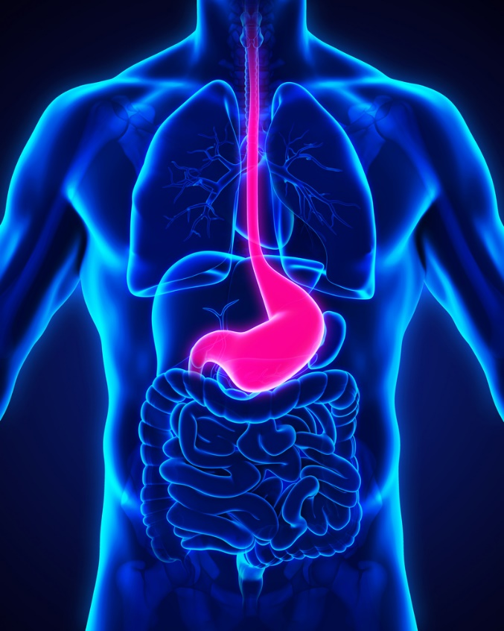
The stomach
The enzyme pepsin is also active in the stomach. It starts to break down protein to form peptides and amino acids.
Alcohol is absorbed through the stomach wall and taken to the liver where it is broken down.
When the food has been churned into a creamy mixture known as chyme, the pyloric sphincter (a ring of muscles) opens, and the chyme is released gradually into the small intestine. Chyme consists of gastric juices and partly digested food.

Slide 25
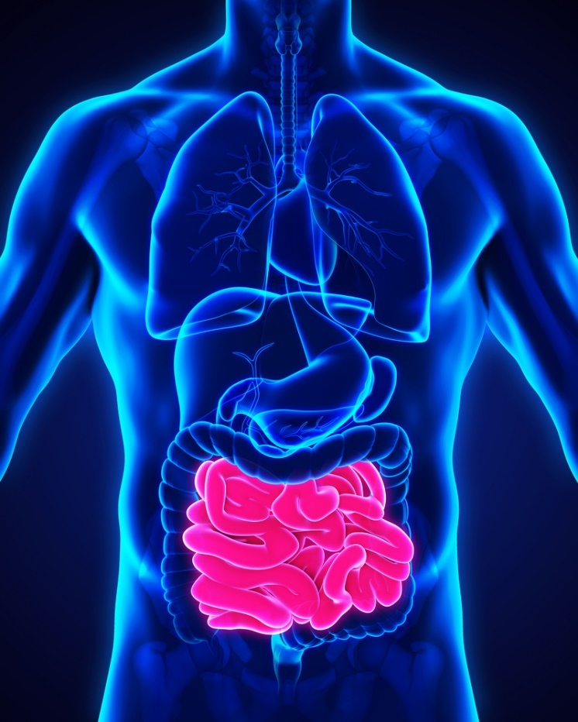
The small intestine
Chyme passes out of the stomach through the pyloric sphincter into the small intestine.
The small intestine is a tube about 6 metres long.
The small intestine is divided into three sections:
duodenum;
jejunum;
ileum.
The first section of the small intestine is the duodenum.

Slide 26
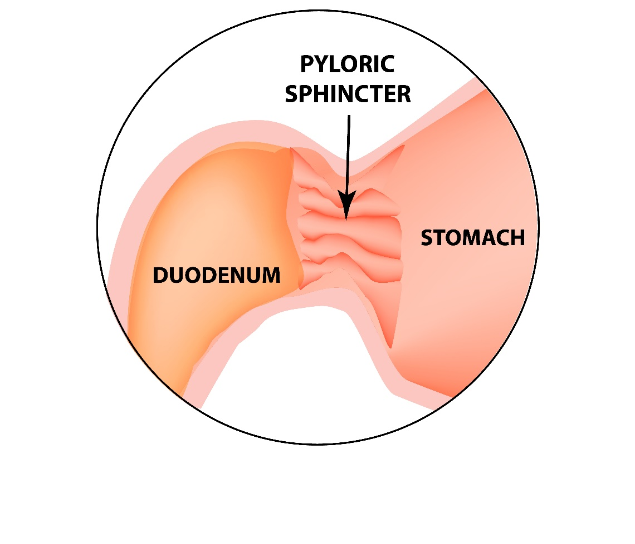
The duodenum
In the duodenum, chyme is diluted with bile salts (from the gall bladder) and pancreatic juices (from the pancreas).
Did you know?
The duodenum is about 25 centimetres long and in the shape of a horseshoe.

Slide 27
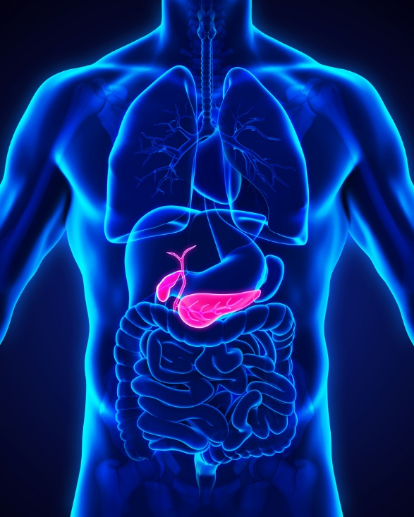
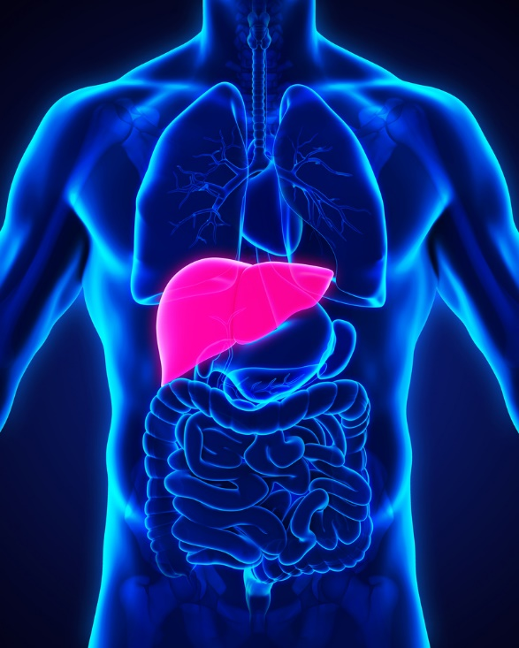
Bile
Bile is a fluid produced in the liver and stored in the gall bladder. This contains bile salts which emulsify fat, which is normally insoluble in water.
Emulsified fat droplets can then mix with the watery digestive juices, which contains the enzyme lipase to digest the fat efficiently.

Slide 28
Pancreatic juices
The pancreas secretes alkaline pancreatic juices.
These juices contain sodium bicarbonate to neutralise the hydrochloric acid mixed into the chyme from the stomach and provide an optimum pH level for the enzymes to work.
Pancreatic juices also contain digestive enzymes to break down nutrients:
Protein → Peptides + Amino acids
Trypsin and Chymotrypsin
Starch / Glycogen → Maltose
Pancreatic amylase
Fat → Fatty acids + glycerol
Pancreatic lipase

Slide 29
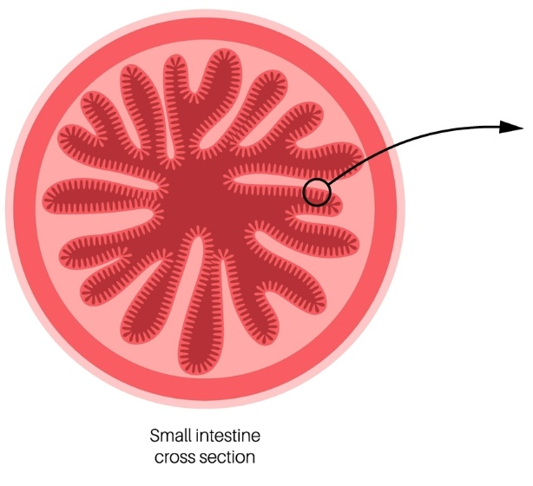
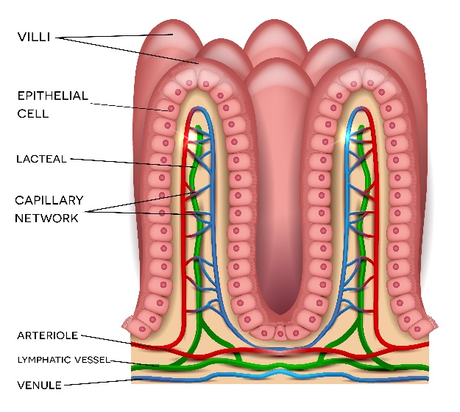
Wall of the small intestine
The inner surface of the small intestine is folded into finger-like structures called villi, which greatly increase the surface area available for absorption.
Did you know?
The villi have a surface area of about 200m², this is equivalent to the size of a tennis court.

Slide 30
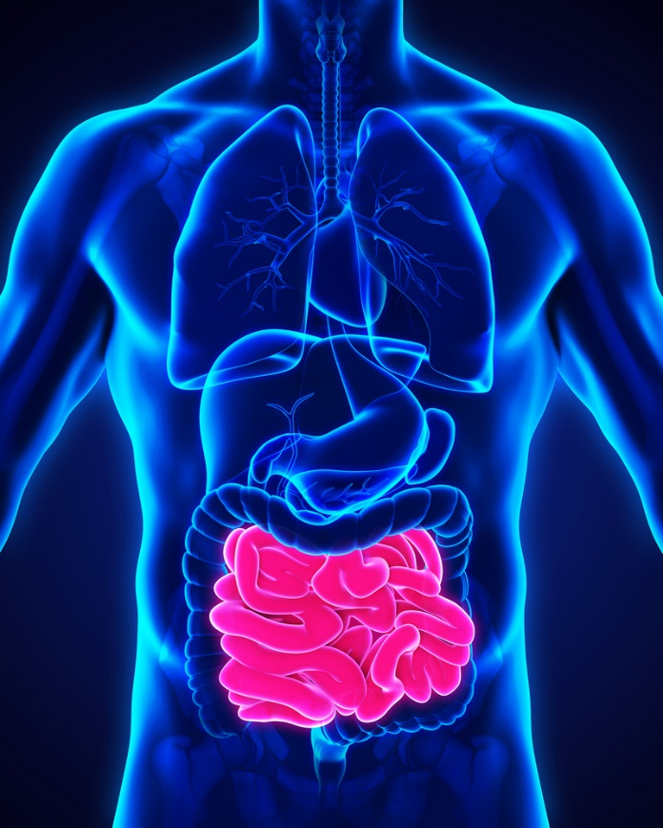
Small intestine
Digestion which occurs in the wall (brush border) of the small intestine includes:
Peptides → Amino acids
Protease
Maltose → Glucose
Maltase
Sucrose → Glucose + Fructose
Sucrase
Lactose → Glucose + Galactose
Lactase
The enzymes important in each process are highlighted in bold.

Slide 31
Absorption
These substances are absorbed in the small intestine:
water;
alcohol;
sugars;
minerals;
water soluble vitamins;
peptides and amino acids;
fatty acids, glycerol and fat-soluble vitamins.

Slide 32
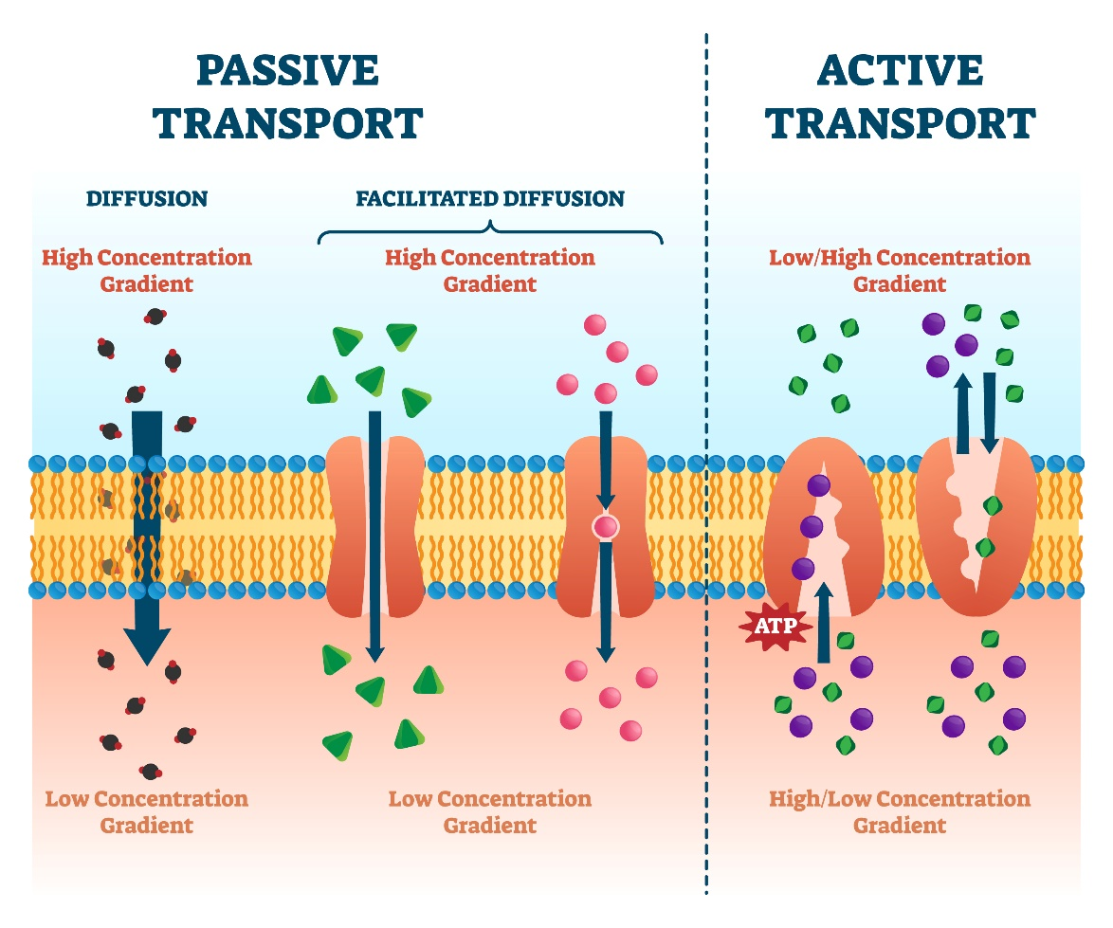
Absorption
The villi in the small intestine have a high blood supply. There are two types of absorption which occur here.
Passive – through the process of osmosis, the nutrients pass through the wall of the small intestine into the blood supply. Passive absorption moves molecules from their higher concentration to their lower concentration.
Active – a carrier transports nutrients through the wall of the small intestine into the blood supply. This type of absorption requires energy as it occurs against a concentration gradient.

Slide 33
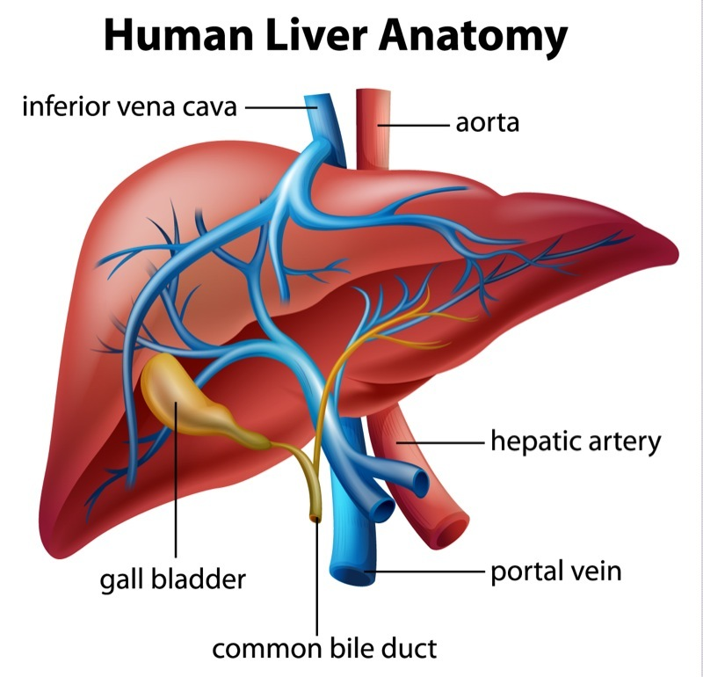
Absorption
Once in the blood, the nutrients are transported to the liver via the hepatic portal vein. Most fatty acids and glycerol pass into the lymphatic system, and then into the bloodstream.
The liver filters and converts the nutrients into substances that can be used by body cells for energy and growth.
Once the nutrients have been absorbed, the undigested substances pass into the colon (large intestine).

Slide 34
Elimination – the colon (large intestine)
The colon is a tube just over 1.5 metres long and is inhabited by bacteria.
The main function of the colon is to absorb water into the bloodstream and to process waste products.
Bacteria in the colon ferment dietary fibre and produce fatty acids and gas.
Other bacteria produce vitamin K, which is also absorbed.
The products of bacterial digestion, along with water and any remaining minerals are absorbed leaving a residue behind.

Slide 35
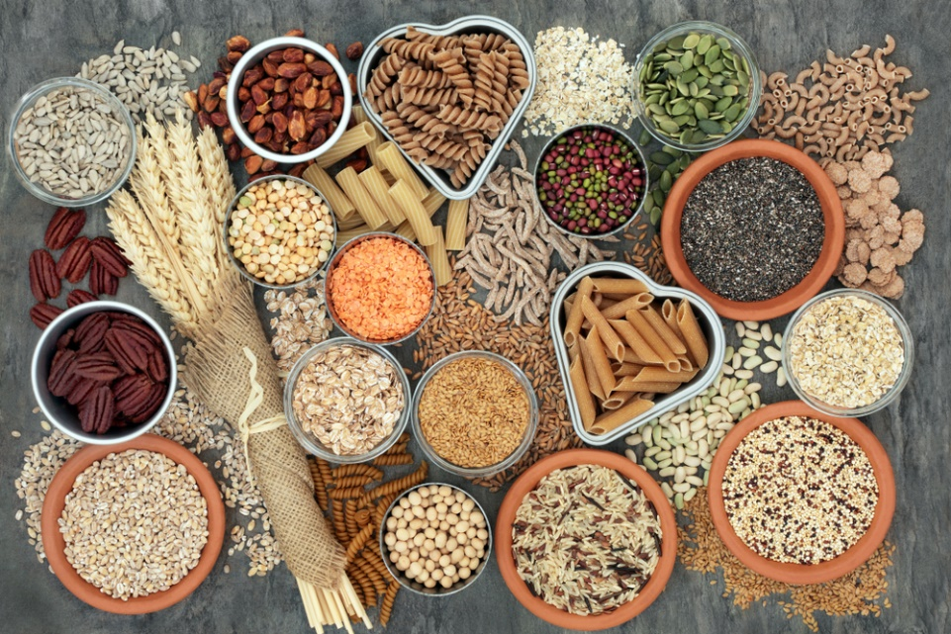
Elimination
The watery residue moves along the colon, the faeces are formed and stored in the rectum before being excreted through the anus.
Young children gradually learn to control this action.
The time taken for faeces to pass through the colon can be reduced if the diet is high in fibre.

Slide 36
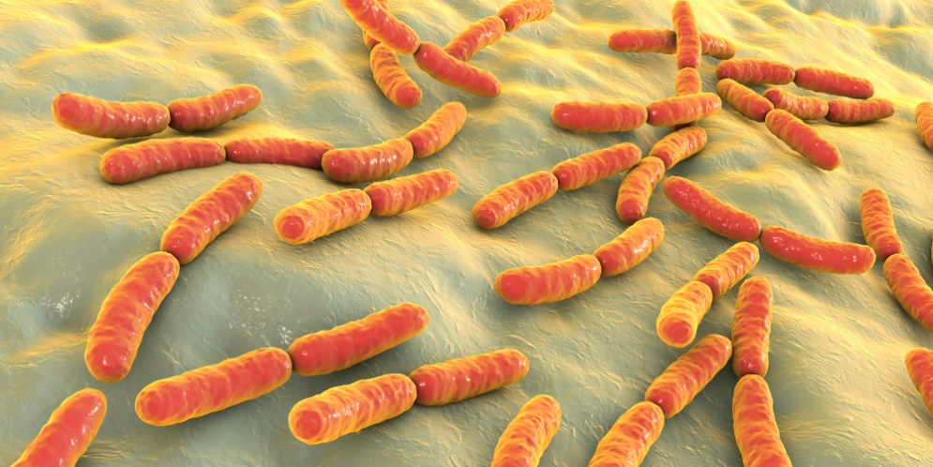
Gut bacteria
The gut contains 400 – 500 different species of bacteria and includes potentially pathogenic (e.g. Clostridia) and potentially beneficial (e.g. Bifidobacteria and Lactobacilli) bacteria.
These are measured in colony forming units per millilitre (cfu/ml).
Stomach 10¹ – 10³ cfu/ml
Duodenum & jejunum 10² – 10⁵ cfu/ml
Colon 10¹⁰ – 10¹² cfu/ml

Slide 37
Summary of the phases of digestion
Ingestion
The intake of food into the gastrointestinal tract.
Digestion
A series of physical and chemical processes which begin in the mouth but take place mainly in the stomach and small intestine.
Absorption
The passage of digested food substances across the gastrointestinal lining into the bloodstream and lymphatic system.
Elimination
The excretion of undigested food substances (such as cellulose) or waste in faeces.

Slide 38
Digestive system
For further information, go to:
www.foodafactoflife.org.uk
This science pack is one of a series of resources produced for the pHood Futures project, supported by the Royal Society of Chemistry.
This resource meets the Guidelines for producers and users of school education resources about food.

