Slide 1
8 tips for healthy eating

Slide 2
Eight tips for healthy eating
These eight practical tips cover the basics of healthy eating and can help you make healthier choices.
Base your meals on starchy carbohydrates.
Eat lots of fruit and veg.
Eat more fish – including a portion of oily fish.
4. Cut down on saturated fat and sugar.
5. Eat less salt.
6. Get active and be a healthy weight.
7. Don’t get thirsty.
8. Don’t skip breakfast.

Slide 3
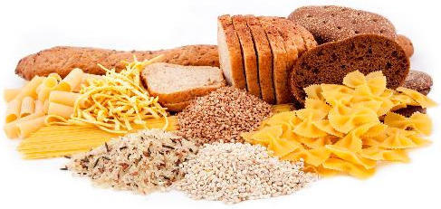
1. Base your meals on starchy carbohydrates
Starchy carbohydrate foods include potatoes, bread, pasta, rice and noodles. Where possible, it is recommended you choose wholegrain or higher fibre versions with less added fat, salt and sugar.
Starchy foods provide energy (calories), as well as dietary fibre, calcium, iron and B vitamins.
Did you know?
Starchy carbohydrate foods contain fewer than half the calories of fats per gram.

Slide 4
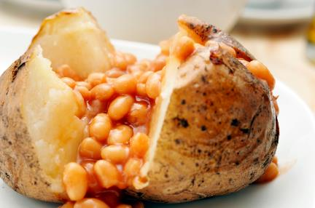
1. Base your meals on starchy carbohydrates
Most people need to eat more of these types of foods, especially those high in fibre, so try to include an item from this group in each of your main meals.
Can you think of some ideas?
Breakfast – porridge or wholegrain cereals.
Lunch –sandwich made with wholemeal bread, jacket potato or wholegrain rice salad.
Dinner – pasta, potatoes or rice with your evening meal.

Slide 5
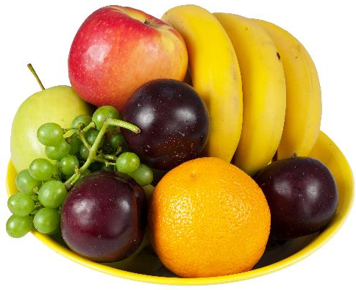
2. Eats lots of fruit and veg
Try to eat at least 5 portions of a variety of fruit and vegetables every day (5 A DAY).
Fruit and vegetables provide a range of nutrients, including vitamins and minerals, such as folate, vitamin C, potassium and dietary fibre.

Slide 6
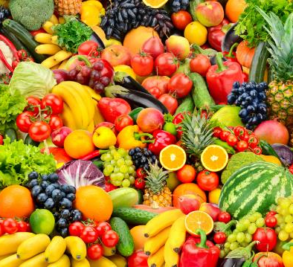
2. Eats lots of fruit and veg
Fresh, frozen, canned, dried and juiced fruit and vegetables all count.
Potatoes do not count towards 5 A DAY as they are a starchy food.
What is a portion?
One adult portion of fruit or vegetables is 80g.
Young children may need less depending on their age and size. As a rough guide, one portion is the amount they can fit in the palm of their hand.

Slide 7
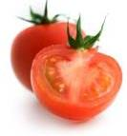
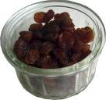





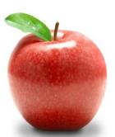

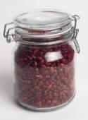
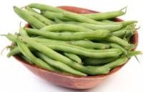

What is a portion?
3 heaped 15ml spoons
3 heaped 15ml spoons
7 strawberries
I medium or
7 cherry tomatoes
1 heaped 15ml spoon
2 spears of broccoli
1 x 150ml glass
2 kiwi fruits
3 heaped 15ml spoons
1 apple
3 heaped 15ml spoons
1 slice

Slide 8

Did you know?
Only one glass of fruit juice and smoothie counts towards our 5 A DAY, no matter how much we drink. This is because much of the fibre is lost through juicing.
Fruit juice and smoothies are also a source of free sugars and so you should, therefore, limit consumption to no more than a combined total of 150ml per day.
Our free sugar intake should not exceed 5% of total dietary energy however at the moment on average we are exceeding this amount.

Slide 9

3. Eat more fish
Fish is a good source of protein and provides many vitamins and minerals.
Fish can provide essential nutrients, such as protein, to the diet and is a good source of many vitamins and minerals. Oily fish are one of the only natural food sources of vitamin D, which is important for bone health and is also our main source of long chain omega 3, which is important for heart health.

Slide 10
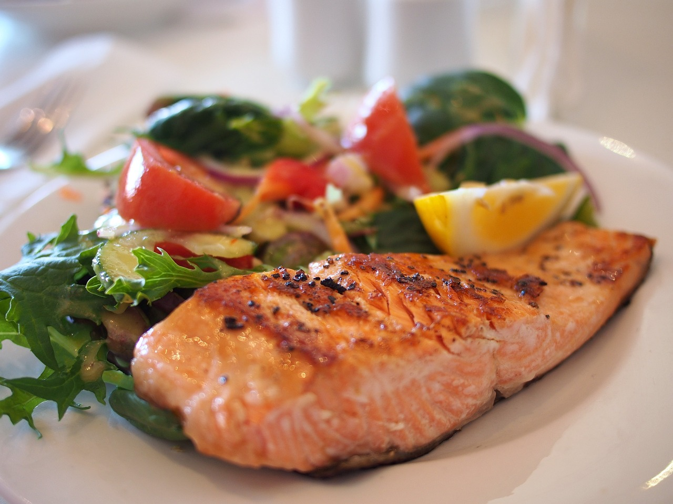
3. Eat more fish
The governments recommendations are to try to eat at least two portions (1 portion =140g) of fish a week, including a portion of oily fish.
Can you name some oily fish?
Salmon, mackerel, pilchards, sprats, trout and sardines are all oily fish.
Fresh and canned tuna do not count as oily fish as the amount of long-chain omega 3 fatty acids are similar to those in other fish.

Slide 11
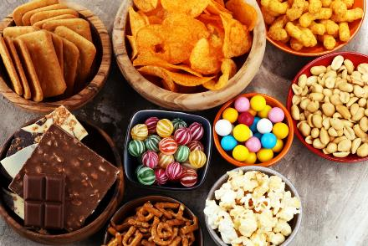
4. Cut down on saturated fat and sugar
We all need some fat in our diet, but it is important to get the right type and amount.
There are two main types of fat: saturated and unsaturated.
Eating too much saturated fat can increase blood cholesterol levels which can increase the chance of developing heart disease.
Saturated fat is found in many foods, such as hard cheese, cakes, biscuits, pies, pastry, cream and butter.

Slide 12
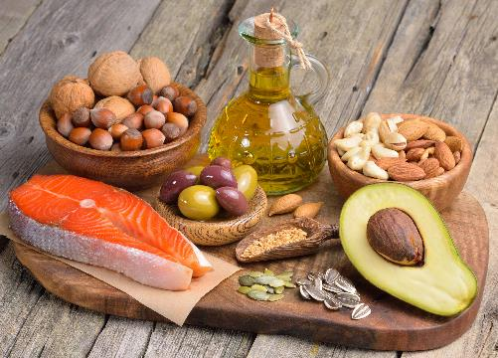
4. Cut down on saturated fat and sugar
Try to cut down on foods high in saturated fat and replace with foods that are high in unsaturated fats, such as vegetable oils, oily fish, avocados, nuts and seeds.
Did you know?
There's good evidence that replacing saturated fats with polyunsaturated fats can help lower cholesterol.

Slide 13
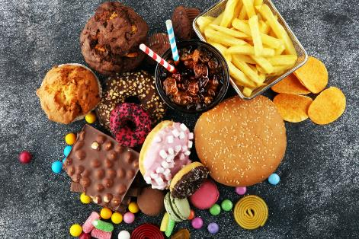
4. Cut down on saturated fat and sugar
Too many sugar-containing food and drinks consumed between meals is associated with an increased tendency towards tooth decay, especially in those with poor dental hygiene.
Food and drinks high in sugar include sweets, cakes, biscuits and some carbonated drinks.

Slide 14
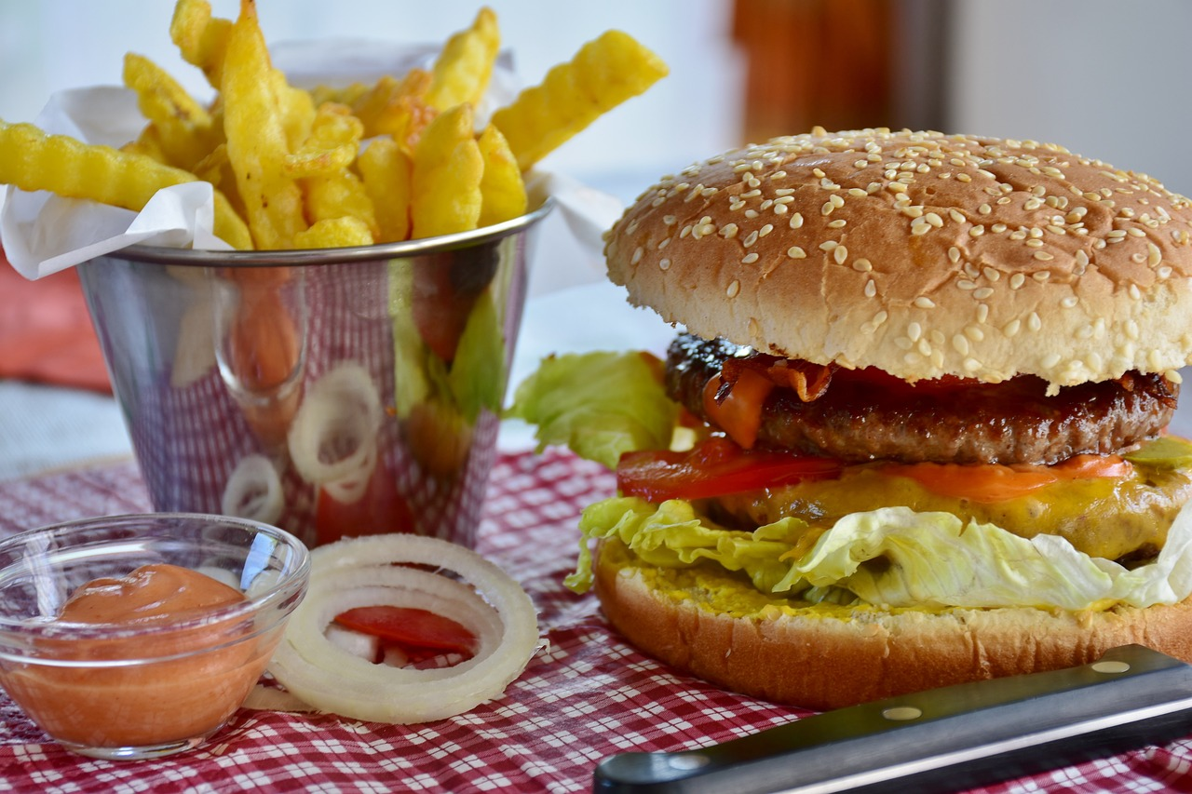
4. Cut down on saturated fat and sugar
Use food labels to check how much saturated fat and sugar foods contain.
More than 5g of saturated fat per 100g of food means that it is high in saturates. More than 15g of sugar per 100g of food means that the food is high in sugar.
You can also use the traffic light system on the front of pack to determine whether a food is high or low in saturated fat or sugar.

Slide 15
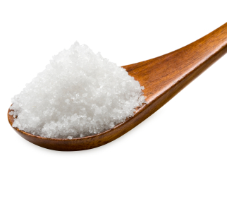
5. Eat less salt
Maintaining a normal blood pressure is important for health.
Eating too much salt may raise blood pressure and lead to stroke and heart disease.
Most of our salt intake comes from processed foods rather than salt added during cooking or at the table, so it is recommended to always check food labels for the salt content.

Slide 16
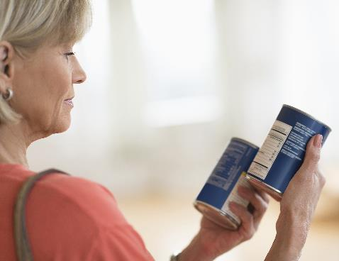
5. Eat less salt
Did you know?
Adults should eat no more than 6g of salt each day, children under 11 years should eat less.
You can use food labels to help you cut down. When comparing foods, a high salt content is more than 1.5g salt per 100g of food and low is 0.3g salt or less per 100g.

Slide 17
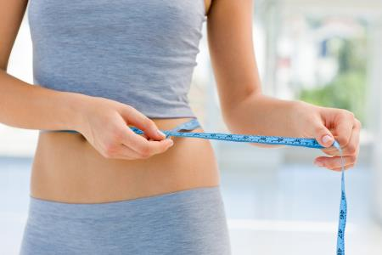
6. Get active and be a healthy weight
To achieve a healthy weight, we need to balance the energy from food and drinks with the energy we use up through activity.
Being active can reduce the risk of type 2 diabetes, heart disease and stroke and help maintain a healthy weight.
Being overweight or obese can lead to health conditions such as type 2 diabetes, some cancers, heart disease and stroke.
Being underweight could also affect our health.

Slide 18
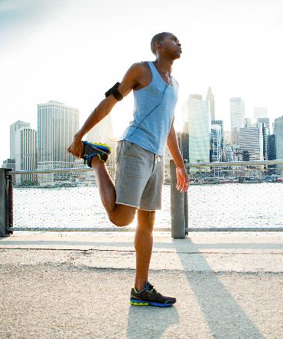
6. Get active and be a healthy weight
Young people should do at least 60 minutes of physical activity of moderate to vigorous intensity every day.
Adults should aim to be active daily and achieve at least 150 minutes of physical activity of moderate intensity every week and perform strength exercises on two or more days a week that work all the major muscles.

Slide 19


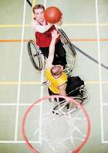
6. Get active and be a healthy weight
Active living, e.g. brisk walking, gardening, using the stairs.
Active recreation, e.g. playing, dancing, cycling, skateboarding.
Organised sport, e.g. basketball, netball, running, gymnastics.

Slide 20
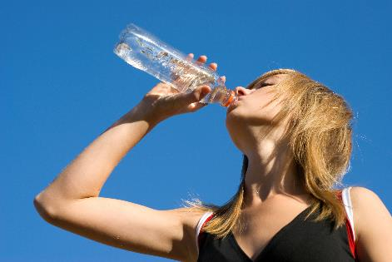
7. Don’t get thirsty
Around two-thirds of the body are made up of water. We lose water throughout the day when we breathe, sweat and use the toilet.
When our bodies do not have enough water, we are said to be dehydrated. We need to drink around 6-8 glasses of fluid every day to stop us getting dehydrated. More when the weather is hot or when we are active.
Apart from water, most drinks count towards your fluid intake – but not alcohol.

Slide 21
7. Don’t get thirsty
Did you know?
Common signs of dehydration are:
thirst;
dark-coloured urine;
lack of energy;
not passing much urine when you go to the toilet;
headaches;
feeling lightheaded.

Slide 22

8. Don’t skip breakfast
Eating breakfast provides us with energy as well as some important nutrients that we need for good health.
Breakfast can help to increase concentration and alertness during the morning.
For example, a healthy breakfast of wholegrain breakfast cereal or a slice of toast with low fat spread and a glass of fruit juice, will give our bodies the energy and nutrients we need to start the day.

Slide 23
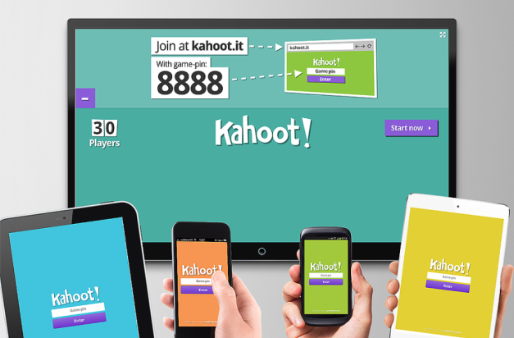
Quiz - Kahoot
Open the link below on the main screen and get students to log onto kahoot.it on their tablets or smartphones.
They can then enter the code (that will come up on the main screen when you start the game) and their own nickname.
They can then play along with the quiz choosing the multiple-choice answers that correspond with the questions on the main screen. There will then be a leaderboard of the scores after each question and at the end.
Links for this are on the next slide.

Slide 24
Quiz- Kahoot
‘Drink Plenty’ quiz
‘Have Breakfast’ quiz
‘Get active’ quiz
‘5 A DAY’ quiz
Note that for these quizzes, not all the answers are found in the presentation but it can be a good chance to learn some new facts!

Slide 25
8 tips for healthy eating
For further information, go to:
www.foodafactoflife.org.uk
This resource meets the Guidelines for producers and users of school education resources about food.

