Slide 1
Diet and health

Slide 2
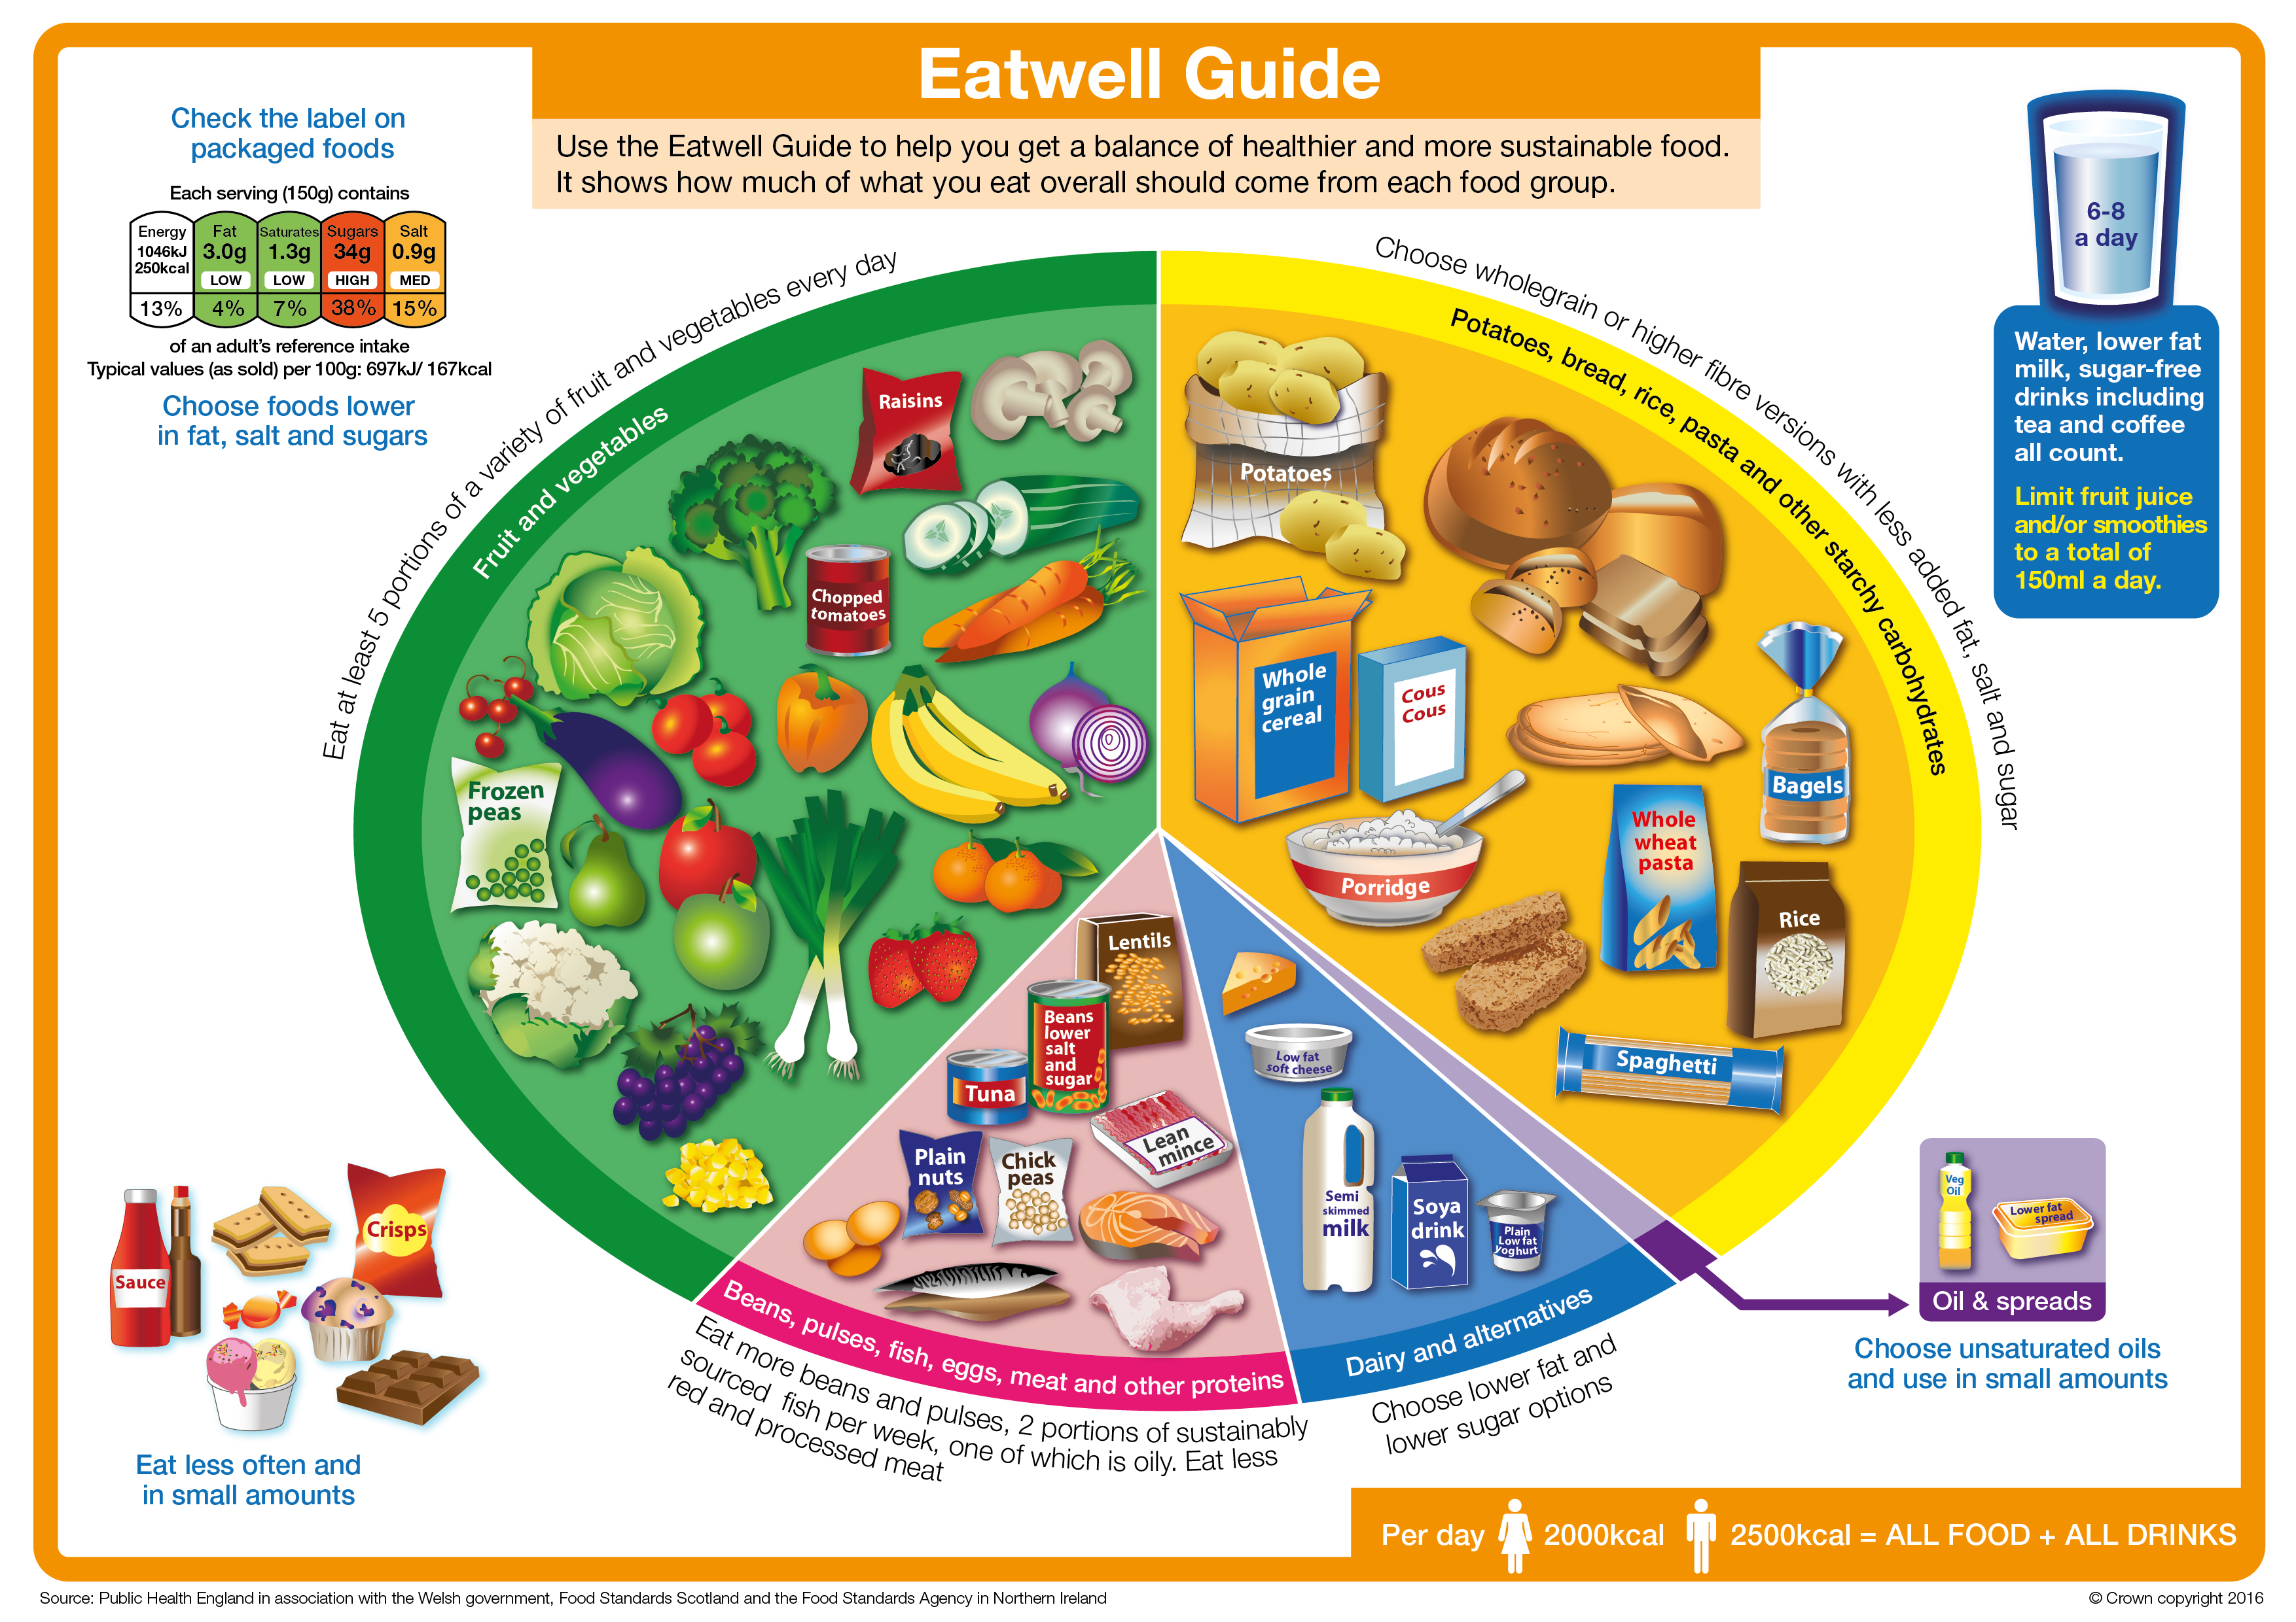
A balanced diet
A balanced diet is based on the Eatwell Guide.
An unbalanced diet can lead to dietary related diseases.

Slide 3

Malnutrition
Having intakes of energy and/or nutrients below or in excess of needs for long periods of time can affect health. This is called malnutrition.
Severe under nutrition (having an intake of energy and/or nutrients below what is needed) is rare in the United Kingdom, but can be common in some developing countries. However, under nutrition does occur in the UK, e.g. micronutrient deficiencies.
Children suffer the effects of starvation (not enough food) more quickly than adults.

Slide 4
Undernutrition
Worldwide, Kwashiorkor and marasmus are two common diseases caused by a lack of protein and energy.
Fat soluble vitamins (A, D, E and K) and minerals are stored in the body so it takes time for deficiency diseases to develop.
Water soluble vitamins are not stored in the body so low intakes usually lead to signs of deficiency relatively quickly.

Slide 5

Over nutrition
Over nutrition is a problem usually associated with developed countries, such as the United Kingdom.
The most common over nutrition problem is obesity caused by too much energy being consumed, or high levels of inactivity.

Slide 6
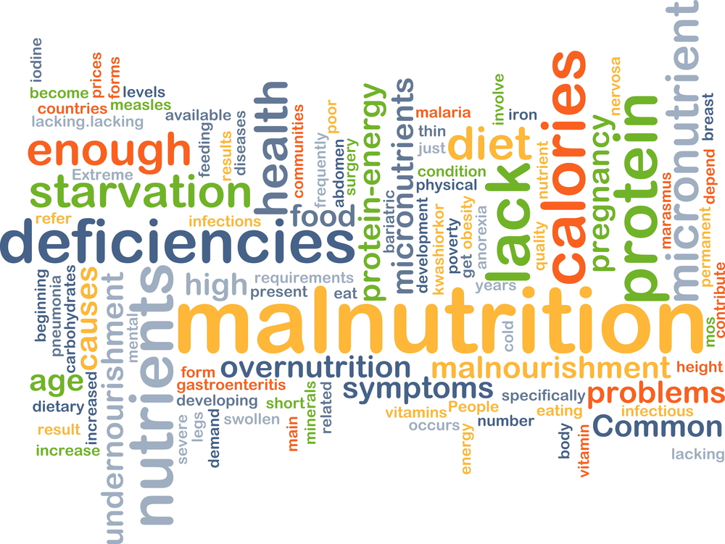
Malnutrition
The risk of malnutrition is increased by:
increased requirements for some nutrients;
restricted range of foods;
reduction in available income;
very low income;
medical conditions;
psychological conditions.

Slide 7

Cancer
Cancer is a complex disease which can take a long time to develop.
A wide variety of factors are involved in the development of cancer, including:
age;
genetics;
environment;
hormones;
infections.

Slide 8

Cancer
Cancer occurs when abnormal cells in the body develop and increase rapidly. The abnormal cells can also spread to other parts of the body and multiply.
Cancer can occur in different parts of the body.
In the UK, the most common cancers in men are lung, prostate or bowel cancer. The most common cancers in women are lung, breast or bowel cancer.

Slide 9

Cancer prevention
The World Cancer Research Fund
has released nine cancer prevention
recommendations.
Be a healthy weight.
Move more.
Avoid high-calorie foods and drinks.
Enjoy more grains, veg, fruit and barley.
Limit intake of red meat and avoid processed meat.
Don’t drink alcohol.
Eat less salt.
Don’t rely on supplements.
Breastfeed your baby.

Slide 10
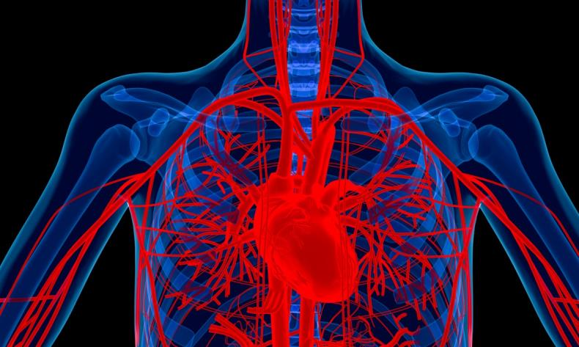
Coronary heart disease
Coronary heart disease (CHD) is caused by a narrowing of the blood vessels to the heart. This reduces the flow of blood to the heart.
If one of the blood vessels becomes completely blocked, the blood supply to part of the heart stops and that part is damaged. This is called a heart attack.

Slide 11
Coronary Heart Disease
The chance of suffering from Coronary Heart Disease (CHD) is affected by many factors. These are called risk factors.
Factors that increase the risk of CHD include being:
male;
older;
a cigarette smoker;
overweight;
inactive;
stressed.
Factors that increase the risk of CHD also include having:
a family history of CHD;
high blood cholesterol level;
high blood pressure;
high intake of saturated fats;
diabetes.

Slide 12

Coronary heart disease
Changes to the diet to reduce the risk of CHD include:
increasing oily fish intake;
reducing salt intake;
increase fruit and vegetables;
decreasing alcohol consumption.

Slide 13
Physical activity
If a person regularly consumes more energy from food and drink than they need, they will start to gain weight, eventually becoming overweight. For example, energy in > energy out.
Extra energy from food and drink is stored in the body as fat. There are a range of weights which are considered healthy for a given height. These can be calculated by calculating BMI (Body Mass Index).
BMI =
Recommended BMI range
Underweight | Less than 18.5
Normal | 18.5 – less than 25
Overweight | 25 – less than 30
Obese | 30-40
Very obese | Over 40
weight (kg)
height (m) x height (m)

Slide 14

Obesity
People who are obese are more likely to suffer from:
• coronary heart disease;
• type 2 diabetes;
• gall stones;
• arthritis;
• high blood pressure;
• some types of cancers, i.e. colon, breast, kidney and stomach.

Slide 15

Bone health
Calcium is important for strong bones. Diet and nutrient status are important factors in formation of healthy bones, in particular calcium, vitamin D and vitamin K.
Osteoporosis is a disease where bones become weak, brittle and break easily. It is caused by severe losses of calcium.
During childhood, adolescence and early adulthood, calcium and other substances are added to the bone. This makes it stronger.
After the age of 30-35, bone loss begins. After the menopause women lose bone at an increased rate.

Slide 16

Bone health
Strong bones contain plenty of calcium and their strength is affected by:
genetics;
sex;
diet;
exercise;
body weight;
hormones.
Consuming adequate amounts of calcium, vitamin K and vitamin D throughout life will help with bone health and strength.

Slide 17
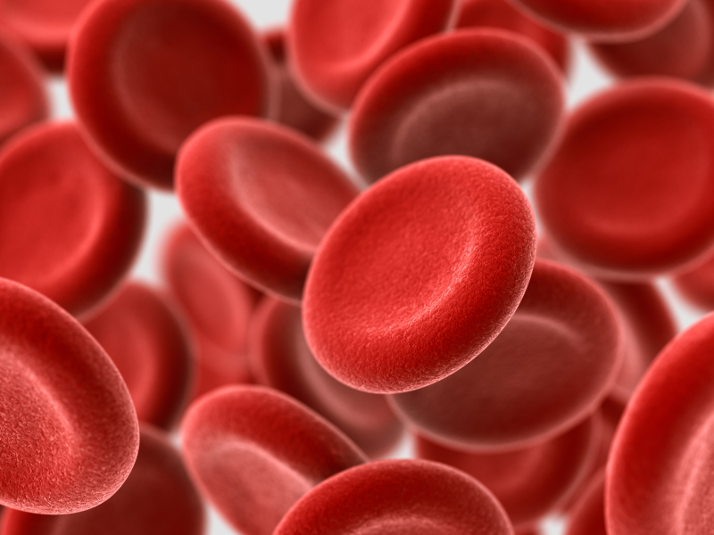

Anaemia
The mineral iron is vital for making red blood cells. Iron from the diet forms haemoglobin, which carries oxygen in the blood.
If the body’s store of iron is low and there is too little iron in the diet, the symptoms of iron deficiency anaemia will start to develop. This is particularly common in young women who have higher iron requirements due to their menstrual cycle.
Iron from animal sources is generally more easily absorbed than iron from plant sources. Vitamin C increases absorption of iron from plant sources.

Slide 18
Diet and health
For further information, go to:
www.foodafactoflife.org.uk
This resource meets the Guidelines for producers and users of school education resources about food.

