Slide 1
World diets

Slide 2
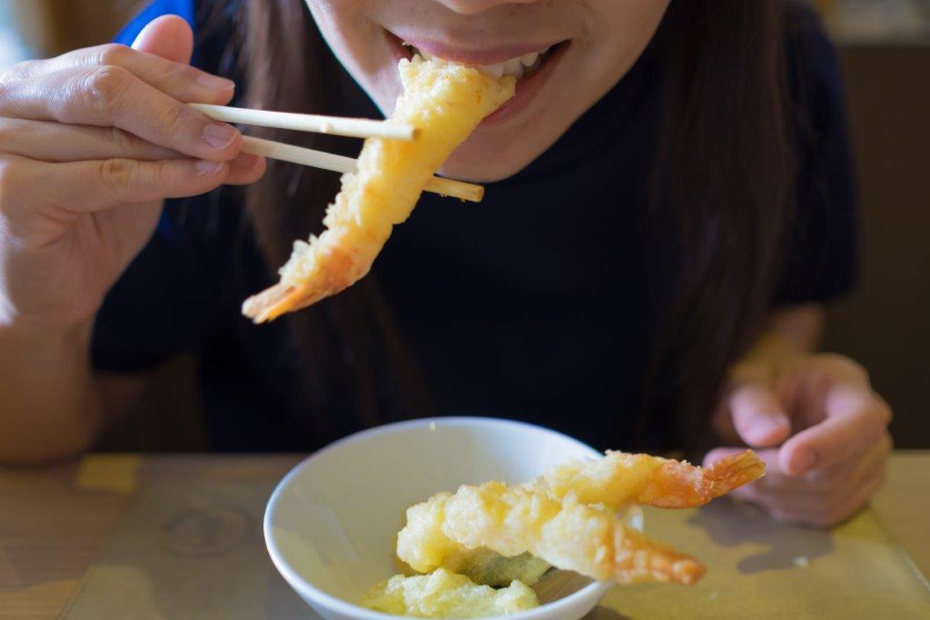
Food around the world
There are many different types of foods from around the world.
People eat different foods depending on their culture.
Their culture might decide the foods that are commonly or normally eaten. This is different in different countries.

Slide 3
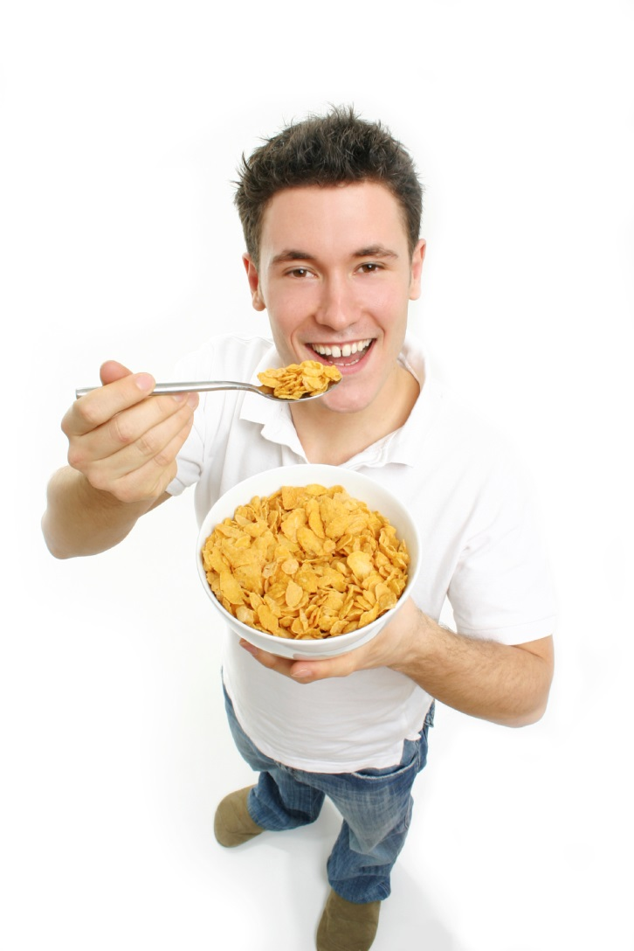
Food preferences
People choose lots of different types of food to eat.
The type they choose depends on:
the food available;
their likes and dislikes;
time;
culture and religion;
whether they can cook.

Slide 4

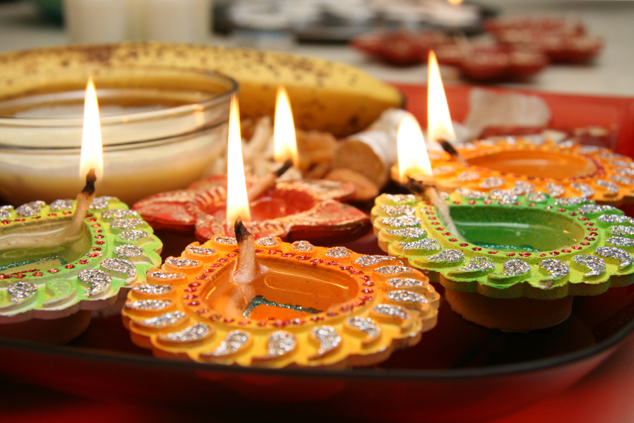
Religion
People also eat different things depending on their religion.
Their religion might dictate which foods can or cannot be eaten, or what types of foods can be served at special celebrations.
What examples do you know?

Slide 5
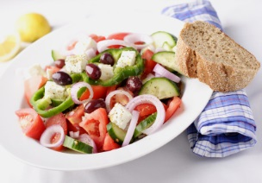
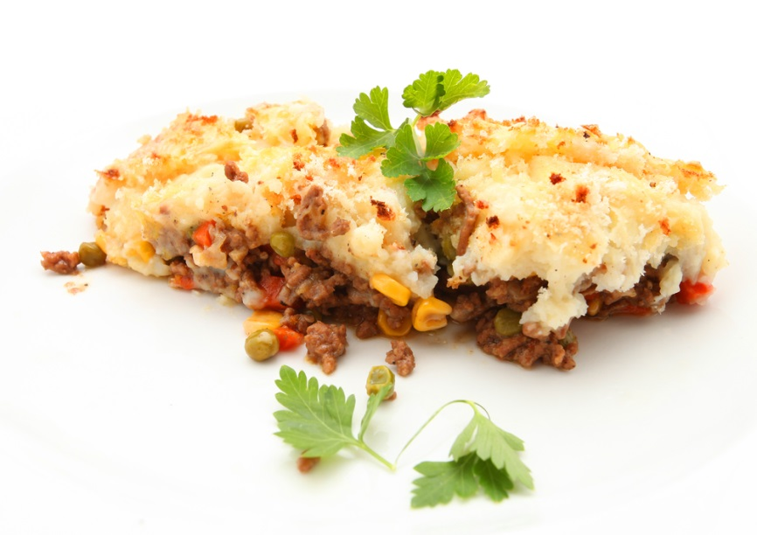
Where in the world?
Shepherd's Pie, UK
Greek salad, Greece

Slide 6
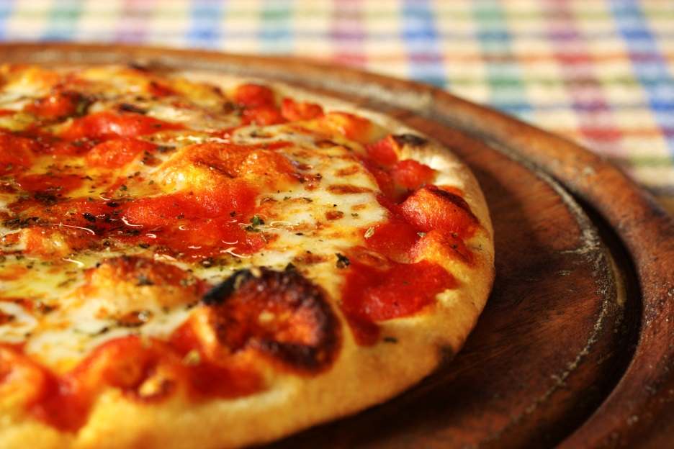
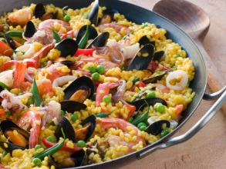
Where in the world?
Paella, Spain
Pizza, Italy

Slide 7
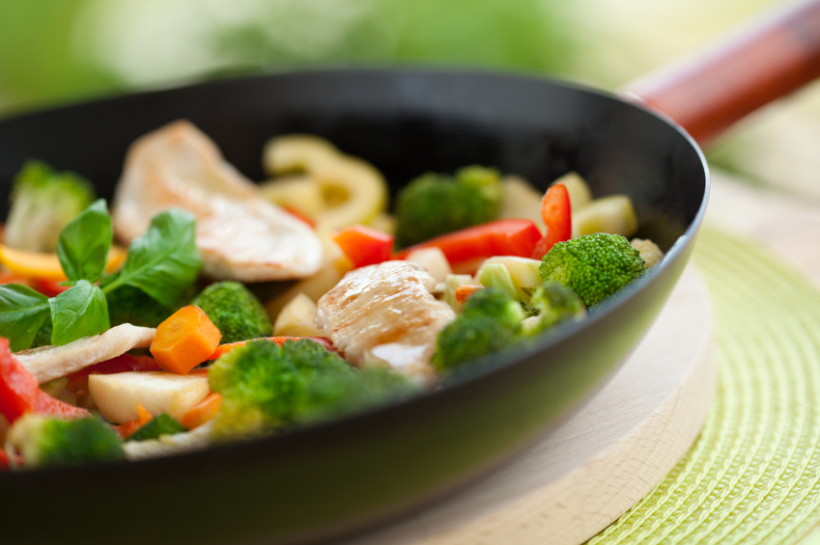
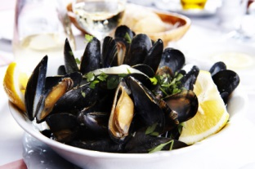
Where in the world?
Mussels, France
Stir-fry, China

Slide 8
World diets
For further information, go to:
www.foodafactoflife.org.uk
This resource meets the Guidelines for producers and users of school education resources about food.

