Slide 1
Healthier cooking methods

Slide 2
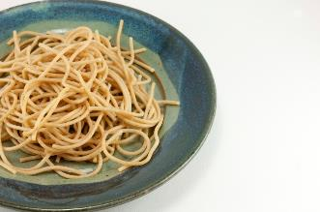

Healthier cooking methods
When creating and making a meal or planning a menu, it is important to take into consideration healthy eating recommendations to ensure that the meal/menu can be consumed as part of a varied, balanced diet.
Planning - consider whether the meal meets the nutritional needs and preferences of those it is being cooked for. Base your meals on starchy food.
Choosing - when choosing ingredients, choose low fat/sugar/salt versions, where possible.

Slide 3
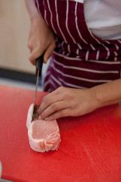
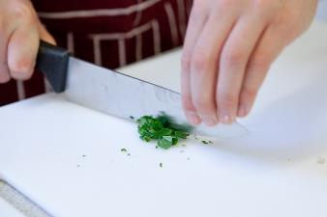
Healthier cooking methods
Preparing - when preparing food, limit the amount of fat added and replace salt with other flavourings, such as herbs.
Cooking - use cooking practices which reduce the amount of fat needed and minimise vitamin losses from fruit and vegetables.
Serving - serve the meal in proportions which reflect current healthy eating advice. Do not forget to include a drink.

Slide 4
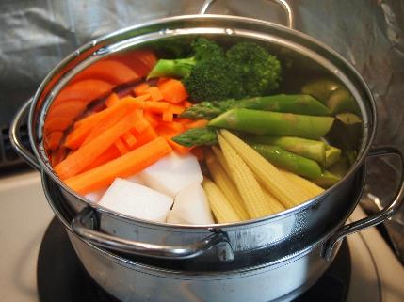
Healthier cooking methods
The choice of cooking method can affect the nutritional profile of a dish along with the colour, texture and flavour.
Grill foods rather than fry to allow fat to drain away.
Drain or skim fat from liquids, e.g. sauces, stews and casseroles.
Dry fry using non-stick pans so no need for oil.
Oven bake rather than fry.
Steam or microwave vegetables.

Slide 5
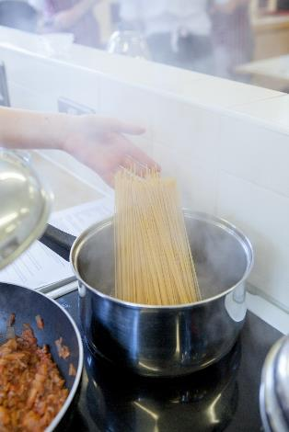
Healthier cooking methods
When cooking:
If using fat, limit the amount used and measure it. Why not try a spray oil?
Do not add salt to the water when cooking pasta or vegetables.
If microwaving, use only a small quantity of water to reduce the amount of water soluble vitamin loss.
Use any cooking water to make a gravy or sauce.

Slide 6

Healthier cooking methods
Barbequing is a fun, sociable and healthier way to cook food.
No added fat is required as heat rays travel upwards to cook the food placed above on a grid or spit. Any fat in the food then drips away.
Name five foods that can be cooked using a BBQ.

Slide 7
Healthier cooking methods
For further information, go to:
www.foodafactoflife.org.uk
This resource meets the Guidelines for producers and users of school education resources about food.

