Slide 1
Terrific tuna tarts

Slide 2
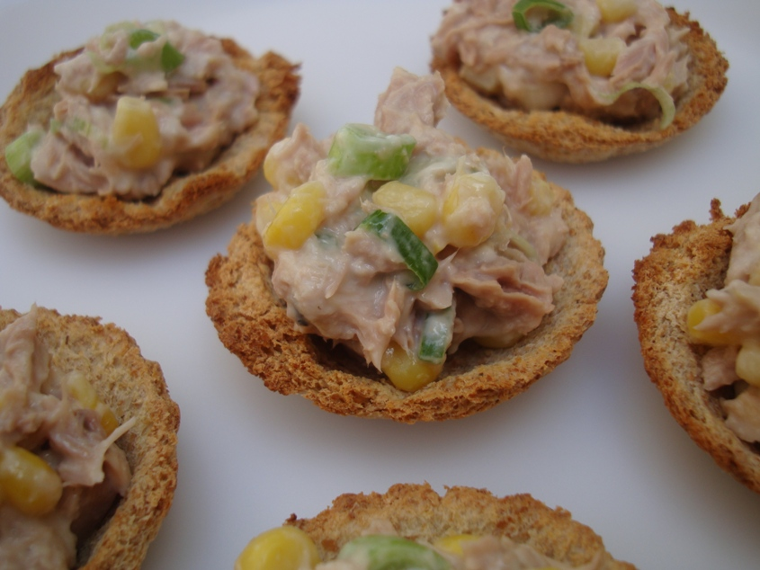

Slide 3
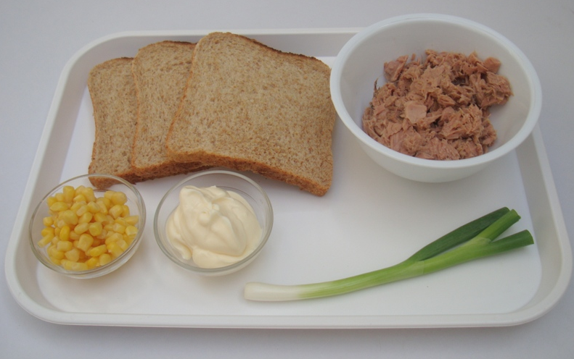
Ingredients
3 x thick slices of bread
1 x 100g canned tuna fish, drained
1 x 15ml spoon low fat mayonnaise
1 x spring onion
1 x 15ml spoon canned sweetcorn

Slide 4
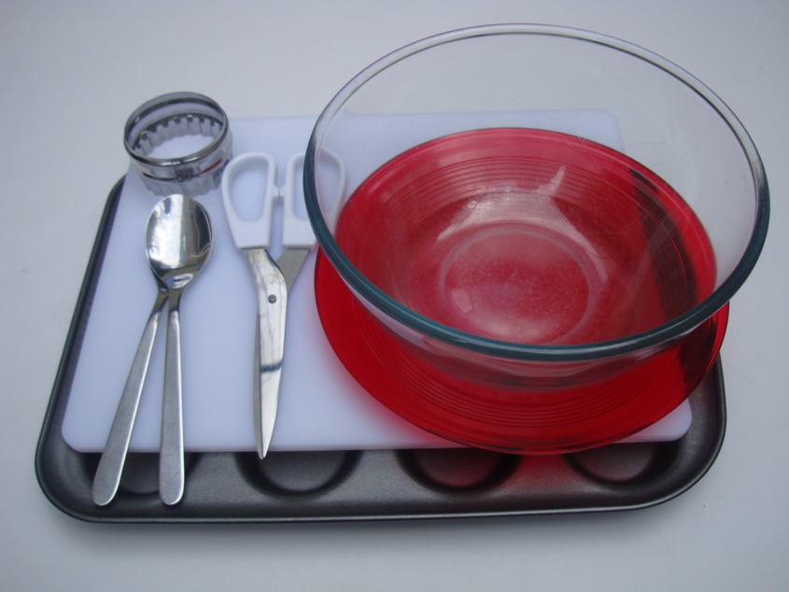
Equipment
Chopping board
Mixing bowl
2 Spoons
Kitchen scissors
Cutter
Non-stick patty tin
Large plate

Slide 5
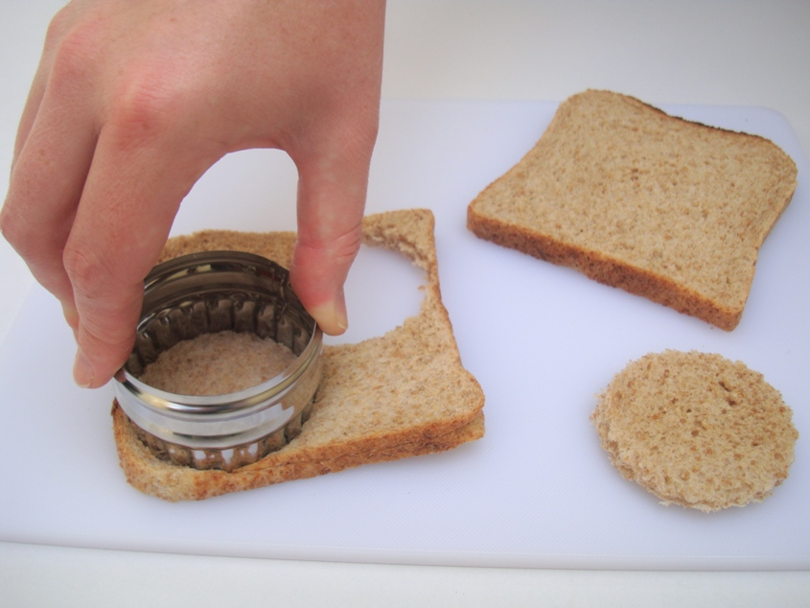
Method
Cut out circles of bread.

Slide 6
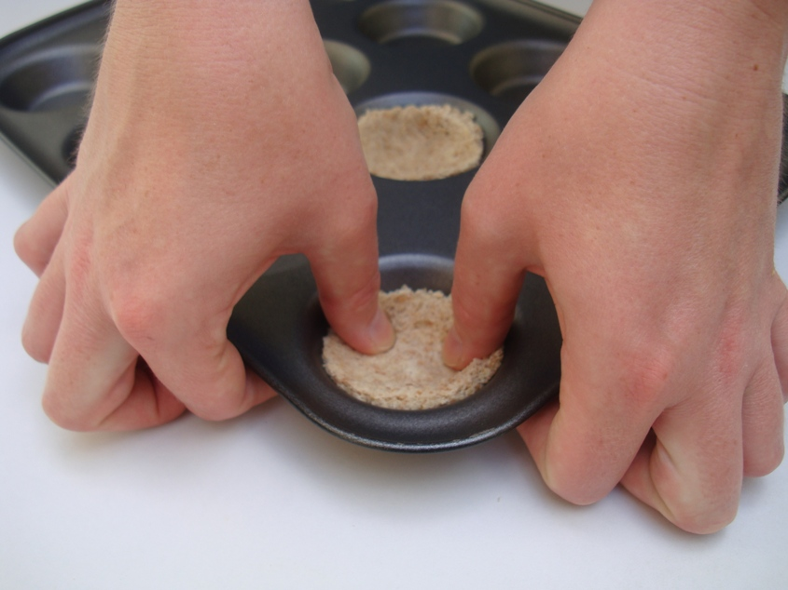
2. Press the bread into the patty tin.

Slide 7
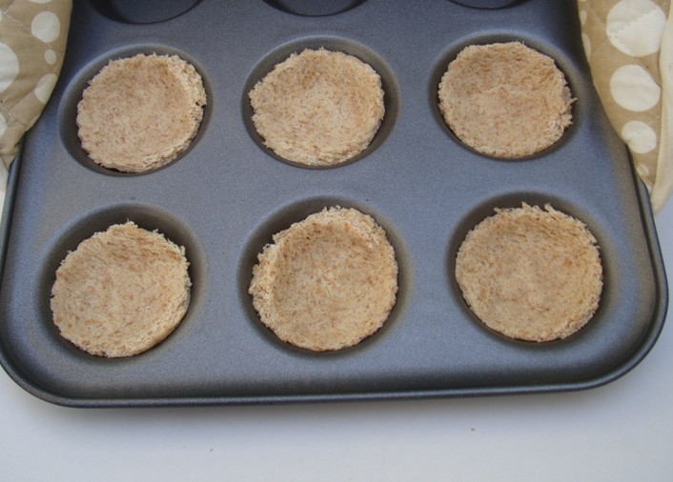
3. Bake for 8-10 minutes. Allow to cool.

Slide 8
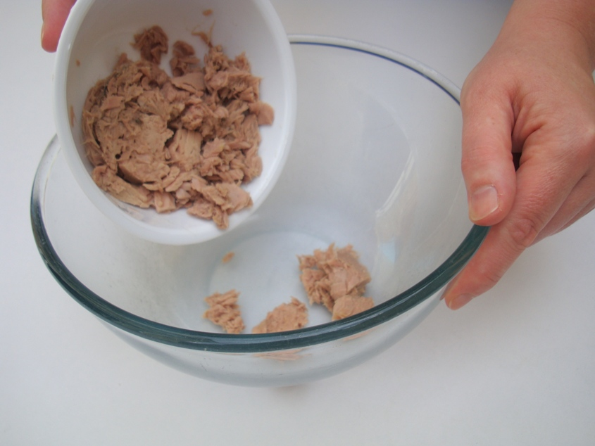
4. Tip the tuna into the bowl.

Slide 9
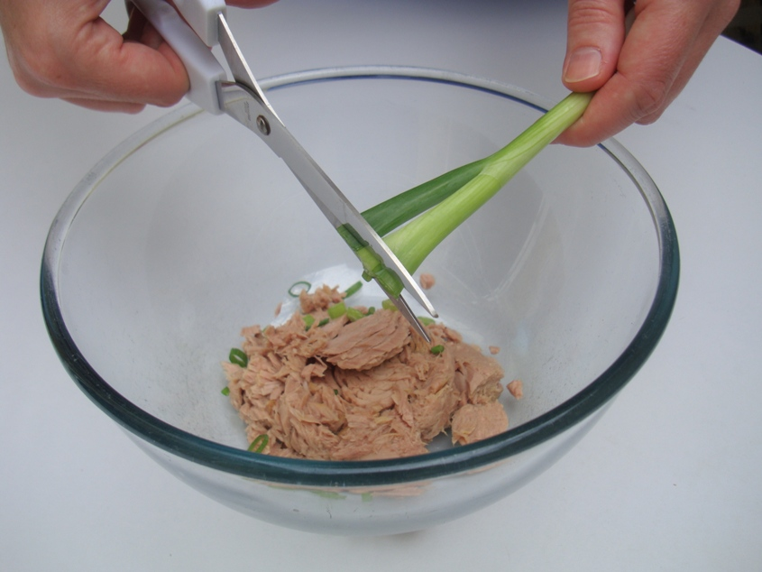
5. Snip the spring onions into the bowl.

Slide 10
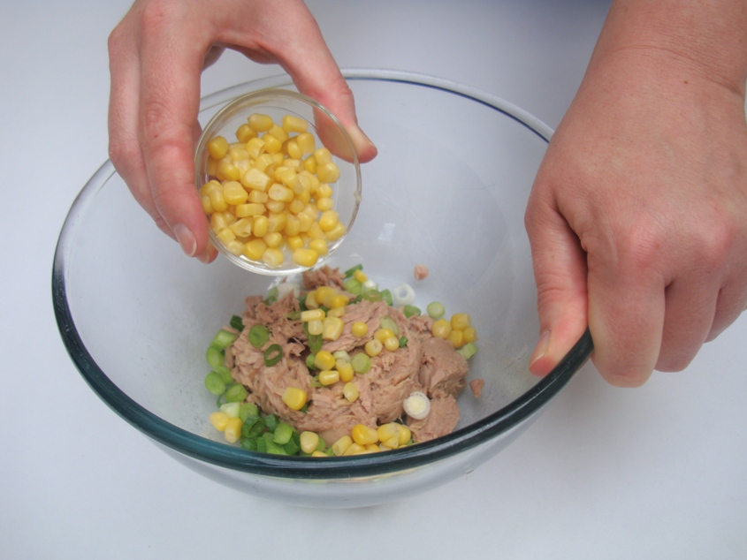
6. Add the other ingredients.

Slide 11
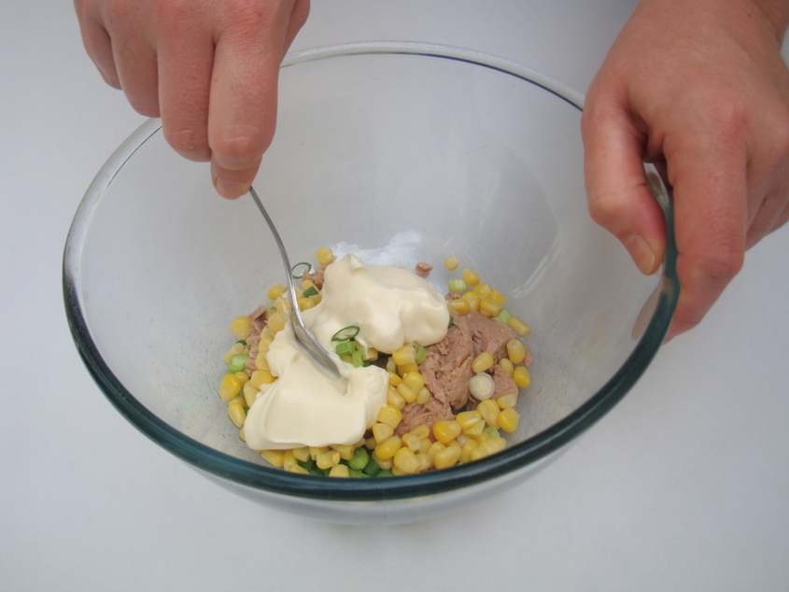
7. Mix everything together.

Slide 12
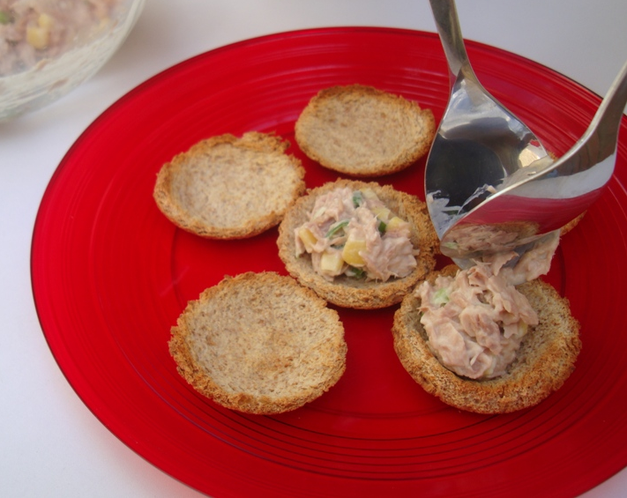
8. Spoon the mixture into the bread cases.

Slide 13
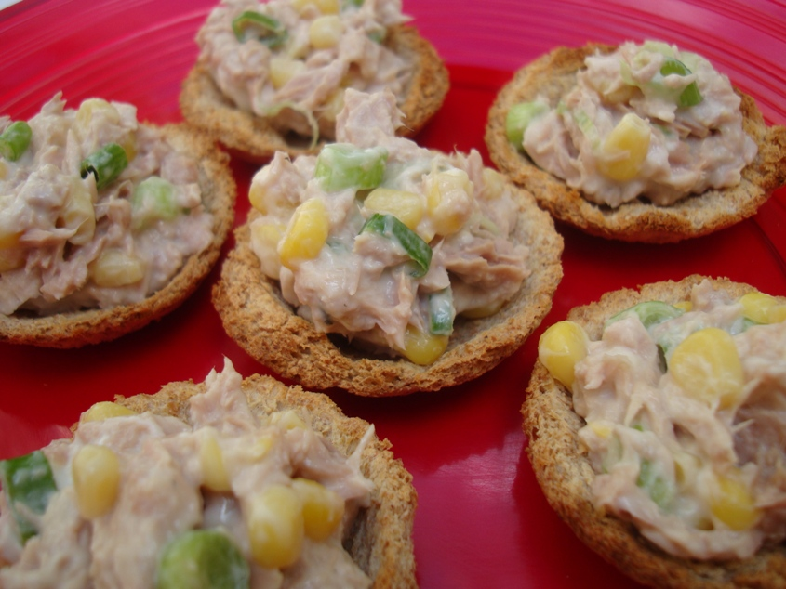
9. Serve.

Slide 14
Terrific tuna tarts
For further information, go to:
www.foodafactoflife.org.uk
This resource meets the Guidelines for producers and users of school education resources about food.

