Slide 1
Type 2 diabetes

Slide 2
Diabetes
What do you know about diabetes?
You have five minutes to complete a mind map of everything you know about diabetes.
Diabetes

Slide 3

Diabetes – type 1 and 2
Complete the table with the information from the video.
 | Type 1 | Type 2
How does it occur?
How is it controlled?
Video used with the kind permission of Cognito

Slide 4
Diabetes – type 1 and 2
 | Type 1 | Type 2
How does it occur? | The pancreas does not make enough insulin. Therefore there isn’t the insulin to break down blood glucose. This leads to high levels of glucose in the blood. | The body is unable to respond to its own insulin or there is an impaired secretion of insulin. This leads to high levels of glucose in the blood.
How is it controlled? | Injections of insulin for life and a healthy diet. | Exercise and appropriate diet.

Slide 5
Practical – is there sugar in urine?
Glycosuria, or glucose in urine, is a phenomenon caused by the presence of sugar in urine.
It can be used to identify whether someone has or does not have diabetes.
Discuss with the person next to you how you might be able to test for sugar/glucose in someone’s urine.
Test For | Reagent | Positive test
Glucose | Benedict’s Solution | Orange/red precipitate

Slide 6
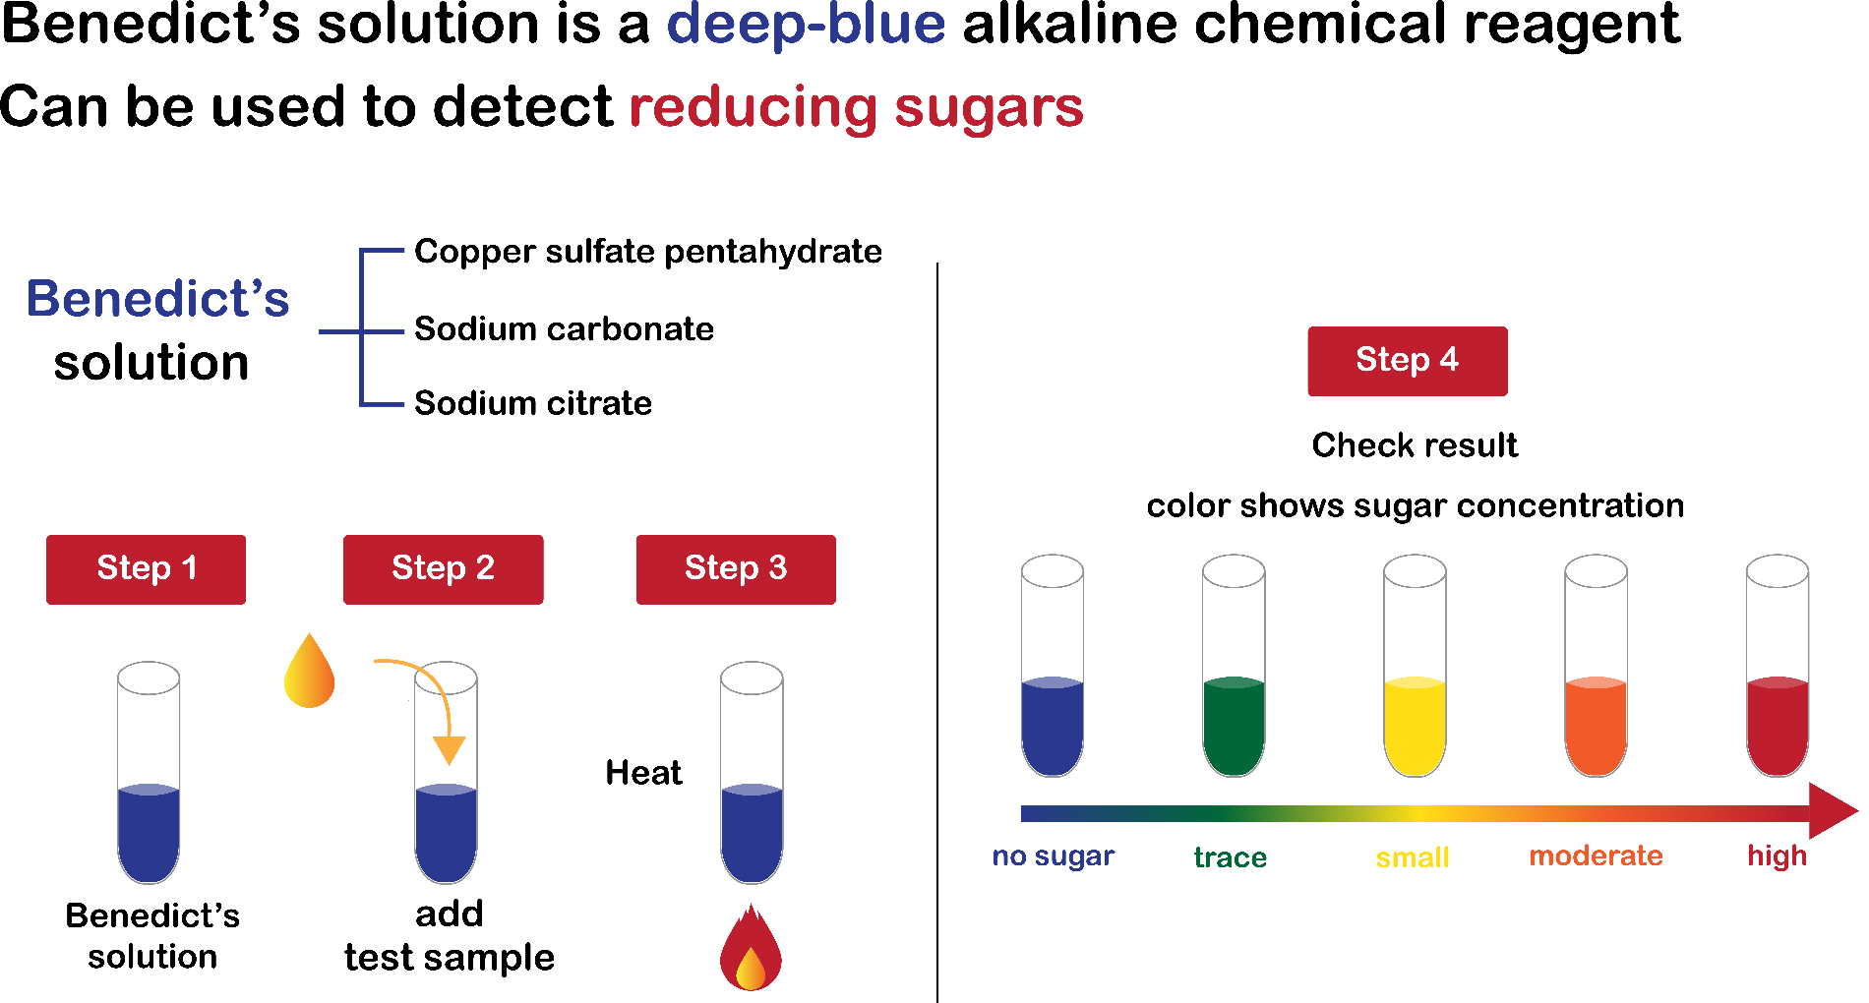
Food tests
1 Place a small amount of the ‘urine’ in a test tube.
2 Add enough Benedict’s solution to the solution.
3 Place the test tube in a warm water bath for 10 minutes.
4 Blue Benedict’s solution turns brick red on heating if a sugar such as glucose is present.
5 Repeat steps 1–4 for other ‘urine’ samples.
6 Record all your results in a results table.

Slide 7
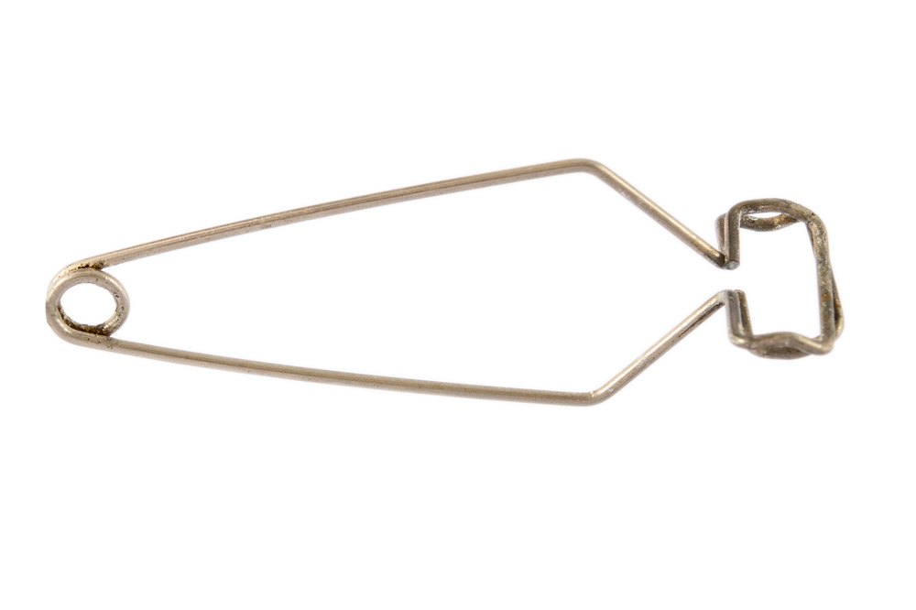
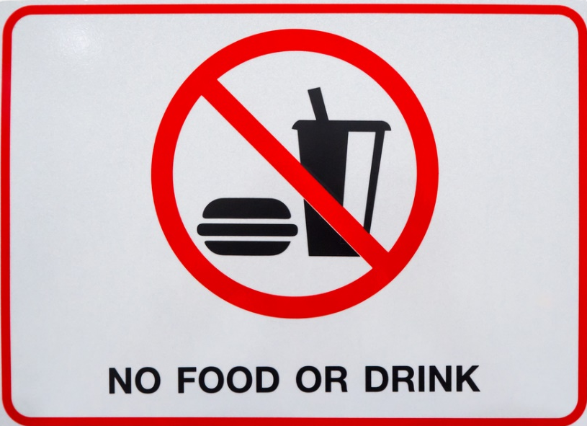
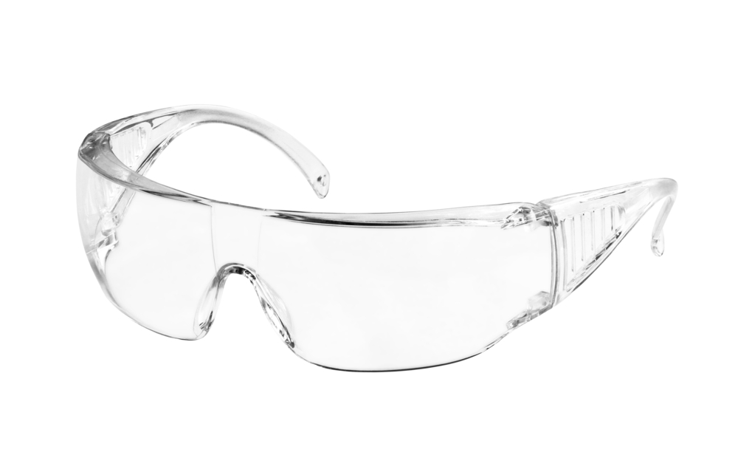

Turn and talk – how are we going to stay safe during this practical?
Wear safety goggles
Use test tube holders
No eating or drinking
Keep desks/benches tidy and make sure bags are not trip hazards

Slide 8
Results table
 | Result from Benedict’s test | Does the person have diabetes?
Person 1
Person 2
Person 3
Person 4
Person 5
Insert the names of the urine samples around the room.

Slide 9
Analysis of results
Thinking of what you learnt about diabetes earlier in the lesson, discuss your results.
Why might people with glucose in their urine have type 1 or type 2 diabetes?

Slide 10
Risk factors for type 2 diabetes
Risk factors for type 2 diabetes include:
family history/genetics;
overweight or obesity, especially central obesity;
adults aged over 40;
people of Asian or African-Caribbean origin;
lower socio-economic status;
low birth weight;
previous gestational diabetes (during pregnancy).

Slide 11
Regulation of glucose by hormones
Hormones are chemical messengers produced in one part of the body and carried in the blood to cause some action in another part of the body.
Different hormones have different actions.
The level of glucose is regulated by the hormones, insulin and glucagon, both produced and released by the pancreas.

Slide 12
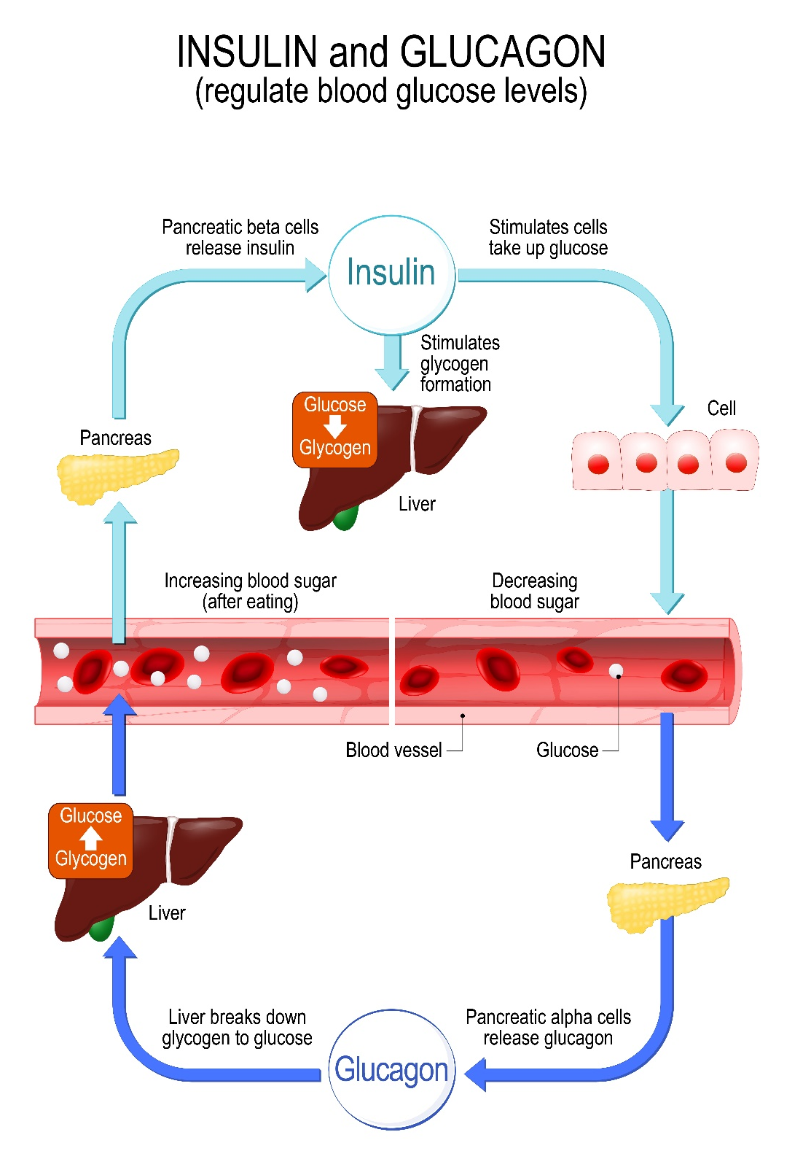
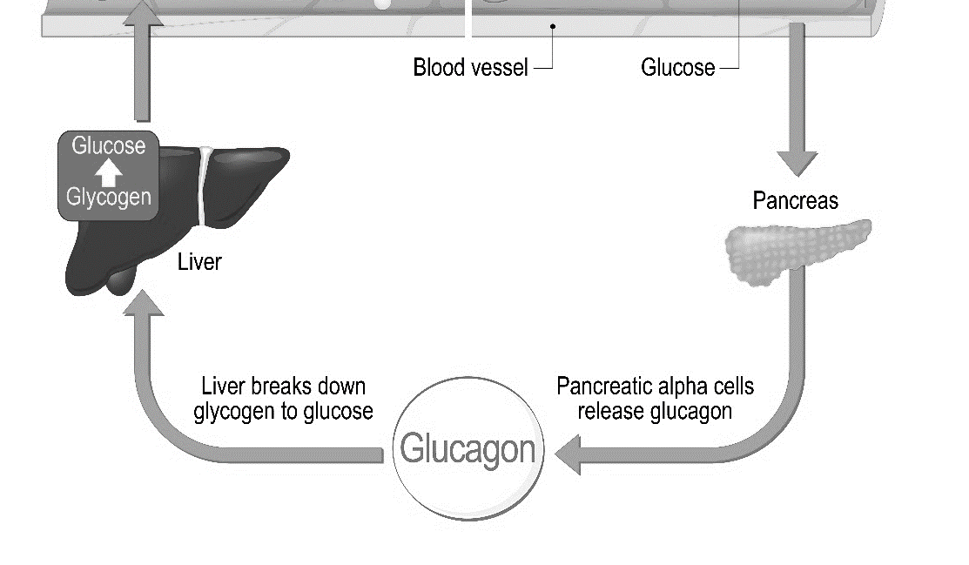
When blood glucose rises
The amount of glucose in blood increases after a meal. This is called hyperglycaemia.
Insulin is released from the pancreas and causes the cells in the body, the liver, muscle and fat tissues in particular, to take up glucose from the bloodstream.
This reduces the amount of glucose in blood and the pancreas stops producing insulin. The blood glucose level then falls back to normal.

Slide 13

When blood glucose falls
As the body takes up the glucose in blood for energy its level falls. The pancreas releases glucagon, which has the opposite effect from insulin. It increases the level of glucose in the blood by stimulating the liver to release glucose.
Other hormones are also produced when the blood glucose level falls too low, e.g. adrenaline and cortisol. These help to bring the level of glucose in the blood back to normal.

Slide 14
How hormones change blood glucose levels
Complete the following table looking at the negative feedback loop of glucose levels.
Glucose level | Effect on pancreas | Effect on liver | Effect on glucose level
Too high
Too low

Slide 15
How hormones change blood glucose levels
Glucose level | Effect on pancreas | Effect on liver | Effect on glucose level
Too high | Insulin secreted into the blood. | Liver converts glucose into glycogen | Reduces
Too low | Glucagon secreted into the blood. | Liver converts glycogen into glucose | Increases

Slide 16
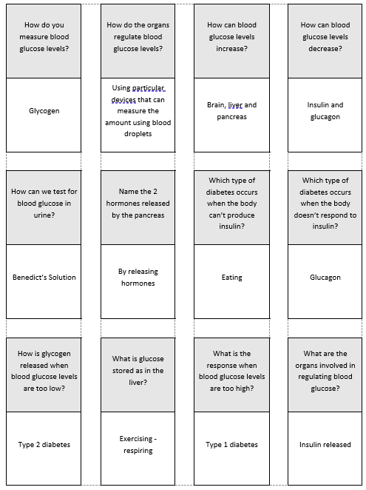
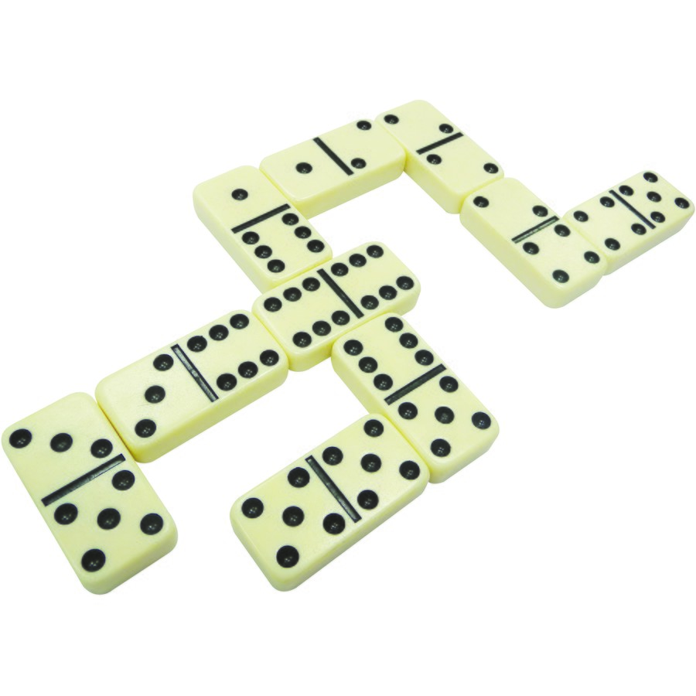
Blood glucose dominoes
Blood glucose dominoes. Cut the dominoes out and rearrange them so the question faces the answer.

Slide 17
Quiz - Kahoot
Open the link below on the main screen and ask students to log onto www.kahoot.it on their tablets or smartphones.
They can then enter the code (that will come up on the main screen when you start the game) and their own nickname.
They can then answer the quiz choosing the multiple-choice answers that correspond with the questions on the main screen.
There will then be a leader board of the scores after each question and at the end.
https://play.kahoot.it/#/?quizId=ac3fda90-06f9-4483-9325-6a1664c04ed1

Slide 18
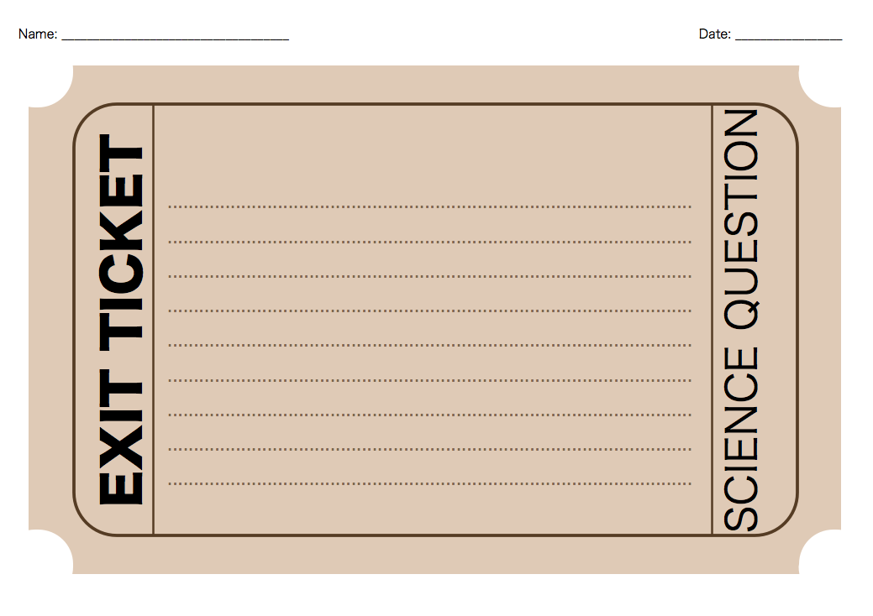
What is ONE THING you learnt about diabetes today?
Write it on a piece of paper with your name and leave on the front desk.

Slide 19
Key words
Key word​ | Meaning​
Diabetes (type 1) | A medical condition caused by the pancreas producing little or no insulin. Usually presents in childhood. Mostly unrelated to diet.
Diabetes (type 2) | A medical condition caused by cells not responding properly to insulin. Usually presents in adulthood. Related to being overweight.
Glucagon | A hormone which is released in response to a fall in blood glucose level. It stimulates the liver to release glucose, thus raising the blood glucose level.
Glycogen | Glycogen is the stored form of glucose. Stored largely in liver and skeletal muscle and functions as an energy store in the body.
Glycosuria | A phenomenon caused by the presence of sugar in urine.
Insulin | Insulin is a hormone created by your pancreas that controls the amount of glucose in your bloodstream.

Slide 20
Teachers’ guide

Slide 21
Lesson structure
Starter: Mind map for diabetes and discuss answers. (5 minutes)
Fill in table - Video and go over (10 mins)
In the main lesson practical, students test for the glucose in urine. Glucose test for 4/5 foods. Give chance to draw conclusions. (25 minutes)
Complete table based on information in slides (10 minutes)
Extension: Diabetes dominoes
Plenary: Exit ticket to leave on front desk.

Slide 22
Teaching about food tests
Describe how glucose is kept constant through hormonal release.
Understand the difference between type 1 diabetes and type 2 diabetes.
Conduct an effective practical to test for glucose in urine.
Draw conclusions from practical lessons.

Slide 23
Tips for setting up the practical
Running the practical, you will need to create ‘fake’ urine.
You could give a person’s name each of the beakers of ‘urine’ to make it seem more real.
Students must test the ‘urine’ for glucose levels using the information they have learned in the past about food tests. This can be a good way to see if the information they learnt in food tests has been carried forward.
It is important to use glucose or fructose as the dissolved sugar, not sucrose (this is because sucrose is not a reducing sugar, so will not react with Benedict's solution).
You can colour the water by using tea, which will not affect the reaction.

Slide 24
Blood glucose
Blood contains glucose, which is an important source of energy for the body, including the brain and nervous system.
The glucose levels in the blood must be kept within a normal range for the body to function properly.
If blood sugar rises or falls significantly, the body can usually bring it back to normal.
This process is called homeostasis.

Slide 25
Diabetes Mellitus
Diabetes Mellitus, commonly referred to as diabetes, is a condition where chronic hyperglycaemia occurs since the body is unable to control the amount of glucose in blood. The glucose rises above the normal range.
People with diabetes either do not produce enough insulin or the insulin they produce is not effective.

Slide 26
Health problems caused by diabetes
Diabetes is a common, serious, chronic disease which affects health and life expectancy.
Symptoms of diabetes include thirst, large amounts of urine, tiredness, blurred vision, dry skin and the loss of weight in some cases.
In the long-term, uncontrolled diabetes can lead to damage to the eyes, nerves, kidneys and blood vessels. Coma and death may also result.

Slide 27
Types of diabetes
There are two main types of diabetes:
Type 1 diabetes
Also known as insulin dependent diabetes mellitus. This accounts for around 10% of all cases of diabetes.
Type 2 diabetes
Also known as non-insulin dependent diabetes mellitus. This accounts for around 90% of all cases of diabetes.

Slide 28
Type 1 diabetes
The pancreatic cells which normally produce insulin in people with Type 1 diabetes are missing or damaged. The body does not produce insulin, so blood glucose levels remain high.
Type 1 diabetes usually develops in a few weeks and the symptoms are obvious, but they can quickly be relieved by treatment.
This must be treated by daily injections of insulin which helps control the blood glucose level. Type 1 diabetes usually begins before the age of 40, often in early childhood.

Slide 29
Type 2 diabetes
This is also called non-insulin dependent diabetes. People with Type 2 diabetes produce insulin in their pancreas, but it is insufficient to control blood glucose effectively. This is often because the body tissues are resistant to the action of insulin.
Type 2 diabetes can be controlled or improved by diet. If someone with Type 2 diabetes is overweight, then weight loss will usually improve the symptoms. Some people with Type 2 diabetes need to take medicines to reduce the level of glucose in blood.
Type 2 diabetes usually develops in middle-aged people (over the age of 40) and in later life.

Slide 30
Diet and diabetes
Having a healthy, balanced diet is important for controlling the symptoms of both types of diabetes.
People with diabetes should try to keep their blood glucose levels within the normal range. To do this, it is important to eat regular meals, with lots of fruit and vegetables and plenty of wholegrain starchy foods.
People with diabetes are still recommended to follow the Eatwell Guide.
Usually, patients with diabetes are given individual dietary guidance by Registered Dietitians.

Slide 31
Diet and diabetes
Changing diet and increasing physical activity are the two main approaches used to treat type 2 diabetes.
The aim of the treatment is to help the patients to control blood glucose levels and also to help overweight patients to lose weight.
Usually, it is possible to control diabetes through changes to the diet and physical activity patterns but some people may need tablets or insulin injections.
The recommended diet for patients with type 2 diabetes is the same healthy varied diet recommended for all people.

Slide 32
Alcohol
Advice on alcoholic drinks is the same as the general population. The recommendation for men and women is to consume no more than 14 units per week and to spread them over 3 or more days.
No level of alcohol is safe to drink in pregnancy.

Slide 33
Energy balance
Energy out: activity
Physical inactivity, overweight and obesity have been strongly linked to an increased risk of Type 2 diabetes, as well as other diseases, such as hypertension, heart disease, stroke and cancer.
It is important to balance the energy from food with the energy used through activity and keep a healthy weight to maintain health.
Energy in: food and drinks
Energy in > Energy out = Weight gain
Energy in: food and drinks
Energy out: activity
Energy out > Energy in = Weight loss

Slide 34
Losing weight with diabetes
If you're overweight or obese – you have a body mass index (BMI) of 30 or over – you should lose weight by gradually reducing your calorie intake and becoming more physically active.
According to the NHS, losing 5-10% of your overall body weight over the course of a year is a realistic initial target.
If someone with Type 2 diabetes is overweight, then weight loss will usually improve the symptoms.

Slide 35
Diabetes
For further information, go to:
www.foodafactoflife.org.uk
This science pack is one of a series of resources produced for the pHood Futures project, supported by the Royal Society of Chemistry.
This resource meets the Guidelines for producers and users of school education resources about food.

