Slide 1
Our ingredients

Slide 2
Our ingredients
Ingredients can be found in many different places.
What ingredients can you find in these places?

Slide 3
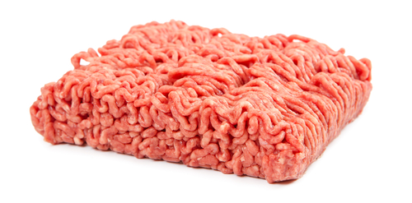
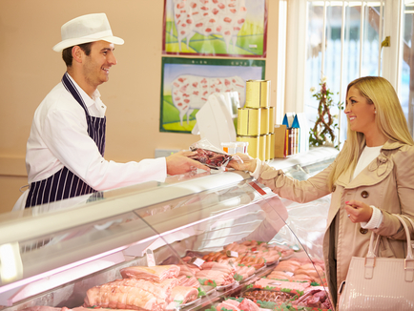
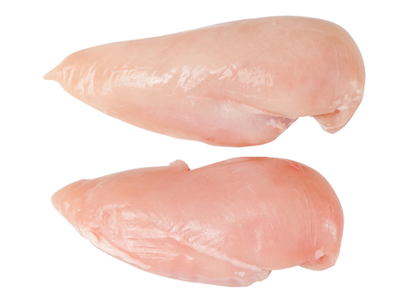
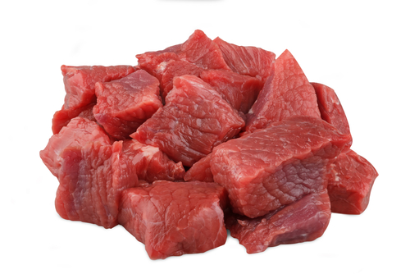
What ingredients can you get from a butcher?
Beef mince
Chicken fillets
Diced lamb

Slide 4
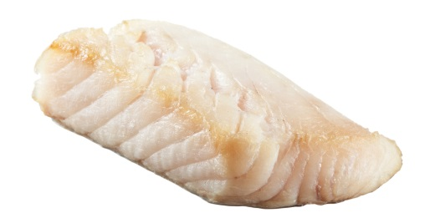
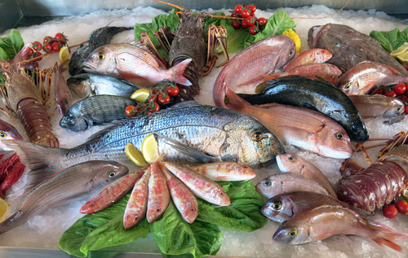
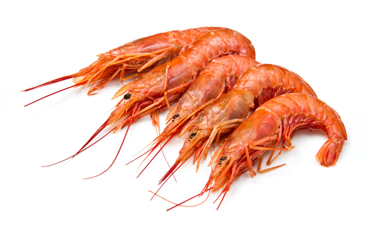
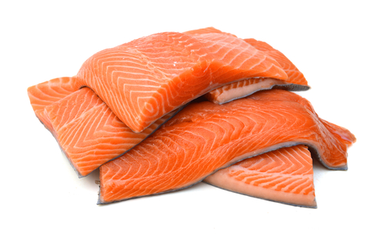
What ingredients can you get from a fish monger?
Cod
Prawns
Salmon

Slide 5
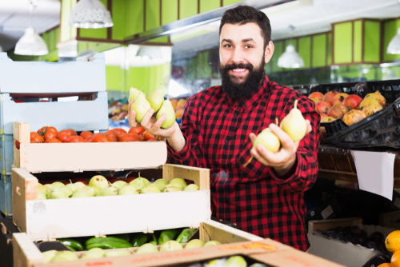
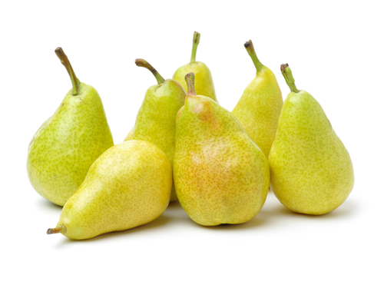
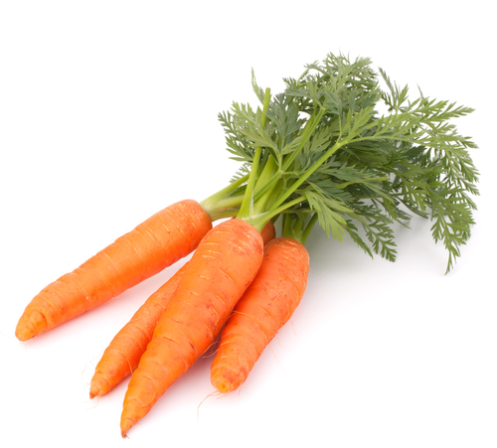
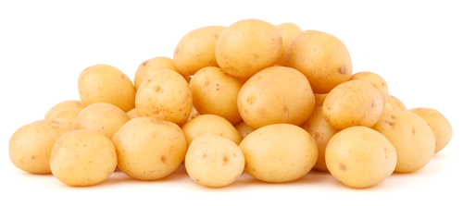
What ingredients can you get from a grocer?
Pears
Carrots
Potatoes

Slide 6
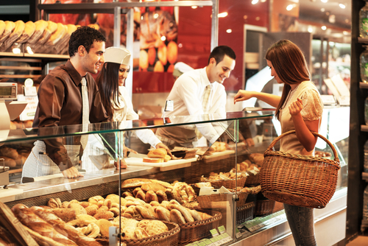
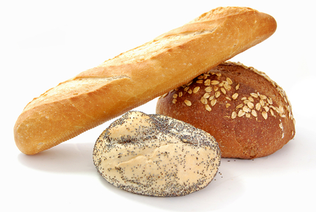
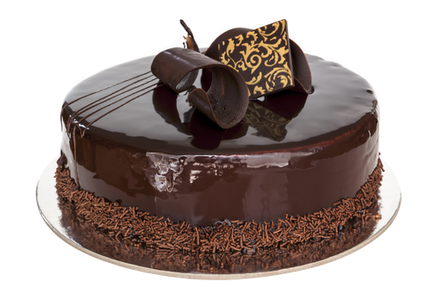
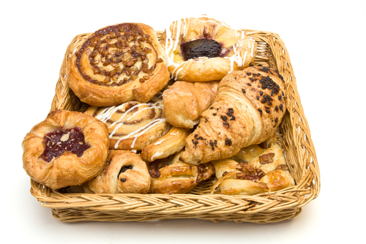
What ingredients can you get from a baker?
Loaves
Cakes
Pastries

Slide 7
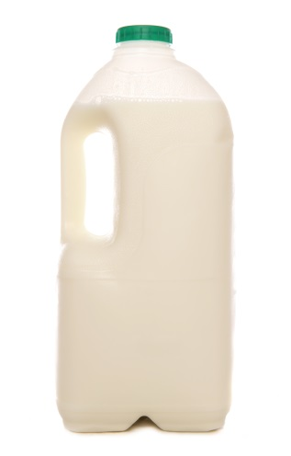
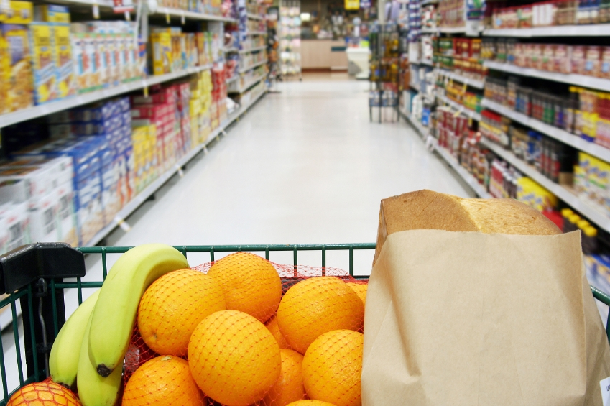
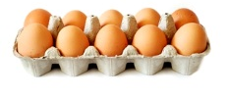
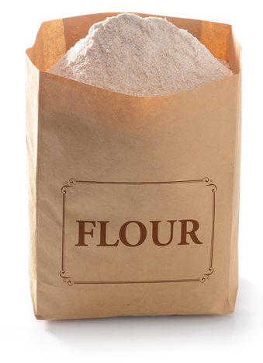
Supermarkets
Lots of different ingredients can be bought in supermarkets.
How many can you think of?
Eggs
Milk
Flour

Slide 8
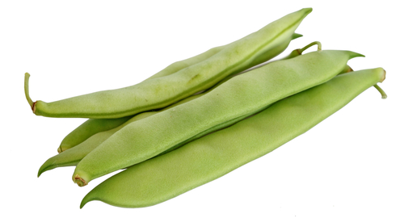
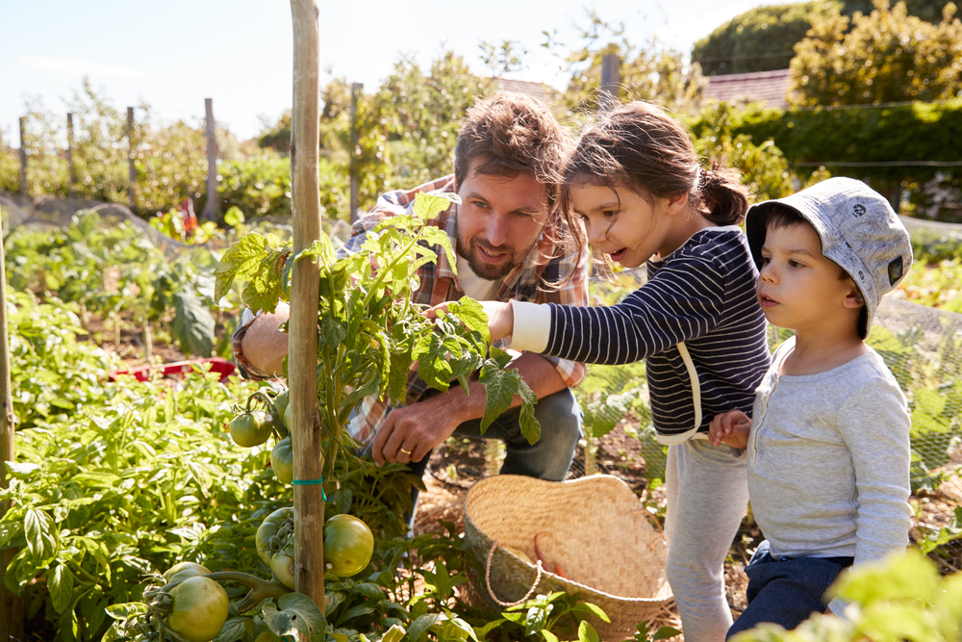
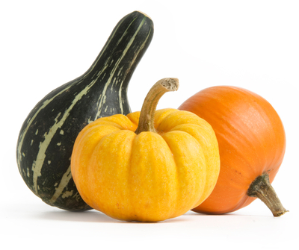
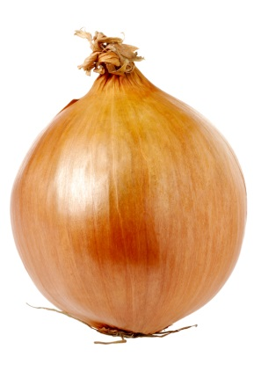
What ingredients can you find on an allotment?
Runner beans
Squash
Onions

Slide 9
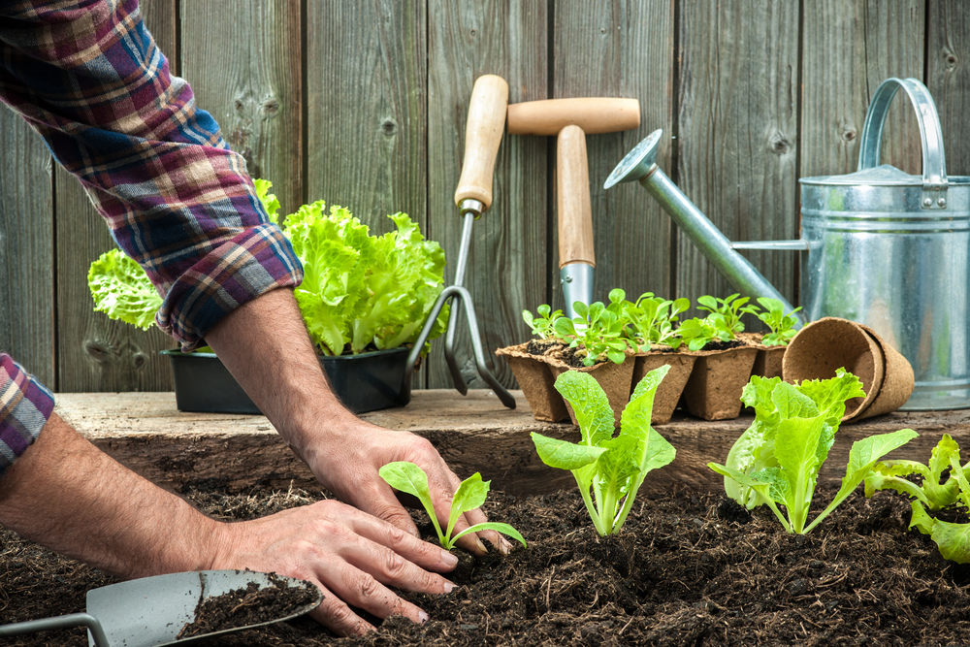
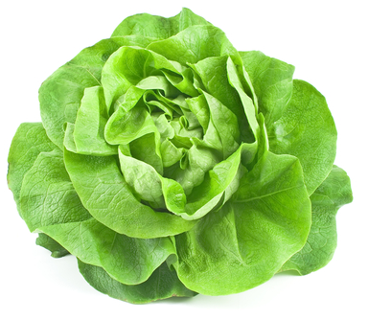
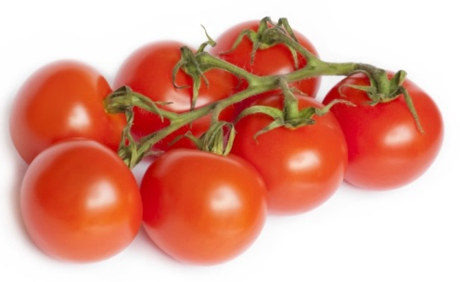
What ingredients do some people grow at home?
Lettuce
Tomatoes

Slide 10
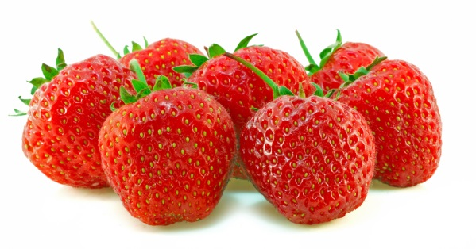
Ingredients
Sometimes you can get the same ingredient from lots of places.
Name two different places where you could get these ingredients.
Chicken
Strawberries
Milk

Slide 11
Supermarkets
Can you think of any other places where you can get ingredients from?
Market
____________________________________
____________________________________
____________________________________
____________________________________
Farm shop
Local shop

Slide 12
Our ingredients
For further information, go to:
www.foodafactoflife.org.uk
This resource meets the Guidelines for producers and users of school education resources about food.

