Slide 1
Fish in the diet

Slide 2
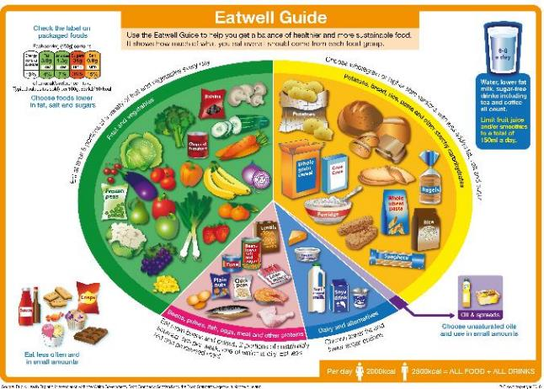
Fish in the diet
Fish is a popular food in many cultures, although many people in the UK do not consume as much fish as is recommended.
Eating a wide variety of fish and buying fish from sustainable sources can help to ensure there are enough fish to eat now and in the future.
‘Sustainable’ fish or shellfish are those that do not cause damage to other animals and plants and are caught or produced in a way that will allow fish stocks to be replenished.

Slide 3
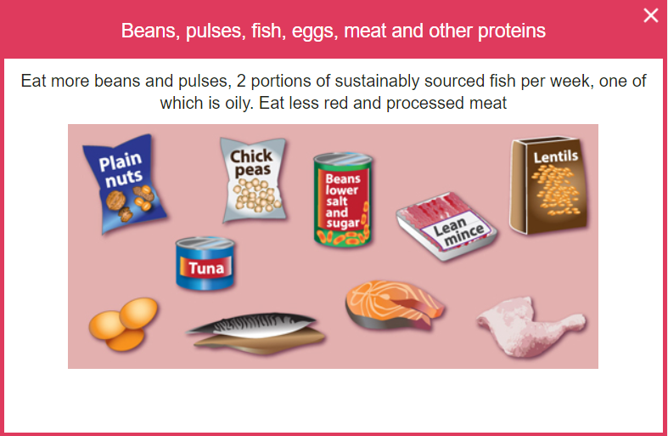
The Eatwell Guide
Fish is in the Beans, pulses, fish, eggs, meat and other proteins food group in the Eatwell Guide.
Around one-sixth of the food that people consume should come from this group in the diet.
It is recommended to consume two portions (one portion is 140g) of sustainably sourced fish per week.
One of these portions should be ‘oily’, because these fish contain healthy fats known as 'Omega-3s'.

Slide 4
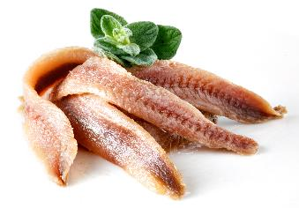
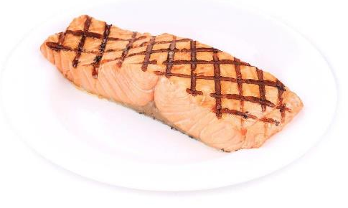
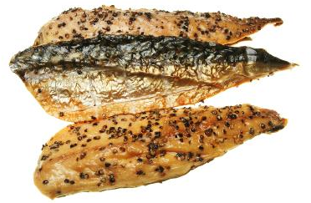
How much fish is eaten in the UK?
No age group in the UK currently meets the recommended intake for fish – low intakes of oily fish is a particular concern.
On average, UK adults eat 56g of oily fish per week and children (under 18 years of age) eat less than 20g per week¹.
¹ NDNS Year 9-11

Slide 5
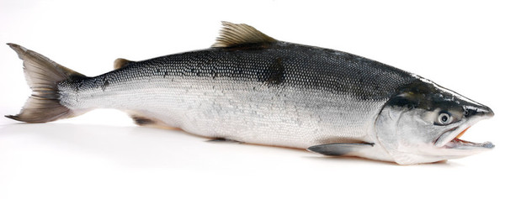
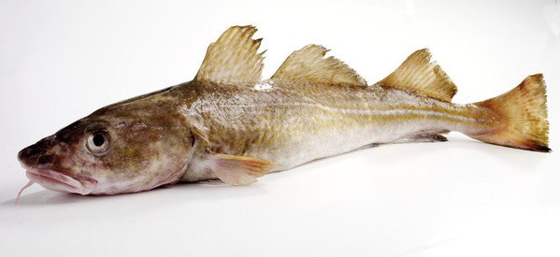
Nutrients provided by fish
Fish provides a range of nutrients, including:
Omega-3 fats (in some fish);
protein;
vitamin D (in some fish);
vitamins B3 (niacin), B6 and B12
selenium;
iodine.
This salmon is high in Omega-3 fats and vitamin D, as well as protein and some B vitamins
Cod is lower in Omega-3 and vitamin D than salmon, but still contains other nutrients and is also high in iodine

Slide 6
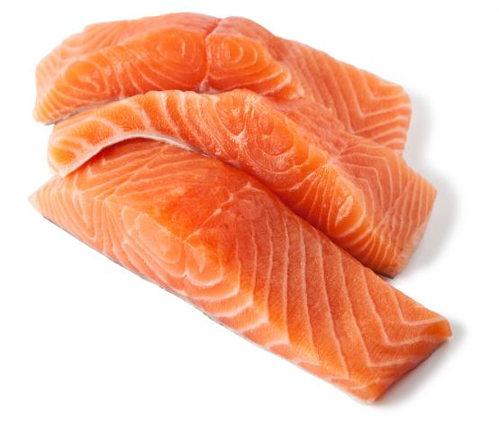
Omega-3 fats
Oily fish, such as salmon or sardines, is high in healthy fats called Omega-3s, which can help to maintain good heart health.
Most people need to eat more oily fish than they are currently consuming.
However, there is some different advice for premenopausal women and girls, pregnant and breastfeeding women, as well as children.
Salmon is an example of an oily fish, meaning it contains Omega-3
NHS Fish and shellfish nutrition

Slide 7
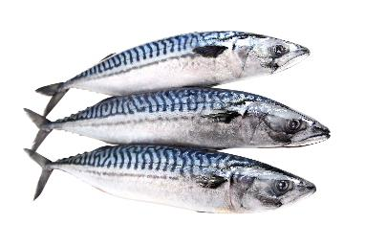
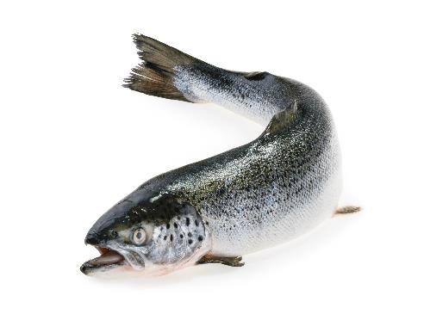
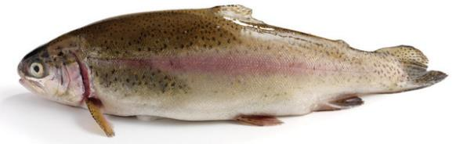
Fish containing Omega-3
Oily fish (contain Omega-3)
Herring
Mackerel
Salmon
Sardines
Sprats
Trout
Anchovies
Mackerel
Salmon
Rainbow Trout

Slide 8
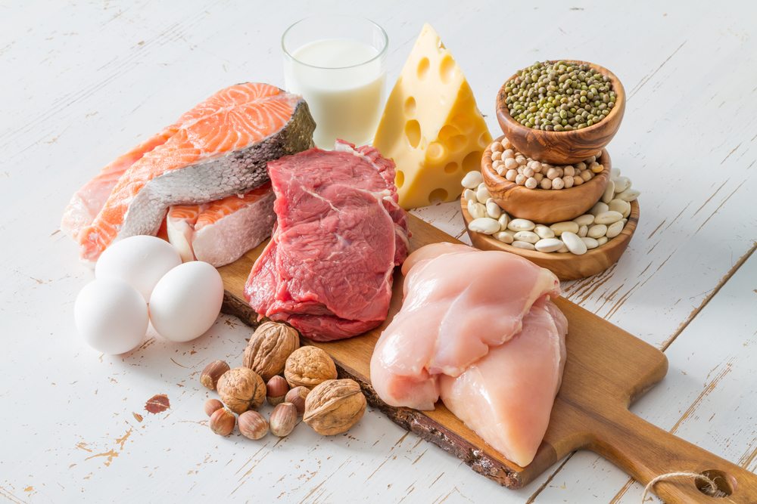
Protein
Protein is essential for growth and repair of the body and maintenance of good health. It also provides energy.
The amount of protein we need changes during a lifetime.
British Nutrition Foundation - protein

Slide 9
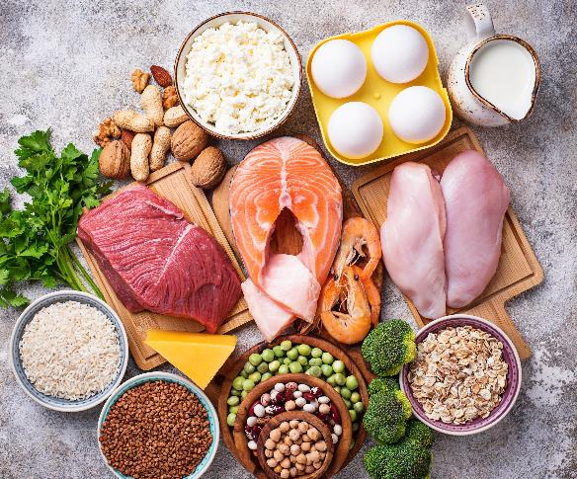
Protein (continued)
Animal proteins (including fish) contain ‘complete proteins’ with the full range of amino acids (the building blocks of proteins) that the body needs.
However, vegans and vegetarians can get all the amino acids they need by eating different plant sources of protein.
Fish is a source of protein. Protein is provided by plant and animal sources.
British Nutrition Foundation - protein

Slide 10
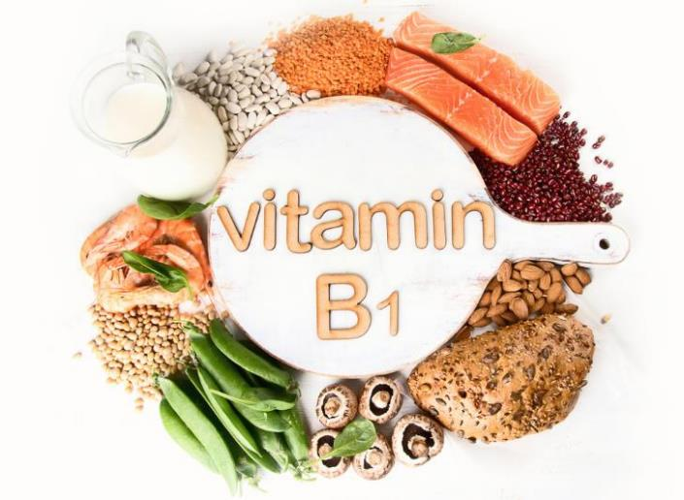
Vitamins in fish and shellfish
Fish contains many vitamins and minerals.
Oily fish contain vitamin D, which helps maintain a healthy immune system, strong bones, muscles and teeth.
They also contain a mixture of B vitamins, which perform a number of important roles in the body. For example, vitamin B1 (thiamin), which can be found in salmon, helps keep the brain and heart working normally.
Fish provides B vitamins, such as vitamin B1 (thiamin).
BNF: Vitamins and Minerals
GB Register of Health Claims

Slide 11
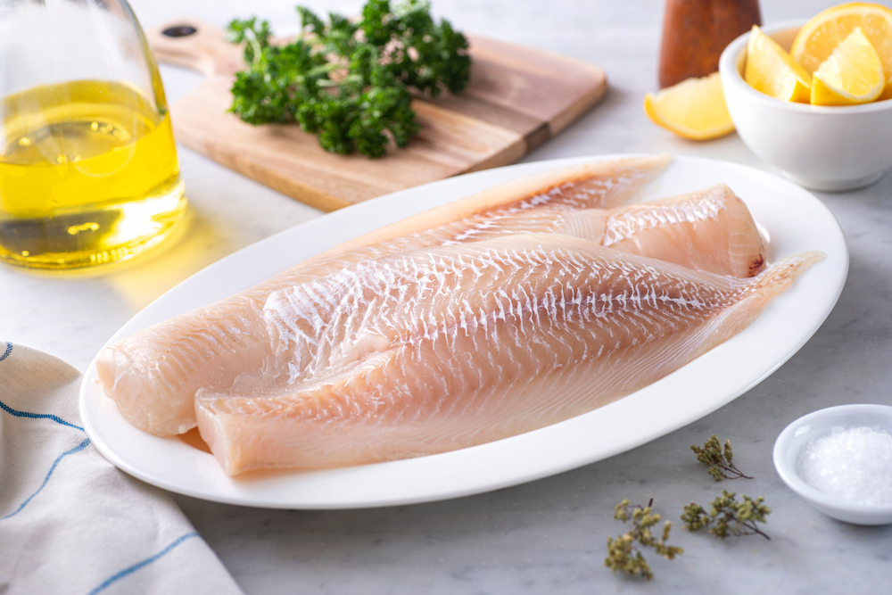
Minerals in fish and shellfish
Minerals in fish and shellfish include zinc and copper, as well as iodine and selenium. Iodine helps with normal growth in children, while selenium helps to maintain hair and nails.
Iodine is higher in fish like haddock and cod, whilst selenium is higher in tuna, sardines and mackerel.
Fish can also provide some calcium (in small fish where bones are also eaten) and phosphorus.
BNF: Vitamins and Minerals
GB Register of Health Claims

Slide 12
Fish intake – special considerations
For certain groups, there are maximum recommended quantities for certain types of fish:
Girls and premenopausal women should have no more than two portions of oily fish per week, and boys should have no more than 4 portions of oily fish as oily fish may contain more pollutants.
Those who are pregnant or trying for a baby should avoid shark, swordfish and marlin and eat no more than 4 cans of tuna or 2 tuna steaks per week, due to levels of mercury in the fish.
All other adults should have no more than 1 portion of shark, swordfish or marlin per week.
Pregnant women should thoroughly cook all fish and shellfish, avoiding raw shellfish or lightly cooked wild fish.

Slide 13
Fish intake – special considerations
For certain groups, there are maximum recommended quantities for certain types of fish:
Those who eat a large amount of fish should avoid eating too much sea bream, sea bass, turbot, halibut, rock salmon and brown crab meat, due to potential build up of pollutants.
Children under the age of 16 years should avoid eating fish such as shark, swordfish or marlin. This is because they may contain mercury which can affect a child's nervous system.
Avoid giving raw shellfish to babies and children to reduce their risk of getting food poisoning.

Slide 14
Fish in the diet
For further information, go to:
www.foodafactoflife.org.uk
This resource meets the Guidelines for producers and users of school education resources about food.

