Slide 1
Biotechnology and nanotechnology

Slide 2
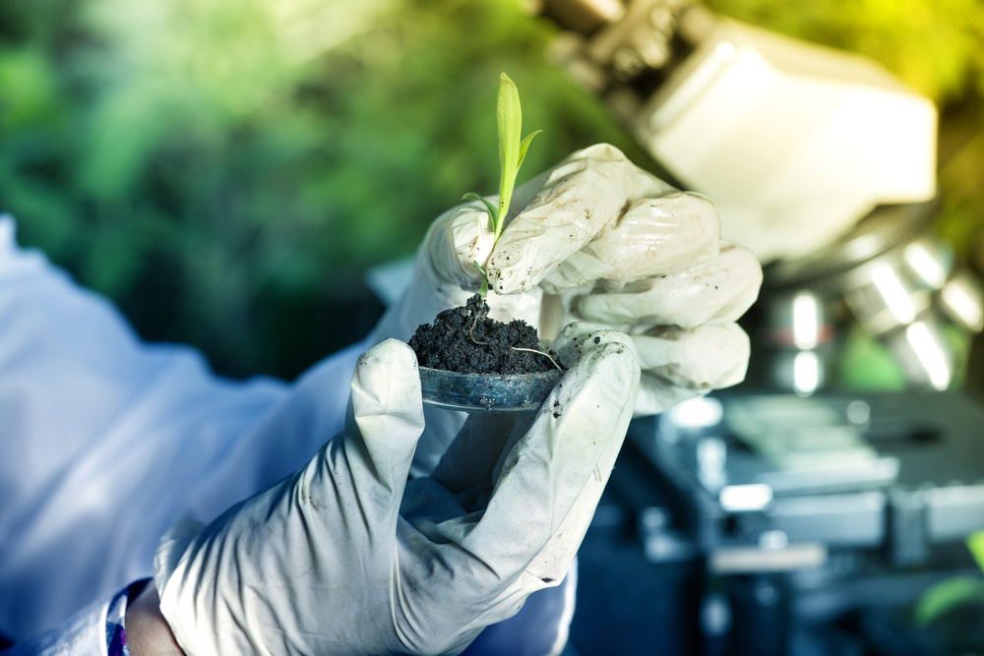
What is biotechnology?
Biotechnology is the industrial use of biological processes to make products.
Biotechnology involves using living organisms, cells, or molecules to develop products and technologies that improve our lives, such as medicines, crops with enhanced traits, and renewable energy sources.
In food, its major uses are in production and preservation.

Slide 3
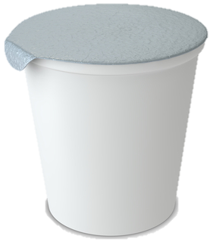
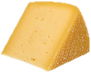


Biotechnology is not new
For many centuries the process of fermentation has used microorganisms (yeasts and bacteria) to make beer, bread, yogurt and cheese. Bread making, beer brewing and pickling all use naturally occurring microorganisms in the production of food and drink.
The basis of the fermentation process is the conversion of glucose (sugar) to alcohol and carbon dioxide, or to lactic acid, by enzymes in the microorganisms.
2
CH₃CH(OH)CO₂H
C₆H₁₂O₆
or
Lactic acid
2
C₂H₅OH
+
2
CO₂
Glucose
Ethanol (alcohol)
Carbon dioxide

Slide 4



Increases in biotechnology
Increases in the use of biotechnology by the food industry are due to:
competition between food companies for an increased market share;
attempts to increase efficiency and reduce the environmental impact of production;
consumer demand for convenient, high quality products at a reasonable cost.

Slide 5
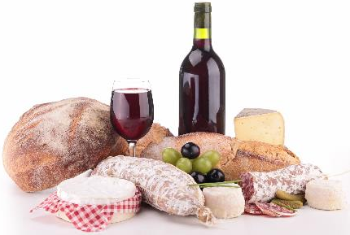
Traditional biotechnology
Traditional biotechnology mainly involves the production of foods such as cheese, bread, yogurt and wine. The fermentation process:
offers a method of preservation, e.g. by producing acid which lowers the pH (converting a perishable food into one that has a longer shelf-life);
can be used to change the nutritional value of food products, e.g. converting milk to cheese;
can create or improve sensory characteristics of foods (flavour, aroma and texture).

Slide 6
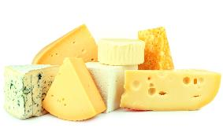

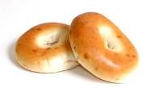
Food production
Cheese – rennet (containing the enzyme renin) is used to coagulate milk, forming curds and whey. The curds are then used to make the cheese. Lactic acid bacteria also contribute to this process. During ripening, other bacteria or moulds may also alter the cheese.
Alcoholic beverages – maltose is broken down into glucose within yeast cells, which then use enzymes to ferment the glucose into alcohol and carbon dioxide.
Bread – enzymes within the flour break down starch, eventually producing glucose. This is fermented by enzymes present in yeast producing alcohol and carbon dioxide. The carbon dioxide trapped in the dough causes it to rise when baked.

Slide 7
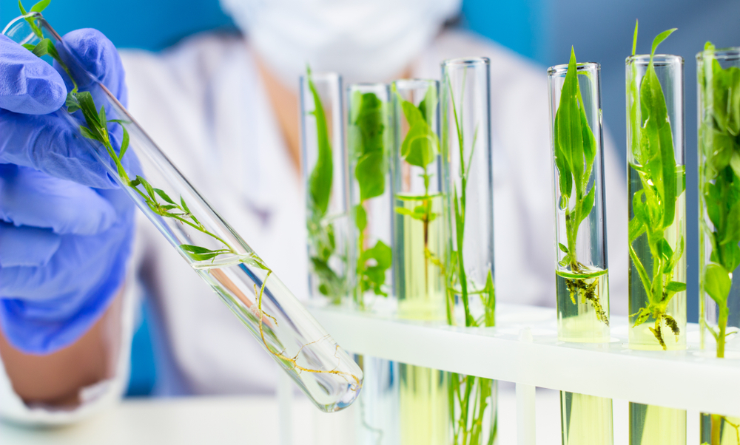
Modern biotechnology
The emphasis of modern biotechnology is on the production of raw materials and food ingredients.
Work is based on changing the characteristics of plants, animals and microorganisms, including fungi.
So far, the majority of this work has been performed in plants.

Slide 8
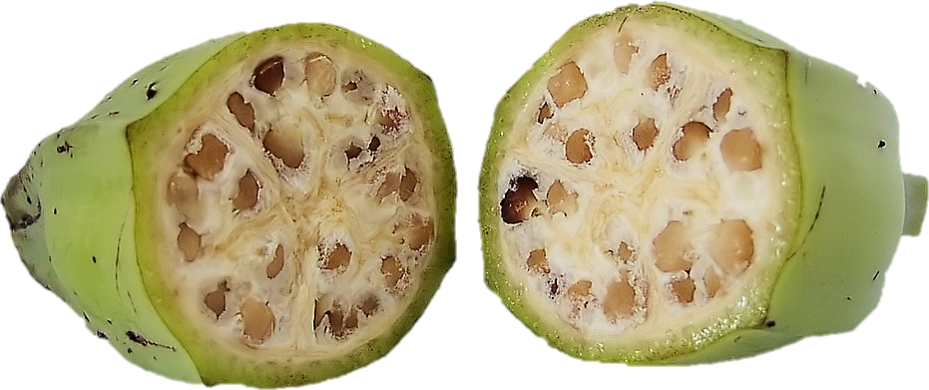
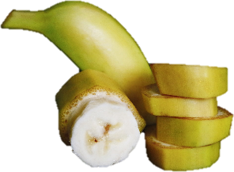
Genetics and selective breeding
Every cell in plants and animals contains genes. They are inherited from each parent and passed on to future generations. They carry information about physical characteristics and ‘qualities’. Historically, plants or animals with a desirable characteristic were bred together, to try and enhance these genetic qualities. This is known as ‘selective breeding’. This process is slow, and so plant and animal breeders have had to work through many generations, waiting for years for noticeable changes (e.g. cross-breeding pigs to produce pork with more muscle and less fat).
Modern bananas have been bred to be much sweeter and have smaller seeds.

Slide 9
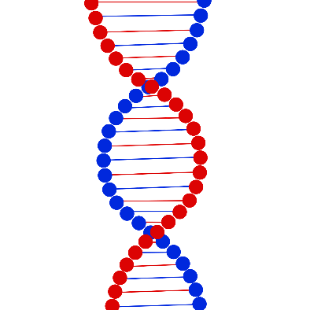
Deoxyribonucleic acid (DNA)
Today, scientists are able to identify genes which control particular characteristics. These discoveries offer a quicker and more exact way to improve crops and livestock. Understanding the nature of deoxyribonucleic acid (DNA) has paved the way for genetic modification. This is the process by which biotechnologists can alter DNA sequences, to produce a crop, for example, with additional or improved characteristics. For example, ‘Golden Rice’ is a genetically modified rice crop that contains vitamin A, in order to combat deficiencies that can be a serious problem in some countries.

Slide 10
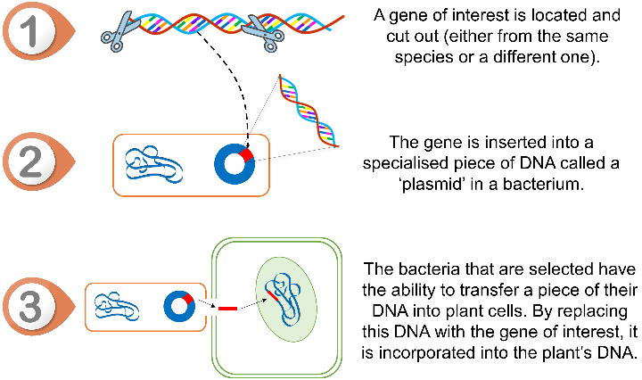
How does genetic modification work?
First, a gene of interest is selected. This is then transferred to a plant cell, usually through one of two main methods:
being fired from a device known as a ‘gene gun’ into the cell;
being inserted into a specialised piece of DNA in bacteria that are capable of transferring this information to plants (see image).

Slide 11
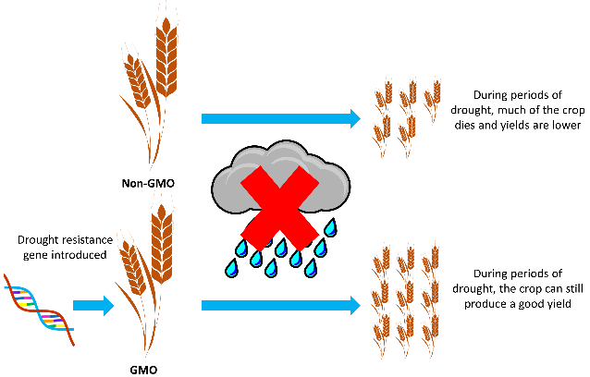
Improving crops and livestock
Improving varieties of crops or livestock by introducing or modifying specific genes is faster and more accurate than traditional breeding. If the gene can be identified and modified, the following changes may be possible:
• plant crops may have a longer shelf-life, be more resistant to pests, disease or drought, be more nutritious, have a better taste or give a higher yield;
• animals may be made more resistant to disease, produce less fatty meat, grow faster or be more fertile.

Slide 12
Concerns about genetic modification
A number of concerns have been raised, regarding genetic modification. These include:
whether genetically modified foods (GMFs) pose any health risk to humans, or increased allergy risk;
whether GMFs pose risks to the ecosystem, particularly if they cross-pollinate with other crops;
objections on moral or religious grounds, namely that we should not interfere with nature in this ‘unnatural’ way;
whether farmers may be negatively impacted;
whether corporations will restrict access to crops.

Slide 13

Health and safety concerns
Because each genetically modified food (GMF) is different from the next, each new food should undergo safety assessments to weigh up both the benefits and any risks. All of the few GMFs available on the market today have been rigorously tested and been deemed safe. There is currently no evidence that any of these have caused any health issues in humans. In Europe, the European Food Safety Authority carefully assesses any new GMF to make sure that it is safe to consume and retests them every ten years.
Nuffield Council on Bioethics , 2003
World Health Organisation, 2014
European Food Safety Authority, 2019

Slide 14
GM labelling in the UK
Foods which have been produced from genetically modified organisms (GMOs) are likely to appear no different from food produced by traditional means. The Government has set up a series of controls to inform consumers, whilst protecting the environment and people who work with GMOs. In the UK, foods that contain GMOs or ingredients produced from GMOs need to be labelled by law. Foods produced with GM technology or foods sourced from animals fed on GM feed do not currently need to be labelled.
Food Standards Agency, 2018

Slide 15
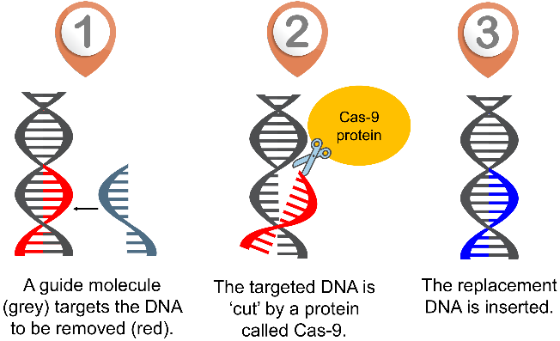
Recent advances
Recent advances in science now allow for a new way to modify genes. This technology is known as gene editing. Gene editing allows for specific and targeted changes to an organism’s DNA. Gene editing is very similar to the ‘cut and paste’ function on a computer. A specialised protein is used to cut the DNA, and the desired replacement piece of DNA can be inserted into the cut.

Slide 16
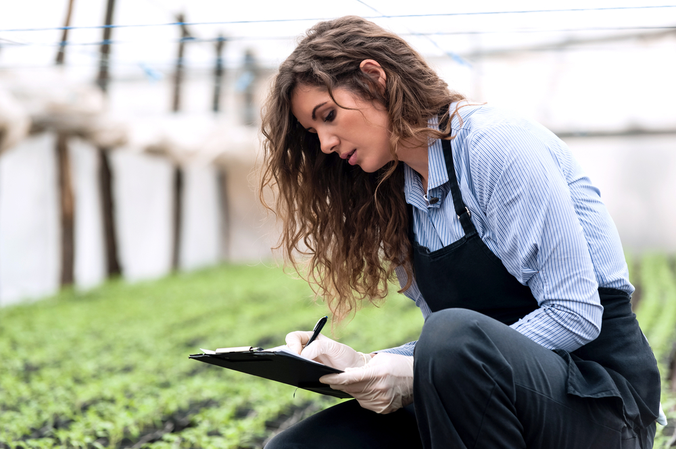
Research
In a sustainable food model for our growing population, food biotechnology is seen as a dependable way to boost and enhance food production.
This includes using genetic engineering on plants, animals, or microorganisms to improve food quality, using advanced packaging to preserve food, fermenting microbes to create new food ingredients, and using 3D printing for innovative food production.
Food biotechnology: Innovations and challenges

Slide 17
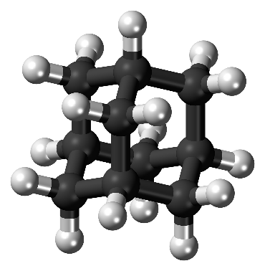
What is nanotechnology?
Nanotechnology is the manufacture and use of materials and structures at the nanometre scale (a nanometre is one millionth of a millimetre). At this small size, particles can often have unique properties. Therefore, nanotechnology offers a wide range of opportunities for the development of innovative products and applications for food packaging. Some conventional foods already contain nanoparticles (e.g. milk, which is a ‘nanoemulsion’ of tiny droplets of fat in water).

Slide 18
Nanotechnology
Recent technological developments have led the way for the manufacture of nanoparticles that could be added to food. Nanotechnology applications in the food sector are on the increase worldwide and are expected to grow rapidly in the future, e.g. the use of nano-carbohydrate particles which bind with bacteria so they can be detected and eliminated. Other applications include making nanoparticles of salt, which allow a saltier taste with less total salt in the product. However, food containing nanoparticles are not widely available.

Slide 19
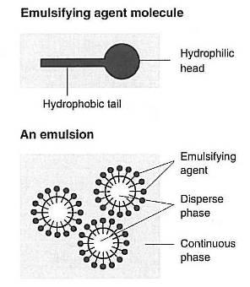
Uses for nanotechnology in food
The texture of food can be changed as food spreadability and stability (nanoemulsions) improve with nano-sized crystals and liquids for better-tasting low fat foods. The flavour of a food can be changed with bitter blockers or sweet and salty enhancers. Nanoencapsulation can help to protect and preserve flavours in foods, by surrounding molecules with a fine protective coating. Nanotechnology can also be incorporated into food packaging, rather than the food itself. For example, silver nanoparticles have been found to extend the shelf-life of foods such as nuts as they can inhibit bacteria.

Slide 20
Issues and concerns
Concerns have been raised in regard to the safety of nanoparticles in foods. Many of the potential effects of these particles are still unknown and require further testing to ensure they have no unwanted effects. This is one of the main reasons why foods containing new types of nanoparticles are not widely available, as tests are ongoing to ensure that any product is safe for human consumption.
British Nutrition Foundation, 2010

Slide 21
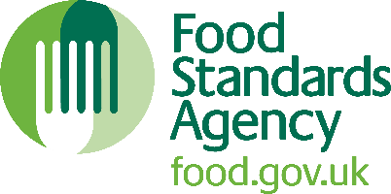
Assessment of novel foods
Any new foods using nanoparticles must be assessed under the EU regulations to see if they are safe for consumption. Because these foods have not been widely eaten in the UK, they are classified as ‘novel foods’, which means they need to pass extra safety tests. Krill oil is an example of an approved novel food, which can provide omega-3 fatty acids to the diet. In the UK, the Food Standards Agency is responsible for ensuring that novel foods being sold are safe for consumers.
Food Standards Agency, 2018
European Food Safety Authority, 2019

Slide 22
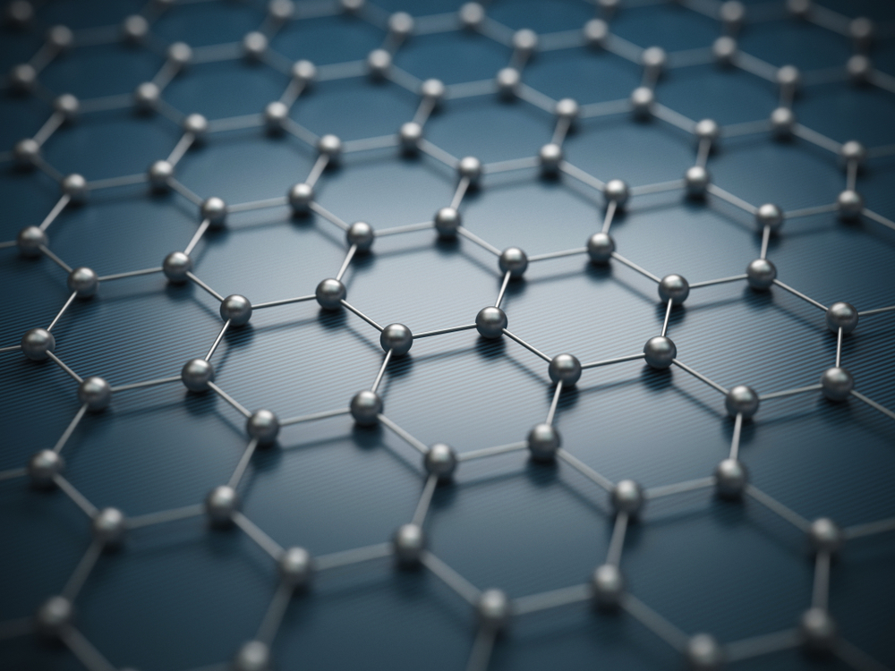
Ongoing research
Recent advances in nanoscience and technology have led to significant innovations in nanofood, nanosensors, nanopackaging, nanofertilizers, and nanopesticides.
These developments have greatly influenced food quality, safety, and packaging, with applications ranging from nanofood drug delivery to nanonutraceuticals and functional food. This is where it is estimated future research will be in this area.
Nanotechnology: Current applications and future scope in food

Slide 23
Biotechnology and nanotechnology
For further information, go to:
www.foodafactoflife.org.uk
This resource meets the Guidelines for producers and users of school education resources about food.

