Slide 1
Biodiversity

Slide 2
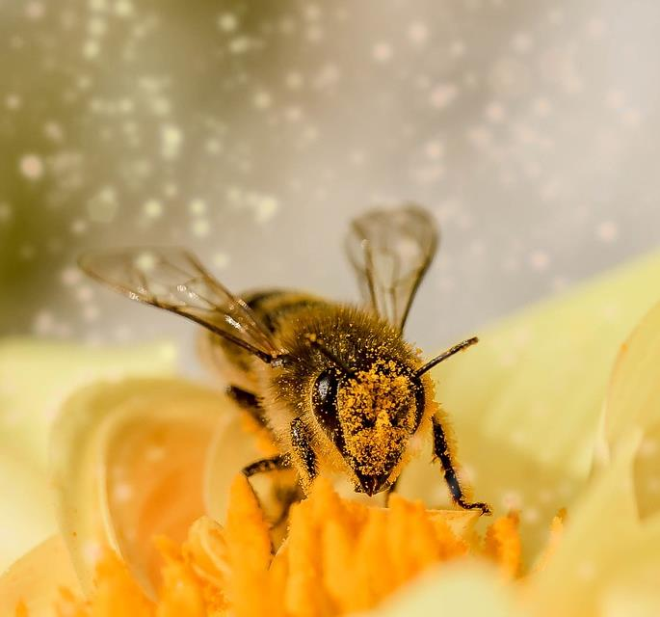
Starter
Why is it important to have a range of different species in an environment?
If species become endangered, what methods can we use to preserve them?
Extension: what could the challenges be with species conservation?

Slide 3
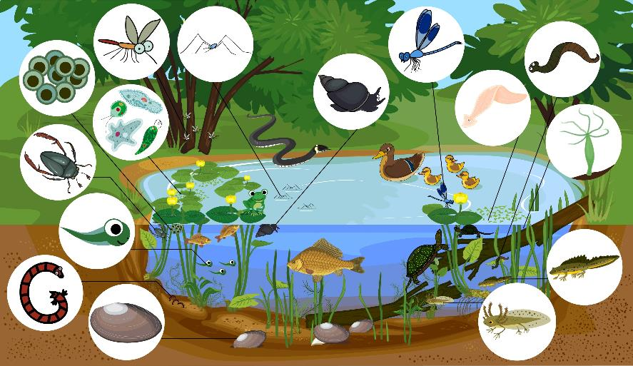
Ecosystems
An ecosystem is an area where many different species of plants and animals live together and interact.
A pond is an example of an ecosystem. In the illustration, you can see that many different organisms live together to maintain the ‘balance’ of the ecosystem.
If one or more of the species are harmed or destroyed, this can affect the other species that live there, and the ecosystem as a whole.

Slide 4
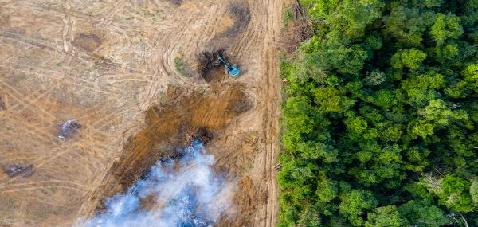
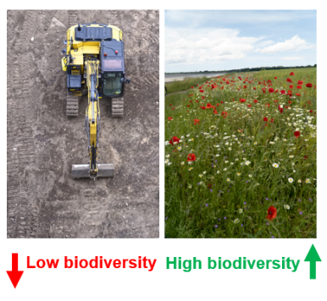
What is biodiversity?
Low biodiversity
High biodiversity
It is important to have a range of different species in an ecosystem to preserve biodiversity.
Biodiversity is a measure of the range of living organisms within a habitat.
Biodiversity can be maintained and enhanced by conservation, preservation and gene banks.
This image above shows an area of ‘deforestation’ where trees have been cut down (left). This area has low biodiversity as there are no plants and no habitats for animals. The remaining forest (right) has higher biodiversity because the plants form a habitat for other animals to live in.

Slide 5
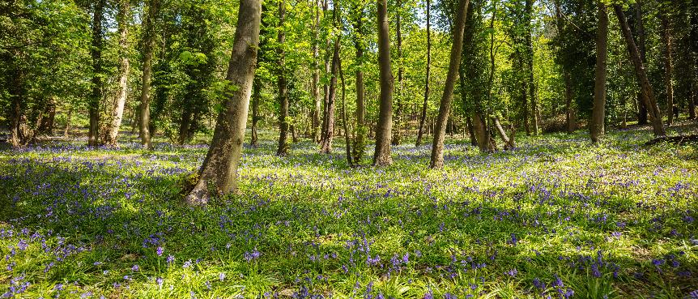
Biodiversity
Maintaining biodiversity enables communities and ecosystems to maintain their gene pool, the range of DNA in a species.
Some habitats like mature woodlands, coral reefs and rainforests have a huge range of species and so are very biodiverse.
Places like the polar regions and deserts have far fewer species and so are less biodiverse.

Slide 6
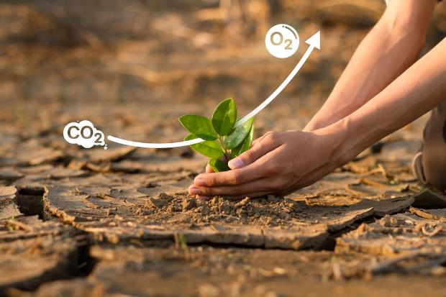
Why is biodiversity important for us?
Biodiversity is important for the entire planet, and for us. For example:
Plants produce oxygen and store carbon dioxide.
Many scientific breakthroughs exist because of plants or animals found in nature. Many medicines were originally discovered in plants.
We also rely on animals and plants for food. Plants and fungi help to keep soils fertile and insects such as bees are vital for pollination.
When ecosystems lose key species, their balance is disrupted, potentially leading to collapse. This can trigger a chain reaction, causing further species loss, increased pollution and other environmental damage.
Increasing biodiversity, particularly wildlife populations, can benefit food production by improving agricultural productivity potential.
The importance of biodiversity and wildlife on farmland

Slide 7
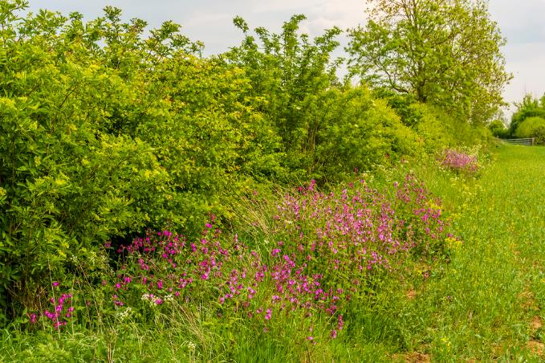
Increasing biodiversity
Across the world, including the UK, some people and farmers are working hard to increase biodiversity.
This includes in areas like farmland, where hedgerows and different species of wildflowers and grasses are being planted.
In other areas, species that were once rare are being reintroduced (e.g. red kites).
Planting hedgerows and wildflowers around fields is one way that farmers are trying to increase biodiversity in the UK.

Slide 8
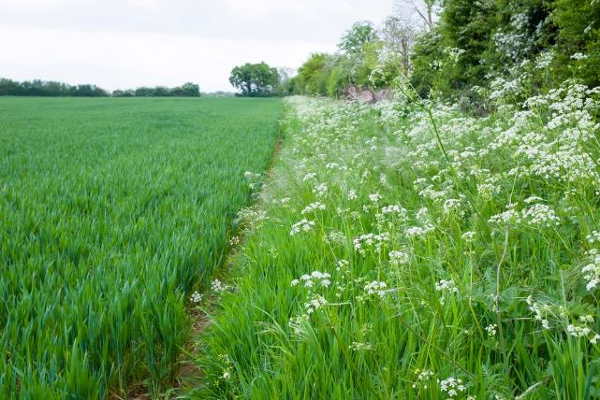
Field margins
Field margins is an approach to farm management that helps to increase biodiversity on-farm.
Although the margins (edges) of fields are often considered less productive (because fewer crops can be grown there), they can be very important for local wildlife.
Grass margins can provide several benefits, including:
providing nest sites for ground-nesting birds;
boosting the numbers of beneficial insects and spiders (who feed on crop pests);
small mammals like voles and mice can live in the margin. They also provide prey for birds of prey, such as owls and kestrels;
rare plant species can be grown in field margins, helping to preserve them.

Slide 9
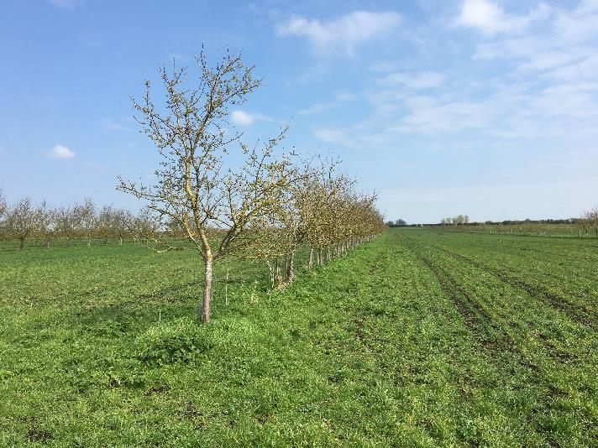
Agroforestry
Agroforestry is an integrated land-use management system that farmers use to combine trees, crops, and/or livestock on the same piece of land in a sustainable manner to produce food and benefit the environment.
Trees can provide several benefits, including:
support for biodiversity with diverse ecosystem promoting variety of plants and animals;
reduced soil erosion and associated losses;
maintenance of fertile soil and biological activity;
improves wildlife habitat and protecting birds and beneficial insects;
shelter given by trees improves yields of nearby crops and livestock.

Slide 10
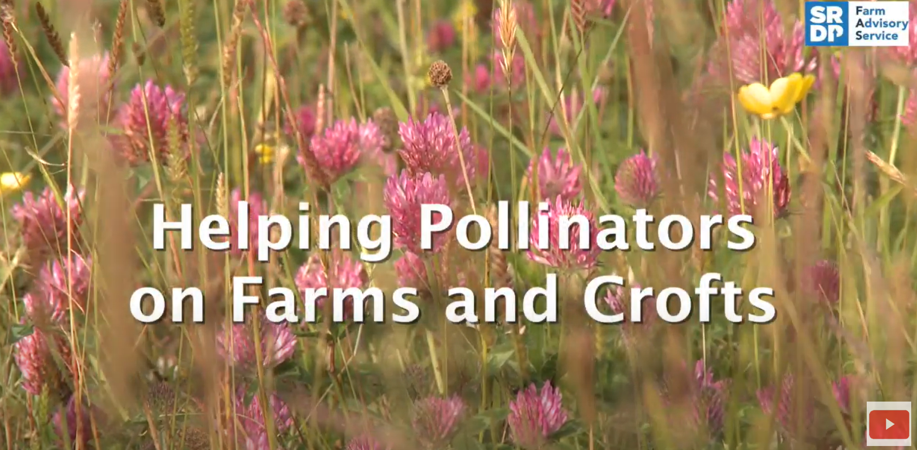
Encouraging insects
Encouraging beneficial insects (and spiders) to farmlands is good for biodiversity and our food supply.
Predatory insects and spiders eat ‘pest’ insects that feed on the crops we use to make food.
One way that farmers boost the numbers of these insects is to create ‘beetle banks’. These are grassy mounds built into the middle of fields, where insects can live.
It is important to spread these throughout the field, as insects will only travel a short distance from where they live.
Some crops, such as oil seed rape, field beans, apples and raspberries, and many wild plants rely on insect pollinators, e.g. bees, hoverflies and beetles.
This video from Scotland’s Farm Advisory Service describes some ways to encourage pollinators to live on farms and pollinate crops and other plants.

Slide 11
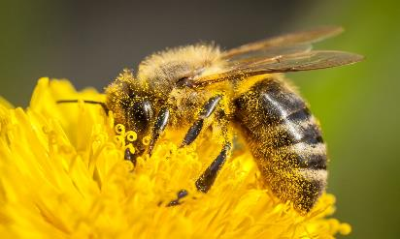
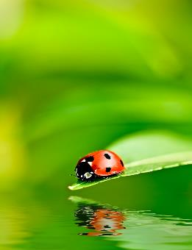
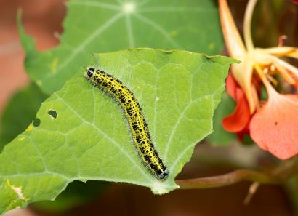
Integrated pest management
On farms, a diverse range of insects play various roles, including beneficial pollinators, friendly predators, and enemy pests:
pollinators e.g. bumble bees, hoverflies, butterflies;
predators (friends) e.g. ladybirds, lacewings, spiders, ground beetles;
Pests (foes) e.g. aphids, caterpillars, flea beetles.
Integrated Pest Management (IPM) strategies aim to balance the presence of these insects for sustainable agriculture, minimising the use of chemical pesticides and promoting natural ecological processes.

Slide 12
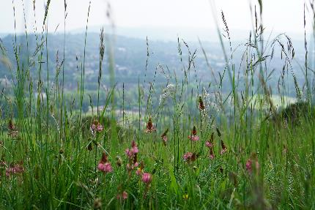
Improving biodiversity in the UK
16% of all species in Great Britain (where sufficient data is available) are threatened with extinction.
Some 69% of the UK land area is farmed and farming practices are key to biodiversity maintenance and recovery.
Improving biodiversity is one of the key aims of new agricultural support schemes being introduced in England, following the UK’s departure from the EU and its Common Agricultural Policy (CAP).
Under the Environment Act 2021, the government proposed a number of further 2042 targets for biodiversity:
Halt the decline in species populations by 2030, and then increase populations by at least 10% to exceed current levels by 2042.
Deliver net zero ambitions and boost nature recovery by increasing tree and woodland cover to 16.5% of total land area in England by 2050.
Restore 70% of designated features in our Marine Protected Areas to a favourable condition by 2042, with the rest in a recovering condition.
House of Comms Library: Biodiversity loss

Slide 13
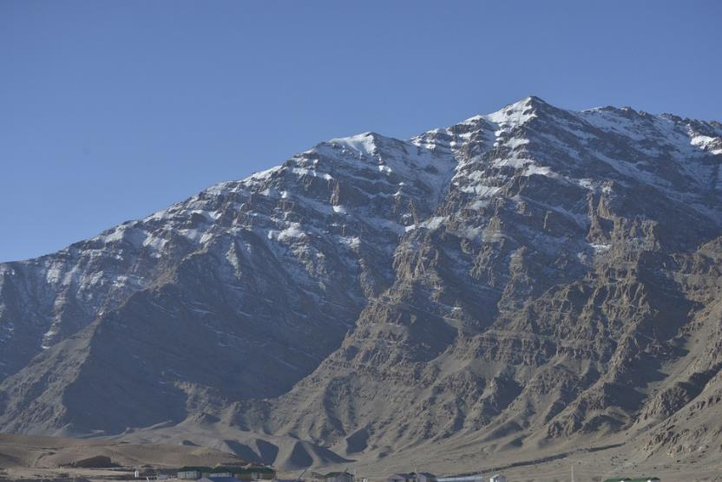
How does climate change impact biodiversity
Climate change refers to changes in the Earth's average temperature.
Climate change can cause changes in the habitat of animals, it can alter their migration patterns and can cause weather changes, particularly in the case of extreme weather events such as forest fires or hurricanes.
These changes reduce biodiversity as organisms are not able to adapt and they may become extinct.

Slide 14
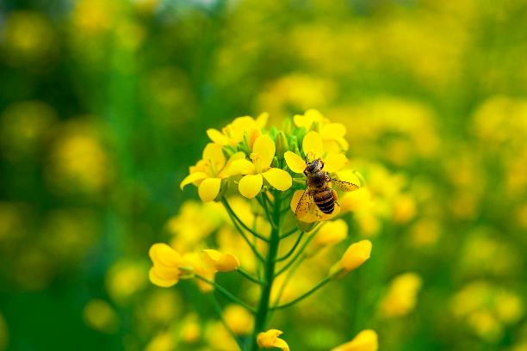
How does climate change impact biodiversity
In the UK, plants are flowering a month earlier due to climate change. This creates an issue as plants and their pollinators have become out of sync, with plants flowering too early in the year for the insects which pollinate them.
Pollinators could be at risk, since plants flowering earlier in the year could lead to gaps in pollen and nectar leaving bees to go hungry.
Bees are less sensitive to a warmer climate so are less likely to emerge earlier in the year to catch up with the plants flowering.
How might this impact crops grown for our food?

Slide 15
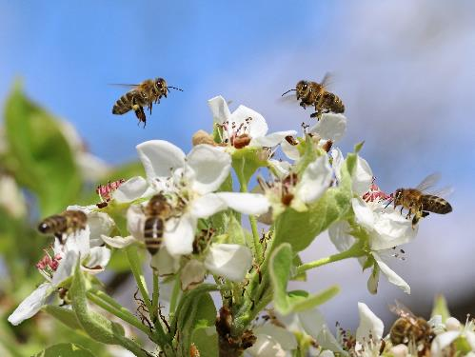
How does climate change impact biodiversity
84% of plants in Europe depend on insects for pollination.
20% of UK crops are pollinated by insects, in particular bees. This relationship is at risk from global warming.
If crops are flowering earlier in the year, and there are no pollinators present this will decrease reproductive success and reduce crop yields.
Less crops being grown and pollinated, means less food will be available to feed our ever-growing population.
Crops and pollinators out of sync

Slide 16
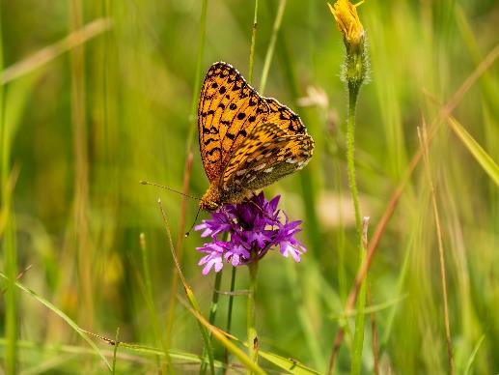
Extinction and biodiversity
In extreme cases, species may be reduced to the point of extinction (where none are left).
When a species becomes extinct, biodiversity is reduced.
Biodiversity is therefore vital for maintaining species in the longer term. Biodiversity maintains variation and the greater the variation within a species the more likely some members of the population will survive environmental changes.
This will reduce the likelihood of that particular species becoming extinct.
The endangered marsh fritillary butterfly is thriving again in a Lake District valley after native ponies have been introduced and farmers have implemented rotational grazing for livestock in lowland farmland.

Slide 17
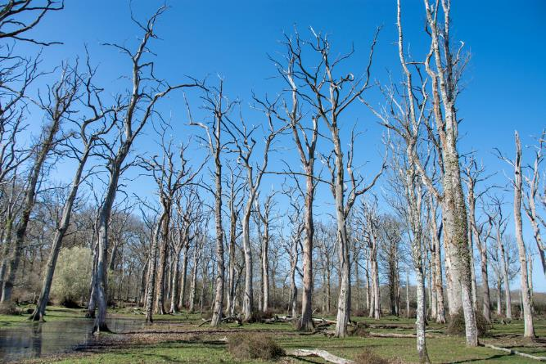
Can we prevent extinction?
Extinction occurs when there are no remaining individuals of a species alive.
Species that are at risk of extinction are called endangered species. This means that there are very few of the species left.
There are lots of reasons that species could become extinct, like climate change and destruction of habitats.
What reasons could cause species to become extinct?

Slide 18
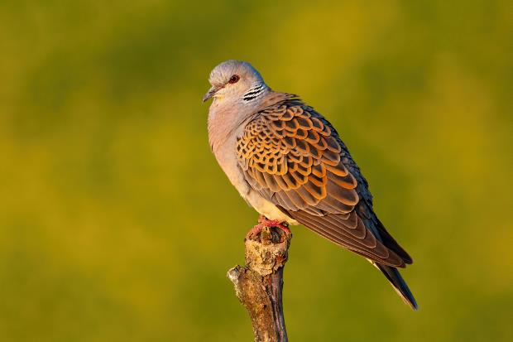
Species extinction
There are a number of reasons species could become extinct, but it is important as humans that we try and preserve species.
There are a number of ways we do this, but three principal ways are conservation, using gene banks and captive breeding.
Task: Research these three terms and complete the table on the next slide with information explaining each.
The number of turtle doves in the UK has reduced by 97% since 1970. Organisations like the RSPB are working with farmers in England to try and preserve this species.

Slide 19
Complete the following table
Method | Description | How it prevents extinction
Conservation
Gene banks
Selective breeding

Slide 20
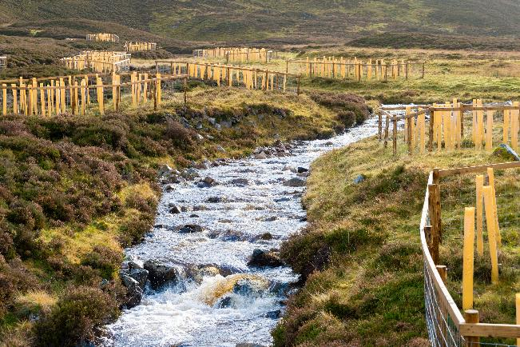
Conservation to preserve biodiversity
Conservation is a way of protecting an environment to ensure that habitats are not lost. This is an important way of preserving biodiversity and avoiding species extinction.
Protecting an organism’s habitat increases their chance of survival, allowing them to reproduce.
These young trees have been planted beside a river to reinforce the bank in the Cairngorms National Park in Scotland.

Slide 21
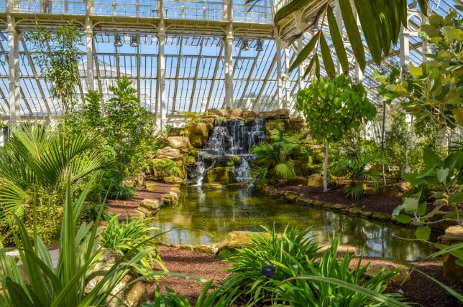
Conservation to protect species
Conservation is important for the biodiversity of an ecosystem as it:
reduces disruption to food chains and food webs, which could cause knock on effects to other species;
protects the future food supply for humans;
reduces the risk of species becoming extinct;
maintains the future possibility that plant species might be identified for medicines.
Many also feel it is our moral duty to protect the species across the planet.
Kew Gardens – London, England
Here, many endangered species of plants are preserved, and their seeds are stored, so they can be replanted in the wild when needed.

Slide 22
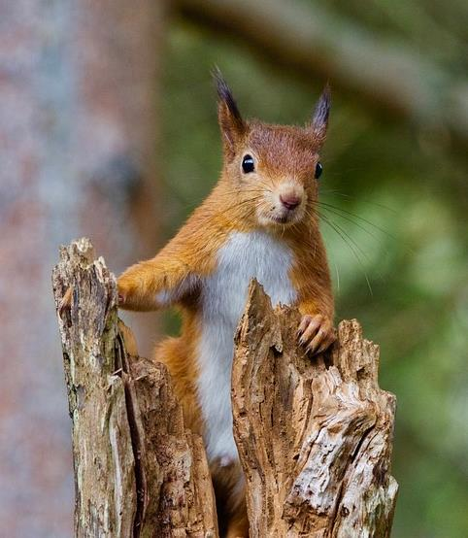
Conservation
Conservation can be carried out in a number of different places and ways, including:
protecting biodiverse areas like rainforests;
replanting trees to reduce the amount of carbon dioxide in the atmosphere;
protecting endangered species in the wild or in conservation;
reducing the use of fossil fuels, such as coal, oil and gas to limit global warming.

Slide 23

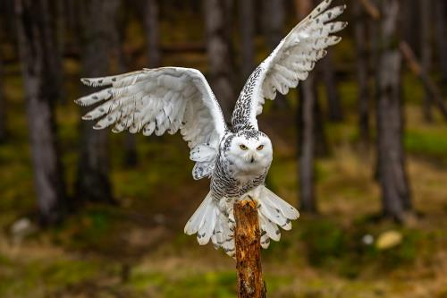
Conservation on a farm
Conservation is taking place across the UK on farms. For example:
owls - farmers support and protect barn owls by putting up nest boxes to encourage breeding in hedgerows and farm buildings;
bees - managing hedges and margins in both grassland and arable fields play a vital role in supporting bumblebees by increasing food and nesting opportunities;
bats - farmland is vitally important to all bat species and the landscape and farm buildings provide shelter and food;
dung beetles - livestock play an important role in protecting and enhancing dung beetle populations through the management of pastures;
conservation grazing - livestock grazing that promotes biodiversity and uses native breeds can be better suited to the local environments.

Slide 24

Gene pools
A gene pool is the range of DNA in a species. The wider the gene pool, the more likely it is to survive.
Variations, the slight changes in some organisms of the same species are, caused by different genetic information (DNA).
These variations often give some organisms advantages. This makes it more likely that they will survive and have offspring with these same features. When this process gives rise to new species of organisms it is called evolution.

Slide 25
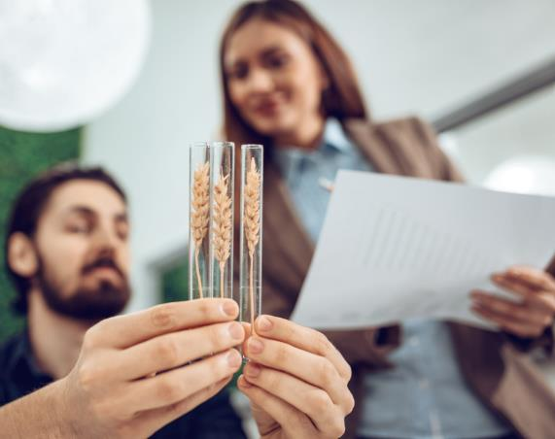
Selective breeding - wheat
Humans have been selectively breeding food crops for many centuries.
Selective breeding means that crops with the best traits, e.g. large grains, resistance to pests, are selected for, bred together, and grown more commonly.
Modern wheat is the result of selective breeding. A scientist named Norman Borlaug selected wheat plants that produced larger grains and bred them together. Unfortunately, these tall and heavy plants often fell over.
To solve this problem, the wheat was crossed with another type of wheat with a shorter stem. This prevented the plants falling over.
This new type of wheat was thought to save many millions from starving across the world.

Slide 26
Gene banks
Gene banks are used to preserve genetic material for use in the future and to help preserve biodiversity. There are a number different types of gene banks which all use low temperatures, including:
seed banks where dried seeds of plants are stored;
tissue banks where buds and other cells from plants are stored;
pollen banks where pollen grains are stored;
a cryobank is where embryos, sperm or ova (egg cells) from animals are stored at very low temperatures in liquid nitrogen. They can be thawed out later for use in breeding programmes.

Slide 27
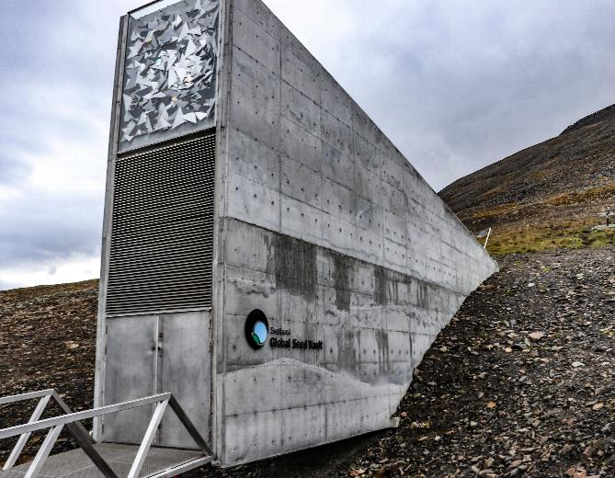
Seed banks
Seeds banks can be used if a plant species is endangered.
Seed banks are buildings in which seeds of different plant species are stored so that new plants may be grown in the future, even if naturally the plants are extinct.
This will help to maintain biodiversity.
Seed banks can also be used to store seeds of crops that are important to feed us.
The Global Seed Vault holds seeds of important crops from around the world, helping to maintain food security for those that need it.

Slide 28
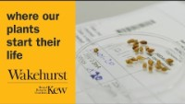
The Millenium Seed Bank
The Millenium Seed Bank, opened in November 2000, is located in Sussex, and contains over 2.4 billion seeds!
This includes nearly every plant species native to the UK.
Seeds are selected based on the level of risk to the plant species, as well as those that are useful to us (e.g. food crops).
Watch this video from Royal Botanic Gardens, Kew, to learn more

Slide 29
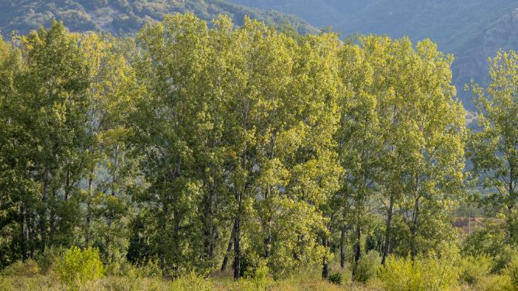
Black poplar trees – a living gene bank
The United Kingdom is home to 30 native trees which play a part in our national biodiversity.
Black poplar is one of the rarer species, and it is found in floodplains and wetlands. However, as land has been drained for agricultural use this has caused a decline in black poplar trees.
The National Trust is creating a living gene bank to help increase the population of the trees once again.
They have planted 80 black poplar trees along a riverbank and close together to allow for pollination. Once these trees have grown cuttings can be taken to spread the tree elsewhere.
Black poplar trees
National Trust

Slide 30
Mix and match
Breeding plants or animals for particular genetic characteristics.
Biodiversity
Extinct
Conservation
The numbers of individuals of a species are dangerously low.
Seed bank
No individuals of the species alive in the world.
A measure of the range of living organisms within a habitat.
Endangered
Seeds are stored so that plants can be grown in the future.
Protecting a natural environment to protect species.
Selective breeding

Slide 31
Mix and match
Extinct
Conservation
Seed bank
No individuals of the species alive in the world.
Breeding animals in human controlled environments.
Seeds are stored so that plants can be grown in the future.
Selective breeding
Endangered
Biodiversity
Breeding plants or animals for particular genetic characteristics.
The numbers of individuals of a species are dangerously low.
A measure of the range of living organisms within a habitat.

Slide 32
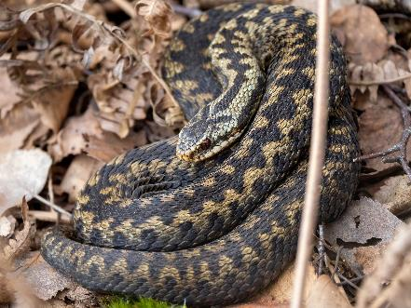
Poster task
Split into groups of three. Your job is to create a presentation or a poster looking at the areas of biodiversity.
Group 1 and 6 - Breeding programmes for endangered species.
Group 2 and 7 - Protect and regenerate rare habitats.
Group 3 and 8 - Reducing deforestation.
Group 4 and 9 - Reducing reliance on fossil fuels such as coal, oil and gas, and carbon dioxide emissions by governments.
Group 5 and 10 - Reducing, reusing and recycling resources.
Adders are most commonly found in Wales in the UK and are reportedly going extinct because they have had a lot of negative press.
Source – endangered species
Include key facts, examples and solutions to any issues associated with the different areas of biodiversity.

Slide 33
Biodiversity
For further information, go to:
www.foodafactoflife.org.uk
This resource meets the Guidelines for producers and users of school education resources about food.

