Slide 1
Bringing where food comes from to life
28/02/2024

Slide 2
Bringing where food comes from to life
Welcome!
The webinar will start at 4.30pm
Let us know who you are – type your name and organisation in the chat box.
Set your chat box to everyone.
Presenters:
Iona Corbett, Faculty Director for Technology, Creative Art & Design, Head of Food & Nutrition​, Chipping Campden School
Joshua Piggott, Science Lead, St Nicholas’ Church of England First School

Slide 3
What we will be covering
Immersive Food & Farming Days in school, linking to the Gatsby Benchmarks of Good Career Guidance.
School farm visits and hands on experiences for pupils, supporting cross-curricular learning and overall wellbeing.
CEVAS accreditation and why this is important when considering taking pupils on farm trips.
LEAF Education Awards.
A farming curriculum.
The impact of enrichment on farms.
Links to Food – a fact of life and other resource hubs.
Suggestions for food and farming initiatives that you and your pupils can get involved with.
Sustainability and climate change: a strategy for the education and children’s services systems

Slide 4
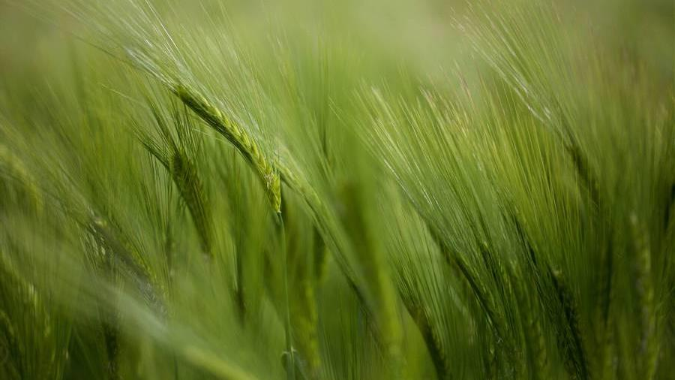
Bringing Where Food Comes from To Life
Iona Corbett: Faculty Director for Technology, Creative Art & Design
Head of Food & Nutrition​ at Chipping Campden School.

Slide 5
Today’s Topics of Conversation
Immersive Food & Farming Days in School
Countryside Classroom
In school session previously for just year 7 whereby local farm businesses are invited in to talk to the students, including organisations such as LEAF.
What is it and how can you benefit from it.
Links to Food – A Fact of Life
Resources available ,support for teachers
School Farm Visits and hands on Experiences for Pupils, Supporting Cross-Curricular Learning and overall Wellbeing
CEVAS Accreditation and Why this is important when considering taking pupils of farm trips
What is CEVAS and why is it good to link with CEVAS accredited organisations

Slide 6
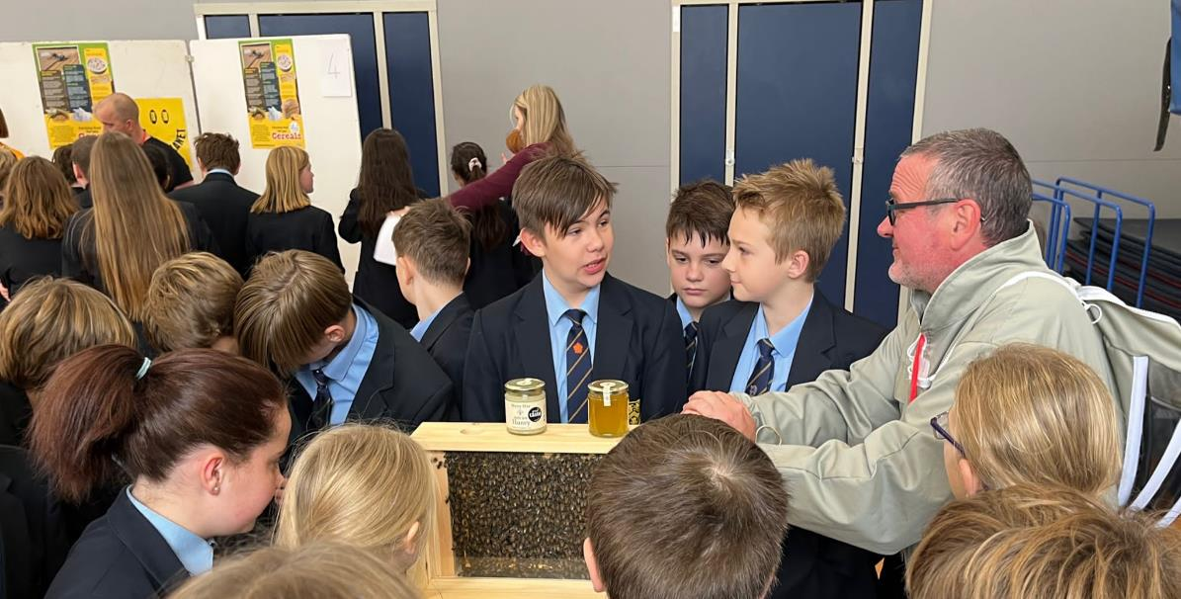
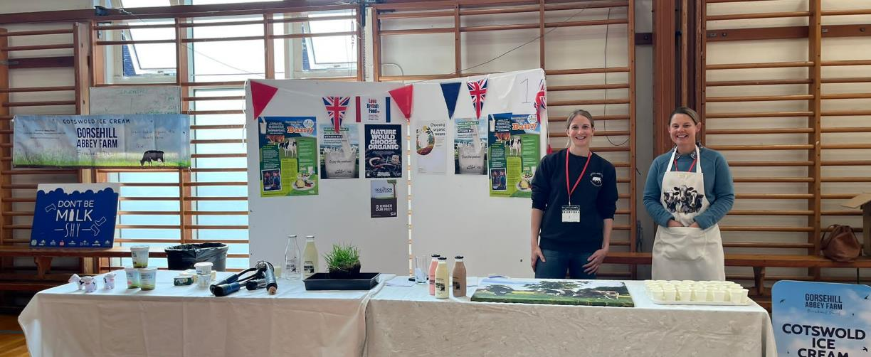
Immersive Food & Farming in School
Previously been run as an hour long session for Year 7 only. Involved a number of food and farming organisations (local farmers, local representatives etc) coming in to school, setting up stands and then tutor groups rotating round the different stations to find out about the different stands.
Plans for next year are afoot.

Slide 7
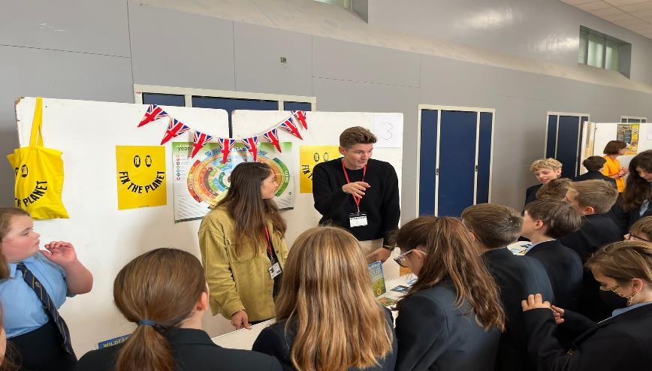
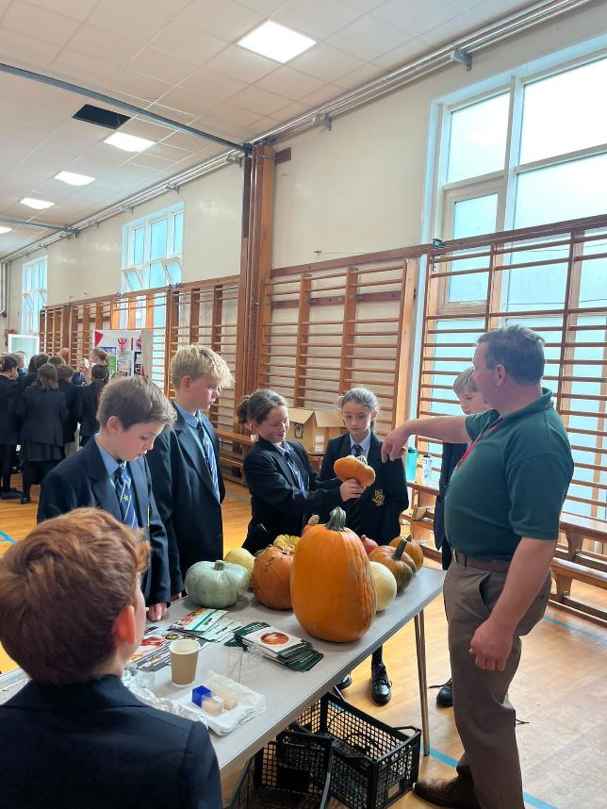
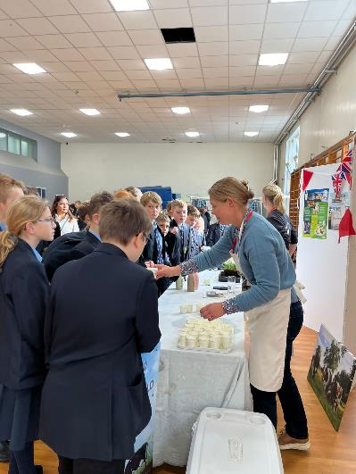
Student's finding out about the different businesses and the part they play in the agricultural sector with the bonus of some free tasters from Gorsehill Ice Cream
20XX
7

Slide 8

The eight Gatsby Benchmarks of Good Career Guidance are:
1. A stable careers programme
2. Learning from career and labour market information
3. Addressing the needs of each pupil
4. Linking curriculum learning to careers
5. Encounters with employers and employees
6. Experiences of workplaces
7. Encounters with further and higher education
8. Personal guidance

Slide 9

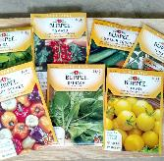
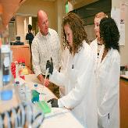
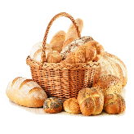
How are we developing it for next year
Grow your Own
Food testing
Hands on Bakery Practical's
Careers workshops with 6th Form
Specific career lectures from companies such as McCain Foods and Ag Colleges for KS4/5 students
Year 7 and 8 will now be growing their own fruit and veg and micro greens that they can take home as well use in class (microgreens)
Working with a local food testing centre to conduct food testing experiments with Year 9
For KS4/5 FPN students practical sessions from professional bakers

Slide 10
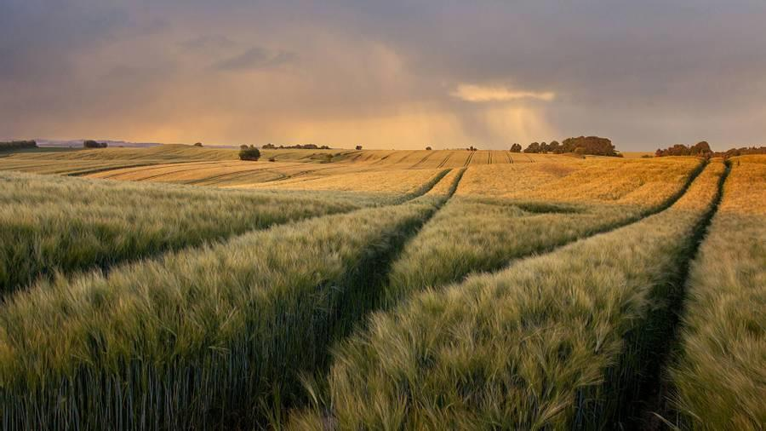
School Farm Visits and hands on Experiences for Pupils, Supporting Cross-Curricular Learning and overall Wellbeing

Slide 11

Personal Experience and the Benefits to Students
Visits to farms
When they see the theory in action you see the light bulb moment. Not only that you expose them to surroundings they may never come across.​ This is also great for their Wellbeing.
More often than note it can break through the propaganda they are exposed to online.
Pay a visit yourself first
Other than for the obvious reason of carrying out a risk assessment, visiting yourself first allows you get your head around the language and various acronyms that farmers will use (assuming everyone speaks their language)​. Learn how to simplify what happens into lay persons
Do your homework
Do some research and find a farm that is CEVAS accredited

Slide 12

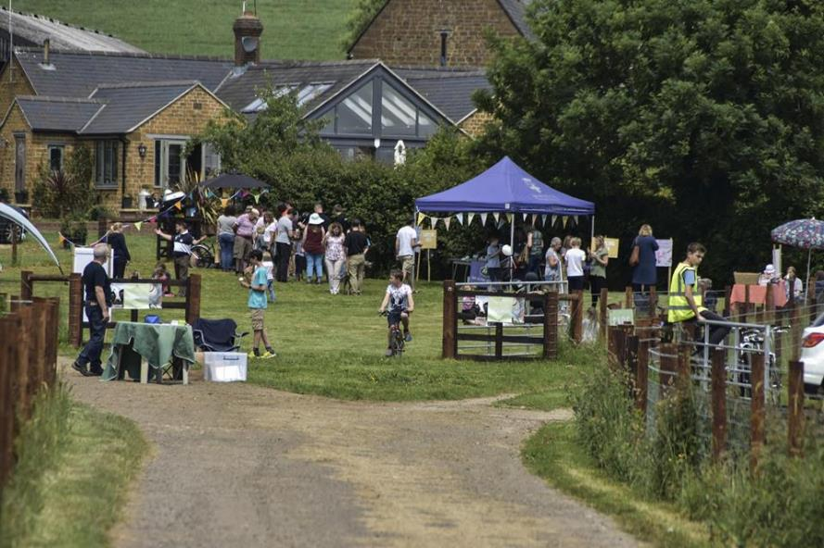
Open Farm Sunday
Why go?
Organised by LEAF but supported by many of the big Agricultural Processors such as Arla, Tesco, etc.
Great way to get a feel for what being on a farm is like (and nice to share with the family too).
Great way to gather information on resources available as many of the big processors provide materials and resources to be handed out.
Gives you an opportunity to have a look at how you could link a farm visit into your curriculum so that you know what to ask a farmer about when trying to organise a visit.

Slide 13

CEVAS
Countryside Education Visits Accreditation Scheme
​A or B ?
Farmers can be accredited via two routes
- A) Education Route
-B) Care Farm Route
Qualified?
CEVAS is managed by LEAF and provides farmers with training to Open College Network level 2 Award standard. They are trained in curriculum needs, cross curricular opportunities, how to plan and risk assess sessions, how to present to children of all ages. Taught to link what they offer to National Curriculum. ​
In SchooL
CEVAS also covers farmers going into schools to work with students and provides them with resource support packs ​

Slide 14
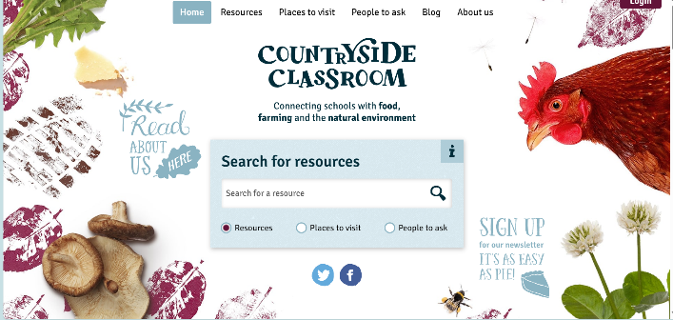
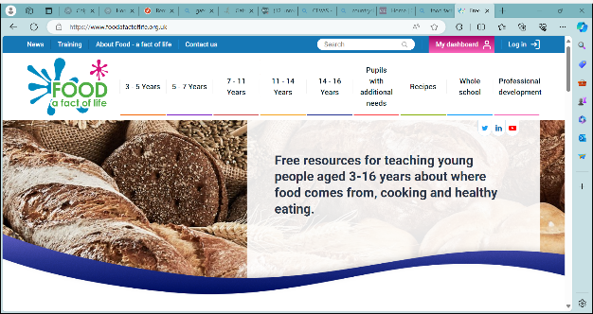
Where can you go for Links and Ideas?
Countryside Classroom
Food Fact OF Life
www.countrysideclassroom.org.uk
www.foodafactoflife.org.uk
Great supply of resources and you can search for famers that host visits
Bucket loads of resources for all curriculum stages including SEND provision, lesson plans, curriculum maps, recipes, careers info, whole school food approach, parental engagement and remote learning which is great for Alt Prov.
14

Slide 15

Any Questions?
Iona Corbett
Faculty Director for Technology, Creative Art & Design and Food.
Head of Food & Nutrition​
Icorbett@campden.school

Slide 16






Joshua Piggott
Science Lead

Slide 17

What I will talk about…
LEAF Education Awards
Threading farming throughout our curriculum
Events and enrichments on farms, and their impact
Articles and resources (e.g. Countryside Classroom)
Joshua Piggott

Slide 18

LEAF Education Awards
Year 1 Bronze:
To be awarded this level, the school has:
Had training or a CPD session at the school with LEAF Education
Organised an event promoting food production / farming / natural environment at the school e.g., a Harvest Festival / Science Week Events
Incorporated an activity or topic that looks at how food and farming has a role to play in us all having climate positive impacts
Had a visit from a local farmer or food production expert, e.g., an agronomist or plant scientist
Visited a farm or taken part in a LEAF Education Virtual Farm tour
One member of staff taking part in the popular Farmer Time initiative
Promoted an organised event and partnership with LEAF among the wider community via social media (tagging in LEAF Education), e.g., within the school newsletter.
Joshua Piggott

Slide 19

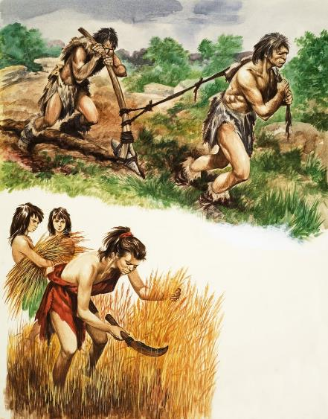

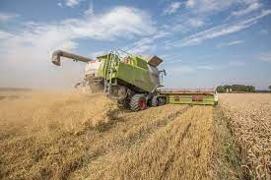

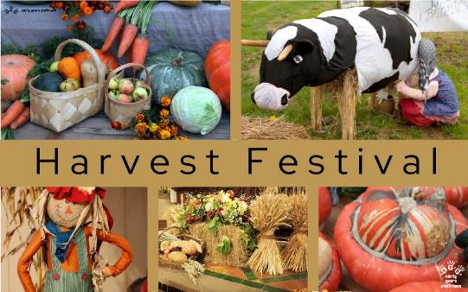

A farming curriculum
Joshua Piggott

Slide 20
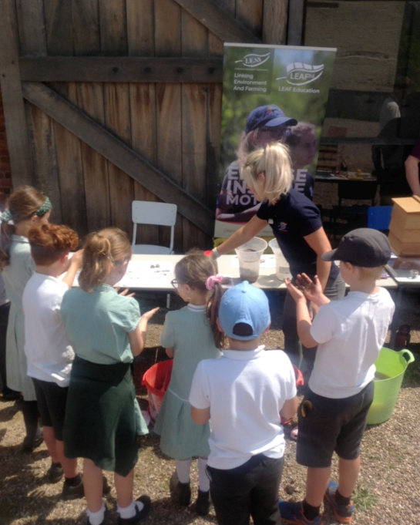
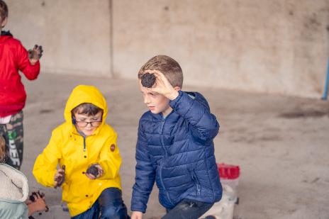
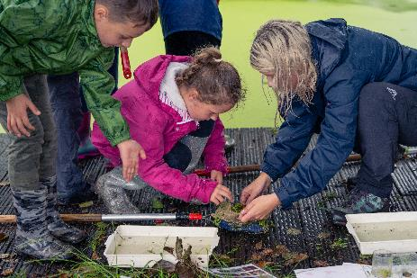
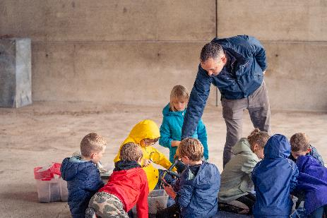
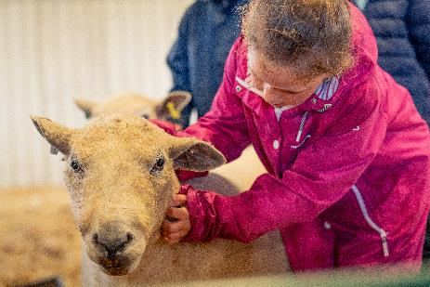
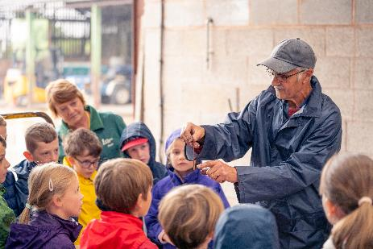
Farm Workshops and Visits
“I thought it was really good because I liked going around to other people’s stalls to see what they got up to at their schools. I learnt that non magnetic things are called insulators. I loved learning about magnets!
Year 3 Pupil.
LEAF “Why Farming Matters” launch at Southfields Farm, Birmingham
“I think my garden has clay soil because it rolls into a ball!”
Year 3 Pupil.
A phenomenal impact on low aspirational and attaining children in learning about science through the Why Farming Matters project.
Children enjoyed another farm visit learning all about soils and how soil helps our food grow, and how important it is for farmers.
Joshua Piggott

Slide 21
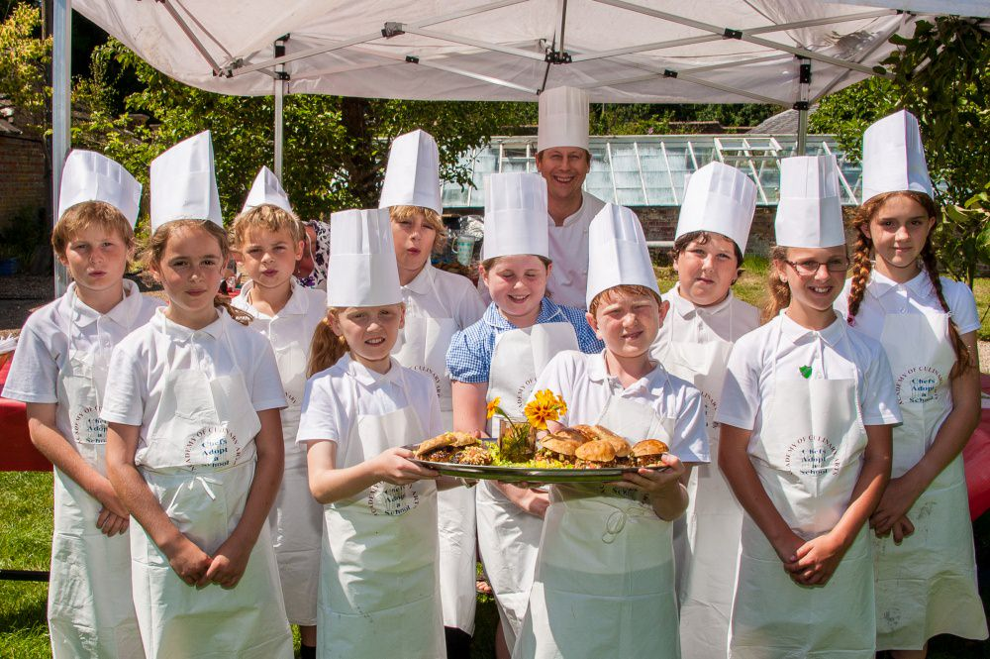
Chef on the Farm
Joshua Piggott

Slide 22
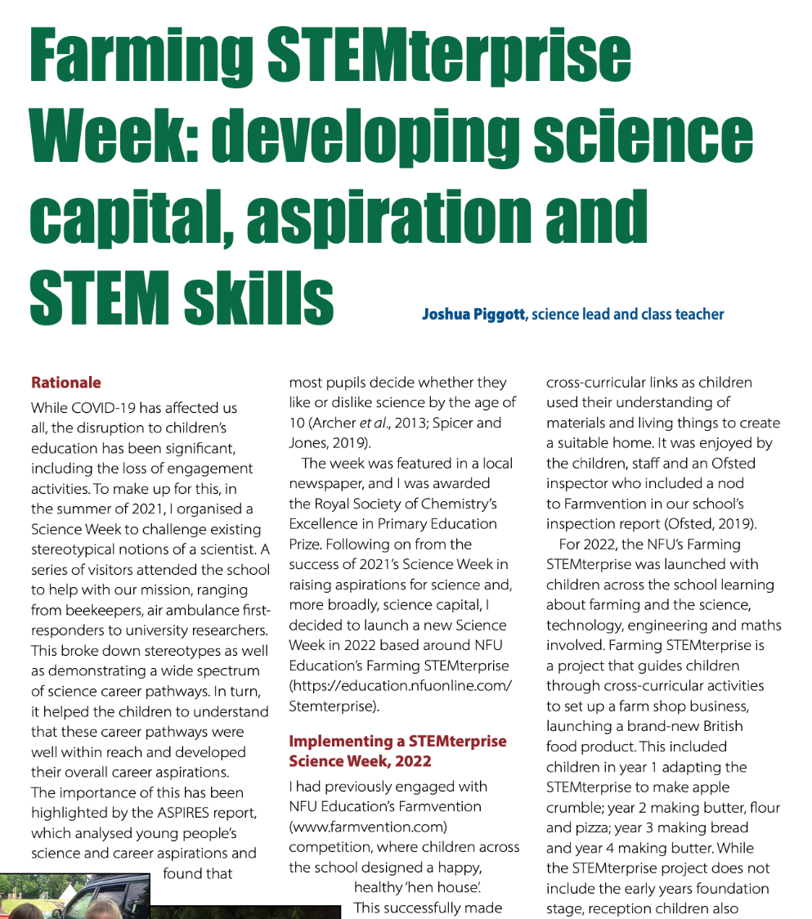
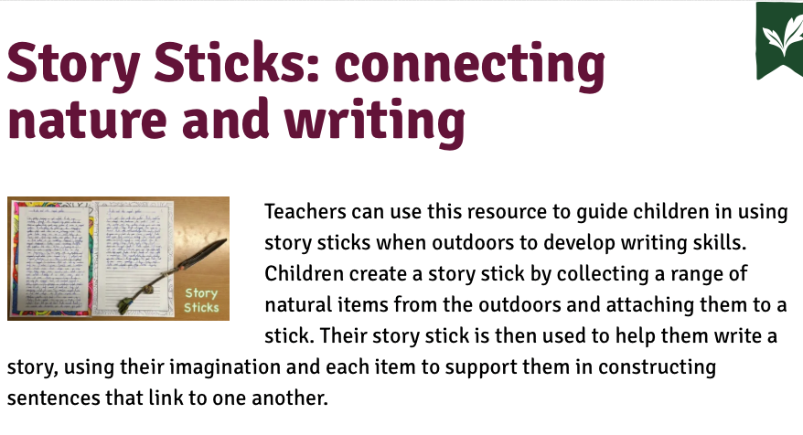
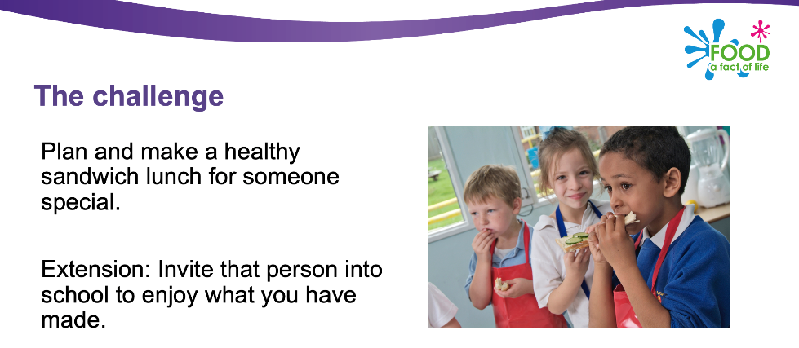
Resources

Slide 23
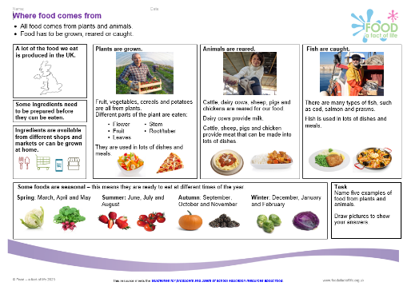
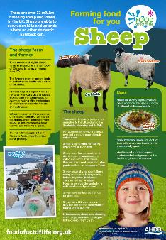
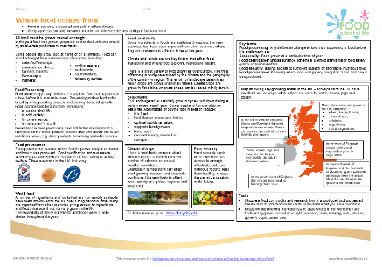
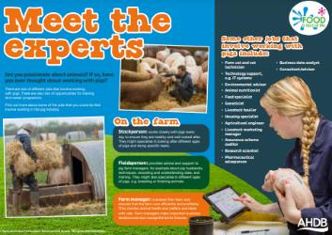
Food – a fact of life resources
Knowledge organisers
Where food comes from resources
Food commodities resources, including growing and food production videos
Challenge activities:
Grow the seasons – 5-7 years
Life on a farm – 7-11 years
Eat your way round the UK – 11-14 years
Journey of your meal – 14-16 years
Posters
www.foodafactoflife.org.uk

Slide 24

Farmer Time video here

Slide 25
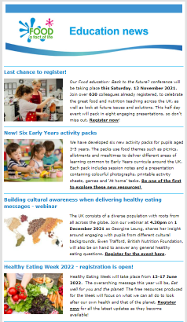

Keep up to date with our free resources and training
Education News (monthly email update)
Sign up on the homepage: www.foodafactoflife.org.uk
PPD newsletter (find out about upcoming FFL training)
https://www.foodafactoflife.org.uk/professional-development/
Follow us on Twitter @Foodafactoflife
https://twitter.com/foodafactoflife
Keep in touch:
education@nutrition.org.uk
BNF news https://www.nutrition.org.uk

Slide 26
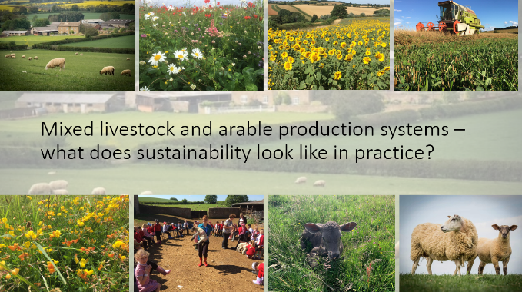
More training …
Webinars
Sustainable farming in practice: the natural world and the importance of sustainability in context – 14 March 2024
Further webinars and virtual practical workshops will be announced soon. If there is a particular topic that we should focus on, let us know!

Slide 27
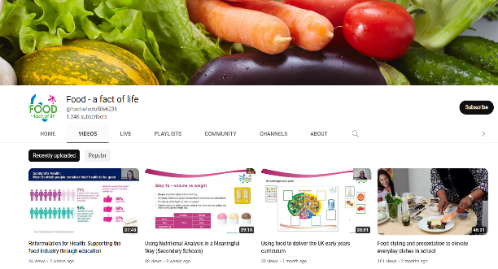
More training…
FREE online modular courses:
Functional properties of food
Sensory science
Food spoilage, hygiene and safety
Teaching food and nutrition in primary schools (England, Northern Ireland, Scotland and Wales)
Characteristics of teaching food and nutrition education – primary, secondary and pupils with additional needs
FFL webinar recordings
To find out more and to book, go to https://www.foodafactoflife.org.uk/training/

Slide 28
Bringing where food comes from to life
For further information, go to:
www.foodafactoflife.org.uk
education@nutrition.org.uk

