Slide 1
The economy of food

Slide 2
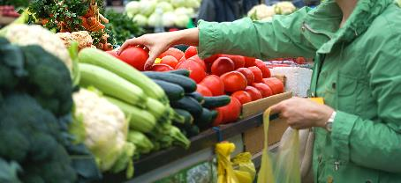
Factors affecting food choice
All around the world, people choose to eat different food for many different reasons.
One very important factor for most people is the cost of the food. Knowing about food and where it comes from can help keep cost down.
In order to have food security, people need to have enough money for sufficient, safe, and nutritious food that meets their dietary needs and food preferences for an active and healthy life.

Slide 3

Cooking on a budget
There are many things that we can do to spend money wisely on food.
In 2020/21 the amount the average UK household spent on food and drink purchases was £39.71 per person per week.
However, by 2024, the average had risen to £63.50.
Sources: Family Food Survey 2020-2021, Living Costs and Food survey 2024

Slide 4

Cooking on a budget
43% of respondents to the Food Standards Agency’s Food and You research (April 2018) reported making at least one change in their buying or eating arrangements in the last 12 months for financial reasons, including:
20% who bought items on special offer more;
18% who had changed where they shopped for cheaper alternatives;
17% who said they ate out less.
We need to make informed choices to achieve a balanced and varied diet.
Food and You wave four

Slide 5
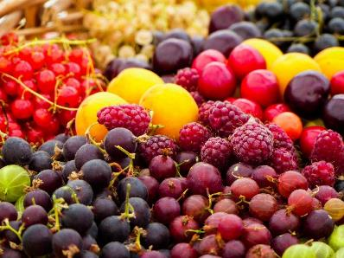
Eat the seasons
Buying and eating food that is in season means that it:
is fresh;
has the best flavour, texture and colour;
has optimum nutritional value.
Seasonal food is readily available which usually means it is cheaper to buy.
If the food has been grown or reared locally, travelling and storage costs are reduced.

Slide 6
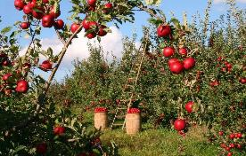
Eat the seasons
Using food in season is easy to do:
use seasonal ingredients to change the flavour and texture of recipes;
combine seasonal fresh fruit and vegetables in main meals as they are often cheaper.
Name two examples of food currently in season.
Remember that it is not just fruit and vegetables that are seasonal – meat and fish can be too!

Slide 7
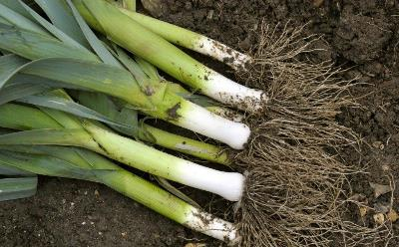
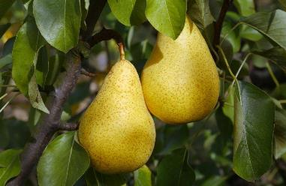
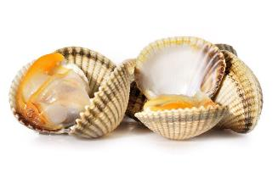
Eat the seasons
Leeks: October - May
Cockles: September - April
Pears: mid August - October

Slide 8
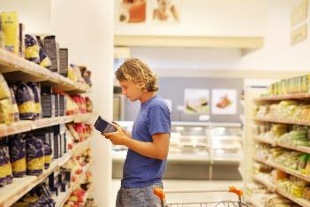
Stock up
When you go shopping see what’s on special offer and stock up on food with a long shelf-life.
Check the price difference between value brands and premium products.
Check out the price per 100g or per 100ml when choosing food.

Slide 9
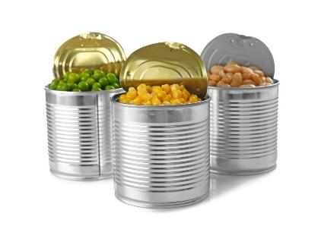
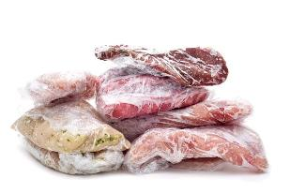
Stock up
Check the frozen and canned vegetable section and buy items that are cheaper, so you always have a variety in the freezer and the cupboard.
Bulk buy meat and fish and freeze in smaller portions until you are ready to use them.

Slide 10
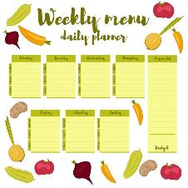
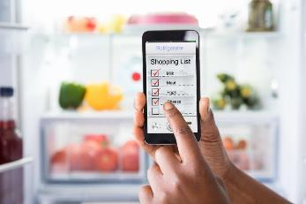
Shop smart
Take time to plan your meals and then compile a shopping list of everything you need.
Products such as canned tomatoes, beans, pulses, rice, pasta, oatmeal and barley are lower cost items. They can be used to bulk up meals and make them go further.

Slide 11
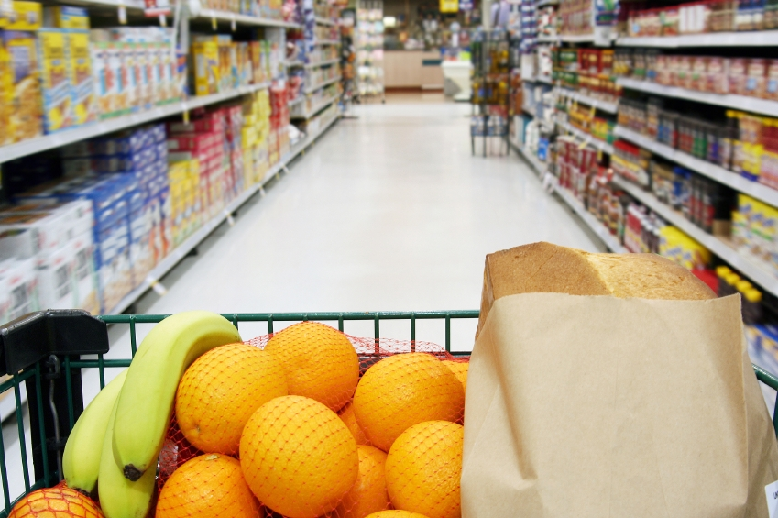
Cost and availability of ingredients
The amount of money available may impact the type and quantity of ingredients bought and selected. If buying for a special occasion or celebratory meal, consumers may wish to spend more on ingredients or buy something required for a particular recipe.
The availability of food can also influence the ingredients selected, e.g. fresh vegetables from a local market or frozen vegetables from a supermarket.

Slide 12
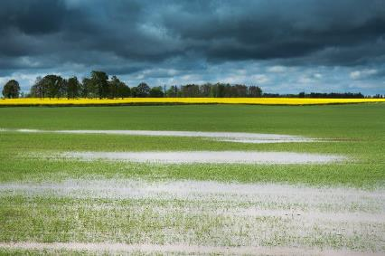
Eating local produce
Many people wish to eat local produce, but this can cost them more. Consuming seasonal produce that is locally grown food means people can eat food that does not have to travel long distances to reach your plate.
This practice also supports local farmers and the regional economy, helping to sustain agricultural livelihoods and reduce the carbon footprint associated with food transportation.
Ensuring that the carbon footprint of the produce is reduced is another key consideration for shoppers.

Slide 13
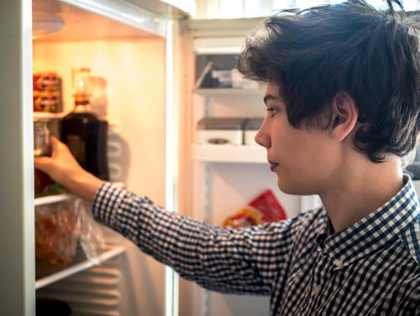
Food waste
Another consideration people have when selecting ingredients is ensuring food is not wasted in the production or processing of food.
It is estimated that the 10.4-13mn tons of food waste produced annually costs the UK £19 billion a year.
Addressing food waste requires concerted efforts across the supply chain, from producers to consumers, to implement more efficient practices and encourage behavioural changes towards more sustainable consumption.
Food Foundation 2024

Slide 14
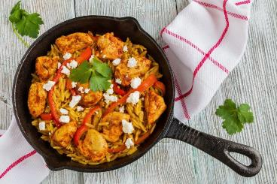
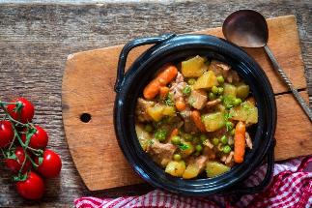
One pot cooking
Save time, heat energy and washing up by cooking ‘one-pot’ meals.
Cheaper cuts of meat can be cooked slowly for a tasty economical meal.
Add root vegetables to make casseroles go further.

Slide 15
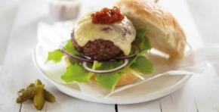
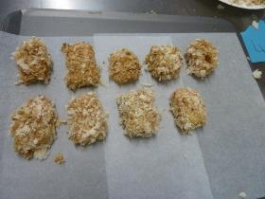
Fake-aways!
Instead of getting a take-away or having fast food delivered, why not make your own ‘fake-away’?
Burgers, kebabs, chicken nuggets and chips, and curries are all dishes you can make at home for far less money.
Aso, home-made versions of take-away dishes often contain far less salt, fat and sugar and taste just as delicious!

Slide 16
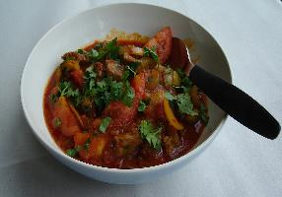

What’s left?
Using leftovers is a great way to save money and reduce food waste.
Use leftover cooked meat in a curry or risotto.
Leftover potatoes could be used to make fishcakes.
Suggest one other idea for using up leftovers.

Slide 17
Why do food prices change?
Food prices can and do change throughout the year. This may be due to a variety of reasons:
climate and weather patterns;
agricultural costs increase;
fuel prices go up;
consumer demand;
seasonality.
Suggest other things that might cause the prices of food to rise or fall.

Slide 18
The economy of food
For further information, go to:
www.foodafactoflife.org.uk
This resource meets the Guidelines for producers and users of school education resources about food.

