Slide 1
Genetic modification and gene editing

Slide 2

Genes
Every cell in plants and animals contains genes. A gene is a segment of DNA that acts as a piece of ‘code’ for producing important molecules in an organism. They are inherited from each parent and passed on to future generations. They carry information about physical characteristics and ‘qualities’.

Slide 3
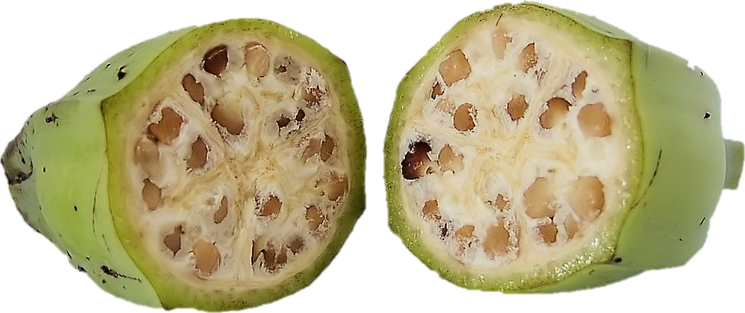
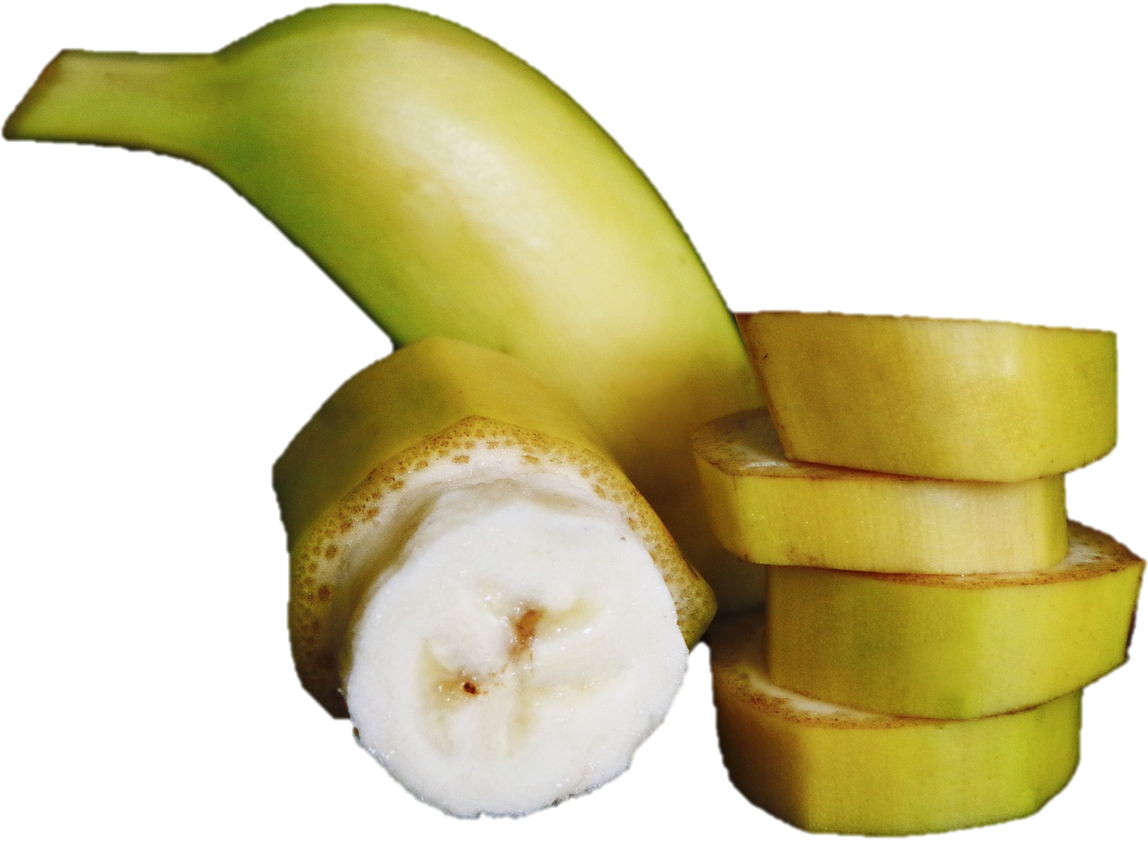
Genetics and selective breeding
Historically, plants or animals with a desirable characteristic were bred together, to try and enhance these genetic qualities. This is known as ‘selective breeding’. This process is slow, and so plant and animal breeders have had to work through many generations, waiting for years for noticeable changes (e.g. cross-breeding pigs to produce pork with more muscle and less fat). Many of our modern crops are very different from the wild varieties they were originally bred from (e.g. corn, wheat, and fruit such as apples, pears, bananas and watermelons).
Modern bananas have been bred to be much sweeter and have smaller seeds.

Slide 4
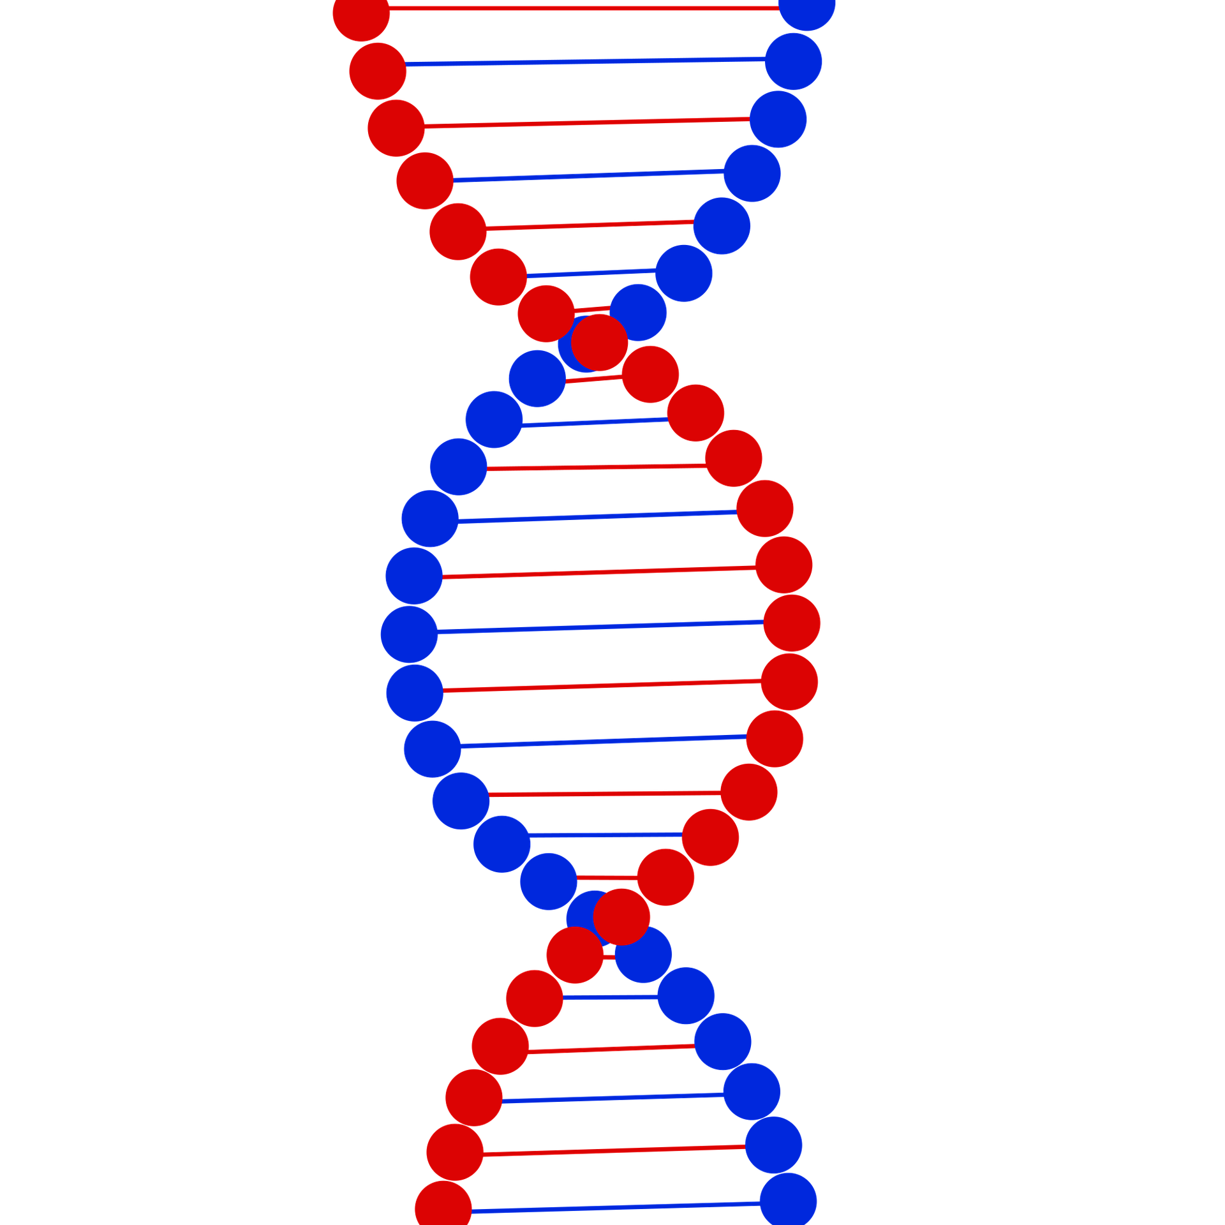
Deoxyribonucleic acid (DNA)
These days, scientists are able to identify genes which control particular characteristics. These discoveries offer a quicker and more exact way to improve crops and livestock. Understanding the nature of deoxyribonucleic acid (DNA) has paved the way for genetic modification. This is the process by which biotechnologists can alter DNA sequences, to produce a crop, for example, with additional or improved characteristics. For example, ‘Golden Rice’ is a genetically modified rice crop that contains vitamin A, in order to combat deficiencies that can be a serious problem in some countries.

Slide 5
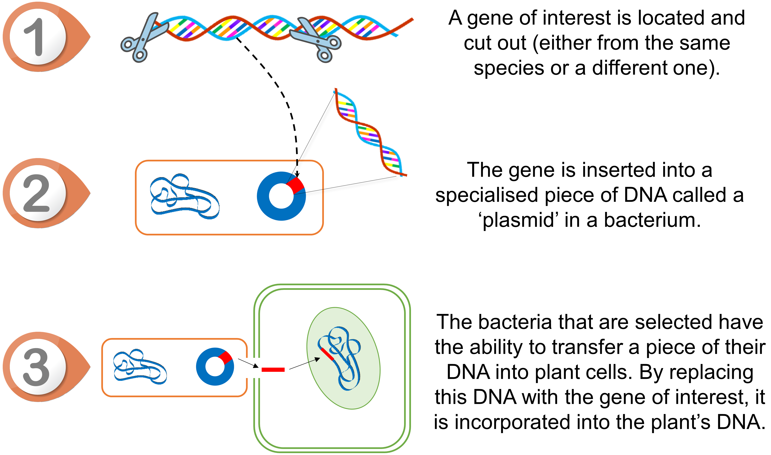
How does genetic modification work?
First, a gene of interest is selected. This is then transferred to a plant cell, usually through one of two main methods:
being fired from a device known as a ‘gene gun’ into the cell;
being inserted into a specialised piece of DNA in bacteria that are capable of transferring this information to plants (see image).

Slide 6
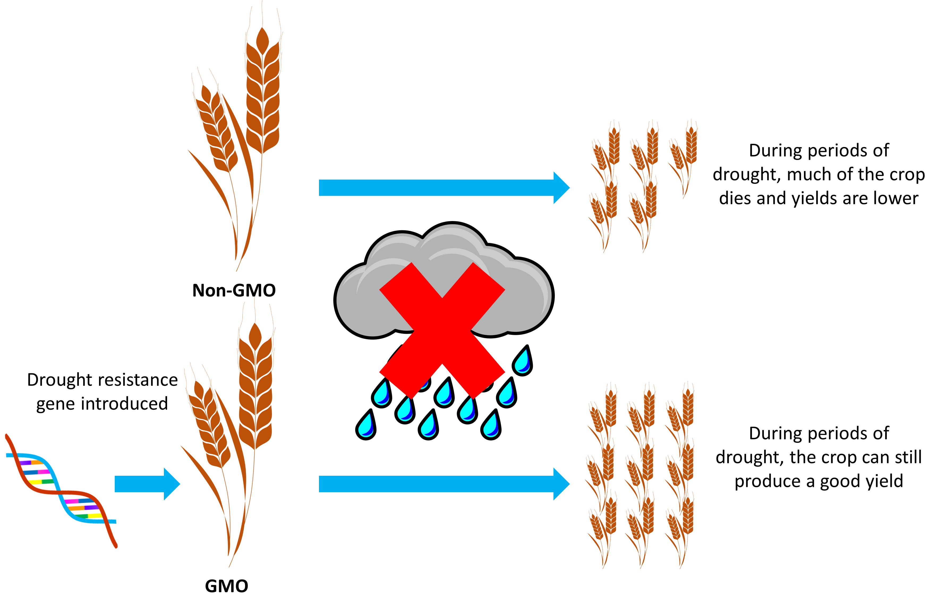
Improving crops and livestock
Improving varieties of crops or livestock by introducing and modifying specific genes is faster and more accurate than traditional breeding. If the gene can be identified and modified, the following changes may be possible:
• plant crops may have a longer shelf-life, be more resistant to pests, disease or drought, be more nutritious, have a better taste or give a higher yield;
• animals may be made more resistant to disease, produce less fatty meat, grow faster or be more fertile.

Slide 7
Concerns about genetic modification
A number of concerns have been raised, regarding genetic modification. These include:
whether genetically modified foods (GMFs) pose any health risk to humans, or increased allergy risk;
whether GMFs pose risks to the ecosystem, particularly if they cross-pollinate with other crops;
objections on moral or religious grounds, namely that we should not interfere with nature in this ‘unnatural’ way;
whether farmers may be negatively impacted;
whether corporations will restrict access to crops.

Slide 8

Health and safety concerns
Because each genetically modified food (GMF) is different from the next, each new food should undergo safety assessments to weigh up both the benefits and any risks. All of the few GMFs available on the market today have been rigorously tested and been deemed safe. There is currently no evidence that any of these have caused any health issues in humans. In the UK, detailed safety assessments of GMFs are carried out by the Food Standards Agency to make sure that they are safe to consume.
Nuffield Council on Bioethics , 2003
World Health Organisation, 2014
European Food Safety Authority, 2019
Food Standards Agency, 2018

Slide 9
GM labelling in the UK
Foods which have been produced from genetically modified organisms (GMOs) are likely to appear no different from food produced by traditional means. The Government has set up a series of controls to inform consumers, whilst protecting the environment and people who work with GMOs. In the UK, foods that contain GMOs or ingredients produced from GMOs need to be labelled by law. Foods produced with GM technology or foods sourced from animals fed on GM feed do not currently need to be labelled.
No GM food crops or animals are currently grown commercially in the UK.
Food Standards Agency, 2018

Slide 10
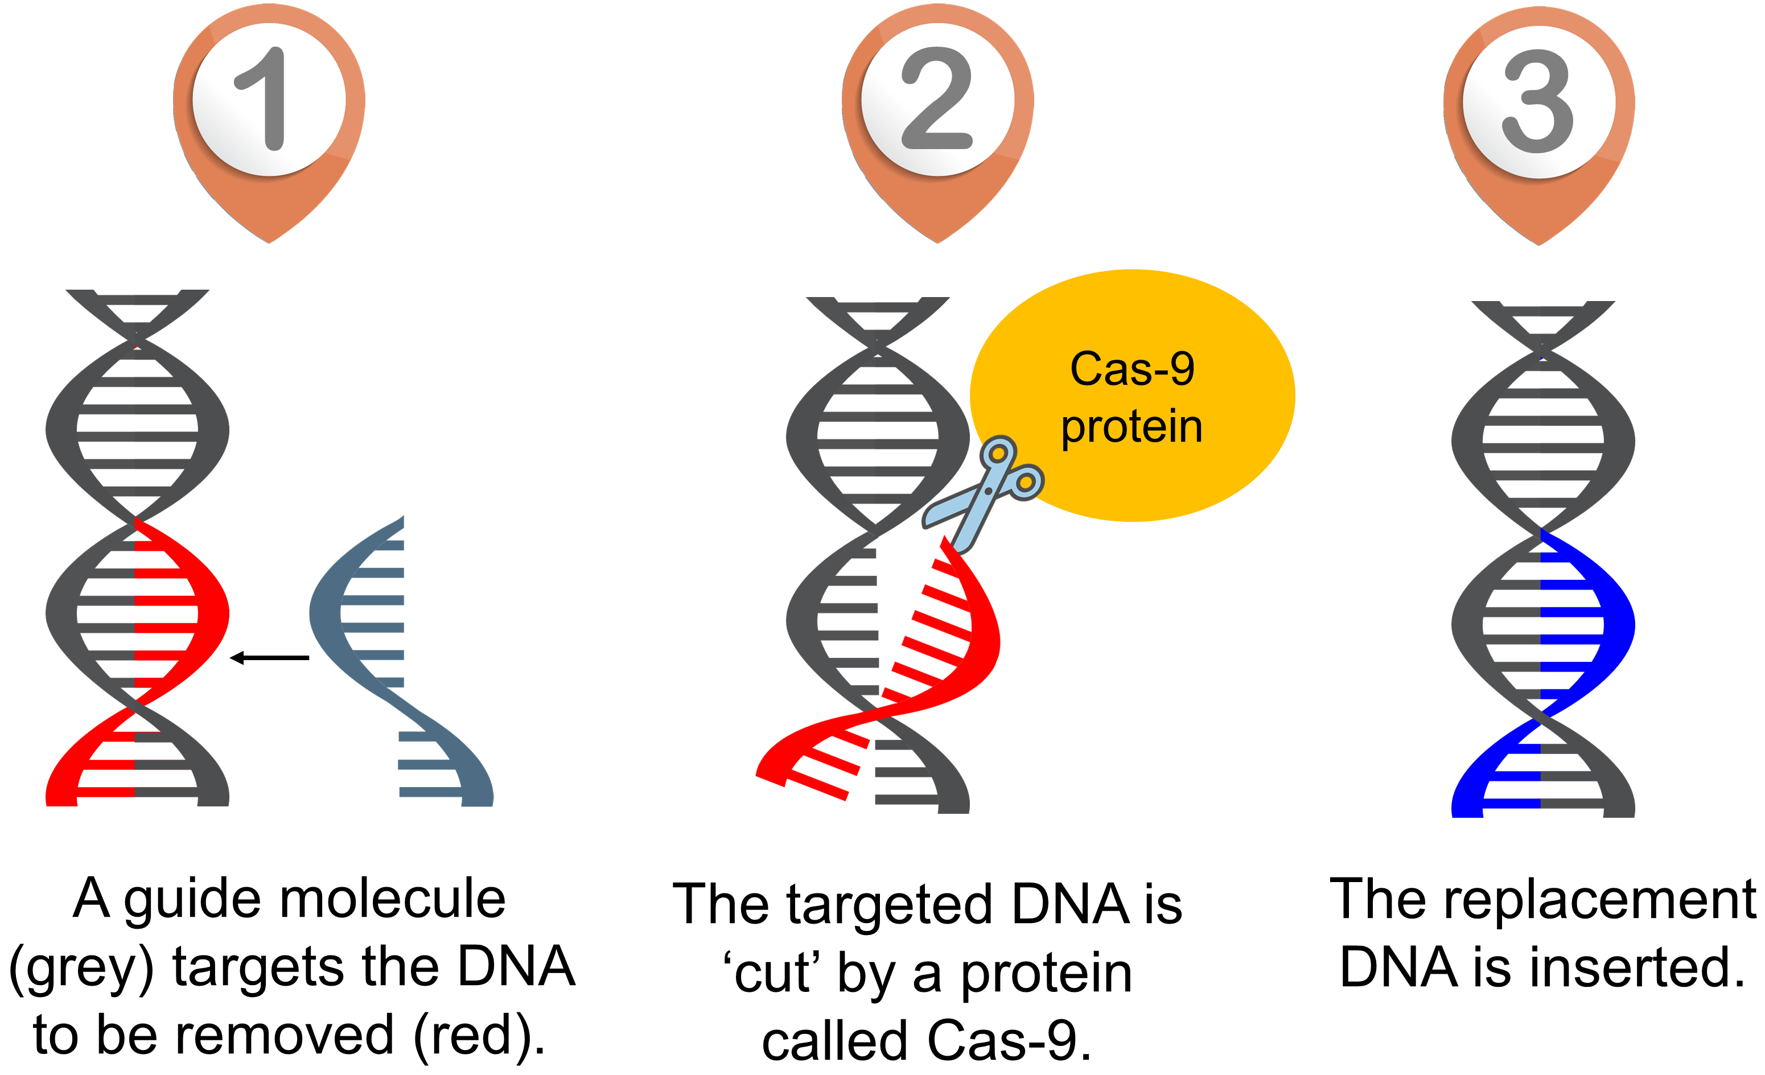
Gene editing
Recent advances in science now allow for a new way to modify genes. This technology is known as gene editing. Gene editing allows for specific and targeted changes to an organism’s DNA. Gene editing is very similar to the ‘cut and paste’ function on a computer. A specialised protein is used to cut the DNA, and the desired replacement piece of DNA can be inserted into the cut.
This diagram shows an example of one kind of gene editing (CRISPR/Cas9)

Slide 11
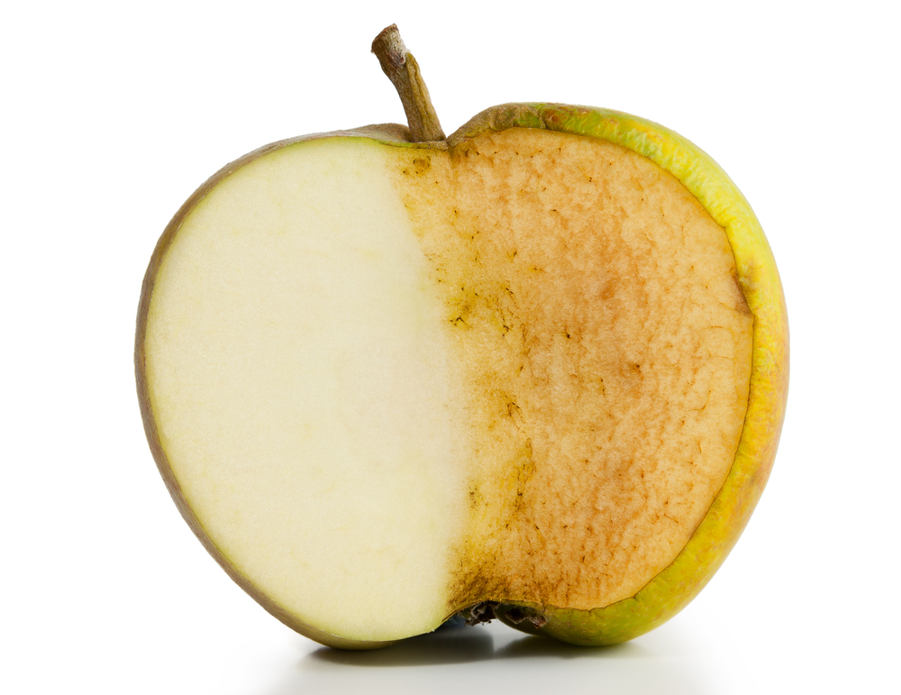
Different types of gene alterations
Genes can be altered in different ways to produce different effects. These include:
Gene knockout – a gene is made completely inactive.
Gene knock-in – a gene is replaced by another one.
Gene knockdown (or gene silencing) – a gene is made partially inactive.
A food example of gene knockdown is a ‘nonbrowning apple’, which produces lower amounts of an enzyme that causes browning when the fruit is cut or bruised.
There are currently very few food products available that use gene editing, due to the new technologies still being perfected, consumer concerns and legal and financial barriers to creating these foods.

Slide 12
Summary
Genetic modification provides a method for making desirable changes to a crop more rapidly than conventional selective breeding.
Genetically modified foods (GMFs) may have useful functions such as drought resistance, having higher nutrient content or pest and herbicide resistance, which can be particularly important in developing countries.
Criticisms of GMFs include concerns about health risks, concerns about harm to other species where new crops are planted, religious or moral objections and concerns about how farmers may be affected.

Slide 13
Summary
To date, no health risks have been identified from any available GMFs.
Foods containing GMOs must be labelled in the UK.
In the UK, no GM food crops or animals are currently grown commercially.
Gene editing is a new approach for modifying genes that is more specific and targeted than genetic modification techniques.
Gene technology is not static – it is advancing all the time.

Slide 14
Genetic modification and gene editing
For further information, go to:
www.foodafactoflife.org.uk
This resource meets the Guidelines for producers and users of school education resources about food.

