Slide 1
Simple spring rolls

Slide 2
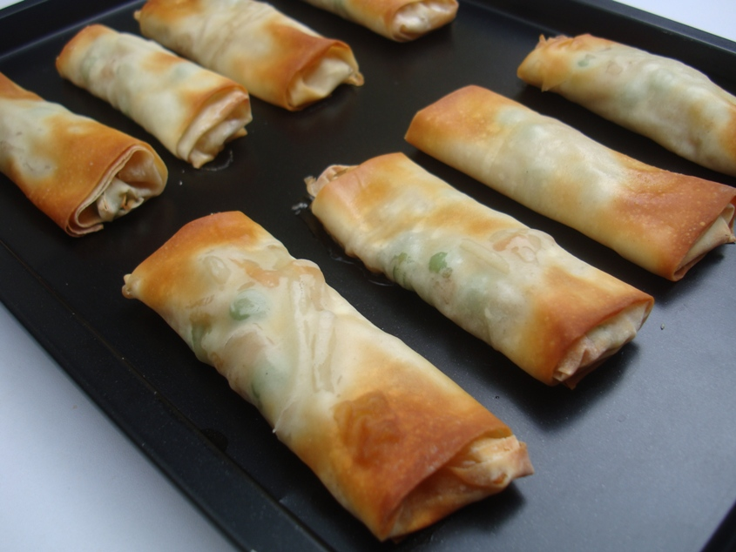

Slide 3
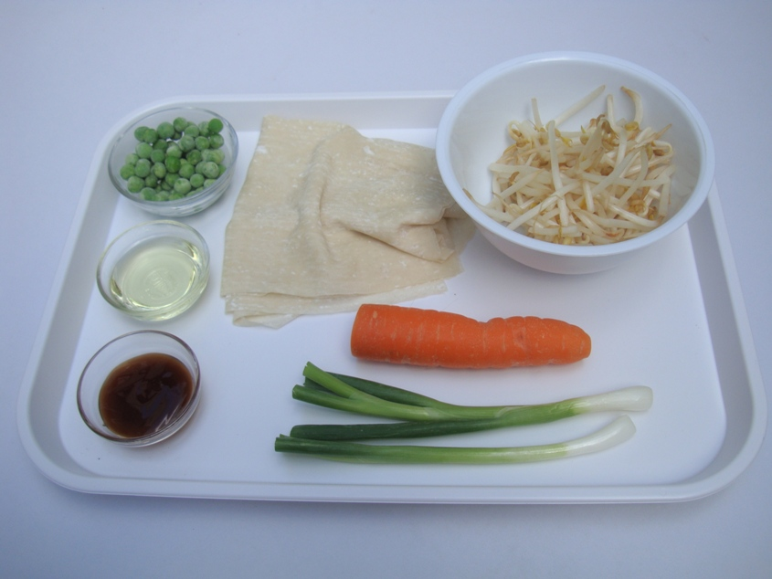
Ingredients
1 x small carrot, topped and tailed
2 x spring onions
40g beansprouts
25g frozen peas
1 x 15ml spoon oyster sauce
4 filo pastry sheets, cut in half
Oil

Slide 4
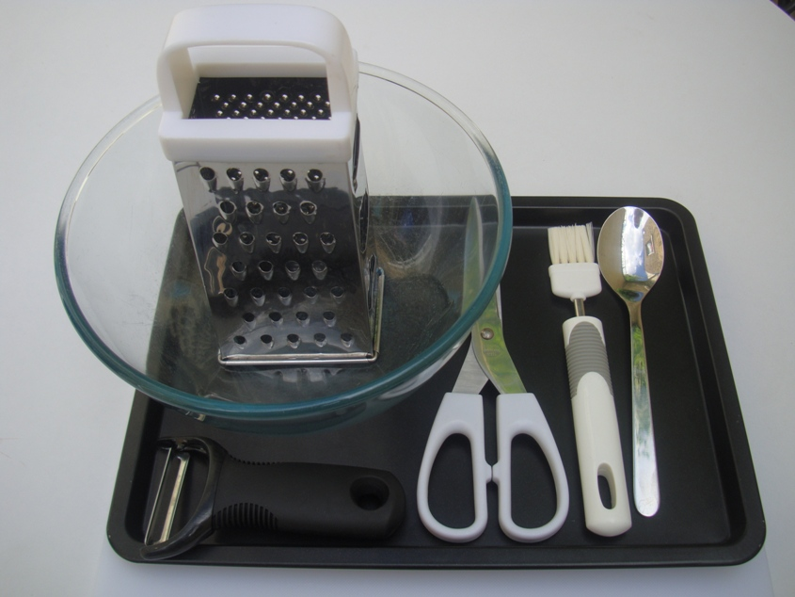
Equipment
Vegetable peeler
Grater
Mixing bowl
Kitchen scissors
Spoon
Non-stick baking tray
Pastry brush
Chopping board

Slide 5
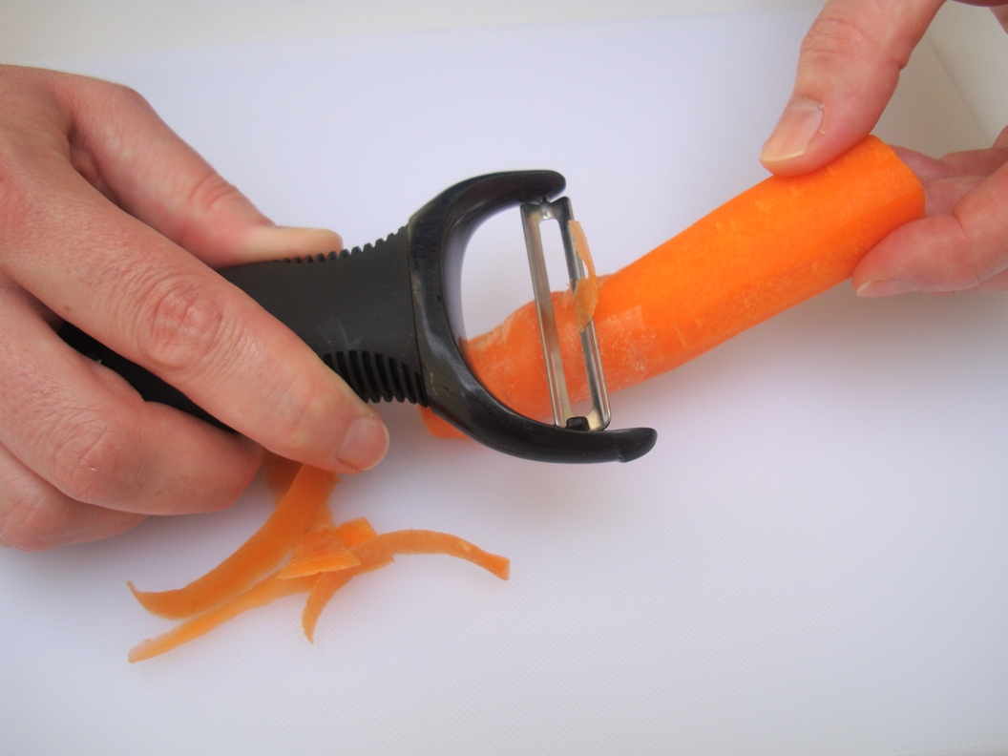
Method
Peel the carrot.

Slide 6
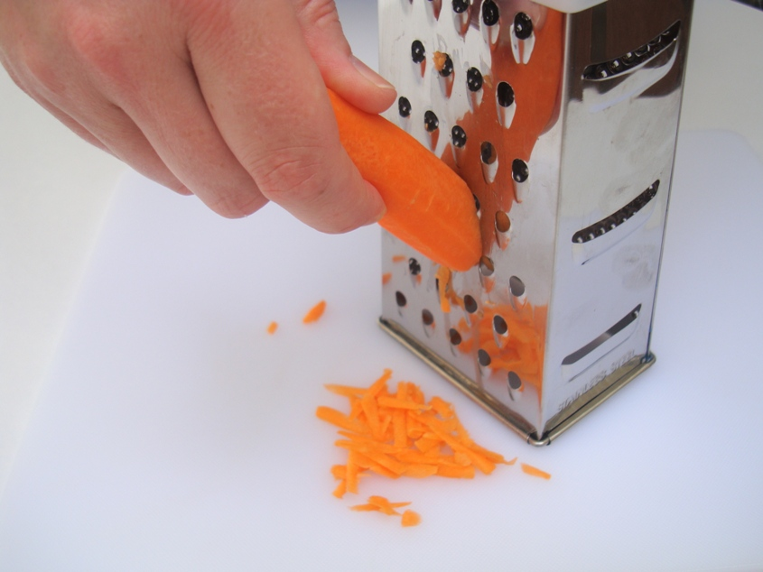
2. Grate the carrot.

Slide 7
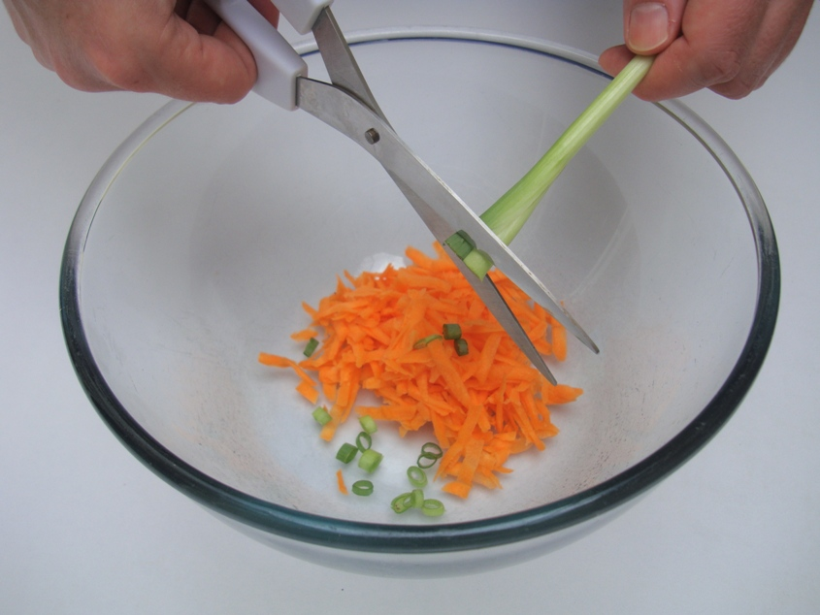
3. Snip the spring onions into the bowl.

Slide 8
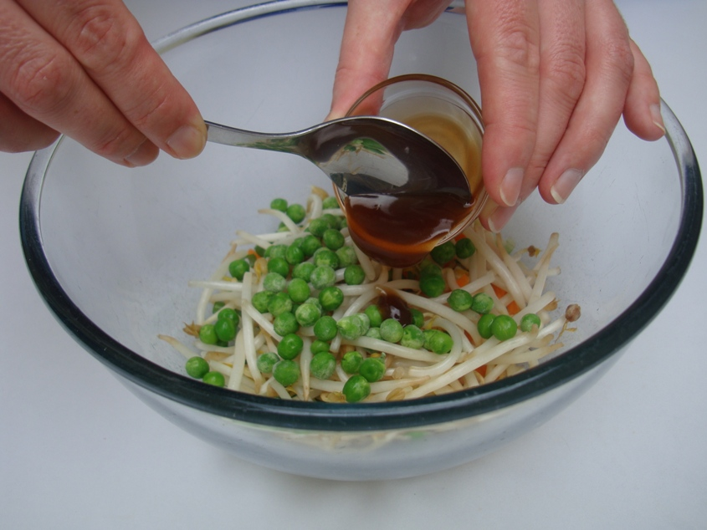
4. Add the beansprouts, peas, and oyster sauce.

Slide 9
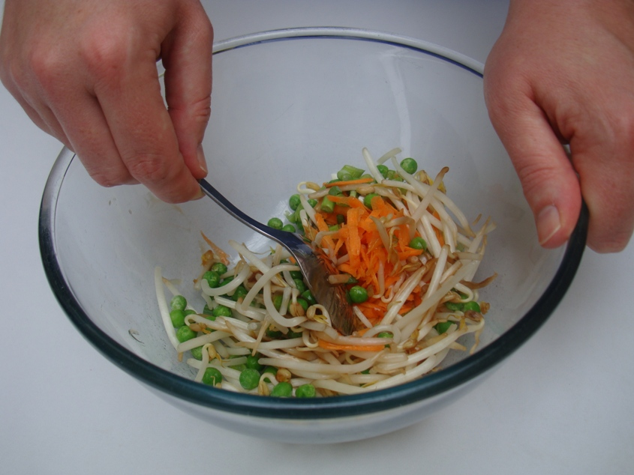
5. Mix everything together.

Slide 10
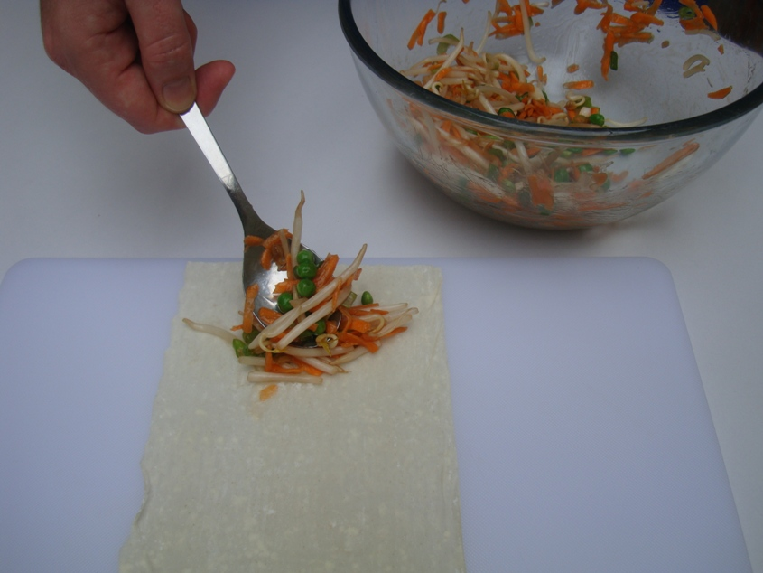
6. Spoon a little mixture onto the pastry.

Slide 11
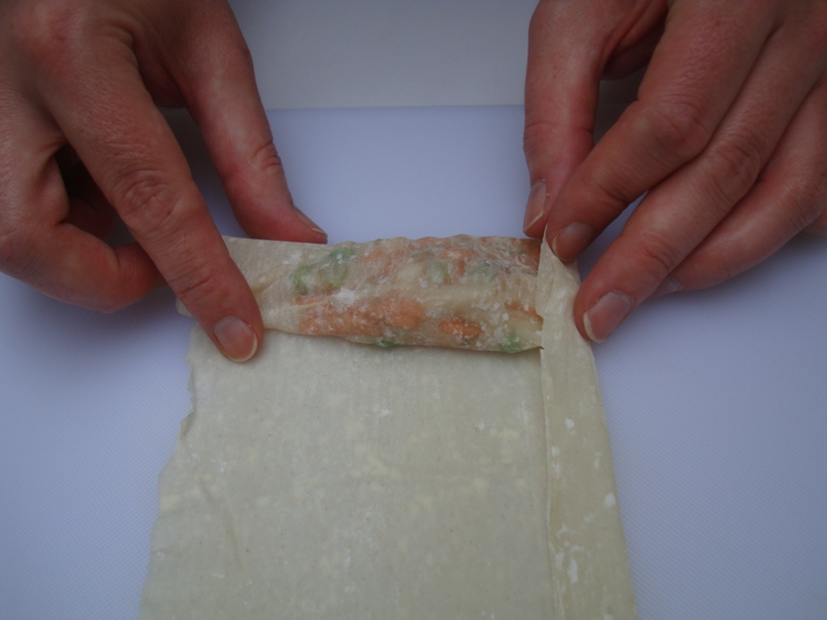
7. Fold in the edges.

Slide 12
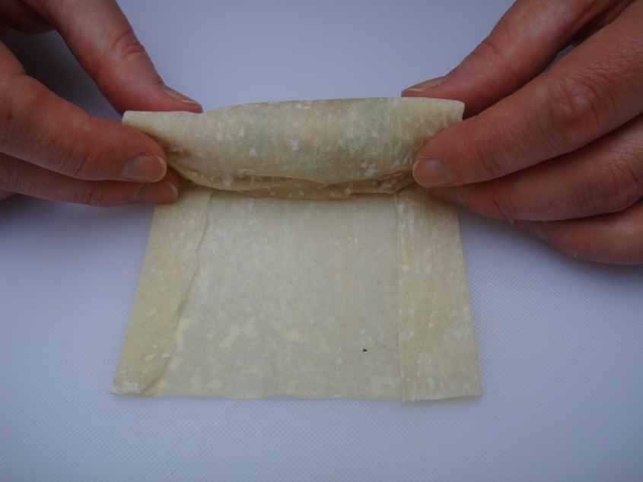
8. Roll up the pastry.

Slide 13
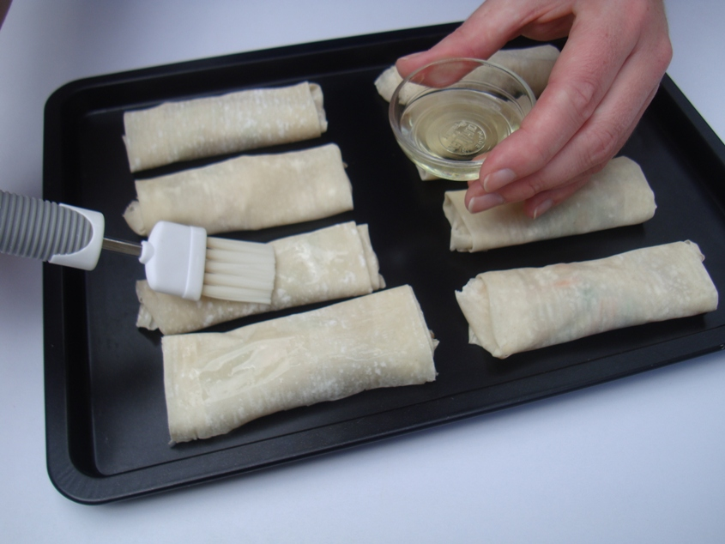
9. Place on a baking tray and brush with oil.

Slide 14
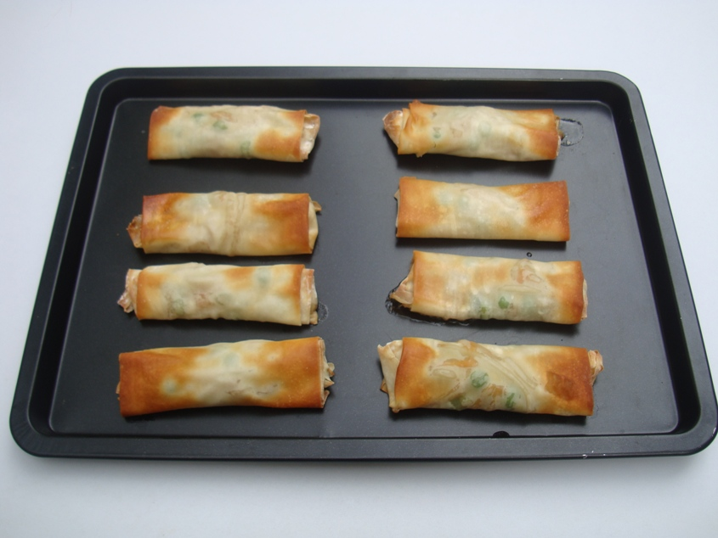
10. Bake for 15 minutes.

Slide 15
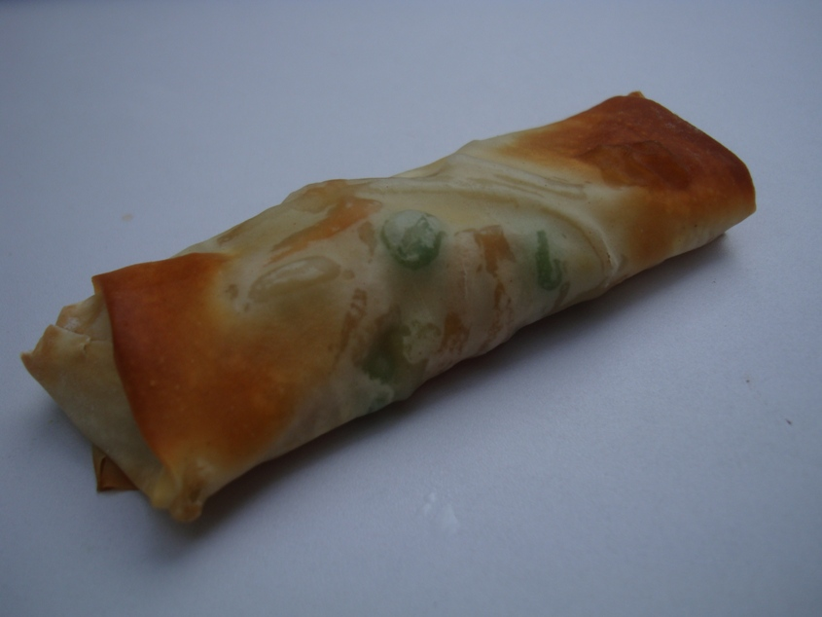
11. Serve.

Slide 16
Simple spring rolls
For further information, go to:
www.foodafactoflife.org.uk
This resource meets the Guidelines for producers and users of school education resources about food.

