Slide 1
Food shopping

Slide 2
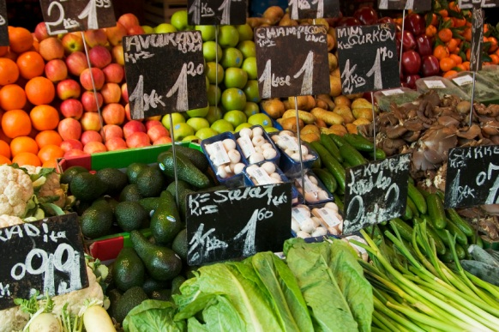
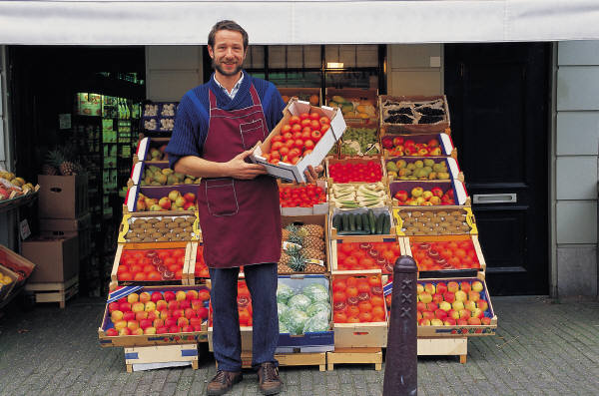
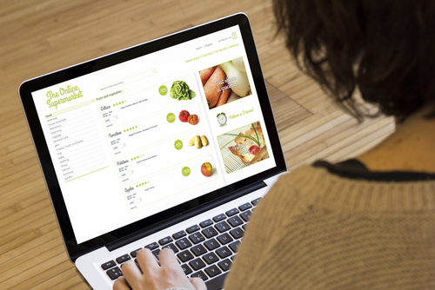
Where can we buy food?
There are many different types of places to buy food.
Name five different places.

Slide 3
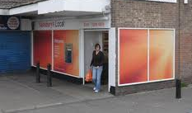
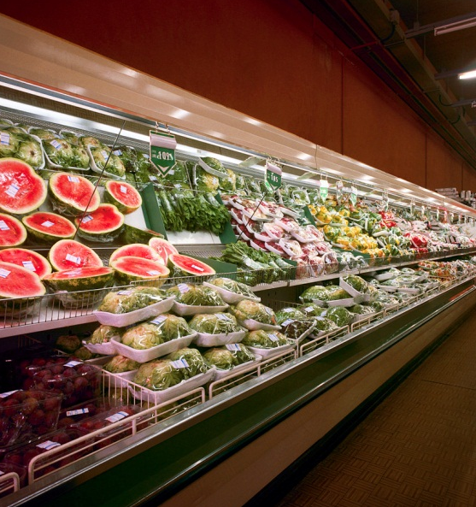
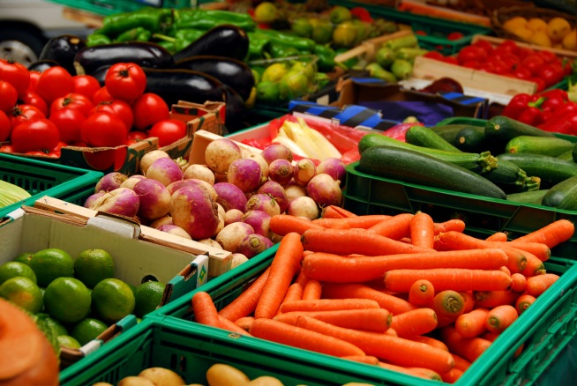
Places to buy food
Match the name with the shop.
Supermarket
Market
Local shop

Slide 4
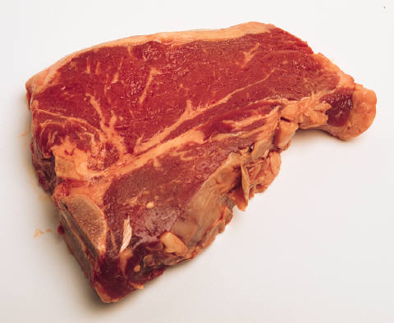
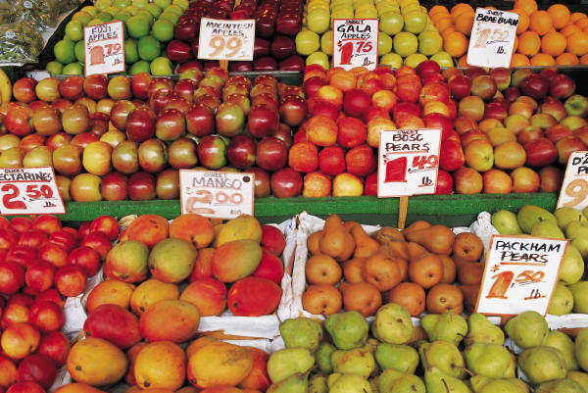
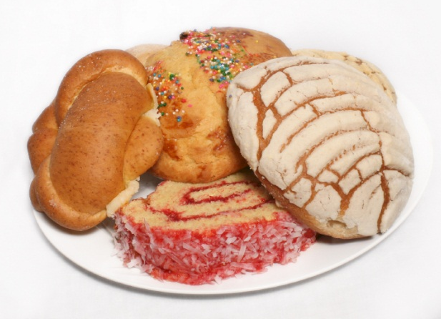
What can we buy in these shops?
Butcher
Greengrocer
Baker
Meat
Fruit Vegetables
Bread
Cakes

Slide 5
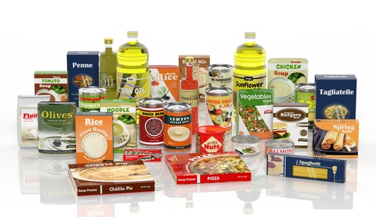
Information for shoppers
Information about food helps people choose what they want to buy.
Name
Date mark
Nutrition information
Weight
Origin (where it is from)
Storage
What else can you see?

Slide 6
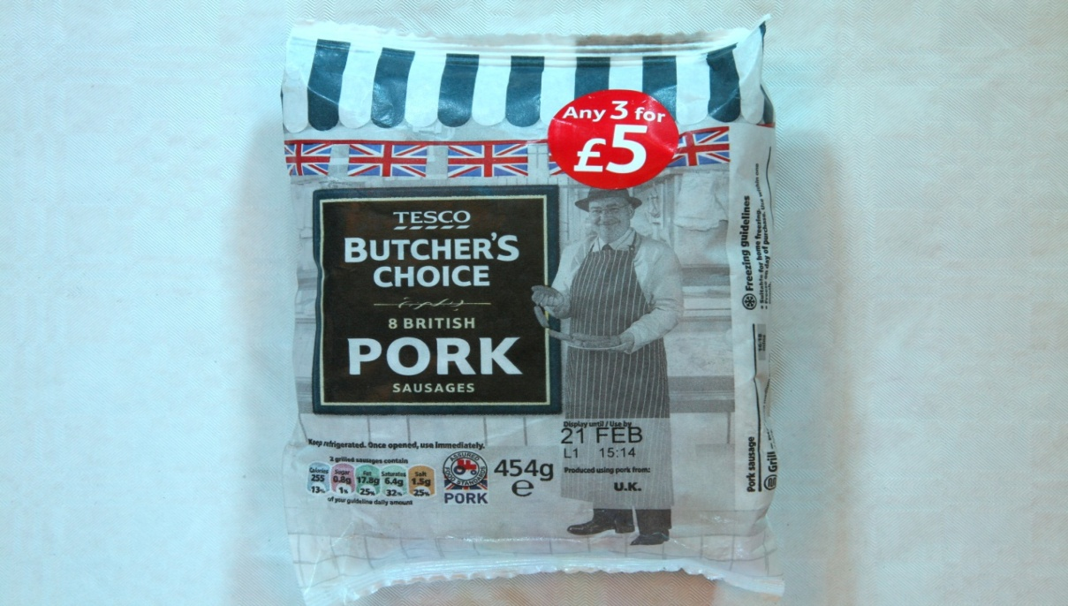

Other information
Some foods also feature a food standard or quality mark.
One example is the Red Tractor.

Slide 7
Red Tractor standards
Producers and farmers must show how they meet the standards.
These include:
how the animals are looked after;
how the farmer protects the countryside;
how they keep the food safe to eat;
keeping records of where the meat comes from.

Slide 8
Food shopping
For further information, go to:
www.foodafactoflife.org.uk
This resource meets the Guidelines for producers and users of school education resources about food.

