Slide 1
Food as fuel

Slide 2




Starter
Look at each of these people. Put them in order of who you think needs the most food and the least food.
Extension
Explain why you think this is the case.
65 year old woman
35 year old man
12 month old girl
9 year old boy

Slide 3
Energy needs are different
Different people need different amounts of energy. The amount of energy they need depends on their age, job, how active they are and their health.
12 month old girl
9 year old boy
65 year old woman
35 year old man
2,700 kJ/day
(646kcal/day)
7,700 kJ/day
(1840kcal/day)
8,000 kJ/day
(1912kcal/day)
11,000 kJ/day
(2629kcal/day)

Slide 4

Turn and talk
Do you think an athlete should eat the same amount of food as an office worker?
How do you think your activity levels affect the amount of energy you require?
Why is this the case?
Extension
What activities do you think would require the most energy?

Slide 5




Uses of energy
Different activities use different amounts of energy.
Which activity uses the most energy*?
Swimming
357kJ (84kcal)
Walking
114kJ (27kcal)
Football
196kJ (47kcal)
Cooking
85kJ (20kcal)
*kJ and kcal values for 15 minutes of each activity

Slide 6



Uses of energy
Different activities use different amounts of energy.
Which activity uses the least energy*?
Gymnastics
153kJ (35kcal)
Walking
114kJ (27kcal)
Standing
42kJ (10kcal)
Sleeping
35kJ (8kcal)
*kJ and kcal values for 15 minutes of each activity

Slide 7

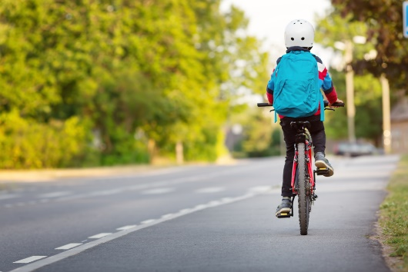

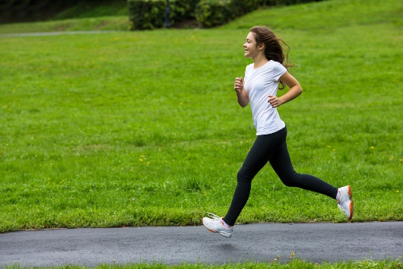


Uses of 400kJ (96kcal)
Swimming about 24 minutes
Cycling about 17 minutes
Sitting about 96 minutes
Running about 17 minutes
Sleeping about 116 minutes
Walking about 31 minutes

Slide 8

Nutritional requirements
People require a variety of nutrients to stay healthy and reduce the risk of diet-related diseases.
The amount of each nutrient needed is called the nutritional requirement.
These are different for each nutrient and also vary between individuals and life stages, e.g. women of childbearing age need more iron than men.

Slide 9

Why do you think nutritional requirements vary?
Think Pair Share
Individual requirements of each nutrient are related to:
age;
gender;
level of physical activity;
state of health.
Some people absorb or utilise nutrients less efficiently than others and so will have higher than average nutritional requirements.

Slide 10
Energy
Different foods are stores of different amounts of energy.
The energy store that is present in food is chemical energy.
Energy is measured in joules (J). A joule is a small amount of energy, so we often use kilojoules (kJ)
1kJ = 1000J

Slide 11
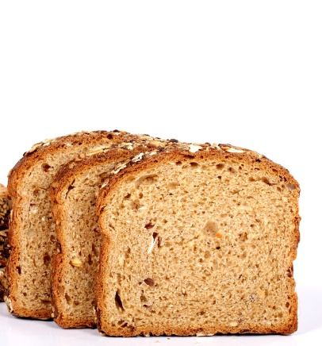
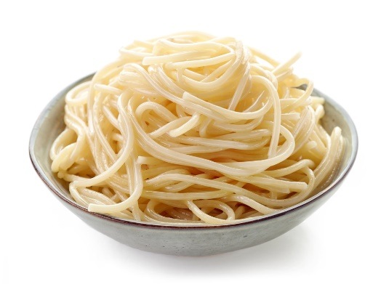
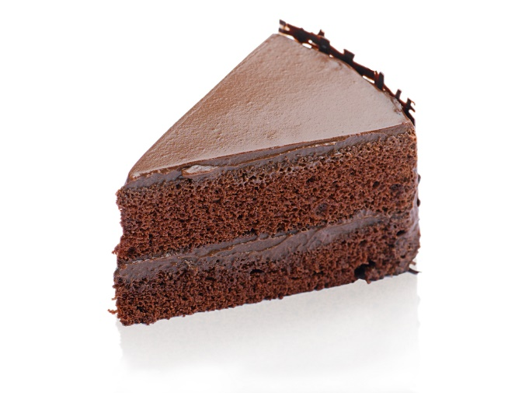
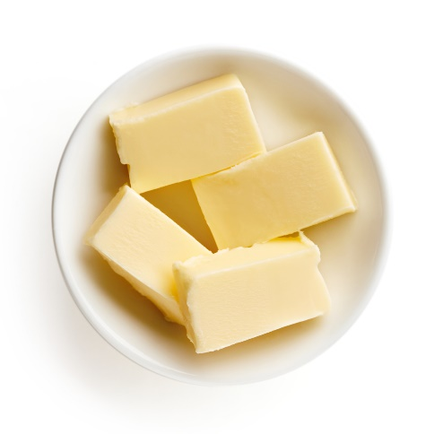

100g of these foods provide…
569kJ (134kcal)
922kJ (217kcal)
1509kJ (358kcal)
3059kJ (744kcal)
215kJ (51kcal)
Notes:
Pasta, wholewheat, spaghetti, dried, boiled in unsalted water
Butter, salted
Cake, chocolate fudge
Bread, wholemeal, average
Apples, eating, raw, flesh and skin

Slide 12
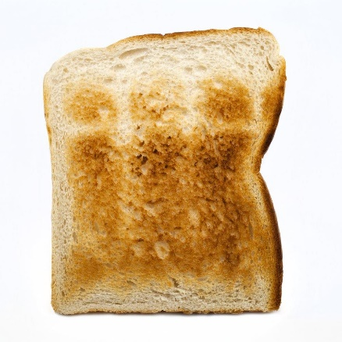
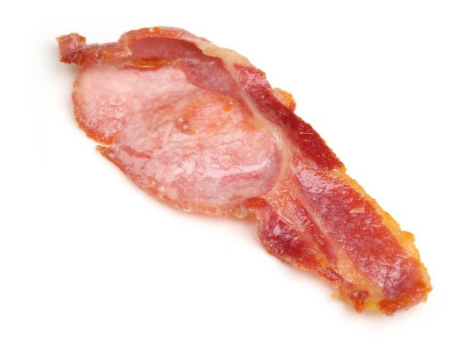
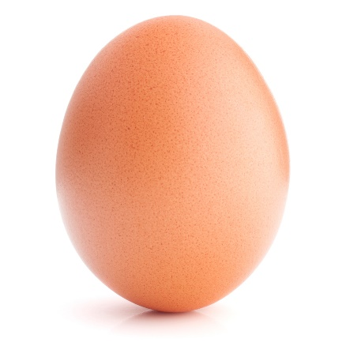
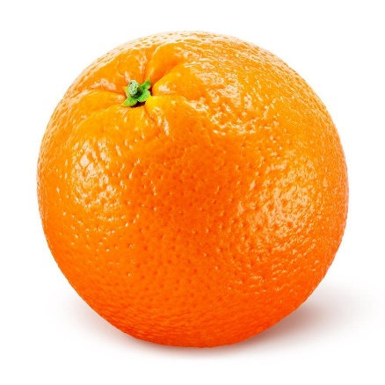
Which food provides the least energy?
1084 kJ (255kcal)
1308 kJ (313kcal)
595 kJ (143kcal)
152 kJ (36kcal)
All foods per 100g
Notes:
Bread, wholemeal, toasted
Bacon rashers, back, grilled crispy
Eggs, chicken, whole, boiled
Oranges, flesh only

Slide 13
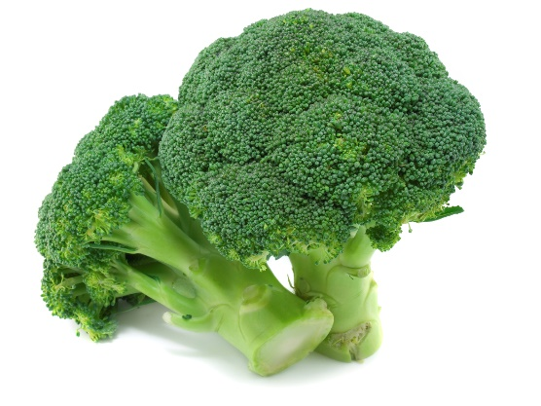
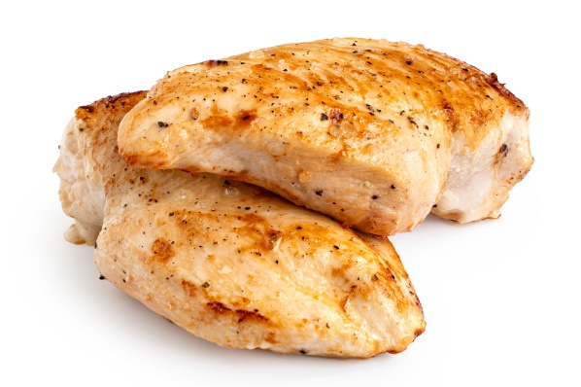
Which food provides the most energy?
215 kJ (51kcal)
3059 kJ (744kcal)
120 kJ (28kcal)
621 kJ (147kcal)
All foods per 100g
Notes:
Apples, eating, raw, flesh and skin
Butter, salted
Broccoli, green, boiled in unsalted water
Chicken, breast, grilled with skin, meat only

Slide 14
Serving size
Different amounts of food provide different amounts of energy. We eat different amounts of different types of food.
Butter
Orange
Per 100g = 3059kJ (744kcal)
On toast (5g) = 153kJ (37kcal)
Per 100g = 152kJ (36kcal)
Small (120g) = 182kJ (43kcal)

Slide 15

Foods providing 400kJ (96kcals) of energy
Wholemeal bread – 43g
Semi skimmed milk - 205ml
Tomatoes - 656g
Orange - 263g
Ham - 89g
Butter - 13g
Egg – 67g

Slide 16
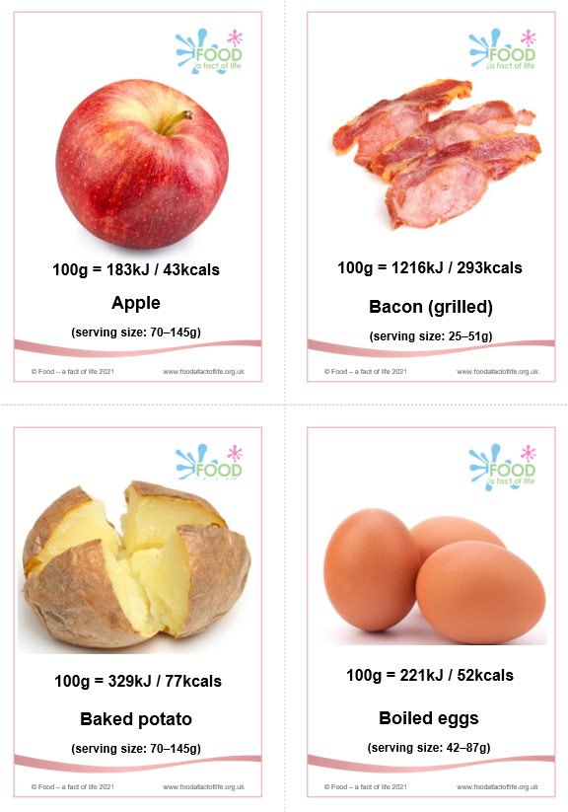
How much energy in foods?
Line up the energy cards from highest to lowest.
Calculate the energy per serving size (using the smaller serving size on the cards) and write these in your book.
Describe the difference between the order and explain what this tells us about serving sizes.
Extension
Use the energy spreadsheet to estimate how much energy you have had to eat today.
Energy cards
Energy spreadsheet

Slide 17

Turn and talk
We are in the shops and buying food for the day.
How can we determine how much energy is in our food?

Slide 18
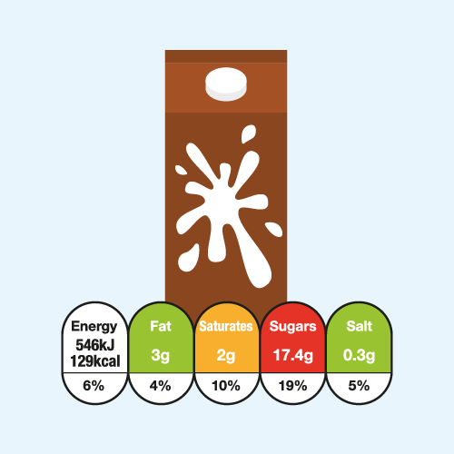
Front-of-pack nutrition labelling
In the UK, most of the major supermarkets and many food manufacturers voluntarily display nutritional information on the front of pre-packaged food and drinks.
The government’s recommended format is red, amber, green colour-coding and percentage Reference Intakes. This is often known as ‘traffic light labelling’.
Front-of-pack nutrition labelling or ‘traffic light’ labelling is voluntary in the UK and was introduced in 2013. In 2018, it was found on 2/3rds packaged food and drink products.
IGD - labelling messaging toolkit

Slide 19
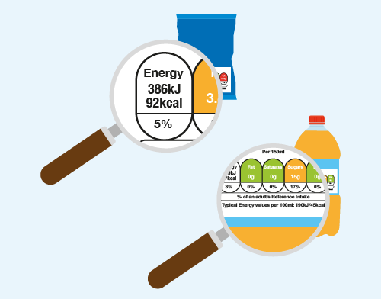
Reference Intakes
Reference Intakes are not targets for individuals to consume, but a guideline or benchmark to help people make dietary choices and balance their daily intake.
Usually, the values for adult women are used for food labels. This is because Reference Intakes have been developed for the nutrients often consumed in excess, they represent levels that should not be exceeded on a regular basis.
To discourage excess consumption, the values for women are typically used as these are slightly lower than those for men.
IGD - labelling messaging toolkit

Slide 20
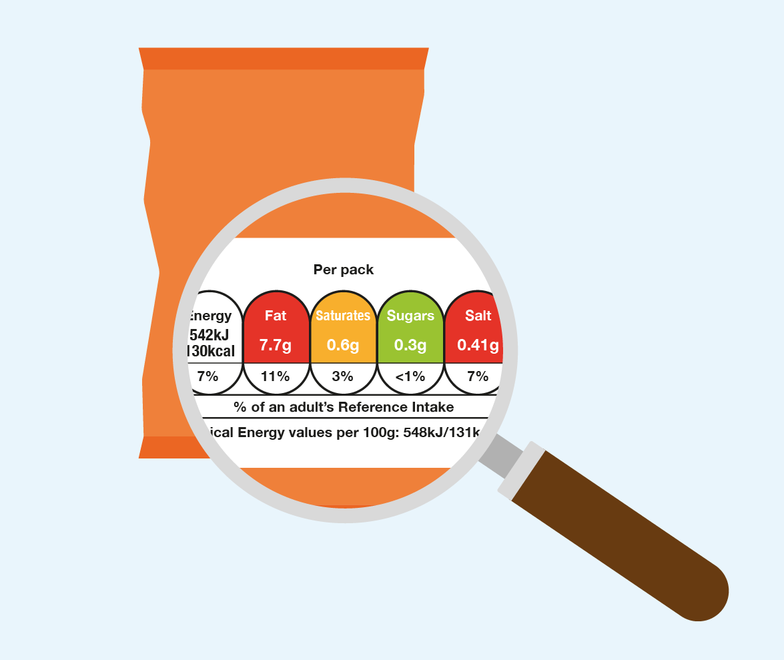
Front of pack labelling – UK
The key principles of front of pack labelling are:
Provision of energy in kJ and kcal per 100g/ml and per specified portion;
Provision of the amount (g) of fat, saturated fat, total sugars and salt per specified portion;
Provision of meaningful, recognisable portion information;
% RI based on the amount of each nutrient and energy value in a portion of the food;
Colour coding of the nutrient content (may also use the descriptors “high”, “medium” or “low”).
IGD - labelling messaging toolkit

Slide 21
How much energy have you used?
Use the values in the table to calculate how much energy you have used today.
Activity | Energy (kJ) for each hour of activity*
Sitting | 250
Working | 400
Playing | 1700
Relaxing | 300
*For a breakdown of different activities, see the factsheet here.

Slide 22
Kahoot Quiz
Open the link below on the main screen and get students to log onto kahoot.it on their tablets or smartphones.
They can then enter the code (that will come up on the main screen when you start the game) and their own nickname.
They can then play along with the quiz choosing the multiple choice answers that correspond with the questions on the main screen. There will then be a leader board of the scores after each question and at the end.
https://play.kahoot.it/#/?quizId=cbee242c-a83c-40d0-9320-a6929747184f

Slide 23
Homework
Using food labels around your home, calculate how much energy you consume in one evening.
Describe how you might be able to balance the amount of energy you have taken in with the amount of energy that you are expending. (6 marks)

Slide 24
Key words
Key word​ | Meaning​
Calories | A unit of energy in food. Can be measured in kilocalories (kcal) or kilojoules (kJ).
Energy | A quantity that is conserved - it cannot be created or destroyed. It can be stored and transferred.
Energy stores | Energy can be described as being in different ‘stores’ and transferred between these stores.
Food label | A label on food that shows details about the product, such as a description, nutritional value, allergen information etc.
Kilocalories (kcal) | A measurement of energy in food (commonly referred to as simply ‘calories’).
Kilojoules (kJ) | A metric measurement used for energy on food labels. Whilst it can be found on food labels, most people usually use calories (kcal).

Slide 25
Teachers’ guide

Slide 26
Teaching about food as fuel
Compare the energy values of food and fuels
Compare the energy in foods and fuels with the energy needed for different activities.
Explain how our food intake should match our activity levels.

Slide 27
Teaching about food as fuel
Common misconceptions:
Energy intake by age – there is a misconception that as you get older, your energy requirements continue to increase (ensure that it is clear that older adults’ energy requirements are lower).
Energy balance - energy is balanced when it is the same between exercise and food intake (ignoring Basal Metabolic Rate (BMR)). Ensure that it is clear the amount of energy expended does not need to equal the amount that is taken in through food intake.
There are ‘bad’ foods – we should be teaching about unhealthy dietary patterns rather than ‘unhealthy’ or ‘bad’ foods or nutrients. Talking about undernutrition as well as overnutrition should support this (you can have too much or too little of a nutrient).

Slide 28
Progressing the learning
The topic of energy from food is also covered at GCSE (14-16 years).
The healthy diet is also covered when looking at topics such as heart disease and type 2 diabetes at GCSE.

Slide 29
Extra information for teachers
The following slides contain extra information for teachers to support the teaching and learning around this topic area.
This may be useful as background reading, or you may wish to extend the learning for students by using this information in the lesson.

Slide 30
Key stages in life
The key stages in life include:
pregnancy;
toddlers;
childhood;
adolescence;
adulthood;
older adulthood.
Energy and nutrient requirements change through life and depend on many factors, such as:
age;
sex;
body size;
level of activity;
genes.

Slide 31

Pregnancy
A varied diet, providing adequate amounts of energy and nutrients, is essential before and during pregnancy. The mother’s diet can influence the health of the baby. Having a healthy body weight is important.
Being underweight can make it more difficult to become pregnant and make it more likely for the baby to have a low birth weight, leading to a greater risk of ill health. Being overweight increases the risk of complications, such as high blood pressure and diabetes during pregnancy.

Slide 32

During pregnancy
During pregnancy, some extra nutrients are needed (mainly in the last three months) to:
help the development of the uterus, placenta and other tissues;
meet the needs of the growing foetus;
lay down stores of nutrients and energy (as fat) for the growth of the foetus and in the mother for lactation.

Slide 33
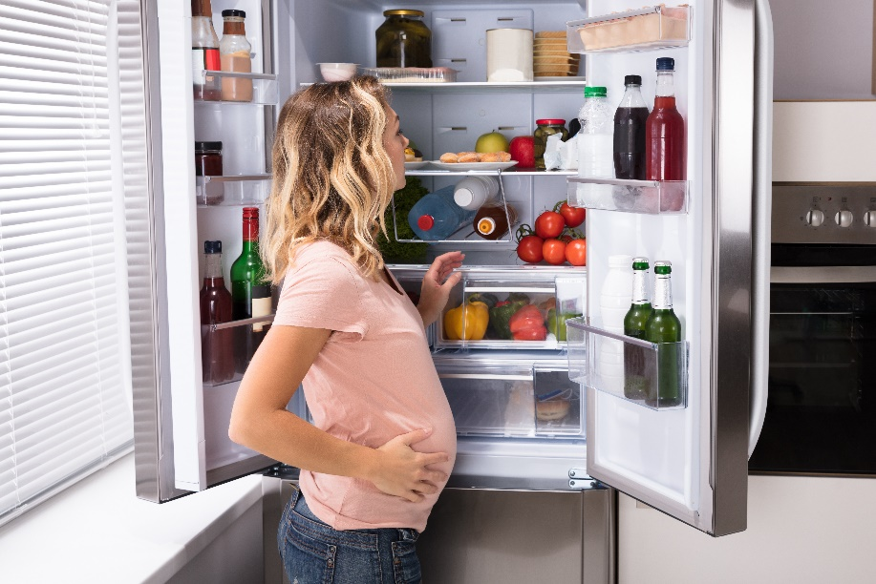
During pregnancy
During the first 6 months of pregnancy, most women do not need to eat more than normal.
The body becomes more efficient at absorbing and using nutrients from food.
The dietary reference value for energy intake during pregnancy in the UK is an extra 200 kcal/day during the third trimester only.

Slide 34
Breastfeeding / lactation
The process of producing breast milk and delivering it to the baby is called lactation.
A healthy diet for breastfeeding mothers should include:
plenty of fruit and vegetables;
wholegrains (e.g. wholegrain breakfast cereals, wholewheat pasta, wholemeal bread);
good quality protein (e.g. pulses, lean meat, oily fish, eggs, nuts and seeds);
some dairy or calcium-fortified dairy alternatives (choosing lower fat and sugar varieties) and;
small amounts of unsaturated oils, such as rapeseed or olive oil, and spreads made from these.

Slide 35

Breast milk
Breast milk provides all the energy and nutrients a baby needs for growth and maintenance during the first 6 months of life. Breast milk also provides special proteins, antibodies and white blood cells which help to protect the baby against infection.
In the first three days after birth, the mother produces a special form of breast milk called colostrum.
It contains less fat, more protein and is rich in antibodies, proteins that play a key role in the baby’s immune system.

Slide 36

Breast milk
Two to three days after birth, colostrum changes to a milk that may look thin compared with colostrum and babies will then begin to take larger volumes of milk.
As well as changing over time from colostrum to a thinner milk, breast milk also changes during a feed – the milk available at the start of a feed is more dilute, providing the baby with extra fluids, whereas that at the end of a feed is more energy-dense.

Slide 37

Bottle feeding
Some women are unable to or choose not to breastfeed their baby. Their midwife or health visitor will be able to give information on preparing and feeding the baby with infant formula.
Infant formula (also known as ‘baby milk’) does not provide any of the factors that help prevent infections.
It is important to note that once a mother has started to bottle feed her baby, it is difficult to change to breast feeding.

Slide 38
Complementary feeding
After 6 months of age, milk no longer fulfils all the baby’s needs for energy and nutrients. The baby must be given other foods in addition to breast milk or infant formula. This process is called complementary feeding.
Complementary feeding too soon (before 4 months) can increase the risk of infections and allergies, as your baby's digestive system and kidneys are still developing.
Leaving complementary feeding too late (longer than 6 months) may mean your baby doesn’t get enough of all the nutrients they need. This is because stores of essential nutrients, such as iron, decline from birth and by 6 months need to be replenished with food.
Solids must be semi-fluid and soft, since the baby has no teeth and cannot chew.

Slide 39
Complementary feeding – key points
Exclusive breastfeeding is recommended for around the first 6 months;
Introduce solid foods at around 6 months, ideally alongside continued breastfeeding for at least the first year;
Start by offering small amounts of food and gradually increase the amount, so by 9-12 months your baby is eating 3 healthy meals a day plus some healthy snacks;
Smooth purees and mashed foods are a good start but move to lumpier foods soon as your baby is ready. Soft finger foods can be given from the start of complementary feeding;
Appropriate complementary foods to offer from 6 months include vegetables and fruit, starchy foods, protein foods and dairy products;

Slide 40
Complementary feeding – key points
Sugar and salt should not be added to complementary foods, and foods with added salt and sugar should be avoided;
Breastmilk (or formula) should be your baby’s main drink until 12 months of age;
Babies consuming less than 500 ml/day of infant formula should be given a daily supplement containing vitamins A, C and D;
Repeatedly offering your baby a wide variety of foods that are part of a healthy, balanced diet, will help them accept and gradually learn to like these foods;
To reduce the risk of choking, always stay with your baby while they are eating and never offer small round foods.

Slide 41
Toddlers (up to 5 years)
Supplements of vitamins A, C and D in the form of drops are recommended for children aged from 6 months to 5 years. This is particularly important if they do not eat a varied diet. For some, these are available free via the Healthy Start scheme.
Semi-skimmed milk (as a main drink) can be gradually introduced when the child reaches 2 years if they are having a healthy, varied diet; but 1% or skimmed milk should not be given as a main drink until the child reaches 5 years.
Young children should not be given whole nuts (risk of choking) and deep sea fish such as shark, marlin and swordfish (potential for high mercury levels).
For more information on nutrition in toddlers, click here.

Slide 42
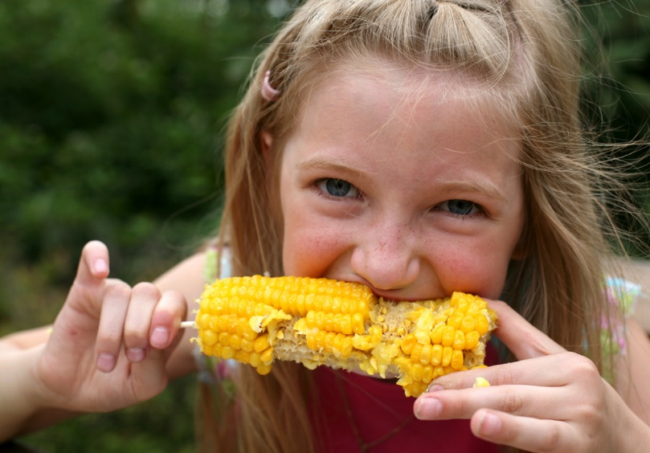
Childhood
Children have a higher energy requirement for their body size compared to adults because they are growing rapidly and are often very active.
A nutrient-dense diet providing adequate energy and nutrients, which includes healthy snacks, is essential for growth and development. It is also important for children to have sufficient to drink.
Young children also have small stomachs so they need to eat small and frequent meals.

Slide 43

Childhood
Children’s diets from the age of 5 should be based on the principles of the Eatwell Guide and include plenty of starchy carbohydrates, fruit and vegetables, and some protein and dairy foods.
Children should be encouraged to remain a healthy weight with respect to their height.
A healthy family lifestyle can help to maintain a healthy weight, such as being active together or sharing meals.

Slide 44
Adolescence
Adolescence is a period of rapid growth and development and is when puberty occurs.
The demand for energy and most nutrients are relatively high.
Boys need more protein and energy than girls for growth.
Girls need more iron than boys to replace menstrual losses.
It is important to encourage an active lifestyle with a healthy, balanced diet during this time. This is because good habits practised now are likely to benefit their health for the rest of their lives.

Slide 45
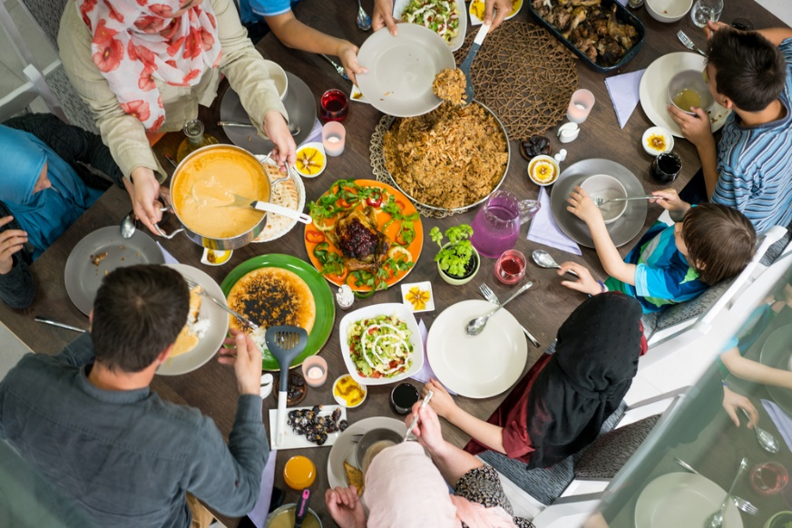
Adulthood
Nutritional requirements do not change much between the ages of 19 to 50, except during pregnancy and lactation.
On average, UK adults are eating too much saturated fat, sugar and salt from food, and not enough fruit and vegetables.
A poor diet can lead to diseases such as obesity, cardiovascular diseases, cancer and diabetes.

Slide 46

Older adults
Older adults is the term usually referring to people over the age of 65.
Requirements for energy gradually decrease after the age of 65 as activity level falls.
Older adults should adopt a healthy, balanced diet to maintain health. It is also important they keep hydrated by drinking plenty of fluid. Even minor dehydration may lead to health problems.

Slide 47

Older adults
Older people may eat less for different reasons, for example:
difficulty in chewing and swallowing;
dental problems;
changes in sense of smell and taste;
difficulty in shopping, preparing and cooking food;
living alone;
financial problems;
illness.

Slide 48
Older adults
After menopause (when menstruation stops), women lose bone strength at an increased rate.
Having a great peak bone mass (PBM) in early adulthood helps adults to start from a higher point from which bones will be lost during the ageing process.
Older adults should have plenty of calcium intake from the diet, but also remain active and have adequate vitamin D from foods, or through the action of sunlight on the skin.
Adults over 65 years who are housebound should take a daily supplement of vitamin D as skin synthesis of this vitamin requires sunshine.

Slide 49
Food as fuel
For further information, go to:
www.foodafactoflife.org.uk
This science pack is one of a series of resources produced for the pHood Futures project, supported by the Royal Society of Chemistry.
This resource meets the Guidelines for producers and users of school education resources about food.

