Slide 1
Eating social story

Slide 2
What does this social story cover?
Following healthy routines
Who is eating?
Do you need to set the table?
What will you need?
Serving food and drink
How much food and drink?
Eat and enjoy!
Tidying up afterwards
Storing leftovers safely
Eating out of home

Slide 3
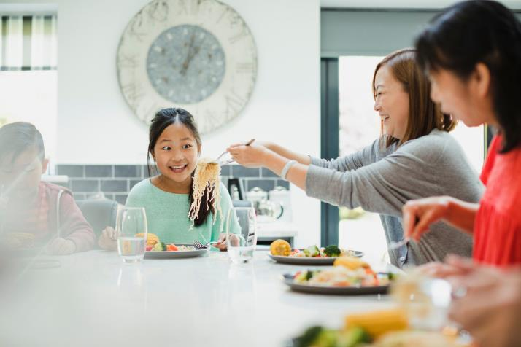
Time to eat!

Slide 4
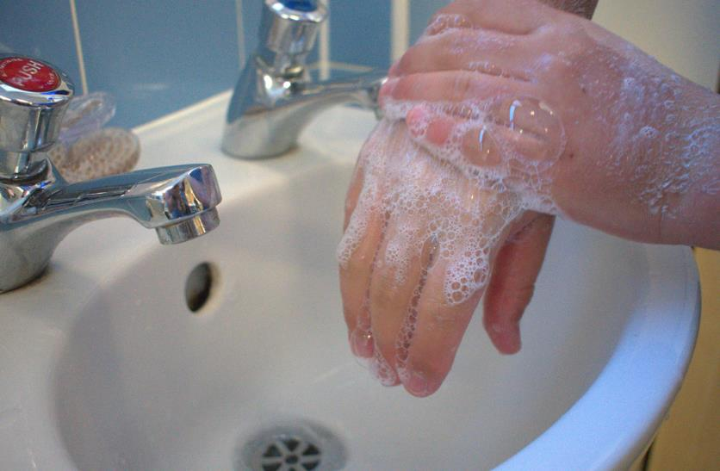
1. Following healthy routines
Wash and dry your hands before eating

Slide 5
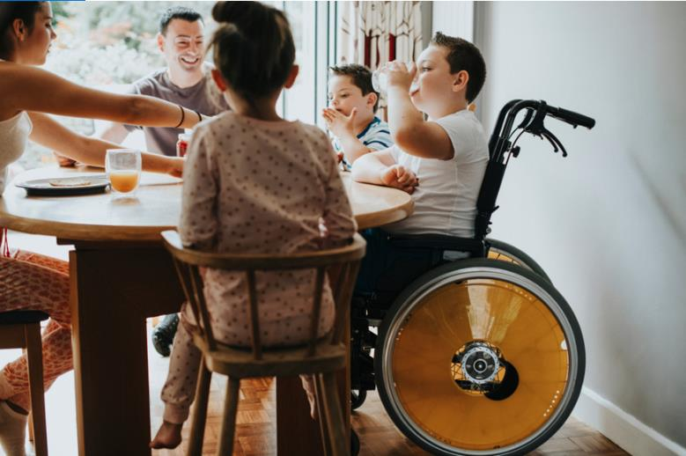
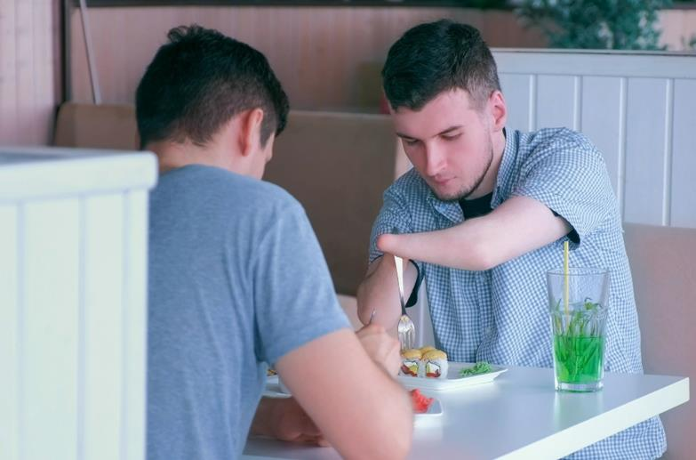
2. Who is eating?
Family
Friends

Slide 6
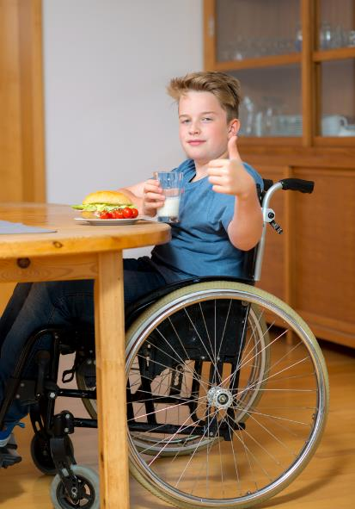
2. Who is eating?
Just you

Slide 7


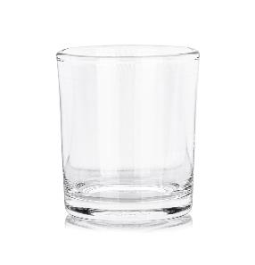

3. What will you need?
Cups and glasses

Slide 8

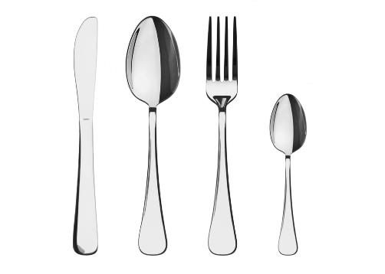
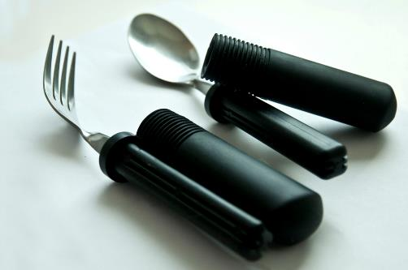
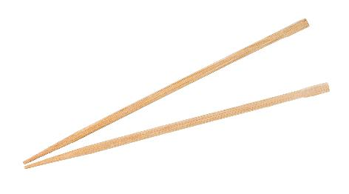
3. What will you need?
Cutlery

Slide 9

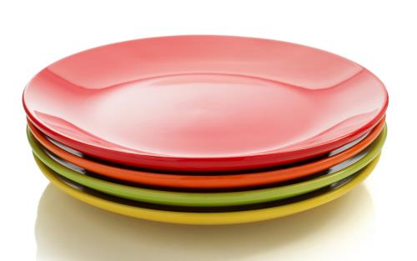
4. What will you need?
Plates and bowls

Slide 10
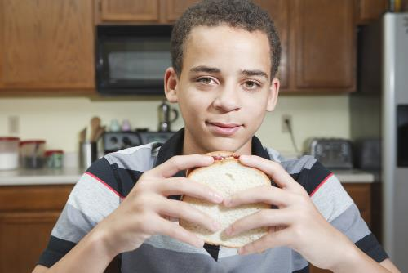
5. What will you need?
Your hands!

Slide 11
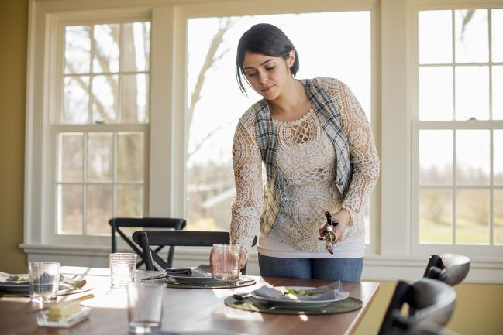
6. Do you need to set the table?

Slide 12
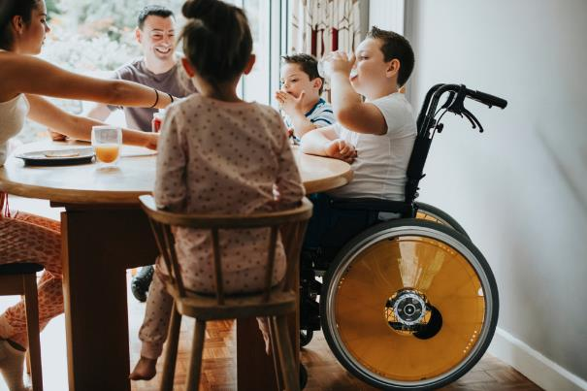
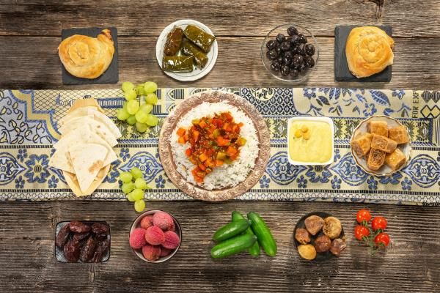
6. Do you need to set the table?
How many people?
What food is being eaten?

Slide 13
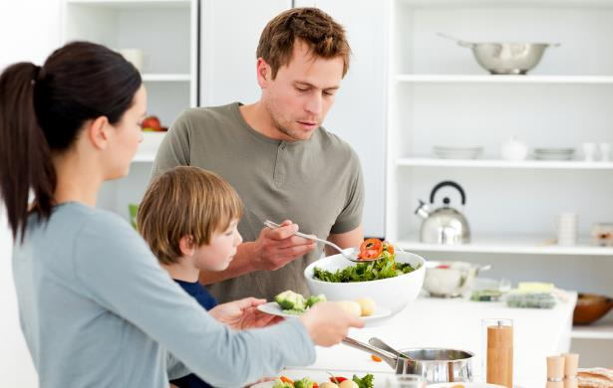
7. Serving food and drink

Slide 14
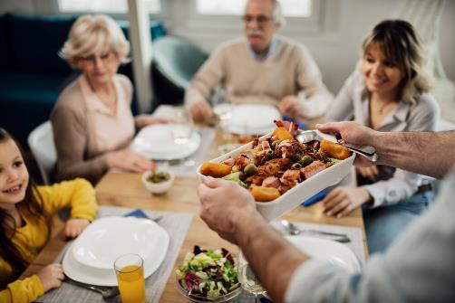
7. Serving food and drink

Slide 15
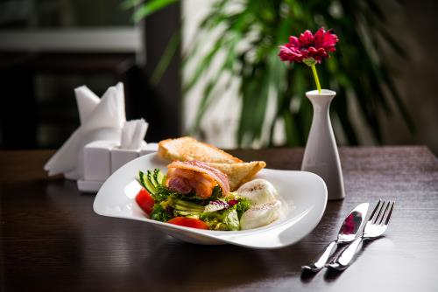
7. Serving food and drink

Slide 16
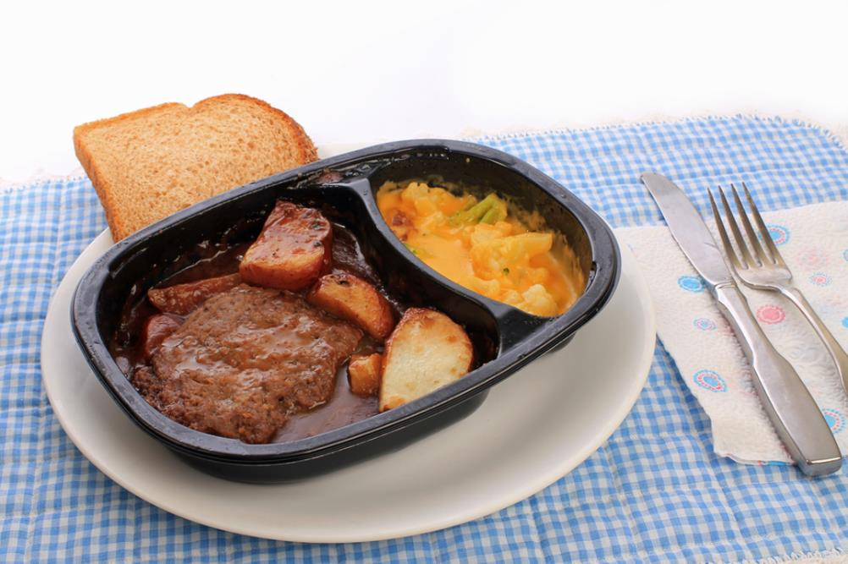
7. Serving food and drink

Slide 17
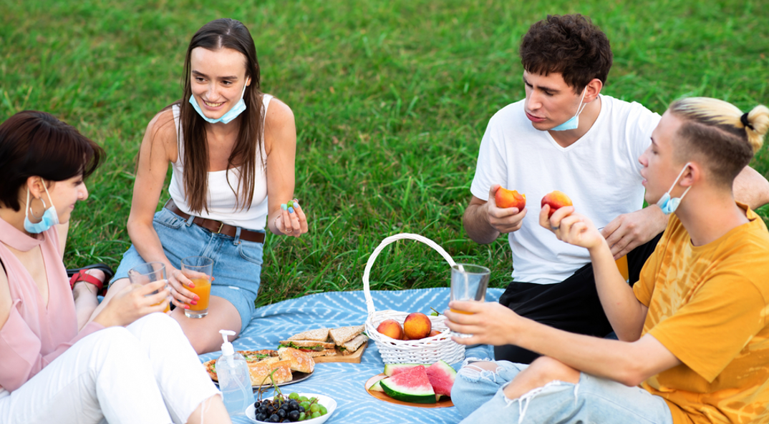
7. Serving food and drink

Slide 18
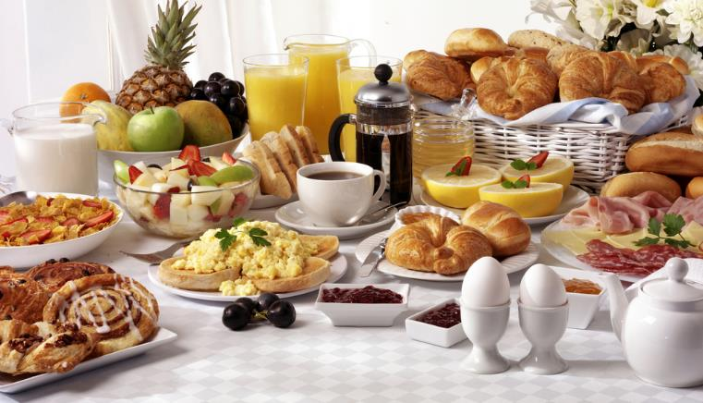
7. Serving food and drink

Slide 19
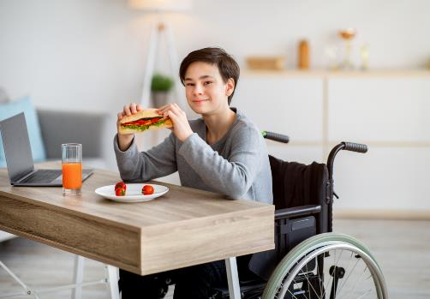
7. Serving food and drink

Slide 20

7. Serving food and drink

Slide 21

7. Serving food and drink

Slide 22
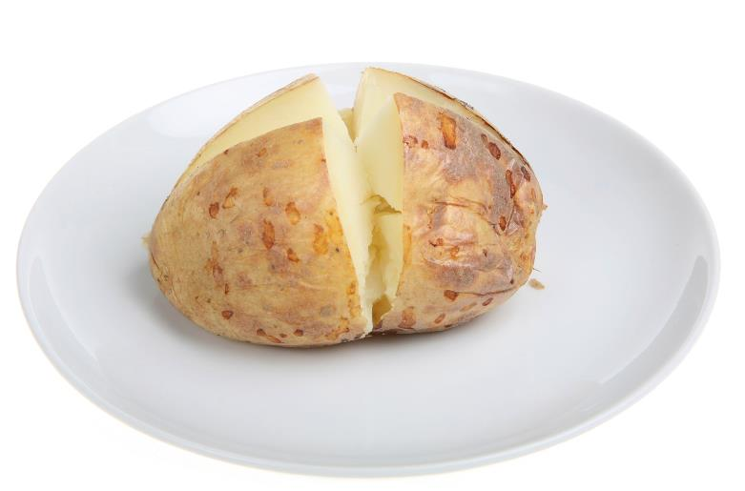
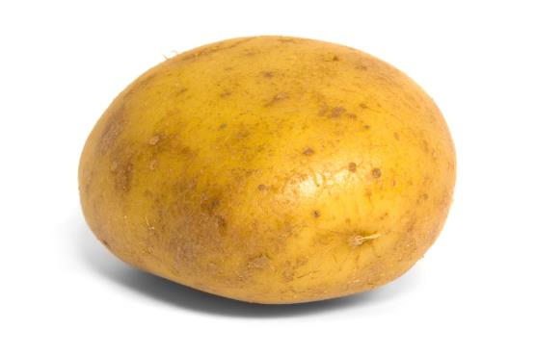

8. How much?
A potato
The size of a fist

Slide 23
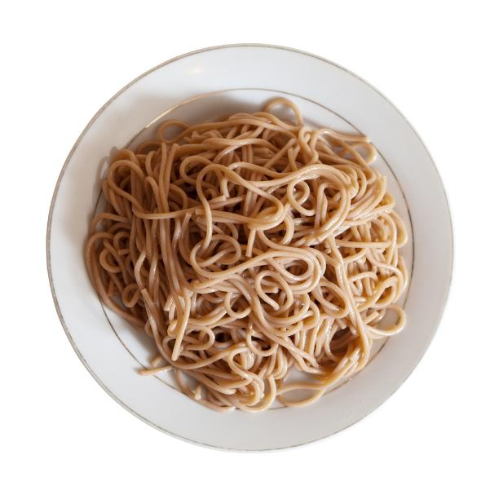

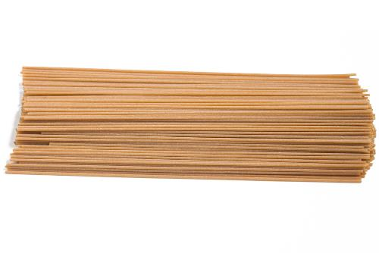
8. How much?
Spaghetti
Finger and thumb

Slide 24
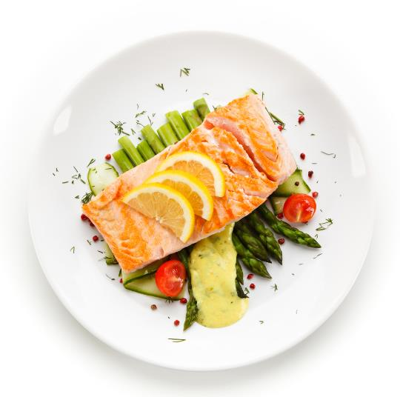
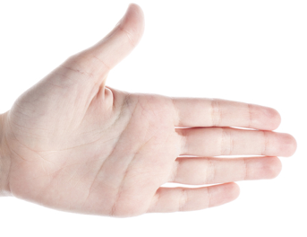
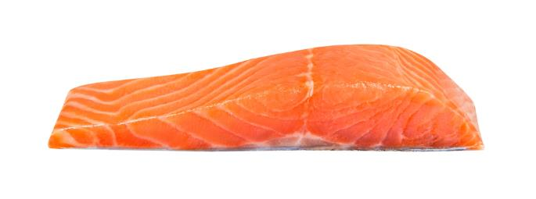
8. How much?
Salmon fillet
The size of half a hand

Slide 25

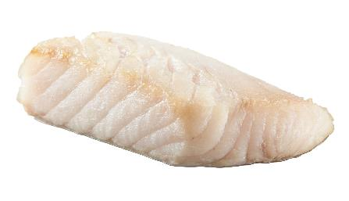
8. How much?
Fish fillet
the size of a hand

Slide 26
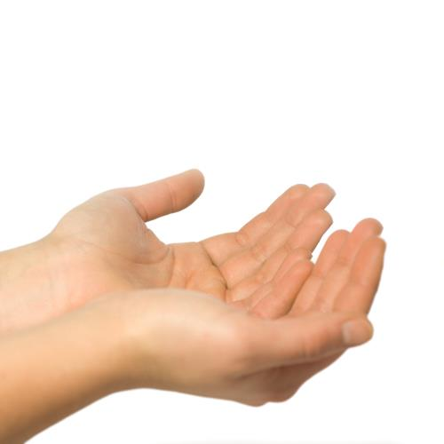
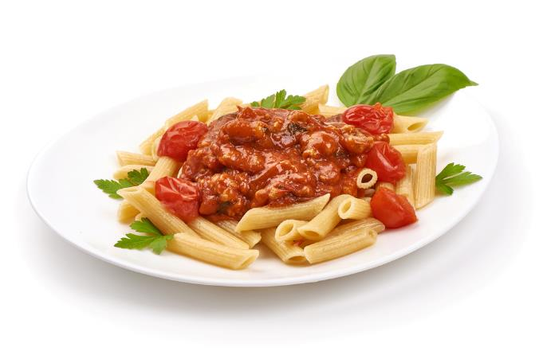
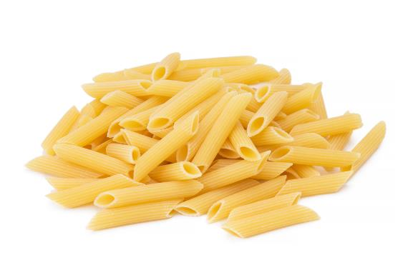
8. How much?
Dried pasta
Cupped hands

Slide 27

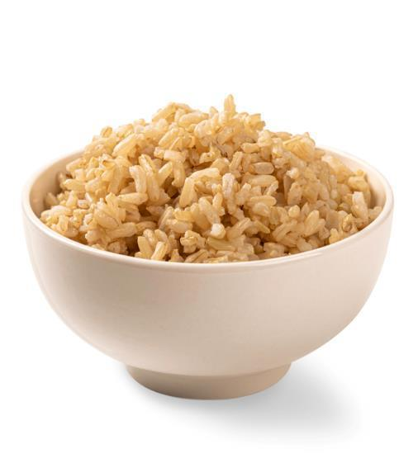
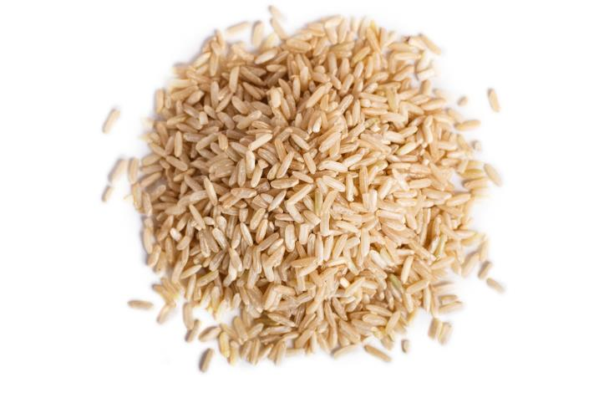
8. How much?
Dried rice
Cupped hands

Slide 28
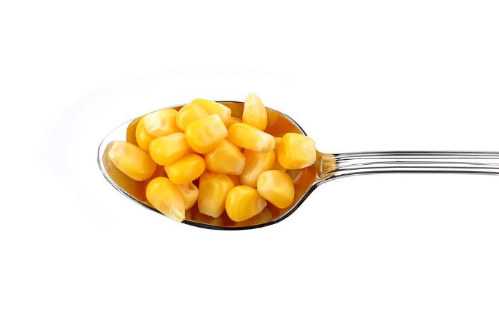
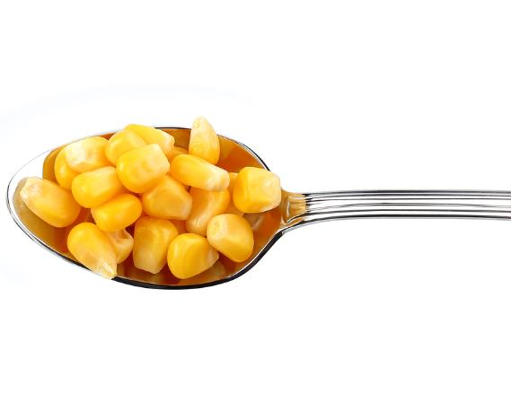
8. How much?
Three spoons of vegetables

Slide 29

8. How much?
Three spoons of beans

Slide 30
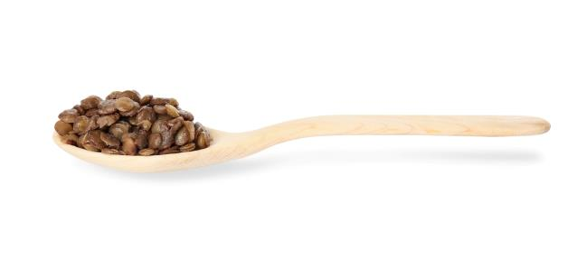

8. How much?
Three spoons of pulses

Slide 31

8. How much?
A small glass

Slide 32
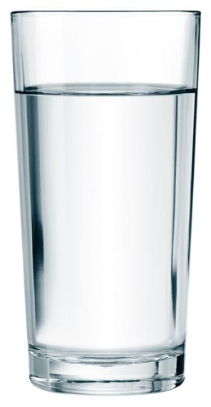
8. How much?
As many as you like!

Slide 33
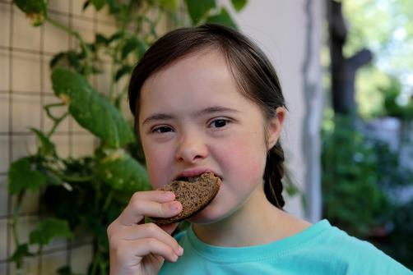
7. Eat and enjoy!

Slide 34
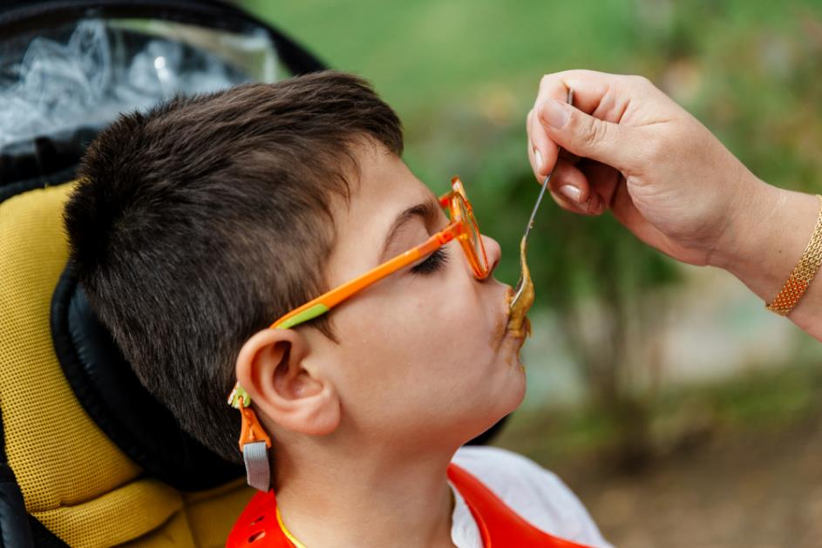
7. Eat and enjoy!

Slide 35
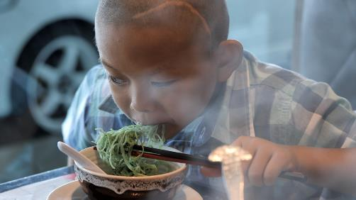
7. Eat and enjoy!

Slide 36
7. Eat and enjoy!

Slide 37
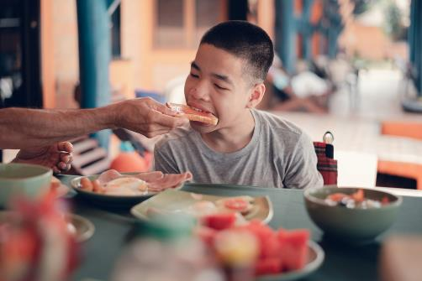
7. Eat and enjoy!

Slide 38
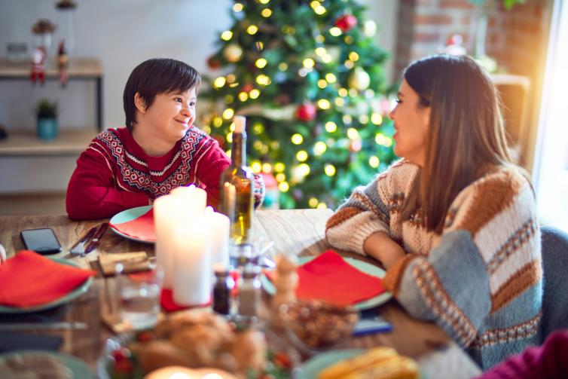
7. Eat and enjoy!

Slide 39
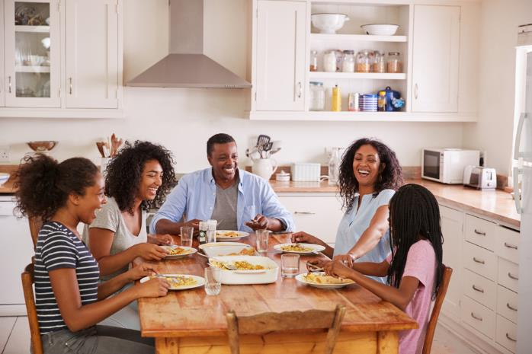
7. Eat and enjoy!

Slide 40
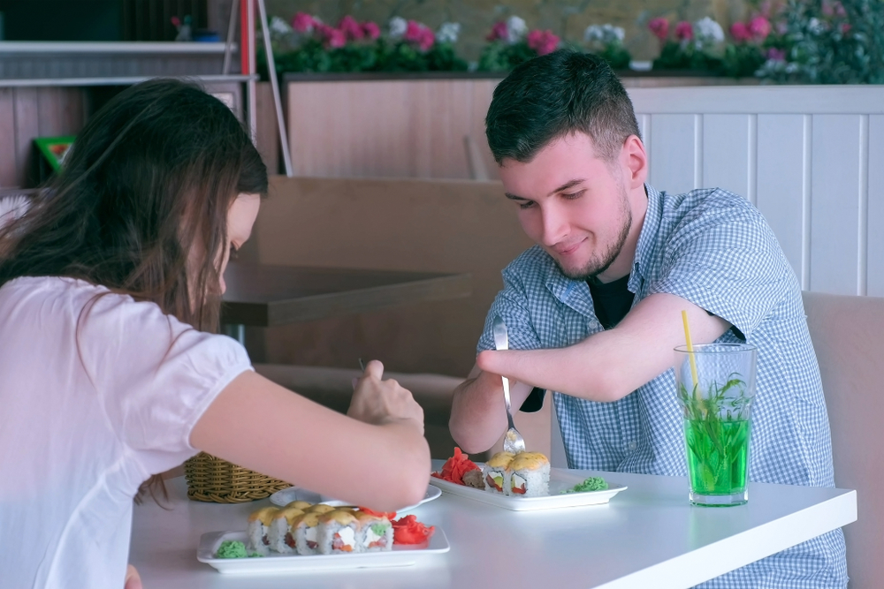
7. Eat and enjoy!

Slide 41
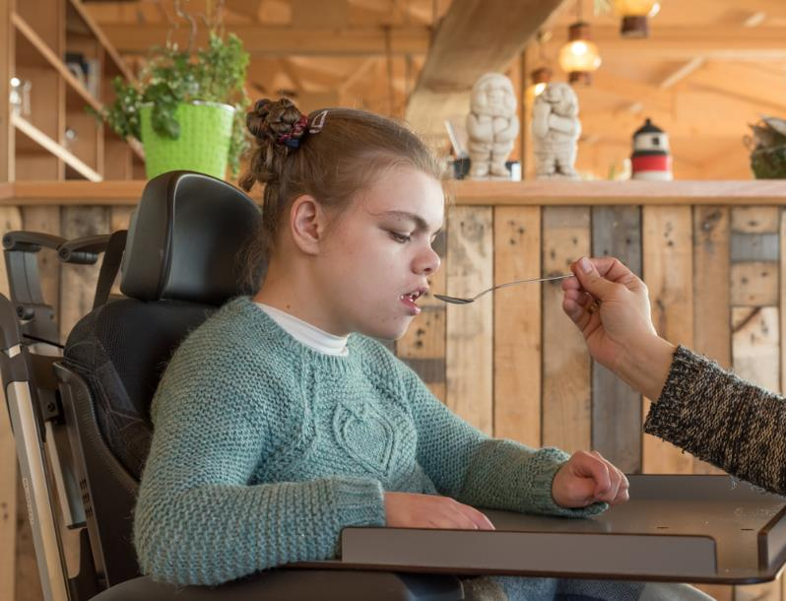
7. Eat and enjoy!

Slide 42

7. Eat and enjoy!

Slide 43
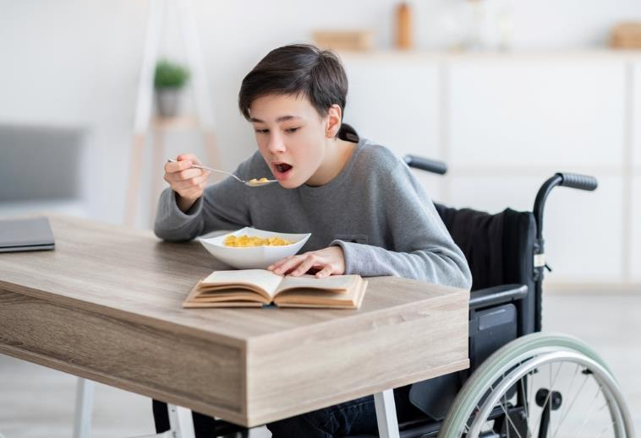
7. Eat and enjoy!

Slide 44
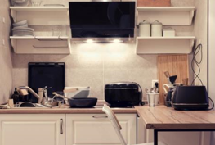
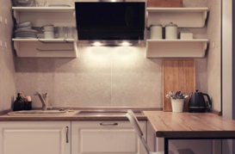
8. Tidying up after eating
From this
To this

Slide 45
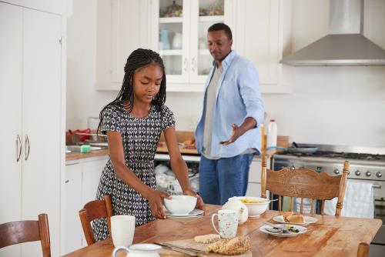
8. Tidying up after eating
Clearing the table

Slide 46

8. Tidying up after eating
Wiping the table

Slide 47

8. Tidying up after eating
Washing up

Slide 48

8. Tidying up after eating
Drying up

Slide 49

8. Tidying up after eating
Putting away

Slide 50


9. Storing leftovers safely

Slide 51

10. Eating out of home
Café

Slide 52

10. Eating out of home
Restaurant

Slide 53

10. Eating out of home
Coffee shop

Slide 54

10. Eating out of home
School canteen

Slide 55

10. Eating out of home
Quick-service restaurant

Slide 56

10. Eating out of home
Quick-service restaurant

Slide 57

10. Eating out of home
Food van

Slide 58

10. Eating out of home
On the go

Slide 59

10. Eating out of home
At school

Slide 60

Enjoy your food and drink!

Slide 61
What did this social story cover?
Following healthy routines
Who is eating?
Do you need to set the table?
What will you need?
Serving food and drink
How much food and drink?
Eat and enjoy!
Tidying up afterwards
Storing leftovers safely
Eating out of home

Slide 62
Eating social story
For further information, go to:
www.foodafactoflife.org.uk
This resource meets the Guidelines for producers and users of school education resources about food.

