Slide 1
Inflammatory bowel disease

Slide 2

Introduction
Inflammatory bowel disease (IBD) is mainly used to describe Ulcerative Colitis and Crohn's disease, two conditions which involve inflammation of the gut.
These two conditions affect more than 300,000 people in the UK.
Crohn’s and Colitis UK

Slide 3
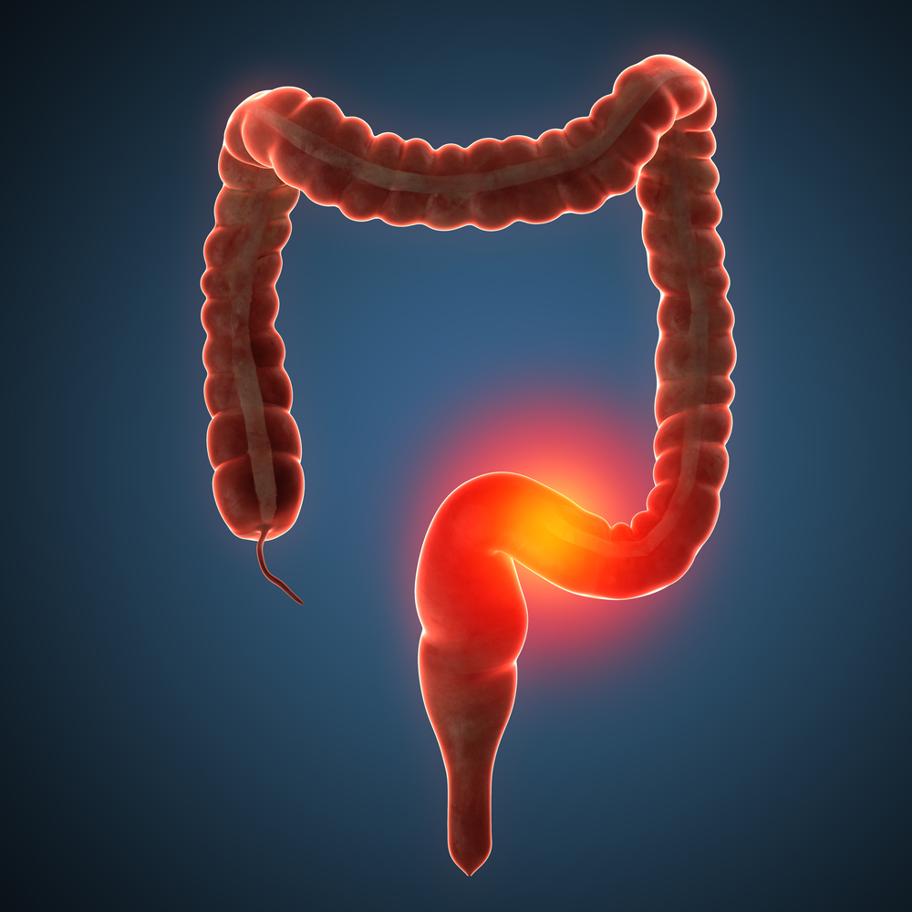
Inflammatory bowel disease
Each condition affects a different part of the gut. Ulcerative Colitis only affects the colon (large intestine) whereas Crohn's disease can affect any part of the digestive system.
NHS

Slide 4

Ulcerative Colitis
Ulcerative Colitis causes inflammation and ulceration of the inner lining of the colon and rectum (the large bowel).
When the colon is inflamed, it is less able to absorb fluid and cannot hold as much waste. This means people with Ulcerative Colitis have a larger volume of watery stools and very frequent bowel movements.
Ulcerative Colitis is a chronic condition, meaning it affects people throughout their lives. There is currently no cure for Ulcerative Colitis, however drugs are used to treat and manage the symptoms.
Crohn’s and Colitis UK

Slide 5
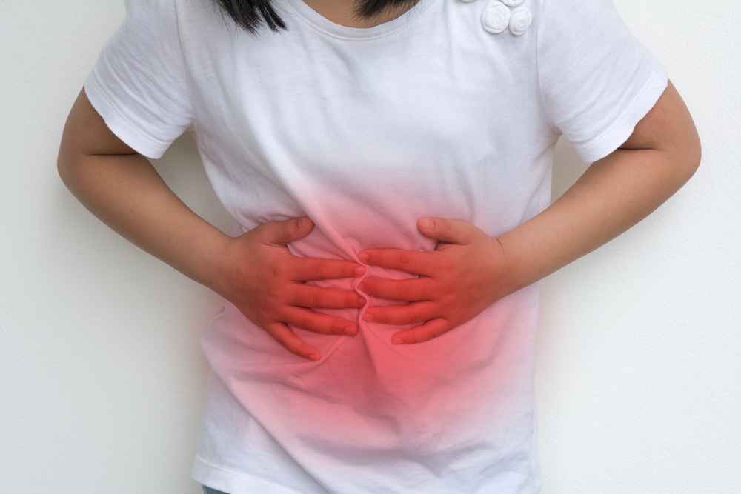
Crohn’s Disease
Crohn’s Disease is a condition that causes inflammation of the digestive system.
This inflammation alters the body’s ability to digest food, absorb nutrients and eliminate waste.
Like Ulcerative Colitis, Crohn’s Disease is a chronic condition, meaning it affects people throughout their lives. Again, there is currently no cure for Crohn’s Disease, however drugs are used to treat and manage the symptoms.
Crohn’s and Colitis UK

Slide 6

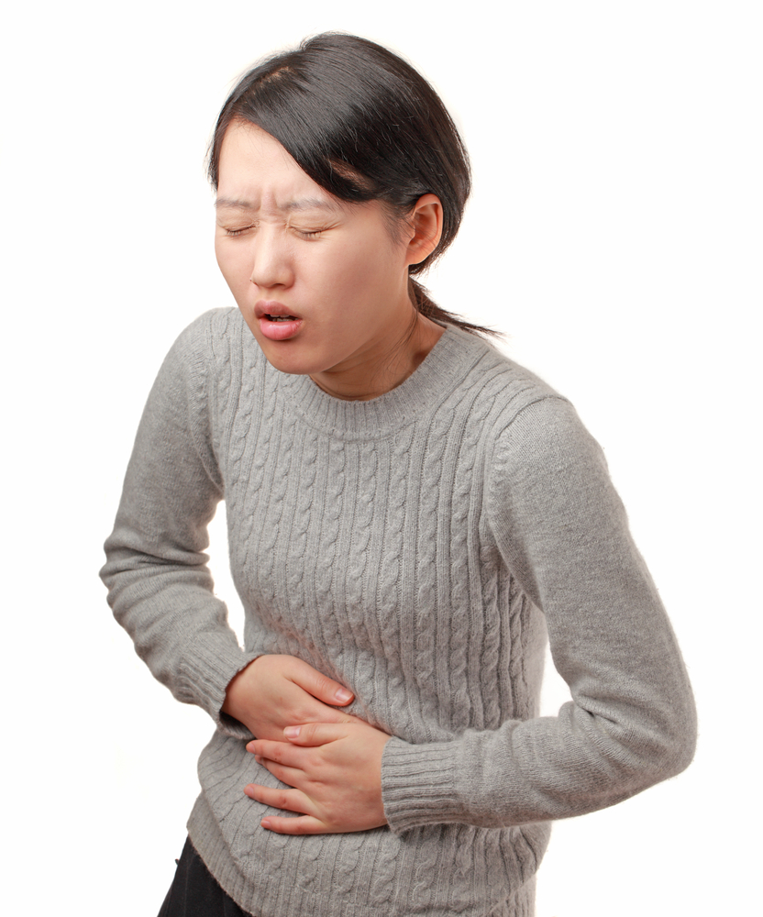
Symptoms
Symptoms of IBD include:
pain, cramps or swelling in the tummy;
recurring or bloody diarrhoea;
weight loss;
extreme tiredness.
These symptoms will not occur in all sufferers, and, in some, there may be additional symptoms, including fever, vomiting and anaemia.
The symptoms of IBD can vary in severity however drugs, specific diets, lifestyle changes and even surgery can be used to manage severe symptoms.
NHS

Slide 7
Inflammatory bowel disease
For further information, go to:
www.foodafactoflife.org.uk
This resource meets the Guidelines for producers and users of school education resources about food.

