Slide 1
Savoury rice
Complexity: medium

Slide 2
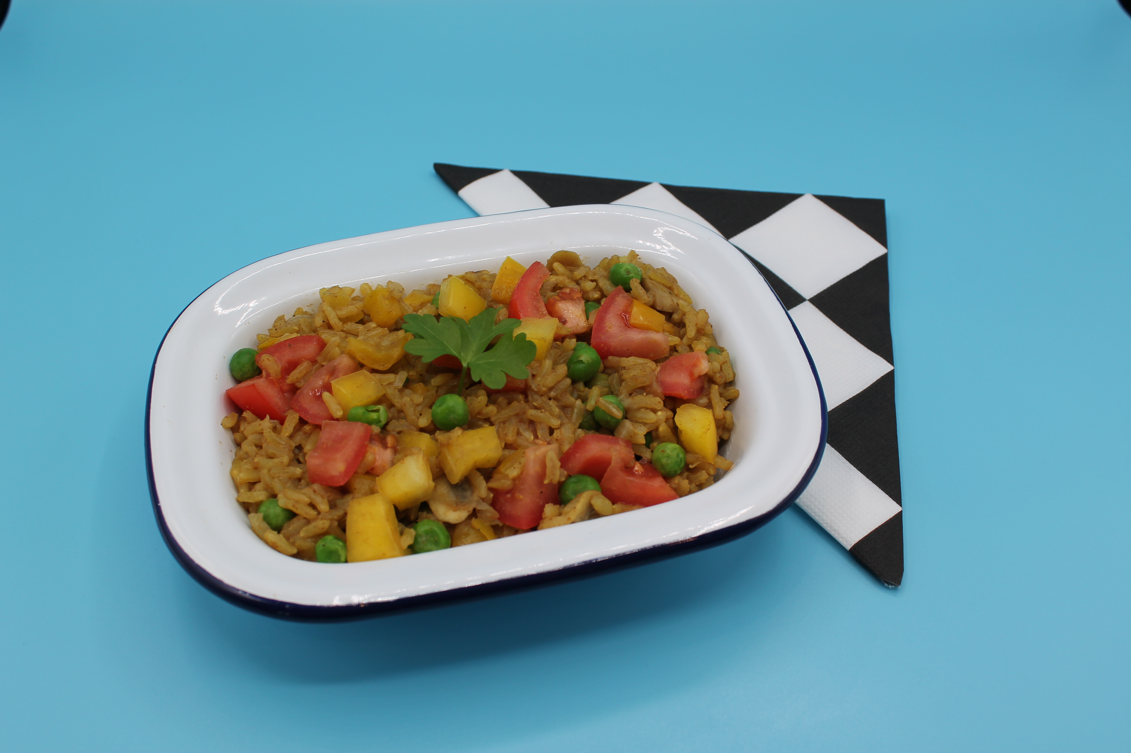
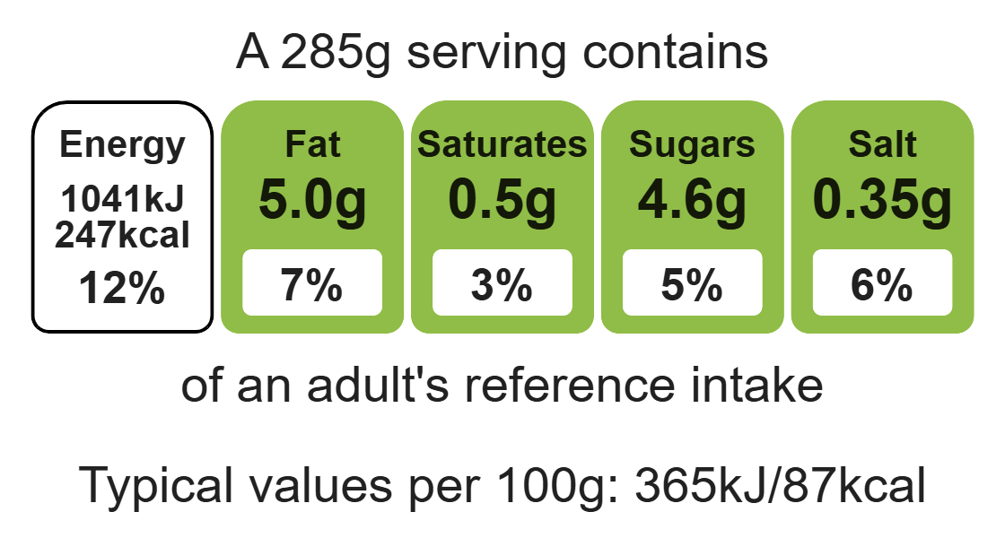
Nutritional analysis
Serves 3

Slide 3
Starter activity
Name three different rice dishes.
2. Name three herbs.
3. Name three spices.
Bonus question: What has to happen to dried rice to make it edible for us to eat?

Slide 4
Example responses
Name three different rice dishes.
Paella, risotto, savoury rice, jollof rice
2. Name three herbs.
Basil, mint, rosemary, thyme, coriander, sage, chives, dill
Name three spices.
Paprika, saffron, nutmeg, mixed spice, cinnamon
Bonus question: What has to happen to dried rice to make it edible for us to eat?
We cook it in hot liquid to make it soft and edible. The rice absorbs the liquid, swells and softens.

Slide 5
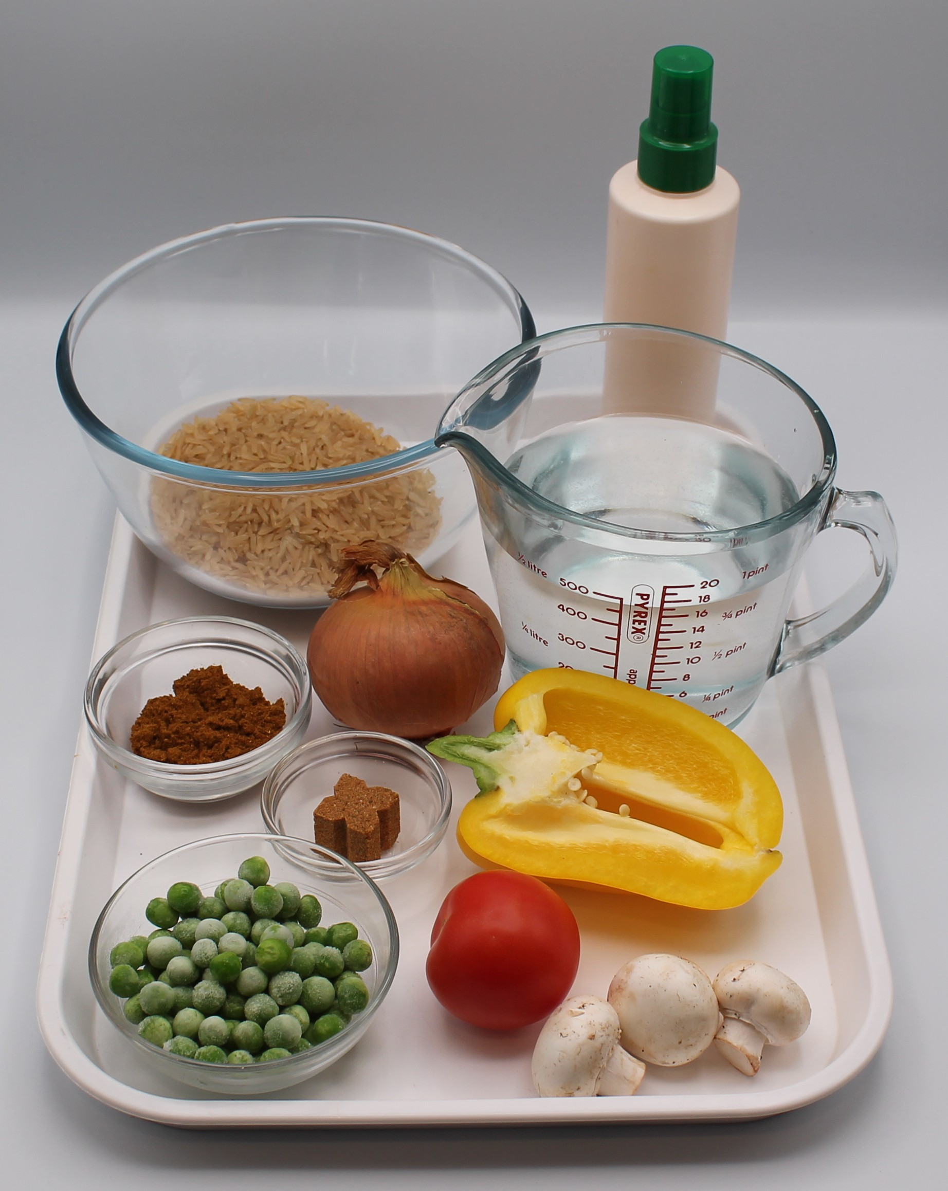

Ingredients (serves 3)
½ onion
3 mushrooms
½ pepper
1 tomato
1 x 15ml spoon oil or spray oil
150g wholegrain rice
550ml water, boiling
1 reduced-salt vegetable stock cube
50g frozen peas
1 x 10ml spoon curry powder
Black pepper
Check for any food allergy, intolerance, special dietary requirement or religious/cultural reasons for not handling or eating the ingredients in this recipe.

Slide 6
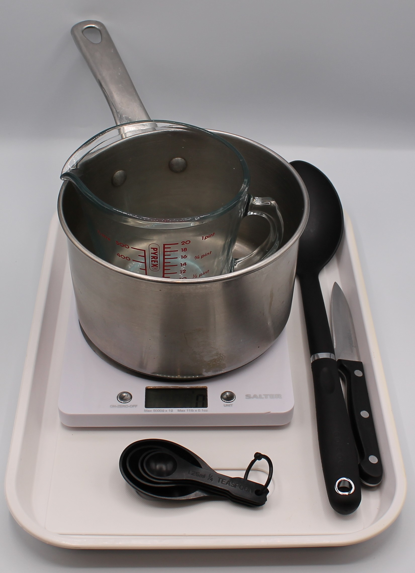
Equipment
Chopping board
Sharp knife
Saucepan
Heat resistant spoon
Weighing scales
Measuring jug
Measuring spoons

Slide 7
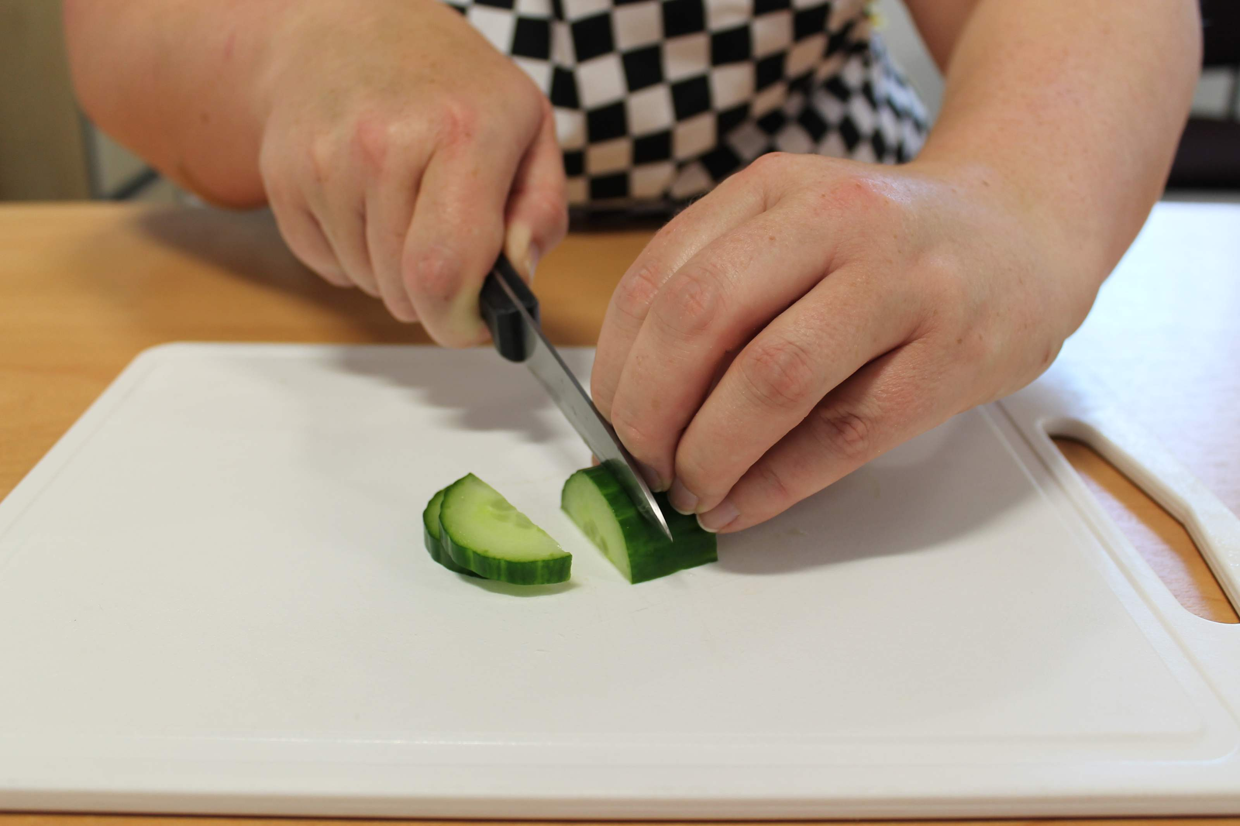
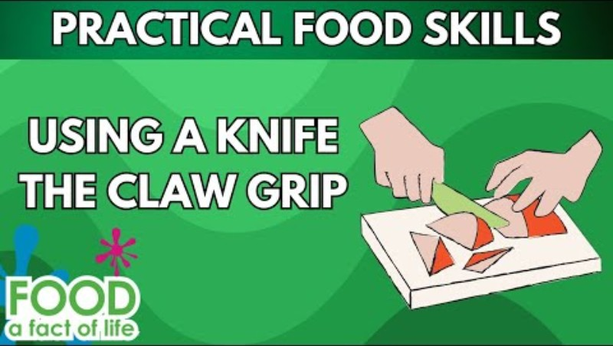
Food skills
Weigh
Measure
Peel
Cut
Chop
Slice
Dice and trim
Fry and sauté
Stir and combine
Simmer and boil
Click below to watch how to use the claw grip.

Slide 8
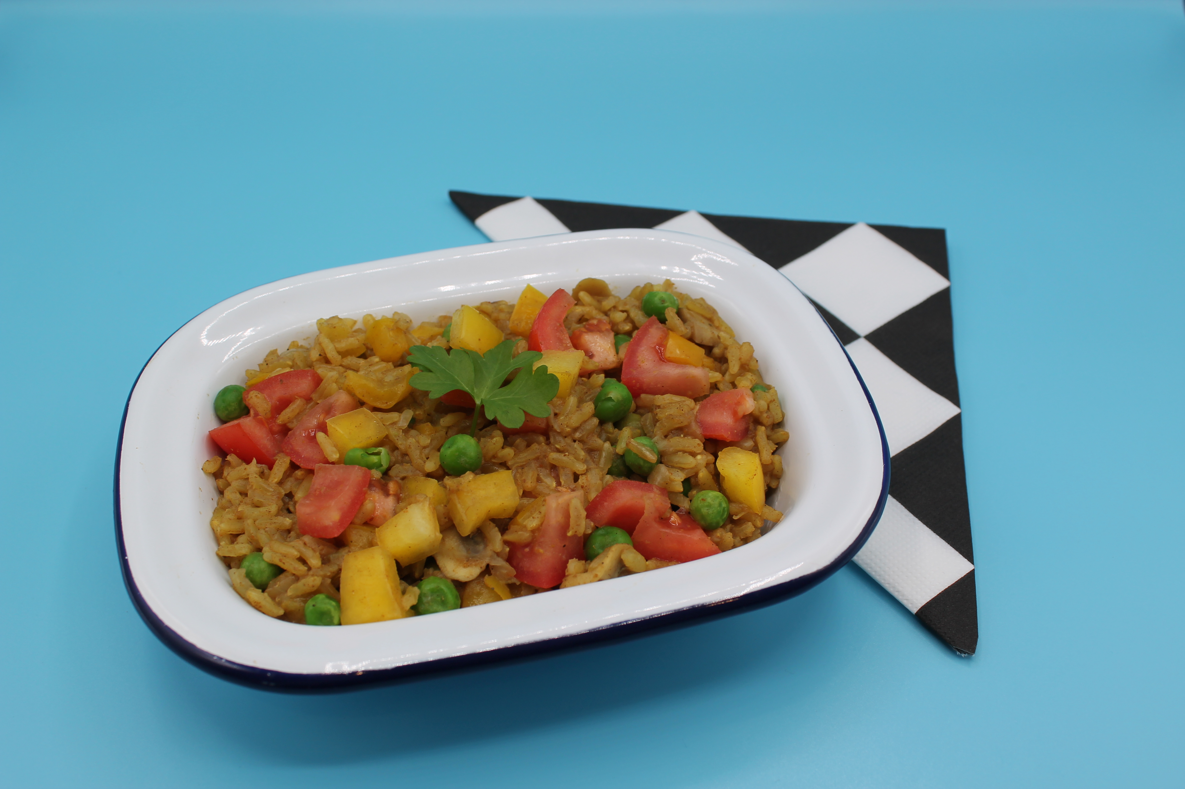
Method
Prepare the vegetables:
  peel and dice the onion;
  slice the mushrooms;
  deseed and dice the pepper;
  chop the tomato.
Add the oil to the saucepan and allow it to heat.
Fry the onion until soft.
Add the mushrooms and pepper and cook for a further 2 minutes.
Stir in the rice.
Crumble the stock cube into the boiling water and mix.
Add the stock, peas and curry powder to the saucepan.
Season with black pepper.
Simmer for 15 minutes, stirring frequently, until the rice is tender.
To serve place the rice in a bowl and sprinkle the chopped tomato on top.

Slide 9
Top tips
5 A DAY: Try different vegetables including frozen mixed vegetables or peas.
Vary you protein: Add beans or pulses such as chickpeas to increase the protein and fibre content.
Reduce food waste: Store any leftovers in the fridge and eat for lunch the next day.

Slide 10
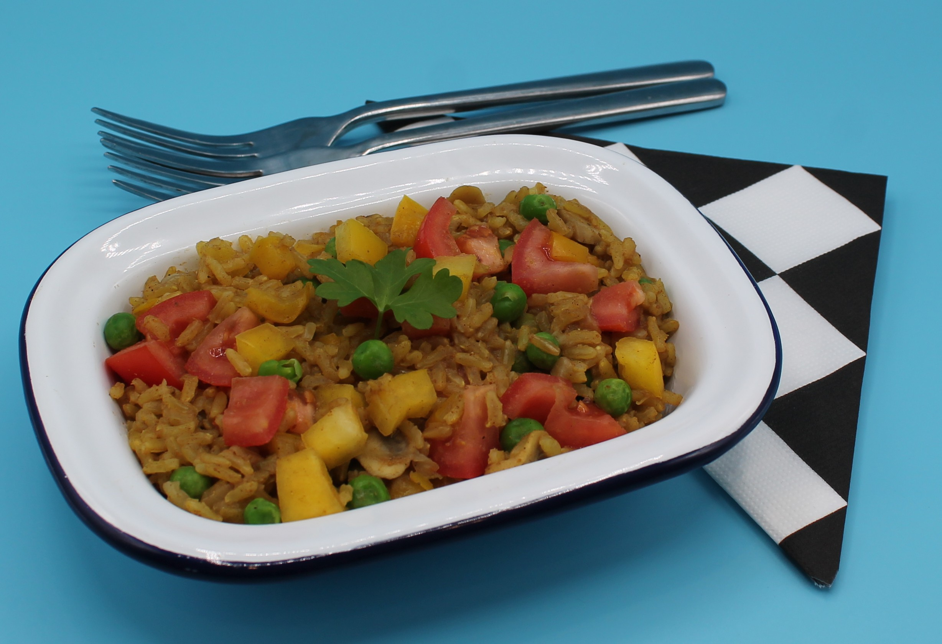
Food science
Absorption
Rice is not edible when raw. As the rice is heated, the starch absorbs the liquid and swells, creating a tender texture.

Slide 11
Food safety
Cooked rice can grow harmful bacteria if it’s left out too long before being refrigerated. One type, called Bacillus cereus, can produce toxins that cause food poisoning. These toxins aren't always destroyed by reheating.
To stay safe:
Cool and refrigerate rice quickly after cooking (ideally within two hours).
Eat leftovers within 24 hours.
Reheat thoroughly until it's steaming hot

Slide 12



Plenary
Evaluate your savoury rice to the following criteria.
 |  |  |  | Comments
The onion and pepper are evenly diced.
The mushrooms are evenly sliced.
The rice is tender.
The savoury rice has a good flavour.

Slide 13

Example responses
Evaluate your savoury rice to the following criteria.
 |  |  |  | Comments
The onion and pepper are evenly diced. |  |  |  | My onion and pepper were evenly diced, I used my bridge hold and claw grip correctly.
The mushrooms are evenly sliced. |  |  |  | My mushrooms were equally sliced.
The rice is tender. |  |  |  | My rice was a little bit gritty, I think it needed to be cooked for longer.
The savoury rice has a good flavour. |  |  |  | The rice has a nice curry flavour, not too strong.

Slide 14
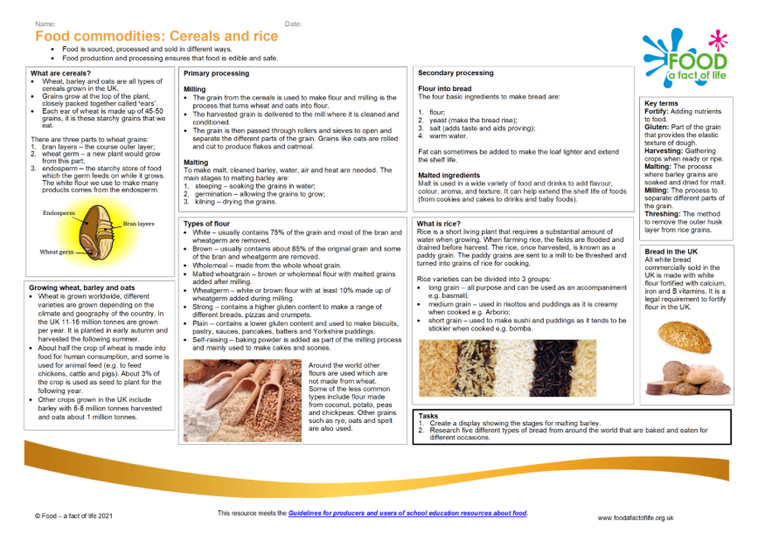
Looking for more…
Continue the learning with your pupils, check out our rice presentation and discuss where rice comes from.
We also have our cereals and rice knowledge organiser with key facts about cereals and rice.
This lesson belongs to our year 8 SOW, check out the savoury rice lesson plan and others to help your planning.

Slide 15
Savoury rice
For further information, go to:
www.foodafactoflife.org.uk
This resource meets the Guidelines for producers and users of school education resources about food.

