Slide 1
Dry heat

Slide 2
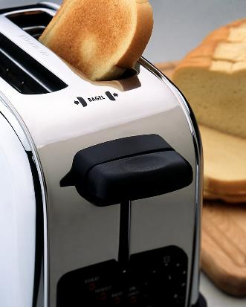
Toasting bread
What happens when bread is toasted?

Slide 3
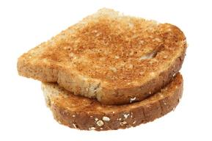
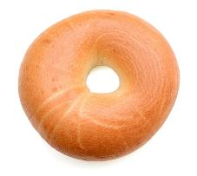
Heating foods
Foods which are baked, grilled or roasted undergo colour, aroma and flavour changes.
This is a result of different reactions, including dextrinisation and the Maillard reaction.

Slide 4
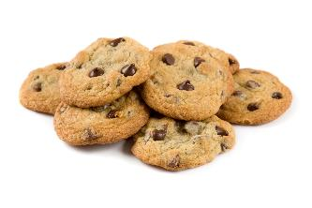
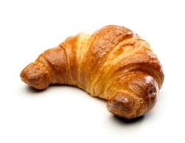
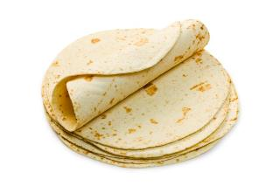
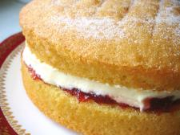
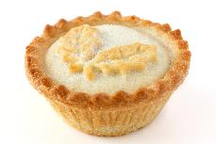
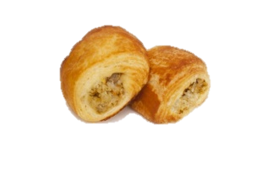
Heating foods
What other dishes change colour this way?
What is the connection between this food?

Slide 5
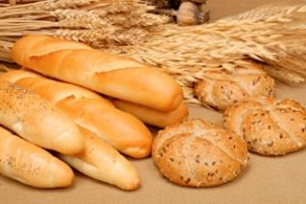
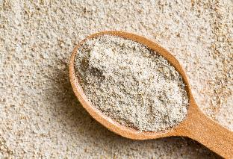
Dry heat
All of them are cooked through dry heat (rather than the transfer of heat through liquid).
All of them are made with starchy foods, e.g. flour

Slide 6
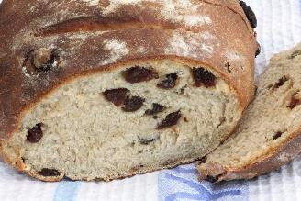
Baking and grilling
Foods which are baked, grilled or roasted undergo colour, odour and flavour changes.
This is primarily due to a group of reactions involving amino acids (from protein) and reducing sugars.
These compounds contribute to the colour and flavour of many foods such as toast, bread and croissants.

Slide 7
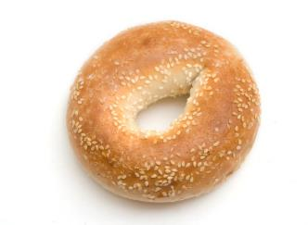
Dextrinisation
Dextrinisation also contributes to the browning of foods containing starch (when subjected to dry heat).
On dry heating, the starch in the food is broken down by heat into smaller molecules known as dextrins.
Dextrinisation contributes to the colour, aroma and flavour of many foods such as toast, bread and croissants, alongside the Maillard reaction and sometimes also caramelisation.

Slide 8
Dry heat
For further information, go to:
www.foodafactoflife.org.uk
This resource meets the Guidelines for producers and users of school education resources about food.

