Slide 1
Energy in foods practical

Slide 2
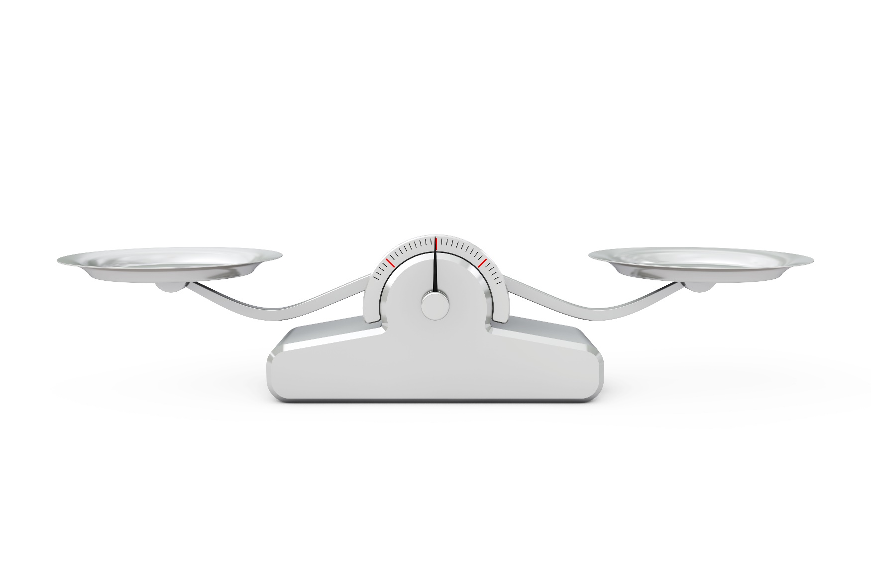
Starter
Describe what is meant by the term ‘energy balance’.
Describe how you could increase your energy intake or your energy expenditure.
Name three conditions that can be caused by unbalanced energy intake and expenditure.

Slide 3
Energy balance
To maintain body weight it is necessary to balance energy intake (from food and drink) with energy expenditure (from activity).
This is called energy balance.
When energy intake is higher than energy output, over time this will lead to weight gain (positive energy balance).
When energy intake is lower than energy output, over time this will lead to weight loss (negative energy balance).

Slide 4
Turn and talk
What is energy and why is it important?
Why might some people need different amounts of energy?
Talk to the person next to you.

Slide 5

Energy
Energy is essential for life, and is required to fuel many different body processes, growth and activities.
These include:
keeping the heart beating;
keeping the organs functioning;
maintenance of body temperature;
muscle contraction.

Slide 6

Energy
Different people need different amounts of dietary energy depending on their:
age;
gender;
body size;
level of activity;
genes.

Slide 7
Energy measurements
Energy intake is measured in joules (J) or kilojoules (kJ), but many people are more familiar with Calories (kcal).
1 kilojoule (kJ) = 1,000 joules
1 megajoule (MJ) = 1,000,000 joules
1 kilocalorie (kcal) = 1,000 calories
To convert from one unit to another:
1 kcal = 4.184 kJ
Therefore, a 1000-kcal diet provides 4.184 MJ or 4184 kJ
1 MJ = 239 kcal

Slide 8
Testing the energy in food
When food burns, it releases chemical energy.
If the food is burned under a test tube containing water, chemical energy in the water is transferred to heat energy and the water heats up.
The hotter the water gets, the more energy there is in the food.
You can use this equation to calculate the total energy transferred for each food:
q = mcΔt
q = energy transferred (J)
m = mass of water (g)
c = specific heat capacity of water (J/[g°C])
Δt = change in temperature (°C)

Slide 9
Testing the energy in food - variables
A variable is a factor that can be changed in an experiment.
Identifying control variables, independent and dependent variables is important in making experiments fair.
Knowing about variables can help you make scientific predictions and test them.
There are three types of variable:
Independent variables – the variable that is being changed.
Dependent variables – the variable being tested or measured.
Control variables – the variables that are kept the same.

Slide 10
Testing the energy in food - variables
change
Independent variables are ones you ________
Independent variables are ones you ________
Dependent ones you _________
Get it wrong you’ll feel displeasure
Independent variables are ones you ________
Independent variables go on the ____ -axis
Independent variables go on the ____ -axis
Dependent ones go high
On the axis known as ____
Independent variables go on the ____ -axis
change
measure
change
x
x
y
x

Slide 11
Testing the energy in food - variables
In this experiment, what are the independent and dependent variables? Write down the variables, including what we will keep the same (control variables)
Independent variables – the variable that is being changed.
Dependent variables – the variable being tested or measured.
Control variables – the variables that are kept the same.

Slide 12
Practical equipment
Eye protection
Clamp stand
Clamp
Boss
Boiling tubes
Thermometer
20 cm³ measuring cylinder
Needle with wooden handle
Bunsen burner
Heatproof mat
Food samples
Paper towels

Slide 13
Practical method
Measure out 10 cm³ of tap water using a measuring cylinder and pour into a test tube.
Use a thermometer to record the initial temperature of the water.
Clamp the test tube in place on a clamp stand (15 cm from the bottom of the stand).
Place one piece of food carefully on the end of a needle and hold the food in a Bunsen flame until it catches light.
Immediately hold the burning food about 5 cm under the tube of water.
Hold until the food has burned fully and record the final temperature of the water.

Slide 14
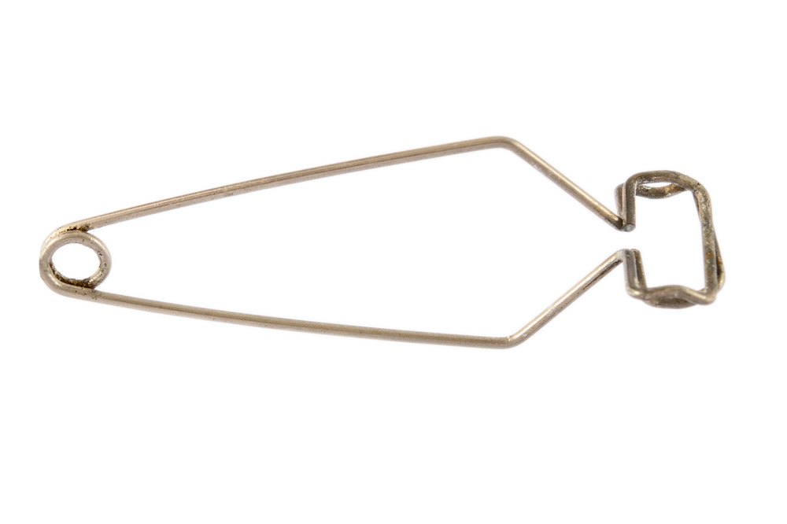
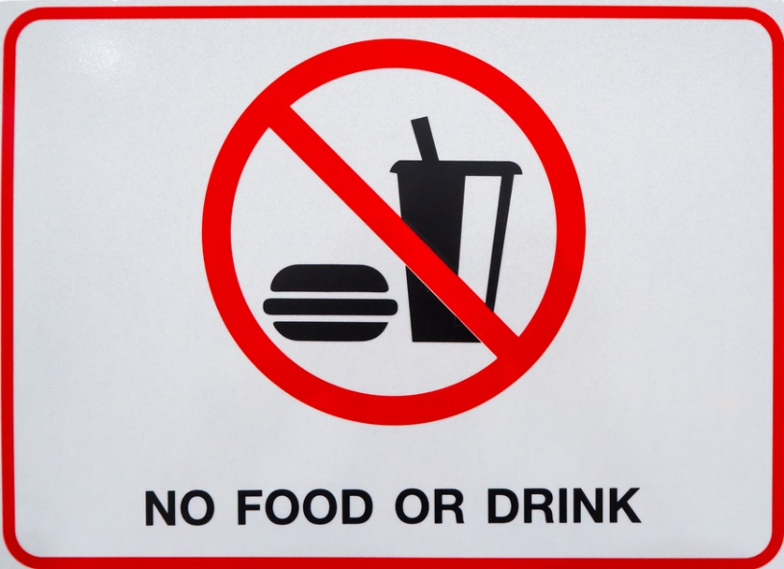
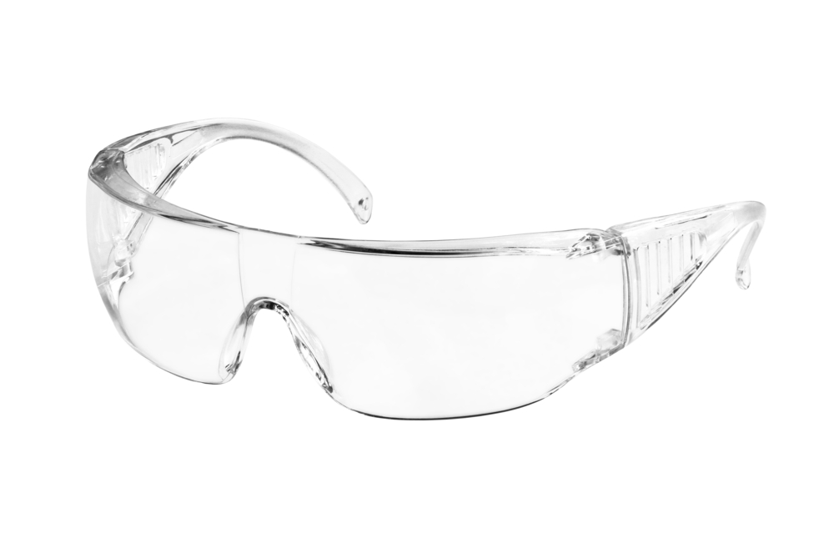

Turn and talk – how are we going to stay safe during this practical?
Wear safety goggles
Use test tube holders
No eating or drinking
Keep desks/benches tidy and make sure bags are not trip hazards

Slide 15
Practical safety
Specifically for this practical, you will also need to:
Take care when using a needle to burn the food. The needle may be sharp.
Tell your teacher if you are allergic to any of the foods.
Wear goggles.
Take care when using glassware.
Take care when using the Bunsen burner (including tying back hair).

Slide 16
Food | Start temperature of water (°C) | Final temperature of water (°C) | Temperature difference of water (°C)

Slide 17
Testing the energy in food
Use the equation below to calculate the amount of energy in different foods.
You can use this equation to calculate the total energy transferred for each food:
q = mcΔt
q = energy transferred (J)
m = mass of water (g)
c = specific heat capacity of water (J/[g°C])
Δt = change in temperature (°C)

Slide 18
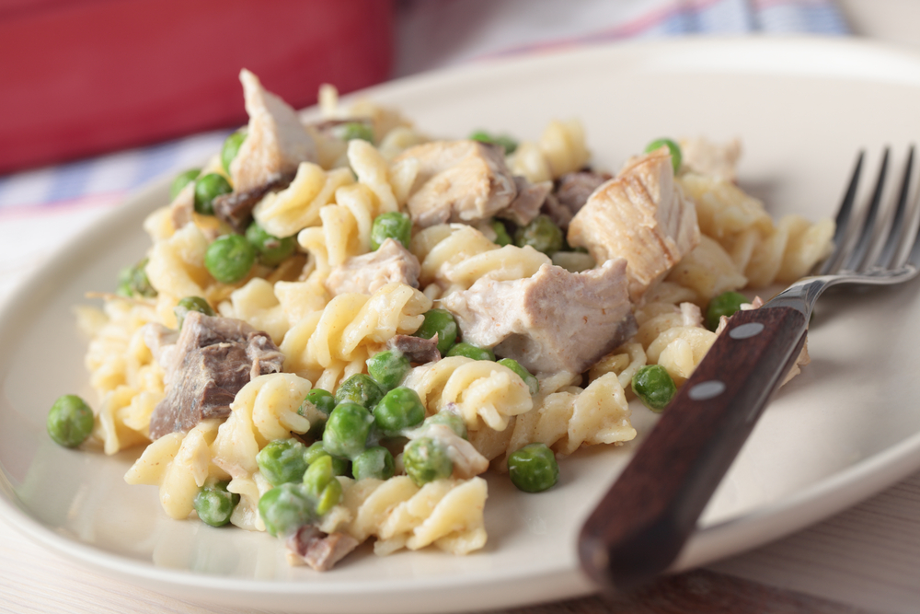
Macronutrients
Energy is provided by the carbohydrate, protein and fat in the food and drink we consume.
These are known as macronutrients.
The amount of energy that each of these macronutrients provides varies.

Slide 19
Energy
Carbohydrate (starch and sugars) provides 3.75 kcal (16 kJ) per gram (for the purposes of food labelling this is rounded up to 4 kcal (17kJ) per gram).
Protein provides 4kcal (17kJ) per gram.
Fat is the most energy dense nutrient, providing 9kcal (37kJ) per gram.
Energy intake can be estimated by applying these figures to the amount of carbohydrate, protein and fat we consume from food and drink.
Alcohol also provides energy at 7kcal (29kJ) per gram.

Slide 20
Conclusion
Write out a method and the conclusion for your experiment in your books.
You can write this in your own way or use the sentences below:
I can check which food has more energy by…(describe what you did in the experiment)
The food sample with the highest amount energy was……..
I know this because……

Slide 21
Key words
Key word​ | Meaning​
Energy (physics) | A quantity that is conserved - it cannot be created or destroyed. It can be stored and transferred.
Specific heat capacity | The heat required to raise the temperature of the unit mass of a given substance by a one degree.
Calorie (physics) | The energy needed to raise the temperature of 1 gram of water through 1°C
Independent variable | The variable that is being changed during the experiment.
Dependent variable | The variable being tested or measured during the experiment.
Control variable | The variable(s) that are kept the same.

Slide 22
Teachers’ guide

Slide 23
Running a food test practical classroom
Common misconceptions:
Foods high in carbohydrates have the most energy – often students think ‘carbs are bad’ so will believe carbohydrates have the most energy in them. Overcome this by getting students to carry out the tests and discussing the results.
Using equations – students can find any type of equation question very challenging, so practise makes perfect when using the specific heat capacity equation.

Slide 24
Running a practical classroom
Common pitfalls:
Bottlenecking in the classroom – one risk with the practical is that students will bottleneck in one area of the classroom when collecting equipment, which can waste time and reduce safety. To combat this, spread out the equipment around the room for collection and, if students are working in pairs, get each to collect half of the equipment.

Slide 25
Progressing the learning
The topic of energy is also covered at GCSE (14-16 years).
Specific heat capacity is an important equation in GCSE Physics that may come up in examinations. At GCSE, students may also have to rearrange the equation.

Slide 26
Extra information for teachers
The following slides contain extra information for teachers to support the teaching and learning around this topic area.
This may be useful as background reading, or you may wish to extend the learning for students by using this information in the lesson.

Slide 27
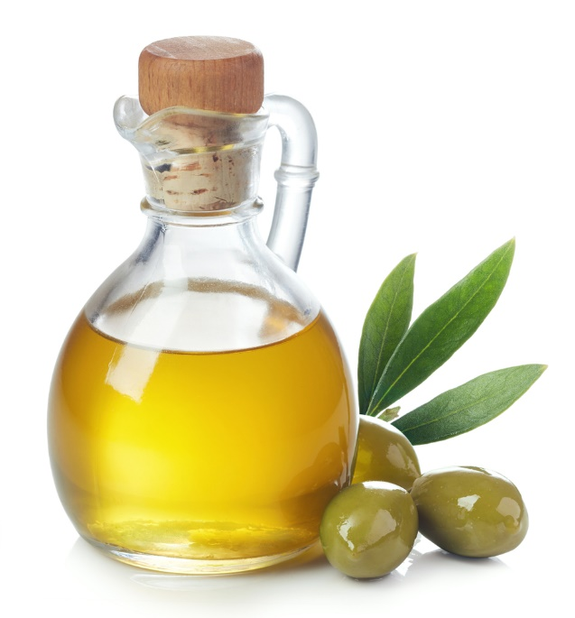
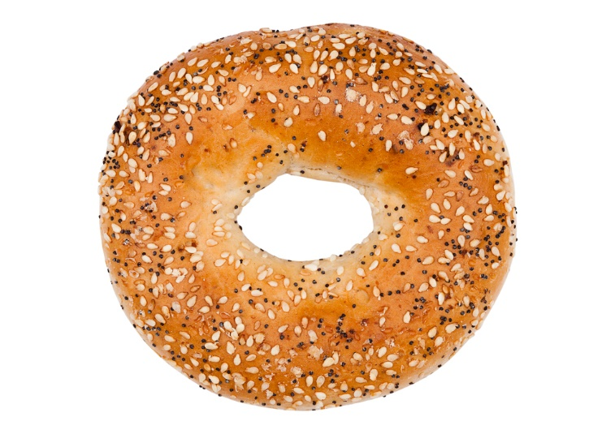
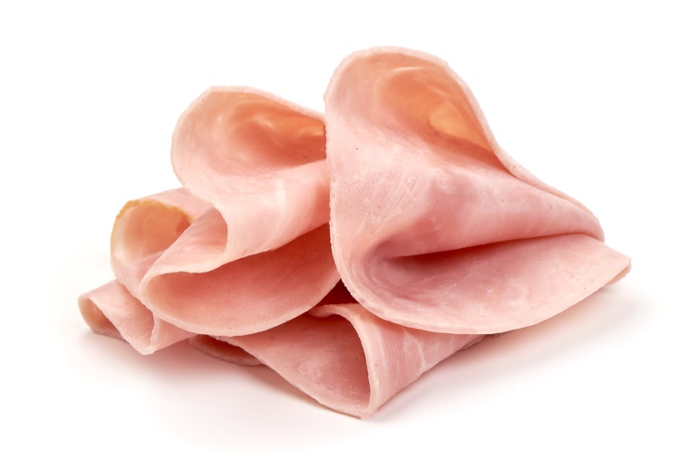
Energy
Which of these foods do you think contributes the most energy per 100g?
Bagel
Oil
Ham
Total Energy: 1161kJ
Carbohydrate 982.6kJ
Protein 170.0kJ
Fat 66.6kJ
Total Energy: 3696.0kJ
Carbohydrate 0.0kJ
Protein 0.0kJ
Fat 3696.0kJ
Total Energy: 451kJ
Carbohydrate 17.0kJ
Protein 312.8kJ
Fat 122.1kJ

Slide 28
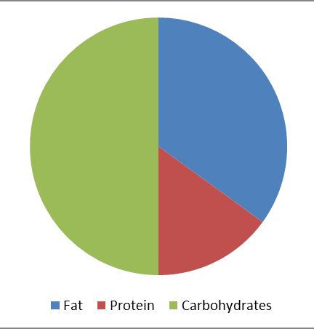
Dietary Reference Values
Experts have estimated the average requirements for energy for different types of people.
These figures are known as Estimated Average Requirements (EAR) for energy.
Experts also recommend that:
about 50% of our energy intake should come from carbohydrate;
no more than 35% of our energy intake should come from fat;
That means around 15% of our energy intake should come from protein.
Nutrient requirements

Slide 29

Dietary Reference Values
EARs vary throughout life.
Babies, young children and teenagers need more energy in relation to their size to grow and be active.
After the age of 18, energy requirements decrease and remain the same until 50, but actual needs depend on people’s activity levels. The EAR for women who become pregnant increases by 200 kcal/day but only in the final three months of pregnancy.
Energy requirements for older adults decrease as activity levels fall, and there is a reduction in the basal metabolic rate.

Slide 30
EARs - children
 | Breast-fed
Months | Boys (MJ) | Boys (kcal) | Girls (MJ) | Girls (kcal)
1-2 | 2.2 | 526 | 2.0 | 478
3-4 | 2.4 | 574 | 2.2 | 526
5-6 | 2.5 | 598 | 2.3 | 550
7-12 | 2.9 | 694 | 2.7 | 646
The Scientific Advisory Committee on Nutrition (SACN) has published reference values for daily energy requirements as follows:
Years | Boys (MJ) | Boys (kcal) | Girls (MJ) | Girls (kcal)
1 | 3.2 | 765 | 3.0 | 717
2 | 4.2 | 1004 | 3.9 | 932
3 | 4.9 | 1171 | 4.5 | 1076
4 | 5.8 | 1386 | 5.4 | 1291
5 | 6.2 | 1482 | 5.7 | 1362
6 | 6.6 | 1577 | 6.2 | 1482
7 | 6.9 | 1649 | 6.4 | 1530
8 | 7.3 | 1745 | 6.8 | 1625
9 | 7.7 | 1840 | 7.2 | 1721
10 | 8.5 | 2032 | 8.1 | 1936
11 | 8.9 | 2127 | 8.5 | 2032
12 | 9.4 | 2247 | 8.8 | 2103
13 | 10.1 | 2414 | 9.3 | 2223
14 | 11.0 | 2629 | 9.8 | 2342
15 | 11.8 | 2820 | 10.0 | 2390
16 | 12.4 | 2964 | 10.1 | 2414
17 | 12.9 | 3083 | 10.3 | 2462
18 | 13.2 | 3155 | 10.3 | 2462
Nutrient requirements

Slide 31
EARs - adults
Why do you think there is a difference in requirements for males and females?
What effect would increasing activity levels have on the energy requirements?
Years | Men (MJ) | Men (kcal) | Women (MJ) | Women (kcal)
19-24 | 11.6 | 2772 | 9.1 | 2175
25-34 | 11.5 | 2749 | 9.1 | 2175
35-44 | 11.0 | 2629 | 8.8 | 2103
45-54 | 10.8 | 2581 | 8.8 | 2103
55-64 | 10.8 | 2581 | 8.7 | 2079
65-74 | 9.8 | 2342 | 8.0 | 1912
75+ | 9.6 | 2294 | 7.7 | 1840
Nutrient requirements

Slide 32
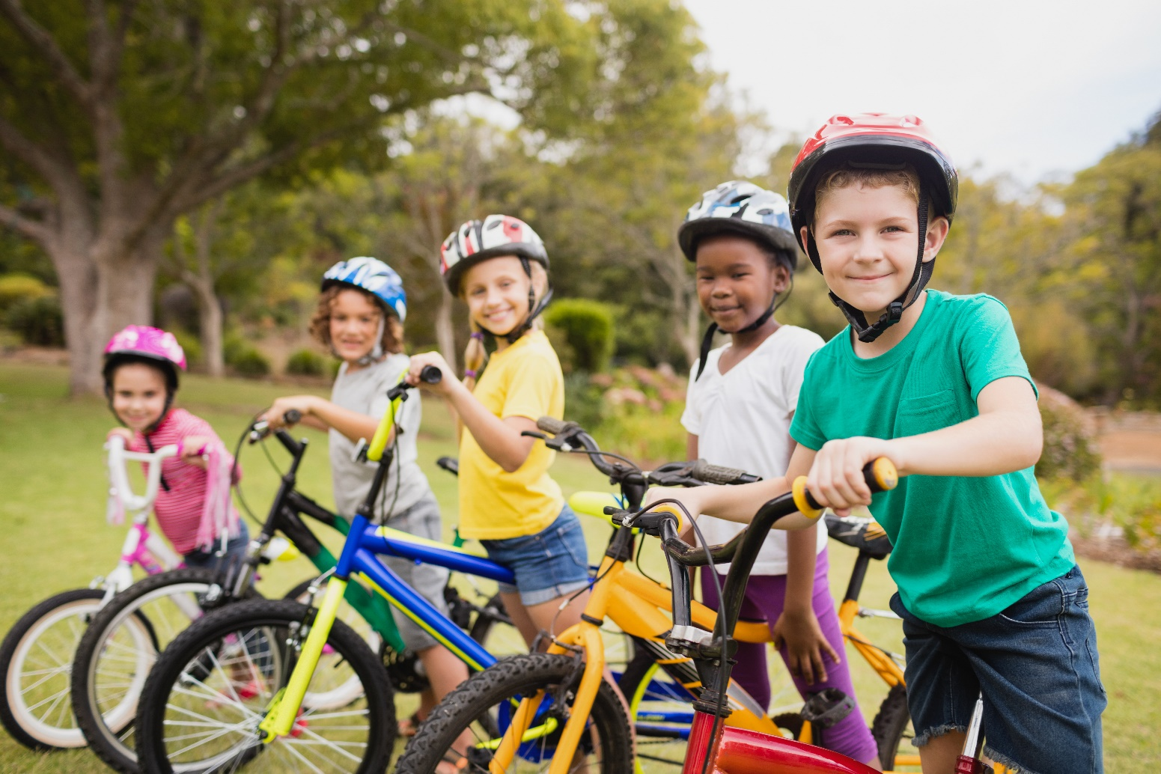
How much energy do we need?
Energy requirements vary from person to person, depending on the Basal Metabolic Rate (BMR) and Physical Activity Level (PAL).
Total energy expenditure =
BMR x PAL

Slide 33

What is basal metabolic rate?
Basal metabolic rate (BMR) is the rate at which a person uses energy to maintain the basic functions of the body when it is at complete rest, such as:
breathing;
keeping warm;
keeping the heart beating.

Slide 34
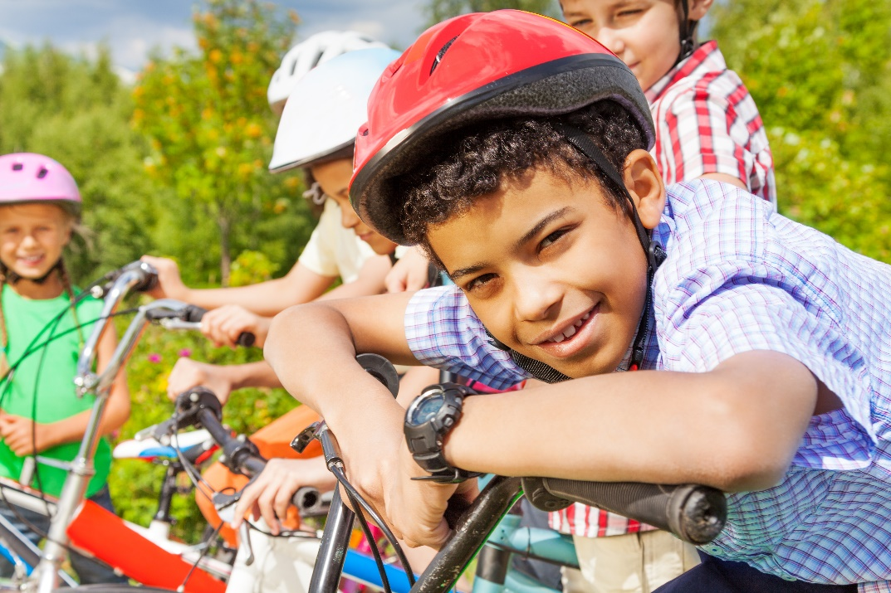
Physical activity
In addition to their BMR, people also use energy for movement of all types, expressed as Physical Activity Level (PAL).
The amount of energy a person uses to perform daily tasks varies.

Slide 35
Physical activity
Physical activity should be an important part of our daily energy expenditure.
Many different types of activity contribute to our total physical activity, all of which form part of everyday life.
What do you think physical activity includes?
Activity at work, e.g. use the stairs not the lift.
Household chores, e.g. vacuuming.
Looking after others.
Leisure-time activities, e.g. gardening.
Transport (walking or cycling to school or work).
Sport.

Slide 36
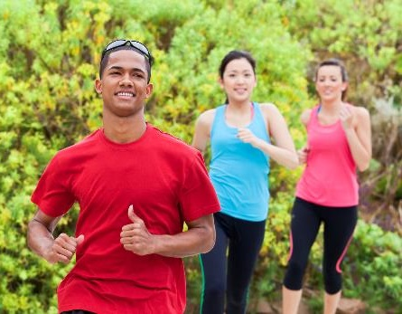
Physical activity
Children and young people are recommended to do at least 60 minutes of moderate intensity exercise every day.
Adults are recommended to do at least 150 minutes of moderate aerobic activity every week or 75 minutes of vigorous aerobic activity. They are also recommended to do strength exercises on two or more days a week that work all the major muscles.

Slide 37
Body Mass Index (BMI)
Body Mass Index (BMI) can be used to identify if an adult is a correct weight for height.
BMI can be calculated as follows:
BMI = weight (kg)
(height in m)²
Recommended BMI range (adults)
Less than 18.5 Underweight 18.5 to 25 Desirable or healthy
range 25-30 Overweight 30-35 Obese (Class I) 35-40 Obese (Class II) Over 40 Morbidly or severely
obese (Class III)

Slide 38
Positive energy balance
A person is said to be in positive energy balance when the diet provides more energy than is needed to meet energy demands of the body. Energy is stored as fat and the person puts on weight over time.
People who achieve a positive energy balance over an extended period of time are likely to become overweight or obese.
Being overweight or obese is associated with an increased risk of developing certain cancers, cardiovascular disease and type 2 diabetes.
Carrying a large amount of weight/fat around the waist also increases the risk of these health problems.
Energy out: activity
Energy in: food and drinks
Energy in > Energy out = Weight gain

Slide 39
Negative energy balance
A person is said to be in negative energy balance when there is insufficient energy from the diet to meet energy demands of the body. Energy is derived from energy stores and the person loses weight.
People who achieve a negative energy balance over an extended period of time are likely to become underweight.
Being underweight is associated with health problems, such as osteoporosis (low bone mass), infertility (difficulty to conceive) and even heart failure.
Energy in: food and drinks
Energy out: activity
Energy out > Energy in = Weight loss

Slide 40
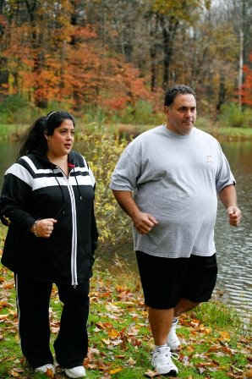
Energy balance
Energy balance can be maintained by:
regulating energy intake through the diet;
adjusting physical activity levels;
a combination of both.

Slide 41
Energy in foods practical
For further information, go to:
www.foodafactoflife.org.uk
This science pack is one of a series of resources produced for the pHood Futures project, supported by the Royal Society of Chemistry.
This resource meets the Guidelines for producers and users of school education resources about food.

