Slide 1

Food skills, recipes and diversity South American cuisines
18 May 2022
@foodafactoflife

Slide 2
Housekeeping and overview
Good food hygiene and safety practices - are you ready to cook?
Long hair tied up.
Jumpers removed/long sleeves rolled up.
Nail varnish and jewellery/watches removed.
Thoroughly washed and dried hands.
Clean apron on.
Turn off mobile phone (pop on vibrate)
You should have all your equipment and ingredients ready/handy
Get ready to cook!
Chat box – feel free to use to ask questions and share info/links and ideas
Camera on – we want to see your food skills
Help and direction (please don’t take as criticism!)
Feel free to ask questions and engage!
Feedback – it’s good to get your views!
Tweet or post on Facebook!
Enjoy!
@foodafactoflife

Slide 3
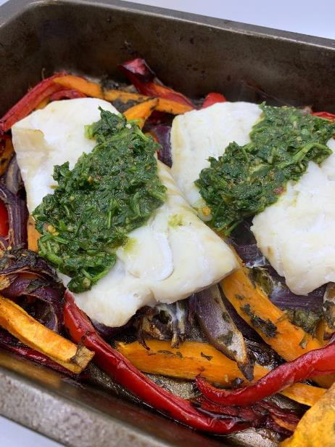
Welcome
As part of the British Nutrition Foundation’s work around a ‘modern, diverse food and nutrition education’ we asked students what was important to them about the recipes they cooked at school.
Students responded that they want dishes that are:
tasty, healthy, family/everyday recipes;
most significantly they want them to be dishes from around the world that are - modern, diverse and reflect different cultures.
Please say hello in the chat box!
The British Nutrition Foundation is grateful for the support from the All Saints Educational Trust for this work.

Slide 4
Session aims
During the session we will:
make two recipes from around the world that are new to Food – a fact of life;
use traditional ingredients and consider alternatives;
develop, acquire and secure practical food skills using recipes that are suitable and practical for schools and their budgets, promote healthier eating, reflect more global cuisine, and encourage dialogue around culture and inclusivity;
consider planning and implementing practical activities in the secondary classroom;
demonstrate good food hygiene and safety practices;
provide links to Food – a fact of life.

Slide 5
Programme
16.45 Registration
17.00 Welcome
Practical food skills, recipes and diversity – South American cuisines
17.15 Chimichurri fish traybake – activity and review
17.45 Quibe and spicy tomato sauce – activity and review
18.25 Review and next steps
18.30 Finish – Evaluation, certificate and voucher

Slide 6
Diversity and inclusion in Schemes of Work
Know your pupils!
Know and understand the local community, e.g. what are the challenges that young people are facing?
Understand what young people (and their families) want to make in food lessons. Not just cakes though!
Ensure recipes and practical activities build on knowledge and skill.
Incorporate different flavours, ingredients and culinary techniques and experiences to widen young people’s understanding of food and cultures around the world.
Encourage pupils to share their personal experiences around food culture, ingredients and recipes with the class or school community.
Consider healthy, sustainable diets – nutrition.org.uk
Did you know?
Some food and drink-related traditions are currently recognised by UNESCO and its Representative List of the Intangible Cultural Heritage of Humanity

Slide 7
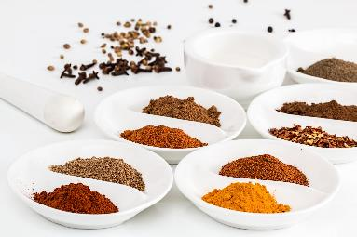
In the classroom
Consider the following:
time and budget available;
pupils - practical skills;
equipment available;
provision/availability of ingredients e.g. spices or herbs that may not be used often, vegetables that might not be readily available in your area;
involving the school/local community – there may be an ‘expert’ in a particular cuisine that could offer guidance and/or input to the lesson;
sharing the success of your pupils work through school social media, newsletters and special events such as open evening and options.

Slide 8
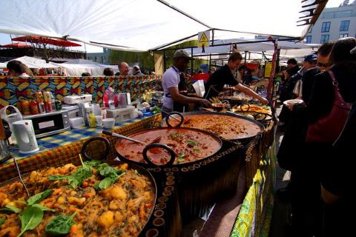
Generation Z and food culture
Globalisation has been changing the food we eat and the ways we eat those foods. But it is not new!
Food cultures are moving, and globalisation has made a wide range of cuisines more accessible.
Food culture is no longer tied down to where it originated from and can spread far and wide.
Trends:
Street food
Fusion food
Travel – trying a wider variety of cuisines
Notes:
Gen Z = born in 1997 or later - makes up a quarter of all the people going out to eat – high spending power. Organics/sustainability/plant based all feature.
A strong theme in Gen Z eating habits is authenticity and exploring exciting flavours from all over the world. Some of this may come from growing up in the same households as Gen X and Millennial foodies.
Gen Z brought up as 'digital natives' - they see and experience food around the globe – heritage and authenticity are key words.
Food trade has played a significant role in the history of globalisation, as it has allowed for cultural exchange for thousands of years. From the transporting of spices along the Silk Road, to the potatoes being imported from the Andes to Ireland in 1589 by Sir Walter Raleigh.
e.g. Italian coffee culture – worldwide verses local culture e.g. snakes, spiders
The economic and cultural boundaries between countries are becoming less rigid and the gradual diffusion of different elements of national culture such as food and cuisine are some examples of this trend.

Slide 9
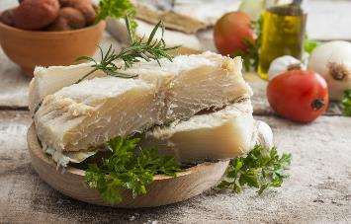
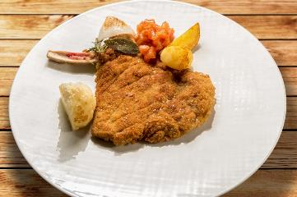
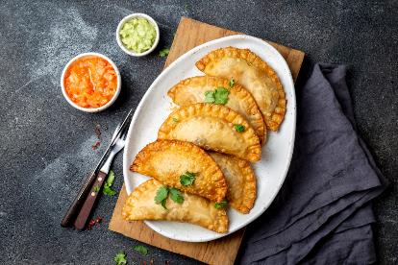
History
The Treaty of Tordesillas in 1494 divided South America, between Spain and Portugal.
In order to find workers for plantations that would be resistant to diseases, that Europeans brought in Africans to replace Native Americans.
Europeans also brought pigs, cows, chicken, goats, citrus fruits, wheat, and almonds.
European settlers learned to make Spanish, Italian, Portuguese dishes using available South American ingredients and South Americans started developing new dishes with these new sources of food.
Some examples of dishes brought to South American by the Europeans include: bacalhau, milanesa and empanada.
Bacalhau
Milanesa
Empanada
Notes:
One of the greatest impact of the arrival of the Europeans was the demographic change. European diseases such as smallpox, measles, influenza and typhus were unknown to the people in South America who had no biological resistance to them. This resulted in the population being decimated by diseases.
Inhabited by the Arawak and Carib tribes of the Amerindians, the Dutch established colonies from 1616 until the British took over control in the 1814. Many indentured workers from Portugal, Germany, Ireland, Scotland, Malta, China, India, and Vietnam came in to work on sugar plantations. Therefore, Guianese cuisine reflects diverse influences. Indian influences included dishes such as curry, roti and rice and British influence is reflected in the traditional art of homemade bread-making in many villages that includes pastries such as cheese roll, pine tarts and patties.

Slide 10
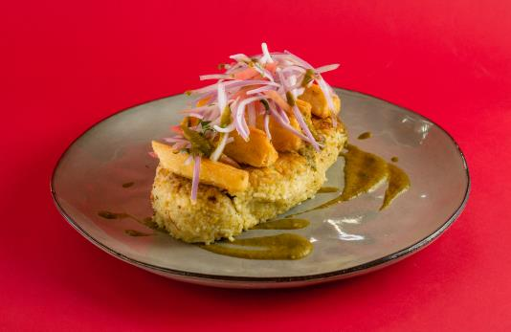
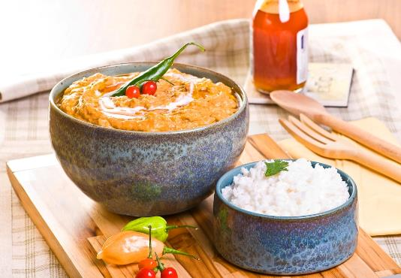
History
Fried leftover rice and canary beans are mixed with garlic, chili and onion to make tacu tacu.
The name comes from the Quechua word taku, which means “mixed”.
Enslaved African peoples were brought to South America (mainly Brazil) to work on sugar plantations.
African influences can be seen in the dishes of South America. For example, African people would mix and season the food landlords left for them.
These were adopted into the dishes of their respective nation – such as the Peruvian tacu-tacu.
Dishes were also influenced by a wave of immigration from Asia, most notably China and Japan. Chinese spices and food-styles were adopted.
Vatapá is an Afro-Brazilian dish made from bread, shrimp, coconut milk, finely ground peanuts, and palm oil, kneaded into a creamy paste.
It is a typical food from Salvador and is common in the North and Northeast regions of Brazil.
Notes:
African enslaved people were brought into South America because their immunity to European diseases and their strong physical constituency made them suitable for the harsh conditions and climate of plantation life.
Ships headed towards Brazil and the Caribbean islands, where workers were sold for sugar plantations (engenhos). At first the Portuguese had relied on the native Tupani for slave labour; however, in 1570 a series of epidemics decimated the already weak Tupani communities, and by 1630, Africans had replaced the Tupanis as the largest source of labour on Brazilian sugar plantations.
Filipinos settled in South America due to Spain’s trade involving Asia and the Americas. The majority of Asian immigrants were Japanese or Chinese in Brazil and Peru; Brazil has the largest ethnic Japanese community outside of Japan. Brazil has 1.49 million people of Asian descent and Peru has one of the largest Chinese communities in the world with almost 1 million in Peru of Chinese ancestry.

Slide 11
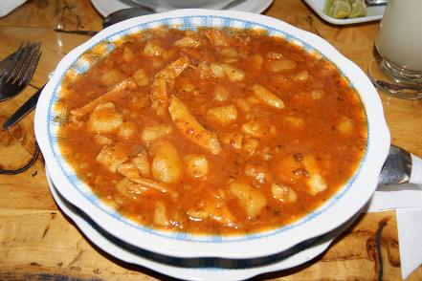
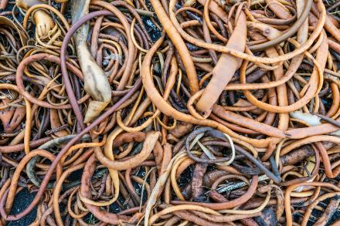
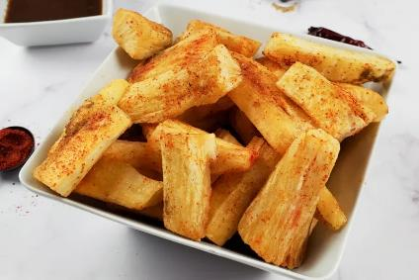
History
Spicy Tacneña originated on cotton and sugar cane farms in the Sama Valley, in Peru.
They used the leftover meat for food and combined them with some food from the region, such as peppers, potatoes, charqui (dried beef), and cochayuyo (seaweed).
The spicy dish of Tacneña was initially prepared with leftovers of guanaco or alpaca llama, animals that transported minerals from the silver mines of Bolivia to Peru in the 1530s.
Mogo mogo is made from cassava, well known in Peru, Colombia, Ecuador and Brazil. This dish is like making chips, but replacing potatoes with cassava, to accompany any dish with meat and vegetables.
Tacneña
Cochayuyo – a type of kelp seaweed
Mogo mogo

Slide 12
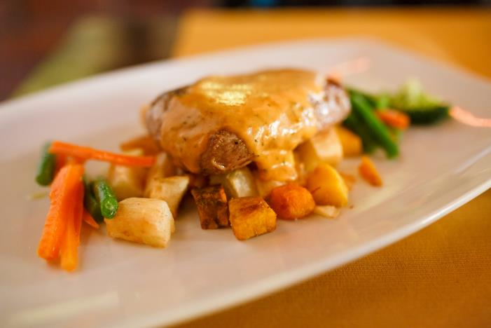
Modern cuisine
Some indigenous foods of South America were not incorporated into the European-style cuisine that is now popular in cities like Buenos Aires and Santiago.
However, the Indigenous populations continue to cultivate and eat them. More recently, these foods have been gaining popularity.
Chefs now showcase Andean products such as alpaca meat, grains like quinoa and kiwicha (also known as amaranth), and unusual tubers such as yucca and maca in new ways.
Burghul
Freekeh
Alpaca steak
Notes:
Sopa de quinoa is a traditional quinoa soup originating from Peru. Although there are many variations and recipes, the soup is usually made with a combination of quinoa, carrots, celery, leeks, garlic, cabbage, vegetable or chicken stock, onions, cumin, salt, and pepper.
Argentina is famous for its meat consumption and has the highest red meat consumption per capita in the world.

Slide 13
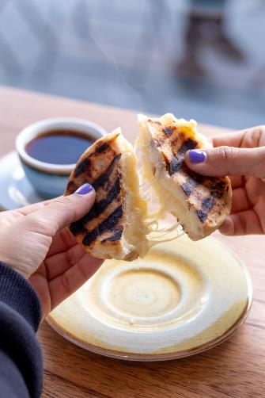
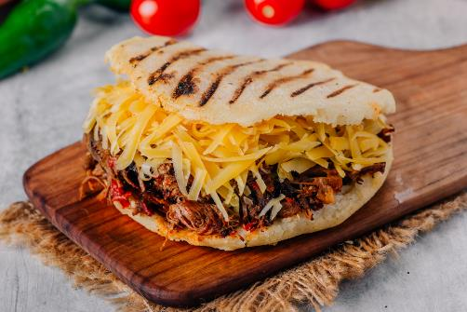
Popular dishes
The name arepa comes from the word erepa, which is the indigenous word for this corn bread. Its origins are believed to be from the Indigenous tribes across Venezuela, such as Timoto-Cuicas, Arawak, Carib, and Karina.
Arepa is a versatile cornbread made from ground corn dough or precooked corn flour. It is commonly eaten at any time of the day in Venezuela and Colombia, also in Central America.
The arepa have a crispy, browned crust and are commonly stuffed with a variety of ingredients, including beans, cheese, and avocado to shredded beef and onions.
For a Venezuelan breakfast, arepas are traditionally served with a cup of strong coffee and hot dipping chocolate.

Slide 14
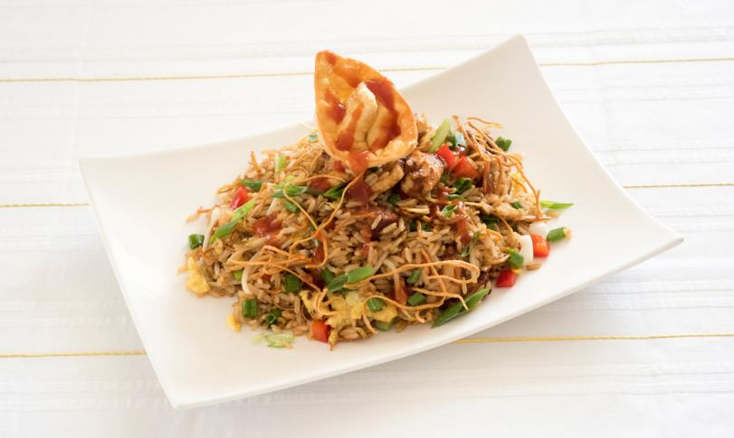
Popular dishes
Arroz chaufa is a popular Peruvian dish influenced by Chinese cuisine. It consists of a combination of fried rice, meats, vegetables, and fruits.
Most commonly, rice is fried with shredded chicken, salami, garlic, ginger, slivered almonds, eggs, chicken stock, soy sauce, pineapple chunks, and pineapple juice. There are many variations on the dish using ingredients such as fish, beef, pork, jerky, and even alligator meat.
Once prepared, the dish is typically garnished with chopped spring onions and coriander.

Slide 15
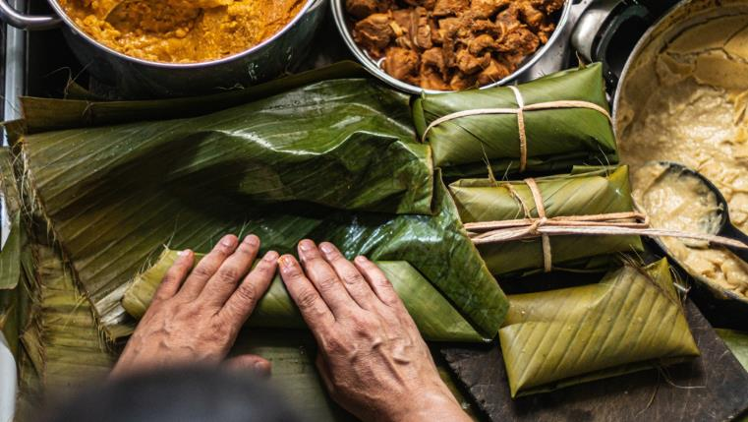
Popular dishes
Originally from Mexico, Tamales are found in a few countries of South America but are very popular in Ecuador. Tamale is a traditional dish made of starch and filling, wrapped in a corn husk or banana leaf which is used to keep the filling together while being steamed.
There are various fillings. When the Aztecs and Mayans created tamales, it consisted of squash or beans.
Europeans brought more ingredients and now the filling is a mixture of cornmeal (masa), meat, vegetables, and spices.
They are a popular street food.

Slide 16
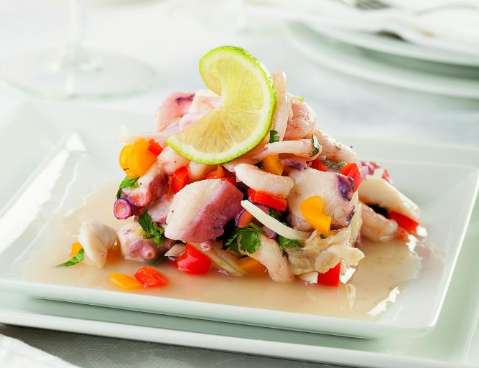
The science of ceviche
Ceviche is a dish using raw fish and seafood marinated in citrus juice.
The marinade known as Lech de tiger (Tiger’s milk), is traditionally made using limes from the north coast of Perú, known as limón sutil, Peruvian chilies, coriander roots and other ingredients that vary depending on the region.
The acid in the citrus creates low pH conditions, this denatures the proteins in the fish, causing it to become opaque and producing a firm texture.
Just like when cooking with heat, too much time spent in the acid marinade can turn seafood rubbery and tough.
Notes:
Proteins are made up of long chains of amino acids, and when exposed to acid, these chains break apart and arrange themselves into different configurations.
A more common way of denaturing proteins is by exposing them to heat (essentially, cooking them). So with ceviche, the fish is effectively "cooked" even though there's no heat involved.
Note that while heat is an effective method for killing the bacteria that cause food poisoning, marinating it in citrus juice is not. So it's important to use the freshest seafood from a trusted source.

Slide 17
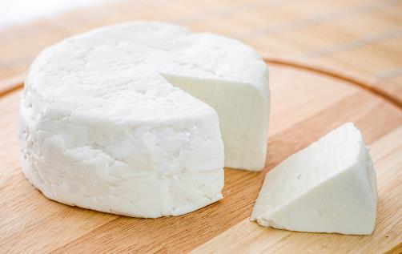
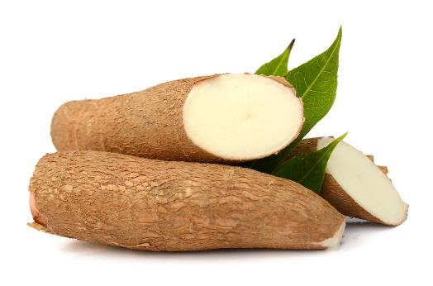
Ingredients
Queso fresco / queso blanco: This fresh cheese is a staple of South American cooking. Queso fresco is a lightly salted, unripened cow’s milk cheese that is added to sauces and crumbled in salads.
Yucca (manioc, cassava): The starchy edible root of the yucca plant is another very important food. It is especially popular in Brazil, where the root is ground, dried and roasted to make farofa. Farofa is a key ingredient in feijoada, a pork and black bean stew.
Other regions use a sweet variety of yucca that can be mashed or fried. Cassava flour is often used in baking, such as the Brazilian cheese rolls pão de queijo.
Check the list of ingredients for any potential allergens and consider alternatives. For more information on allergens.
Notes:
Coconut milk is not the slightly opaque liquid that flows from a freshly opened coconut – that is coconut water.
A seasoning tradition used in the region is based on green herbs and oil-based marinades called Mojo. Ingredients may include garlic, onions, scotch bonnet peppers, celery, green onions, and herbs like coriander, marjoram, rosemary, tarragon and thyme. Used for many dishes, this Mojo is popular in Caribbean cuisine
The 14 allergens are: celery, cereals containing gluten (such as barley and oats), crustaceans (such as prawns, crabs and lobsters), eggs, fish, lupin, milk, molluscs (such as mussels and oysters), mustard, peanuts, sesame, soybeans, sulphur dioxide and sulphites (at a concentration of more than ten parts per million) and tree nuts (such as almonds, hazelnuts, walnuts, brazil nuts, cashews, pecans, pistachios and macadamia nuts).

Slide 18
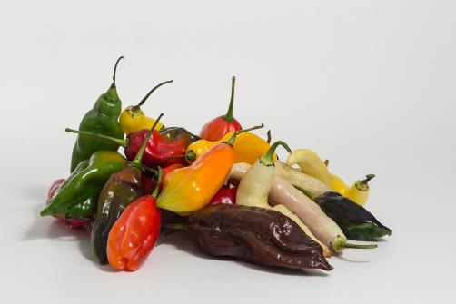
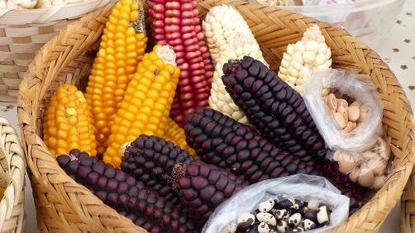
Ingredients
Peppers (ajis): Chili peppers are one of the most important seasoning ingredients in South American cooking. There are both sweet and hot varieties, and they are used in many ways, such as the colourful marinades for ceviche.
Corn (maiz, choclo): Corn has been cultivated in South America for more than 5,000 years and is the key ingredient of many staple dishes, such as arepas (cornbread), tamales, various pasteles (casseroles or savoury tarts) and chicha, an ancient (yet still popular) drink.
Notes:
Aji peppers are known generally as the Peruvian hot pepper, where "aji" is the common name primarily in South America and areas of the Caribbean for chili peppers.

Slide 19
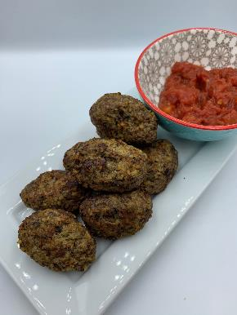

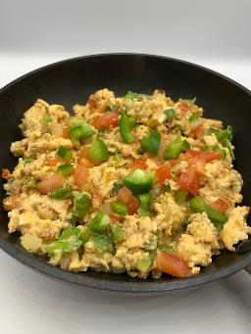
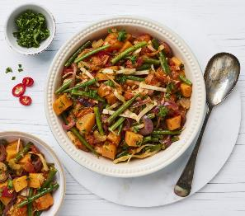
The recipes
Recipes that will be available on the Food – a fact of life website:
Chimichurri fish traybake
Quibe and spicy tomato sauce
Cajun inspired vegetable gumbo
Quick bean enchiladas
Perico
Mexican chilli

Slide 20
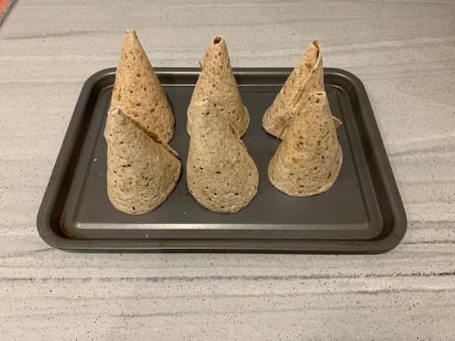
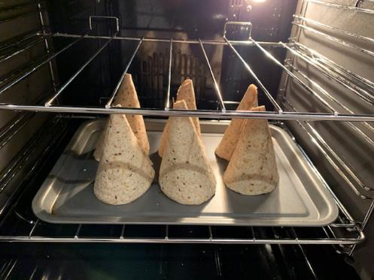
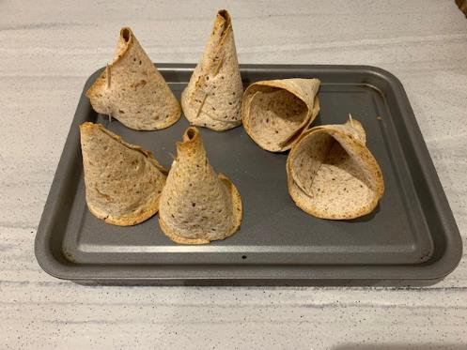
Toasted tortilla cones!

Slide 21

Chimichurri fish traybake
Why are we doing this?
Learning in lesson: focus on skill/knowledge, not recipe.
A quick to prepare, medium-high complexity recipe.
Demonstrates a wide range of basic food skills but can be extended to allow for differentiation and inclusion.
Uses ingredients that are easy to source and mostly stored at ambient temperatures.
Nutrition science: Protein and alternatives. Vegetables in the diet.
Food science: Heat transfer. Effect of heat on protein.
Sensory science: Testing, tasting and evaluation.
Maths: Weighing, measuring, time, temperature.
English: Reading and following a recipe, following written and verbal instructions.
Notes:
There are two theories about the origin of the name–one says that it was invented (and aptly named) by a British meat dealer called Jimmy Curry, and the other one says that it stems from the phrase "che mi curry", spoken by captive English soldiers who requested to eat curry after their unsuccessful attempt to invade Argentina, a Spanish colony at the time.

Slide 22
Chimichurri fish traybake
Ingredients
2 small sweet potatoes (about 350g)
1 medium red onion
1 red pepper
1 garlic clove
25g fresh flat-leaf parsley
1 x 15ml spoon olive oil
1 x 15ml spoon red wine vinegar
¼ x 5ml spoon crushed chillies
¼ x 5ml spoon smoked paprika
1 x 5ml spoon dried oregano
Black pepper
250g skinless white fish fillets, e.g. basa
Method
1. Preheat the oven to gas 6, 200°C, fan 180°C.
2. Prepare the ingredients:
  peel and slice the sweet potatoes into wedges;
  peel and slice the red onion into wedges;
  deseed and slice the red pepper;
  peel and crush or chop the garlic.
3. Put the sweet potato, onion and peppers in a large roasting tin.
To make the chimichurri dressing, put the parsley, oil, vinegar, garlic, crushed chillies,
paprika and ½ x 5ml spoon oregano into a food processor. Alternatively, use a hand-held
blender.
5. Blitz until the parsley is finely chopped and you have a thick sauce. Season with black pepper.
Add 1 x 15ml spoon of the sauce to the vegetables in the tin and toss together. Scatter over the
remaining oregano, then roast for 25-30 minutes until the vegetables are just tender.
7. Top with the fish fillets and return to the oven for 5-10 minutes until the fish is cooked through.
Add 1-2 x 15ml spoons cold water to the remaining sauce and stir well to make a pourable
dressing.
9. Spoon over the roasted vegetables and fish to serve.

Slide 23
Chimichurri fish traybake - review
Skills and knowledge developed and demonstrated | Practicalities in the secondary classroom | Alternatives – ingredients, cooking methods …
 | Cooking tins/trays – if possible, ask pupils to bring a suitable tin or consider foil containers. Storage pre+post preparation and cooking. Hygiene and safety when handling raw fish. Electrical safety – using a food processor/hand blender
Practical food skills: Weigh, measure, peel, slice, chop, crush, blitz, stir, roast
Nutrition science: Protein and alternatives. Vegetables in the diet.
Food science: Heat transfer. Effect of heat on protein.
Sensory science: Testing, tasting and evaluation.
Maths: Weighing, measuring, time, temperature.
English: Reading and following a recipe, following written and verbal instructions.
For a vegetarian or vegan dish, try sliced halloumi, tofu, paneer or ready-made polenta instead of fish. Alternatively, add a variety of vegetables.
Choose fish labelled as sustainably sourced – frozen fish fillets are often competitively priced.
Balsamic vinegar can be used instead of red wine vinegar.
Ground cumin can be used as an alternative to smoked paprika.
Notes:
Smoked paprika, also called Spanish paprika or pimenton is a spice made from smoking and drying mild capsicum peppers and grinding them into a fine powder.

Slide 24

Quibe and spicy tomato sauce
Why are we doing this?
Learning in lesson: focus on skill/knowledge, not recipe.
A quick to prepare, high complexity recipe.
Demonstrates a wide range of basic food skills but can be extended to allow for differentiation and inclusion.
Uses ingredients that are easy to source, stored at mostly ambient temperatures and traditional to South American cuisines.
Nutrition science: Protein and alternatives.
Food science: Effect of cooking on protein. Heat transfer. Maillard reaction.
Sensory science: Testing, tasting and evaluation.
Maths: Weighing, measuring, time, temperature.
English: Reading and following a recipe, following written and verbal instructions.

Slide 25
Quibe and spicy tomato sauce
Ingredients
50g bulgur wheat
1/2 small onion
1 garlic clove
250g lean beef mince
¼ tsp ground cinnamon
1 x 5ml spoon dried mint
1 x 5ml spoon dried parsley
200g canned chopped tomatoes
¼ x 5ml spoon chilli flakes
1 x 15ml spoon red wine vinegar
1 x 5ml spoon sugar
Method
Place the bulgur wheat in a heat proof bowl and pour over boiling water until it is covered
completely. Cover the bowl with film and leave for around 20 minutes, until the bulgur is soft.
2. Prepare the ingredients for the quibe:
  peel and finely dice the onion;
  peel and finely chop or crush the garlic.
3. Place the tomatoes, chilli flakes, red wine vinegar and sugar in a small saucepan.
4. Simmer gently for 5-10 minutes until the liquid has reduced.
Divide the beef mince into two portions, one weighing 50g and the other 200g. Set aside the
bigger amount.
Place the smaller amount in a small frying pan with the onion and half the garlic. Dry fry until
it is browned all over.
Add the cinnamon, cook for a minute, then remove from the heat and add half the mint
and half the parsley. Leave to cool.
8. Drain the bulgur wheat, pressing it to remove as much excess water as possible.
9. Place the bulgur, remaining mince, garlic and herbs in a large bowl and mix well.
To make the quibe, take eight golf ball-sized pieces of the bulgur mixture and roll into balls.
Make a dent in the middle and fill with the cooked meat mixture, then press the bulgur
mixture over the top to seal it in. Roll into pointed oval shapes. Do this until all the mixture is
used up. Thoroughly wash and dry hands after touching raw meat.
To cook the quibe, either bake in the oven at 200°C for 15-20 minutes or spray a large frying
pan with oil and fry in batches for 3-4 minutes on each side until cooked. They should be
crispy on the outside and hot all the way through.
12. Serve with the sauce for dipping.

Slide 26
Quibe and spicy tomato sauce - review
Skills and knowledge developed and demonstrated | Practicalities in the secondary classroom | Alternatives – ingredients, cooking methods …
 | Storage pre+post preparation and cooking. Remove as much water as possible from the bulgar wheat. Hygiene and safety using raw meat. If oven baking, line the baking tray with greaseproof or parchment paper. | For a vegetarian version, use a plant-based mince instead of beef mince. Fresh mint and parsley can be used instead of dried. Fresh chilli can also be used – ½ a red or green chilli, finely chopped. Cooked quinoa can be used for a gluten free version of this recipe. Bulgar wheat - check the label to make sure it is a medium variety. There are also coarse and very coarse types that require more soaking and cooking. Couscous is another alternative for bulgar.
Practical food skills: Weigh, measure, peel, dice, chop, crush, simmer, fry, stir, mix, portion/divide, shape and form, bake or fry
Nutrition science: Protein and alternatives.
Food science: Effect of cooking on protein. Heat transfer. Maillard reaction.
Sensory science: Testing, tasting and evaluation.
Maths: Weighing, measuring, time, temperature.
English: Reading and following a recipe, following written and verbal instructions.
Notes:
Quinoa is a pseudocereal. This implies the seeds are not actual grains but are eaten like grains. It is an ideal choice if you are looking for gluten-free bulgur substitution in kibbeh.
Quinoa is a staple diet in South America. It’s gluten-free and can be used in the same way you would use bulgur.
Kibbeh, a form of the Arabic word kubbah or "ball," is a staple in Middle Eastern cuisine. Served as an appetizer or side dish, often with hummus, khyar bi laban (a yogurt-cucumber salad), pita bread, and labneh (strained yogurt).

Slide 27

Food – a fact of life: How can we help?
Food – fact of life website.
Tried and tested recipes.
Good practice guidance for primary and secondary schools, as well as supporting pupils with additional needs.
Resources to support pupils with additional needs
Whole school support
Guidelines for school education resources around food
My dashboard – store collections of recipes and resources in your own online area.
Personal and professional development (PPD) for teachers. PPD newsletter – sign up!
www.foodafactoflife.org.uk

Slide 28
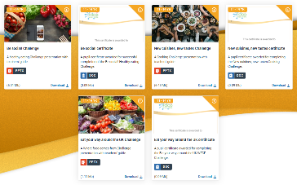
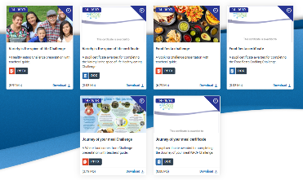
Challenge activities
The Challenges cover Healthy eating, Cooking and Where food comes from and provide a wide range of activities that teachers can select depending on their pupils’ needs, age and abilities, and the time available.
there are 12 Challenges developed to be used with nursery, primary or secondary pupils;
each Challenge presentation comprises:
  slides to present the Challenge to the class, including images, information and questions/tasks to stimulate pupil discussion and planning;
  a teachers' guide with opportunities for learning and a variety of pupil activities that can be completed individually or in groups.
11-14 years and 14-16 years

Slide 29
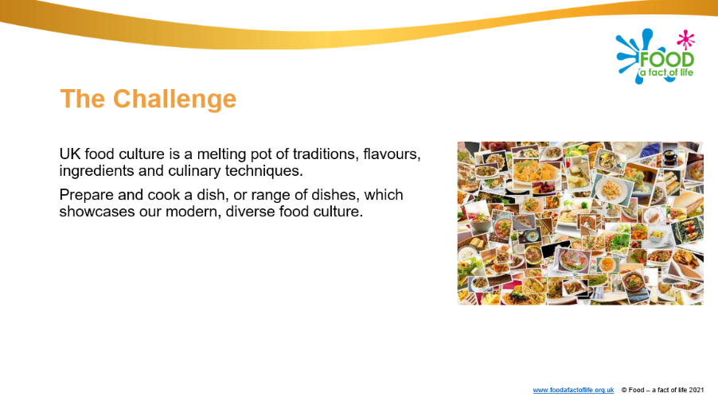
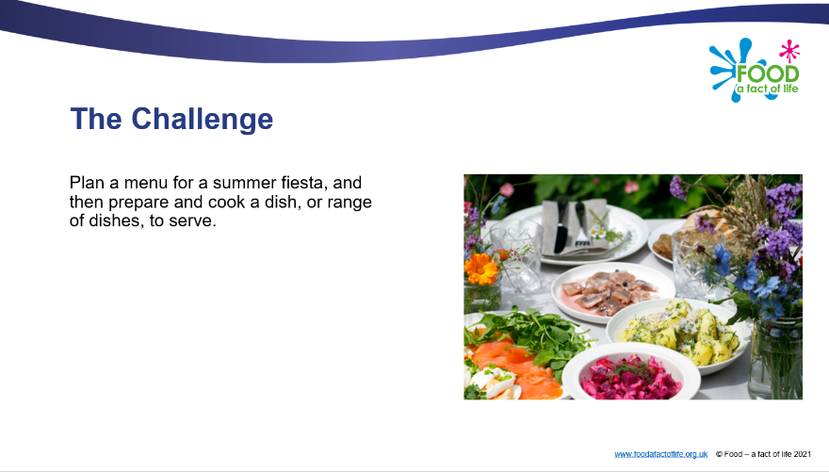
Diverse food culture Challenges
11-14 years and 14-16 years

Slide 30
Other FFL resources
Classroom resources and activities | Teaching and learning | Personal and professional development (PPD)
Bread activity pack Fibre activity pack Harvest activity pack Knowledge organisers 11-14 and 14-16 Nutritional analysis Quizzes 11-14 Quizzes 14-16 Remote learning resources Videos – cooking Videos – where food comes from | Good food hygiene and safety practices Planning sheets Resources and presentations Resources to support UK examination specifications Schemes of Work Teaching and learning videos Practical food skill progression and complexity rating | FFL training PPD toolkit Schemes of Work and lesson planning – advice and support Teacher knowledge and skills
Links to resources that focus on topics covered in today’s workshop can be found in your joining instructions.

Slide 31
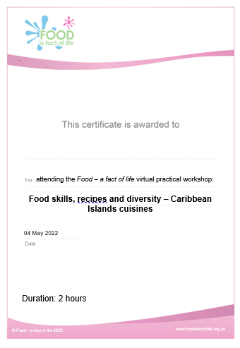
Last words ...
Review of training – ‘bright spots’?
Evaluation – a link will be sent to you. When completed …
Personalised certificate – will be emailed to you
Voucher – will be sent to you

Slide 32
Thank you for joining!
For further information, go to:
www.foodafactoflife.org.uk

